Slide 1


Impressions and Findings from ESA’s
EO for Carbon Markets Forum
Antony Delavois and Frank Martin Seifert
Directorate of Earth Observation
ESA/ESRIN, Frascati, Italy
14/11/2023

Slide 2
Notes:
Co Organised with:
DG-CLIMA
DG-JRC
BNP Paribas
Verra
South Pole
Equinor
Satelligence

Slide 3
Organizing Committee
Simon Kay
DG-CLIMA C.3
Richard Hall
Equinor
Spencer Plumb
Verra
Nanne Tolsma
Satelligence
Basanta Gautam
South Pole
Mirco Migliavacca
JRC
Jeremy Neyrou
BNP Paribas CIB
Antony Delavois
ESA
Frank Martin Seifert
ESA
Notes:
Reflecting the different sectors: academia, industry, finance, NGOs and governments

Slide 4
Objectives EO for Carbon Markets Forum
Bring together experts in the field to share their experiences and knowledge, discuss current challenges and opportunities, and identify best practices and innovative solutions related to the use of Earth Observation data in support to carbon markets.
Foster collaboration and networking among participants from different sectors, including academia, industry, finance, NGOs and governments, to promote knowledge exchange and support the development of effective and sustainable carbon markets.
Explore the role of Earth Observation data in carbon markets and how it can improve transparency and credibility of carbon projects.

Slide 5


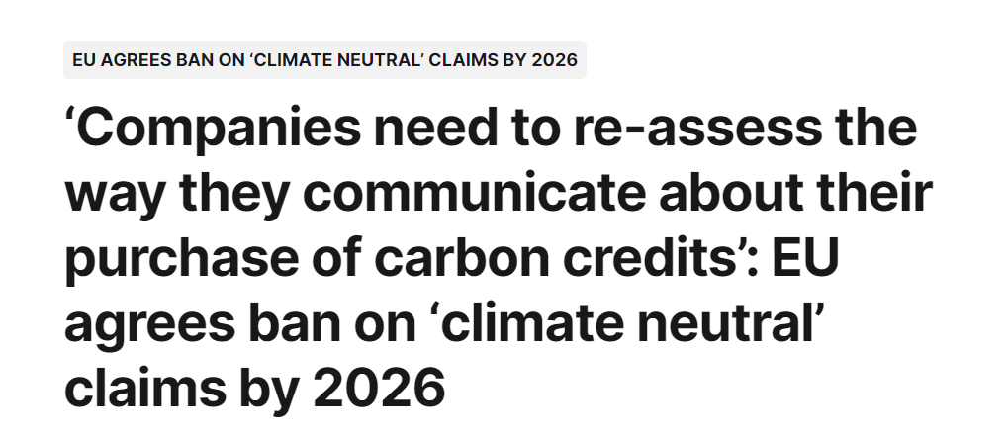

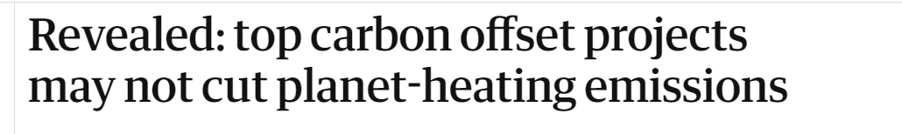
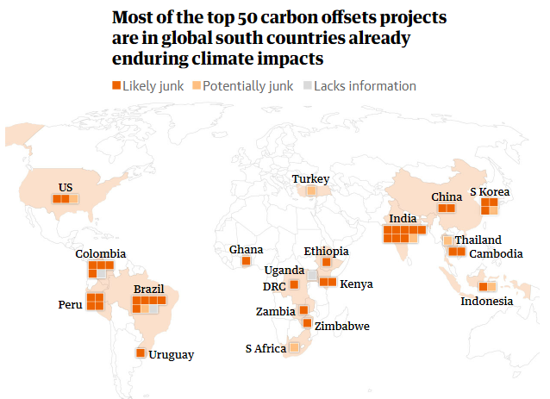

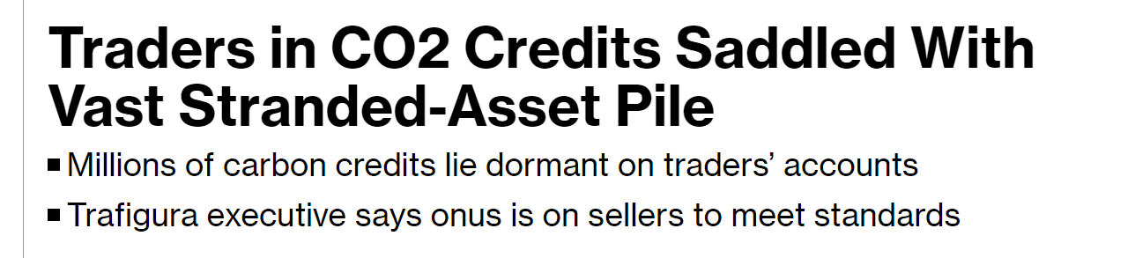
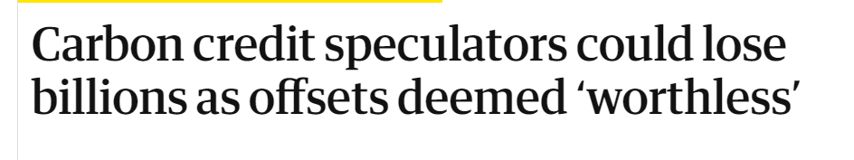
Credibility at stake
Notes:
However, despite this promising future, Voluntary Carbon Market faces issues related to credibility, transparency and greenwashing.
Press headlines highlighted recently some of these issues, pointing double counting, false claims or greenwashing.
An article from the guardian attracted a lot of attention in January 2023
The EU just released it intends to ban ‘climate neutral’ claims coming from the purchase of carbon offsets on sell products
Links:
Carbon credit speculators could lose billions as offsets deemed ‘worthless’ | Carbon offsetting | The Guardian
Traders in CO2 Credits Saddled With Vast Stranded-Asset Pile – Bloomberg
Revealed: top carbon offset projects may not cut planet-heating emissions | Carbon offsetting | The Guardian
‘Companies need to re-assess the way they communicate about their purchase of carbon credits’: EU agrees ban on ‘climate neutral’ claims by 2026 (foodnavigator.com)
EU to ban greenwashing and improve consumer information on product durability | News | European Parliament (europa.eu)

Slide 6
Earth Observation can bring
Quality, Transparency and Credibility
to Carbon Markets
Notes:
What can Earth Observation bring to Carbon Markets ?

Slide 7

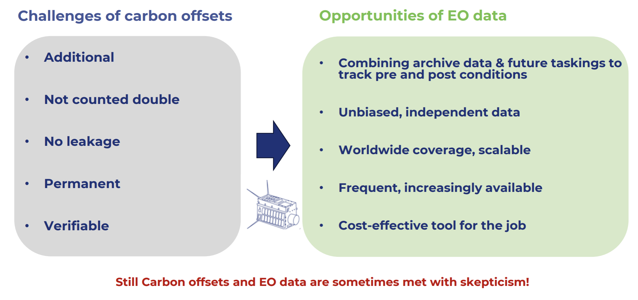



Role of EO in Verification for Carbon Markets

Slide 8
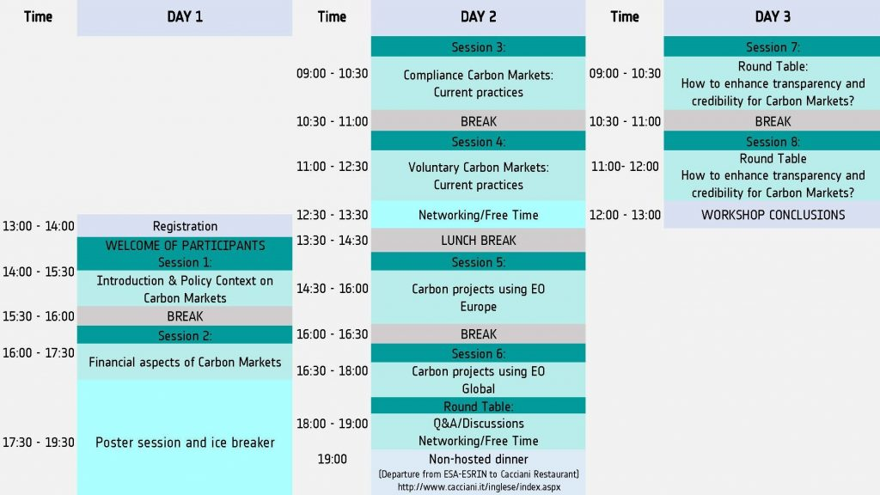
Structure
Presentations available on
eo-carbonmarkets.esa.int

Slide 9

European Policy Framework: Fit for 55 Package
Pricing
Targets
Rules
Emissions Trading System (ETS1)
Strengthened carbon price for fossil fueled electricity and centralized heat
Effort Sharing Regulation
sets yearly MS emission targets (incl. ETS2 sectors)
CO₂ emission standards for cars, vans and heavy-duty vehicles
New: ETS2
caps and puts a price on all remaining building, road transport and industrial combustion emissions
Land Use, Land Use Change and Forestry (LULUCF) Regulation
sets MS net removal targets
New infrastructure for alternative fuels, ReFuelEU aviation & FuelEU maritime
Energy Taxation Directive
aligns minimum tax rates with Green Deal objectives
Renewable Energy Directive
targets support uptake in buildings and transport
Energy Performance in Buildings Directive
provides minimum standards and renovation plans
CBAM
Carbon Border Adjustment Mechanism
Energy Efficiency Directive
e.g. binding MS energy savings obligations
F-gas & Ozone-depleting Substances Regulations
incl. for heat pumps
Promote innovation, build solidarity and mitigate impacts for vulnerable citizens - notably by channeling revenues through the new Social Climate Fund and the enhanced Modernisation and Innovation Funds
Support Measures
Notes:
European policy framework set by the European Green Deal and its Fit for 55 Package i.e. reduce 55% GHG emissions by 2030
This uses different pricing elements like Emission Trading Systems, energy taxation and other mechanisms, addressing different targets
– latest the LULUCF sector -
With various rules.

Slide 10
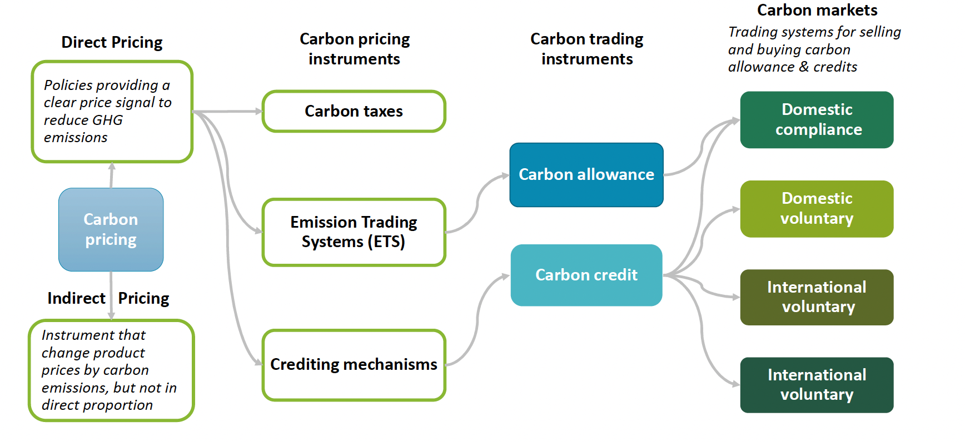
Overview of Carbon Finance
Notes:
That fits to Carbon Finance with direct and indirect carbon pricing mechanisms, the before mentioned pricing instruments,
Trading instruments and different markets ….

Slide 11
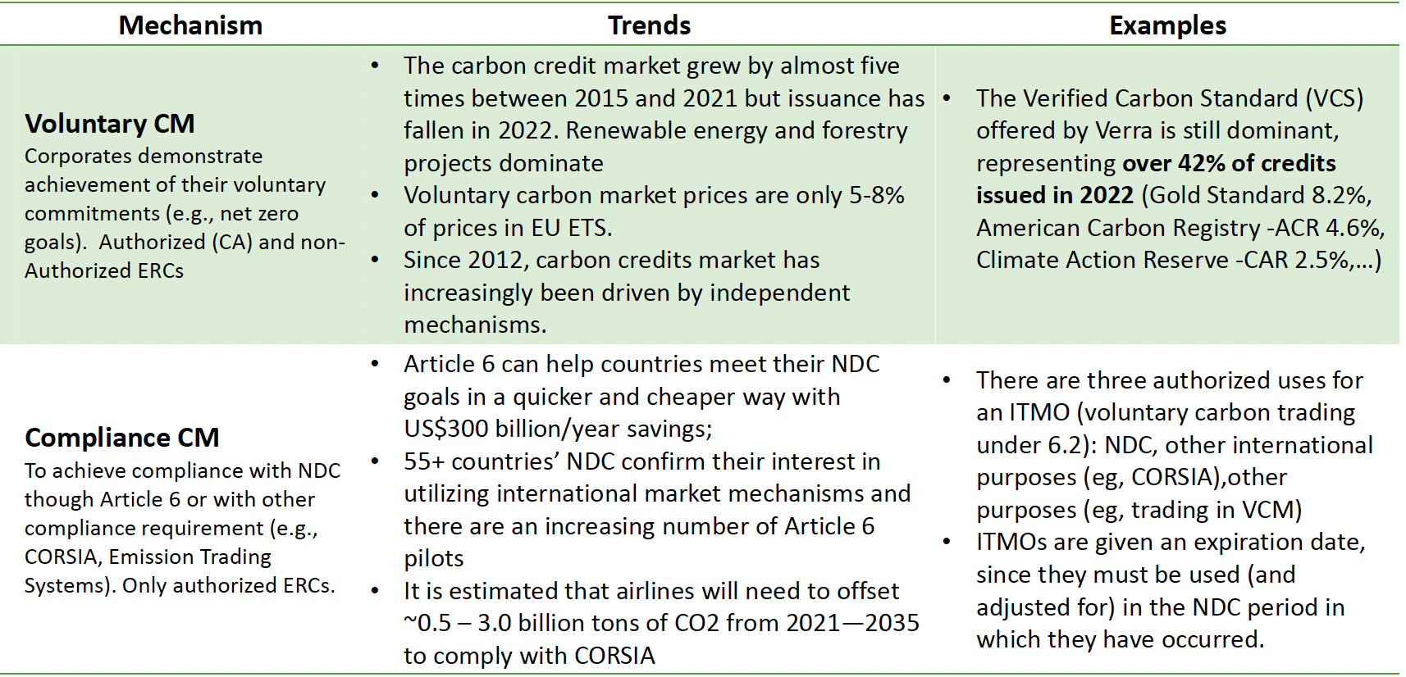
Carbon Markets
Notes:
Voluntary carbon market with the VCS from VERRA with almost half of the share
Compliance Market with NDC and the Paris Agreement (Art 6)
Carbon projects were presented within Europe and Globally,
Addressing i.a. maritime and aircraft emissions, Blue Carbon and carbon removal => Findings

Slide 12
Key major high-level recommendation with unanimity
EO shall be integrated to improve:
quality,
transparency,
provide global solutions,
increase trust
in this growing market (both Compliance and Voluntary markets) which is an essential contribution to stimulate climate change mitigation and the implementation of the Paris Agreement Article 6 towards net zero.

Slide 13
Some challenges on EO data implementation in Carbon Markets
Spatial heterogeneity of carbon brings the necessity for spatial data. High-quality data for both validation and verification must be ensured.
Flexibility for the use of different datasets (including non-EO data sources) and their integrity also with upcoming mission products in coordinate way to allow for true synergy.
Uniformity is a key for transparency and trust in carbon credit evaluation. Extend the use of methodologies and approaches to maintain consistency across compliance markets.
Prioritize the best performing methodologies which are easy to explain to clients for increased confidence.
Aim for high-quality carbon credits addressing decarbonisation, soil health, water management, biodiversity;

Slide 14
Challenges in Communication & Partnership in Carbon Markets
  Accurate communication regarding projects, setting realistic expectations and objectives, avoiding exaggeration or overselling must be ensured.
  The role of a common language in capacity building and risk reduction for clients must be understood. Transparency and clarity in communication to instill confidence in the credibility of carbon credits.
  Encourage real partnerships among users, environmental administrations, and the industry to reach common goals. Developed product to be accepted by the global clients to meet their expectations.
  Facilitate a collaborative approach in comparison of biomass estimations over the same European areas, utilizing different algorithms and processing pipelines.
  Aim for a consensus on accuracy levels to enhance overall reliability.

Slide 15
Others remarks and conclusions
Transparency is an evolving journey rather than an immediate achievement.
Acknowledgement of the inherent imperfections in RS data and carbon reporting is crucial, most important is to understand the degree of deviation from perfection.
Action now is better than perfection.
Balancing methodological rigor with flexibility, selecting optimal methodologies, ensuring consistency, and prioritizing precision in ground-based measurements will contribute to building trust and confidence in the carbon credit market.
Continuous improvements in standards to align with advancements in technology and carbon accounting algorithms.
Parametric-approach in estimation of carbon credits damage should be put on place to precisely account losses.

Slide 16
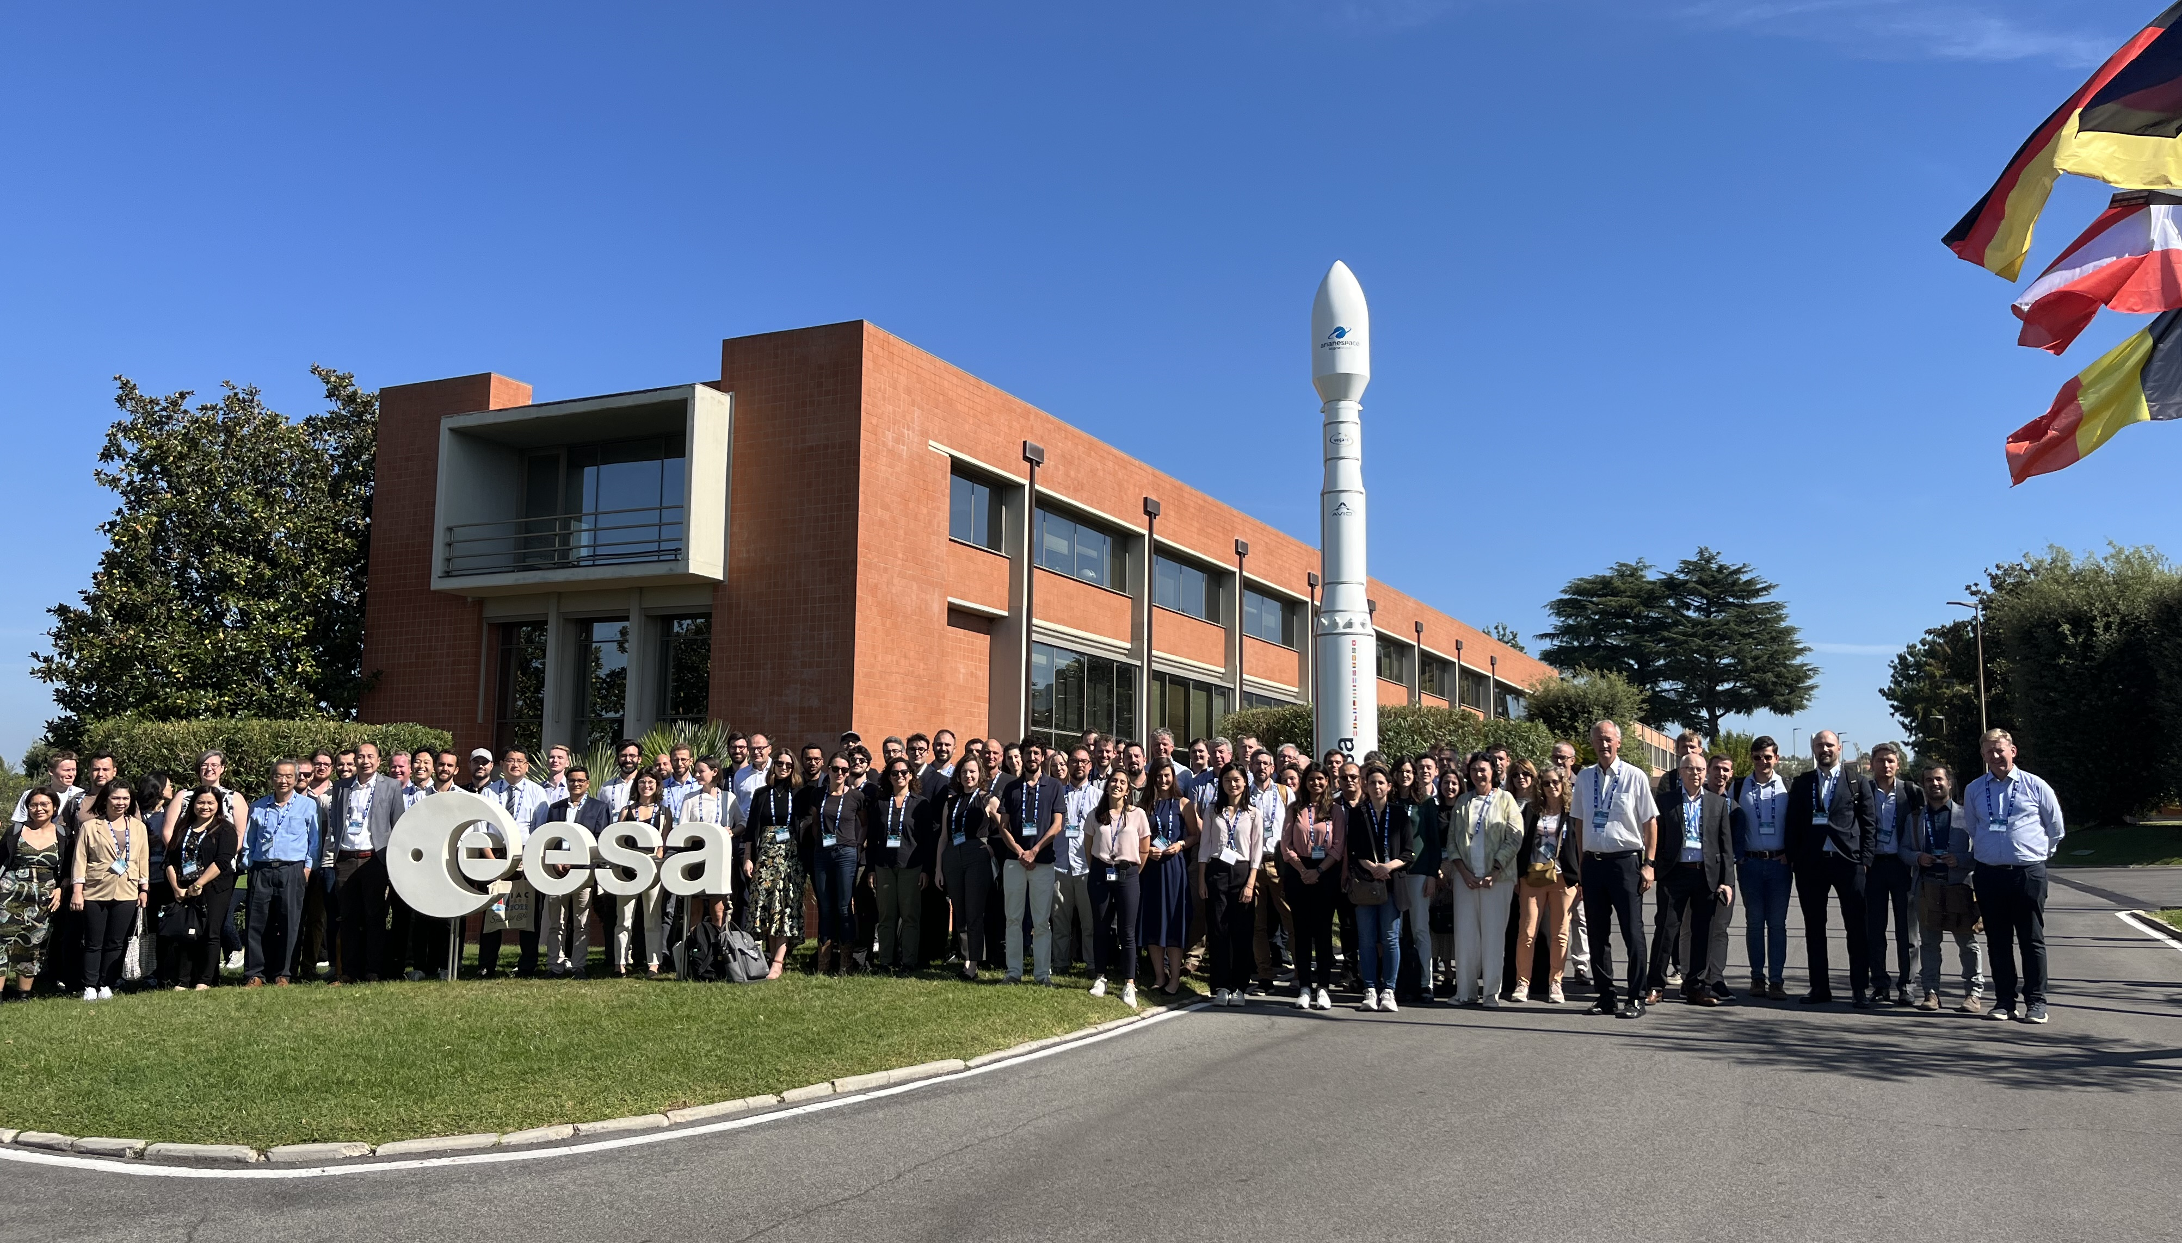

Slide 17

Soils
www.eo4soilprotection.org
Notes:
Forest is not the only ecosystem that matters related to carbon, soils also have a tremendous role in the carbon cycle and have a huge potential for nature-based solutions.
On this topic, please refer to ongoing project on Topsoil Organic Carbon (WorldSoils project), that will be further presented in Section 5, on Wednesday afternoon.
ESA is committed to monitor soils, the weathering upper surface layer of the Earth, with its key role for terrestrial life functions: plant growth, gas exchange with the atmosphere, retention of water and nutrients; in short, the habitat for organisms, a key component of terrestrial ecosystems and the source to food and timber.
In the meanwhile, the EU has launched its Soil Mission, bringing to the forefront the role soils must play in the Green Deal, i.e., 75 % of soils should be healthy in 2030, and the Paris Agreement through The International “4 per 1000” Initiative, stating that agriculture, and in particular agricultural soils, can play a crucial role in food security and climate change.
Soil Organic Carbon (SOC) is a dynamic soil property reacting to past and current land use and management procedures. The rapidly evolving capacities of orbital sensors, with unprecedent high spectral, spatial and temporal resolutions over continental areas, are an essential component for monitoring the SOC seamlessly in the context of the EU Soil monitoring Law.

