Slide 1
Ecosystem Extent Task Team and Demonstrator Outcomes
Gary Geller
NASA Jet Propulsion Laboratory
California Institute of Technology
Shaun Levick, CSIRO
Sandra Luque, INRAE/CNES
Roger Sayre, USGS
Agenda Item 2.3
38th CEOS Plenary
Montreal, Canada
23rd - 24th October, 2024
(c) 2024 California Institute of Technology.
Government sponsorship acknowledged.

Slide 2
Agenda
EETT overview and overall status
Overview of demonstrators
Discussion
US BLM

Slide 3
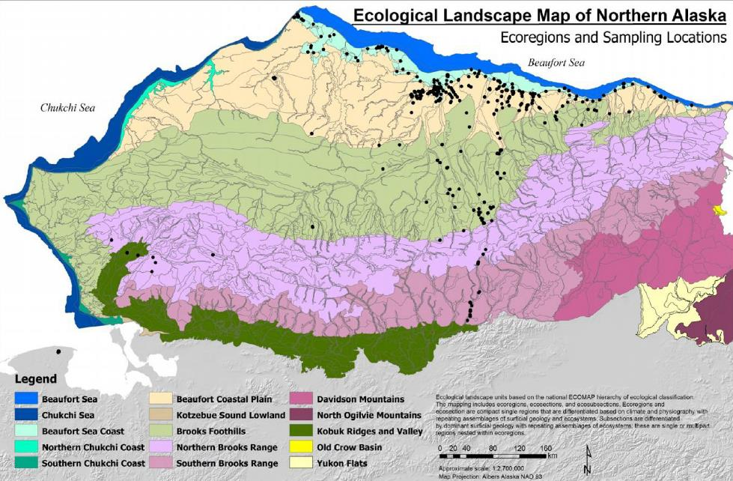
Task Team Basics
Purpose
Assess the utility for mapping Ecosystem Extent using current and new space-based observations that will become available in the next 10 years
Two Deliverables
White Paper
Demonstrator
Notes:
White Paper (delivered November 2023)
Demonstrator (HBL-Wapusk NP wrapping up)

Slide 4
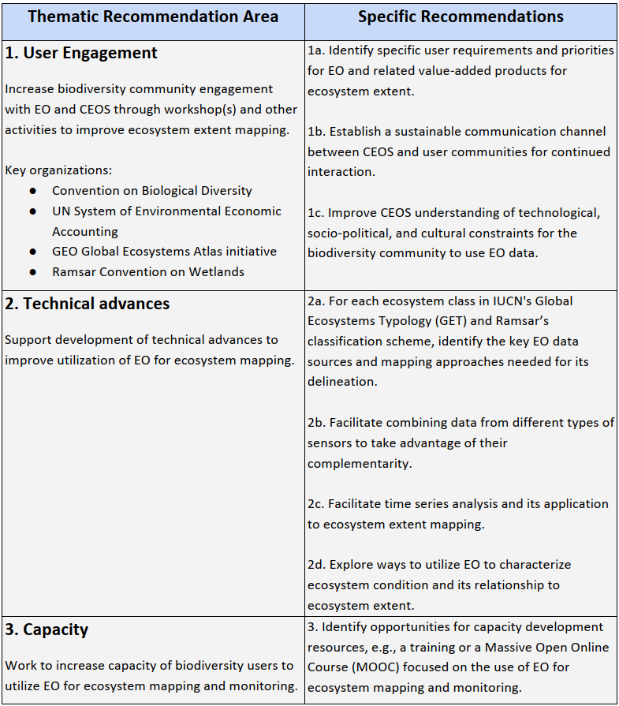
White Paper Outcome
Eight recommendations
User engagement (3)
Technical advances (4)
Capacity (1)

Slide 5
Demonstrator
EETT was tasked to deliver one demonstrator but had three opportunities
(1) Hudson Bay Lowlands
Wapusk NP demonstrator wrapping up--broader HBL work will continue
(2) & (3) Great Western Woodlands & Tropical Forests in Costa Rica
Shaun Levick (CSIRO) and Sandra Luque (INRAE/CNES) submitted proposals to their funding agencies
Successful—funding started end of 2023
Work is underway: Results-to-date will be presented
Work will continue--funded for another year (+)

Slide 6
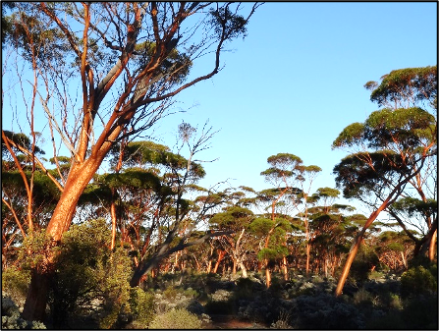
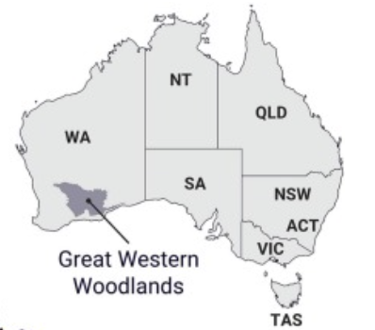
Great Western Woodlands
Biodiversity hotspot in Western Australia
Distinguishing vegetation assemblages and stand ages is critical for effective land management and conservation
Ecosystem extent mapping underway using CSIRO’s EASI platform
Testing the fusion of Sentinel-1, ALOS-2, Sentinel-2 and Landsat-5/-7/-8/-9

Slide 7
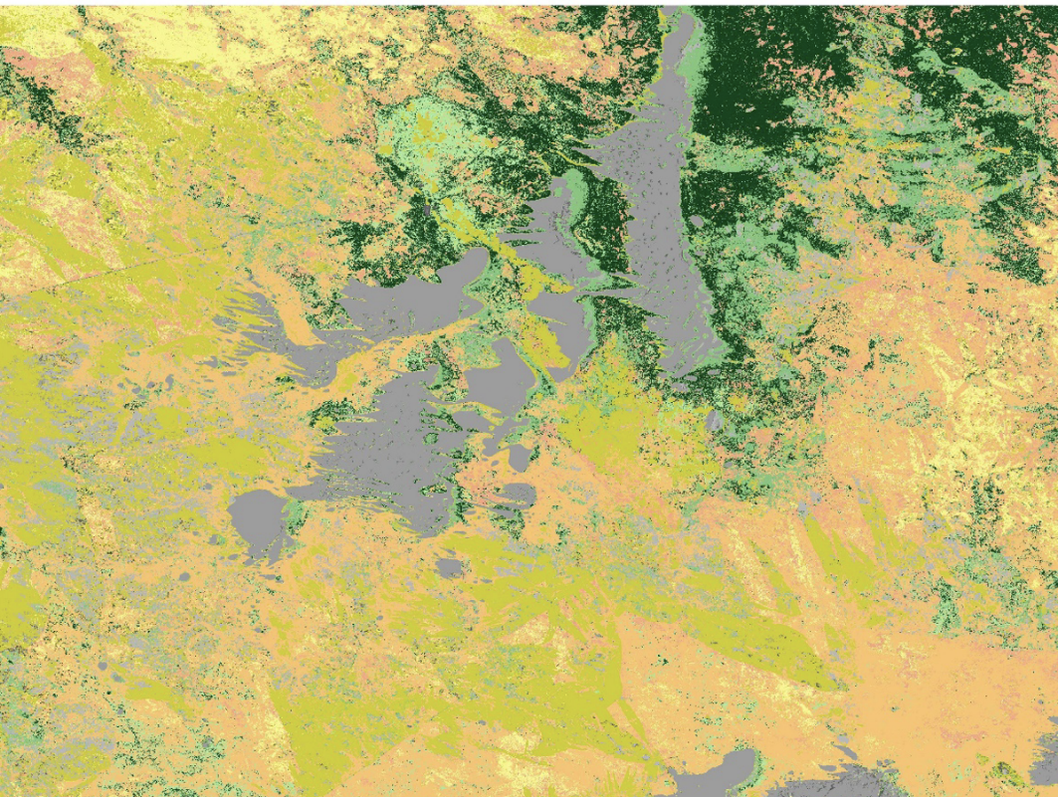
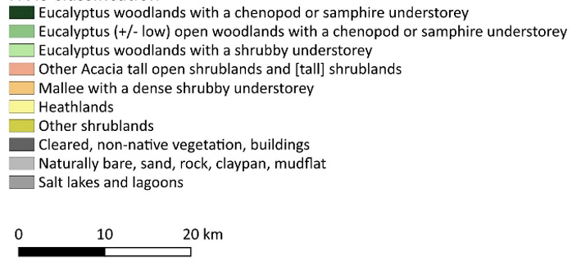
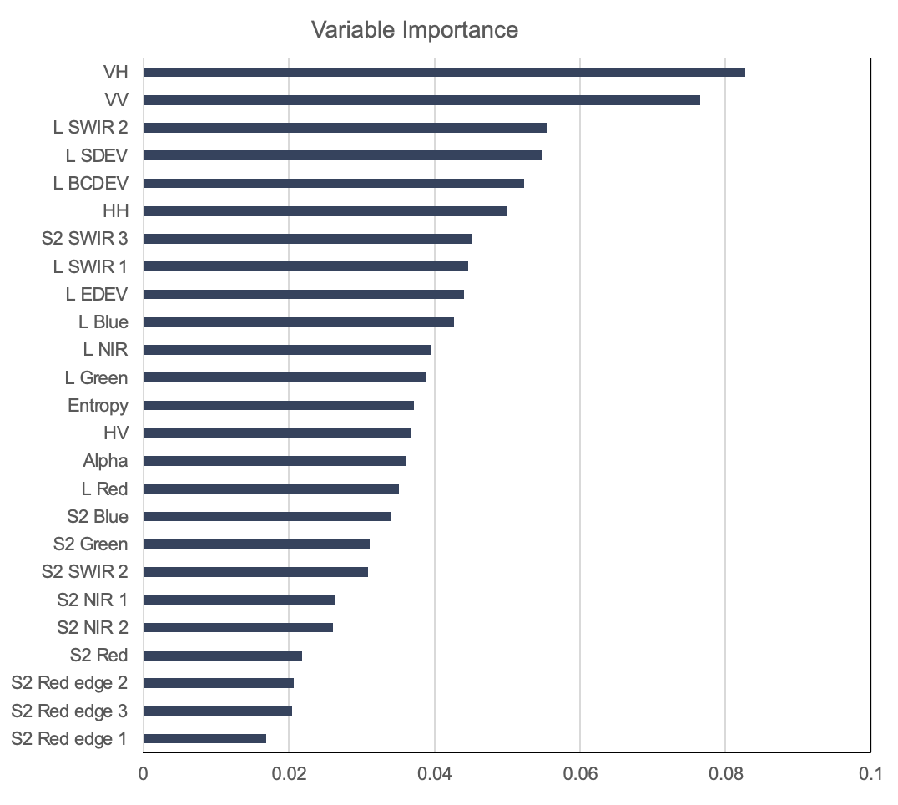
Great Western Woodlands
Current model with both optical and SAR data achieves an overall accuracy of 90.1%
Results - Adriana Parra Ruiz (CSIRO)

Slide 8
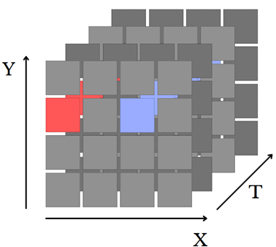
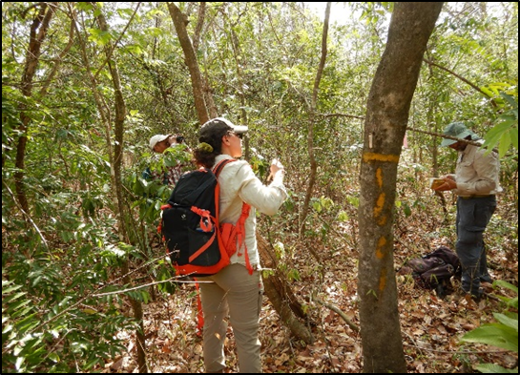
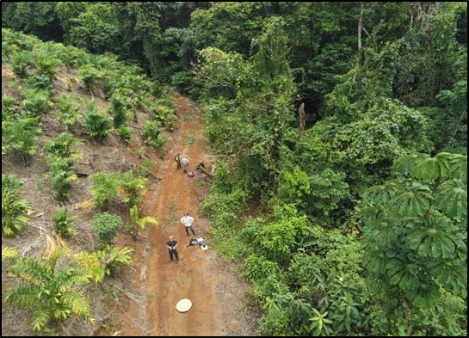
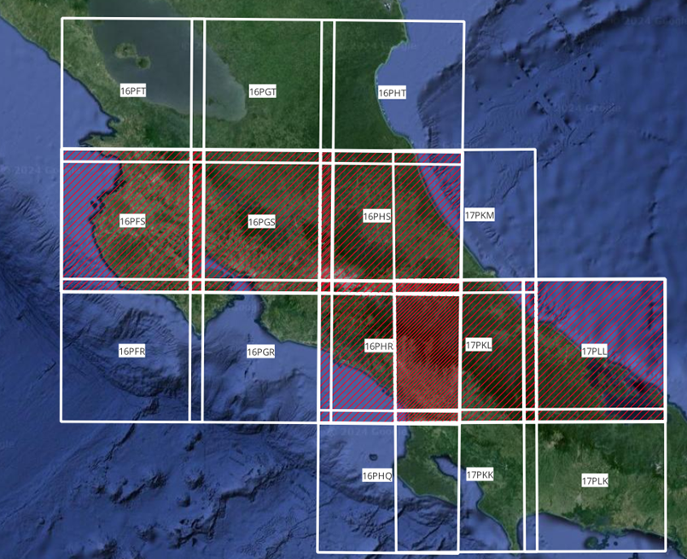
Tropical Forests – Costa Rica
Data Cube architecture operational
Earth Observation and in situ data from monitoring across
scales - collaboration with local Institutions and experts
Combining sensor types (SAR, optical)
Seasonal Spectral Indices calculated (CCCI, EVI, NDWI1, SAVI, NDVI, mNDVI)
Vegetation Diversity Indices from spectral information
Validation with Species Assemblage Network analysis

Slide 9
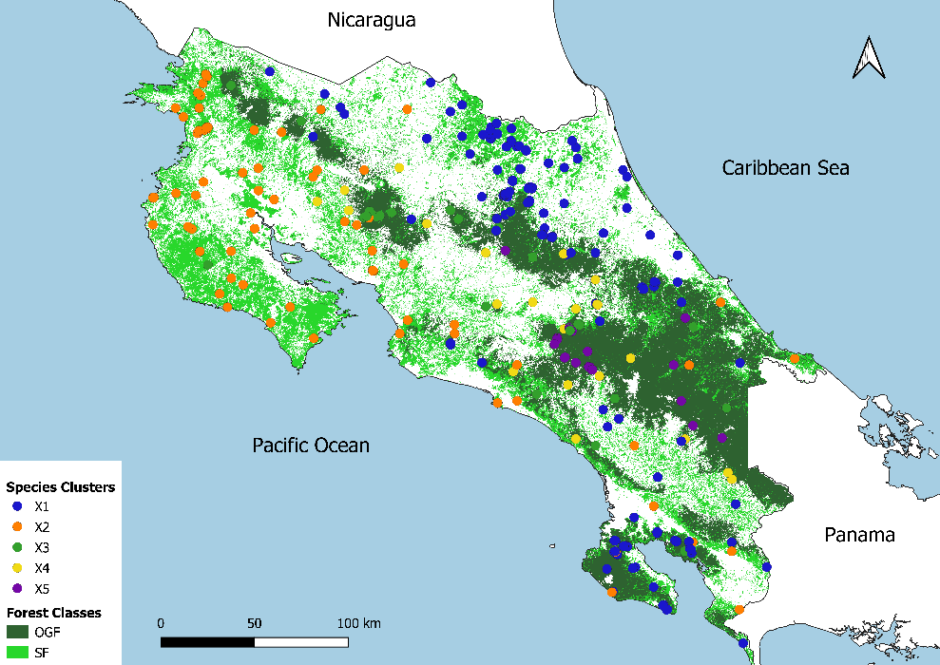
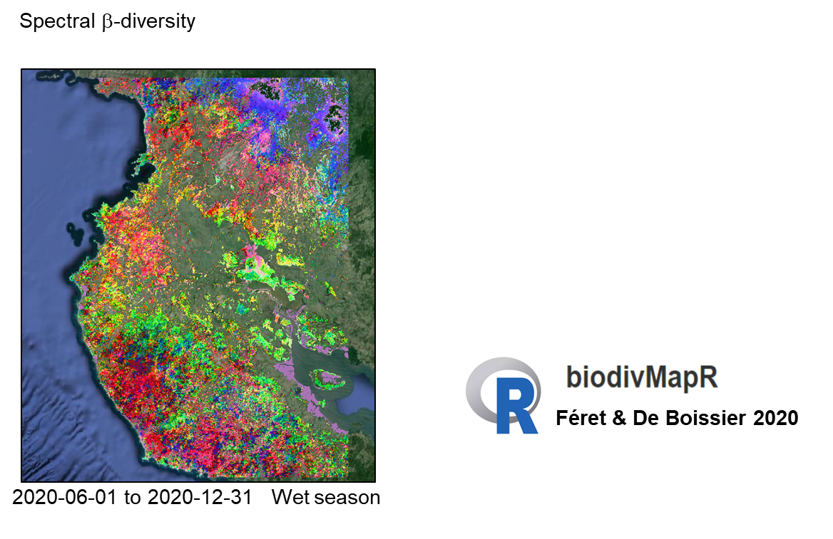
Mapping spatial distribution of tree species on large scales to characterize forest ecosystems and habitats
Implemented Open Data Cube (ODC), infrastructure for other users via National Portal (DataTerra, France)
Integrated core ODC datasets, incl. S-2 and SPOT 6 & 7
Calculated Beta diversity estimates using biodivMapR
Validated biodiversity estimates using in situ National Forest Inventory data, showing the distribution of ecotypes
Defined ecotypes as the spatial distribution and organization of distinct tree species assemblages influenced by ecological, environmental, & historical factors
Discriminated five key forest ecosystems: Low-altitude Rainforest, Low-altitude Dry Forest, Riparian Forest, Cloudy/Mountainous/Alpine Forest, Subalpine Forest
Spectral β-diversity
Notes:
biodivMapR estimates beta diversity (a type of biodiversity) based on the spectral variation hypothesis using EO spectral data

Slide 10
EETT Has Completed its Tasks
White paper
Delivered (November 2023)
Demonstrator:
Wapusk National Park in HBL (completed)
Great Western Woodlands (continuing)
Tropical Forests—Costa Rica (continuing)
EETT momentum will continue
Broader HBL (ongoing)
Great Western Woodlands (> 2 more years)
Tropical Forests—Costa Rica (at least 2 more years)

Slide 11
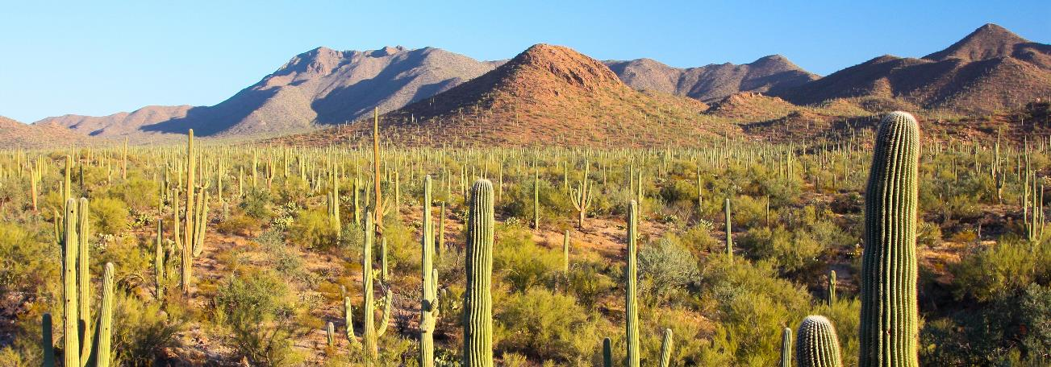
EETT Wrap Up
We invite interventions acknowledging for the record successful completion of the tasks given to the EETT
Thank you for supporting the EETT
Special thanks to CSA!
Image Credit: Joe Parks (Wikimedia)

