Slide 1
GHG Roadmap
Issue 2
Wenying Su, NASA WGClimate Vice Chair
Yasjka Meijer, ESA GHG Task Team Lead
Agenda Item 4.4
38th CEOS Plenary, Montreal, Canada 23rd – 24th October 2024

Slide 2
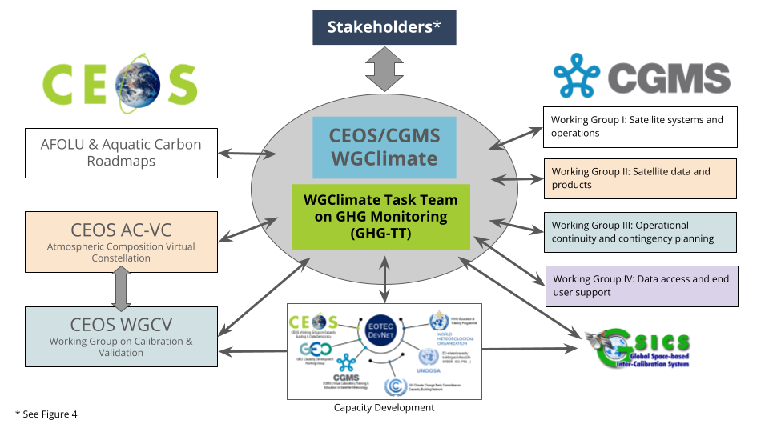
GHG Task Team - Recall
Greenhouse Gas Task Team (GHG TT) is part of joint CEOS-CGMS WGClimate
Responsible for maintaining and implementation of the GHG Roadmap
Coordinates GHG related activities across various CEOS & CGMS WGs
GHG Roadmap issue 1 is from Mar. 2020 and followed from recommendations in GHG White Paper
Decision to update GHG Roadmap

Slide 3
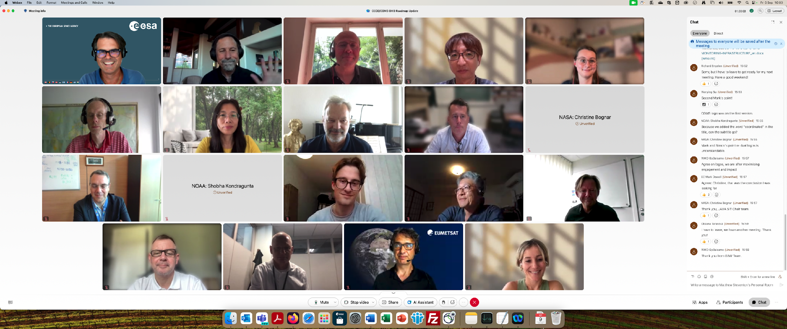
GHG Roadmap – Issue 2 – drafting
Since SIT-39 in Tokyo, an outline was drafted and followed by biweekly GHG TT meetings
Coordinating with CGMS WGs in June
CGMS-52 appointed Simon Elliott as PoC to coordinate CGMS’ input
Issue 2 has been established In coordination with G3W and IMEO
A real team effort and until the last telecon well attended 🡪
Special thanks to Dave Crisp & Libby Rose for drafting issue 2

Slide 4
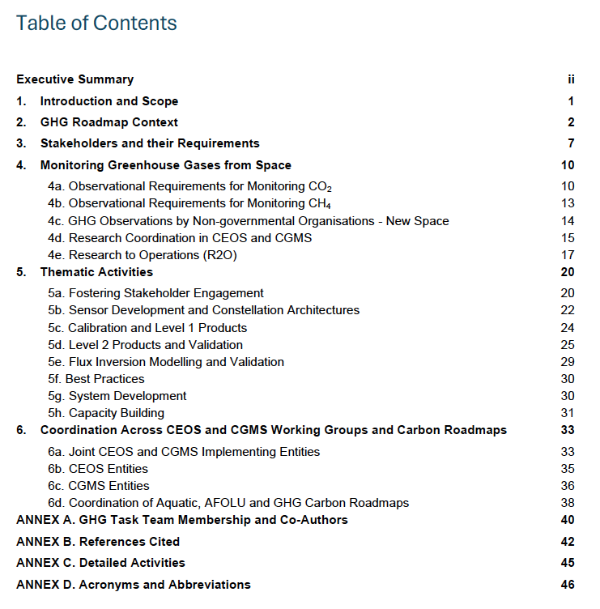
GHG Roadmap – Issue 2
Includes (1-page) executive summary
This version has been expanded in its scope to support the rapid evolution of the international GHG science, policy and regulatory communities. The updated Roadmap describes specific thematic areas where CEOS and CGMS are working with (new) stakeholders and partners to develop improved, fit-for-purpose space-based GHG products. As in issue 1, detailed activities and action items which are continuously evolving, are described in an Annex. With these changes, the GHG Roadmap should foster the coordination of space-based GHG products that better address the needs of an increasingly diverse stakeholder community and be more resilient to the future evolution of this rapidly evolving field.
Table of contents 🡪
Specific detailed actions tracked in Annex C and maintained online (living document)

Slide 5
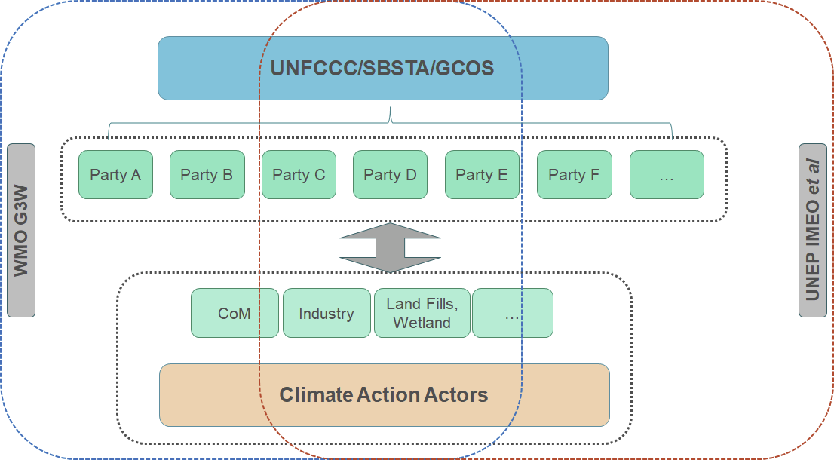
GHG Roadmap – Stakeholder
Issue 2 has specific focus on co-developing activities with stakeholders
Section 3 covers “Stakeholders and their Requirements”, which explicitly includes WMO G3W and UNEP’s IMEO
Section 5a describes the thematic activity for “Fostering Stakeholder Engagement”
John Worden (NASA) is the GHG TT PoC vis-à-vis IMEO
Vincent-Henri Peuch (ECMWF) is the GHG TT PoC vis-à-vis G3W
Collaboration with IMEO is part of planned activities
Intention to have a follow-up meeting of the joint CEOS-IMEO Harvard meeting “International Coordination Workshop on Detection of Anthropogenic Methane Emissions from High-resolution Satellites”, which was held in June 2023

Slide 6
GHG Roadmap – Issue 2 – final
Draft issue 2 circulated on 9 Sep (CEOS & CGMS)
Feedback received at SIT-TW, Sydney
Final issue 2 delivered on 8th October
Endorsement of issue 2 decision at CEOS Plenary
Endorsement of issue 2 requested to CGMS

Slide 7
GHG TT – Next steps
Thematic activities (long-term goals) described in section 5 with leads (plus deputies):
Fostering Stakeholder Engagement - Mark Dowell (John, Wenying)
Sensor Development and Constellation Architectures – John (AC-VC) (Yasjka)
Calibration and Level 1 Products – Hiroshi (Kuze)
Level 2 Products and Validation – Ruediger & Dave
Flux Inversion Modellin g and Validation – Kevin (Frederic)
Best Practises – John (Paul Green)
System Development – Richard (John, Kevin)
Capacity Building – TT
Focus is now on updating short-term actions (to be) described in online GHG Roadmap Annex C
Required resources are similar to current level (current activities)
Additional resources for specific new/larger activities will be reflected in CEOS Work Plan and/or CGMS HLPP
GHG Task Team meeting scheduled 11–13 Feb. ‘25 in Harwell, UK, coincident with WGClimate

Slide 8
Time for questions,
discussion and decision
THANKS!

