Slide 1


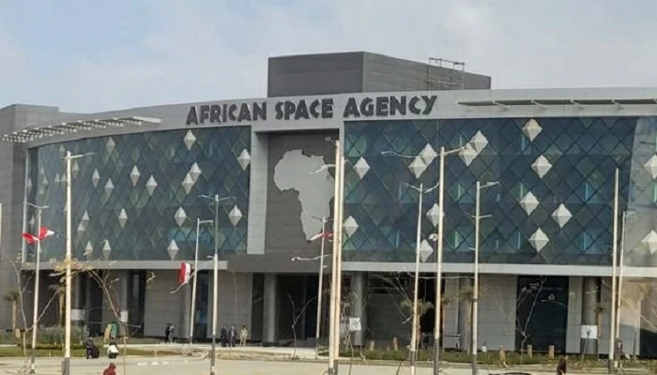
Online Presentation for Associate Membership to the Committee on Earth Observation Satellites (CEOS)
Advancing Earth Observation for Africa through partnership
H.E. Dr. Tidiane Ouattara
President of the Arican Space Agency’s Space Council
2025 CEOS Plenary, 04-06/11/2025

Slide 2
Presentation Outline
AfSA’s Policy Framework and Statutory Process
AfSA’s Mission, Priorities and Goals
AfSA’s Strategic Actions and Programmatic Achievements, including GMES & Africa and AESPP
Valuation of Space Industry in Africa
Alignment of AfSA’s Mandate and CEOS’s Mission
Proposed Engagement with CEOS
Mutual Benefits & Value Proposition
Conclusion

Slide 3

African Outer Space Flagship and Agenda 2063
African Outer Space Flagship

Slide 4
Statutory Process
2016: Adoption of the African Space Policy and Strategy
2017: Approval of the African Space Agency Act
2018: Adoption of the Statute of the African Space Agency
2019: Selection of the Republic of Egypt to host AfSA’s headquarters
2024: Election of the first African Space Council
2025: Official Inauguration of the African Space Agency
2025: handover of the headquarters building by Egypt to the African Union and full Operationalization

Slide 5
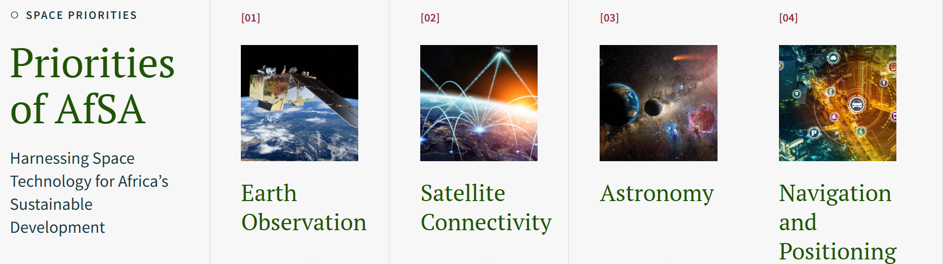
AfSA Mission and Priorities
Mission Statement
The African Space Agency (AfSA) is the continental space agency of the African Union. It was established to promote collaboration amongst African nations and other regions in harnessing space science and technology for Africa's socio-economic development, promoting collaborative research and peaceful exploration of outer space.

Slide 6
AfSA as the Continental Instrument to achieve the Space Policy and Strategy Goals
AfSA Objectives:
One of its key objectives, as outlined in the African Space Agency Act, is to enhance space missions across Africa, ensuring optimal access to space-derived data, information, services, and products. Once fully integrated into national, regional, and continental programmes, AfSA will be crucial in eliminating duplication and inefficiencies within the African space ecosystem. As the official body overseeing and coordinating these efforts, it will also be responsible for effectively implementing the African Space Policy and Strategy and achieving the continent’s space-related goals.
African Space Policy Goals:
African Space Strategy Goals:
Well-coordinated and integrated African space Programme that is responsive to the social, economic, political and environmental needs of the continent, as well as being globally competitive.
Space-derived products and services used for decision-making and addressing the economic, political, social and environmental challenges.
Regulatory framework that supports an African space Programme and ensures that Africa is a responsible and peaceful user of outer space.
An indigenous space capability, both in the private and public sectors, that defines a coordinated, effective and innovative African-led space Programme.

Slide 7
AfSA Strategic Actions
Addressing user needs
Harnessing the potential of space science and technology to address Africa’s socio-economic opportunities and challenges.
Accessing space services
Strengthening space mission technology on the continent to ensure optimal access to space-derived data, information services and products.
Developing the regional and international market
Developing a sustainable and vibrant indigenous space industry that promotes and responds to the needs of the African continent.
Adopting good governance and management
Adopting good corporate governance and best practices for the coordinated management of continental space activities.
Coordinating the African space arena
Maximising the benefit of current and planned space activities and avoiding or minimising the duplication of resources and efforts.
Promoting international cooperation
Promoting an African-led space agenda through mutually beneficial partnerships.

Slide 8
Programmatic Achievements
Survey on Earth Observation private sector in Africa
Implementation of GMES & Africa
AUC-EC agreement on Copernicus Data access
Survey and Gap Analysis on Navigation and Positioning in Africa
Baseline Study on Socio-Economic Benefits of Space in Africa
Baseline Study on Astronomy and Space science
Baseline Study on Satellite Communication
Survey on Earth Observation Academia
Africa Space Agency operationalization
New Space Partnership Programme
Etc.

Slide 9
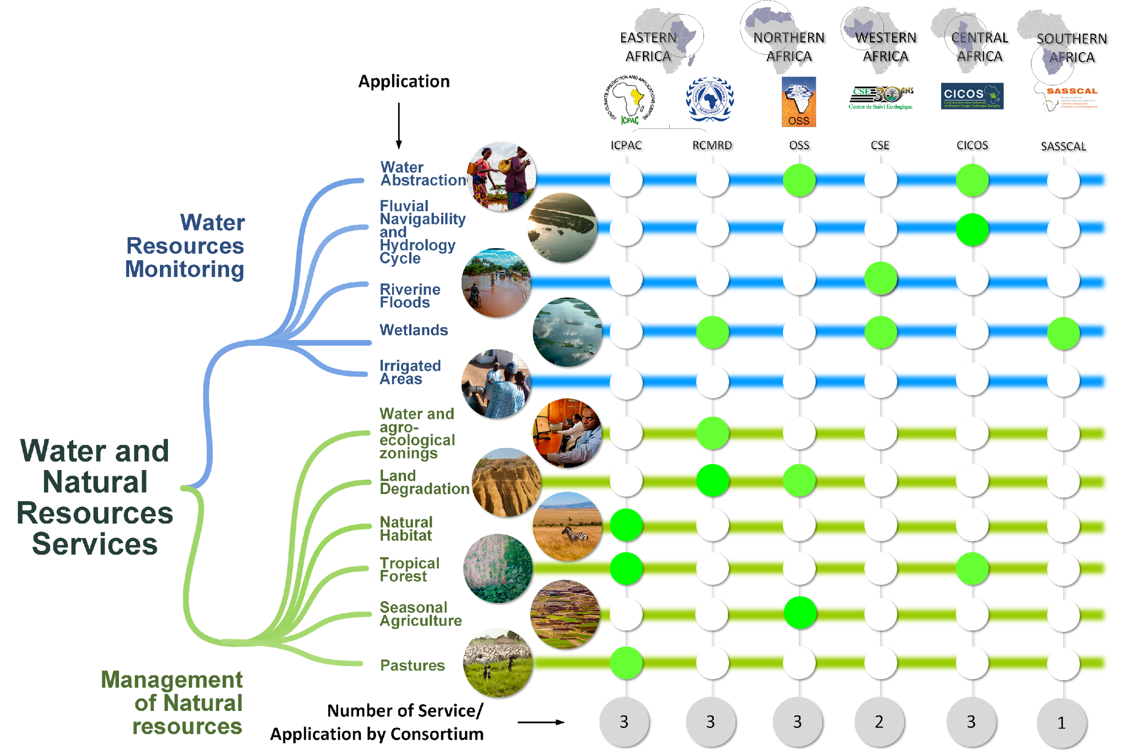
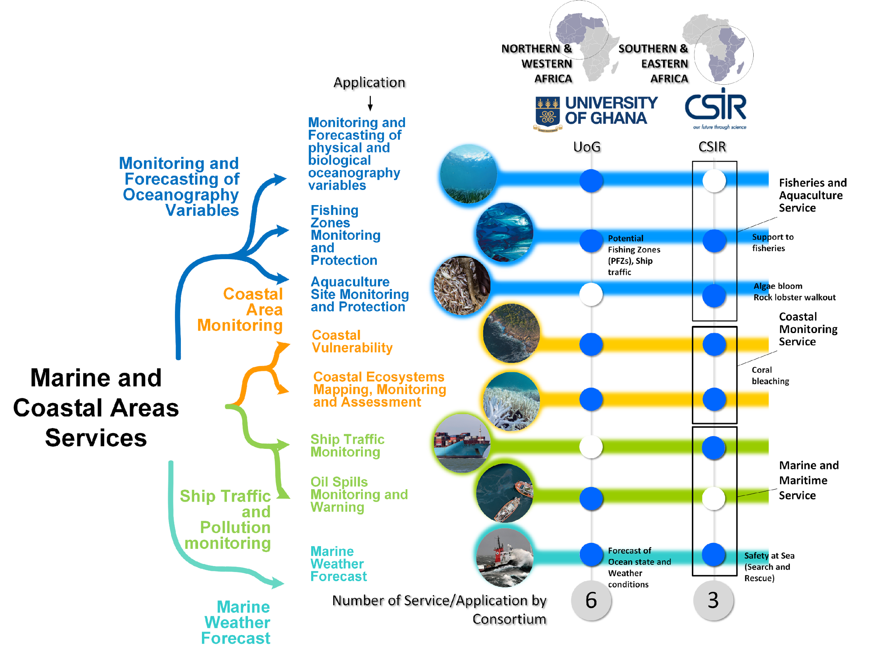
GMES & Africa Operational Services

Slide 10
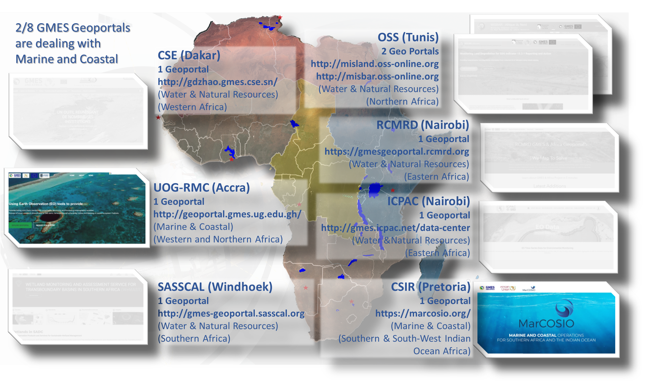
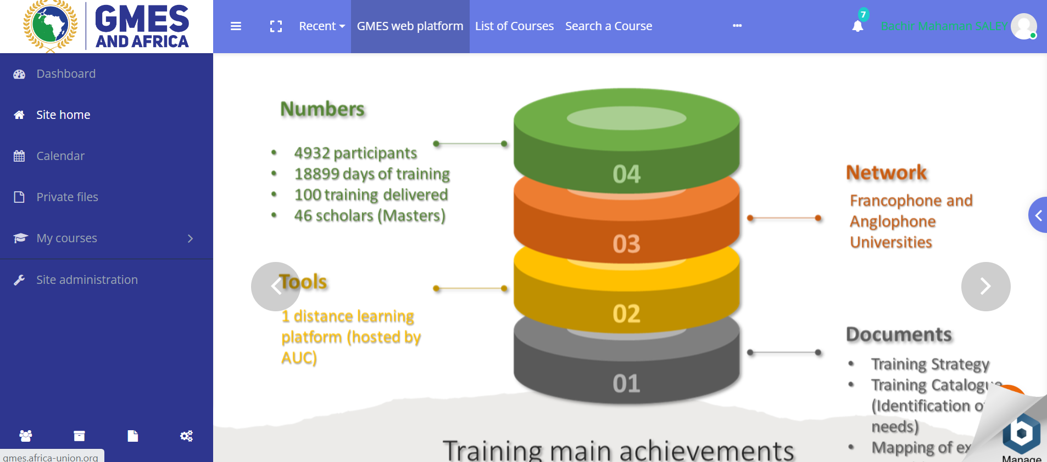
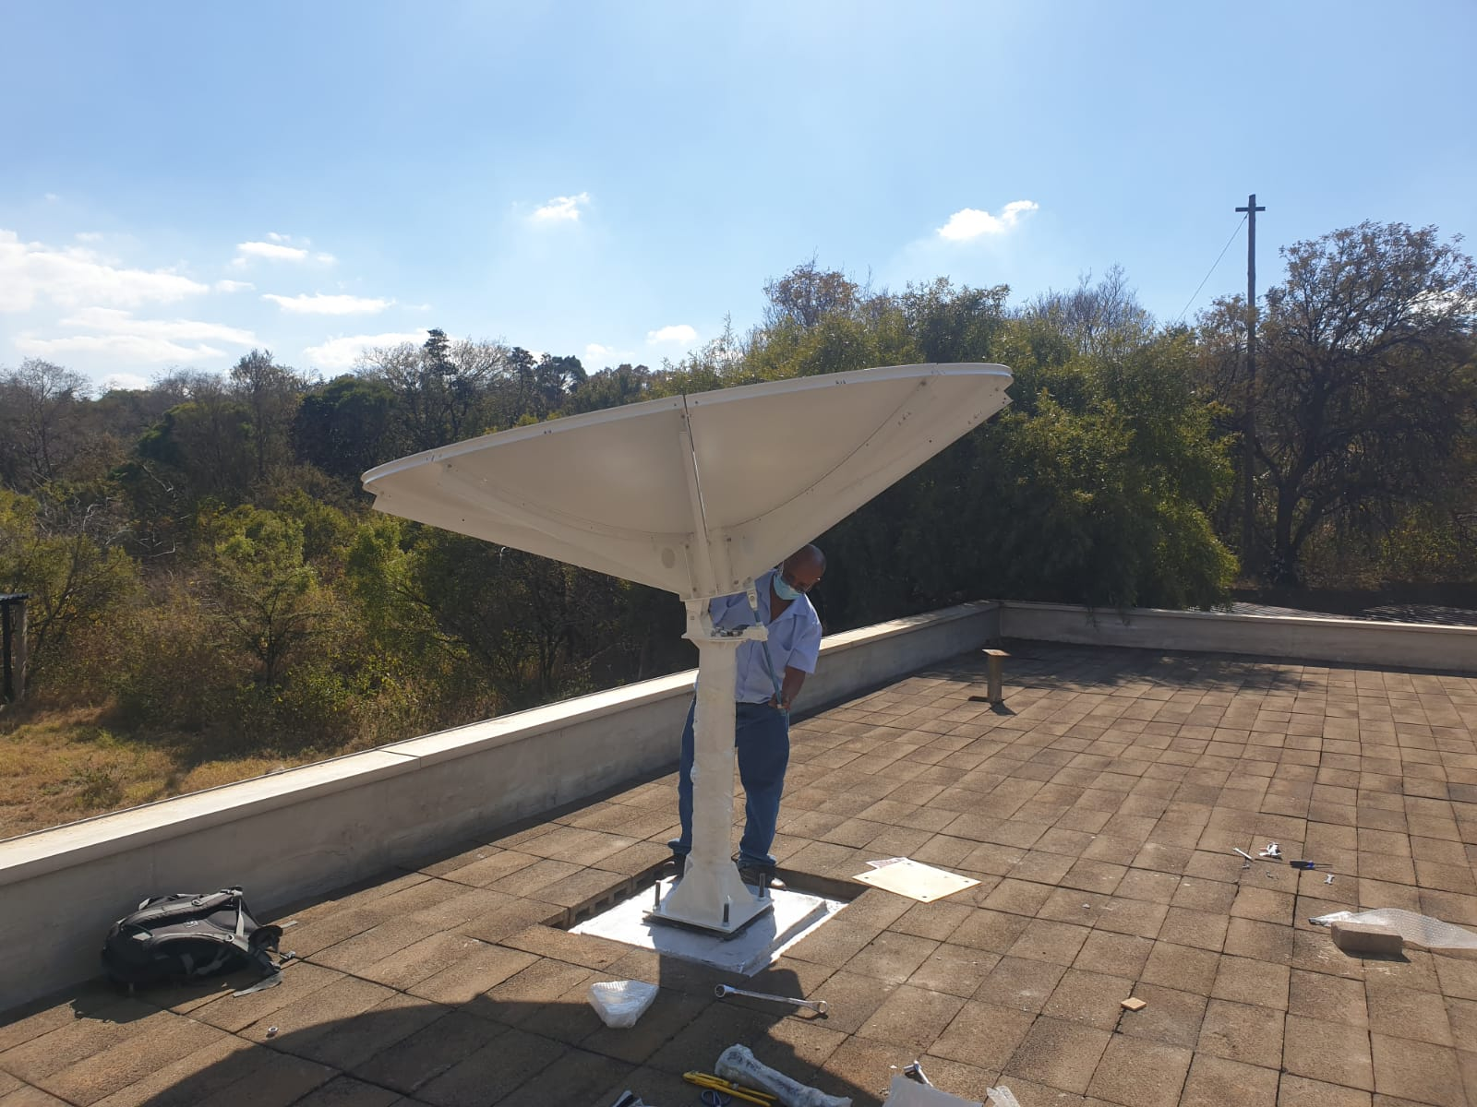




GMES & Africa Achievements
200+ eStations
09 Geoportals
Digital Learning Platform (DLP)
Women in GMES
GMES Network for flood and Wetland
GMES Network of Academia
Incubator / Accelerator
Notes:
Developed Adequate skills and expertise in Earth observation applications and usage.
Strengthened Earth observation institutions in Africa
Fostered Knowledge sharing among African experts, users and stakeholders.
Installed Space-based and in-situ infrastructure to help in responding to user needs and ensuring societal benefits.
Developed Earth observation services and products using web-based and other appropriate technologies in order to meet user needs.
Improved Stakeholder engagement to ensure the generation of the relevant services and products that maximize the benefits of Earth observation applications.
Raised Awareness among the public, users, and policy and decision makers.

Slide 11
Looking Forward
Capacity Development (Human, technical and Institutional)
Industrial Partnership
Academia Strengthening and Collaboration
Upstream and Downstream reinforcements
The New Africa-Europe Space Partnership

Slide 12
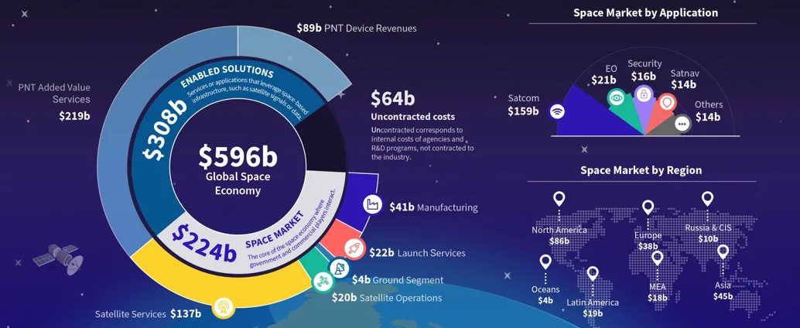
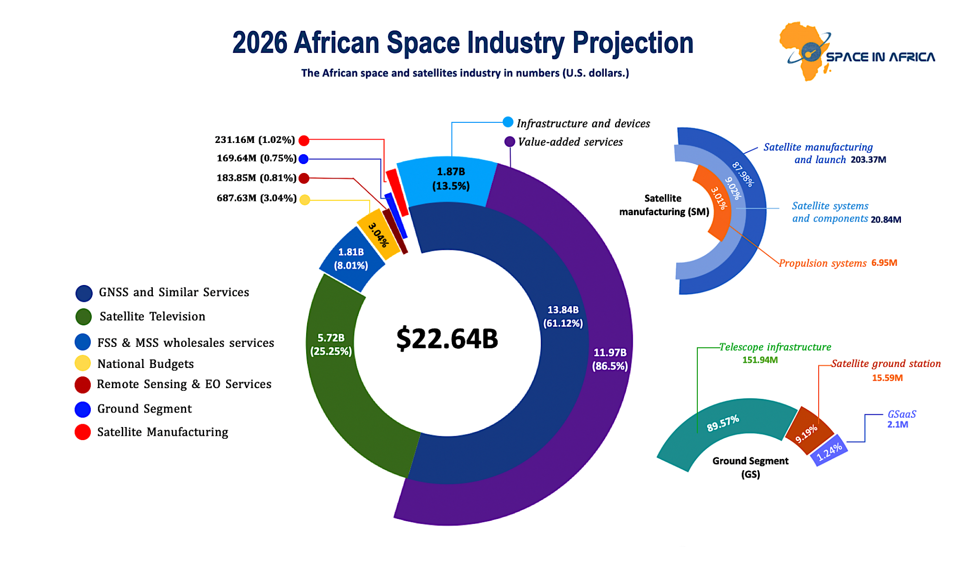
Valuation of Space Industry in Africa
Value of EO in Africa:
About 50% of the African satellites are for Earth Observation.
100+ space application projects are currently being implemented across the continent, mainly on Earth Observation (EO) and satellite communications.
GMES & Africa, PanAfrican EO proramme addressing the continent’s most pressing socio-economic challenges.
AESPP as the way forward to crystallize the long-standing cooperation between Europe and Africa in terms of Space activities.

Slide 13
Alignment of Mandate and Mission
AfSA’s mandate: coordinate and harness space/EO services for societal benefit across Africa.
CEOS’s mission: coordinating EO satellites and data for global benefit.
user-centric EO services

Slide 14
Proposed Engagement with CEOS
Strategic
  African Space Council leads strategic alignment with CEOS
Technical
  Capacity Building & Data Democracy
  Calibration & Validation
  Disasters

Slide 15
Mutual Benefits & Value Proposition
CEOS gains: expanded representation of Africa in the CEOS community; access to African expertise and subject matter knowledge.
AfSA gains: access to CEOS coordination, standards, best practices, global networks; acceleration of EO service readiness in Africa.
Win-win Partnership

Slide 16
Conclusion
Recap: AfSA requests Associate Membership in CEOS; strong mandate alignment; demonstrated achievements; clear engagement plan; mutual benefits.
Call for Decisioin: “We respectfully ask this Plenary to approve AfSA’s associate membership so we can advance Earth Observation in Africa and globally together.”
Any questions?

Slide 17
Contact
Address:
AfSA Headquarters
Egypt Space City, New Cairo Governate, Egypt
Phone:
+00 123456789
Email: info@africanspaceagency.org
Website:
https://africanspaceagency.org/
Thank you for your attention

