Slide 1
CEOS Plenary 2025
CEOS Executive Officer Report
CEO Team
Agenda Item 1.3
39th CEOS Plenary
Bath, United Kingdom
4th–6th November, 2025

Slide 2

Outline
Word of thanks to new CEOS Members
2025-2027 CEOS Work Plan overview and progress
2026-2028 CEOS Work Plan schedule
Future staffing of the CEOS Executive Office

Slide 3
New CEOS Members
Thanks to the African Space Agency, the Hellenic Space Center and the Philippine Space Agency for their support and collaboration regarding their membership applications for CEOS.
There are other space agencies and offices also interested in participating in CEOS,
namely Ghana, Kenya, Rwanda and Saudi Arabia.
          The CEO team will work with new potential members from CEOS Plenary onwards.

Slide 4
Work Plan collaboration
In the last year, increased collaboration has been observed within CEOS groups and initiatives.
  Indicative examples
                WGCV working with CEOS-ARD
                WGISS and WGCV working on data management and stewardship maturity matrices
                WGClimate update on Climate Data Records Inventory at WGISS
                GHGStrategy activities connected to COAST-VC, WGCapD, WGDisasters, etc.
                Joint meeting in India in 2026, e.g., WGDisasters and WGISS – decision ready data

Slide 5
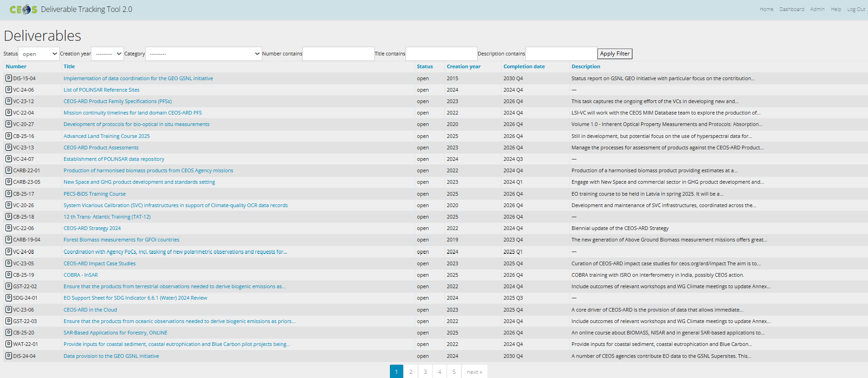
2025-2027 CEOS Work Plan Overview and Progress
Regular and up-to-date management of the CEOS deliverable tracking tool
Regular communication with the responsible parties for each deliverable
Total current number of open deliverables: 115

Slide 6
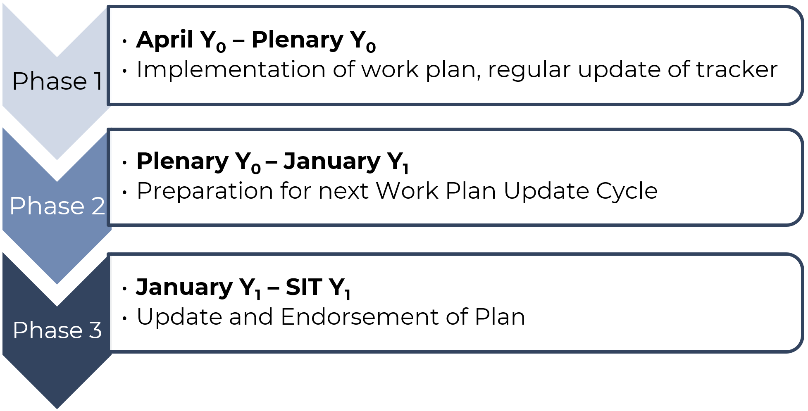
Work Plan Update – high-level picture
We are here

Slide 7
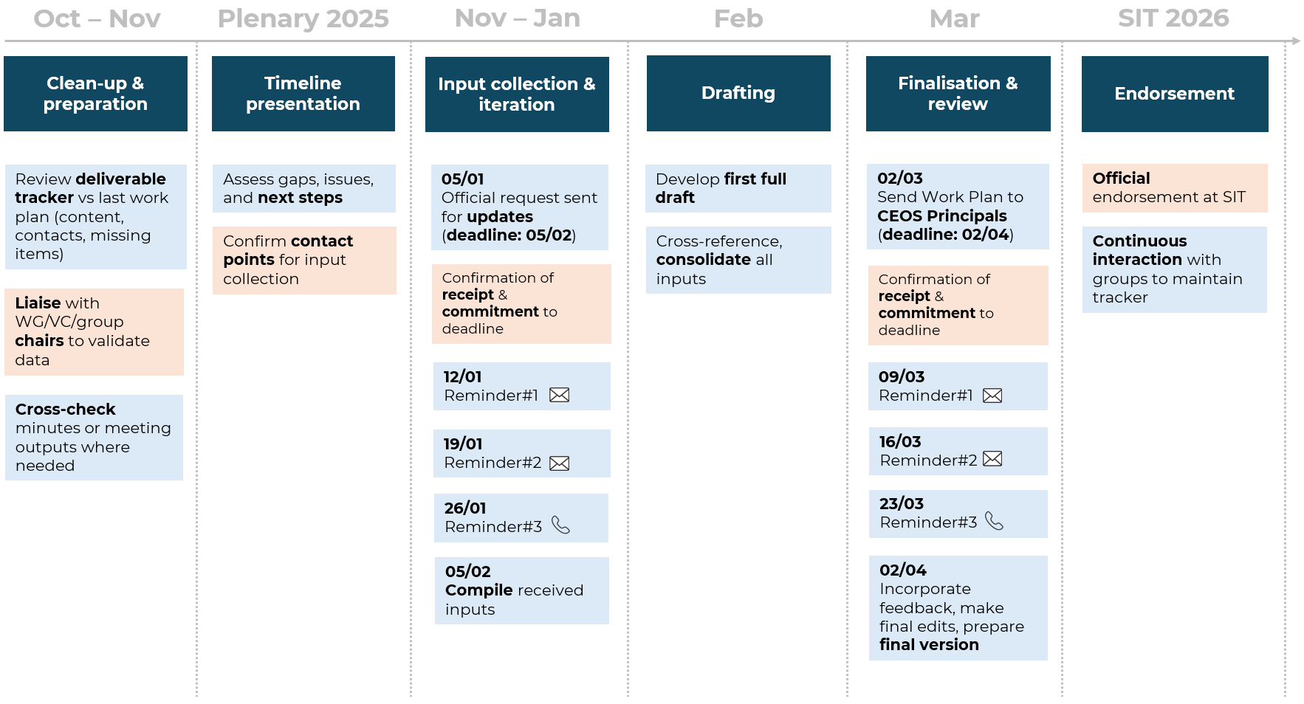
Work Plan Update – detail
Executive Office
CEOS entities

Slide 8
Reminder: CEOS Executive Office Tasks
Work Plan Coordination
  Continuous engagement with CEOS community to get inputs
  Development of the Work Plan document
  Regular update of Deliverables Tracker
Liaison with CEOS WGs, VCs, task teams
  Routine interactions with all parts of CEOS to identify areas with cross-fertilisation or synergy potential
  Attendance at WG meetings
Support to CEOS Chair and CEOS SIT Chair
  Provide overall guidance regarding CEOS actions, associated activities and stakeholders

Slide 9
Reminder: CEOS Executive Office Tasks
Representation
  GEO: PB preparation and attendance (ExCom in agreement with SIT Chair)
  Other ad-hoc requests
Maintenance
  Event tracker, mailing lists, CEOS contacts, CEOS governance documents
External liaison
  Provide guidance to external stakeholders and help them prepare their application to CEOS
  Coordinate response to external requests (e.g. from UN bodies)
SDG Coordination Group
  Facilitate the work of the Group (planning monthly meetings, keeping minutes)
Ad hoc requests
  Specific actions agreed at SEC or during key events

Slide 10
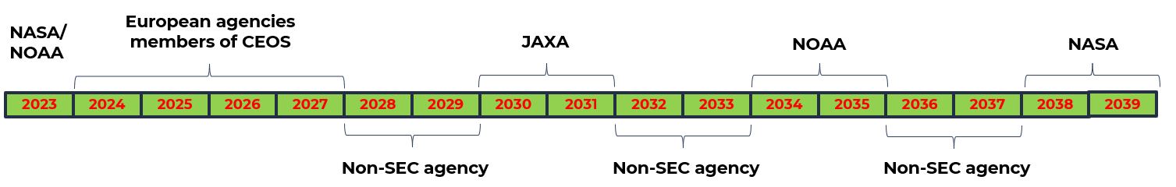
Overall pattern for Executive Office Role
Continuity ensured via a rotation of responsibilities among the 5 SEC agencies, with slots reserved for Non-SEC agencies
Need for visibility to allow resources planning
  Full rotation to be confirmed periodically at the yearly Plenary
  Firm commitments should cover the 4-year period following the Plenary

Slide 11
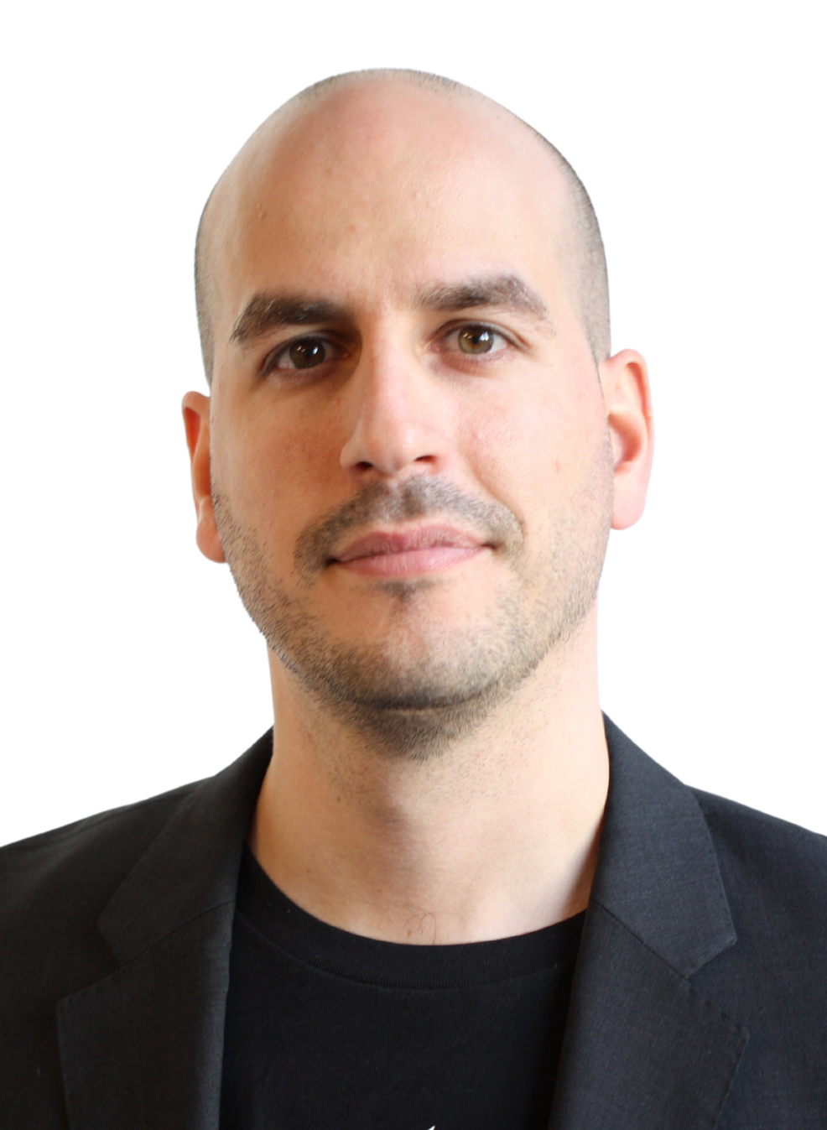
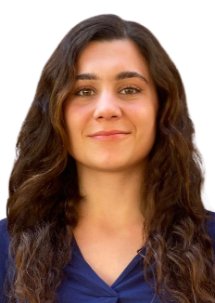
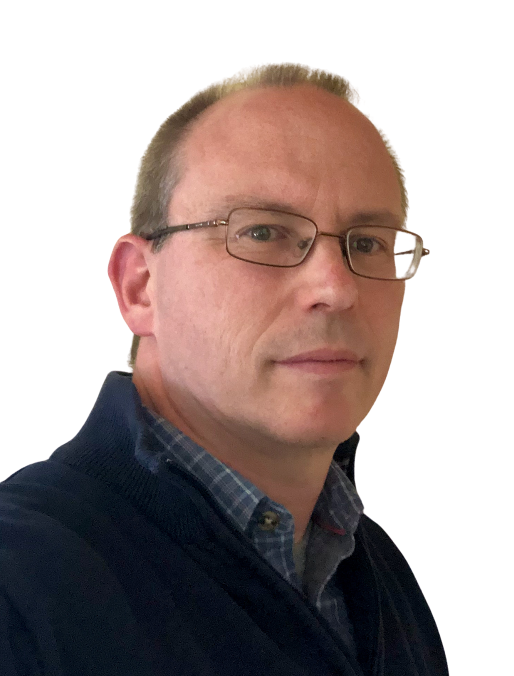


Future staffing of CEO team
Lef Mamais – Lead CEOS Executive Office
Julia Caufape – CEOS Executive Office support
Co-founder and Director at Evenflow; 15+ years in the sector
2 years as part of current CEO team
Consultant at Evenflow; heavily involved in EuroGEO
Work Plan Coordination
Liaison with CEOS WGs, VCs, task teams
Support CEOS groups: WGCapD, OCR-VC, OST-VC, OSVW-VC
Phil Harwood – Deputy to Lef
Branimir Radun – CEOS Executive Office support
Senior Consultant at Evenflow;
20+ years in the sector
Support CEOS groups: WGCV, WGISS, CEOS-ARD Oversight Group, AC-VC, COAST-VC
Senior Consultant at Evenflow;
10+ years in the sector
Support CEOS groups: Biodiversity Study Team, SDG Coordination Group, P-VC, SST-VC
All team members are part of the Strategy Consulting Practice of Evenflow led by Lef and have been working together on complex projects and prominent clients for several years.
If needed, Evenflow can use more of its team (20+ FTEs) to bring in additional support or skills e.g., linked to CEOS communication activities.

Slide 12
executive_officer@lists.ceos.org ceos_exec_support@evenflowconsulting.com
Thank you
CEO Team
Agenda Item 1.3
39th CEOS Plenary
Bath, United Kingdom
4th–6th November, 2025

