Slide 1
CEOS Plenary 2025
NASA SIT Chair Priorities
Julie Robinson
Agenda Item 10.3
39th CEOS Plenary
Bath, United Kingdom
4th - 6th November, 2025

Slide 2











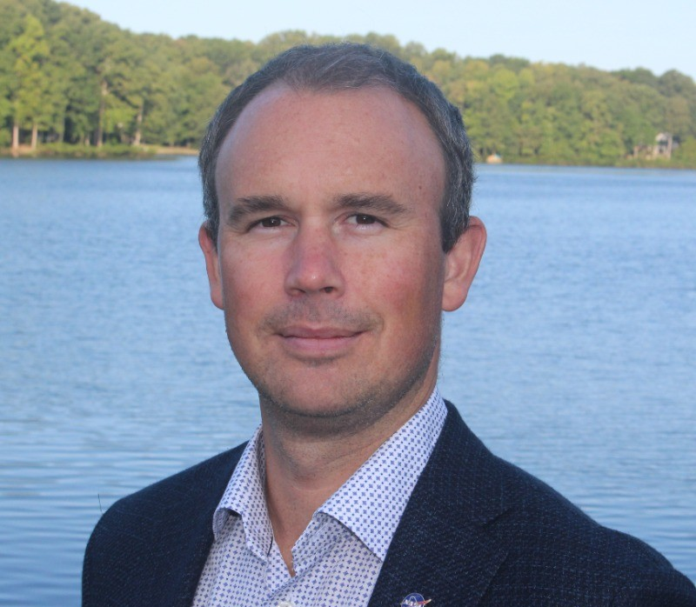

NASA SIT Chair Team
CEOS SIT Chair Support
Karen St. Germain
Director, NASA Earth Science Division (ESD)
SIT Chair
Julie Robinson
Deputy Director, NASA ESD
SIT Co-Chair
Stephen Ward
Matt Steventon
Priority #1
Water Planet: Seeing Earth’s Water from Space
Erin Urquhart
Priority #1 Lead
Michelle Hanssen
CEOS Contact
Sid Boukabara
Strategy Lead
Nicole Herrmann
SIT Chair Core Team
Harvey Jones
Libby Rose
Priority #2
Connected Data for Community Resilience
Eleanor Pierel
Priority #2 Lead
NASA SIT Chair Team Email:
nasa-sit-chair-2026-27@googlegroups.com
Wenying Su
SIT Chair Core Team, WGClimate Chair
Dave Borges
SIT Chair Core Team, SEO

Slide 3
NASA SIT Chair Priorities
Priority 1: Water Planet- Seeing Earth's Water from Space
  Advance understanding of Earth's water cycle by monitoring terrestrial waters, coastal regions, and oceans from space. Transform this knowledge to actionable insights to enhance water use efficiency, improve water quality, and enhance resilience to water-related hazards such as droughts, floods, and storms.
Priority 2: Connected Data for Community Resilience
  Advance community-level resilience by leveraging CEOS disaster risk reduction successes and partnerships to enhance cross-collaboration, data interoperability, and actionable information.

Slide 4
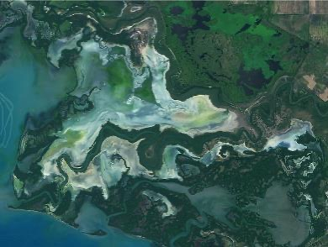
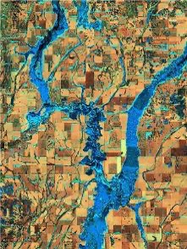

SIT Chair Priority 1: Water Planet
Water Planet- Seeing Earth's Water from Space
Water is fundamental to life on Earth yet increasing pressures on global water resources—combined with rising exposure to water-related extremes such as droughts and floods—demand innovative solutions to ensure a sustainable future.
Satellite observations play a critical role in advancing our understanding of the water cycle and monitoring changes over time. These observations provide essential data needed to address challenges in water availability, accessibility, quality, and hazards.

Slide 5
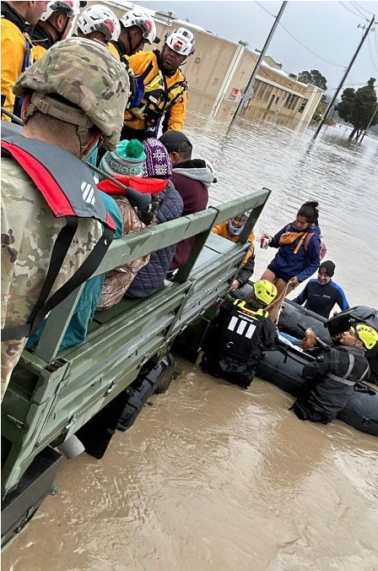

SIT Chair Priority 1: Water Planet
By integrating the capabilities of legacy and new missions, this priority focuses on delivering tailored water data and information designed to support research, inform water management decisions, and enhance preparedness for water-related hazards at a global scale.
CEOS offers valuable assets and collective strength to deliver multisource, integrated data and a user-driven approach to address Earth’s most pressing water challenges.

Slide 6
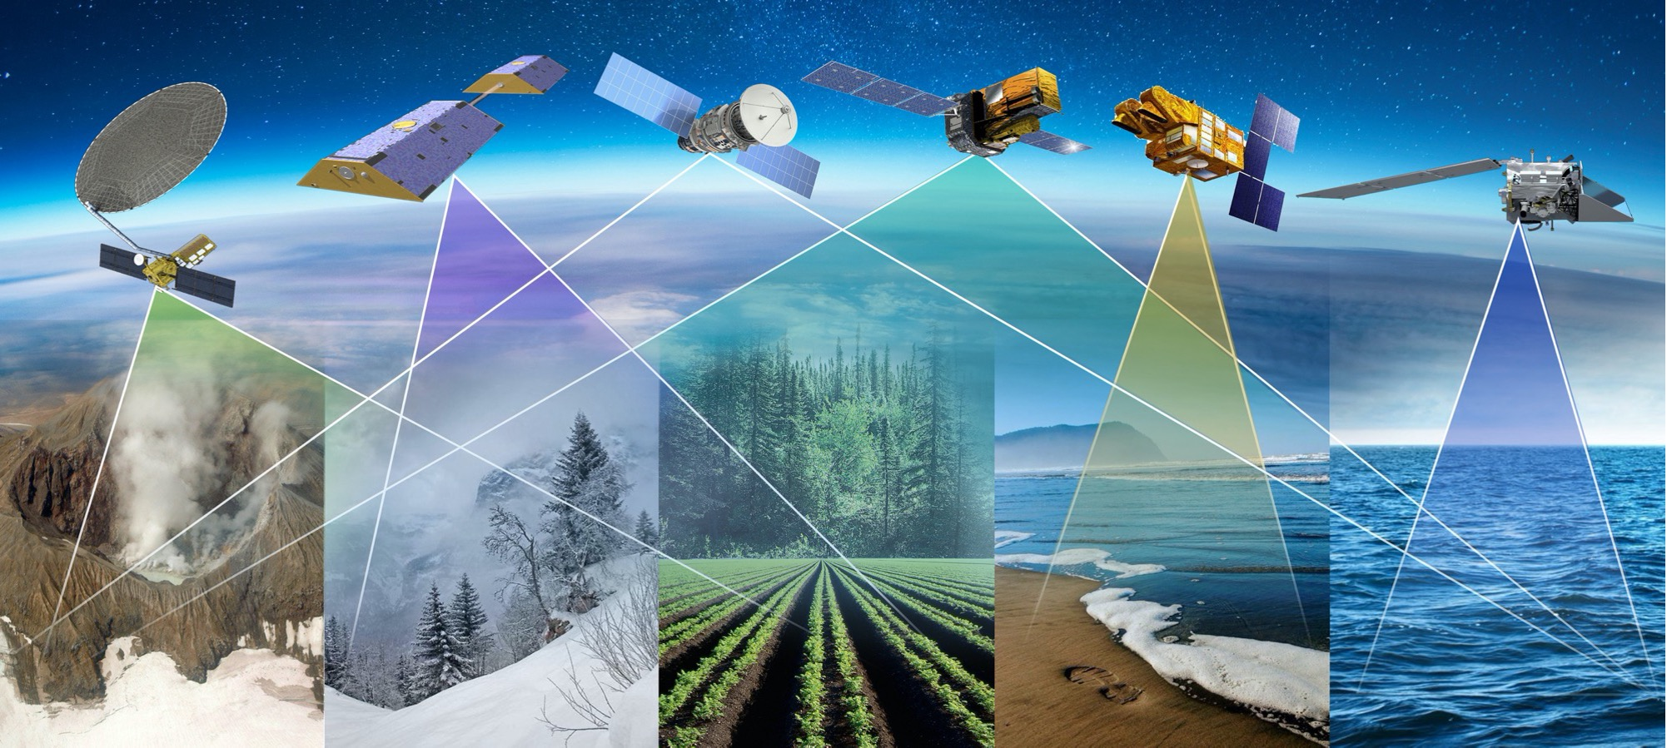
Priority 1: Key Objectives
Coordinated Water Observations
Accessible and Interoperable Water Data Products
User-Center Solutions for Water Challenges
Assessment of Socio-Economic Benefits

Slide 7
Priority 1: Deliverables
Impact Assessment Report on CEOS Water and Resilience Activities (in collaboration with Priority 2 Team)
Best Practice Guidance on Combining Multiplatform and Multispectral Data
Contribute a water thematic section to updated CEOS-ARD strategy (in collaboration with CEOS Chair)
Stakeholder Engagement & Capacity Building Initiatives
  Water Quality Workshop (co-led with CEOS Chair; 2026)
Best Practice Guidance for Scaling and Transitioning EO Data Into Actionable Water Solutions
Use Cases Illustrating Socio-economic Benefits and Applicability of Satellite-based Water Solutions Across Regions and Sectors
Notes:
Best Practice Guidance on Combining Multisource Data: Develop comprehensive best practice guidance for combining optical and SAR (Synthetic Aperture Radar) data to derive critical water variables. Include integration protocols for multisource datasets as part of an integrated water observatory framework.
Establish and promote a roadmap for the development of a multisource integrated water observatory. This will support the seamless integration of past, present, and future observational missions, combining diverse datasets to improve understanding of the global water cycle over time.
CEOS Analysis-Ready Data (ARD) for Water Strategy and Implementation Plan:
Create and deploy a CEOS-ARD for water strategy and implementation plan to guide the delivery of interoperable, open-access water data and products tailored to user needs. Include standards for analysis-ready datasets that integrate optical, SAR, and other satellite data to support global and regional water cycle monitoring.
Stakeholder Engagement Initiatives: Strengthen collaboration with OpenET, AquaWatch, CyAN, GEOGLOWS, and other partners through joint projects and stakeholder forums. Develop pilot projects to test tailored applications, such as water information systems or hazard monitoring tools, with direct community involvement.
Water Quality Workshop for Community and Stakeholder Engagement: Co-host a water quality-focused workshop, providing education and resources to increase community uptake of satellite-based data and solutions. Engage key stakeholders to develop clear application guides and materials aimed at enhancing water quality monitoring and decision-making.
Best Practice Guidance for Transitioning EO Data into Actionable Water Solutions: Provide guidance on leveraging Earth observation data to create decision-focused solutions for resilience to water-related hazards.
Use Cases Demonstrating Socio-Economic Benefits Across Sectors and Regions: Develop sector-specific and regional use cases that illustrate the socio-economic benefits of satellite-based water variables. Focus areas could include agriculture, emergency response, transportation, insurance, natural resource management, and energy. Demonstrate the applicability and value proposition of satellite-based water information by showing tangible socio-economic impacts. They bridge the gap between raw data or models and actionable solutions—helping a wide range of stakeholders understand the data's relevance and usability.

Slide 8
Priority 1: Deliverables Timeline
Seeing Earth’s Water from Space
SIT TW
2025
Plenary
2025
SIT-41
SIT TW
2026
Plenary
2026
SIT-42
SIT TW
2027
Plenary
2027
Objectives
Gap analysis of water variables
Adequacy assessment of in-situ networks and cal/val infrastructure
Coordinate and promote multisource integrated water observatory products
Develop guidelines on integrating multiplatform & multispectral sensing to derive water variables.
Coordinated Water Observations
Accessible & Interoperable Water Data Products
Collect specific data needs and requirements for water applications
Advance CEOS-ARD for water
Enhance interoperability of multisource integrated water products
Align and promote user-driven tools for water resource management and resilience
                Promote and coordinate resources & training opportunities on EO for water
User-centered Solutions for Water Challenges
Develop guidelines and best practices on transition of EO data into actionable water solutions
Assess socio-economic benefits
Impact assessment of existing CEOS activities related to water and resilience (with Priority 2)
Assess the socio-economic benefits of EO-based water variables (e.g., through use cases) for specific regions, sectors, and challenges

Slide 9
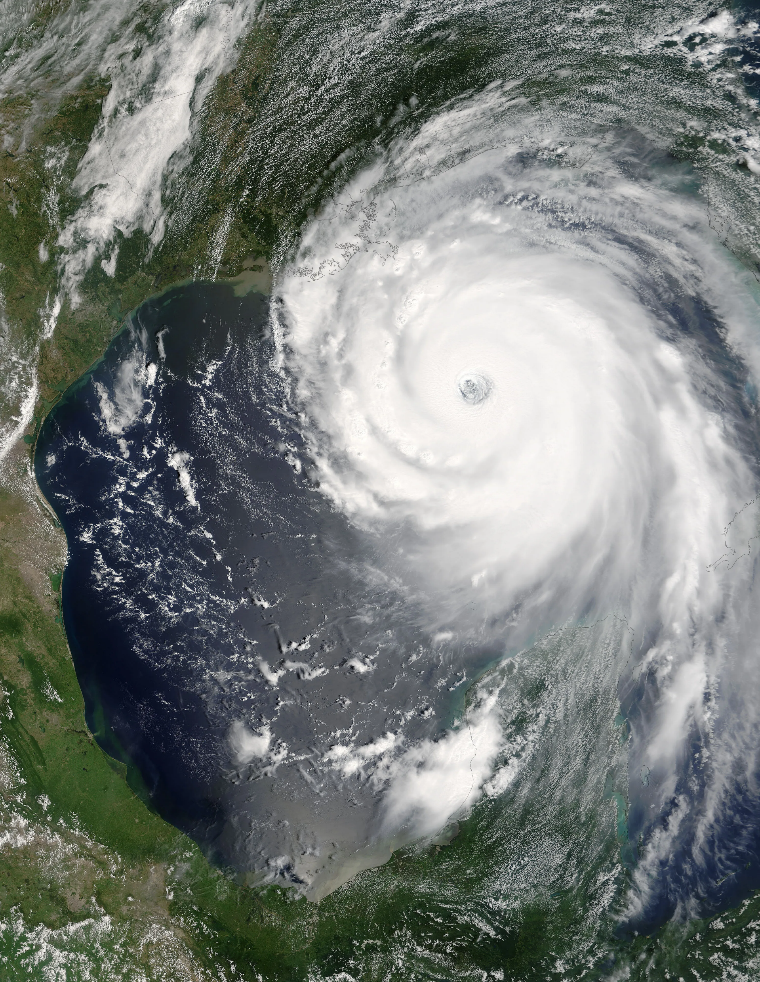
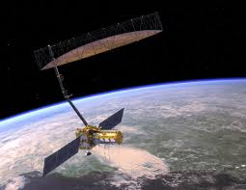
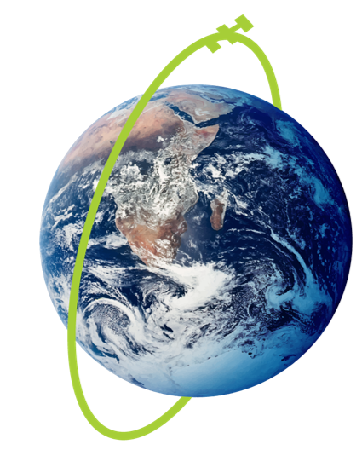
SIT Chair Priority 2
Connected Data for Community Resilience
CEOS works across a data-driven value chain, from observations to impact.
Increasing extreme weather events and disasters demand enhanced support to community resilience
Growing data volume, variety, and complexity require improved coordination and data interoperability
In response, CEOS will advance existing capabilities and provide actionable information to support community-level resilience

Slide 10
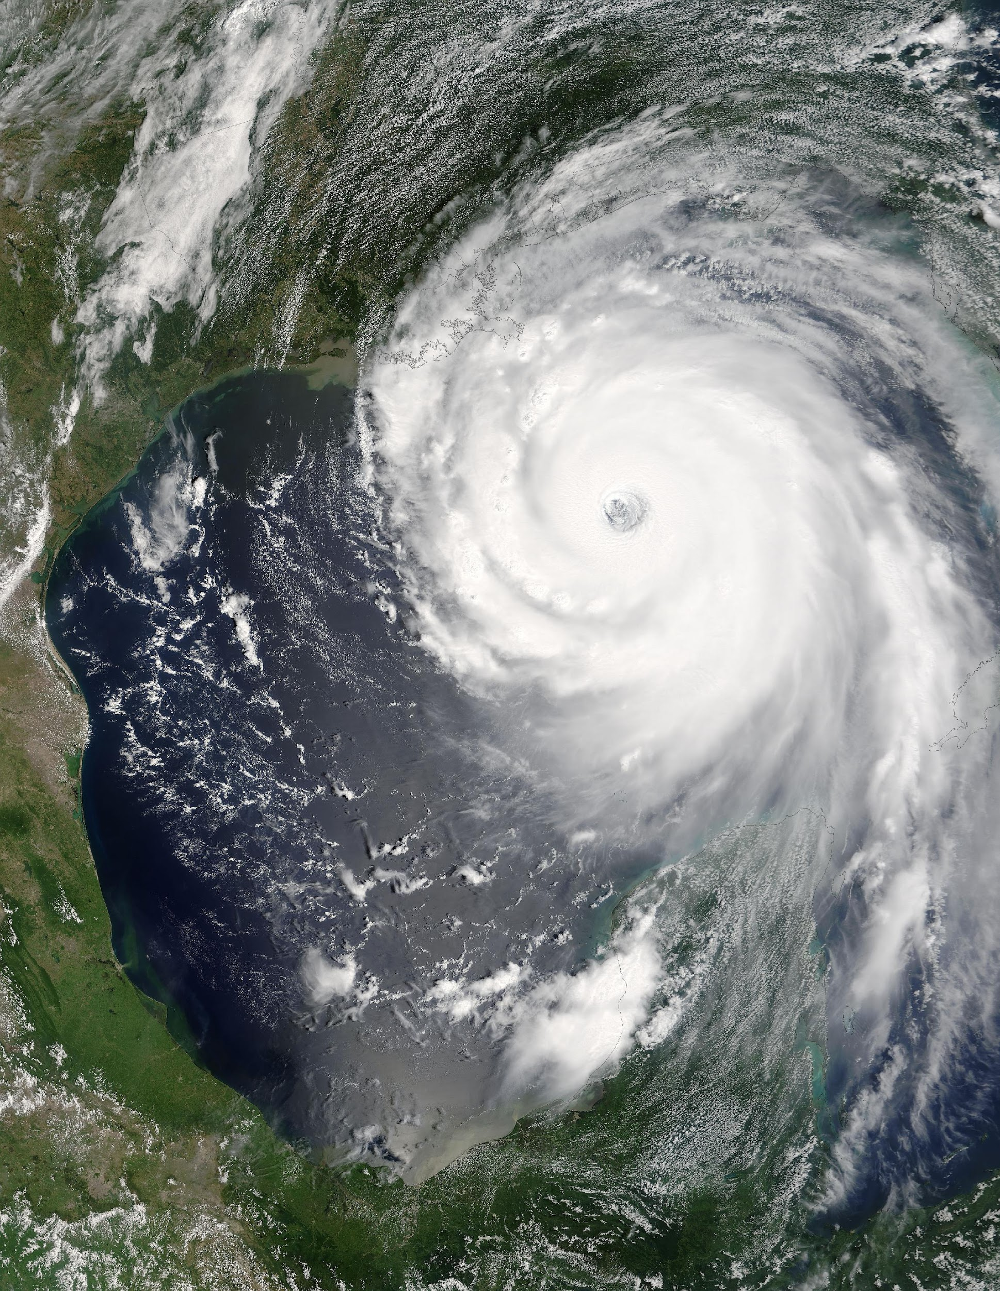
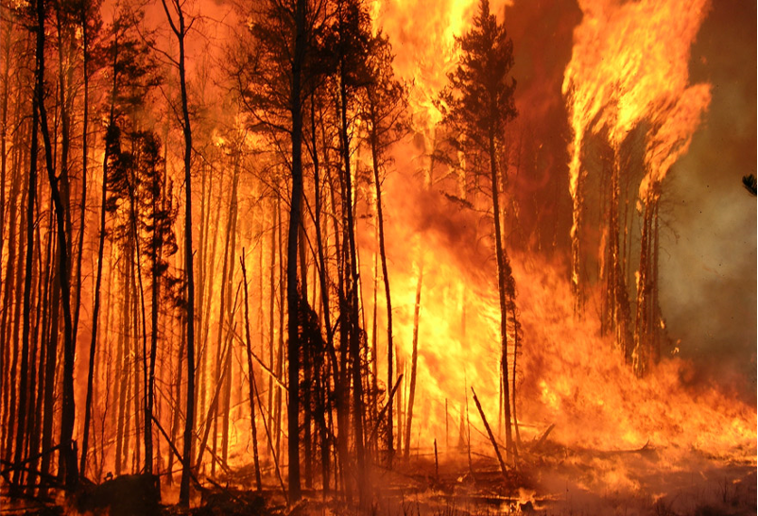
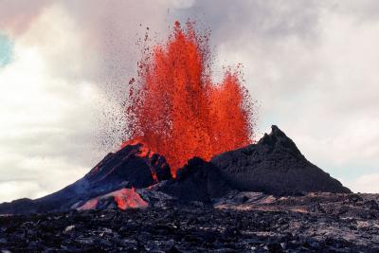
Priority 2: Key Objectives
Understand and enhance cross-CEOS collaboration towards impactful data value chain
Assess impact of existing activities
and end user requirements to build
community resilience
Enhance existing interoperability efforts to address data user needs
Improve capabilities to deliver actionable information built on resilience community input
Credit: NASA
Credit: Canadian Forest Service
Credit: USGS

Slide 11
Priority 2: Deliverables
Impact assessment of key existing resilience-related activities (in collaboration with Priority 1 Team)
Updated data value chain to include co-development​
Interoperability Demonstrator (in collaboration with Priority 1 Team)
Resilience Data Partner workshop
Resilience Findings

Slide 12
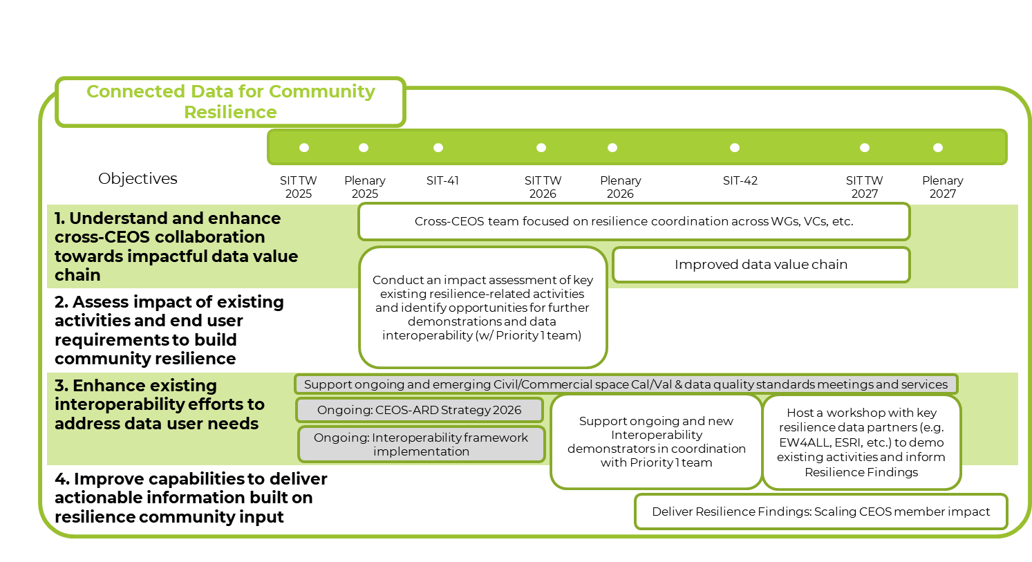

Slide 13




CEOS SIT 2026 Meetings
SIT-41
14-16 April 2026
National Academies of Sciences,
Engineering, and Medicine (NASEM)
Beckman Center
Irvine, California
SIT Technical Workshop
8-10 September 2026
National Academies of Sciences,
Engineering, and Medicine (NASEM)
National Academy of Sciences Building
Washington, DC

