Slide 1
Closing remarks
UKSA CEOS Chair Team
Agenda Item 10.8
39th CEOS Plenary
Bath, United Kingdom
4th - 6th November, 2025

Slide 2
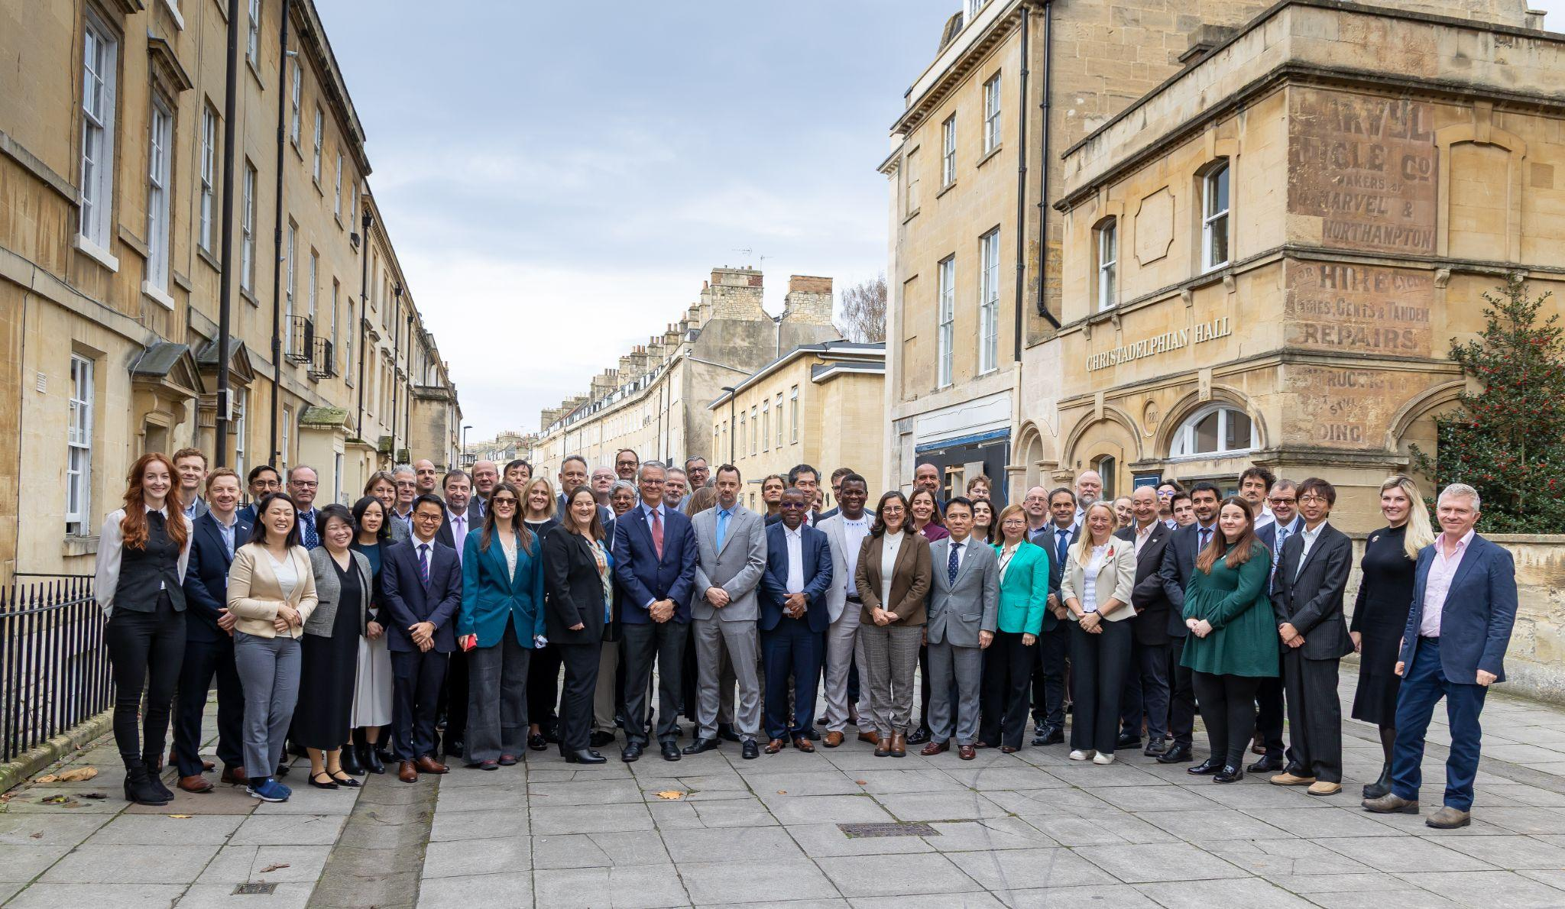
Thank you!

Slide 3
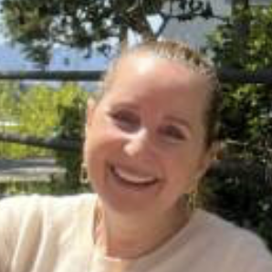
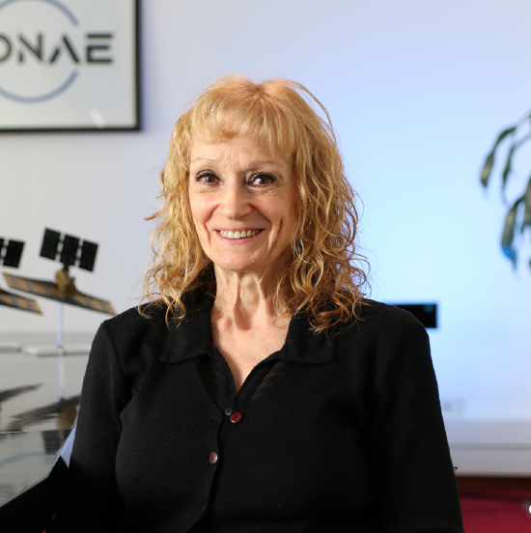
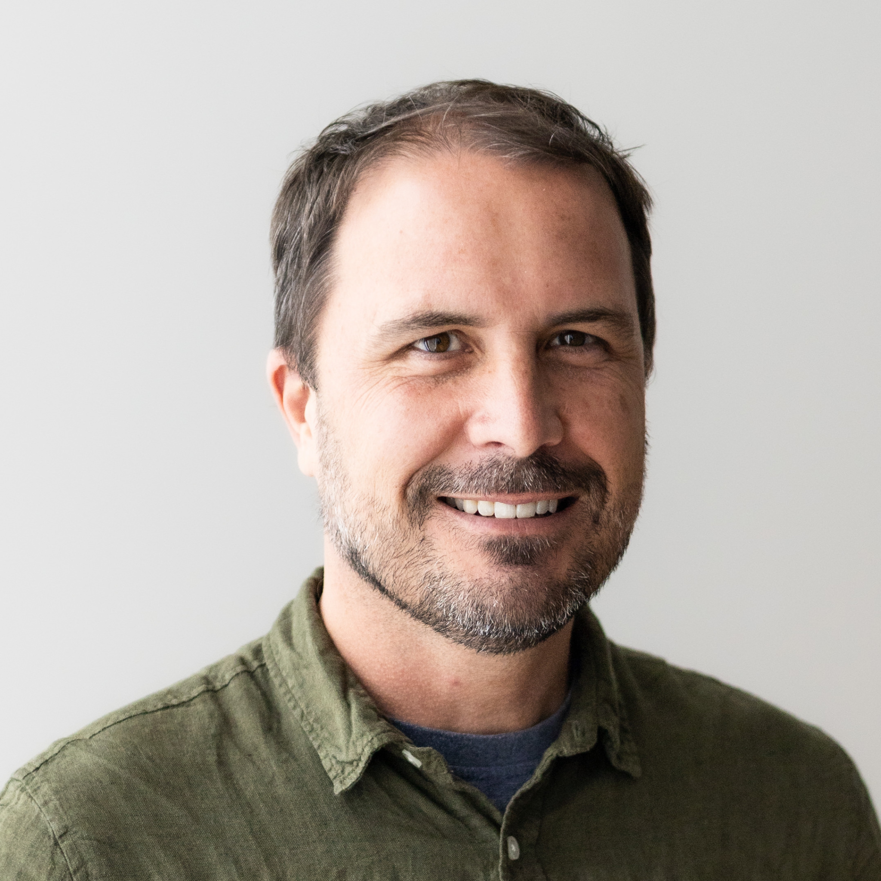
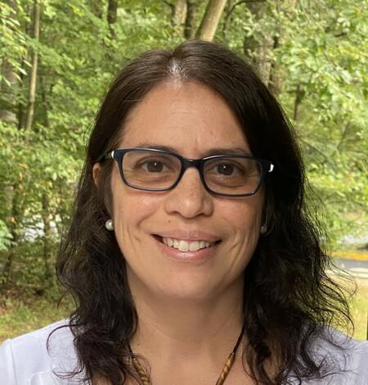
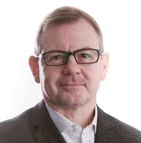
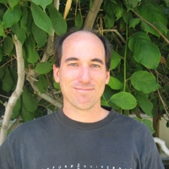
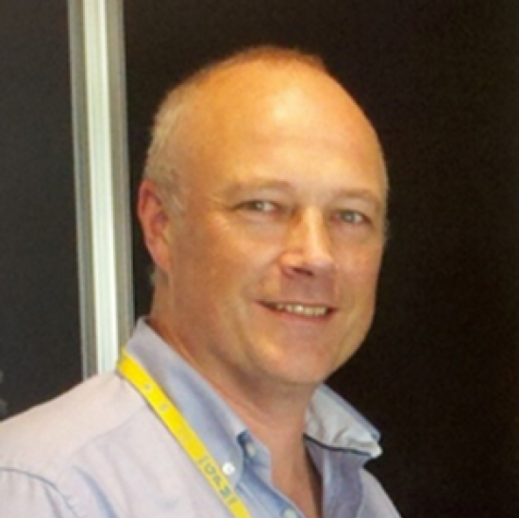
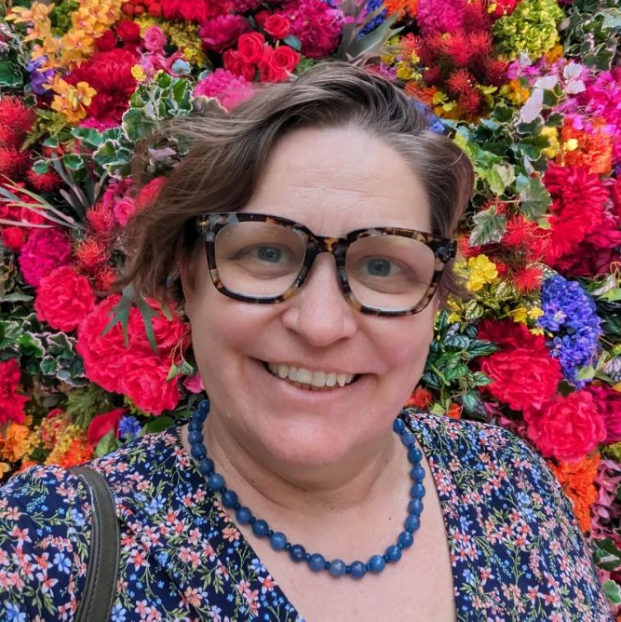
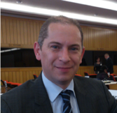
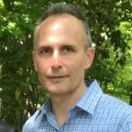
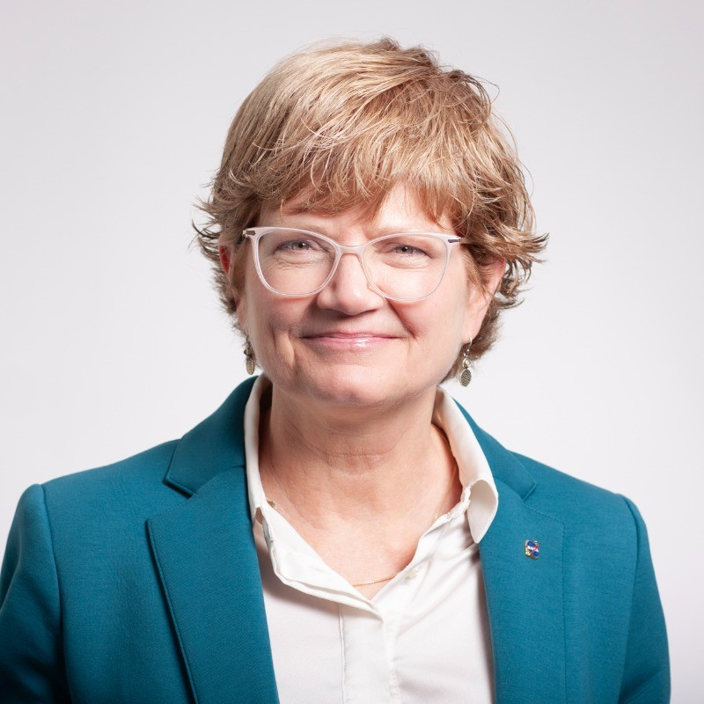
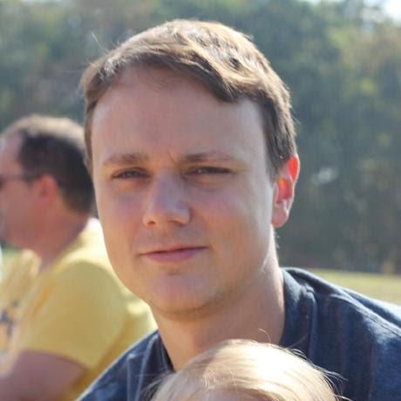
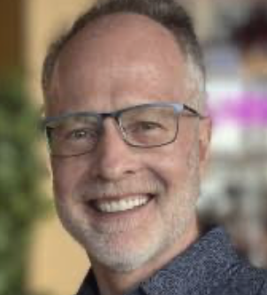
Acknowledgements
On behalf of CEOS, we would like to extend our sincere appreciation for a number of our friends leaving the CEOS community in 2025.
Christine Bognar NASA CEOS Contact & SEC Rep
Laura Frulla WGDisasters Chair 2024-2025
Ben Poulter CEOS AFOLU Roadmap Lead
Sylvia Wilson SilvaCarbon Lead
Steven Ramage CEOS Executive Officer 2024-2025
John Worden AC-VC GHG Lead
Chris Kidd P-VC Co-lead
Katy Matthews NOAA CEOS Contact
Julio Castillo WGCapD Vice Chair
Tim Stryker USGS
Nancy Searby NASA
Patrick Quinn NASA
Brad Doorn NASA

Slide 4
CEOS SEC-342
The 342nd CEOS Secretariat meeting will be held in the Kingsmead Side Meeting Room, led by the 2026 CEOS Chair

