Slide 1
CEOS Plenary 2025
Unlocking EO for Society
CEOS Youth pilot: Review
Beth Greenaway, UKSA
Agenda Item #
39th CEOS Plenary
Bath, United Kingdom
4th - 6th November, 2025

Slide 2
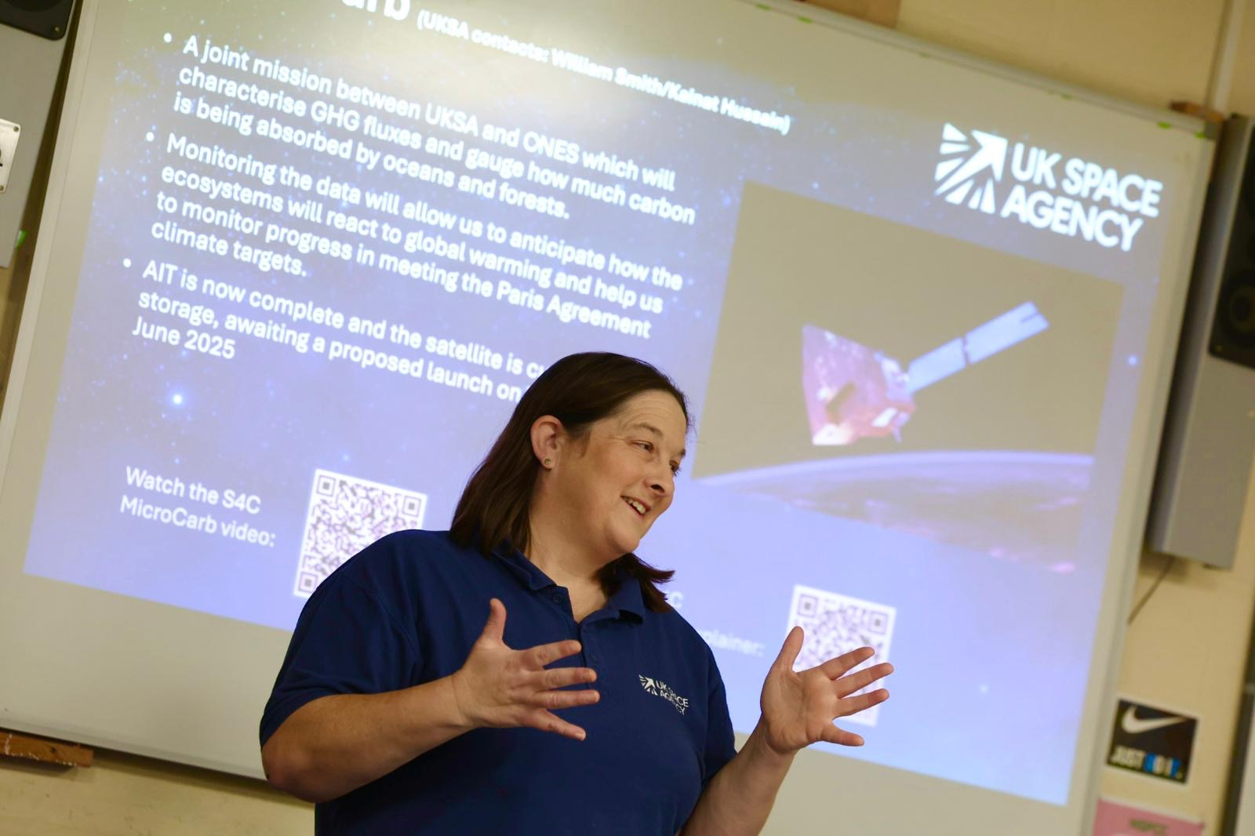
Recap: CEOS in schools
Aim: Pilot a CEOS programme to inspire global youth collaboration in Earth Observation.
Educate: Create a low-cost, potentially repeatable pilot programme that can educate and inspire young people on the benefits of EO for Society.​
Collaborate: Provide opportunities for students to work collaboratively across borders using the platform of CEOS. ​
Engage: Facilitate a dialogue between CEOS principals and youth representatives on key CEOS topic areas. ​

Slide 3




Programme overview
Collation of materials
CEOS in schools' pilot
Collation of materials
Legacy
Engage young people from across CEOS countries
Bring together for discussion and collaboration at 2 international workshops
Deliver a poster/presentation and engage with CEOS experts
Seek input from CEOS agencies to bring together open-access education materials into one easy-access place
Support schools in accessing open-access materials
Share ideas, learn lessons and build upon the work being done this year
Explore appetite for education to remain a long-term CEOS priority

Slide 4
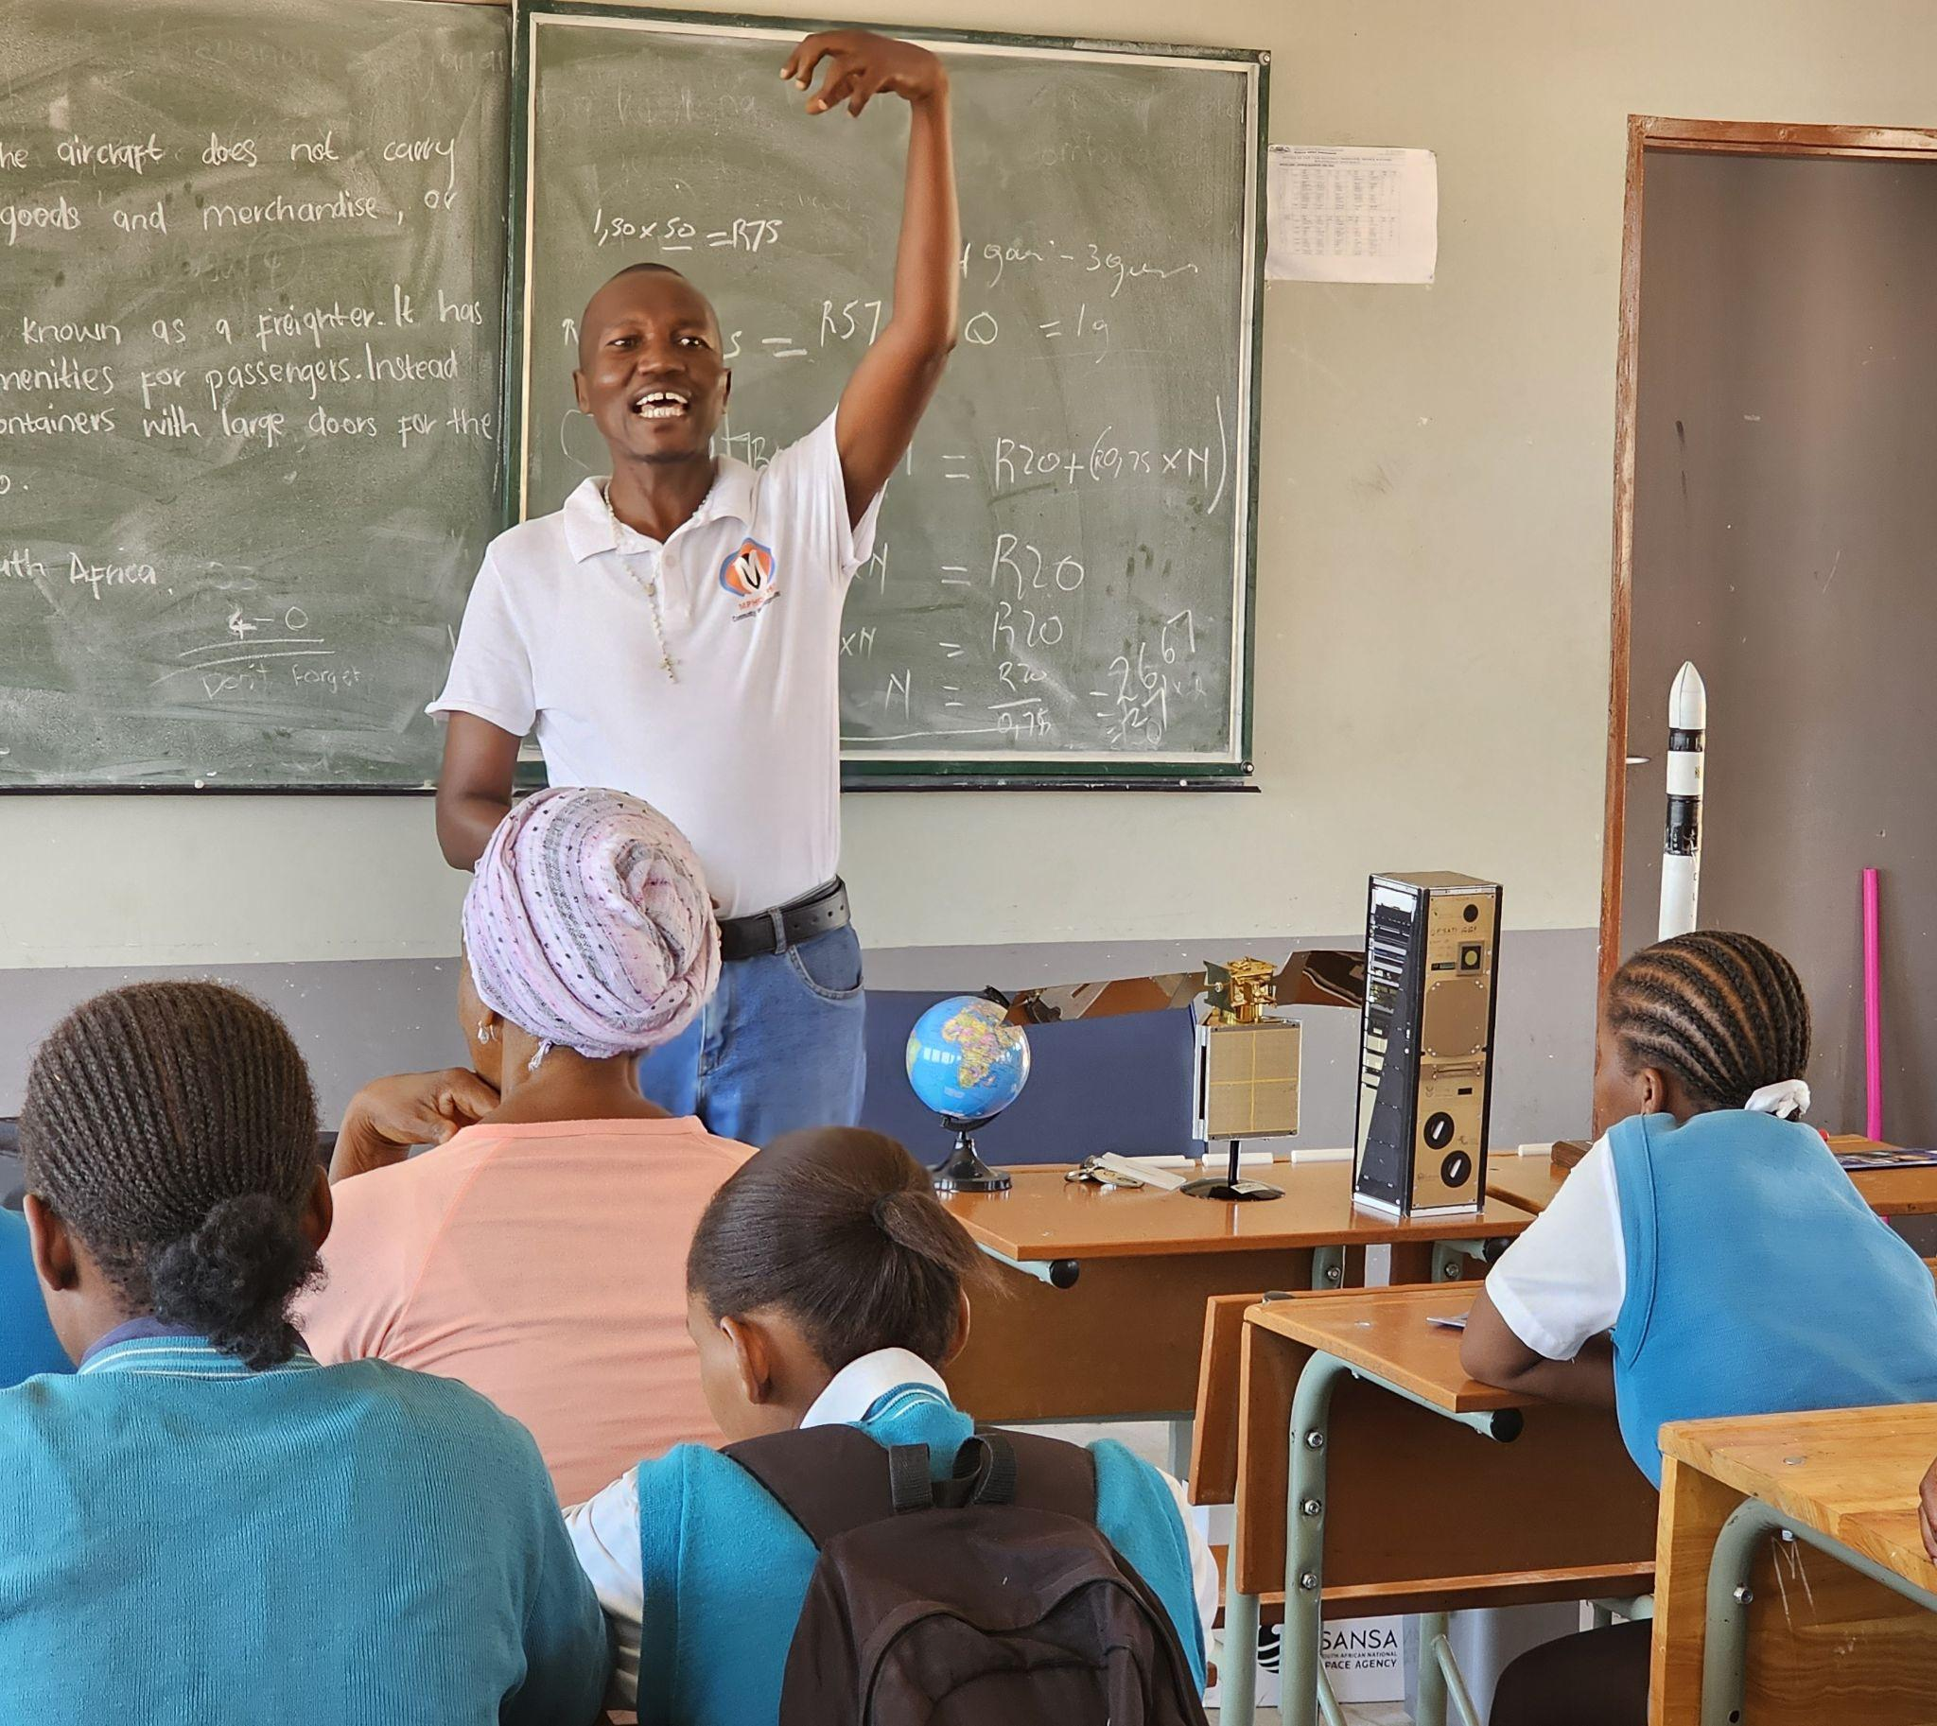
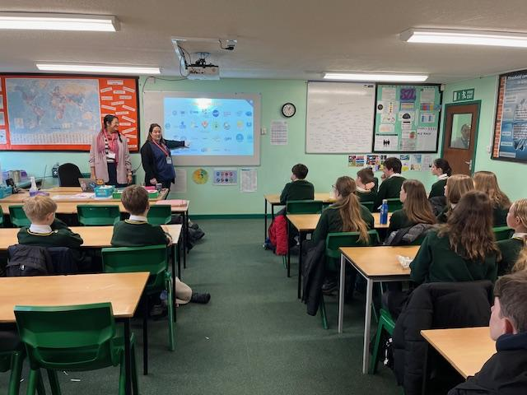
CEOS in Schools: 2 International Webinars
Schools had material and a visit from an expert/Agency to begin to look at EO and the topics and then came together to discuss:
First international webinar: 26 February 2025, ‘EO for natural disaster response ’
125 students across six countries (Australia, Canada, Thailand, Japan, South Africa and the United Kingdom)
Each student got to speak in small virtual breakout groups
Second international webinar: 26 March 2025, ‘EO for biodiversity’
Featured a speaker from ESA’s Biomass mission

Slide 5
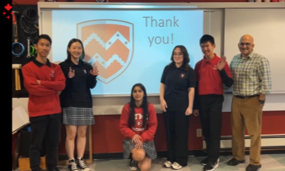
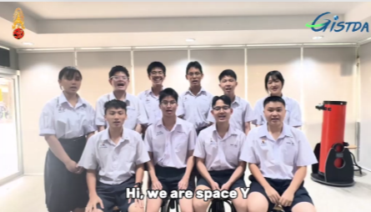
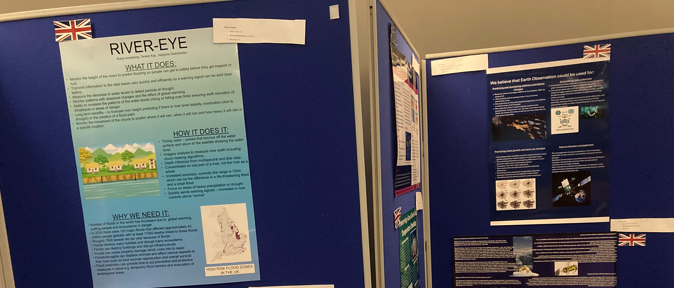
Posters project and Youth summit
The first CEOS Youth Summit took place yesterday (Thanks to everyone who took the time to engage, listen and support this event)
It was an Opportunity for students to present posters and take part in a Q&A with CEOS Principals
Provided a two-way dialogue between the youth voice and CEOS principals

Slide 6
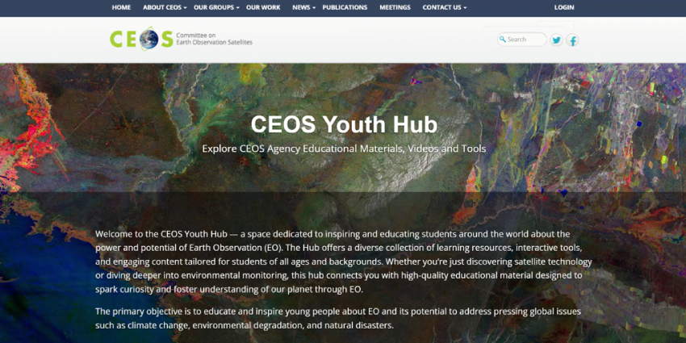
Youth Hub: Improving access to open-source material
CEOS Youth Hub | CEOS | Committee on Earth Observation Satellites

Slide 7






Feedback and lessons learnt
Global Participation: Over 130 + Students from 6 CEOS countries engaged in cross-cultural learning and collaboration.
Interactive Format: The opportunity for each student to engage and speak directly with students from other countries was consistently praised as unique and the most important aspect.
Real-World Relevance: Activities centred on practical applications of EO data in disaster response and biodiversity conservation
Open to all: Support for the approach that is open to students across globe regardless of school curriculum – its an 'extra' to be done in clubs or school lunch time.
Notes:
The teachers local facilitation is key

Slide 8
Recommendations
Support Team Australia's continuation of the programme, embedding lessons learned from the pilot year and expanding participation.
Explore practicalities of a permanent youth programme under the Working Group on Capacity Development

Slide 9
Discussion
Notes:
Timeline:
June 2024: Workshop with all CEOS agencies
July 2024: Follow up workshop Interested CEOS agencies
September 2024: Programme structure agreed, and outreach material provided
November 2024: UKSA becomes CEOS chair
December 2024: Confirmation of participating CEOS Agencies and schools
January 2025: Participating schools undertaken prep materials
February 2025: First International workshops
March 2025: Second International Workshops
April 2025: Students begin Poster project
June 2025: Students submit Poster project
November 2025: CEOS Youth event – Students present Posters and Q&A session with CEOS principals

