Slide 1
Unlocking EO for Public Services
Overview and Discussion
Niall Bradshaw
CEOS Chair Team
Agenda Item 2.2
39th CEOS Plenary
Bath, United Kingdom
4th - 6th November, 2025

Slide 2
Unlocking Earth Observation for Society
Explore strategies to bridge the gap between satellite EO data and services
Learn from the experiences of CEOS Agencies and identify what we might do better together as an international community to maximise the uptake of EO data for societal impact.
Unlocking EO for Society:
Methane best practices
CEOS in Schools
Unlocking EO for the Global Stocktake
Unlocking EO for public services

Slide 3







Unlocking EO for Public Services
A side meeting workshop was held at the 2025 SIT Technical Workshop.
This session explored existing systems and interventions at national levels that are used to bring valuable EO data to the policy and service professionals that need it, to create efficiencies, stimulate growth, and ultimately impact lives for the better.
Public Services: “Interventions and services intended to address public needs and interests, that are delivered by government, public sector agencies, or private or voluntary organisations with public funding”

Slide 4
Discussion
What are the examples of success stories and lessons learned?
What are the practical challenges and technical or policy barriers?
Where are the opportunities for greater use of EO in public services?
How can we encourage greater cross-sector collaboration, capacity building and innovation?

Slide 5
Findings paper
Practical Challenges and barriers to public service uptake:
Trust & Risk Aversion – need for demonstrable value without added complexity
Institutional inertia – resistance to change
Relevance and usability – Complex, bespoke and time sensitive requirements
Procurement and licencing – misalignment of commercial models with Government budgets, restrictive licencing
Scalability – translation of feasibility projects to operational applications

Slide 6
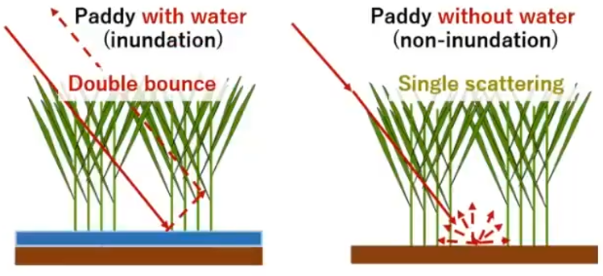
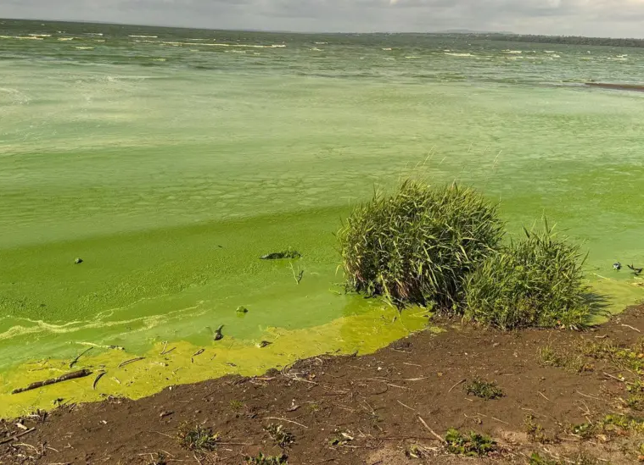
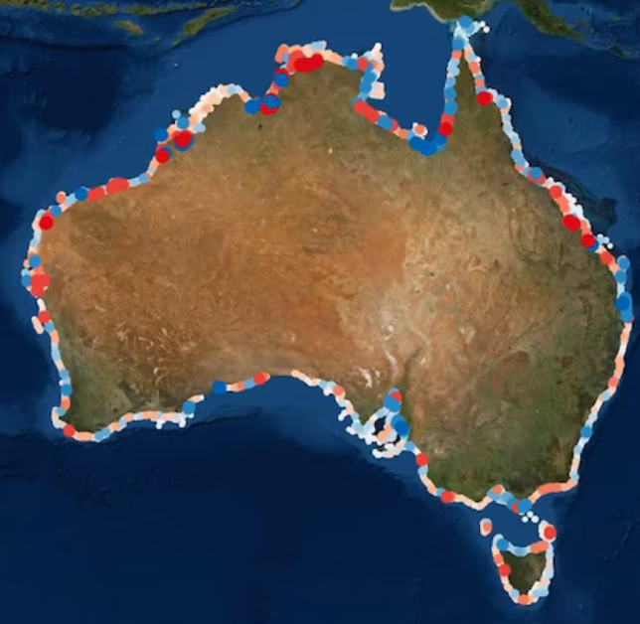
Findings paper
New opportunities & successes:
Digital Earth Australia
KCEO’s thematic deep dives – legislation underpinned by EO
JAXA’s medium-long term plan
Defra’s Centre of Excellence
UKSA’s Unlocking Space for Government programme

Slide 7
Findings paper
A role for CEOS?
Creating space (e.g. side meeting/Agency updates) for sharing of good practice and successful approaches for public sector adoption
Curate and share practical playbooks, case studies, demonstrators and implementation models to help move from pilot projects to operational services
Facilitate the alignment of EO-based indicators and products with both international treaty reporting requirements and national/regional policy implementation needs.

Slide 8
Thank you
A huge thanks to:
Osamu Ochiai – JAXA
Bela Belojevic – Geoscience Australia
Mark Dowell – European Commission KCEO
Oliver Vaughan – DEFRA (UK)
Chris McQuire – UK Space Agency
Harvey Jones – Symbios

