Slide 1
CEOS Plenary 2025
Capacity Development Updates
Dan Matsapola, SANSA
Agenda Item #
39th CEOS Plenary
Bath, United Kingdom
4th - 6th November, 2025

Slide 2
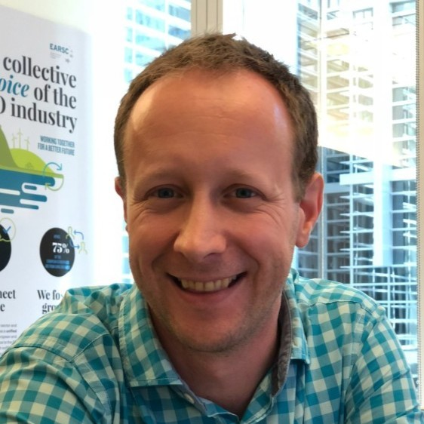
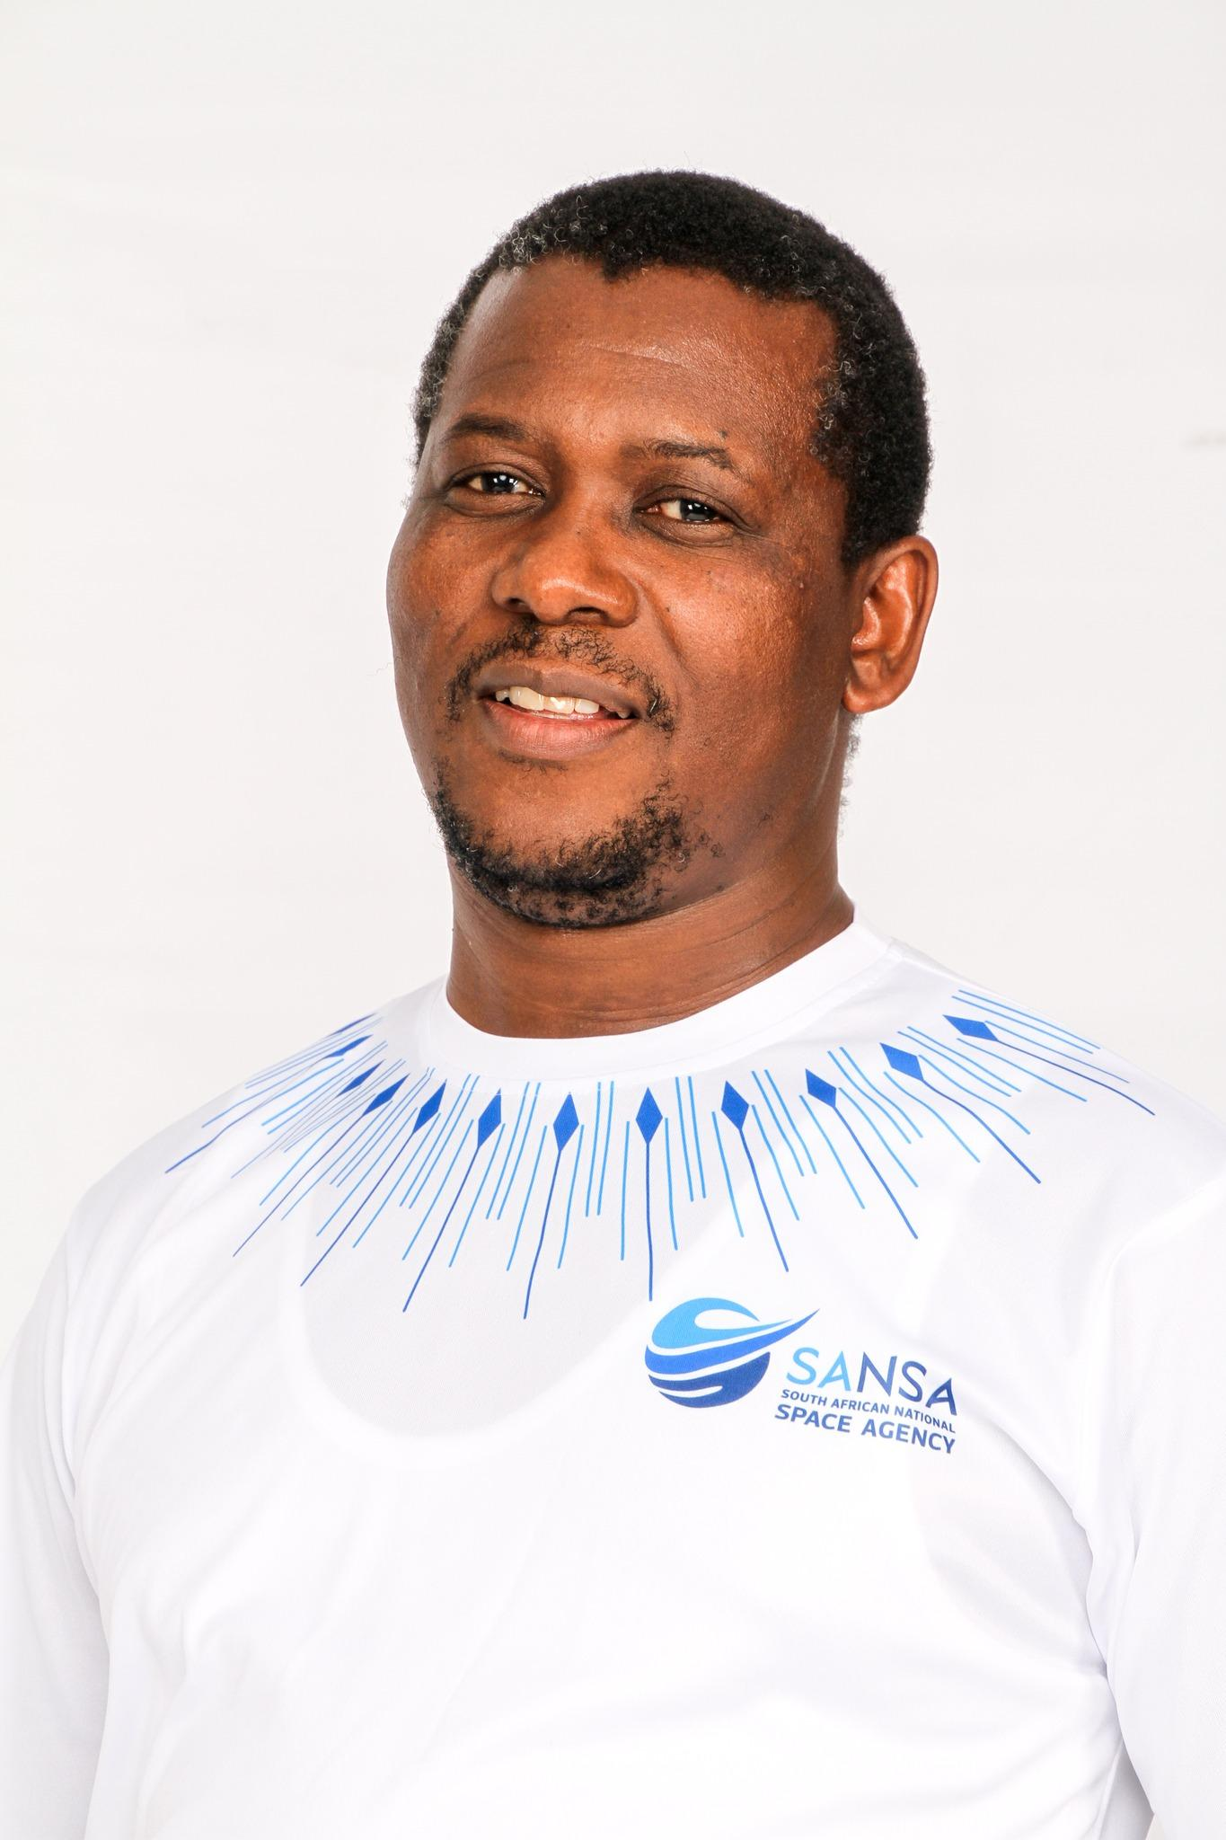

WGCapD Leadership Update
Christoph Aubrecht (ESA) nominated as a WGCapD Vice Chair, expected to serve as Chair starting in 2026
Dan Matsapola (SANSA) staying on as WGCapD Chair for one more year to support smooth transition
WGCapD will be looking for a Vice Chair in 2026

Slide 3

WGCapD Priorities
Shift from one-time joint trainings or webinars to sustained long-term collaborations, i.e. ESA-NASA Transatlantic Trainings
Focus on capacity building of underrepresented communities, i.e. Indigenous Mapping Workshops and Engaging Youth to use EO for Economic Empowerment
Promoting cross-cutting deliverables that involve more than just two agencies, i.e. SDG MOOC
Strengthen collaborations with Working Groups on Disasters, Climate, SDGs, and others
Engaging more CEOS members who are not yet involved in WGCapD
Prioritize capacity development of decision- and policy-makers for greater impact
Incorporate new AI tools and best practices to support capacity building efforts

Slide 4
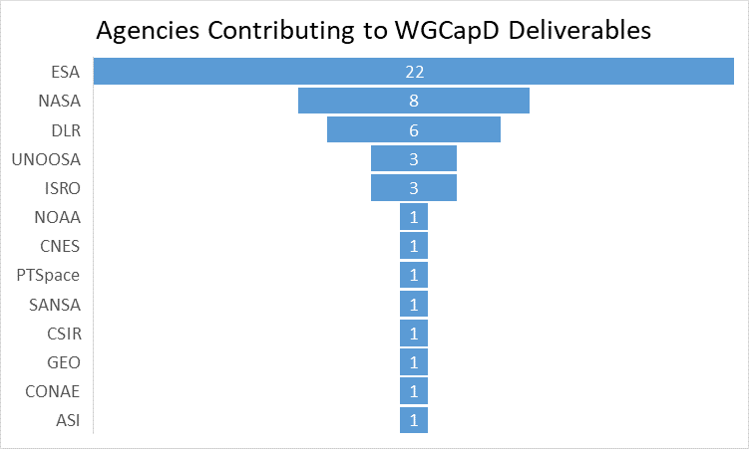
WGCapD Deliverables
WGCapD member agencies are currently working to execute 29(!) deliverables
12 deliverables will be implemented in CY25
17 are expected to be completed in CY26
Examples include:
CEOS In Schools pilot project of UKSA as CEOS Chair 2025
Copernicus User Uptake in Africa (DLR, UNSPIDER, NASA)
Hyperspectral Remote Sensing Training (ESA, DLR, ASI, NASA)
Polarimetric SAR Training Course (ESA, ISRO)
PUMAS training on the joint utility of Sentinel-1 and SAOCOM-1 (ESA, CONAE)
Guidance for Conducting Needs Assessments for Capacity Building (NASA, UNOOSA)

