Slide 1
CEOS-CGMS Working Group on Climate
Wenying Su, NASA
Vincent-Henri Peuch, ECMWF
Agenda Item 3.2
39th CEOS Plenary
Bath, United Kingdom
4-6 November, 2025

Slide 2
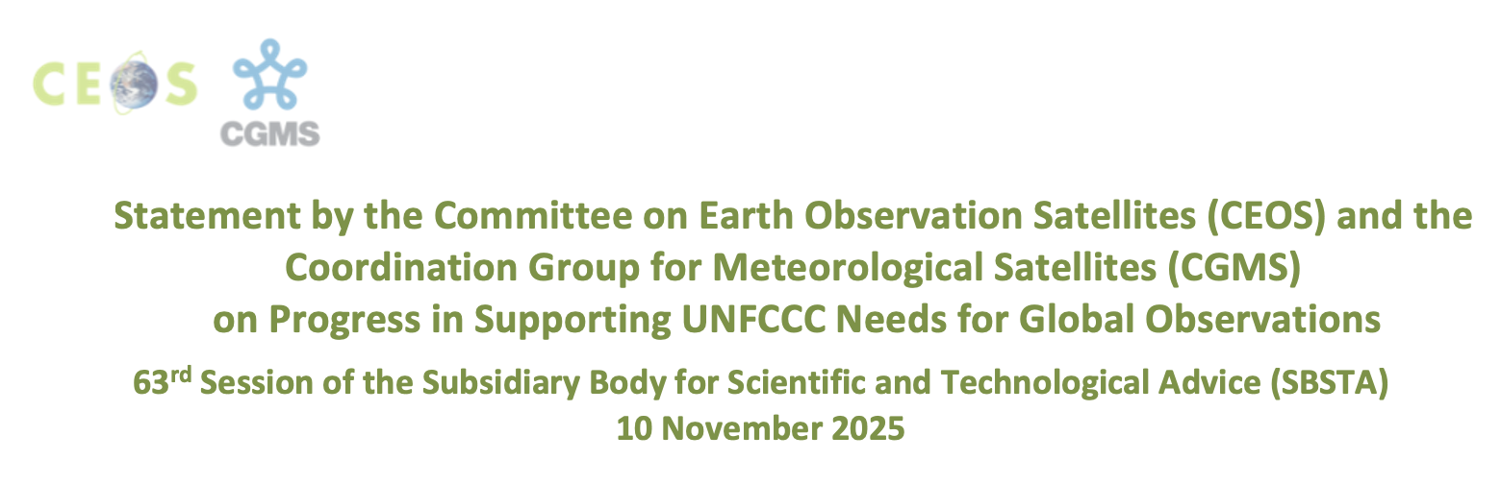

CEOS-CGMS Statement to SBSTA 63
Annual statement prepared by the WGClimate, will be delivered by the CEOS Chair during the SBSTA opening session at COP-30.
The 2025 statement emphasizes knowledge gained from sustained Earth observation in the following key thematic areas:
  Earth’s energy imbalance
  Land cover change and ecosystem dynamics
  Ice loss and glacier retreat
  Sea level rise monitoring and projection
  Atmospheric composition measurement
  Early warning and disaster response
The Statement was endorsed by CEOS and CGMS on October 31, 2025 .
Notes:
Open for comments until Oct. 3, 2025

Slide 3
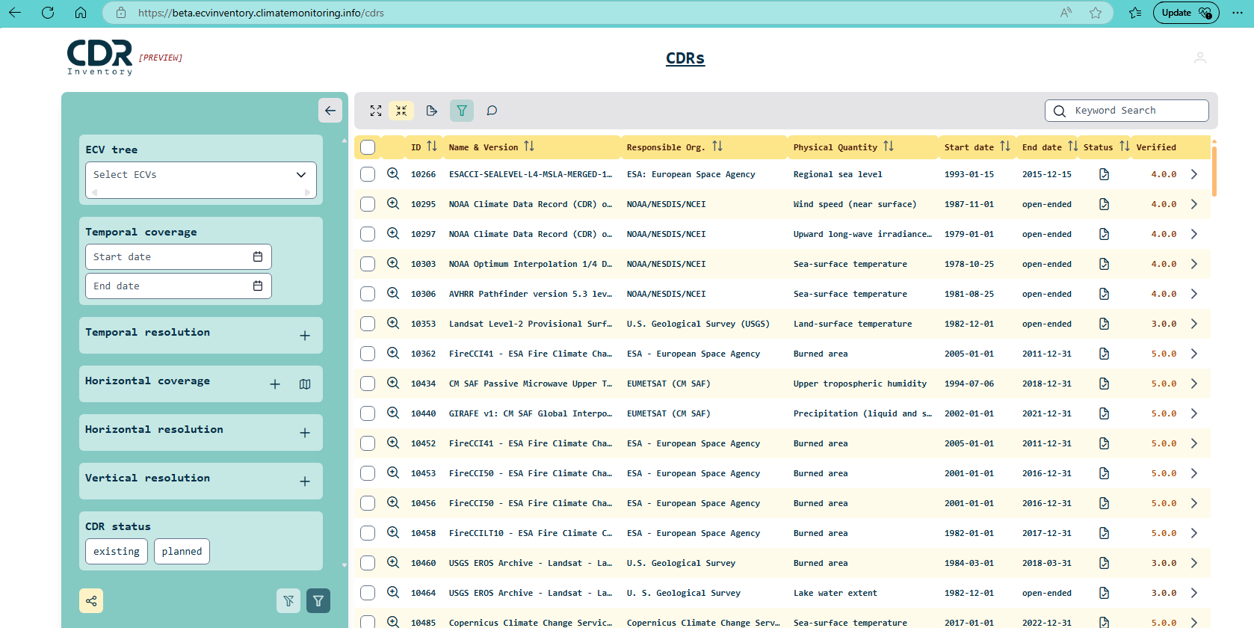
Climate Data Record Inventory
The CDR Inventory is an information database of satellite-derived thematic Climate Data Records addressing geophysical quantities contributing to the GCOS-defined space-observable ECVs / ECV Products.
Capture the number of existing and planned satellite-derived CDRs addressing GCOS ECVs
Get the most accurate information concerning the data records: Generation Process, Record Characteristics, Documentation, Accessibility, Applications
Ensure completeness and consistency of the information displayed
Filter functionalities

Slide 4
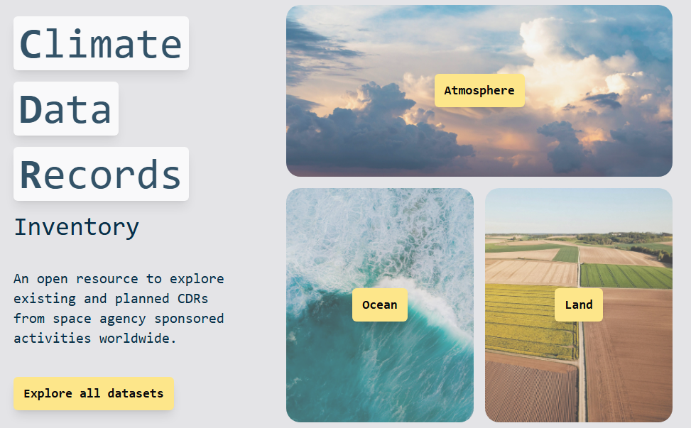
New interface for the CDR Inventory
New interface to enhance discoverability and uptake of CDR Inventory
Added functionalities to make it easier to navigate the Inventory
Streamlined information for easier filtering and analysing the data
Simplified process to populate the database and verify the contents
Continuous publication, individual time tags used for record updates
Accommodation of non-GCOS climate-relevant variables
Discussion on further cooperation/synergies with WMO OSCAR/Space, MIM, and WGISS
Appreciate EUM and EC continued support for this activity.

Slide 5
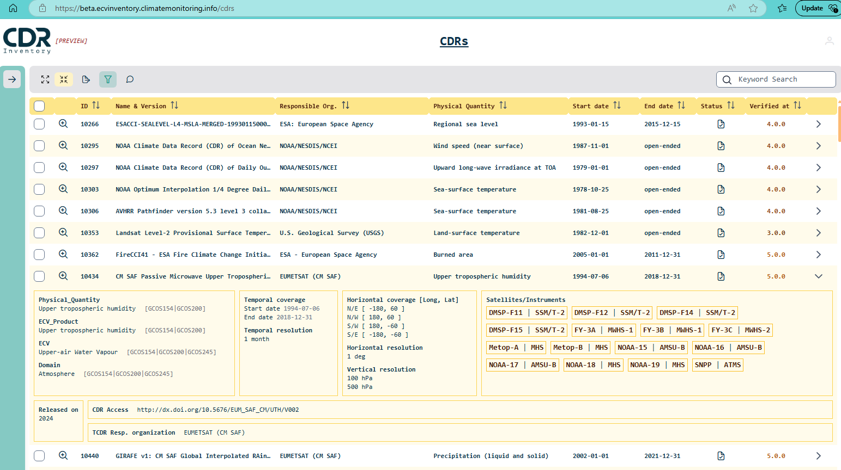
Added functionality to CDR Inventory
Comment
Label
Detailed view ( > new page)
Expanded view
Active links to WMO OSCAR / Space
Direct link to CDR

Slide 6
Expanding the Utility of the CDR Inventory
Objective: Improve discoverability and uptake of the Climate Data Record Inventory by external users/stakeholders of Earth observation data
Develop a typology supporting research and application
Use this typology as the interface of the CDR inventory to improve its discoverability and usability
Currently used effectively for internal gap analyses and prioritization
Under-utilized by the wider external community
Goal: Make the inventory more discoverable and user-friendly
Align with adaptation, mitigation, and policy-support needs

Slide 7
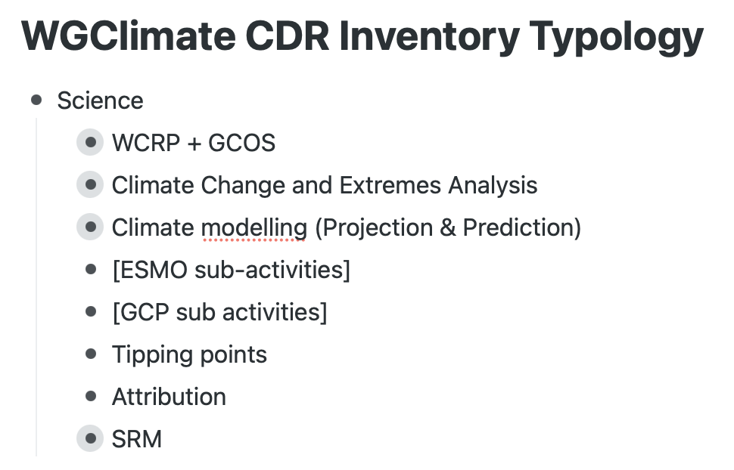
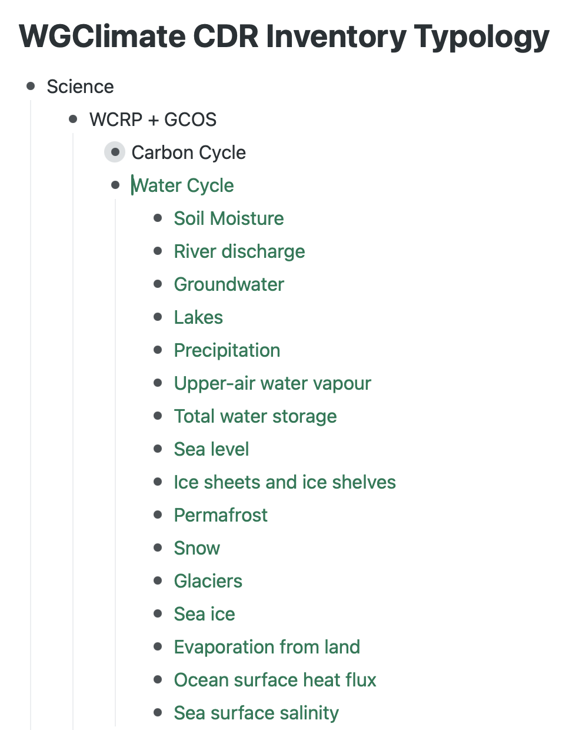
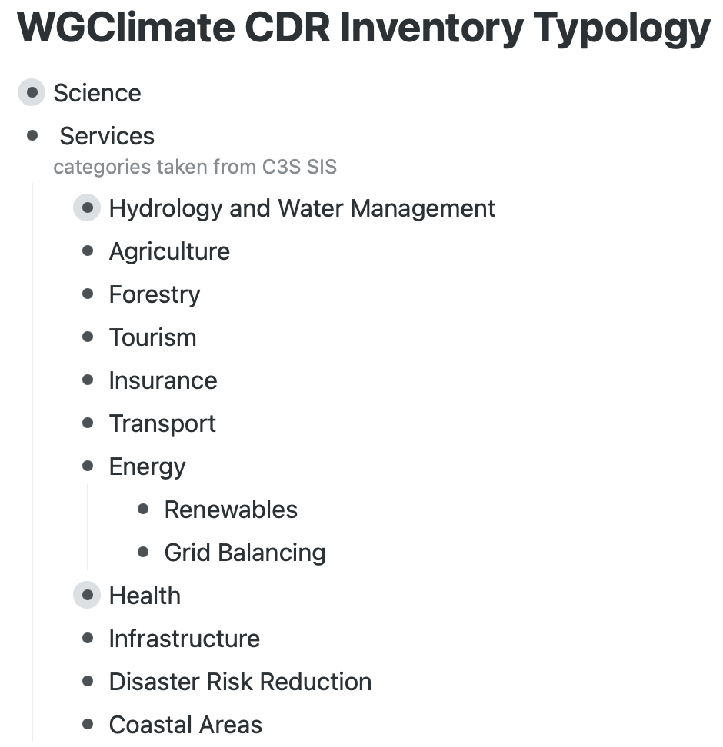
Proposed Typology Structure
Categories aligned with Science, Services, and Policy Support
Based on existing where possible e.g. UNFCCC/NAP subdivisions for adaptation
Application tags: space/time resolution, product level, AI-readiness
Keep initial typology small & manageable, avoid excessive complexity
Notes:
SIS: sectoral information system

Slide 8
Update WGClimate Term of Reference
WGClimate ToR was drafted in 2018, some initiatives referenced therein are no long active and new developments need to be reflected
The new ToR addresses evolving priorities, activities, and governance
Overarching goal of WGClimate: Optimize the benefit of Earth observations for climate research and service to support policymakers.
The final version will be presented at SIT-41, after more in-depth discussion by the Working Group at the WGClimate-24 meeting in February 2026.

Slide 9
WGClimate activities
Documents endorsed by CEOS and CGMS:
  Gap analysis Report and Coordinated Action Plan 2024
  Space Agencies’ Response to the 2022 GCOS Implementation Plan
  Lessons Learned and Recommendations from Space Agencies’ Support for the First Global Stocktake
  CEOS-CGMS Statement for SBSTA 63.
WGClimate – UNFCCC Tiger Team was established, further strengthened the collaborate between CEOS-CGMS with UNFCCC based up on the relationship established during the last two years (item 4.6).
In the process to update the WGClimate Term of Reference.

Slide 10
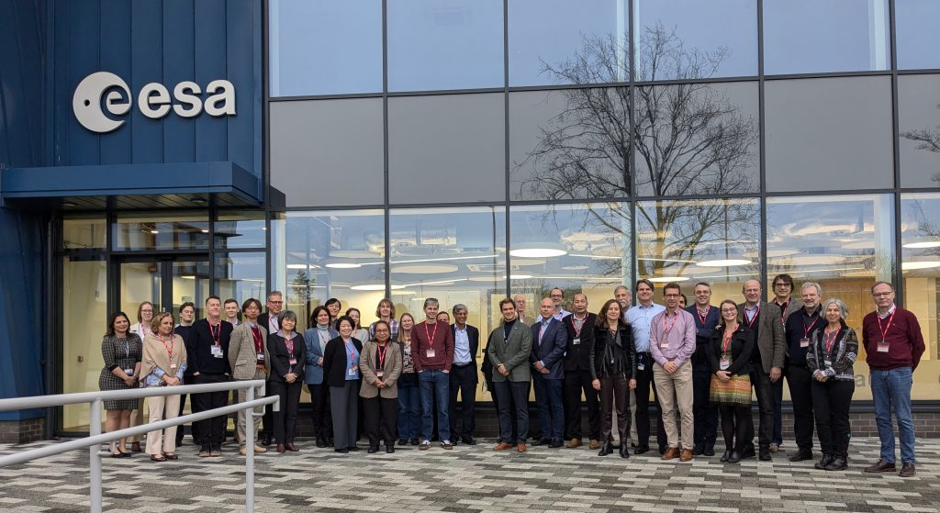
Future meeting
WGClimate-24 & GHG-TT meeting, joint with GCOS
Week of 9-13 February 2026
Hosted by ESA in Harwell, UK
WGClimate-22 in Harwell UK, 2025

