Slide 1
CEOS Plenary 2025
Working Group on Disasters
Marcelo Uriburu Quirno, CONAE
Agenda Item 3.3
39th CEOS Plenary
Bath, United Kingdom
4th - 6th November, 2025

Slide 2
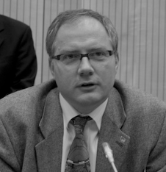

WGDisasters Chair Handover
Welcome New WGDisasters Chair!
Mr. Lorant Czaran - UNOOSA
Chief, Space Applications Section
Coordinator of the United Nations Platform for Space-based Information for Disaster Management and Emergency Response (UN-SPIDER)
Various positions in CEOS since 1997
Former Vice-Chair of WGISS
Secretariat for the WG, to be provided by Andrew Eddy (Athena Global)

Slide 3
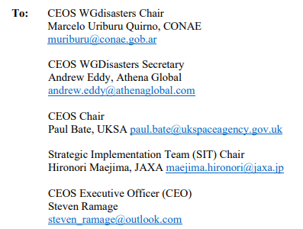
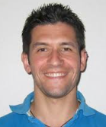


Vice Chair Nomination
WGDisasters Vice Chair Nomination received from ASI - Mr. Antonio Montuori
CEOS Endorsement Requested
Technologist at ASI EO Unit
Active member of WGDisasters since 2018
Lead of WGDisasters Data Coordination Team (DCT)

Slide 4
Vice Chair Nomination
Decision Sought:
CEOS Plenary endorses Mr. Antonio Montuori of the Italian Space Agency (ASI) as WGDisasters Vice Chair for two years (2026-2027), followed by WGDisasters Chair for two years (2028-2029).

Slide 5
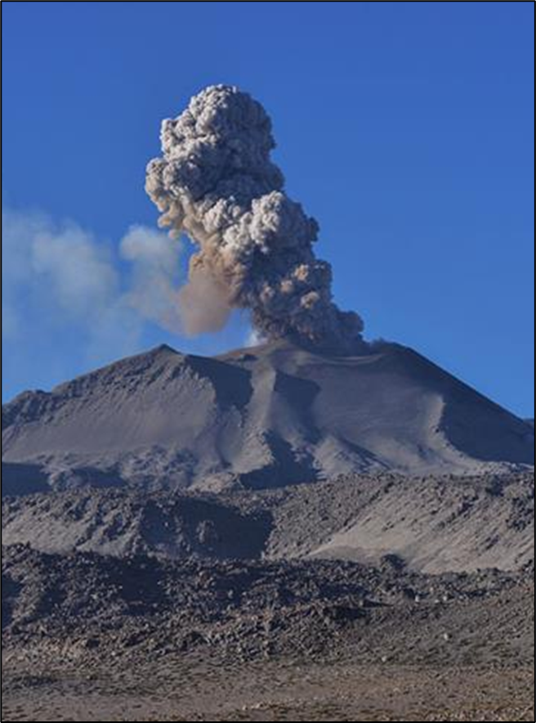
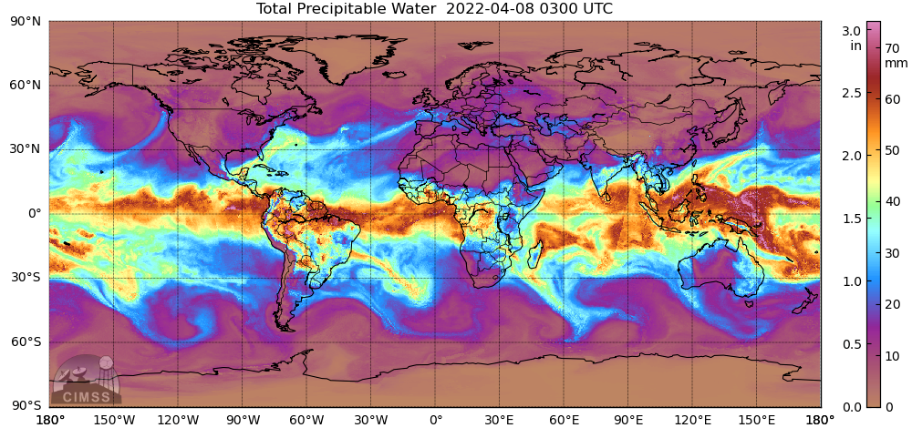
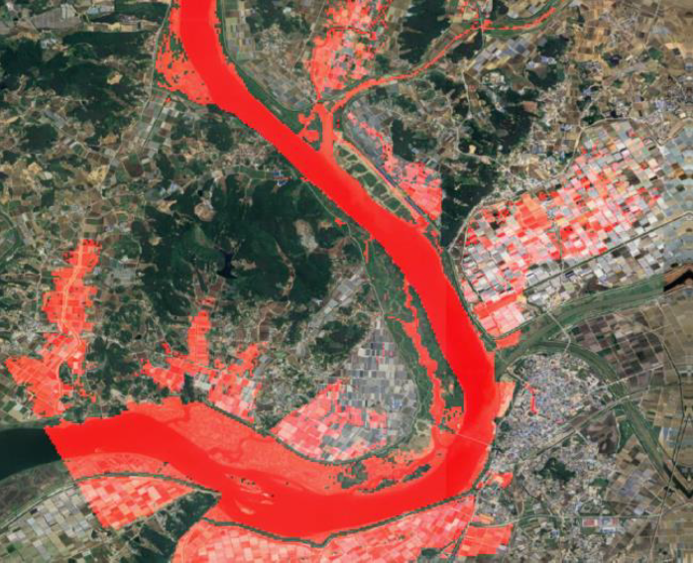
WGDisasters Achievements (2025)
G-VEWERS (now permanent and ongoing)
GSNL (new Cyprus supersite)
RO - Recovery Observatory (transition towards tripartite leadership, WB-UNDP-EU )
Seismic initiative (established, permanent sites in Latin America selected)
Flood Pilot (expansion towards inclusion of soil moisture and other variables)
Wildfire Pilot I (completed)

Slide 6


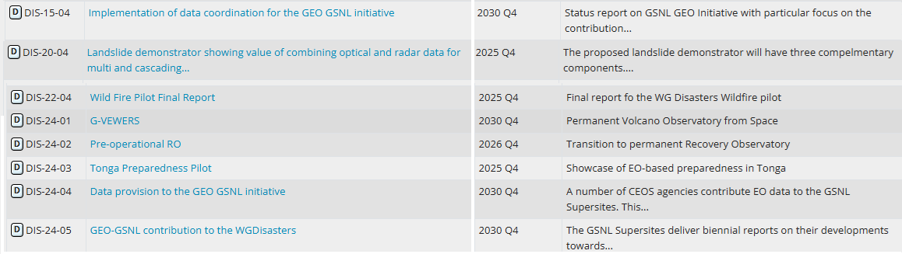
WGDisasters Ongoing Deliverables
https://deliverables.ceos.org/task_manager/deliverables/

Slide 7
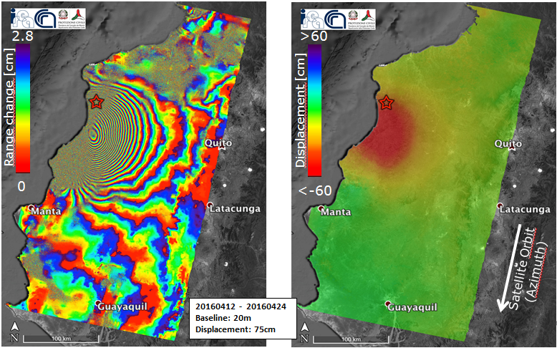
WGDisasters Priorities
Support WGDisasters’ activities, such as existing pilots, demonstrators, labs and other sub-groups’ work
Keep the alignment of WGDisasters’ activities with CEOS objectives and the 2025-2027 Work Plan
Strengthen links between the WGDisasters and CEOS Working Groups, Virtual Constellations and Task Teams, and GEO
Increase synergies with external partners (e.g. UNOOSA initiatives and UN SPIDER missions)

Slide 8
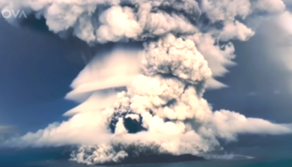
WGDisasters Priorities
Participate in outreach activities to promote WG outcomes (e.g. UNDRR meetings, UR2026)
Increase capacity building and training activities, in collaboration with WGCapD
Explore and encourage new topics
Enhance the use of AI in image processing and product development
Launch new initiatives:
-Wildfire Pilot II -Biodiversity Pilot
-Landslide Pilot -Drought Pilot
-EW4All Sub-group (with UNDRR and WMO)

Slide 9
Future Meetings
WGDisasters-25
Joint meeting with WGISS
16 - 20 March 2026
India, city TBC
WGDisasters-26
September 2026 (exact dates, TBD)
Rome, Italy

Slide 10
Acknowledgements
Lorant Czaran and UNOOSA, for their valuable support and collaboration as Vice Chair throughout this term.
Laura Frulla (CONAE), for her leadership as Chair during most of the period, and all the CONAE team (esp. Ana Médico and Pablo Pepe).
All WG Disasters members, for their active participation, collaboration, and consistently high professional standards.
Andrew Eddy, for his exceptional commitment and efficiency in carrying out the secretariat duties with efficiency, professionalism and extreme generosity.

Slide 11
Thank you for your attention

