Slide 1
Working Group on Information Systems and Services (WGISS)
Tom Sohre, USGS, WGISS Chair
Nitant Dube, ISRO, WGISS Vice Chair
Agenda Item 3.4
39th CEOS Plenary
Bath, United Kingdom
4th - 6th November, 2025

Slide 2
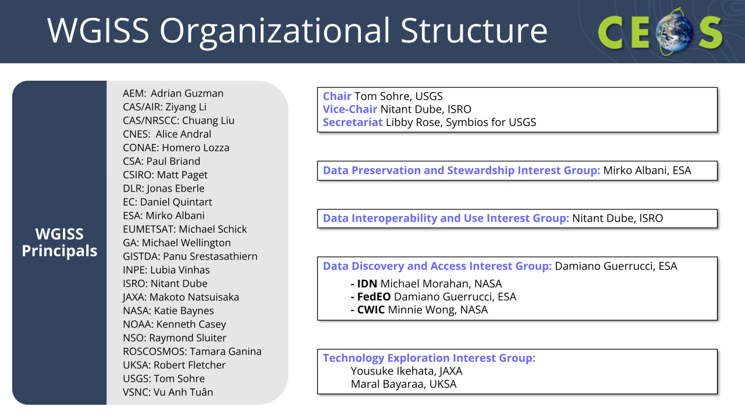
WGISS Membership & Structure

Slide 3
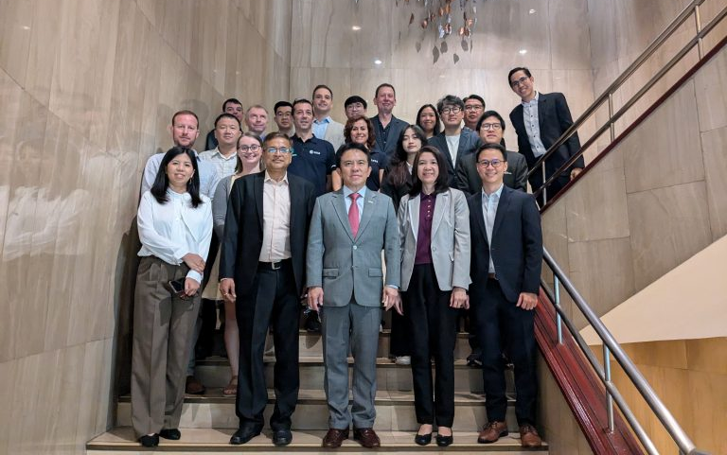
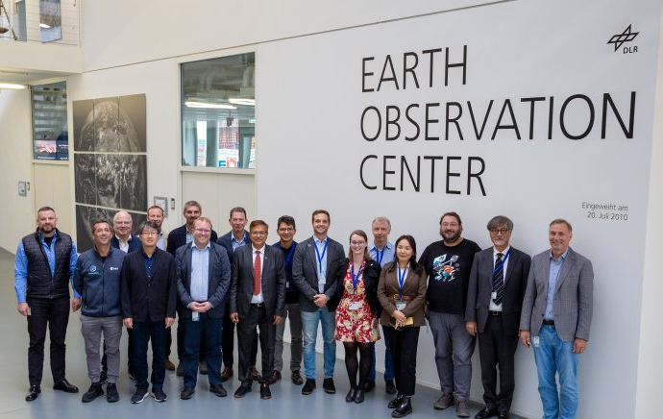
2025 Meetings
WGISS-59: Bangkok, Thailand
24 - 28 March 2025
Hosted by GISTDA
WGISS-60: Oberpfaffenhofen, Germany
13 - 17 October 2025
Hosted by DLR

Slide 4
2025 Main Achievements
Interoperability Handbook development & review [DATA-24-03]
AI/ML White Paper finalisation [DATA-23-01]
Collection Management Principles published [DATA-24-01]
Software Preservation White Paper finalisation [DATA-24-02]
Continued provision of WGISS Connected Data Assets [DATA-24-03]

Slide 5
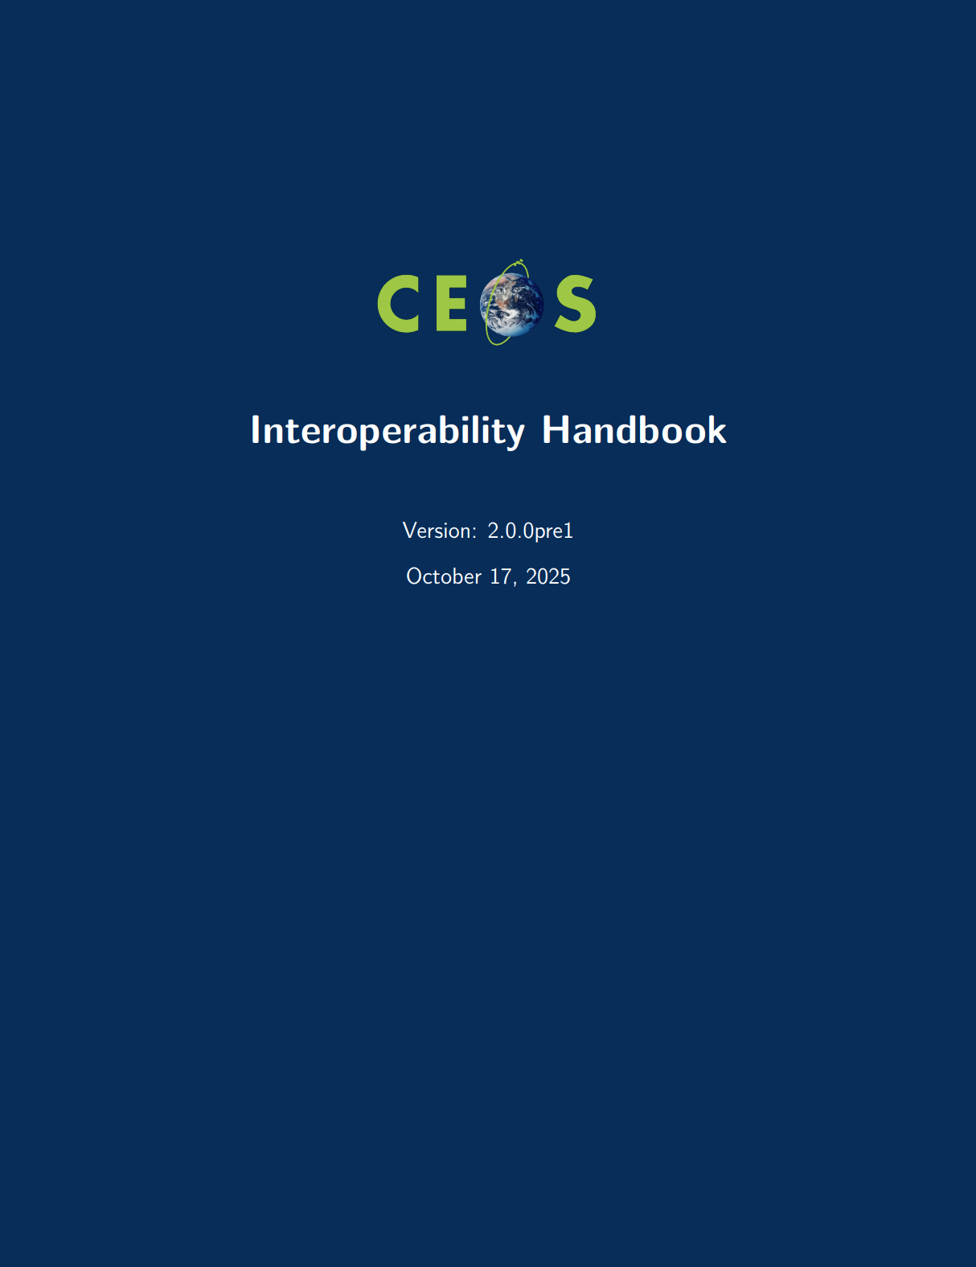
Interoperability Handbook v2.0
Revision of Interoperability Handbook published in 2008
Following Interoperability Framework definition activity conducted in 2023
Developed on GitHub 2024-2025
  Led by WGISS, with contributions by WGCV, LSI-VC and SEO
Feedback and Inputs from the community provided over last six months
  COAST-VC, OGC, NASA, UK NPL, DLR, UKSA
In depth review at WGISS-59, WGISS-60 and WGCV-55
SIT Review (SIT-40 and SIT-TW 2025)
Work Plan Item DATA-24-03

Slide 6
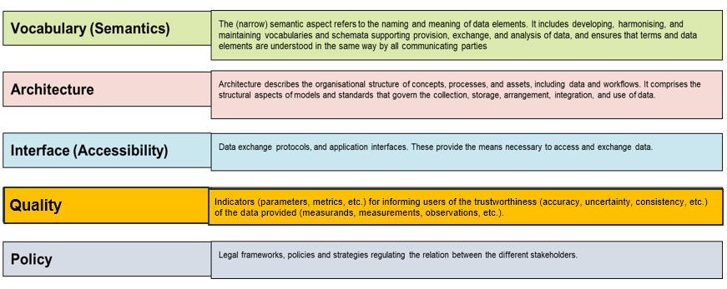
Interoperability Handbook v2.0
Work Plan Item DATA-24-03

Slide 7
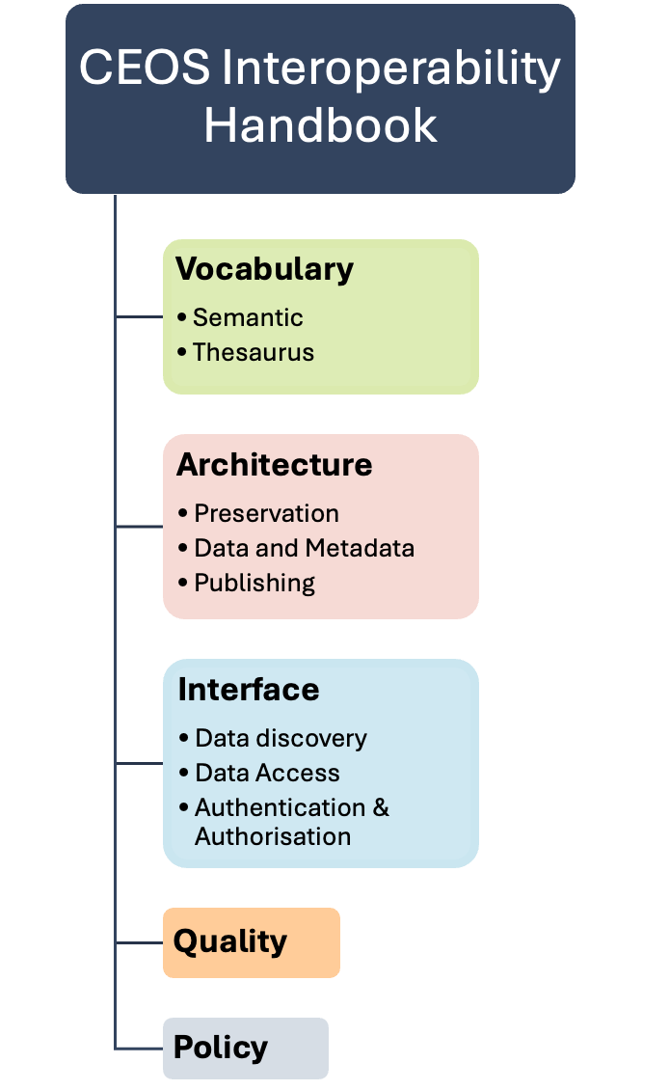
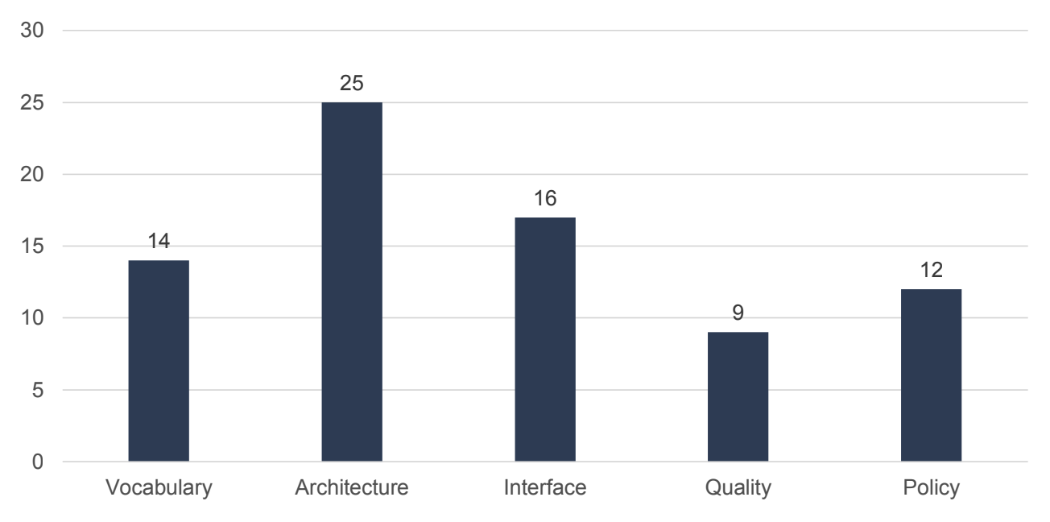
Interoperability Handbook v2.0
Work Plan Item DATA-24-03
Recommendations per factor
76 total recommendations

Slide 8
Interoperability: Next Steps
Work Plan Item DATA-25-02
Interoperability Maturity Matrix
  Allow self-assessment of data/service provider’s maturity level with respect to interoperability
  Linkage with the WGCV Cal/Val and WGISS Data Management and Stewardship Maturity Matrices
Interoperability Demonstrators (discussions commenced at WGISS-60):
  WGCV & LSI-VC: Surface Reflectance Quality and Consistency
  WGDisasters: Hawaii Supersite (InSAR)
  WGClimate: Climate Data Records
  SEO: CEOS Analytics Lab
  CEOS Common Dictionary

Slide 9
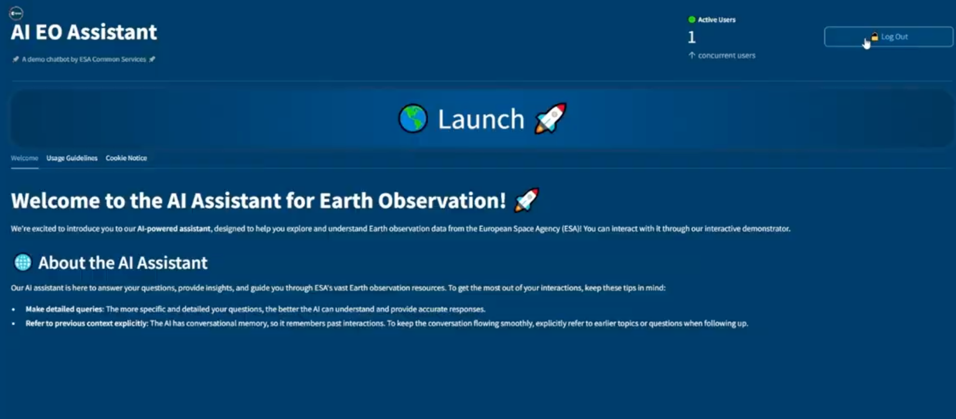
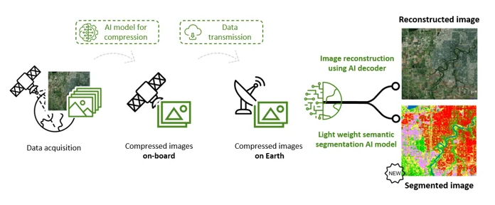
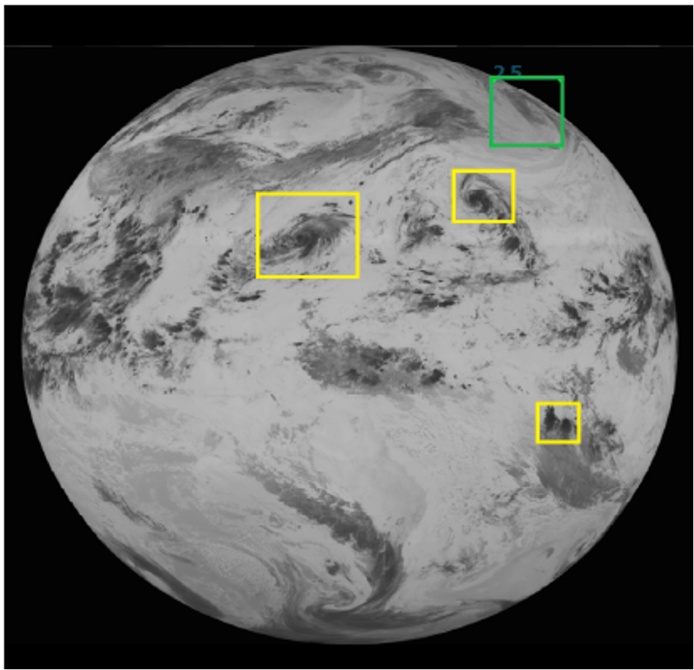
Artificial Intelligence & Machine Learning
Work Plan Item DATA-23-01
Consolidation of Inputs by CEOS Agencies and EO community on use of AI/ML for EO applications at past WGISS meetings
AI/ML White Paper drafted
Will remain a ‘living document’, with frequent updates as the sector evolves

Slide 10
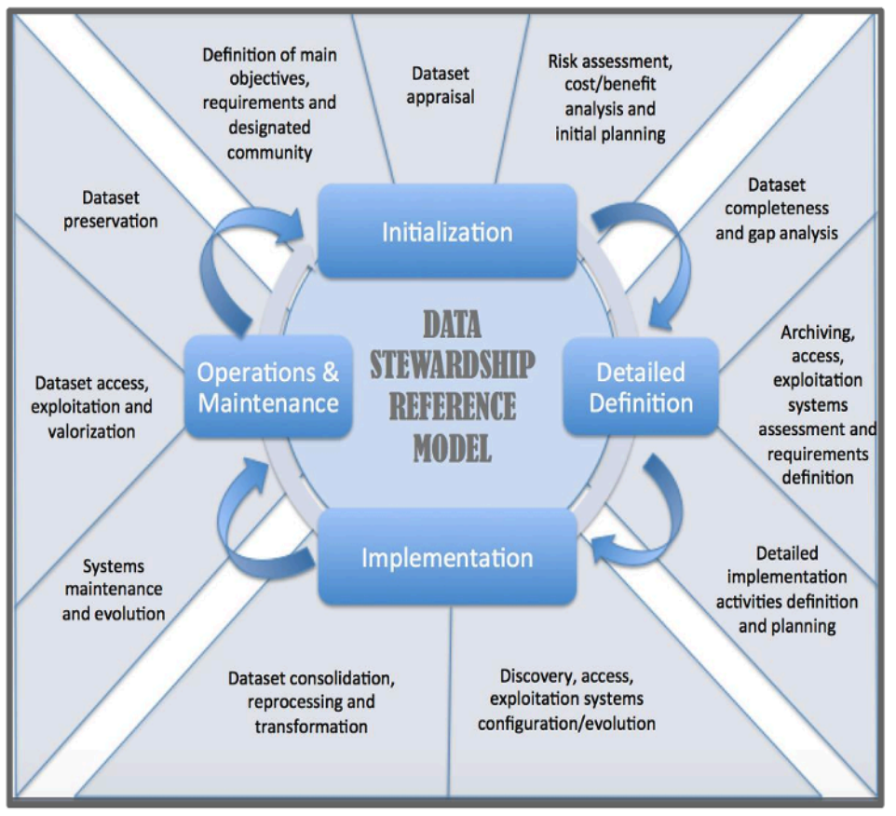
Collection Management Principles
Work Plan Item DATA-24-01
Shared Collection Lifecycle Management Principles for Earth Observation Data
Published March 2025
Describes a set of core EO collection lifecycle management principles shared by CEOS organisations
Set of 16 Principles to provide guidance for data providers on the management of EO collections

Slide 11
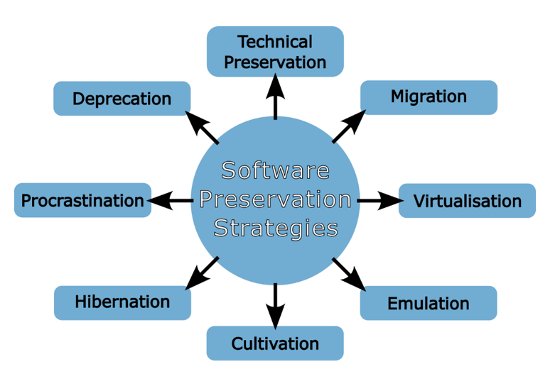

Software Preservation
Work Plan Item DATA-24-02
If data is being preserved, any associated software should be preserved alongside it to maintain the data’s maximum value
Software Preservation White Paper under review by WGISS
Will be published in 2025

Slide 12
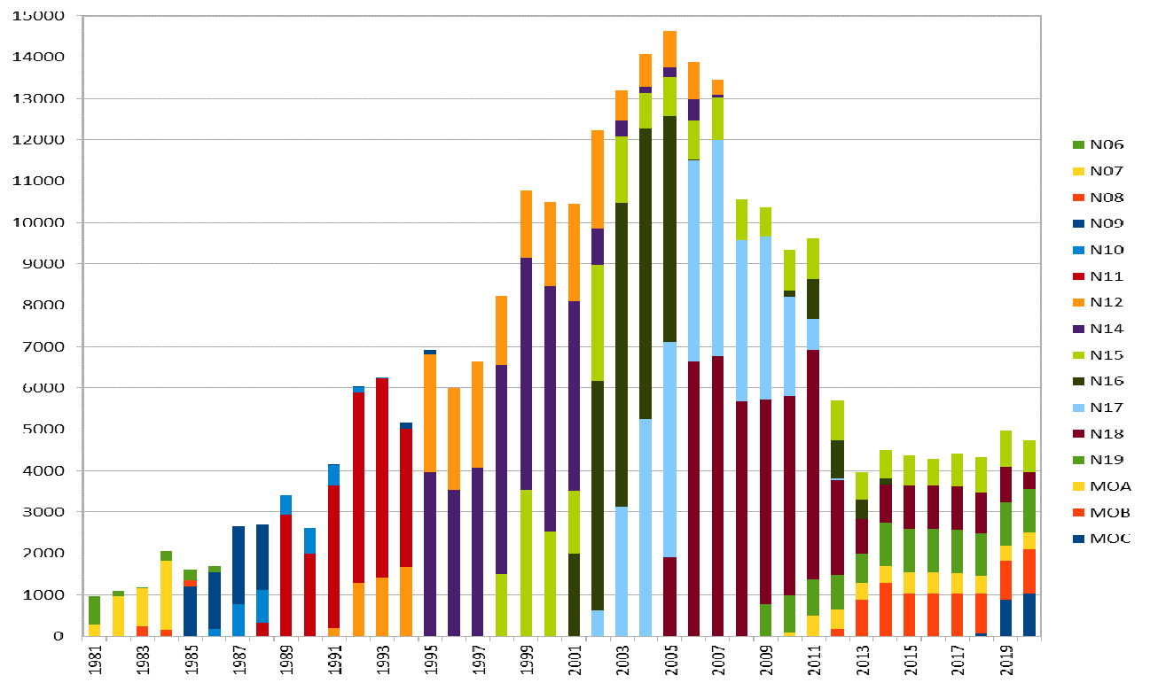
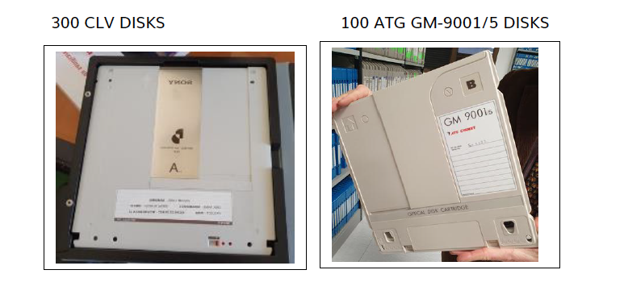
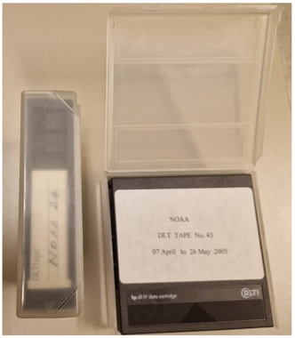
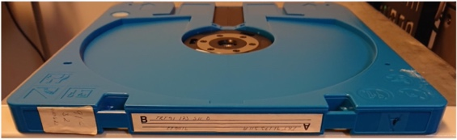
Heritage Dataset Recovery
Request driven by the climate community to recover heritage datasets to extend climate records into the past
Working with CEOS Agencies and other organisations to recover global AVHRR data from NOAA POES and METOP satellites, at 1 km resolution, from 1978 onwards
  Europe recovery complete, 40+ years archive available through ESA
  Continuing work on the global dataset
  CEOS News Story: https://ceos.org/news/avhrr-data-recovery/
Looking at other datasets which may benefit from a global recovery effort
DLT cassettes
LM 1200 optical Disk 2.4GB

Slide 13
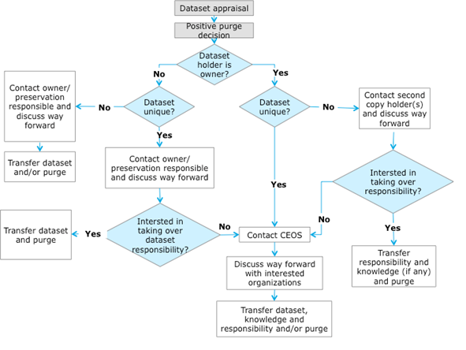
Data Loss Prevention Procedure
Archived satellite data have scientific value
If a data provider (CEOS Agency or commercial) plans to purge a dataset, please let WGISS know so we can consider its value and interested agencies can take over responsibility for preservation and access
Please don’t delete it!

Slide 14
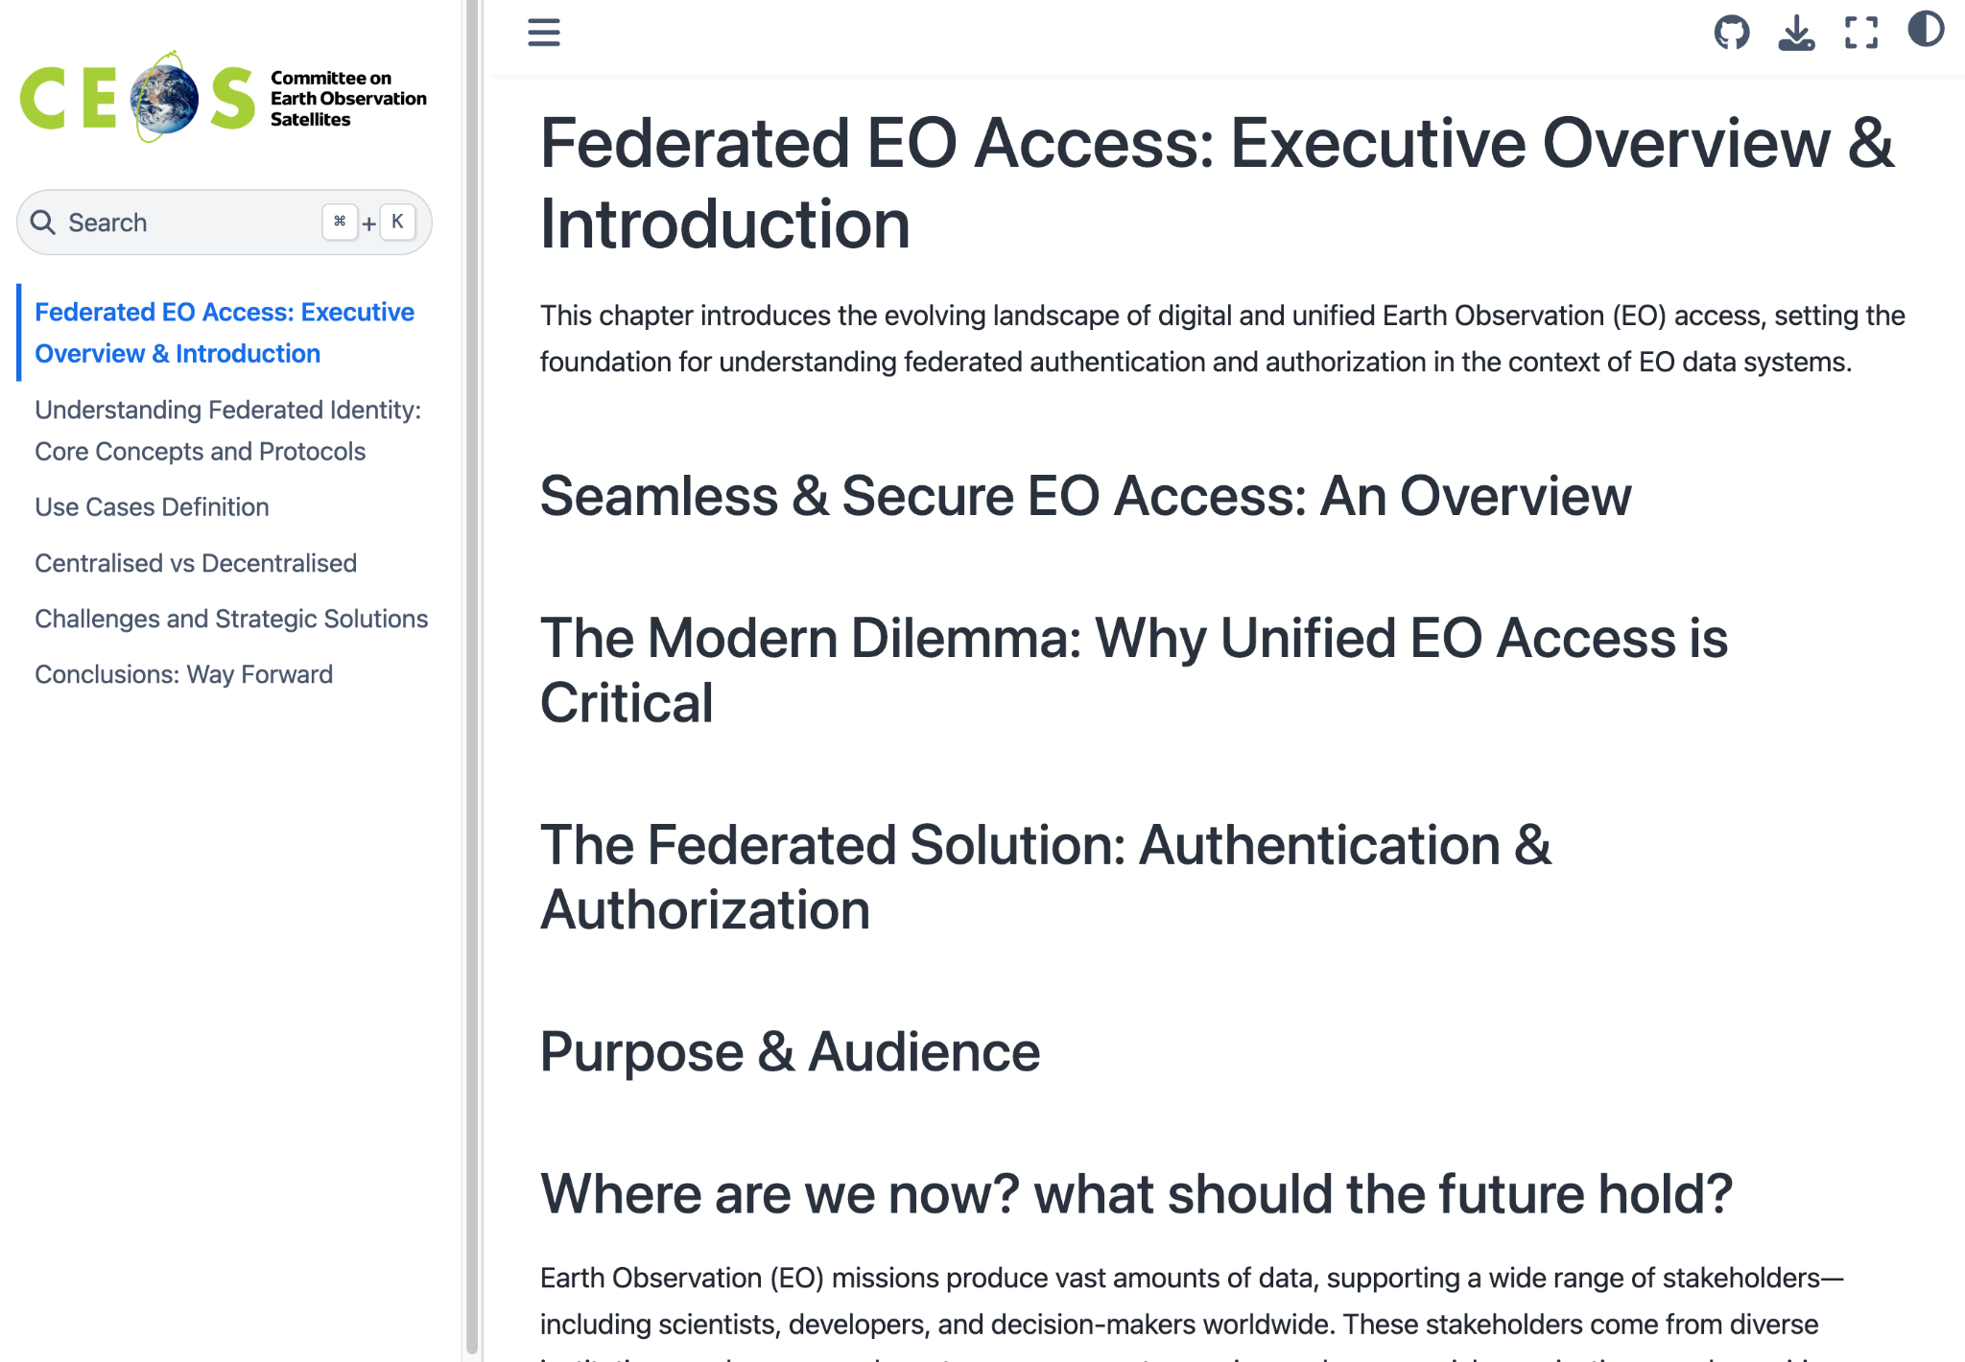
Federated Authentication & Authorisation
Work Plan Item DATA-25-01
Goal: improve user experience to discover and access EO data
DLR-ESA demonstrator in progress
  Log in with either ESA or DLR credentials to access both ESA and DLR collections
White Paper in development - to be completed in Q4 2026
Working with SEO to the possibility of a central CEOS Authentication mechanism
White Paper in Development on Github

Slide 15
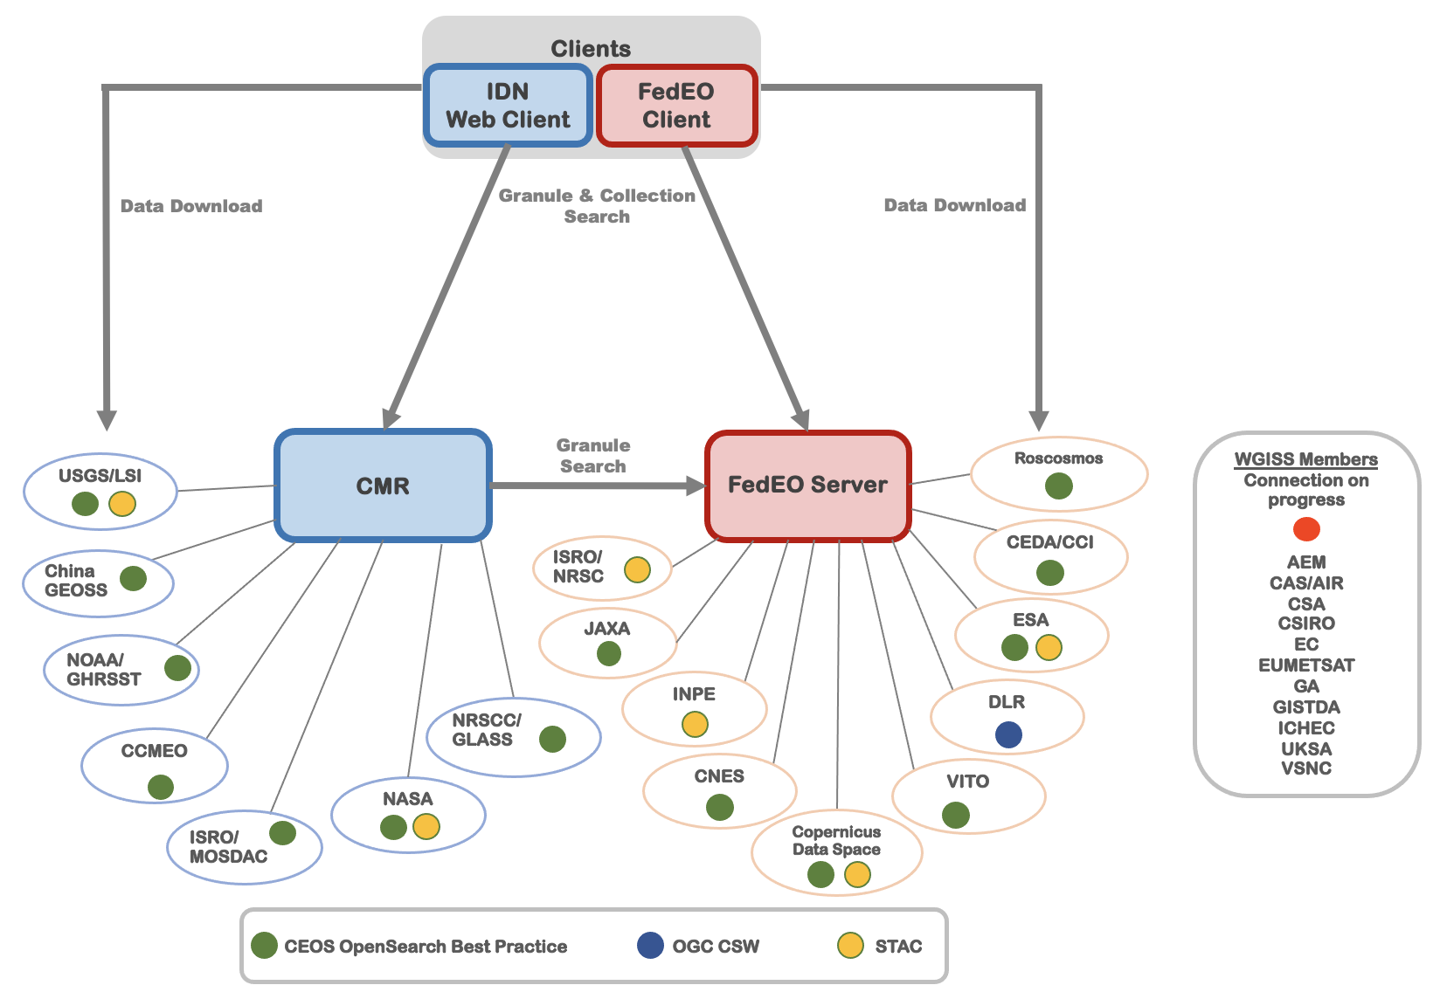
WGISS Connected Data Assets
Key service of WGISS, provided by ESA and NASA for CEOS
  See item 9.4
16 CEOS agencies data are discoverable

Slide 16
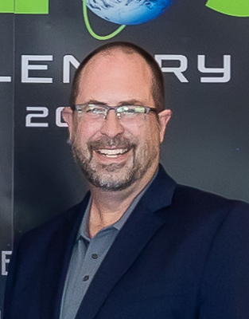

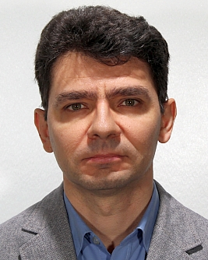



WGISS Leadership
Tom Sohre (USGS)
Chair: 2024-2025
Nitant Dube (ISRO)
Vice Chair: 2024-2025
Chair: 2026-2027
Damiano Guerrucci (ESA)
Vice Chair: 2026-2027
Chair: 2028-2029
[nominated]

Slide 17
Future Meetings
WGISS-61
  Joint meeting with WGDisasters
  16 - 20 March 2026
  India, city TBC
WGISS-62
  Sept-Oct 2026
  Host & location TBC - suggestions welcome!

Slide 18
For Endorsement
Damiano Guerrucci as WGISS Vice Chair 2026-2027, followed by WGISS Chair for 2028-2029
CEOS Interoperability Handbook v2.0

