Slide 1
CEOS Working Group on Calibration and Validation (WGCV)
Cody Anderson, USGS
Agenda Item 3.5
39th CEOS Plenary
Bath, United Kingdom
4th - 6th November, 2025

Slide 2
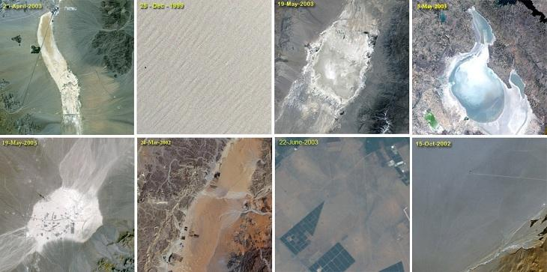
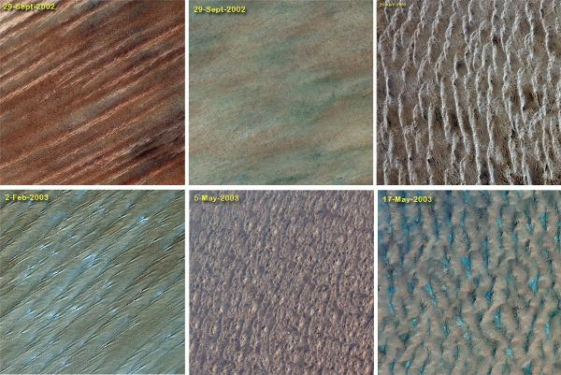
CEOS Working Group on Calibration and Validation
WGCV mission: Ensure long-term confidence in the accuracy and quality of Earth Observation data and products and to provide a forum for the exchange of information about calibration and validation, including the coordination of cooperative activities.

Slide 3
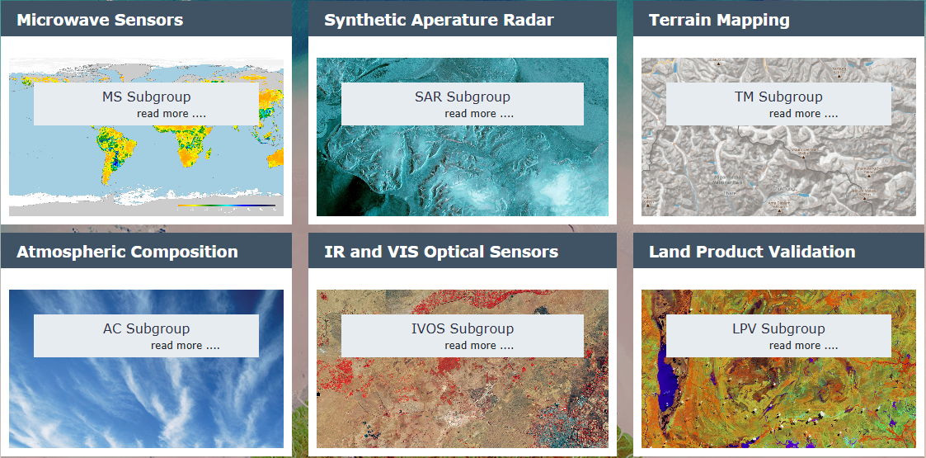
Organisation
WGCV Chair: Cody Anderson (USGS)
WGCV Vice Chair: Medhavy Thankappan (GA)
The six subgroups of WGCV aim to foster high quality Cal/Val of data from Earth Observation sensors and validation of higher level products in each domain
Credit: Cal/Val Portal (https://calvalportal.ceos.org/wgcv)

Slide 4

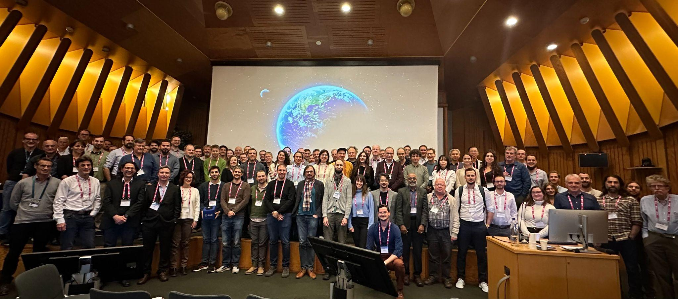
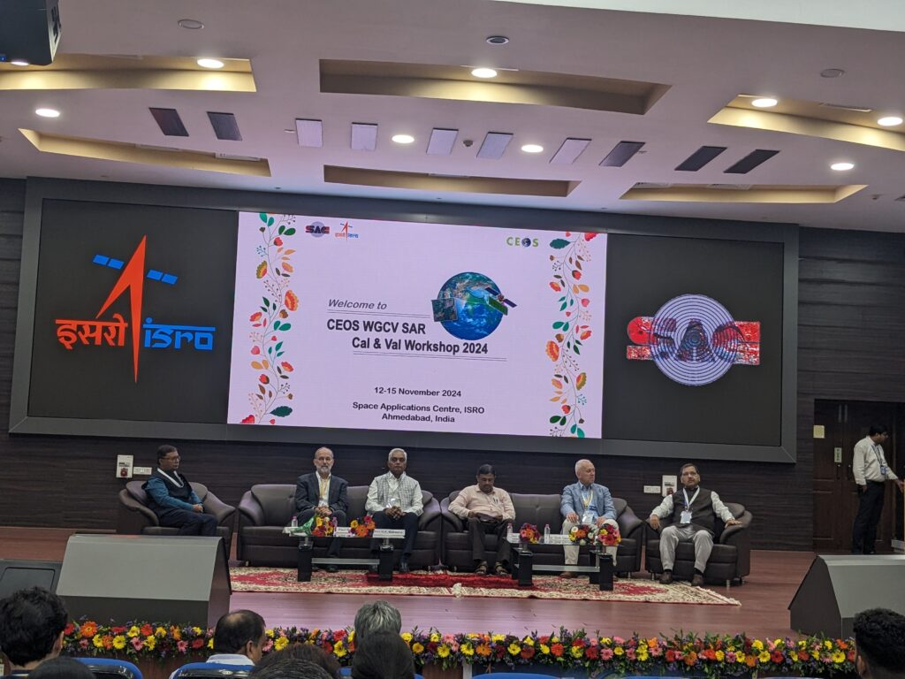
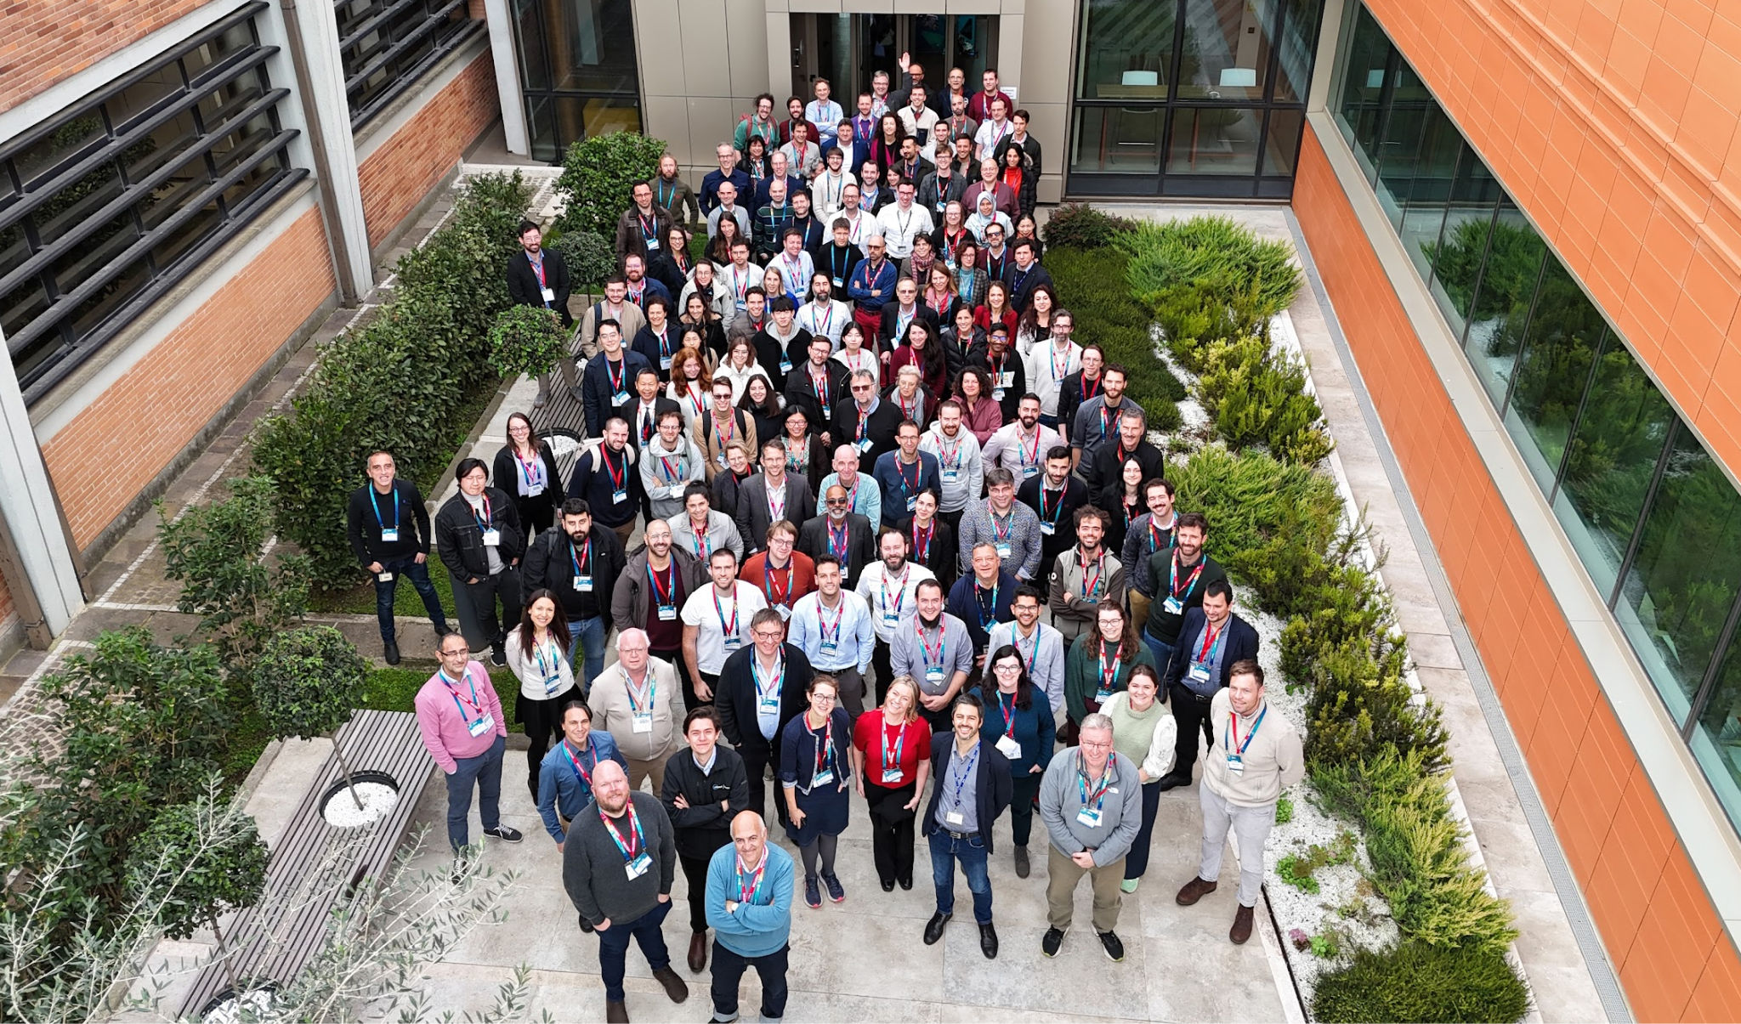
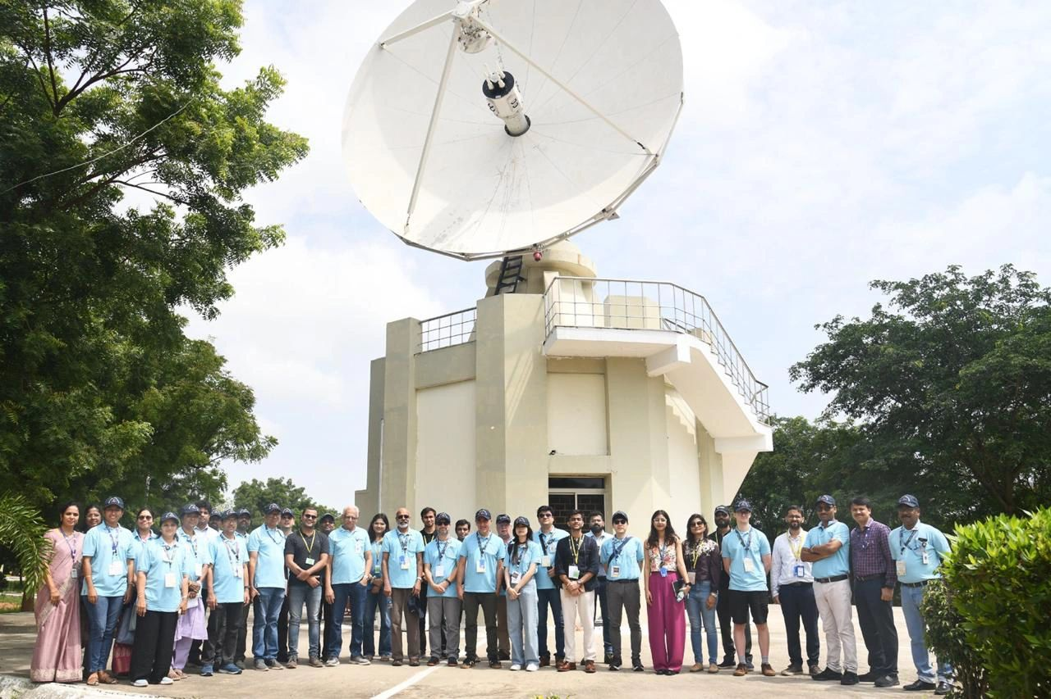
Meetings & Workshops
since 2024 Plenary
WGCV SAR Workshop 2024: 12-15 November, Ahmedabad, India
VH-RODA 2024: 2-6 December, Frascati, Italy
Workshop on Pre-flight Calibration and Characterisation of Optical Sensors: 19-22 October, Noordwijk, the Netherlands
JACIE 2025: 7-11 April, Reston, USA
WGCV-55: 8-11 July, Hyderabad, India
WGCV SAR Workshop 2025: 27-30 Oct, Vancouver, Canada
JACIE 2025
Pre-flight Workshop
SAR Workshop
VH-RODA 2024
WGCV-55

Slide 5


Upcoming Meetings & Workshops
VH-RODA 2025: 17-21 November, ESA-ESRIN, Frascati, Italy
JACIE 2026: 13–17 April, USGS Headquarters in Reston, Virginia
WGCV-56: April 20-24, joint with CEOS LSI-VC-19 Meeting at USGS EROS, Sioux Falls, South Dakota

Slide 6
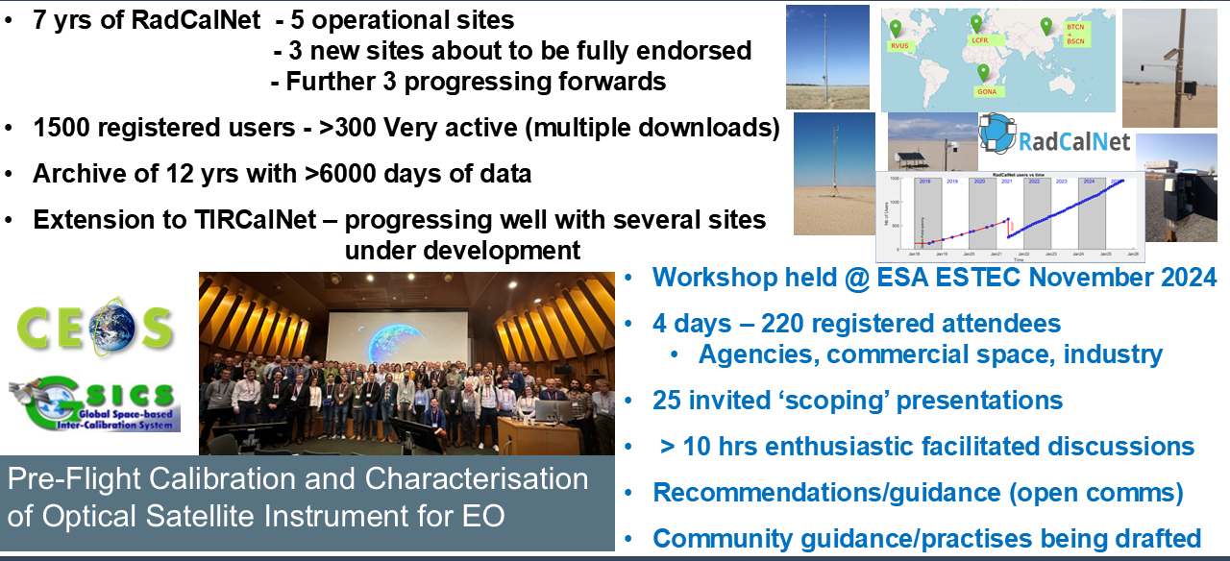
Infrared Visible Optical Sensors (IVOS) Subgroup

Slide 7
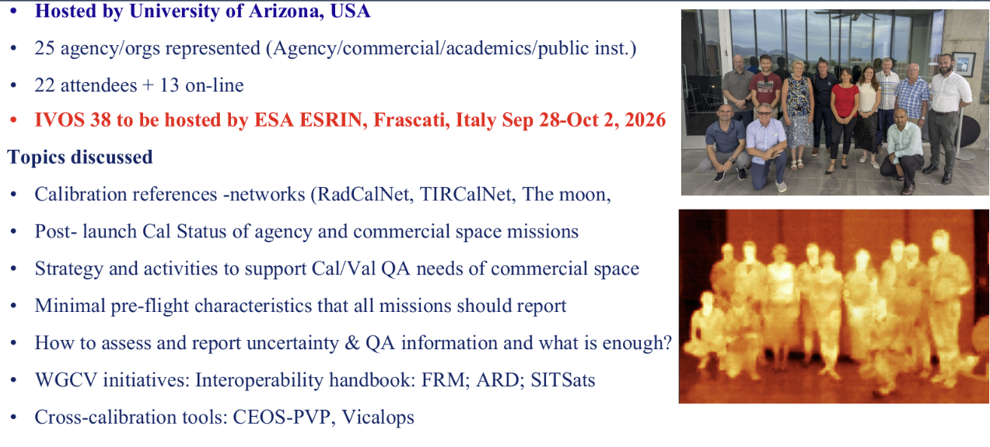
Infrared Visible Optical Sensors (IVOS) Subgroup

Slide 8


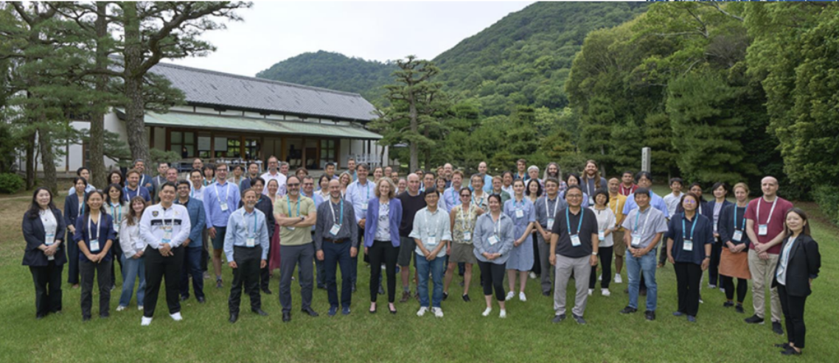
Atmospheric Composition Subgroup (ACSG)
Recent highlights:
Satellite contributions submitted to Tropospheric Ozone Assessment Report 2 (TOAR-II)
Aerosol, Cloud and Precipitation Profiles Validation protocol (ACPPV) published
Published CEOS-FRM assessments for air quality and greenhouse gas monitoring networks (COCCON, MAX-DOAS and TCCON)
Analysis of 3rd Cabauw INtercomparison of DOAS-like Instruments (CINDI-3) data in progress
Cal/Val contributions to CEOS GHG Roadmap V2 and Methane Emissions Community Practices
Various contributions to Network Design and Evolution initiatives (GHG Roadmap Annex C, WMO GAW reports, NDACC strategy paper, agencies FRM plans...)
Meetings:
AC-VC-21 / ACSG Joint Meeting, hosted on 9-13 June 2025 by NIES in Takamatsu (Japan), coordinated with the 21st International Workshop on Greenhouse Gas Measurements from Space (IWGGMS-21).
Plans to repeat joint set-up of AC-VC / ACSG in summer 2026 in Europe

Slide 9

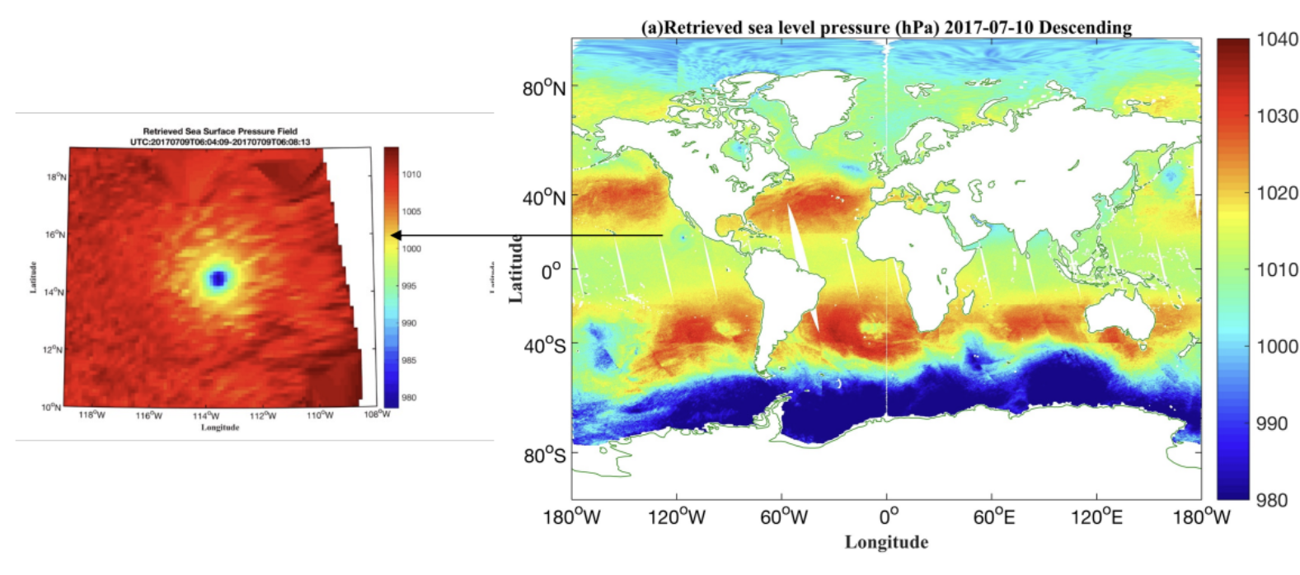
Microwave Sensors Subgroup (MSSG)
Recent highlights:
Contribution to ISO Technical Specifications for cal/val of radar scatterometers and passive microwave radiometers
Currently developing products for extreme sea surface winds with combined active-passive microwave measurements.
Developing an all-weather sea surface pressure product from passive microwave observations
Participation in Radio Occultation Modelling Experiment (ROMEX) alongside CGMS. MSSG aims to establish a benchmark model and protocol for GNSS Reflectometry cal/val over the ocean
Contribution to CEOS-FRM for High-Res Sea Level Profiles (FRM4SLP)
There is no unified reference for space microwave radiometry - raises the idea for a dedicated SI-Traceable satellite

Slide 10
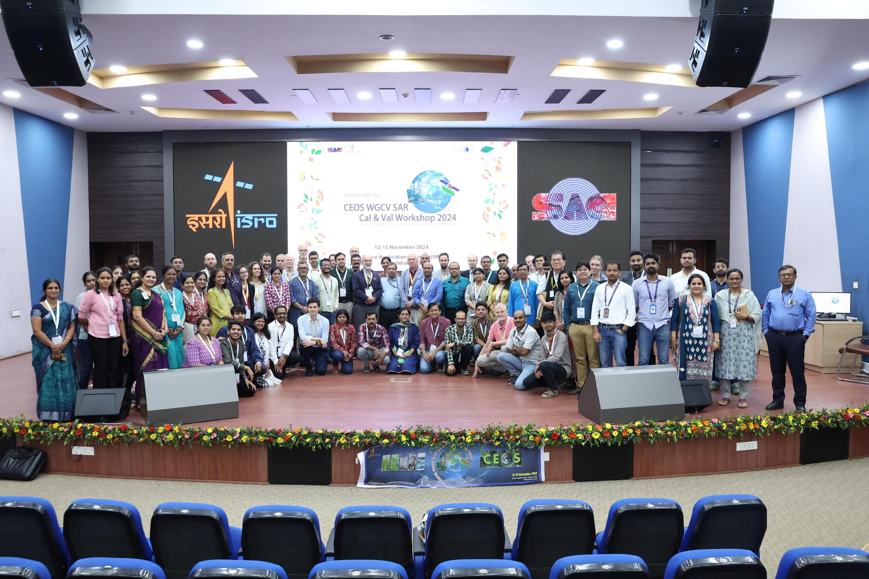
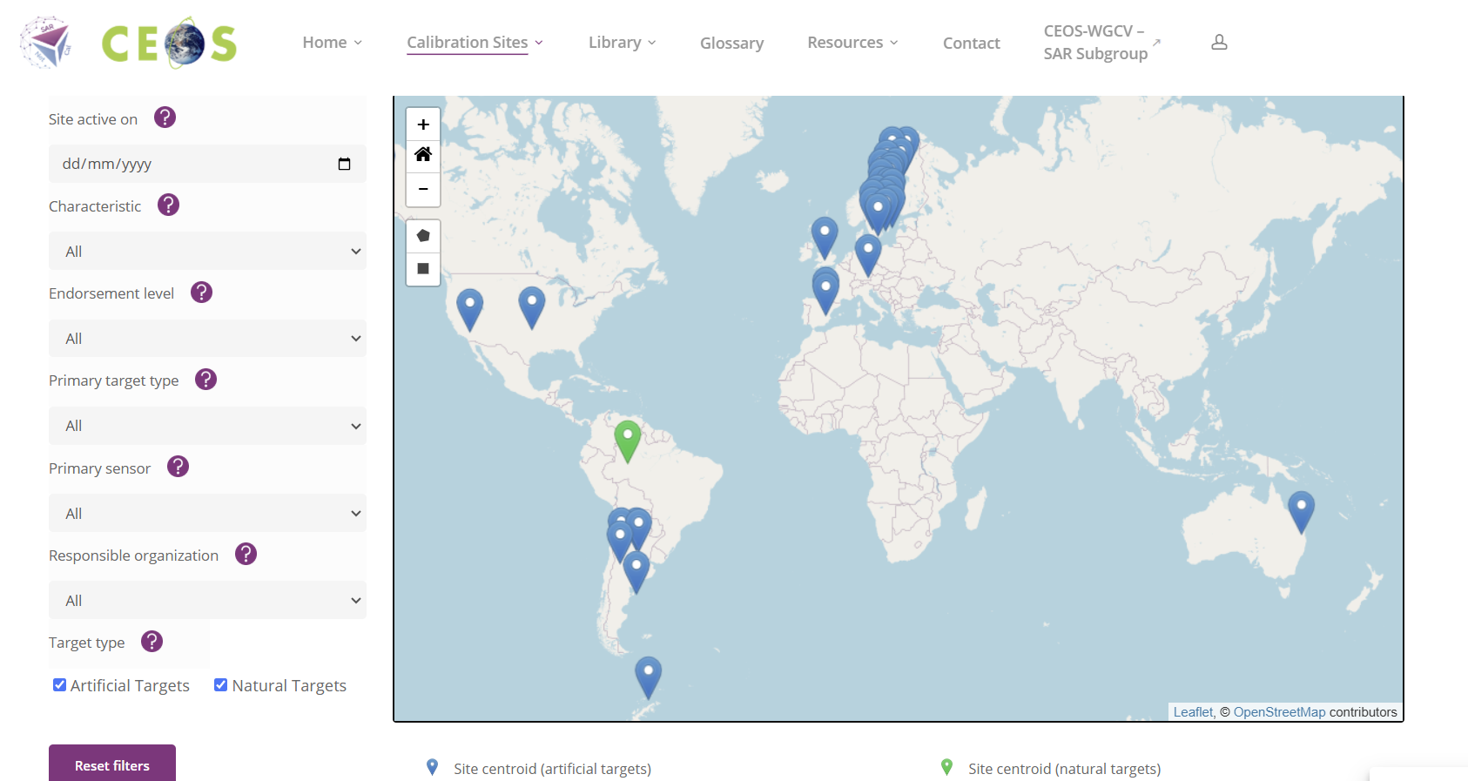
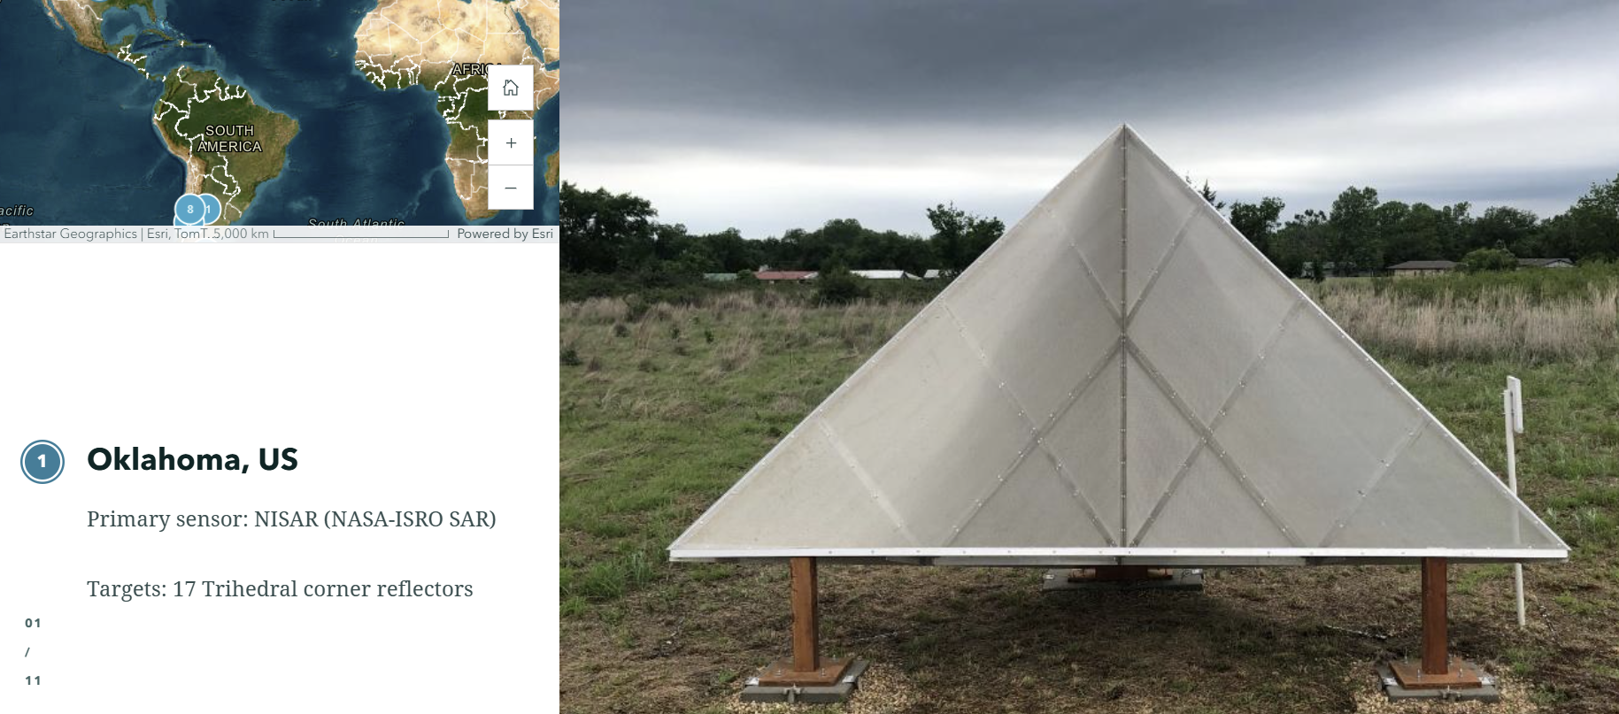
Synthetic Aperture Radar (SAR) Subgroup
Recent highlights
SAR Calibration Network (SARCalNet) operationalised in 2025
Proposed action: CEOS Agencies operating SAR calibration infrastructure are invited to review the SARCalNet database and submit site information
Meetings
31st SAR Cal/Val Workshop, hosted from 12-15 November 2024 by ISRO in Ahmedabad, India with a record 214 participants from the SAR community
32nd SAR Cal/Val Workshop hosted by last week (27-30 October) at the Simon Fraser University, Canada, hosted by SARLab and MDA Space

Slide 11
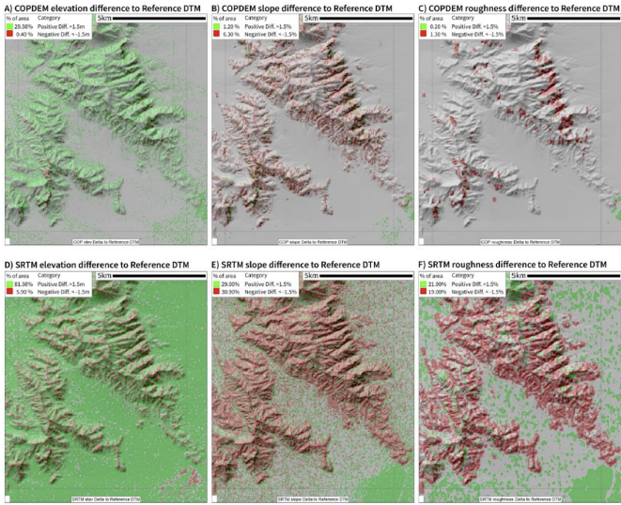
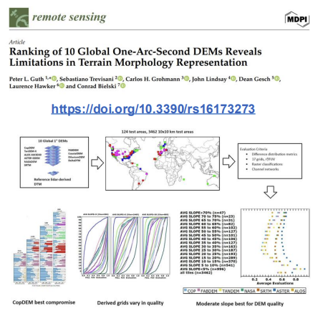
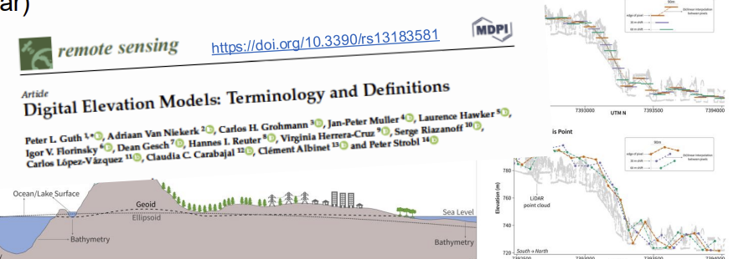
Terrain Mapping Subgroup (TMSG)
Recent highlights
Digital Elevation Model Intercomparison Exercise (DEMIX) produced 5 peer-reviewed publications and a new tiling system. Considering a network of sites, ‘best-of’ DEMs, Analysis-Ready DEMs
CEOS New Space Task Team report recommended the Ground Control Point Intercomparison Exercise (GCPIX). Kicked-off in 2025, aiming to unify CEOS Agency GCP sharing
Global Reference Grid Intercomparison eXercise (GRGIX)
New TMSG co-chairs: Tom Maiersperger (USGS), Leo de Laurentiis (ESA)
Participation is welcomed in GCPIX and GRGIX
Meetings
2025 TMSG Plenary held at the Geomorphometry Conference on 13 June in Perugia, Italy

Slide 12

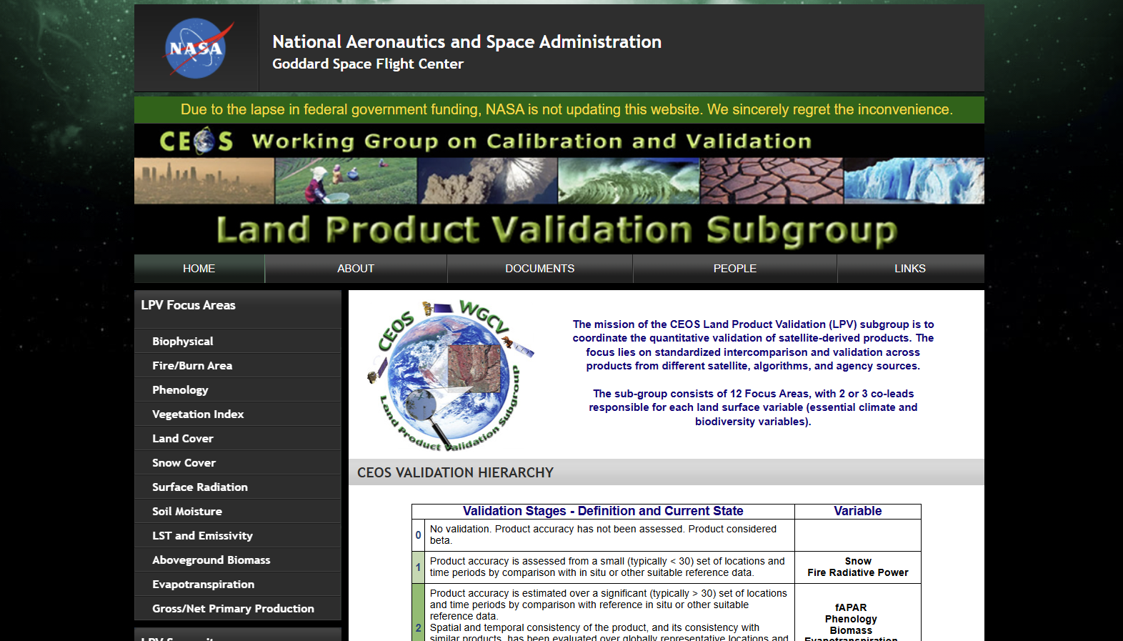
LPV Subgroup
New LPV Chair: Fabrizio Niro (ESA) - Vice Chair position vacant
LPV develops validation good practice protocols for focus areas aligned with GCOS ECV requirements
The Land Cover and Change Map Accuracy Assessment and Area Estimation Good Practices Protocol was reviewed and endorsed by WGCV in October 2025
Proposed action: CEOS Agencies are invited to review the WGCV LPV Land Cover and Change Map Accuracy Assessment and Area Estimation Good Practices Protocol, for endorsement at SIT-41 (April 2026)
A list of LPV ‘Supersites’ is under finalisation. These sites are well characterised, support ECV validation, suitable for long-term operations
Joint LPV-IVOS Surface Reflectance Intercomparison (SRIX4Veg) published in early 2025
LPV Plenary 2025 was held at ESA’s Living Planet Symposium in June, defining updates for LPV’s 2025-2028 Action Plan

Slide 13

CEOS-FRM: Background
Fiducial Reference Measurements (FRMs) are precise and well-characterised measurements tailored for EO mission Cal/Val. The CEOS-FRM Assessment Framework assesses the maturity and compliance of FRMs against community-agreed criteria in a transparent and fair manner.
Mandatory CEOS-FRM characteristics
Traceability
Independence from satellite under test
Uncertainty budget
Documented protocols
Accessibility
Representativeness
Adequacy of uncertainty
Utility (Return on Investment)

Slide 14
CEOS-FRM: How it works
Assessment of fiducial reference measurements:
Submissions are received via self-assessment and reviewed by a WGCV board
Submissions are graded against criteria and presented alongside the degree of compliance in a maturity matrix
Self-Assessment |  |  |  |  |  | Independent Assessor
Nature of FRM | FRM Instrumentation | Operations/ Sampling (single instrument) | Data | Metrology | Completeness, coverage and distribution | Verification
Descriptor | Instrument documentation | Automation level | Data completeness | Uncertainty characterisation | Validation capacity | Guidelines adherence
Location/ availability of FRM | Evidence of traceable calibration | Measurand sampling/ representativeness | Availability and Usability | Traceability documentation | Geographical coverage | Utilisation/ Feedback
 |  |  |  |  | Temporal sampling
Range of sensors | QA Maintenance | ATBDs on processing/software | Data format | Comparison/ calibration of FRM | Centralized data, processing, quality assessment and adherence to community standards | Metrology verification
Complementary observations | Operator expertise | Guidelines on transformation to satellite sensor | Ancillary data | Adequacy for class of instrument/ measurand | Timeliness | Independent verification
FRM CLASSIFICATION |  |  |  |  |  | A B C D
Grade
Not Assessed
Not Assessable
Basic
Good
Excellent
Ideal
Not Public

Slide 15

CEOS-FRM: Status
Pilots for first CEOS-FRM Maturity Matrix Assessment Exercise: PGN, RadCalNet, ICOS, FRM4DOAS, BAQUINN, Brewer Spectrometer NO2 VCDs, FRM4GHG, CREGARS
Welcoming volunteers to participate in second FRM assessment exercise
Background and guidance for developing FRMs detailed in the document: “Roadmap towards an Assessment Framework for CEOS-Fiducial Reference Measurements” (Version 2.0 endorsed at WGCV-55 in July 2025)

Slide 16
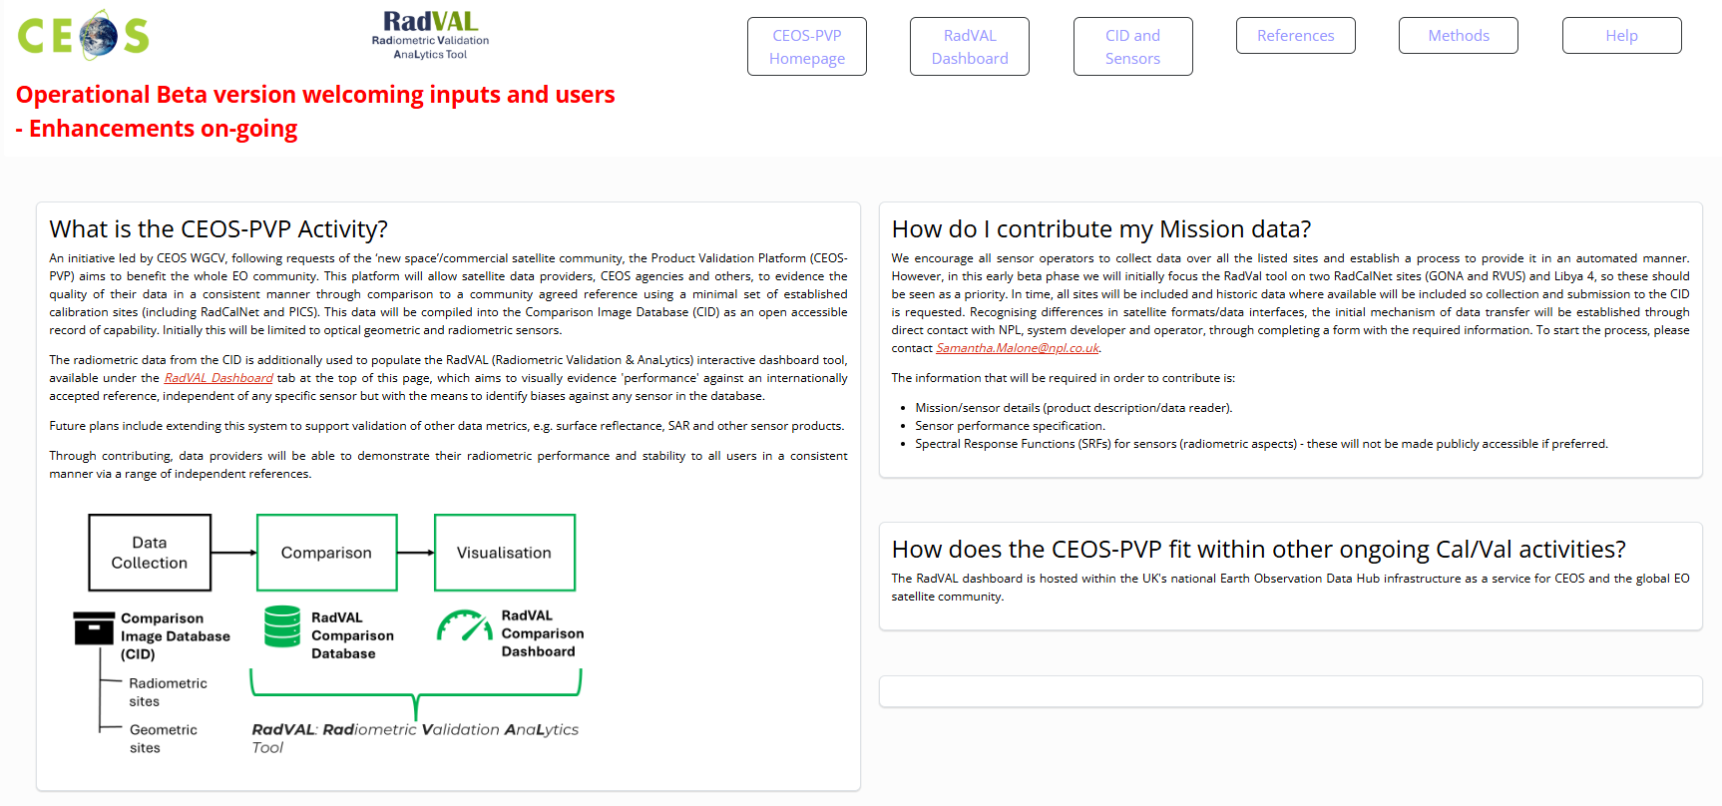
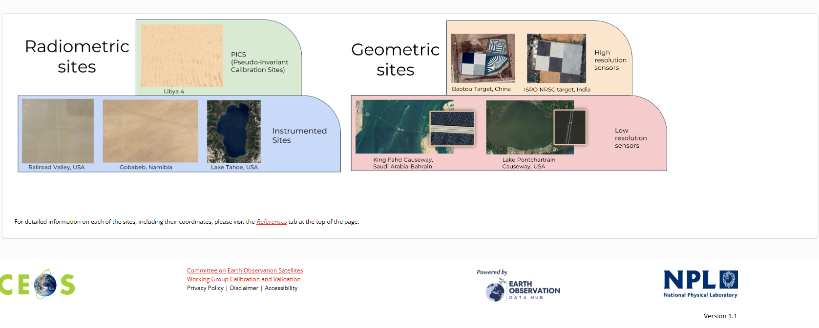
CEOS-PVP (product validation platform)
Formerly ‘match-up’ database
Created at the request of ‘commercial space’ and additionally for the benefit of CEOS agencies
WGCV recommendation endorsed at plenary 24 – ‘Agencies to provide their own, and encourage commercial satellite operators, to regularly collect and provide free access to Level 1 satellite imagery and associated metadata against a common ‘CEOS reference’ (representing radiometric and spatial properties)’ The data will be archived (and accessed) on behalf of CEOS at the UK Earth Observation Data Hub (EODH).
NPL additionally provides an opensource tool, RadVAL, to allow satellite operators and data users to readily
demonstrate/assess sensor level 1 radiometric performance (bias/stability) against a common reference and thus degree of equivalence to each other.
This facilitates the creation of a global system of interoperable (ARD) imagery for both public and commercial agencies and ultimately trustworthy quantitative information from their optimal integration

Slide 17
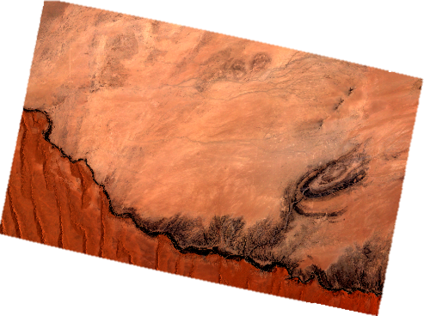
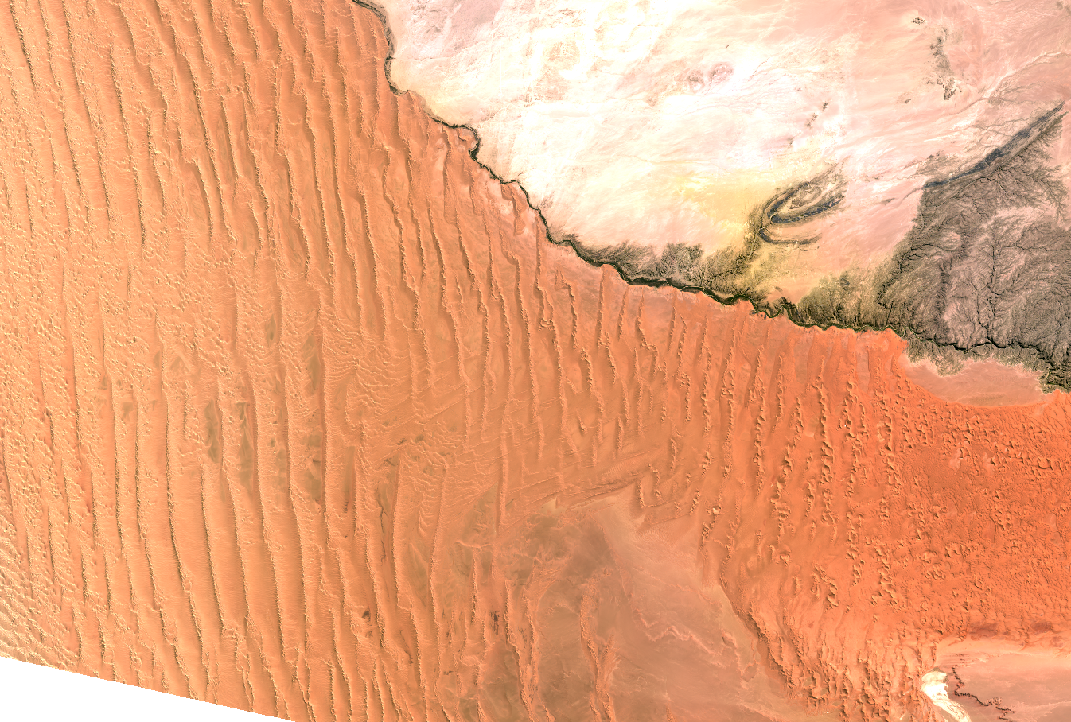
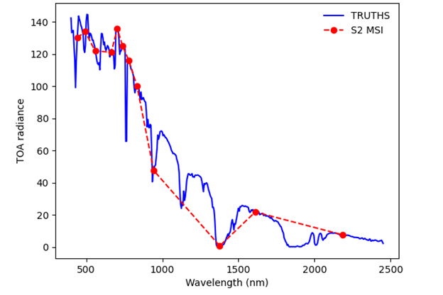
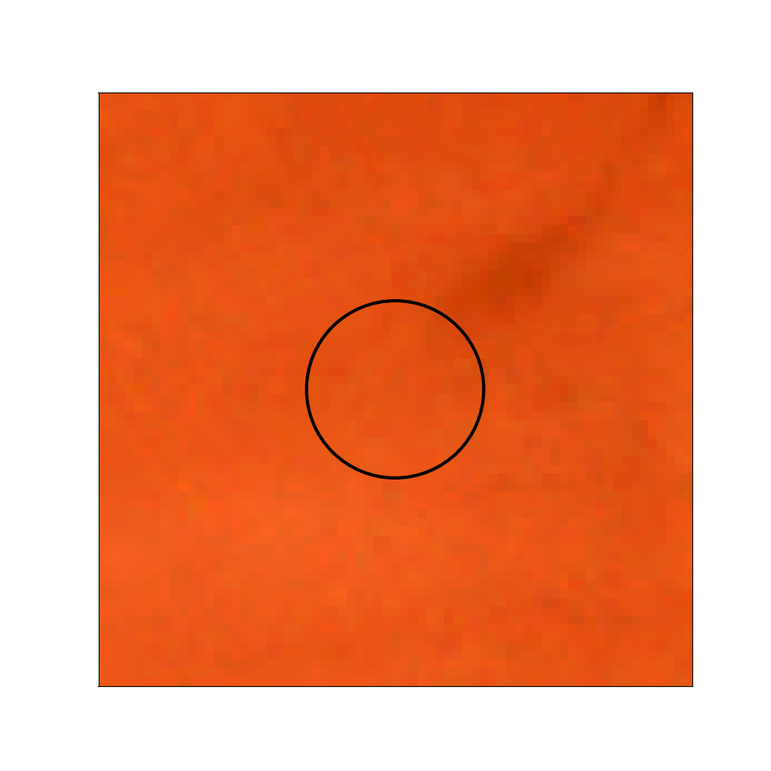
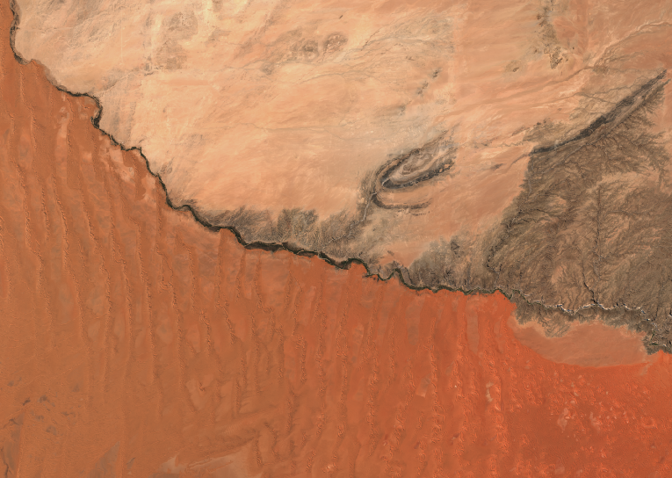


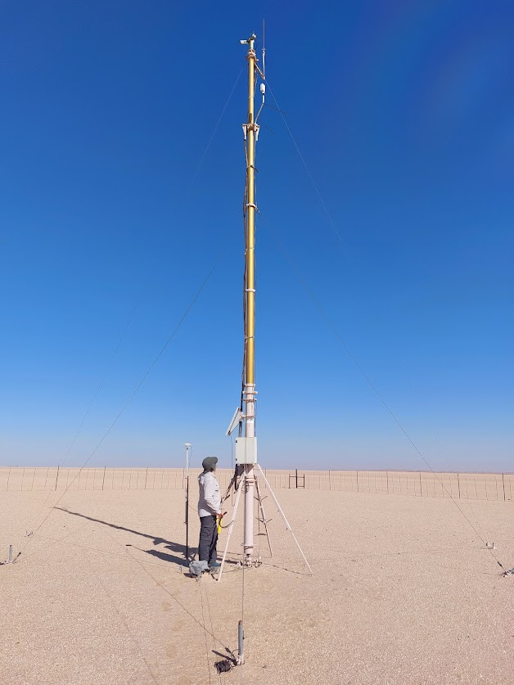




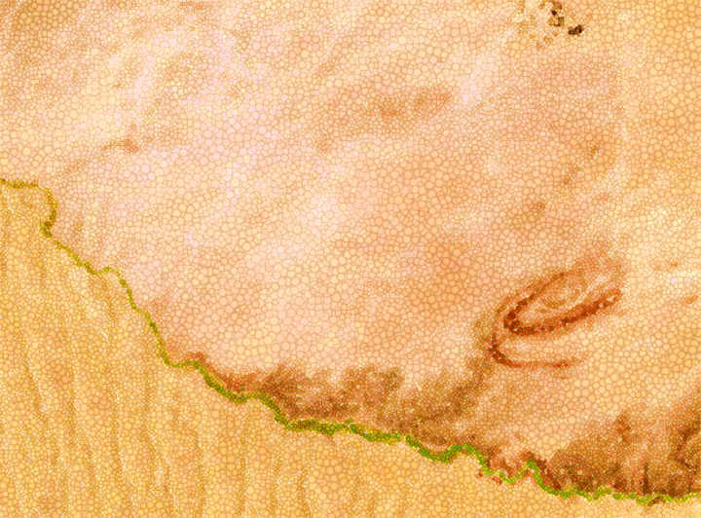



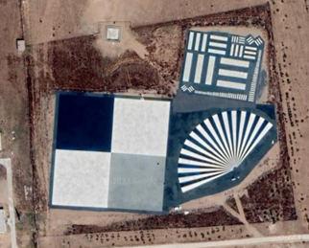
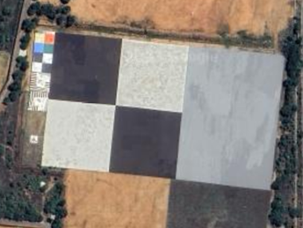
Product Validation Platform: PVP
PVP: Product Validation Platform
Data Collection
Comparison
Visualisation
Comparison Image Database (CID)
RadVAL Comparison
Database
RadVAL
Comparison
Dashboard
& future contributing missions…
Radiometric sites
Spatial
sites
RadVAL: Radiometric Validation AnaLytics Tool

Slide 18
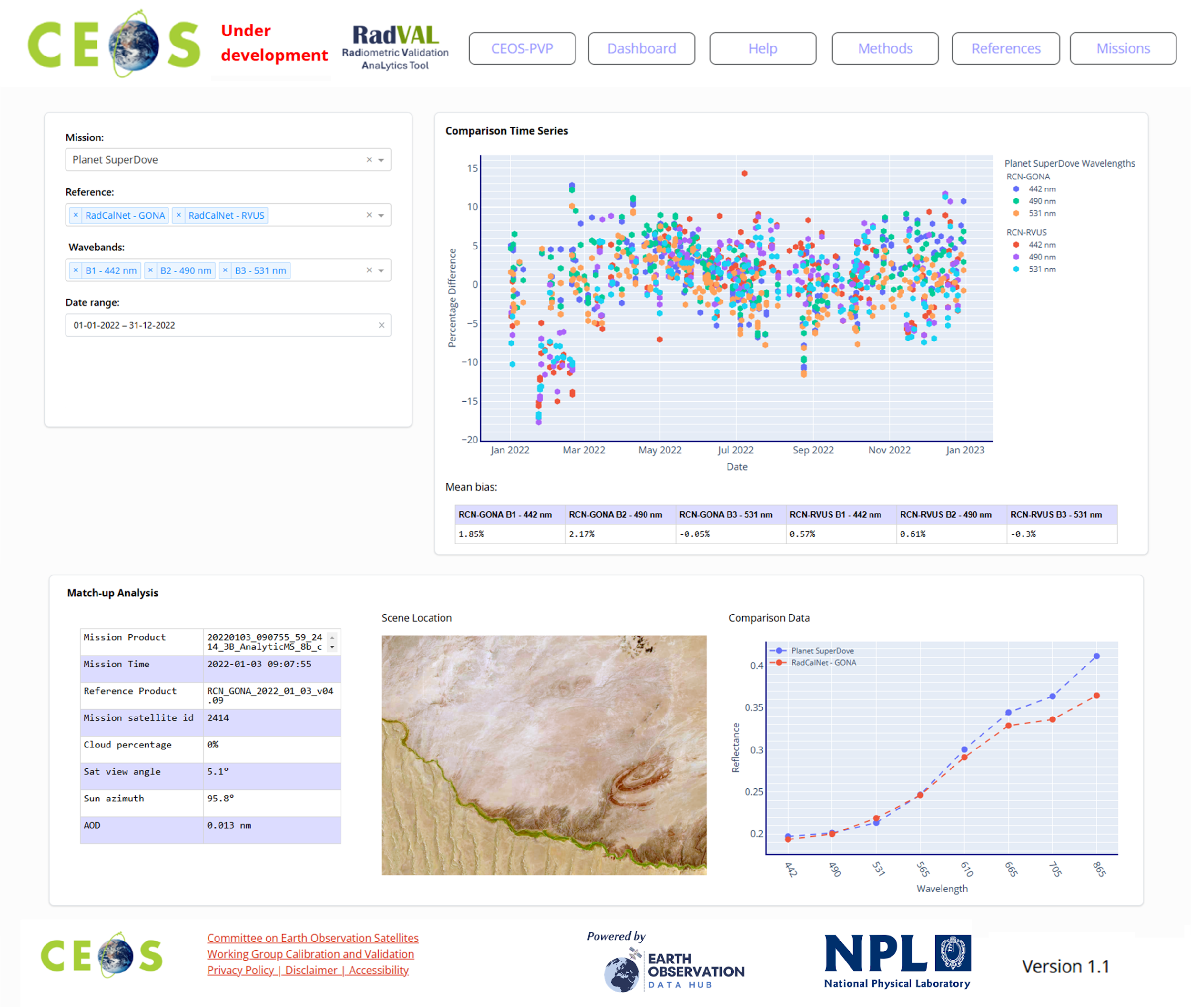
RadVAL: Radiometric Validation AnaLytics
Tool to compare level 1 data against a sub-set of individual CEOS endorsed references & a novel ‘virtual reference’ in an easy to interpret interface.
Provide users with actionable information on the performance of different mission products
Provide vendors (and CEOS agencies with an independent mechanism to demonstrate the quality of their products.
Formally launched in September –actively encouraging agency & commercial participation
On-going developments supported by UK & ESA
Proposed action: CEOS Agencies are requested to identify points of contact for submissions to the CEOS Product Validation Platform

Slide 19
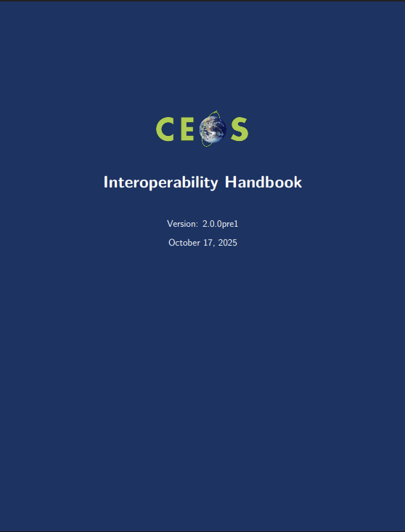

Interoperability highlights
WGCV contributed to the CEOS Future ARD Strategy and notes the focus on data quality
WGCV contributed the Data Quality Factor chapter and recommendations to the WGISS Interoperability Handbook V2.0.
Surface Reflectance Quality and Consistency Project
Developing guidelines for integrating CEOS-ARD surface reflectance data to better support science, operational, and decisional contexts.
Will form a demonstrator for the WGISS Interoperability Handbook V2.0.

Slide 20
Proposed actions from WGCV
CEOS Agencies operating SAR calibration infrastructure are invited to review the SARCalNet database and submit site information
CEOS Agencies are invited to review the WGCV LPV Land Cover and Change Map Accuracy Assessment and Area Estimation Good Practices Protocol, for endorsement at SIT-41 (April 2026)
CEOS Agencies are requested to identify points of contact for submissions to the CEOS Product Validation Platform

