Slide 1
CEOS Plenary 2025
CEOS Agriculture, Forestry and Other Land Use (AFOLU) Roadmap Implementation
Clement Albergel (ESA),
Takeo Tadono (JAXA),
Neha Hunka (ESA)
Agenda Item #
39th CEOS Plenary
Bath, United Kingdom
4th - 6th November, 2025

Slide 2
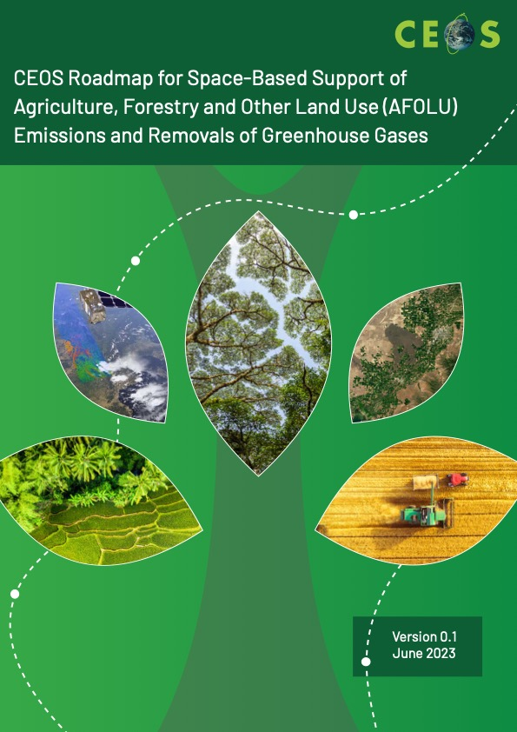
AFOLU Roadmap - Direction
A framework for long-term coordination of agency programmes in support of the needs of society for Agriculture, Forestry and Other Land Use (AFOLU)-related information, with a particular focus on the needs and ambition cycle of the Global Stocktake of the 2015 Paris Climate Agreement.
A guiding vision for long-term space agency coordination around AFOLU.
An effective means for communicating the intentions of CEOS
Address basic observation continuity and necessary agency coordination to achieve goals of sustained land-imaging of land-use and land cover change and biomass estimates

Slide 3
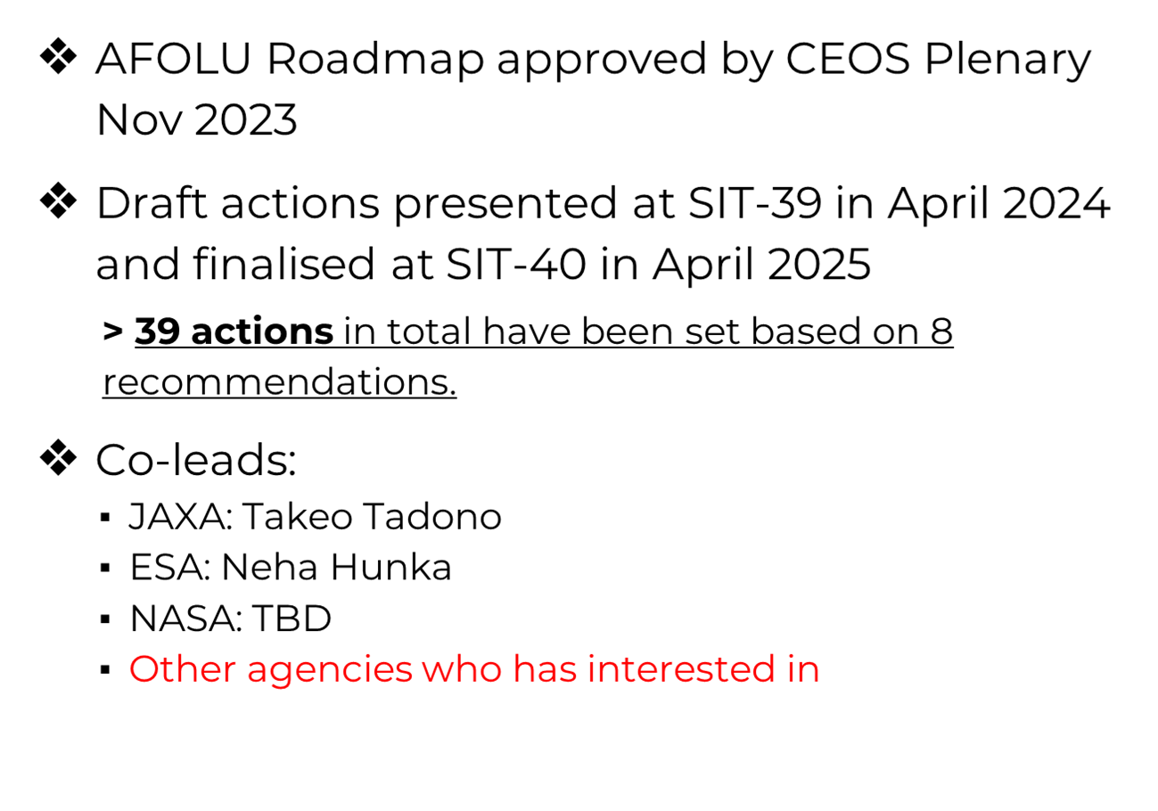
AFOLU Roadmap - Status

Slide 4
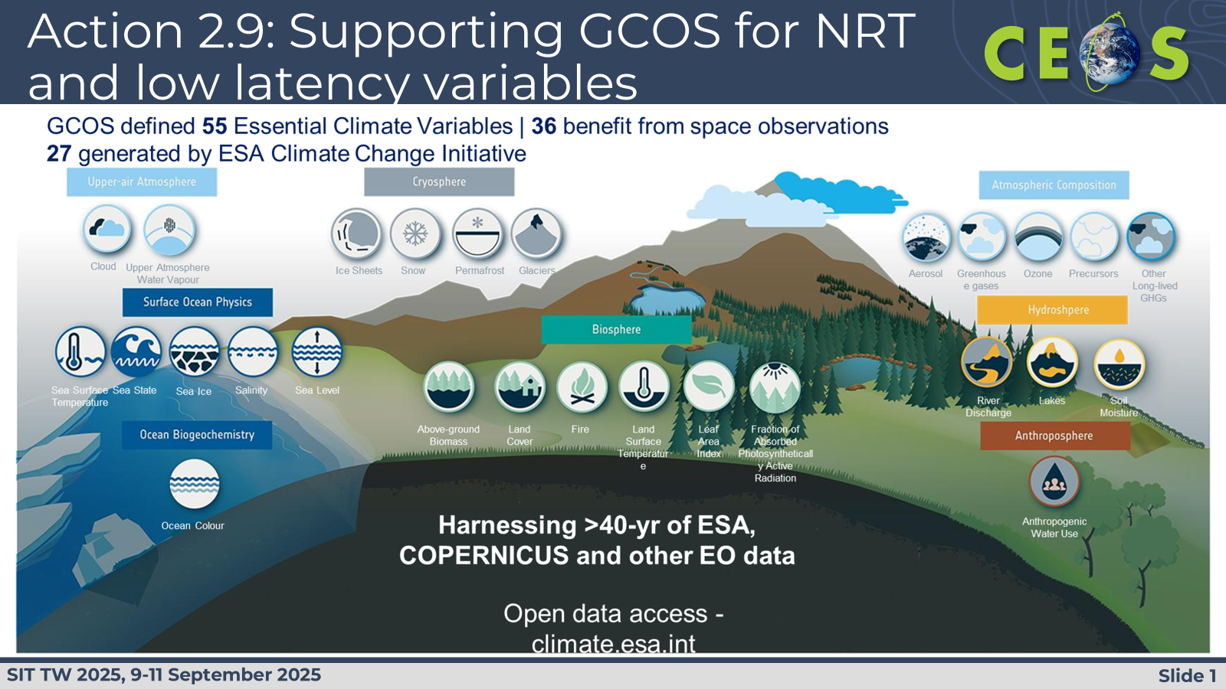
Recommendations
Recommendations from AFOLU Roadmap (reported by Ben Poulter at SIT-40 in Fukuoka, Japan in April 2025):
Universal access to satellite data needed for national reporting
Continuity and backward compatibility for missions providing activity data and emission factors
Improve data use in UNFCCC reporting and IPCC Guidelines
Enable dialogue between inventory practitioners and CEOS community
Reconcile bottom-up, top-down, and inventory estimates of GHG emissions and removals
Systematically target activities to support IPCC Land Cover classes
Work with New Space to provide comprehensive coverage for national GHG inventories
Consistency of AFOLU and GHG Roadmaps for integrated national GHG inventory system, GHG+.

Slide 5
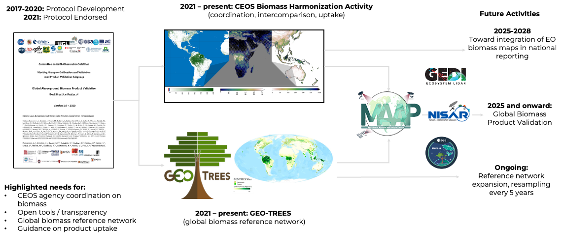



Action 0.3: Support biomass harmonization efforts
Notes:
The biomass harmonization activity is transitioning to a new phase (Phase 2) in recognition of the recent launches of the ESA BIOMASS and NISAR missions, and advances in reference data availability from GEOTREES. Phase 2 will rekindle communication between NASA, ISRO, ESA, and JAXA mission teams focused on intercomparison of new datasets from these new missions, as well as independent validation using available biomass reference maps from GEOTREES. Both ESA and NASA are supporting the development of a biomass validation tool via the MAAP platform to link new mission datasets to GEOTREES.

Slide 6
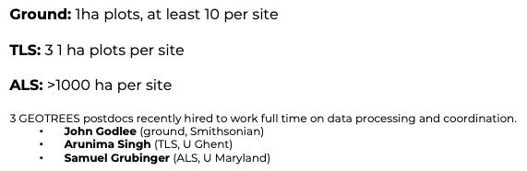
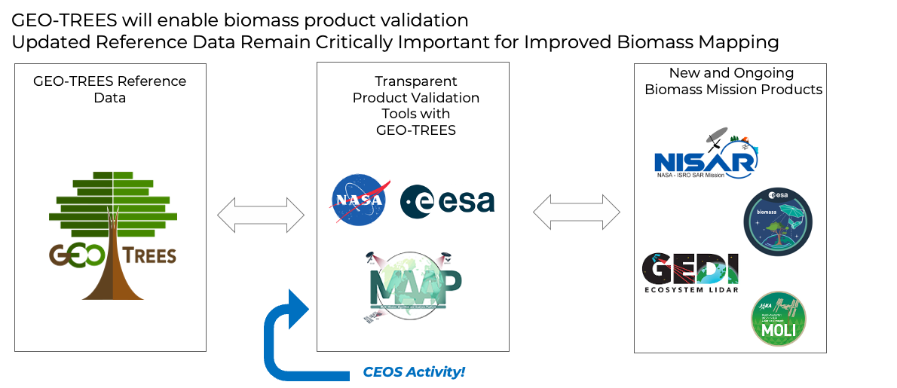
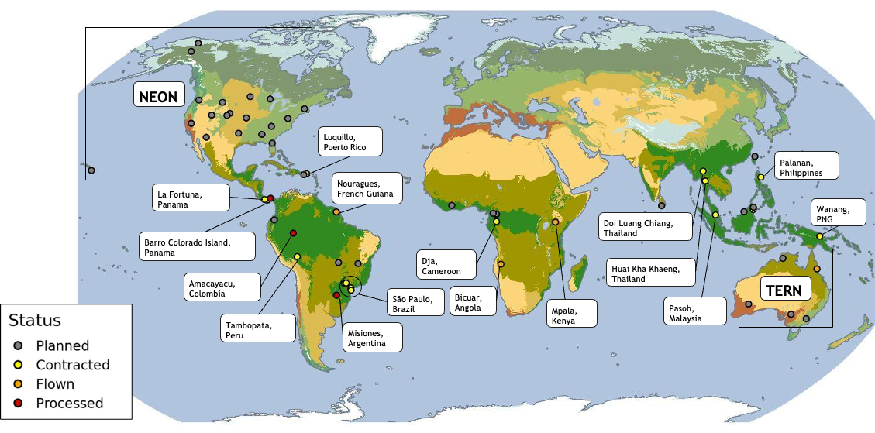
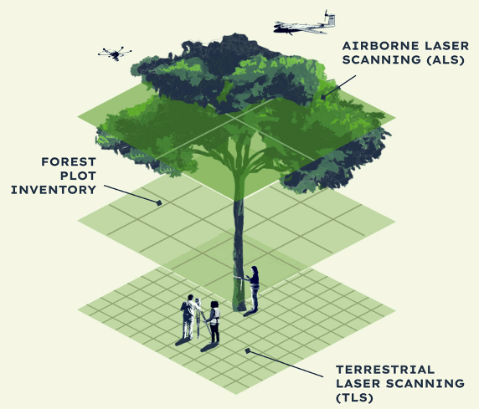
Action 2.5: Support GEO-TREES efforts
GEOTREES ALS Sites (Status August 2025)
Notes:
‘partner networks are being engaged to join, for example TERN in Australia is already a GEOTREES partner, and there are plans to collaborate with NEON in the US to expand beyond the tropics.’
ISRO being a key partner
We have right now 42 sites in the doing. Data should be available starting end of this year and throughout 2026.
Other points of interest for SIT:
Data from the first sites should become available in the next weeks. There is still some technical issues pending (agreeing on formats, versioning numbers etc) but nothing critical.
Complementing observation
All sites are covered with high priority by Tandem-X
All sites are covered by EnMAP though with low priority and cloud cover is an issue (usually we have ~10 acquisitions per site of which 80% are cloud covered). I agreed with them to select ~20 sites for which we will get higher priority to improve the coverage.
CSA RCM, and ALOS cover all sites but I have no visibility about the status.
Engagement of Agencies is still weak. So far ISRO, ESA, CNES and CSIRO (I assume they co-fund TERN activities) are the only ones providing funding for ground data collection. DLR, JAXA, CSA providing EO capacities. Maybe the expansion to the North can be a hook for other Agencies.
I believe we have a unique multi source EO data set. Agencies could support GT by supporting the analysis of this data. CEOS could coordinate these efforts?

Slide 7






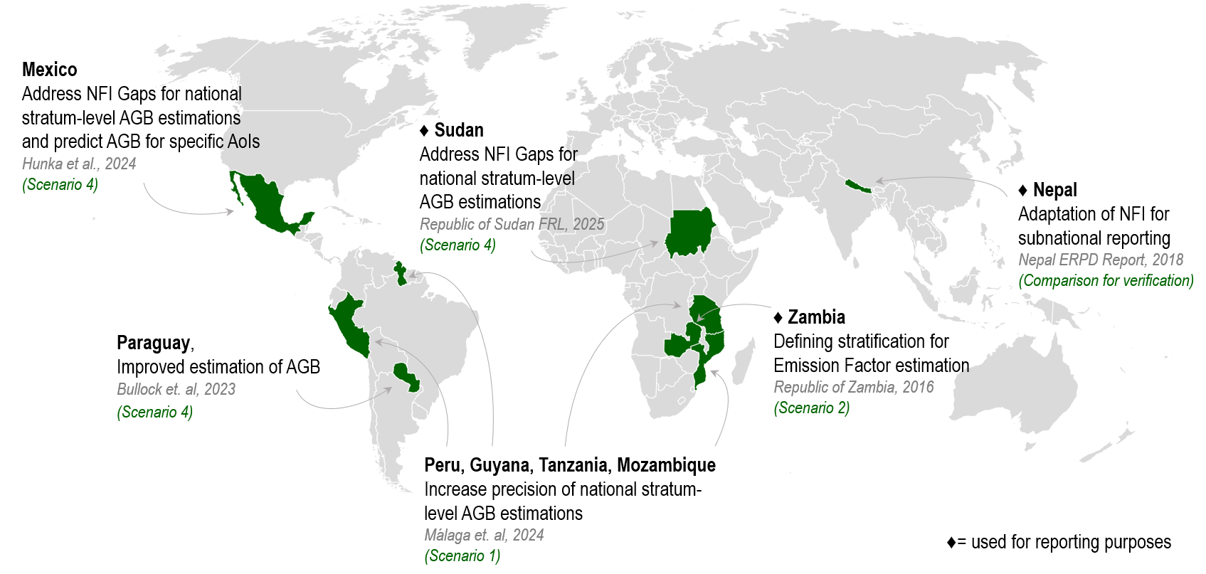
Action 2.6/2.8/3.1: GFOI R&D efforts on informed uptake of space-based biomass products
Theme: ”Forests and the marvel of monitoring” - 21–23 October 2025
Global gathering for countries, donors, development partners and practitioners in the forest monitoring sector
FAO: Launch of the Global Forest Resources Assessment 2025
Release of the GFOI Rapid Response Module integrating EO biomass maps and forest inventories
CEOS-participation or co-led sessions on:
IPCC TFI tools to support transparency on Forest land
Advances in Uncertainty Estimation when using EO datasets
High level overview of ways to integrate biomass data with ground data for MRV needs
Dynamic session with countries: Addressing existing biomass estimation needs: identifying options for improved use
Key operational and research examples for the use of space-based forest biomass-related data as auxiliary information for reporting purposes
Notes:
Facilitates international efforts to bring EO data and research towards operational uptake by countries in the tropics
Identifying gaps and needs to advance research and data provision
Foster a scientific community knowledgeable of country uptake needs
Contribute to the GFOI process, organization of expert meetings, support in capacity building workshops, assessment of maturity of methods and datasets…
Involvement in international forums (UNFCCC, GCOS/TOPC, GEO-TREES, CEOS cal/val efforts, UN-SDGs…)
Advocate for the use of remote sensing coupled with in-situ observations
Global gathering for countries, donors, development partners and practitioners in the forest monitoring sector

Slide 8
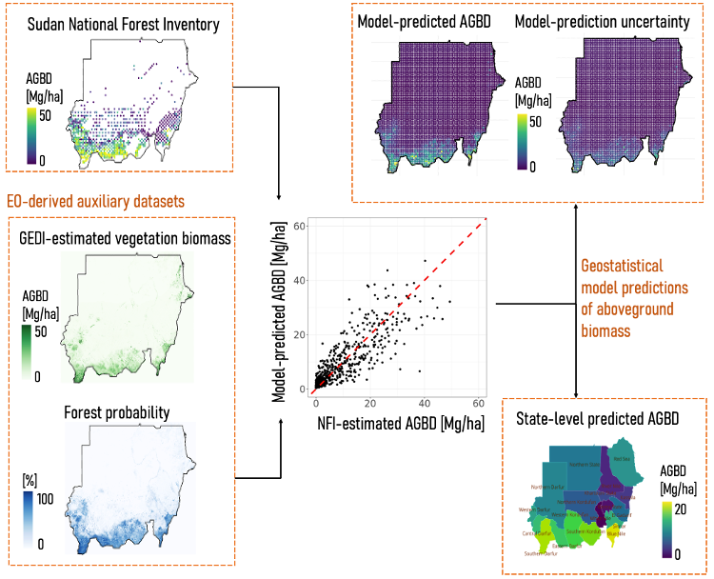


Action 2.6/2.8/3.1: GFOI R&D efforts on informed uptake of space-based biomass products
Uptake of AGB map products: Republic of Sudan
The first uptake of a NASA GEDI-based biomass product for national reporting to the GST.
Submitted by Sudan, positively reviewed by the IPCC, and final approval is expected in late 2025.
This pathfinding uptake of satellite AGBD products will enable other countries to follow.
Product development and analysis was conducted on the NASA MAAP cloud computing environment (https://scimaap.net/)

Slide 9
Action 2.6/2.8/3.1: GFOI - Potential points of interest for CEOS
Continuation of CEOS AFOLU Success stories – aim is to communicate the impact of Agency EO data provision in national reporting activities
Elaboration of guidance material, and summarizing key case studies -> Key outputs contributing to AFOLU roadmap
Expert workshops - Participation of CEOS agencies would benefit two-way communication regarding needs and data provision realities
Enhance data quality, transparency and documentation of available datasets
Communicating the level of maturity of approaches and biomass datasets
Developing and comparing approaches tailored to country needs

Slide 10
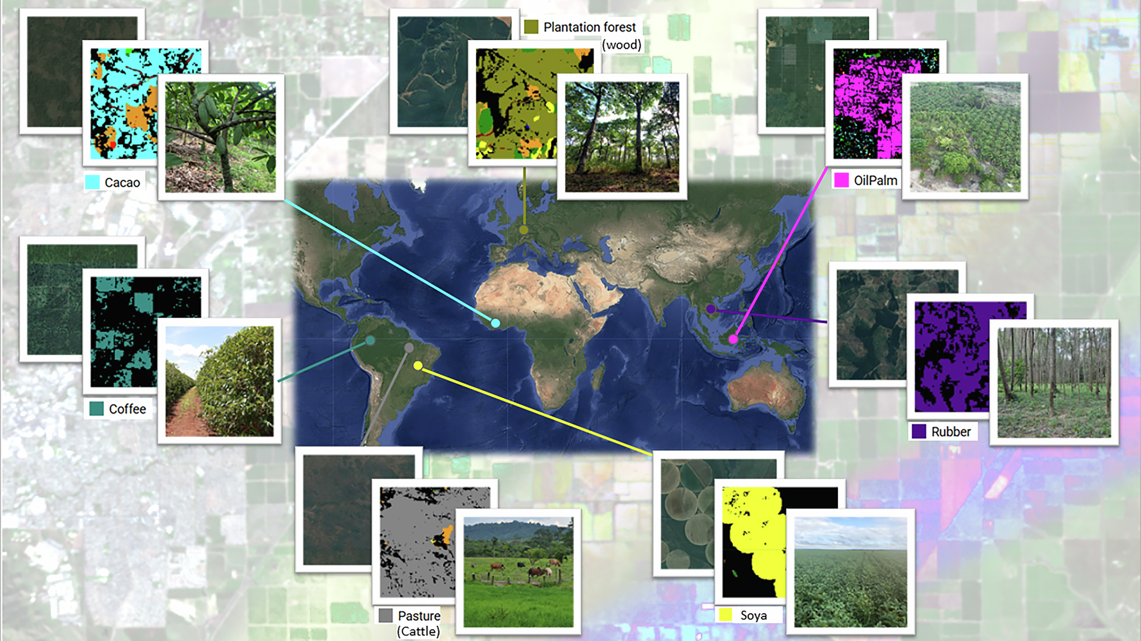

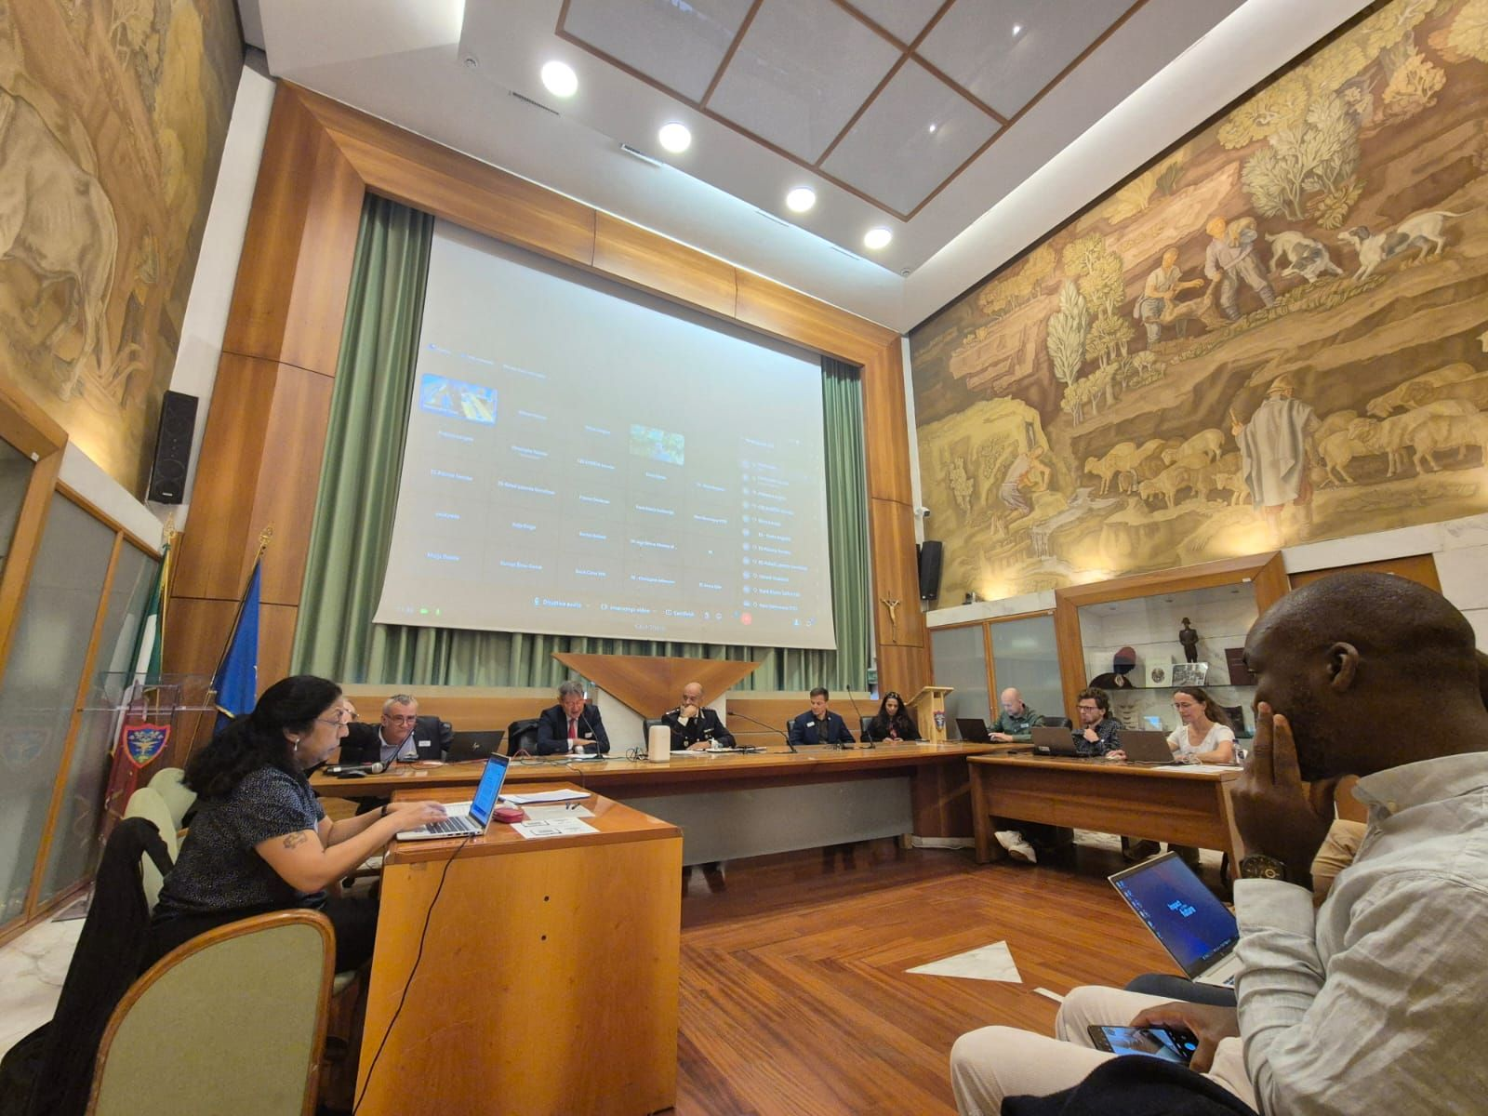
EUDR: Deforestation and Commodities
Living Lab 2025 - Meeting Competent National Authorities
Support for EU Member States in enforcing deforestation-free commodity regulations using EO
Event Overview and Participation
30 September 2025 in CUFA - Comando Unita Forestali Ambientali e Agroalimentari (CUFA)
40 participants onsite and 30 online
9 Competent National Authorities (CNAs) plus representatives from EFI, FAO, JRC, IFAD, and the WorldAgroCommodities consortium, supported by ESA
Key Discussions and Technical Focus
Clarified CNA user needs and requirements for due-diligence reports
Emphasis on a workflow integrating commodity and deforestation mapping
Proposed “traffic light” risk estimation system with uncertainty estimates.

Slide 11


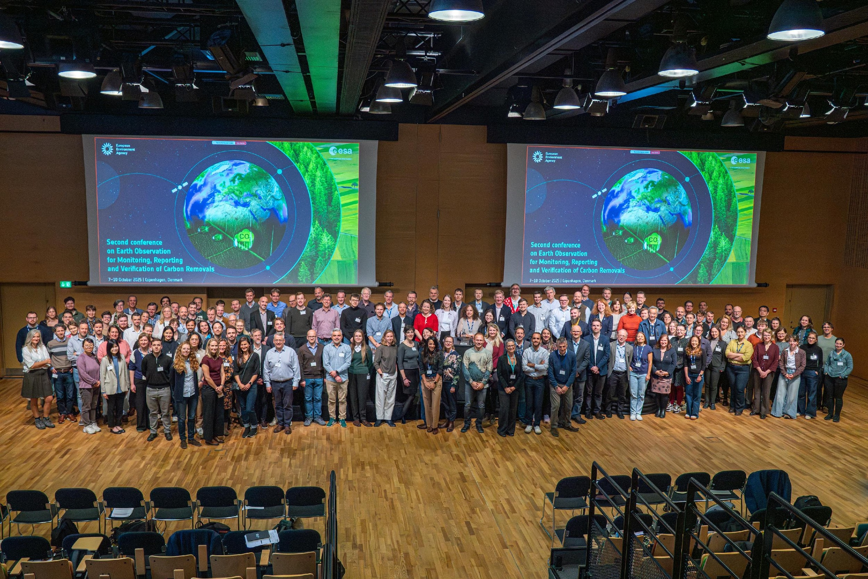
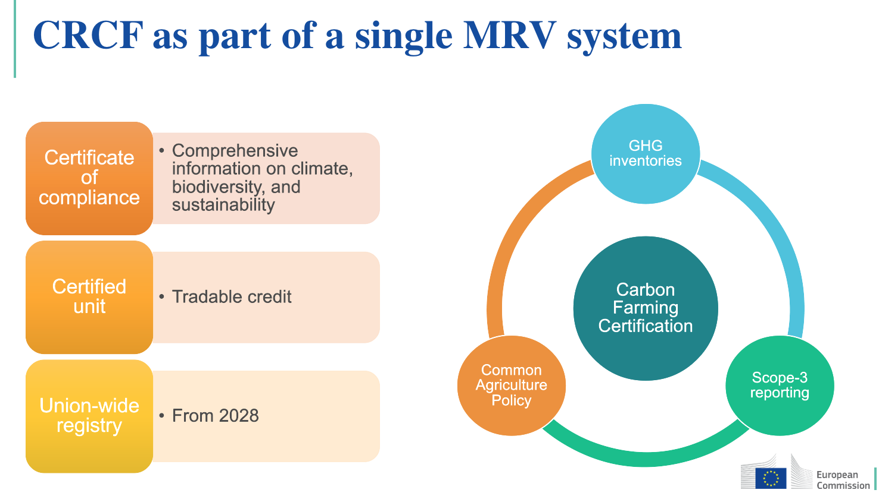
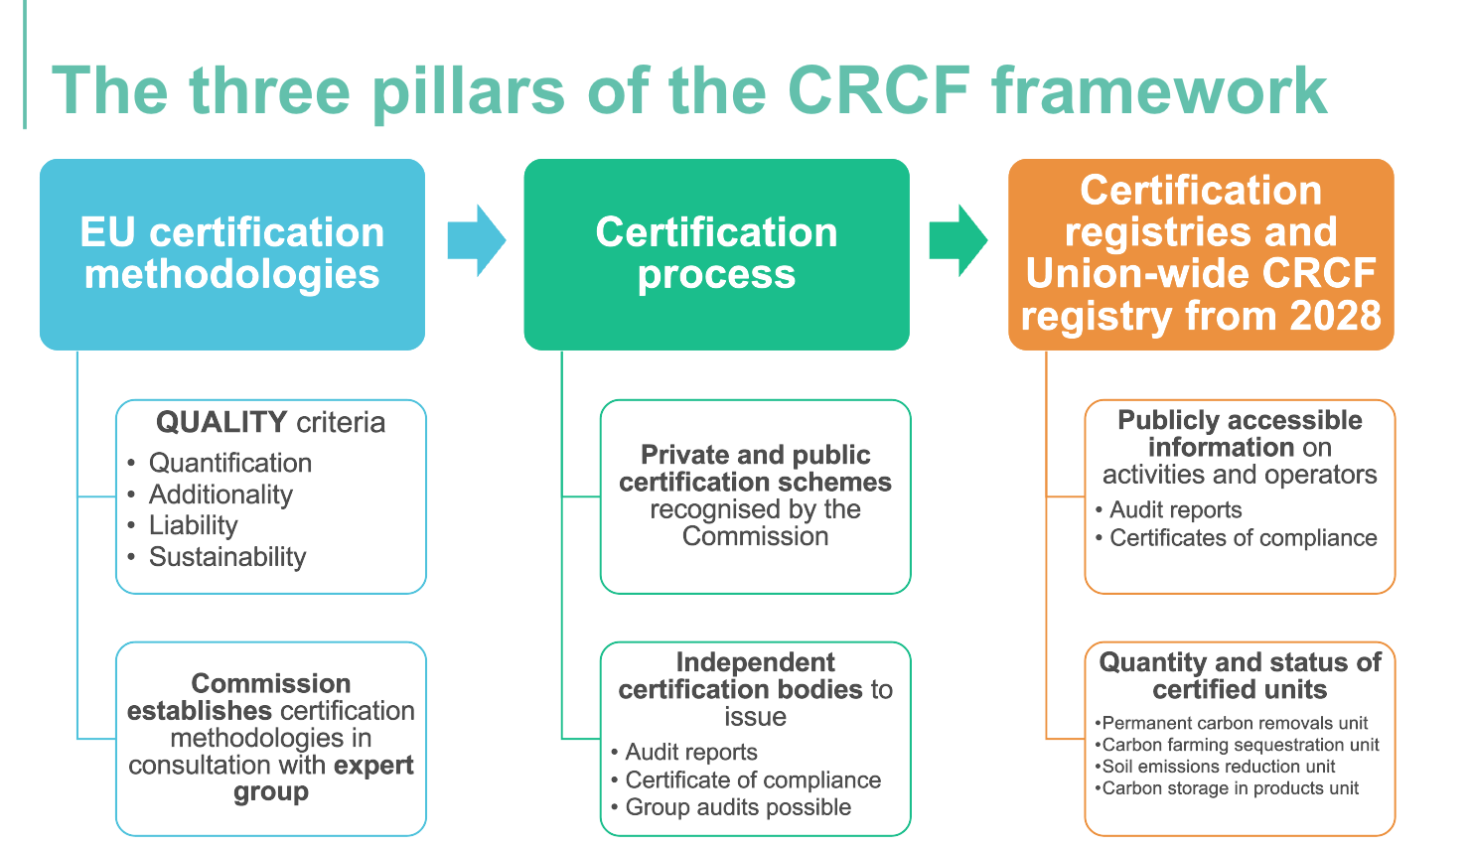
Earth observation for monitoring, reporting and verification of carbon removals 2025 (EO4MRV)
The conference was structured in 2 parts:​
​
EO for improving LULUCF regulation and the Monitoring, Reporting and Verification needs​
Third Forum on EO for Carbon Markets (Carbon Removal and Carbon Farming – CRCF regulation)
200 participants:
Scientists
EU Policy bodies
Operators (forest and farm owners)
National Inventory Compilers & Paying Agencies
Service providers
Financers
Adoption of the first set of carbon farming certification methodologies expected in 2026
EO data to support Carbon Farming in -
(1) Agriculture soils & agroforestry
(2) Planting of Trees
(3) Rewetting of Peatlands

