Slide 1
Greenhouse Gas Roadmap Implementation
Yasjka Meijer, ESA
GHG Task Team Lead
Agenda Item 4.4
39th CEOS Plenary
Bath, United Kingdom
4 – 6 November 2025

Slide 2
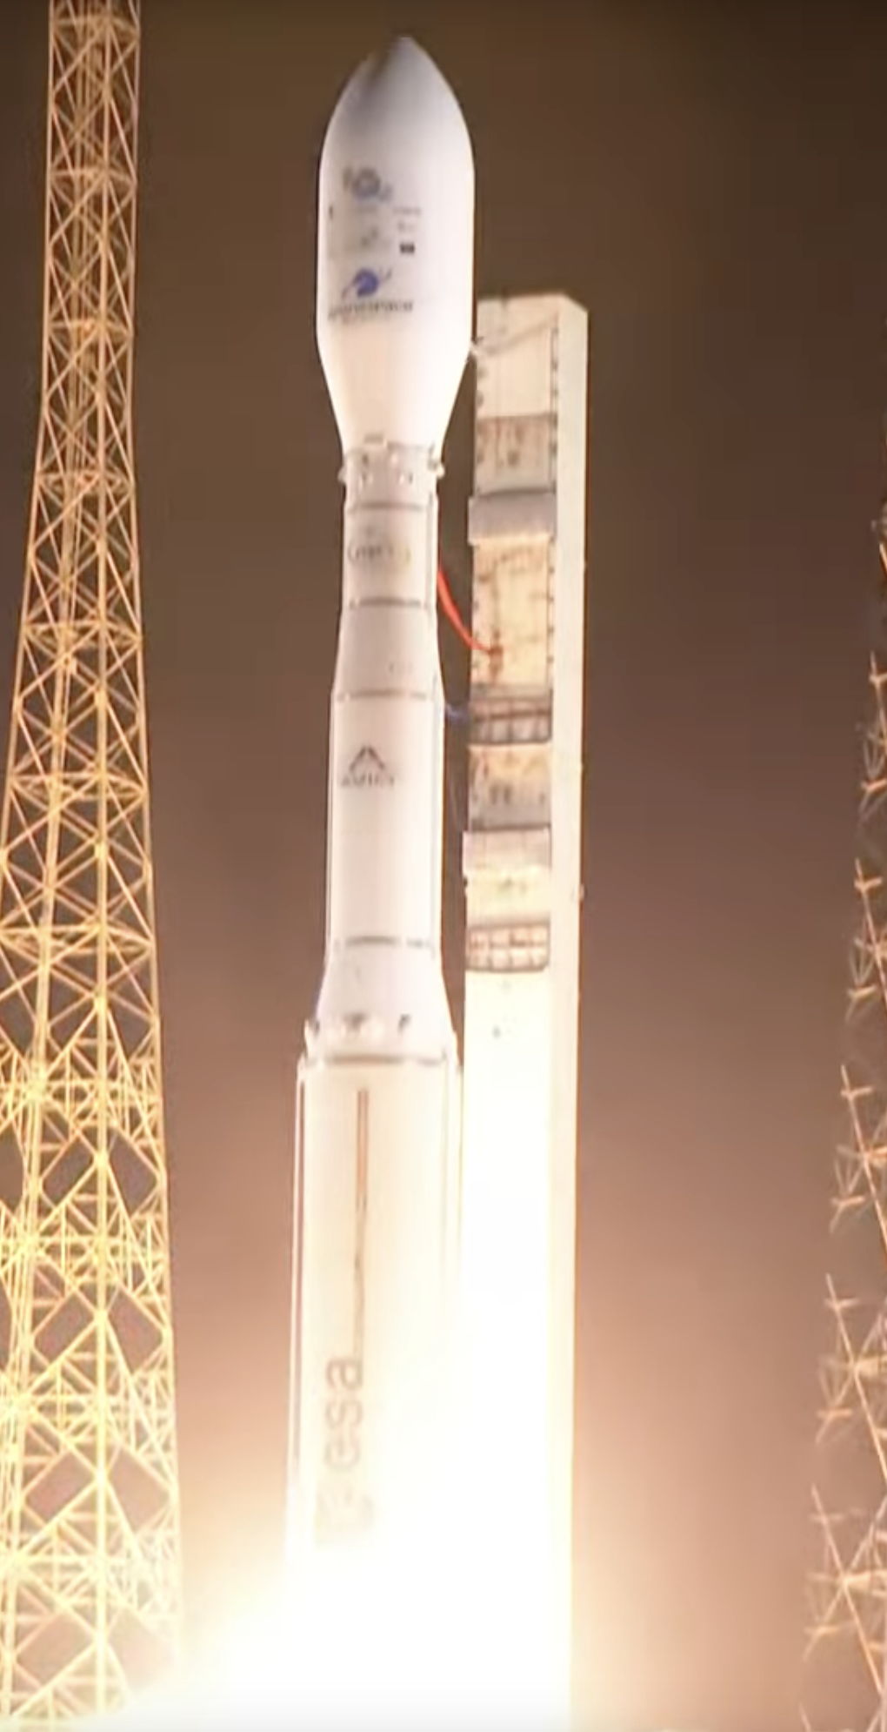
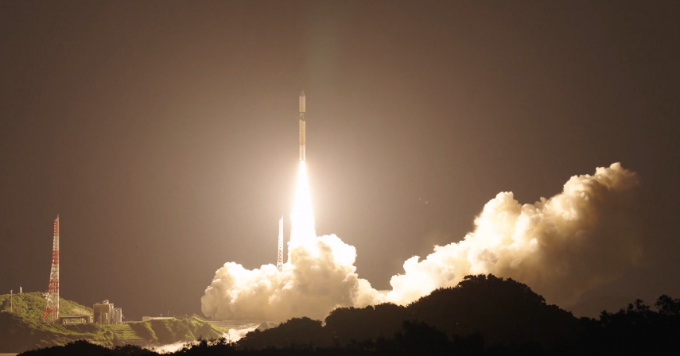
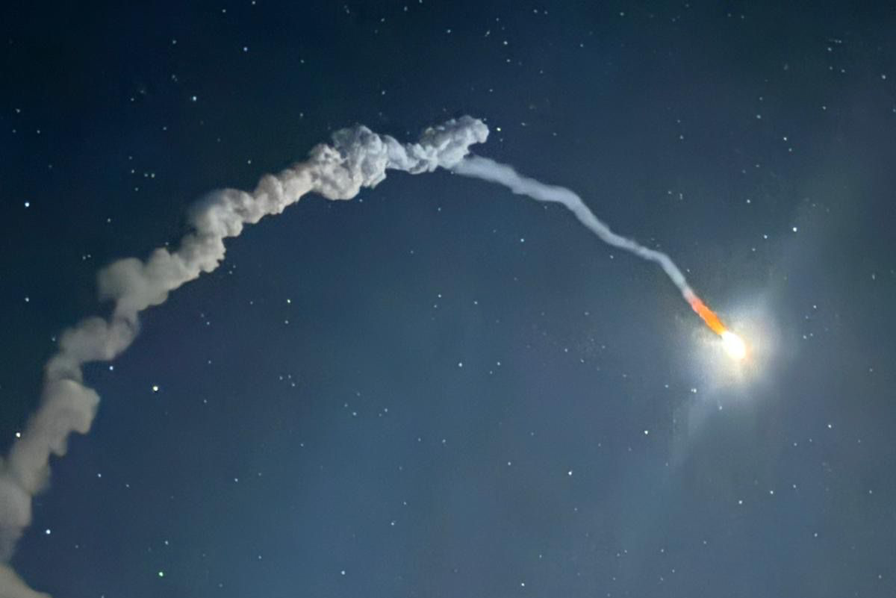
Greenhouse Gas Missions
International constellation is EXPANDING in 2025
Successful launch of:
GOSAT-GW on 29 June
MicroCarb on 26 July
Sentinel-5 on 12 August
(on MetOp-SG-A1)
Overview on GHG Mission Portal,
see item 4.3

Slide 3
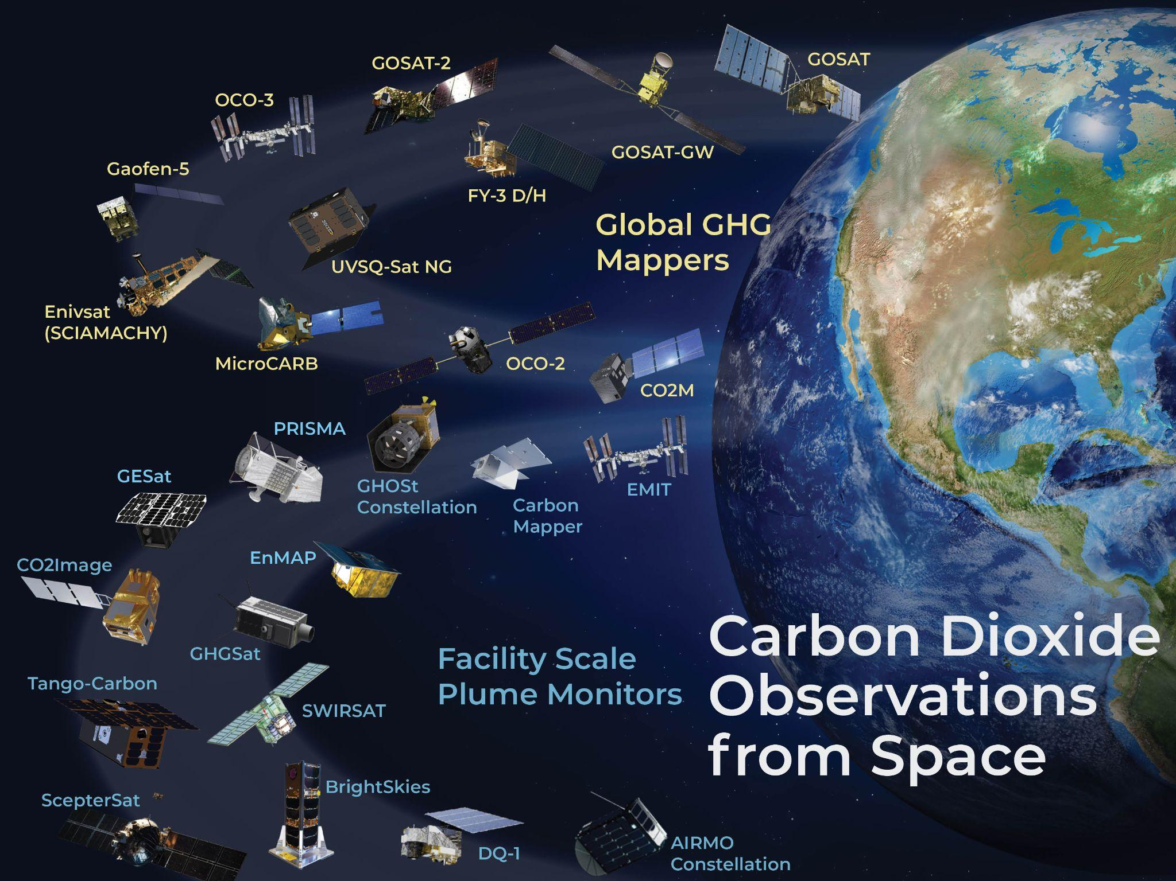

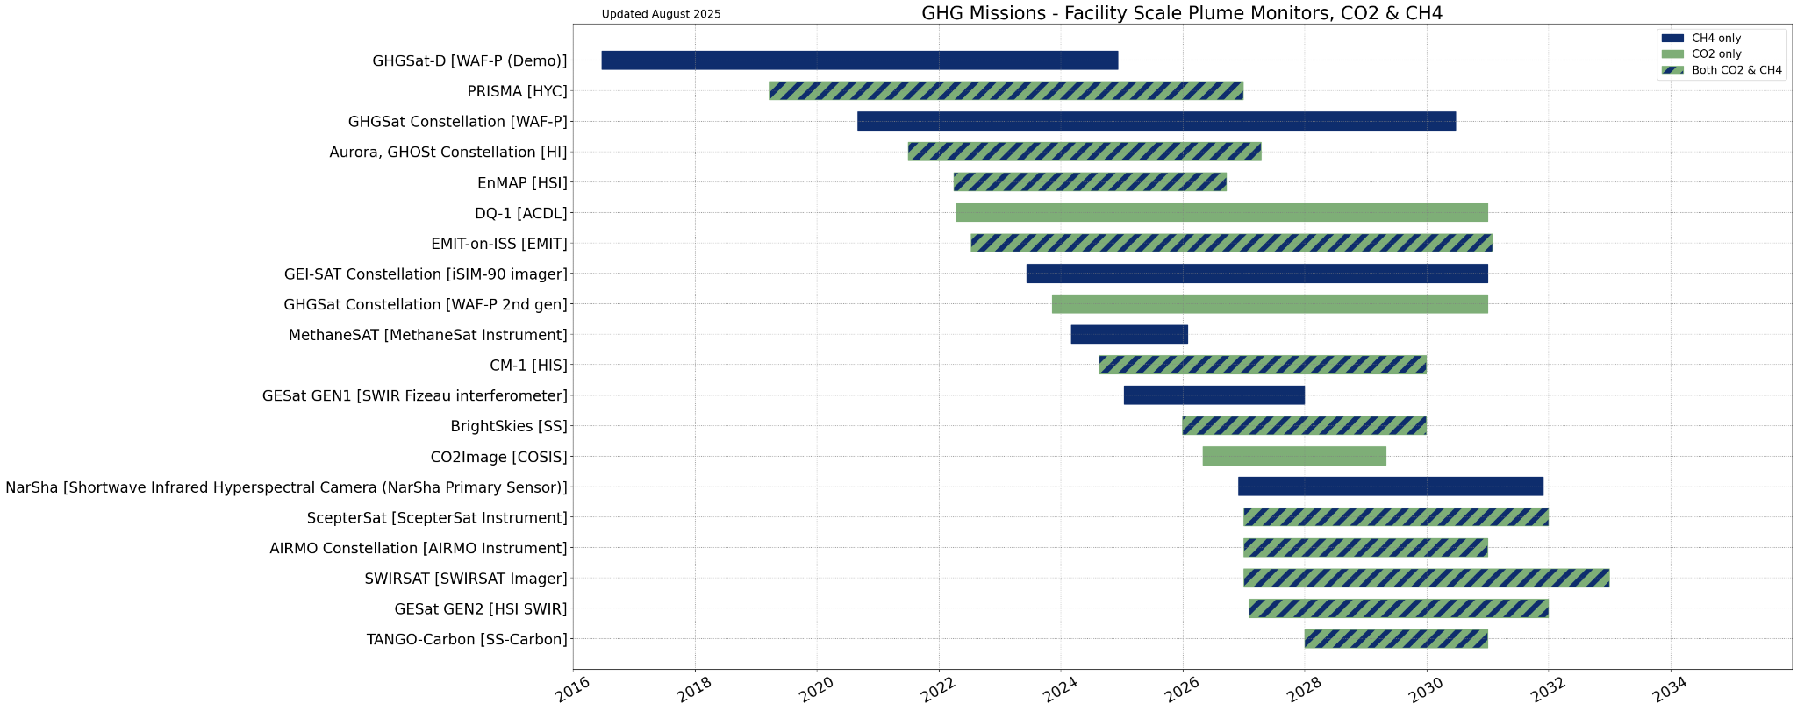
GHG Mission Portal
Updated portal, see ceos.org/ghg (public and non-public)
Allows exploring GHG missions, explore building constellations, detailed mission info, timelines, and case studies

Slide 4

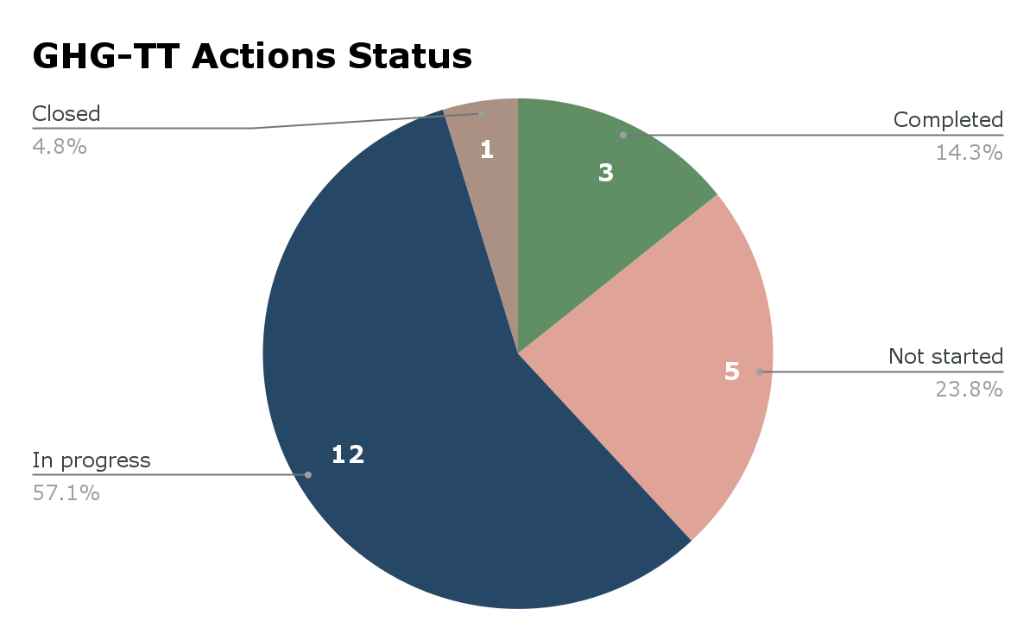
Greenhouse Gas Roadmap Issue 2
Endorsed at CEOS Plenary 2024
Supplemented by Annex C Actions:
  21 near-term actions identified covering
  8 thematic areas described in next slides

Slide 5
Sensor Development and
Constellation Architectures
Lead: John Worden (NASA/JPL)
Sensor Characterization to Meet Stakeholder Requirements
  Reviewed annually by AC-VC & IWGGMS
Track Instrument type and mission timeline
  Via GHG Portal
  Working to invite commercial providers to participate in AC-VC meetings
Track & evaluate other measurements of tracers of carbon cycle
  Tracked by AC-VC
Identify Measurement Gaps
  Tracked by AC-VC & GCOS

Slide 6
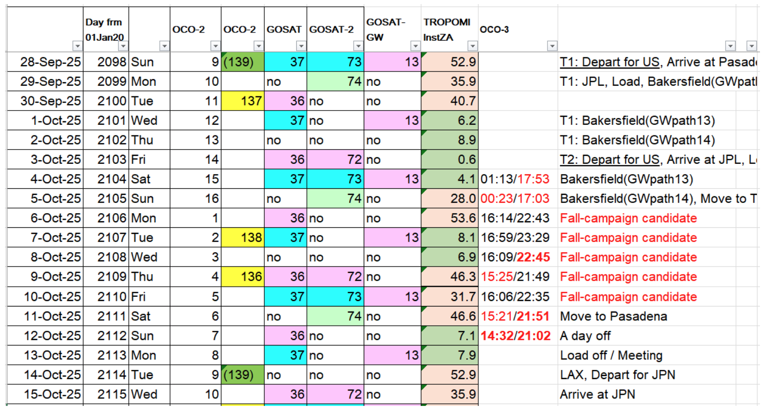
Calibration and Level 1 Products
2025 Fall Campaign Schedule
Lead: Hiroshi Suto (JAXA)
Railroad Valley Campaign 2025:
  GOSAT, OCO-2, OCO-3, TROPOMI, GOSAT-2, TEMPO
  GOSAT-GW will join the Fall campaign
  Sentinel-5 and MicroCarb also invited
Vicarious calibration portal has been updated:
  https://www.eorc.jaxa.jp/GOSAT/GHGs_Vical/
Match-up dataviewer was created comparing GHG sensors
  https://www.eorc.jaxa.jp/GOSAT/Matchup_forCal/top_matchup_viewer.html
CMA is also performing regular campaigns in Gobi Desert

Slide 7
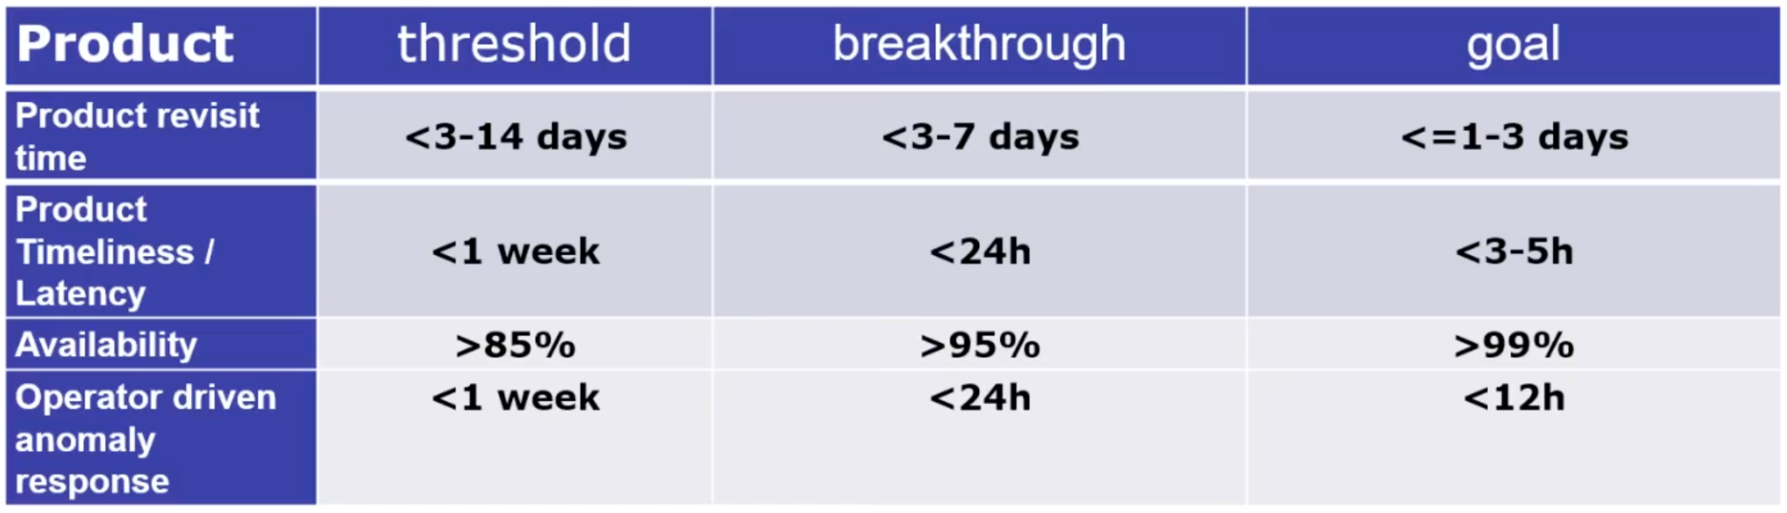
Level 2 Products and Validation
Leads: Ruediger Lang (EUMETSAT), Dave Crisp
Algorithms for Intercomparison: Aerosol scattering
  NASA-funded project led by Chris O’Dell (CSU)
  Focus on CO₂ and global/regional fluxes
  Simulations will be run over Q4 2025, initial results in Q1 2026
Track L2 Validation Capabilities, Evolving Needs and Gaps
  Develop an operational system for validation
Discussing the L2 product requirements for a system like G3W:
DRAFT

Slide 8
Flux Inversion Modelling and Validation
Leads: Kevin Bowman (NASA/JPL), Frederic Chevallier (LSCE)
G3W Applications:
  Model Intercomparison Project (MIP) is underway with international participation
  Capabilities do not meet stringent latency requirements of G3W
UNFCCC National Reporting
  Estimating the error correlation of flux estimates between
  neighbouring countries (e.g. France and Germany)
  Aiming to reproduce the GST results from Bryne et al with updated fluxes
Coordinating with AFOLU & Aquatic Carbon Teams on this topic
Notes:
INV-01: The OCO-2 V11 MIP is underway with international participation. This activity still represents the best practice to date for the exploitation of satellite assets to infer global fluxes. These include protocols for data delivery and a robust validation approach against independent observations. However, this activity does not meet the stringent latency requirements of G3W (the last time I checked). It is important for other CEOS members to develop analogous MIPs, especially for GOSAT-GW and MicroCarb—followed by CO2M. The continued operation of OCO-2 and OCO-3 is uncertain given US executive priorities. This increases the urgency of their initiation.
INV-02: One of the emerging activities within OCO-2 V11 MIP is the calculation of uncertainties and spatial correlations of the top-down inversions. The idea is to be able to calculate the error correlation of the flux estimates between, say, France and Germany. This activity is also working to reproduce the stocktake results from Bryne et al with the updated fluxes, which will include years up to 2024.

Slide 9
System Development
Lead: Richard Engelen (ECMWF)
Activities on hold until G3W plans are defined
  GHG-TT will support the system required by G3W
Capacity sharing between regional GHG Centres
(e.g. Copernicus, Japan, US)

Slide 10

Methane Common Practices
Leads: Paul Green (NPL) &
John Worden (NASA/JPL)
First document completed!
Details in (next) item 4.5
Controlled release experiments form
an important fundament
Enables working with New Space

Slide 11
Fostering Stakeholder Engagement
Lead: Mark Dowell (EC-JRC)
UNFCCC Engagement - Earth Information Day 2025, see item 4.6
GST Parties - 'BYO Inventory Compiler'
  Harwell meeting was a success and will be repeated in other regions
  Suggestion to work with the annual Workshop on Greenhouse Gas Inventories in Asia organised by NIES (Japan)
GST Parties, see item 4.3
GCP & RECCAP, Clement Albergel (ESA) is CEOS POC
IMEO →→ next slides
G3W →→ next slides

Slide 12
IMEO Update
SIT Chair and GHG TT engaged with ASI and DLR to facilitate access for IMEO to PRISMA and EnMAP
Revitalised the joint IMEO-CEOS working groups
CEOS-IMEO community workshop in 2026 (date/location TBD)
CEOS developed a database of controlled release experiments:
    Maximise use of planned experiments providing access for multiple satellites
    Reduce the amount of released methane
  Three elements:
    Table of experiments (past & planned)
    Form to submit experiments
    Automated notifications & mailing list

Slide 13
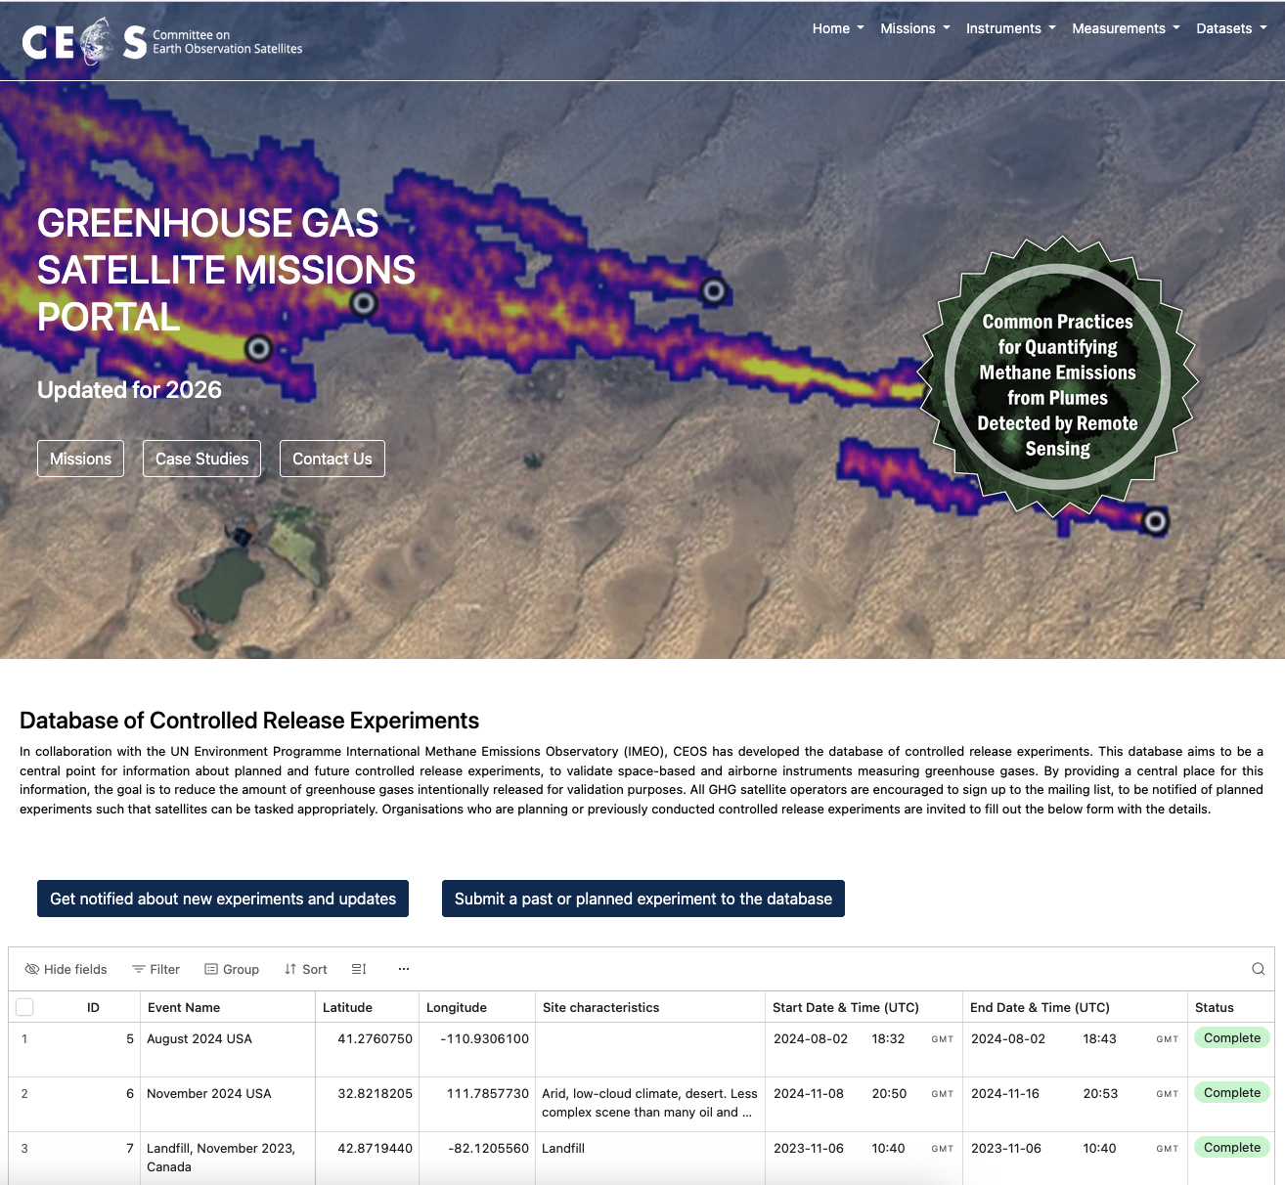
Controlled releases – draft page

Slide 14
G3W Update
Extraordinary WMO council meeting was held to confirm that G3W will continue in new form
G3W would be integrated in existing WMO matrix infrastructure
G3W GHG-TT virtual meeting , date pending on
G3W way forward
PoC vis-a-vis GHG Task Team is Oksana Tarasova

Slide 15
Arctic Observing Mission - AOM
AOM will address a measurement gap
Support letter is requested
First, we seek CSA Principal approval,
then we intend to respond to this request

Slide 16
Outlook
Arigatō JAXA for supporting the GHG Monitoring efforts
Next GHG Task Team meeting will be again jointly with WGClimate on 9–13 February in Harwell, UK
Continue in coming years will be a challenge….

Slide 17
Time for questions
and discussion
THANKS!

