Slide 1
39th CEOS Plenary Update on TT-UNFCCC COP30 preparations
V.-H. Peuch, ECMWF
Agenda Item #4.6
39th CEOS Plenary
Bath, United Kingdom
4-6 November, 2025

Slide 2

Mandate and team
(Open) membership, status 11/2025
Clément Albergel (ESA)
Maggie Arnold (upcoming CEOS chair, GA)
Albrecht von Bargen (DLR)
Antonio Bombelli (WMO/GCOS)
David Crisp (SIT chair)
Adrien Deschamps (CNES)
Mark Dowell (EC)
Patrick Gibson (CEOS chair, UKSA)
Beth Greenaway (CEOS chair, UKSA)
Mariko Harada (SIT chair, JAXA)
Alex Held (upcoming CEOS chair, CSIRO)
Susanne Mecklenburg (ESA)
Yasjka Meijer (ESA)
Osamu Ochiai (SIT chair, JAXA)
Steven Ramage (CEOS exec)
John Remedios (CEOS chair, NCEO)
Frank Martin Seifert (ESA)
Joerg Schultz (EUMETSAT)
Vincent-Henri Peuch (ECMWF)
Matthew Steventon (CEOS exec, Symbios)
Libby Rose(Symbios)
Harvey Jones (Symbios)
WGClimate 22-24 (Feb. 2025): create Tiger Team for Engagement with UNFCCC with specific tasks to
Ensure consistent preparation for Earth Information Day
Enhancing coordination at key UNFCCC events throughout the year
Contribute to GST strategy process led by SIT chair
Define key objectives for each COP and EID, ensuring that CEOS and CGMS efforts are strategic and aligned with broader climate goals.
Survey agencies to understand their level of participation at each COP (individuals and/or pavilions)

Slide 3
Overview of activities
Principle of twin telcos to allow participation at a „reasonable“ time of the day for all members across the globe. 6 meetings: 5 TT sessions (17 March, 15 April, 27 May, 17 July, 9 October) and an online workshop with UNFCCC (30 April).
Main discussions/activities:
Refine ToR/mandate (clarify it is time limited, ~18 months) & interaction with GST strategy update process
Organise workshop to stimulate wider collaboration with UNFCCC & follow-up actions
Limited effort on SB-62 (June 2025) in view of stronger coordinated participation to SB-64; in-person meeting of some members in the margins of the sessions
Prepartion contributions to Earth Info Day at COP30

Slide 4
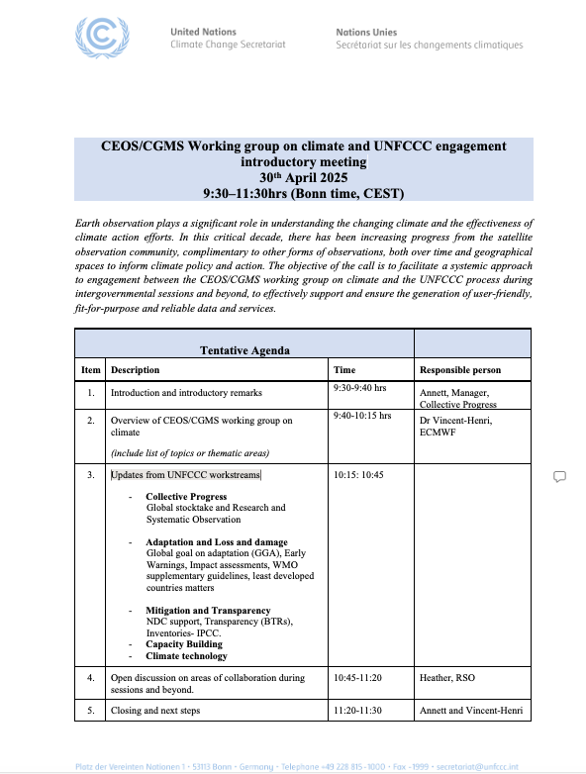
Workshop with UNFCCC
30 April 2025
Main objective: engage with key UNFCCC lead persons and stimulate wider engagement on different streams of activities
Agenda:
Introduction UNFCCC
Introduction WG-Climate
Interests from different UNFCCC “workstreams”
Open discussion and next steps
11 participants from UNFCCC and 16 from WG-Climate/CEOS; minutes (from WG-Climate and UNFCCC) available.

Slide 5
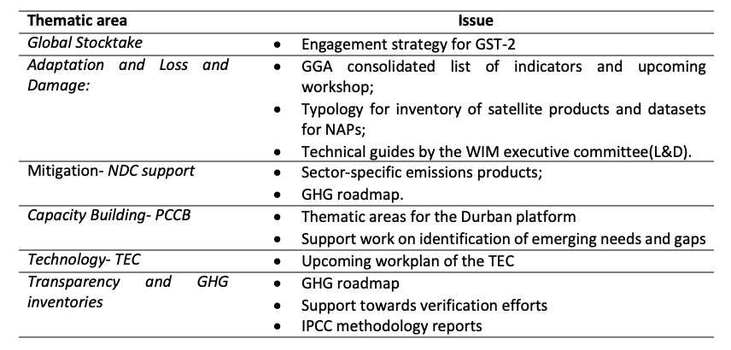
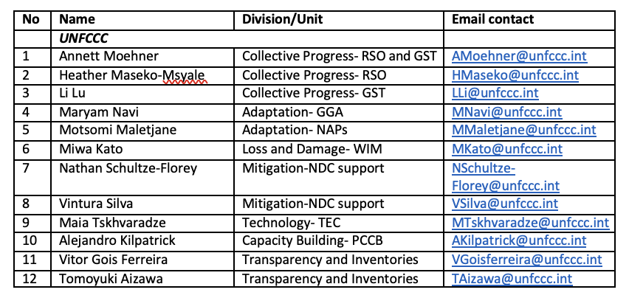
Streams of engagement
WGClimate PoCs
Global Stocktake: S. Mecklenburg and O. Ochiai
Adaptation and Loss and Damage: M. Dowell and S. Connors
Mitigation (NDC support): Y. Meijer and V.-H. Peuch
Capacity Building (PCCB): A. von Bargen and S. Ramage
Technology (TEC): J. Remedios and V.-H. Peuch
Transparency and GHG Inventories: O. Ochiai (or someone from JAXA), S. Mecklenburg and Y. Meijer
(Climate finance): ESA interested to connect with UNFCCC on this
+ COP/EID and SBSTA
Notes:
Yasjka: to ensure a streamlined message across CEOS towards UNFCCC/COP.

Slide 6

EID COP30 Belém
(Prepare SBSTA-63 statement to be delivered by CEOS chair, AU) covered under #3.2
Prepare contribution to the Earth Information Day (EID)
Approach has been to make our proposal fit with EID typical structure of all the past years
Submitted coordinated contribution on 28/08
12 other submissions were sent to UNFCCC
In-person follow up meeting in Bonn with UNFCCC secretariate
Outcome: 3 proposed interventions (one in plenary and one in each of the two breakout sessions)
2 could be confirmed due to limited in-person participation this year

Slide 7
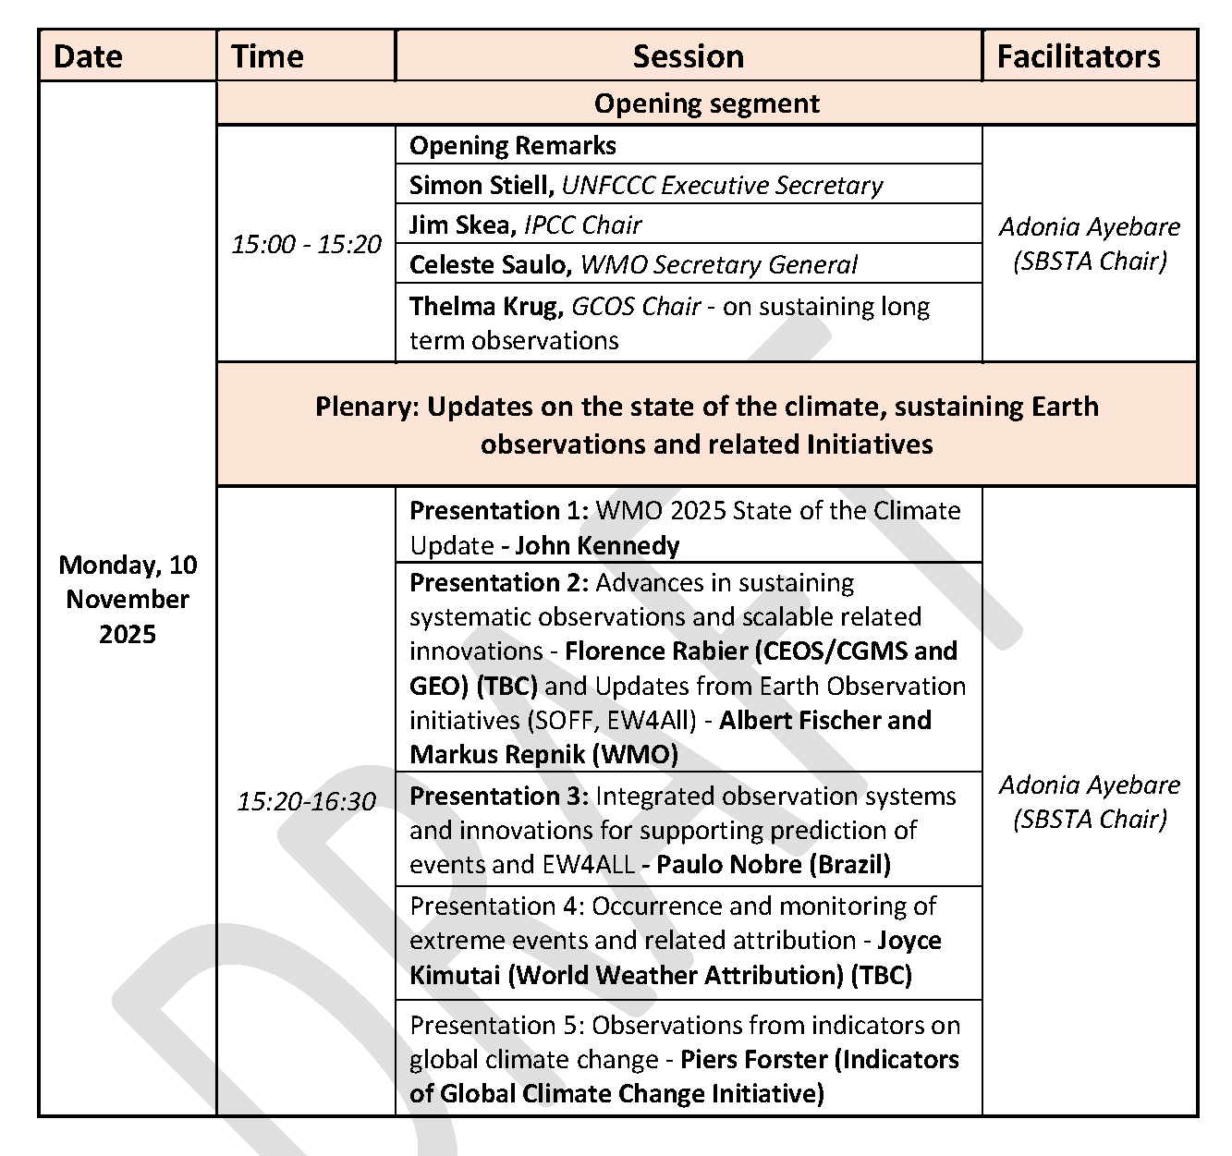
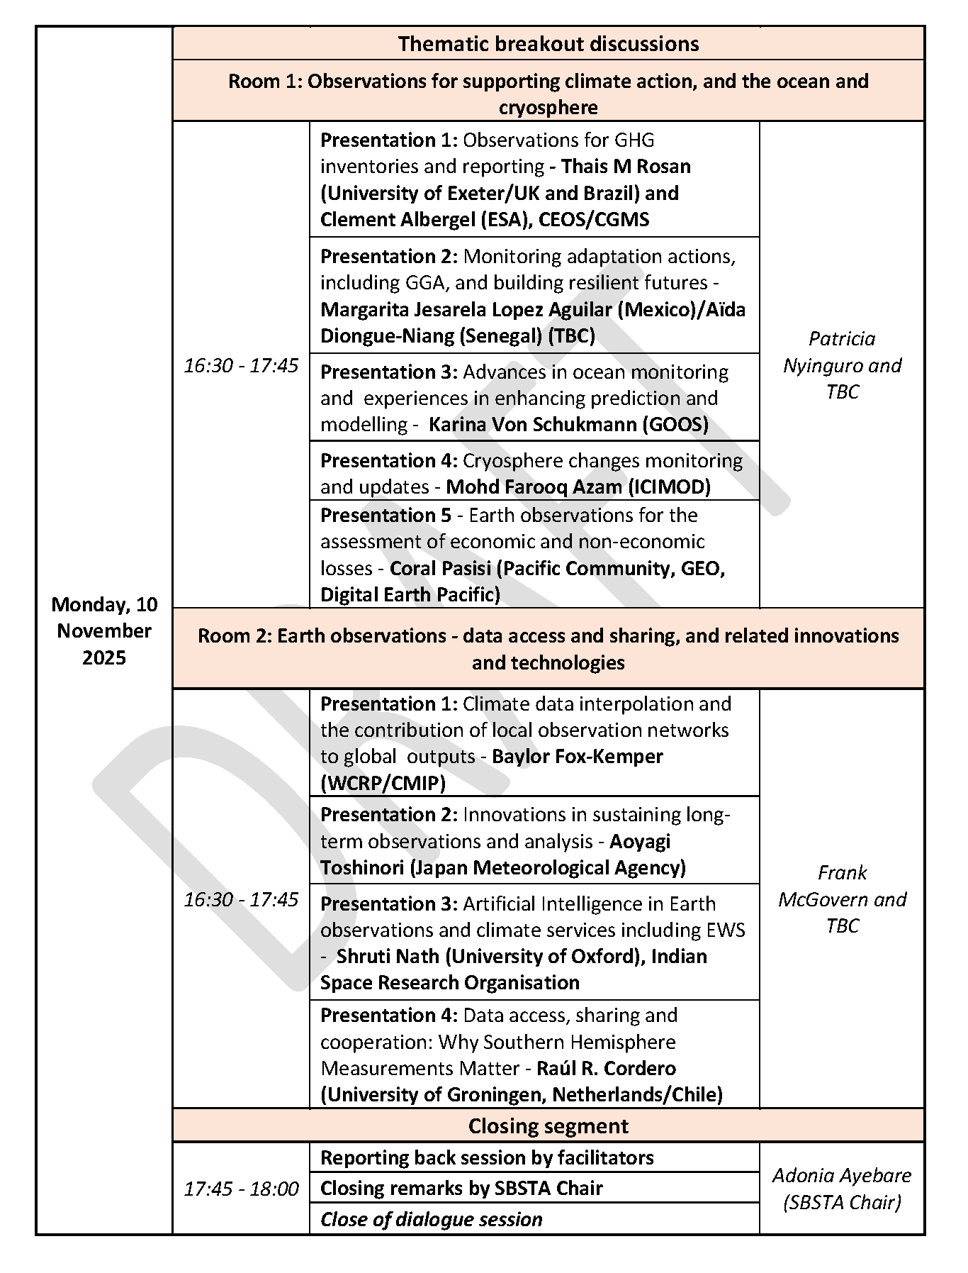
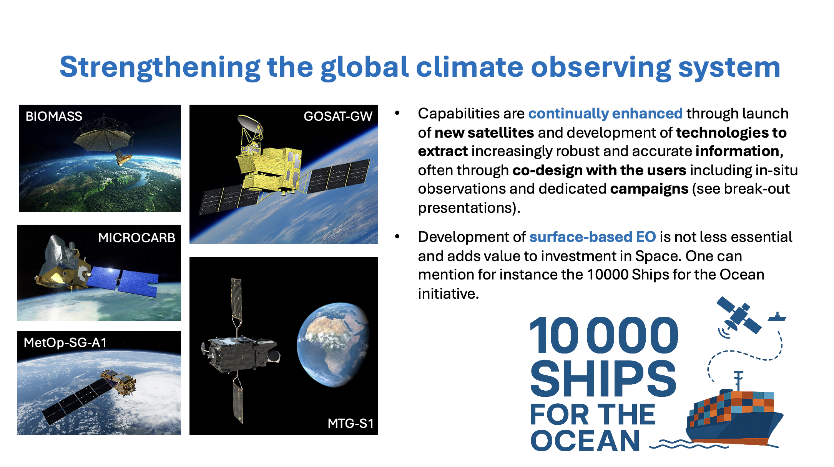
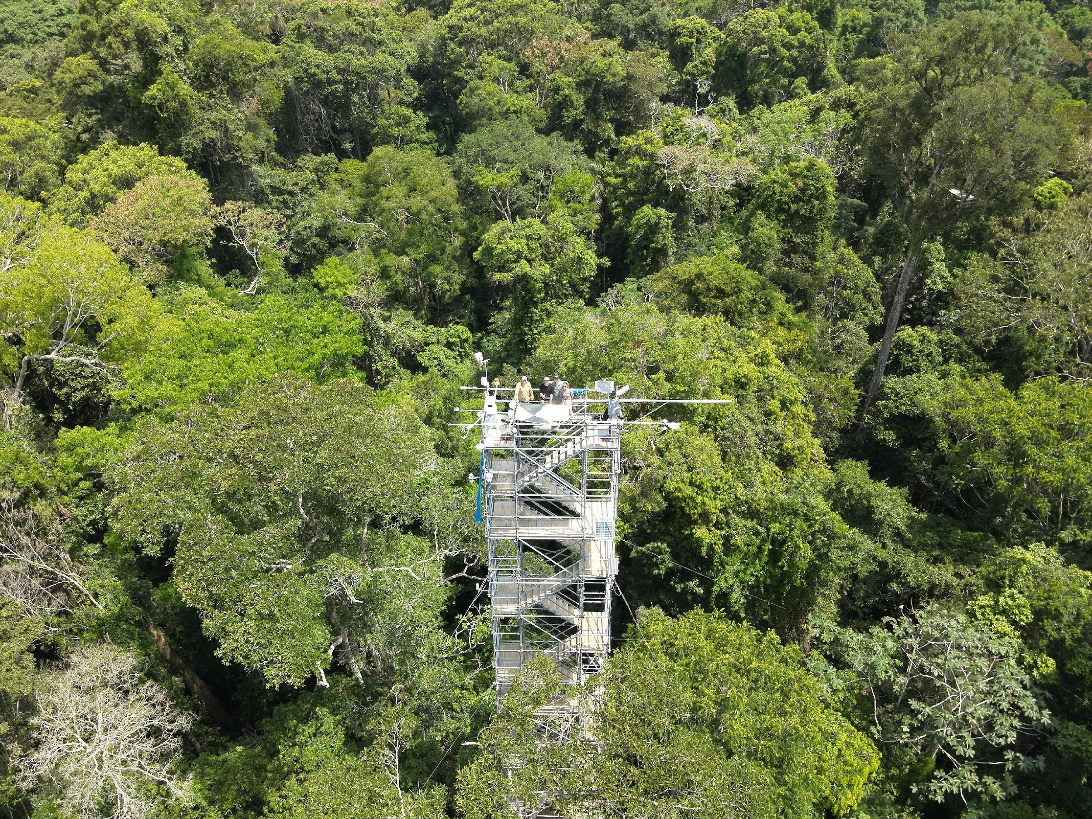
EID COP30 agenda
Plenary presentation joint with GEO and WMO/SOFF around closing data gaps

Slide 8
EID COP30 Belém
Challenging logistics did not allow for a poster session. UNFCCC secretariate looked into the possibility of a virtual poster session (like in COVID times), but it was too difficult for them. Possible suggestion to propose CEOS-CGMS to host in the future a virtual (or hybrid) poster session systematically as part of EIDs?
Much more limited in-person participation than in previous COP: reduced number of accreditations but also accessibility and availability/price of accommodation.
It is unclear how far taking decisions will be possible, depending on participation of Global South delegations particularly. COP30b needed?

Slide 9
Continuation of TT activities
Discussion at SIT Technical Workshop to include a plan for continuing activities beyond the lifetime of the TT (SIT-TW-2025-05)
To be fully discussed at WGClimate -24 (Feb. 2026)
However, from first exchanges:
TT are designed to be temporary
This TT was created within WGClimate in order to re-stimulate (after COVID…) and expand (new opportunities: e.g. GGA…) collaboration with UNFCCC secretariate, but activities are not fully new
Key task is to structure an annual plan ensuring consistent and strong engagement at COP, SBSTA and along UNFCCC work streams making it less dependent on individuals and somewhat scattered knowledge
TT could be disbanded with WGClimate taking on all non-temporary tasks : this is part of the discussion on WG Climate ToR update

