Slide 1
2025 CEOS Plenary
Status of EUMETSAT programmes
Phil Evans
Director-General
Bath, 5 November 2025

Slide 2
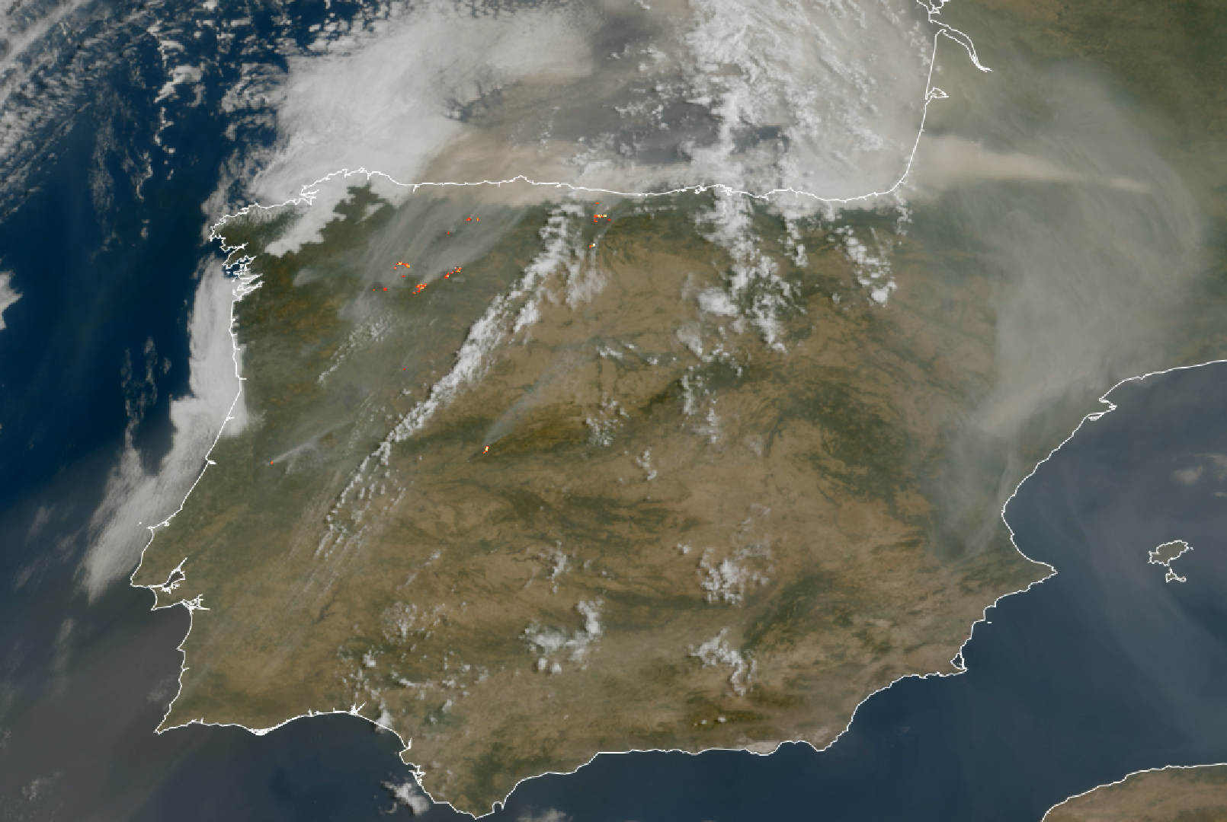
Meteosat-12 declared operational and delivers
Wildfires and storms over Spain as seen by Meteosat-12
Notes:
The first MTG satellite, Meteosat-12, is fully operational since December 2024
Meteorological Satellites made the news and were mentioned on political level: Following wildfires in France last summer, François Bayrou, then French Prime Minister, suggested establishing a satellite system to monitor the ground in other regions that may be affected by wildfires.
(https://www.midilibre.fr/2025/08/06/incendie-dans-laude-on-a-en-commande-deux-canadair-en-plus-annonce-francois-bayrou-a-nimes-12863886.php)

Slide 3

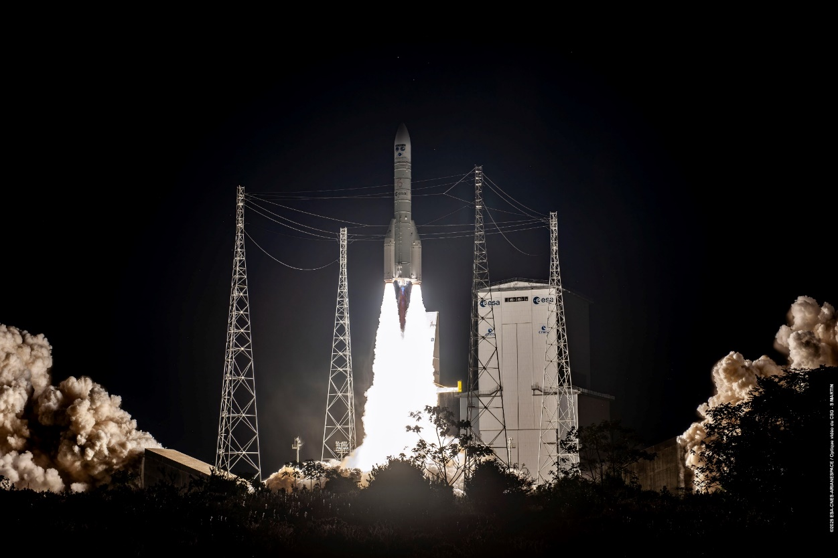
Two launches in 2025 showcasing European masterpieces
Europe is renewing its meteorologicql satellite infrastructure
European success stories born out of the cooperation with ESA and the European industry
Commissioning processes are going well
MTG-S1
Metop-SGA1

Slide 4




MTG-S1
Launched on 1 July 2025, it will provide vertical profiles of data throughout the atmosphere
It is Europe’s first GEO sounder satellite
Carries EU Copernicus Sentinel-4

Slide 5
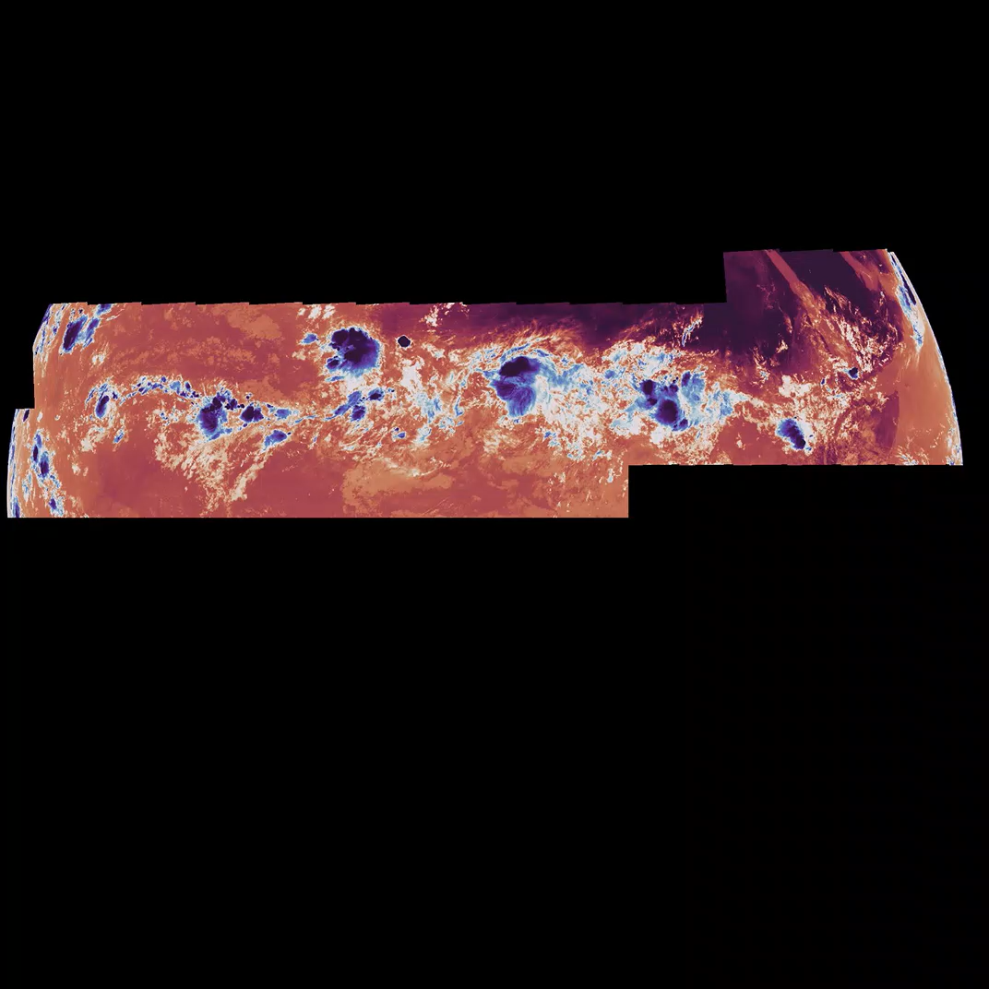

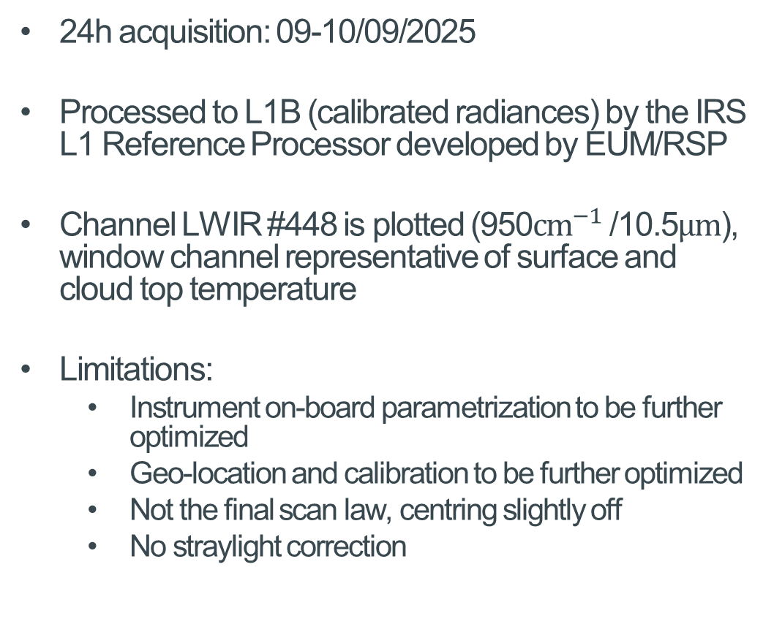
IRS Second light
LWIR: 950$cm^{−1}$ (channel #448)
24h acquisition: 09-10/09/2025
Processed to L1B (calibrated radiances) by the IRS L1 Reference Processor developed by EUM/RSP
Channel LWIR #448 is plotted (950${cm}^{−1}$/10.5$μm$), window channel representative of surface and cloud top temperature
Limitations:
  Instrument on-board parametrization to be further optimized
  Geo-location and calibration to be further optimized
  Not the final scan law, centring slightly off
  No straylight correction

Slide 6
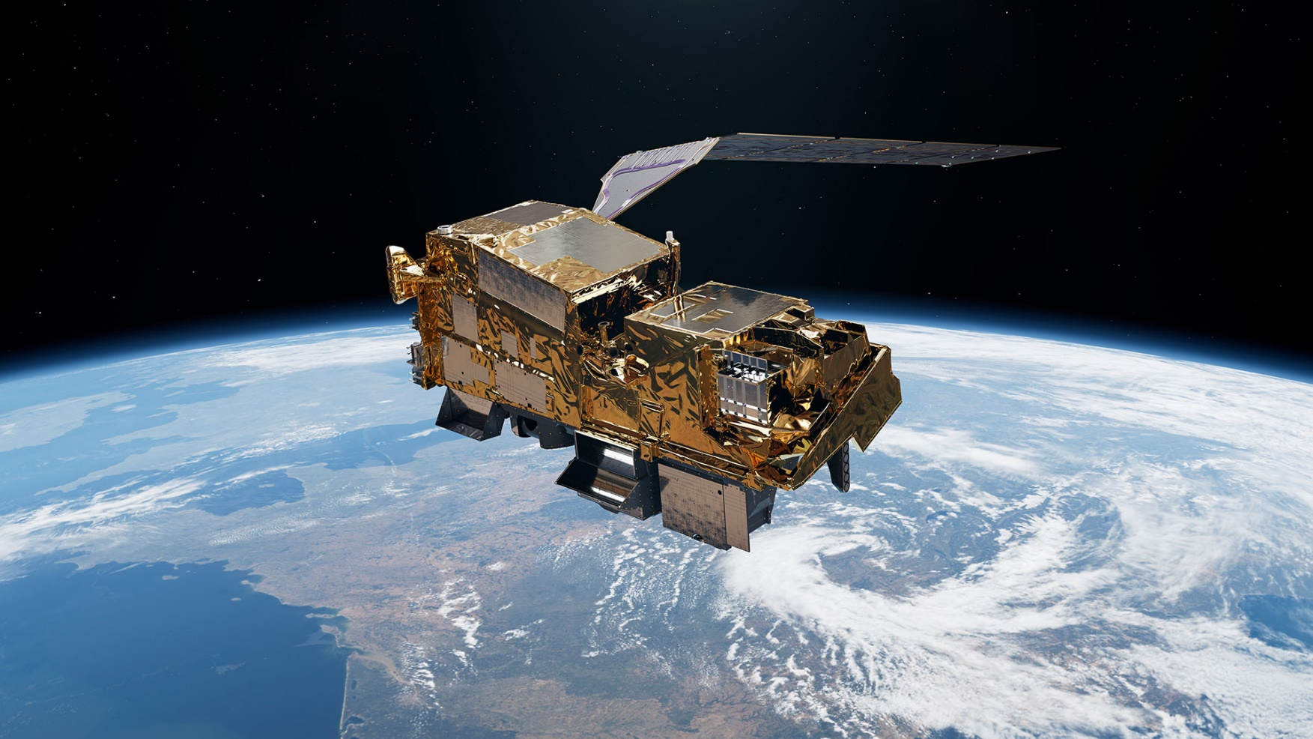

Metop-SGA1
Launched on 13 August 2025 on Ariane-62 , it is the first of the EPS-SG to be deployed and will enhance NWP models.
New 3MI instrument, first time ever on a polar orbit.
Carries EU Copernicus Sentinel-5
It is the first contribution to the IJPS with NOAA
Notes:
3MI delivers unprecedented details on aerosols, air pollution (air quality), and clouds

Slide 7
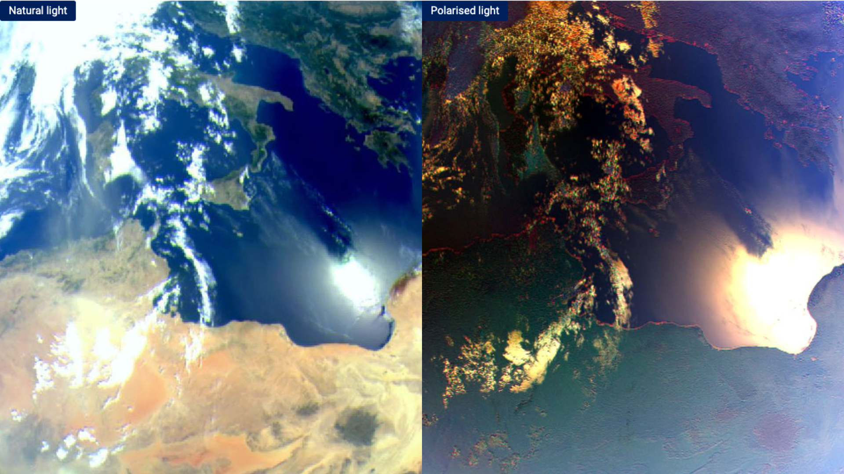
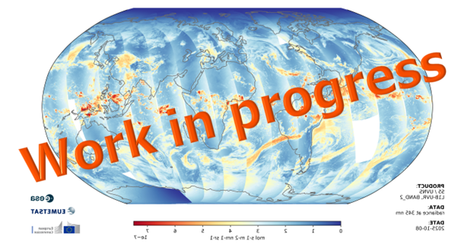
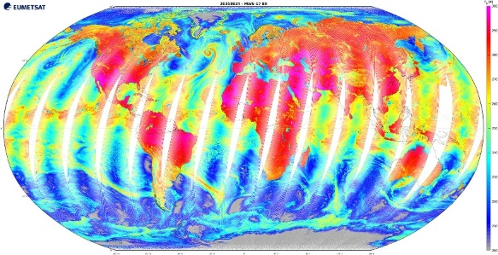

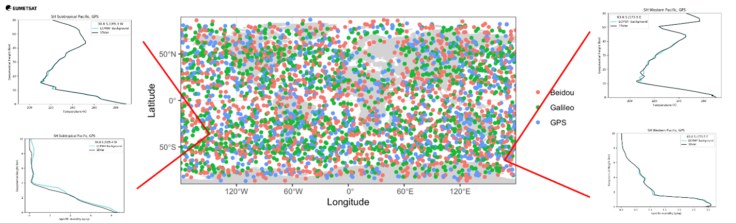
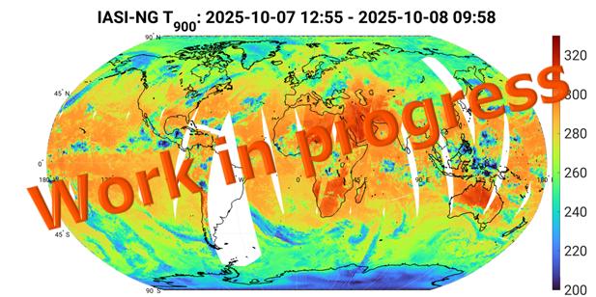
Metop-SGA1 Data Processing
L1
L2 (G/R)
MWS
3MI
Sentinel-5
METimage
RO
IASI-NG

Slide 8

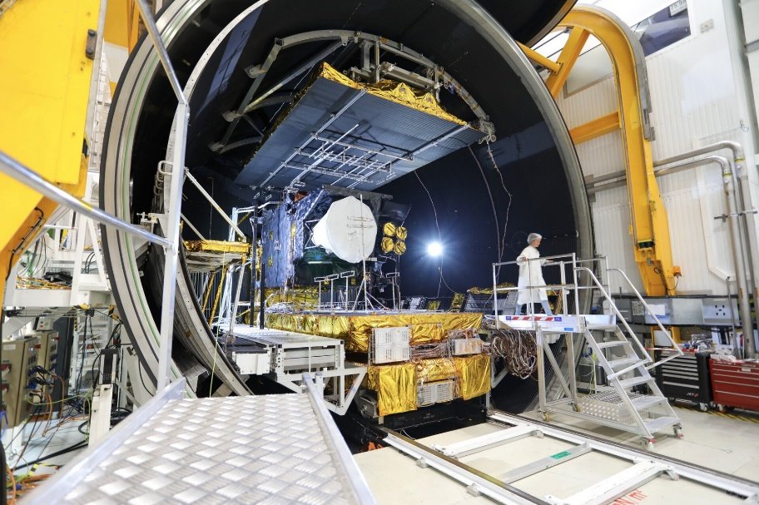

More launches to come!
Copernicus Sentinel 6B – 17 Nov 2025
  Europe-US collaboration – continuity of sea level monitoring
Metop-SG-B1 : Q3/2026
Sentinel-3C : Q3/2026
MTG-I2 : Q3/2026
CO2M-A : Q4/2026
MTG-I2 passed thermal vacuum test in September 2025

Slide 9
Continuation of commercial RO data purchases
Initial Pilot Project August 2022 – August 2024 provided valuable lessons
It was followed by a new contract until August 2026
The market is being constantly monitored for opportunities and risks
New call for tender planned in 2026 to secure continuity and reassess the market
In addition to radio occultation (RO), commercial microwave sounder (MWS) data quality is also considered

Slide 10
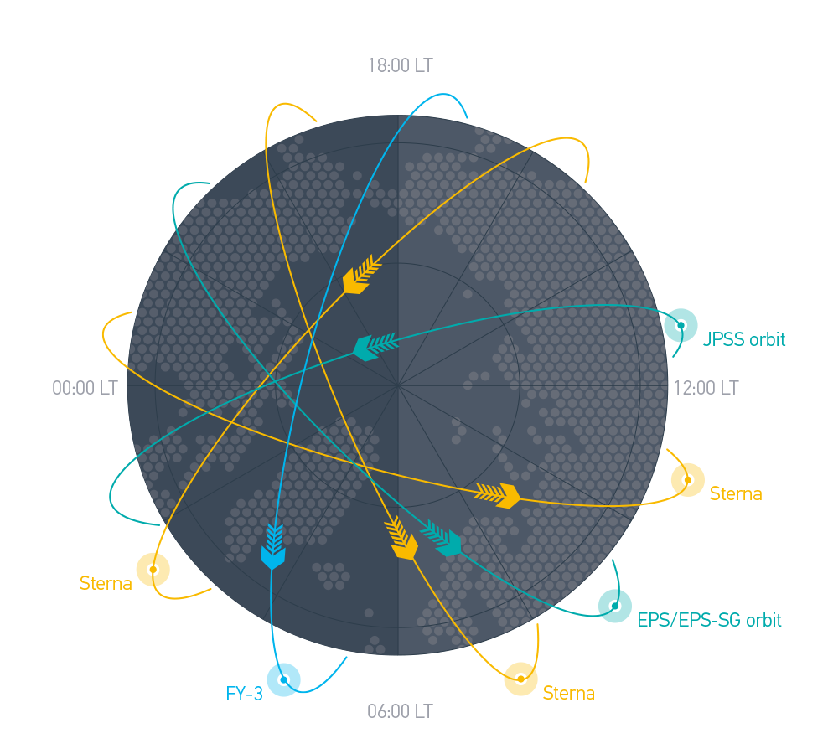
EPS-Sterna
A microwave sounding constellation in cooperation with ESA
Complementary to JPSS and FY-3 satellites
We are approaching the final stages of programme approval
Level of approval is > 80% (26/30 MS)

Slide 11
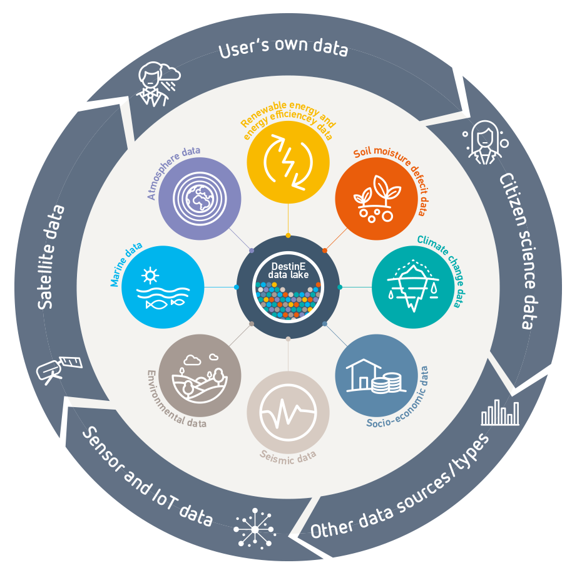
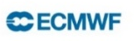

Destination Earth data lake
Self-standing component available from a large number of external data spaces or generated by the Destination Earth digital twins, regardless of data type and location.
Supports near-data processing to maximise throughput and service scalability.
Concepts applied will provide a harmonisation of data access beyond anything that currently exists.
Full production level status with all KPIs at green

Slide 12
Questions?

