Slide 1
CEOS Plenary 2025
UK Space Agency Annual update
Beth Greenaway, UKSA
Agenda Item #
39th CEOS Plenary
Bath, United Kingdom
4th - 6th November, 2025

Slide 2


UK Space Agency Merger
Notes:
Put this in, if preferred. Thought it was might be more brand-consistent.

Slide 3







TRUTHS
Traceable Radiometry Underpinning Terrestrial- and
Helio-Studies
Progress:
Space Segment: Preliminary Design Review was successful; confirming the performance of the mission - technologies were matured to TRL 6, next step was procurement of units.
Ground Segment: contract for phase B2 had started and was ready to achieve its first milestone by the end of this year.
Science studies: provided tests scenes for simulations, worked out the algorithms for processing data, and defined methods for calibration and accuracy determination.
Internationalisation/User engagement: ESA and the Mission Advisory Group widely shared the value of TRUTHS and its uses at international organisation like EUMETSAT, ECMWF and CEOS-BIPM. They visited national user communities in France, Germany, the Netherlands, Belgium and UK, collecting valuable inputs and received positive feedback about the value of the mission for climate science and operational users.
What next for TRUTHS ?
Funding constraints across UK government forces the next stage to stop
Work focused on wrap and reuse of capabilities developed.

Slide 4
The UKSA EO Programmes
Pre-technology development
Upstream activity
Midstream activity
Downstream activity
End user
EO Technology
Earth Observation Investment Package
The International Charter: Space and Major Disasters
EO Missions
UKSA Earth Observation team
EO Data and ground segments
ESA Programmes
Copernicus
Climate – SCO, Space 4 Climate, CEOS

Slide 5


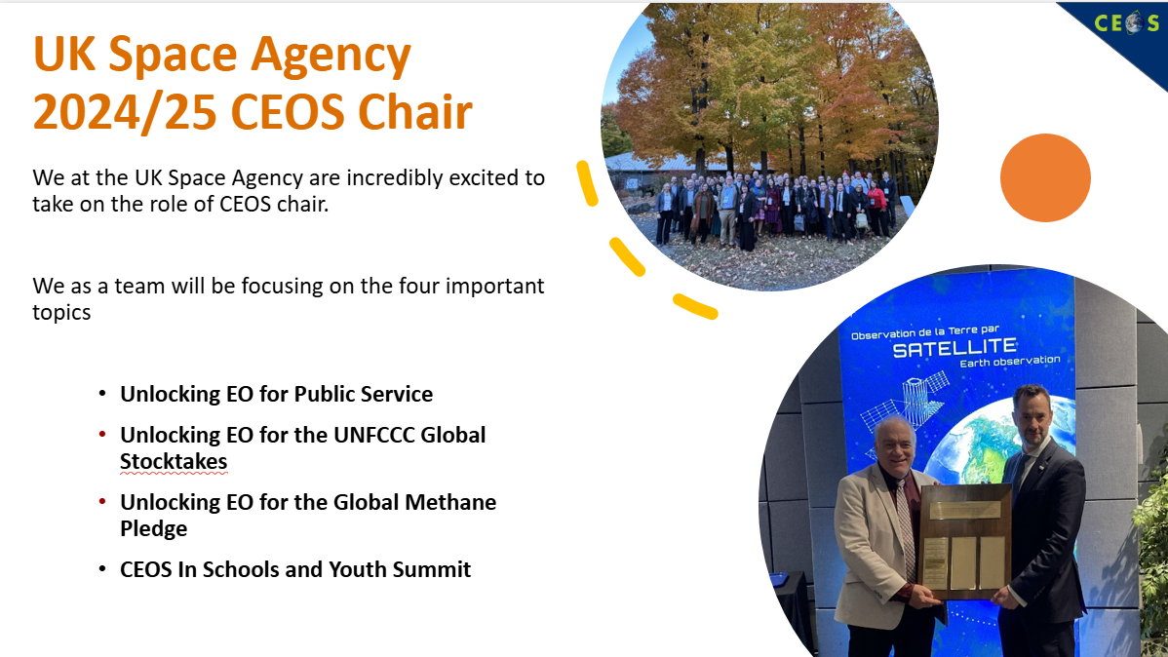
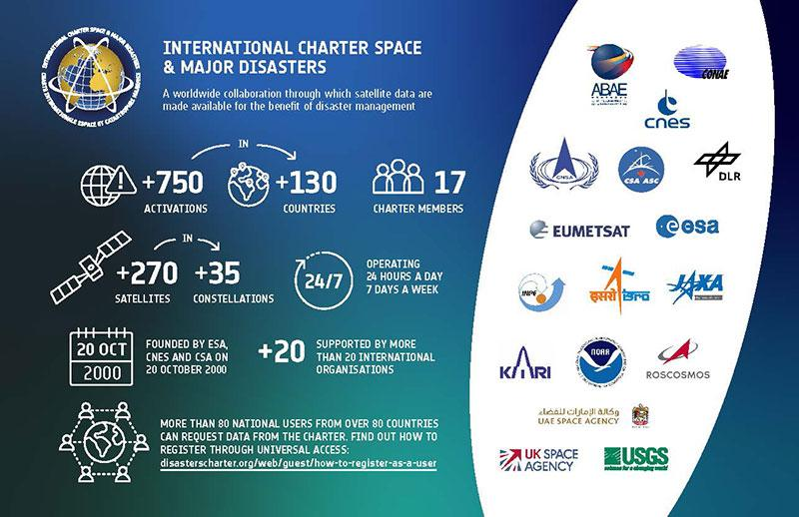
International Partnerships
2024/25 CEOS Chair
Disasters Charter
Notes:
‹#›

Slide 6
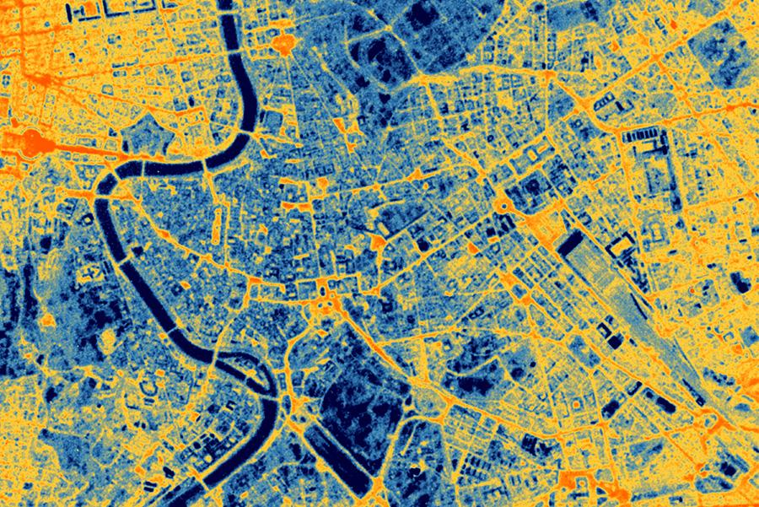
Copernicus
UK working to maximise industrial and data benefits from Copernicus participation
First UK Copernicus Contributing Mission (emerging provider) for VHR thermal imaging
UK able to contribute again to the Copernicus Services component – e.g. UK Met Office, NPL etc. have secured multiple contracts in the Climate Change and Marine Services.
Numerous Sentinel launches this year
High resolution thermal imaging from SatVu's 'HotSat' mission – now part of CCMs.

Slide 7
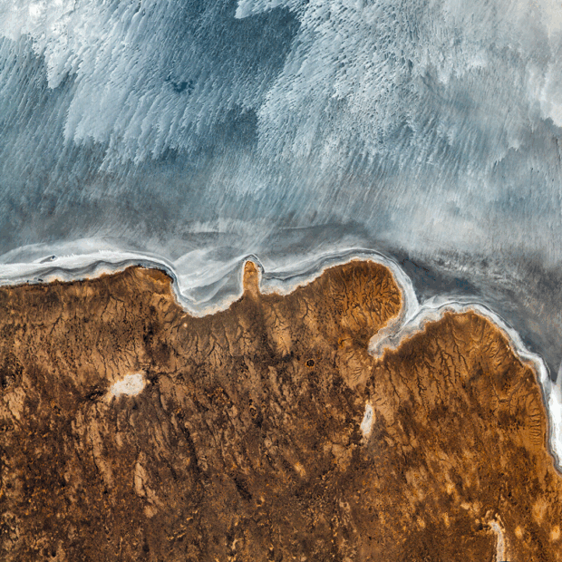

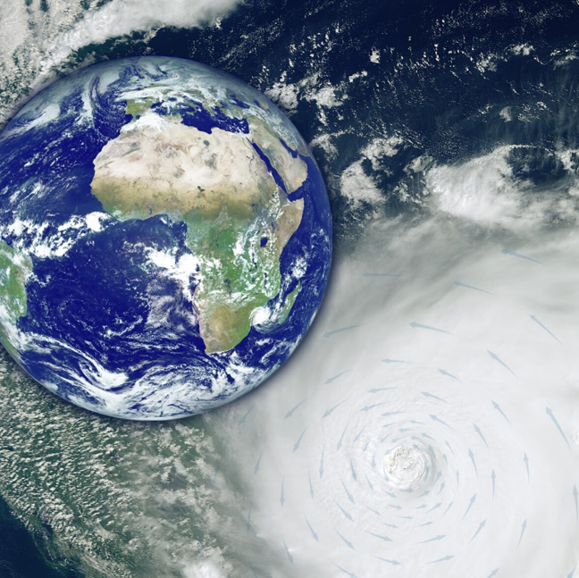
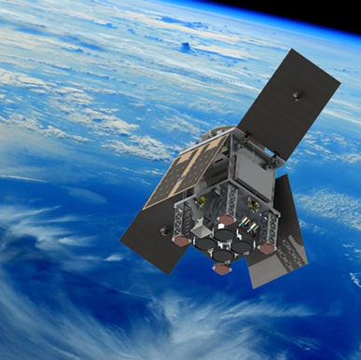





The UK in ESA: Highlights
MANTIS InCubed mission deorbited in Oct 25 after a successful mission.
Digital Twin Earth developing components for societal impact. Many UK roles
WIVERN approved by the 11th Earth Explorer. UK PI first to ever lead 2 EEs.
HydroGNSS First Scout mission launching in Nov 25. Small , quick mission of science quality and rigour.
Notes:
MANTIS: Developed by Open Cosmos, MANTIS was the first satellite mission to be funded from concept to launch through ESA’s commercial InCubed programme. MANTIS is a 12U nanosatellite to deliver high-resolution multispectral imagery and onboard AI processing for sectors like energy and mining.
DTE: Creates virtual replicas of Earth’s systems by integrating satellite data, AI, and advanced modelling to monitor, simulate, and predict environmental changes for informed decision-making and sustainability. This work is broadening user engagement, supporting developer collaboration, and enhancing the integration of EO data into other areas. Significant UK success in DTE so far, with Argans Ltd, Earthwave Ltd, BGS and several UK universities successful in bids for Digital Twin Component projects such as Ice sheets and Coastal Processes. The work also goes beyond UK, collaborating on projects in Greenland and Svalbard.
HydroGNSS: This is the first Scout mission in FutureEO and was led by UK-prime SSTL. HydroGNSS is two small satellites that uses GNSS reflectometry to measure hydrological climate variables—such as soil moisture, freeze–thaw over permafrost, inundation/wetlands, and above‑ground biomass.
WIVERN: Has major UK contributions, including concept proposal by Anthony Illingworth at University of Reading. WIVERN will fly a conically scanning 94 GHz Doppler cloud radar to provide the first global measurements of winds inside clouds while also profiling cloud and precipitation structure to improve weather forecasts and climate research. CAIRT also recognised for the quality of the work and scientific excellence.

Slide 8


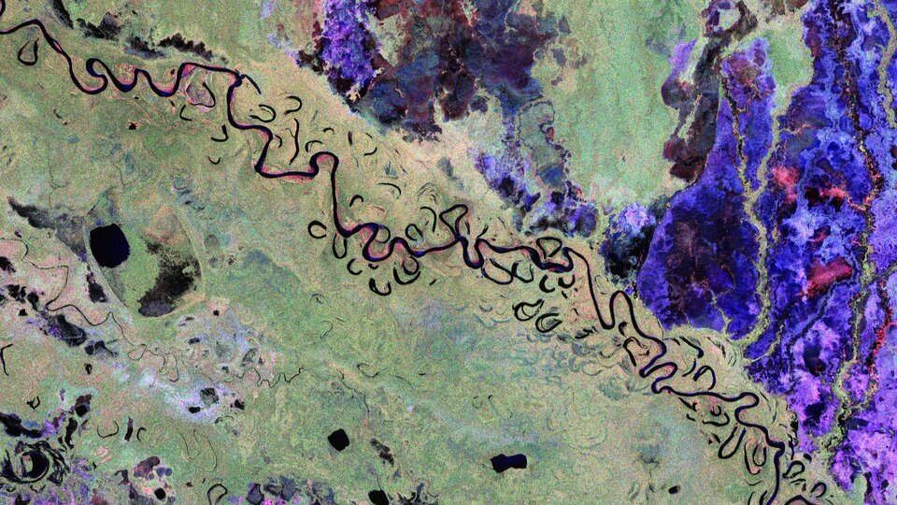
Biomass (ESA Earth Explorer)
Biomass is a fantastic example of UK France science lead, and UK built ESA mission
Successfully launched on 29th April 2025
At the Living Planet Symposium, the first images– marking a major step forward in our ability to understand how Earth’s forests are changing and exactly how they contribute to the global carbon cycle.
This image captures the forests and landscapes of Bolivia, while other available images are already revealing the potential to unlock new insights into some of Earth’s most extreme environments.

Slide 9

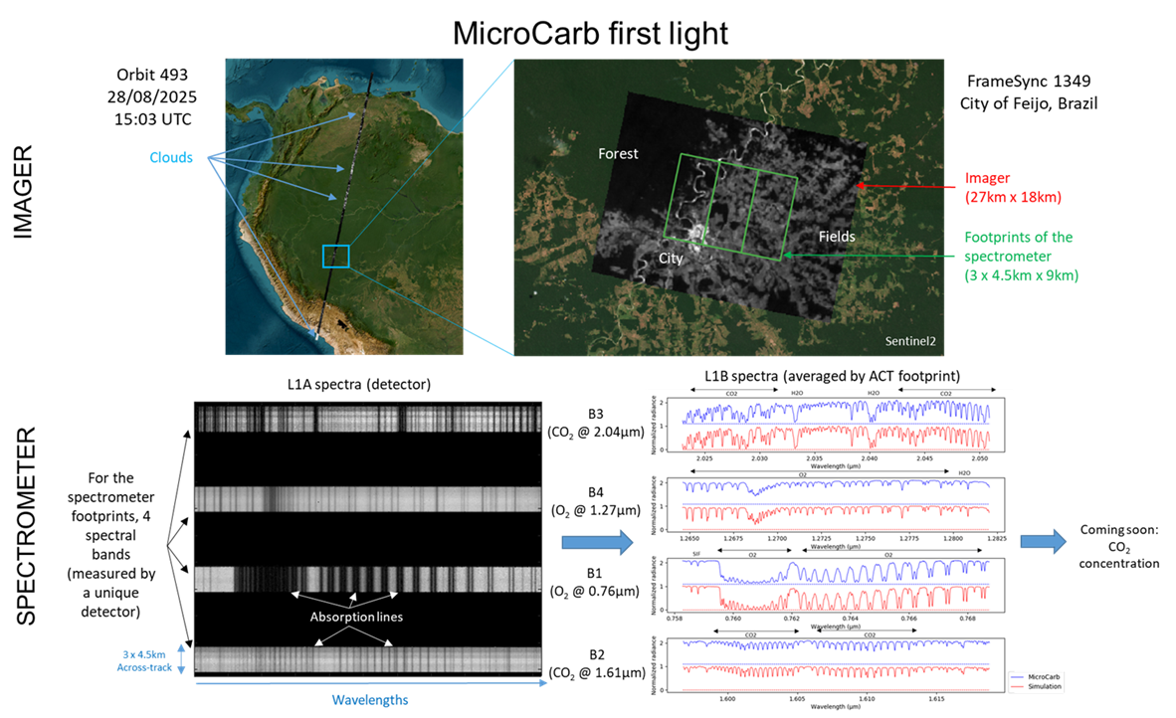
Missions: MicroCarb
Successful CNES UKSA partnership. First observation acquired over the Amazon on August 28th
The images indicate that the satellite is on track to achieving its objectives, including…
Measuring Solar Induced Fluorescence (SIF), a faint glow plants give off during photosynthesis, that can provide key information on the carbon cycle (led by University of Leicester)

Slide 10
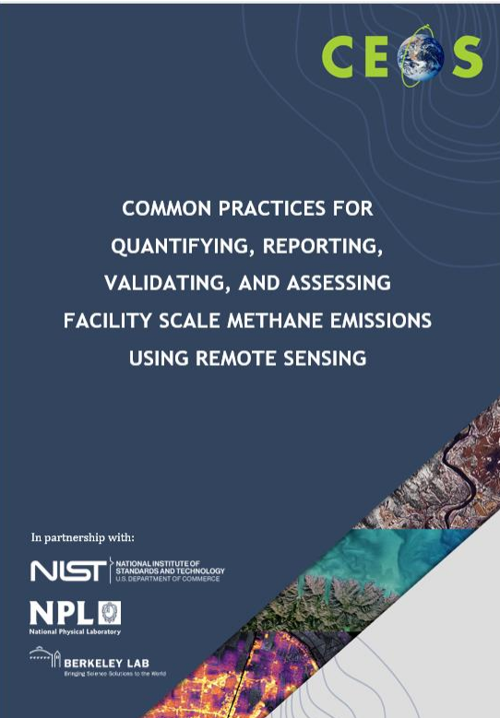
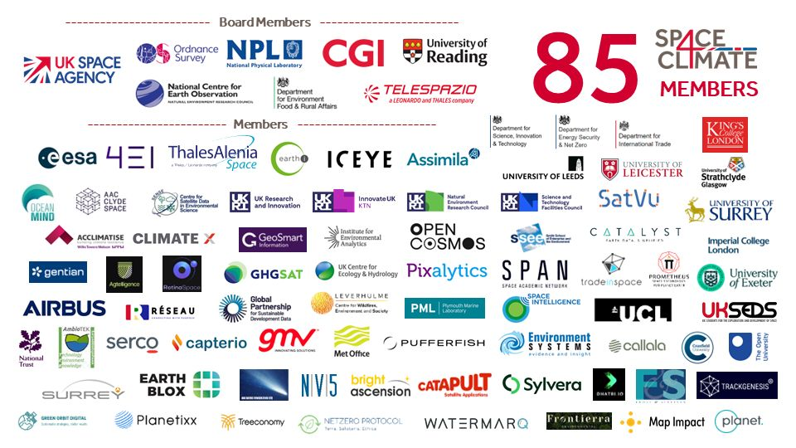
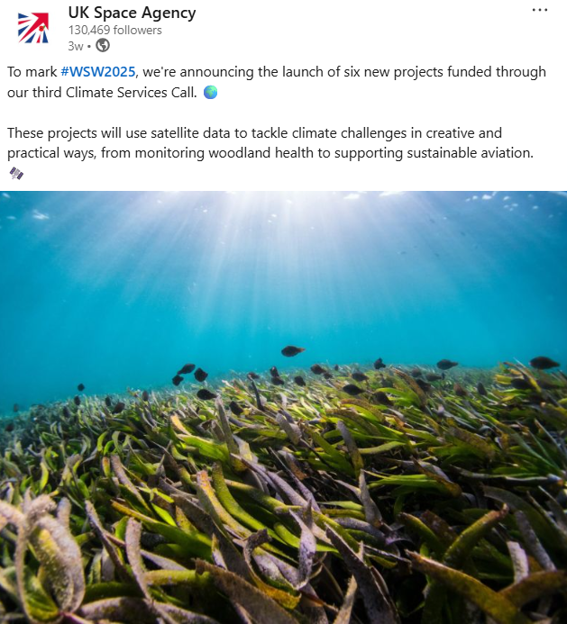

Climate Programme
Methane Best Practice
Space 4 Climate network
Led the CEOS Common practice development and implimentation
UK’s Space4Climate network – breaking into new markets
UKSA 3rd climate services call- 6 Projects funded
UKSA Funded Methane data deal for Government and IMEO use
Notes:
‹#›

Slide 11
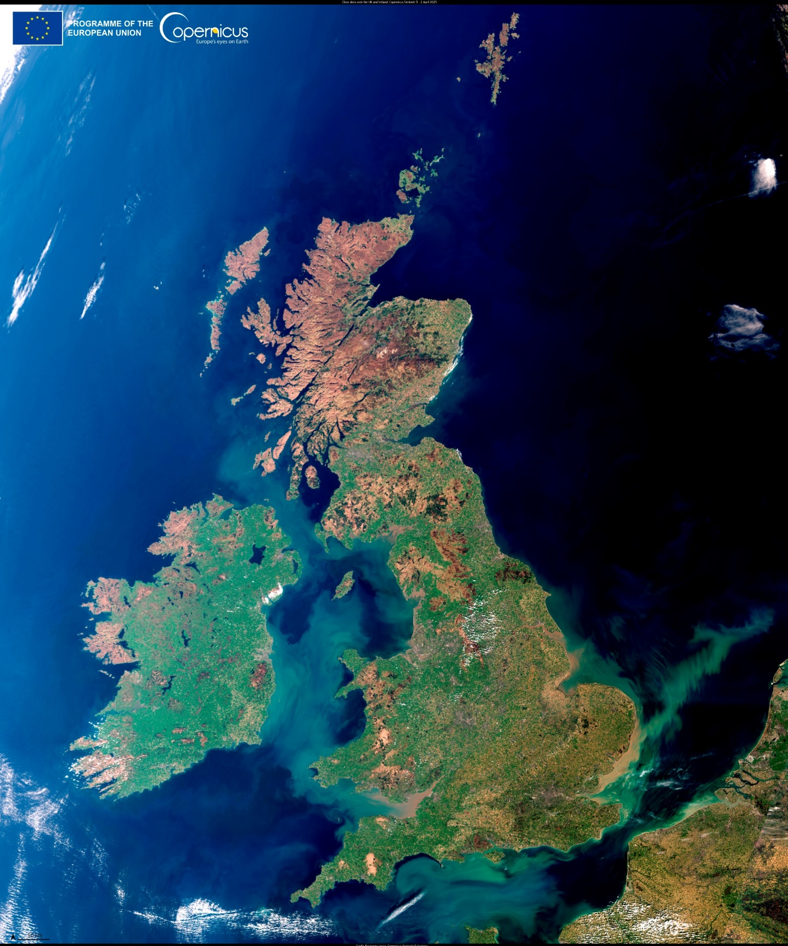





Fostering Innovation: InCubed-2 and Public Sector EO National call
Geospatial Ventures – CORE: Improving infrastructure monitoring.
Clyde Space – THICKET: A biodiversity mapping tool for agriculture.
Earth-i – FANTOM: EO analytics for land use, supporting the Rural Payments Agency.
HR Wallingford – EO4Biodiversity: Enhancing biodiversity net gain monitoring.
GHGSat UK – Emissions Watch Service: Satellite-based methane tracking.
Notes:
‹#›

Slide 12
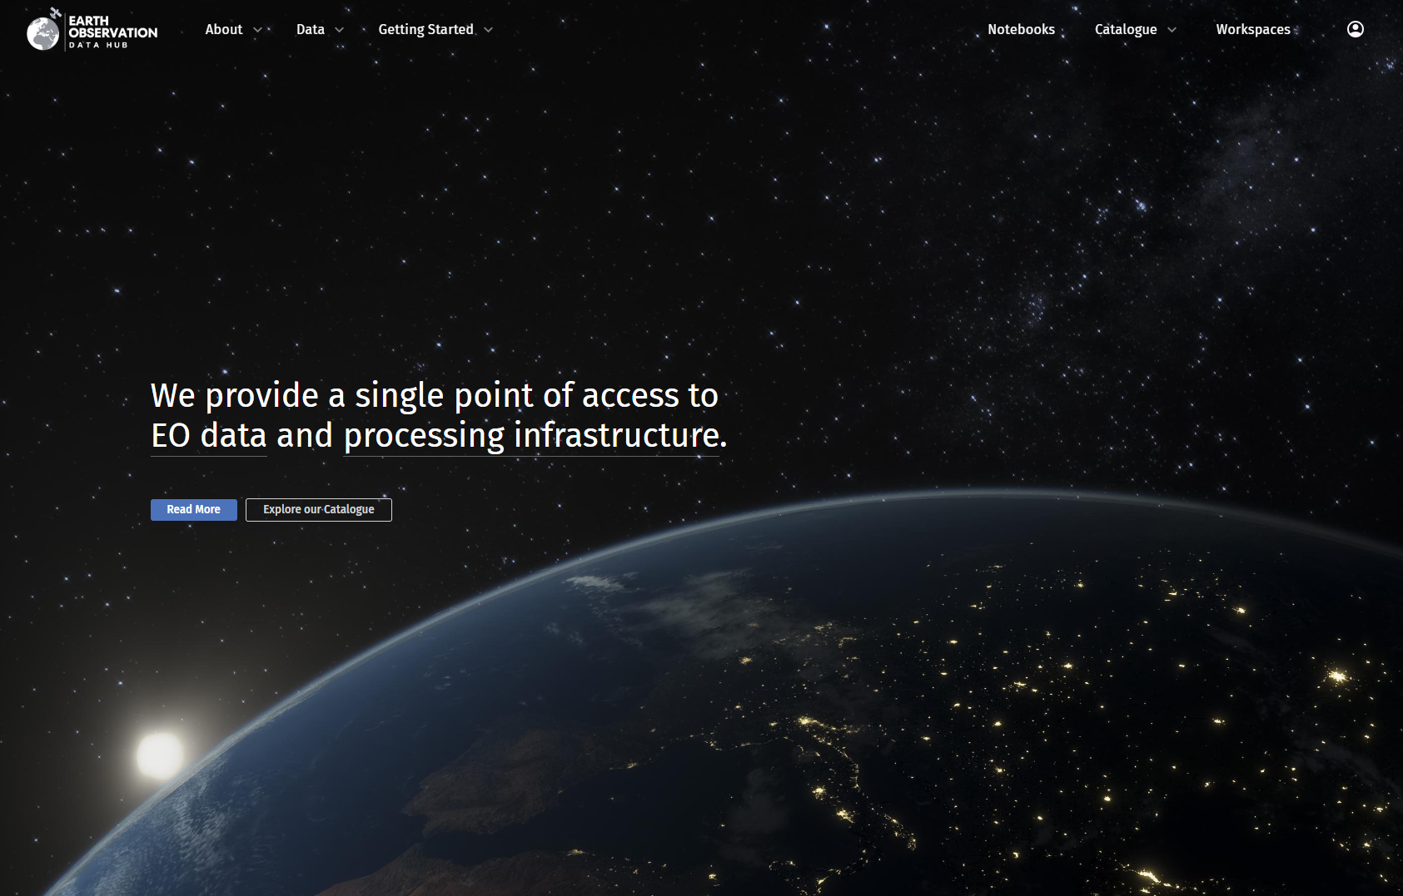
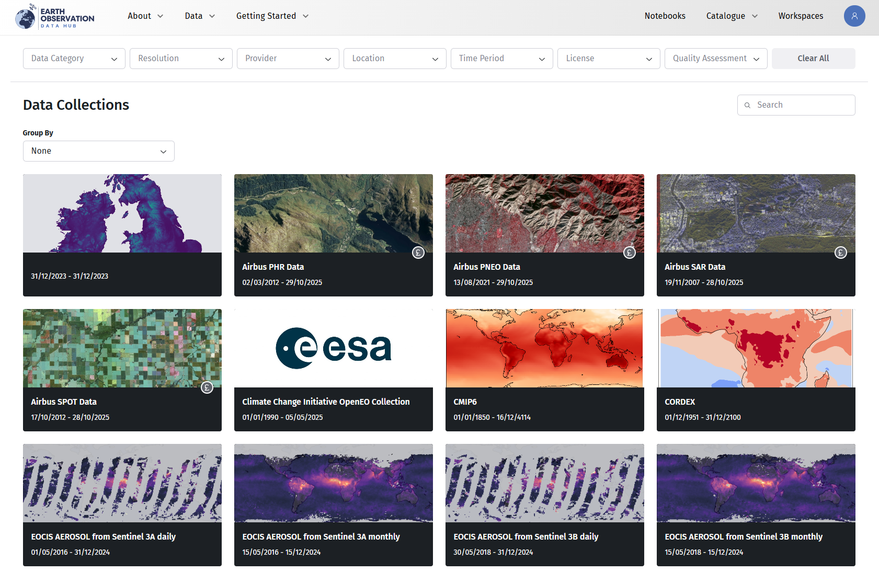
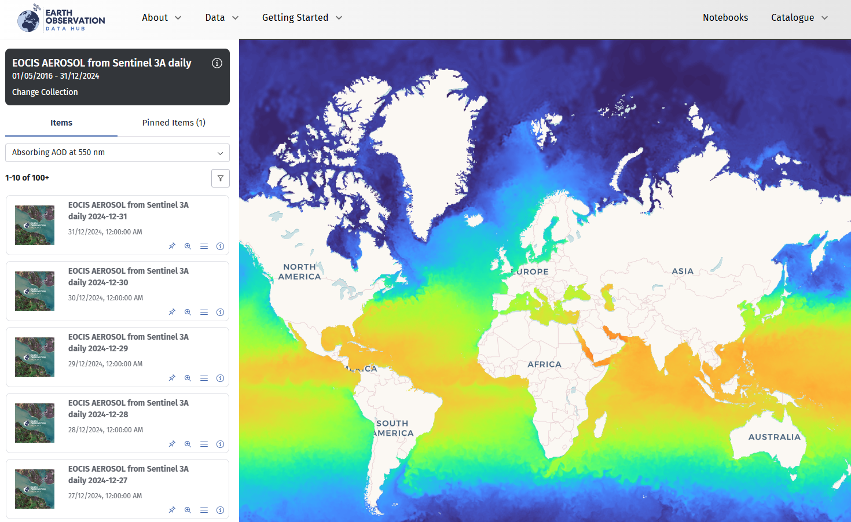









UK EO Data Hub – phase 2
Single point of access to EO Data
Multiple data sources including commercial
Example of hub from user viewpoint
Notes:
After a successful pathfinder phase, UKSA is funding NERC and NCEO to roll out phase 2 of the EO Data Hub, the UK’s innovative data and analysis platform, to users from academia, government and business.
On the slide you can see the partners helping to deliver the Hub, and some real examples of the Hub from a user’s perspective.
It’s providing EO experts and non-experts with easy access to EO data from a range of sources including commercial missions, supporting effective decision-making for economic growth and climate-monitoring.

Slide 13

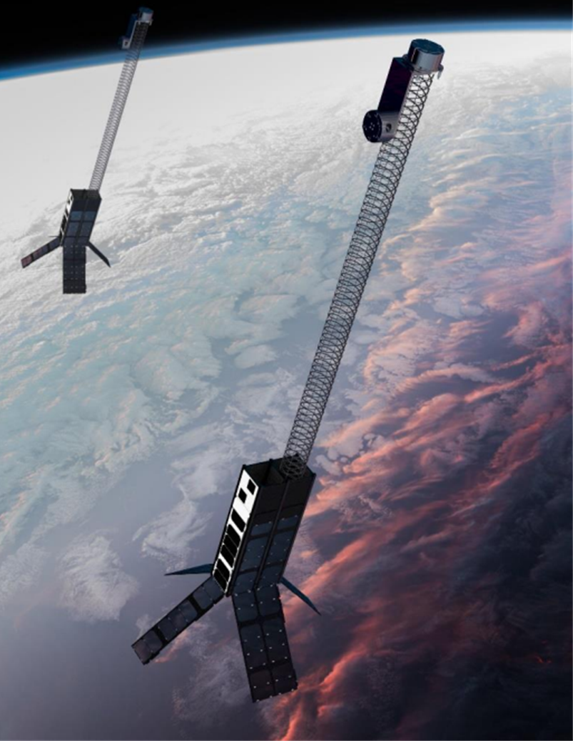
National technology support
25 CEOI technology projects concluded, including 6 Flagships
10 CEOI technology projects are currently underway
18 researchers have enrolled in the CEOI Creative Ideas Lab
Atlantic Constellation ‘Pathfinder’ satellite
A new national EO Technology Strategy being developed
HMSWI Mockup. Credit: STFC RAL Space
Notes:
Over the past year CEOI successfully concluded 25 projects, including 6 large flagships
This year there are 10 projects overall, along with an exciting new Creative Ideas Lab for supporting new and innovative early instrument concepts
The Agency has also supported the Atlantic Constellation Pathfinder with Open Cosmos, the lead satellite in a proposed international constellation of satellites for monitoring climate and natural disasters
In conjunction with CEOI we are developing a new strategy for EO technology in the UK for the next few years

Slide 14

Other UKSA Programmes
Earth Observation activities are being funded through other UK Space Agency national and international programmes e.g.
Unlocking Space for Business:
7 projects use EO for Financial Services and Transport & Logistics
International Bilateral Fund:
EO projects include Forestry Monitoring through UK-Canada Space Collaboration, as well as addressing global water quality challenges through AquaWatch-AUK
National Space Innovation Programme:
10 successful NSIP projects receiving a combined £14m in grant funding since 2023. In Call 1, Super-Sharp Space System's development of an in-orbit unfolding TIR telescope for climate change (Call 2 announcement in December)
Business Applications and Space Solutions Programme (BASS) programme
5 EO projects supported in 2025. Applications range across energy assets, agriculture, biodiversity, and climate

Slide 15



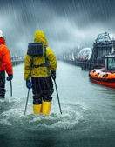

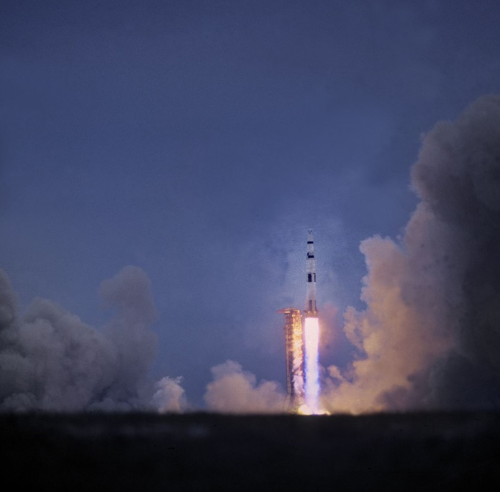
EO Vision for the Future ….....
‘ One government approach’
Notes:
‹#›

