Slide 1
Notes:
The Netherlands is a small country with big challenges, rising seas, subsiding cities and the urgent need for climate action. But it is also a country with big solutions. By combining our knowledge, innovation and space technology, we turn these challenges into opportunities. Driven by science the Netherlands has always been at the forefront in space, being one of the founders of ESA.

Slide 2
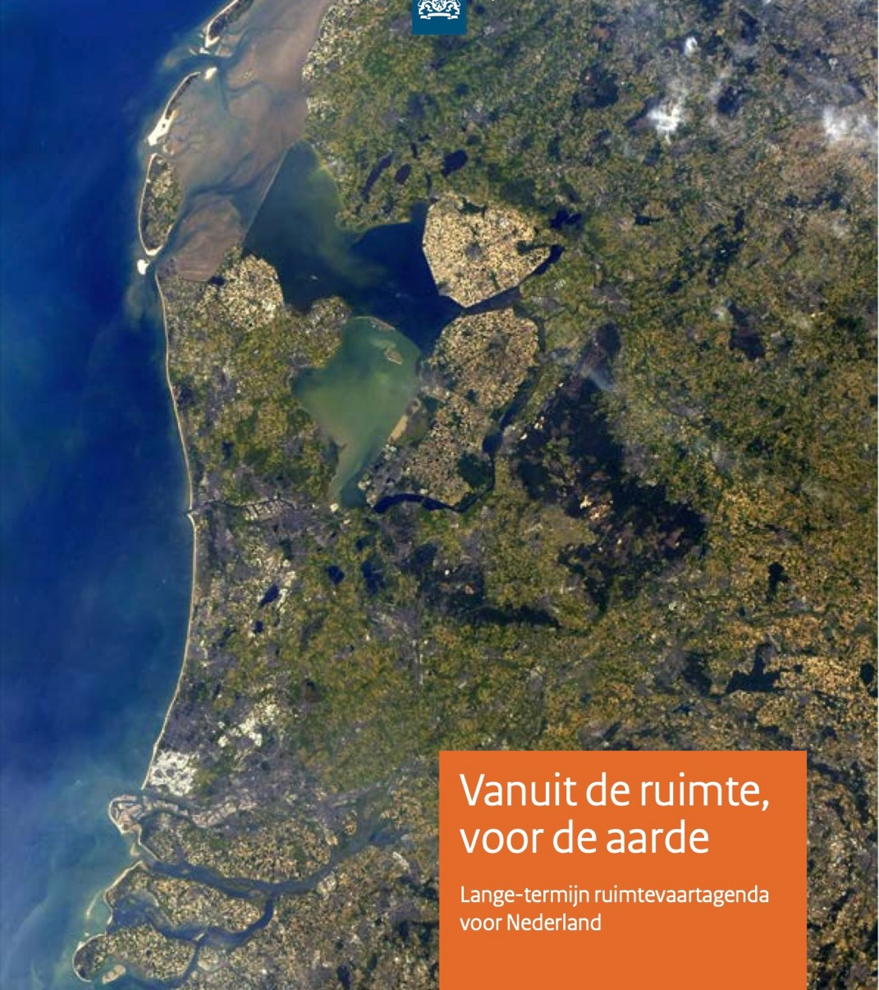






Long Term Space Agenda - Missions
Safety, Security and Autonomy
Climate and Environment
Science and Instruments
Satellite data for Societal Challenges
Economic growth
International Legal Frameworks
Notes:
Key in the space policy of the Netherlands is the Long Term Space Agenda, addressing 6 missions our policy targets.

Slide 3
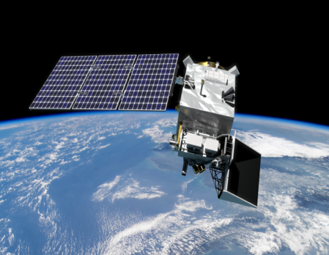
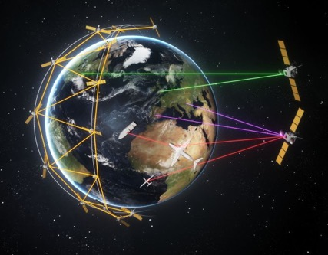
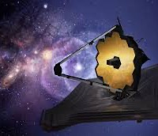
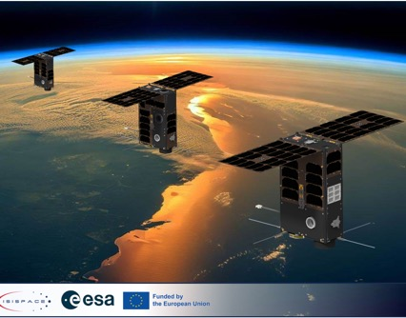
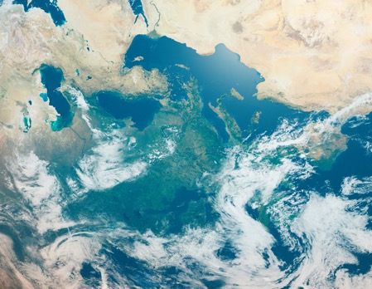
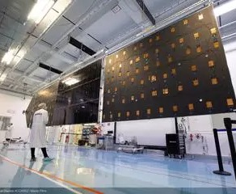
Technology focus of The Netherlands
Atmospheric Monitoring
Secure connectivity
Space Research instruments
Miniaturisation and smallsats
High-end equipment
Satellite Applications
Notes:
Thinking of the strengths of the Dutch space sector, you can think of a couple of areas: atmospheric monitoring, Space Research, Satellite Applications, Optical satcom, Small Sats, Solar Arrays. Let me highlight some concrete examples of where Dutch companies and institutes excel in the next slides.

Slide 4
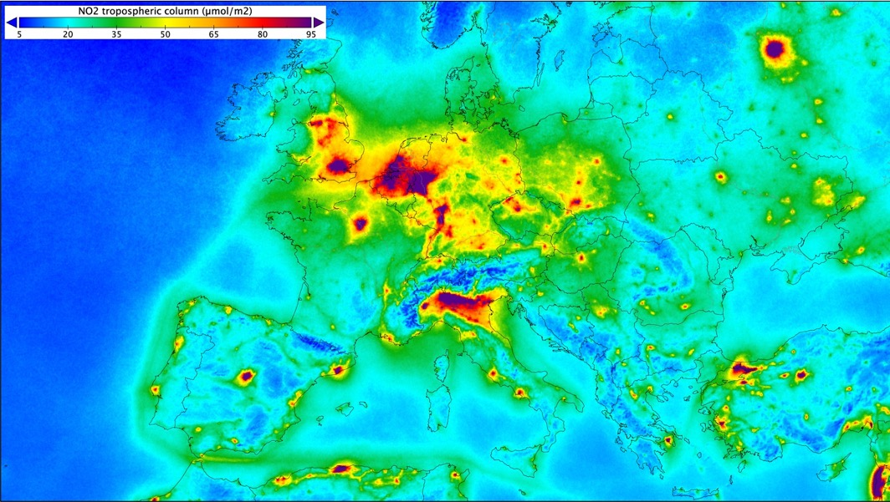
Instrumentents:
Atmosphere heritage
Sciamachy
  GOME
OMI
TROPOMI
  Sentinel-5
SpexOne
Tango

Slide 5
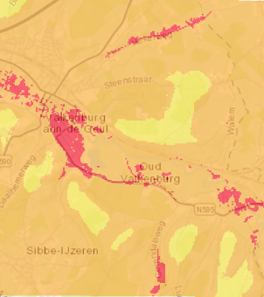
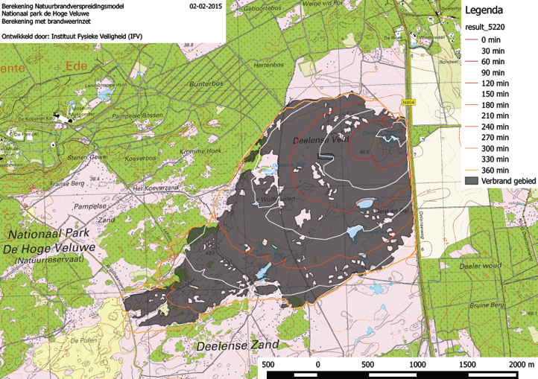
Activities in EO
EO Council for consensus Earth Observation strategy
Focus on articulation of user needs
Early technology national
  KNW: Water, air quality, Radar for argriculture, miniaturised SAR
  IIC: biodiversity, contruction inspection, landscape elements
Instrument early development
  EarthInspect: NH₃ inventory
  Alticubes: swarm of cubesat radar altimeters
Study of user needs
  New data not highest priority!
  Better use of existing data
  Integrations of models, ARD
Study of obstacles
  Gap analysis not sufficient!
  Legal, organisational, personal causes

Slide 6
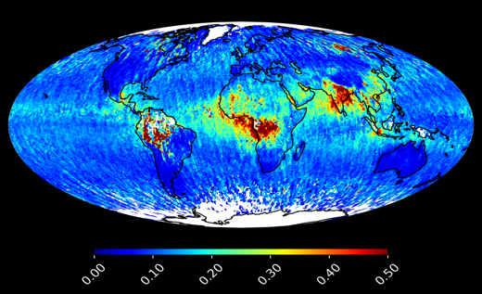
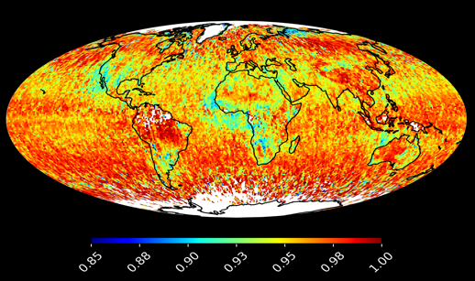
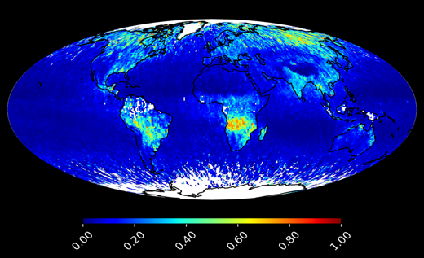
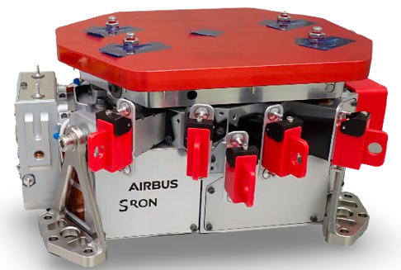
SPEXone-Second Generation spectro-polarimeter
Copy of SPEXone for PACE, but wider swath & coarser resolution/sampling
Able to ensure continuity of unique PACE-SPEXone data, demonstrated exceptionally high-quality data and value for climate and air-quality research
Built and calibrated, in storage at AirBUS NL. Exploring partnerships!
High potential in synergetic combination with other instrument data products (atmospheric correction, aerosol-cloud interactions, air-quality)
Level 1 products:
  Spectral radiances and degree of linear polarization
  (DoLP) at 385-770 nm
  5 viewing angles with ~265 km swath
  100 km² nominal resolution
Mass | 10.2 kg
Envelop | 440 x 157 x 285 mm
Power | 18.6 W, 22.2 W peak
Data rate | 22 Mbps peak
Aerosol optical depth
Reflective aerosols
Level 2 products:
  Aerosol loading (optical depth)
  Unique, high-quality information on
    size, composition, absorption,
    altitude, cloud condensation nuclei
  Cloud masking and cloud properties
  Land and sea surface properties
  Uncertainty quantification
Non-absorbing (in)organic

Slide 7

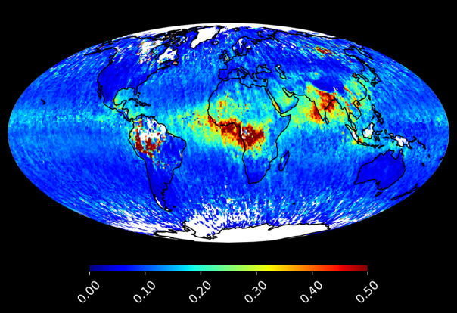
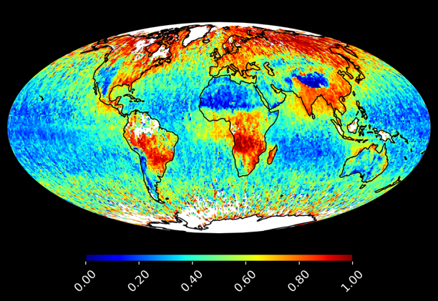
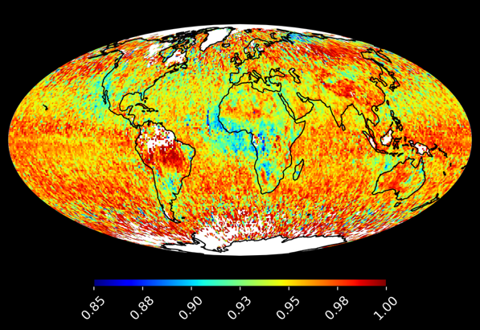
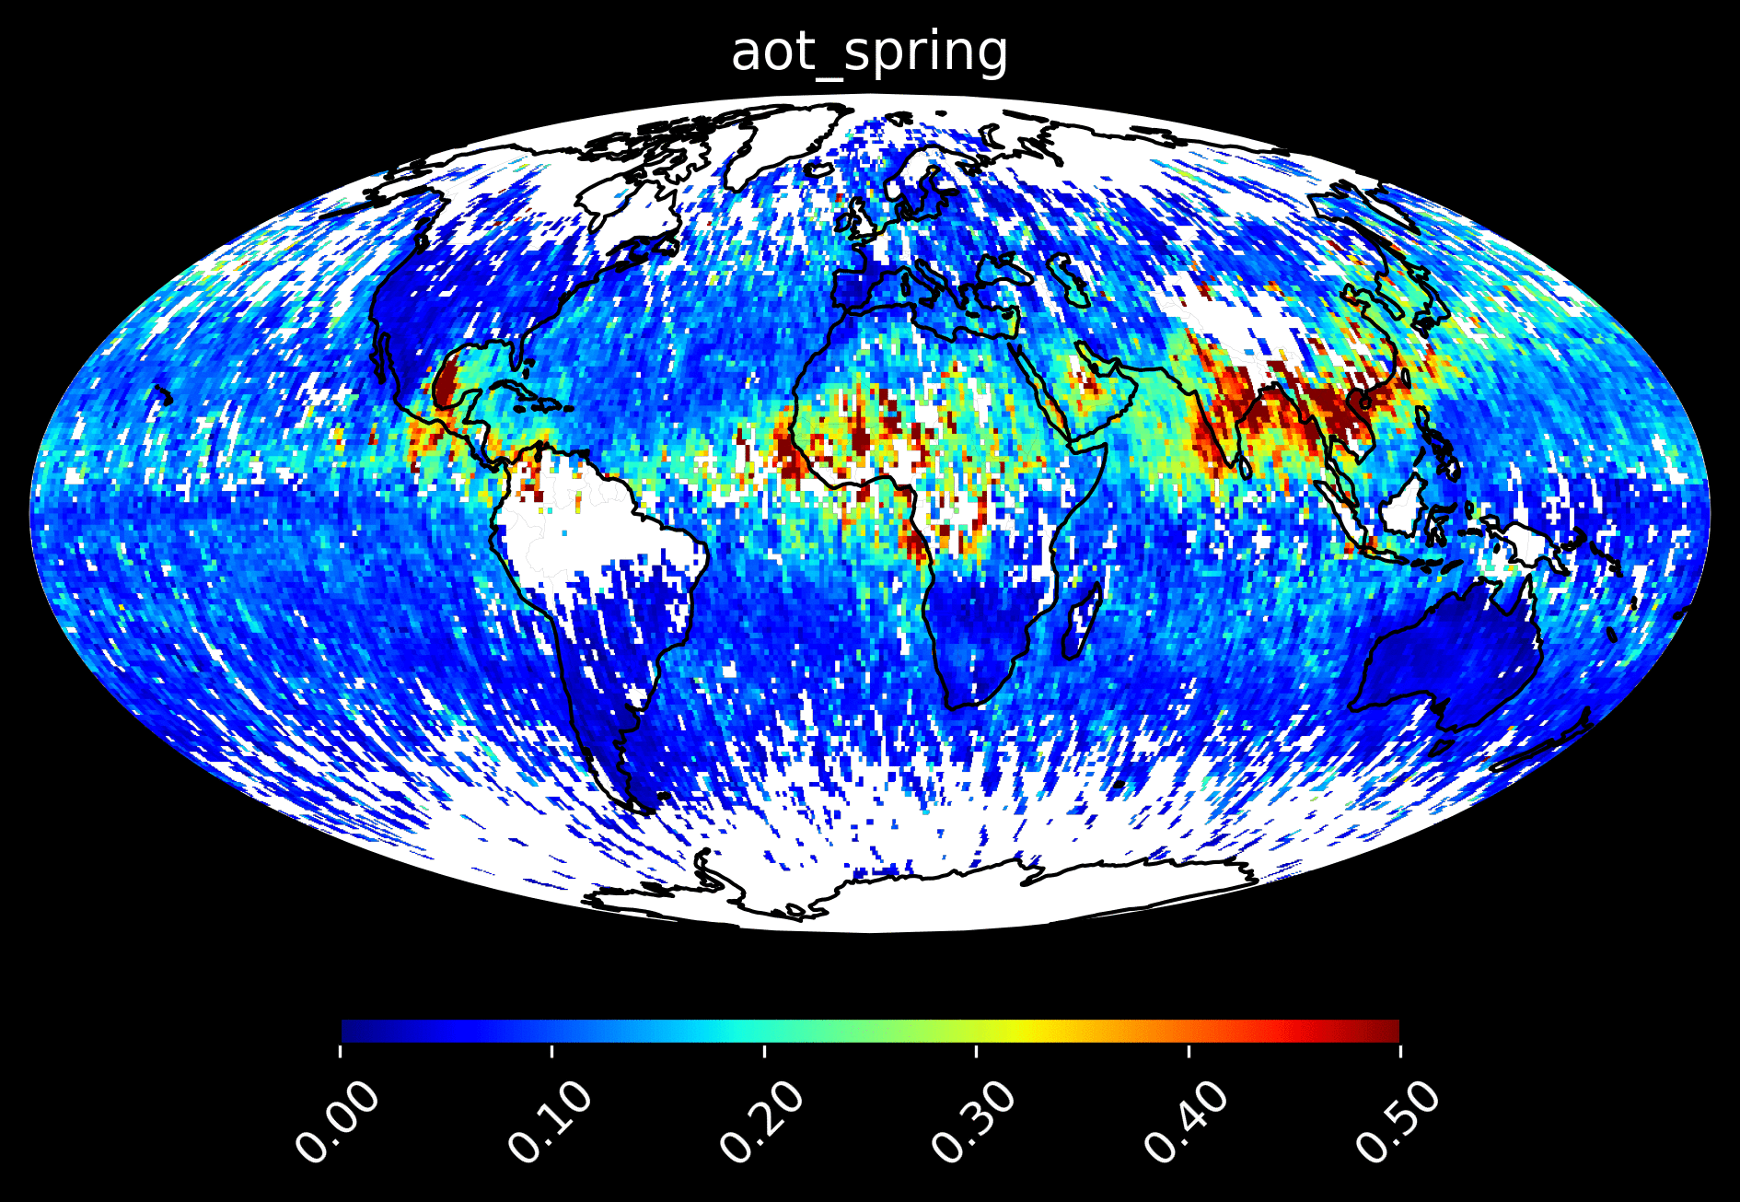
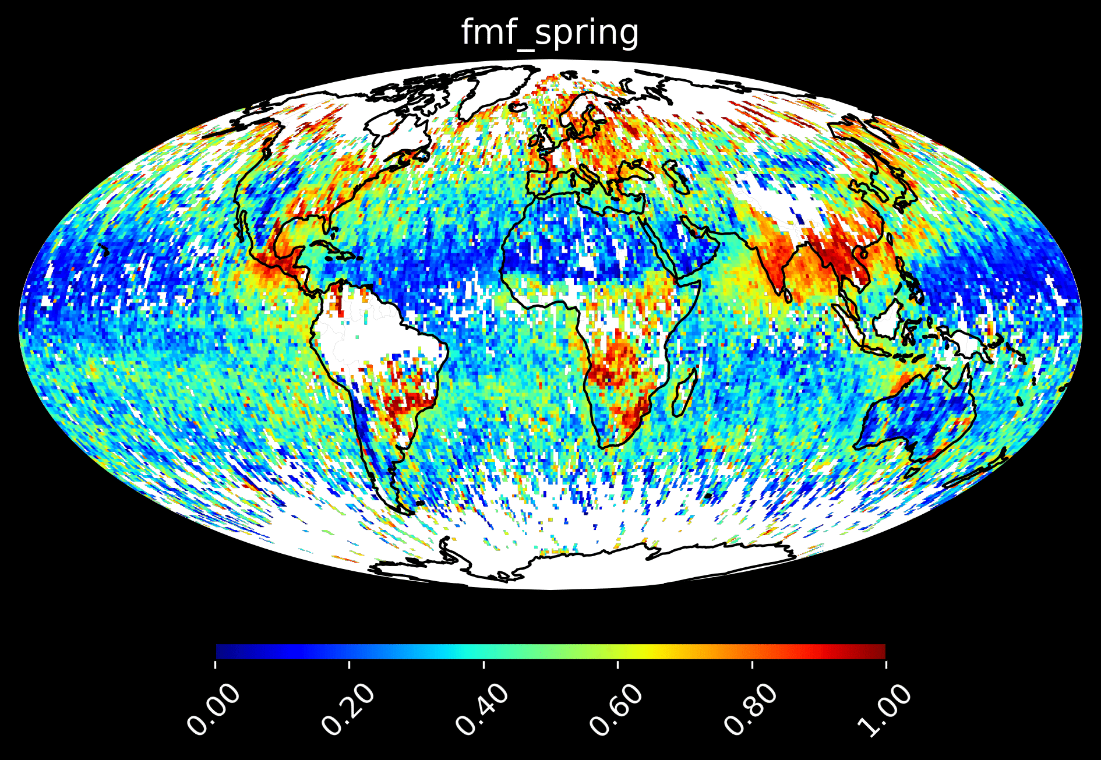
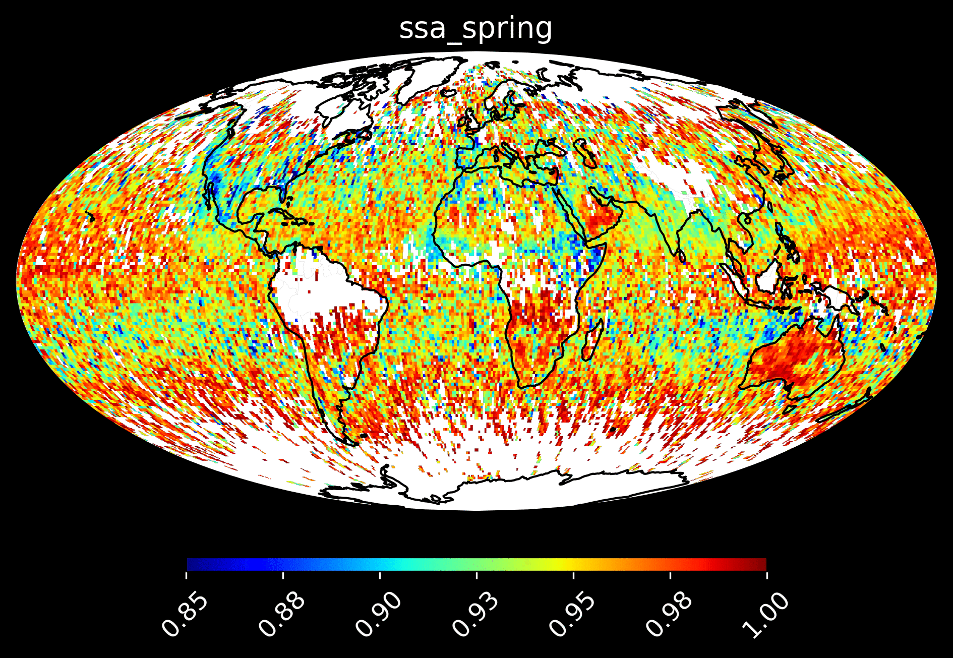
First Year of SPEXone Data: amount, size & absorbtion
Amount
Small particle fraction
Reflective aerosols

Slide 8
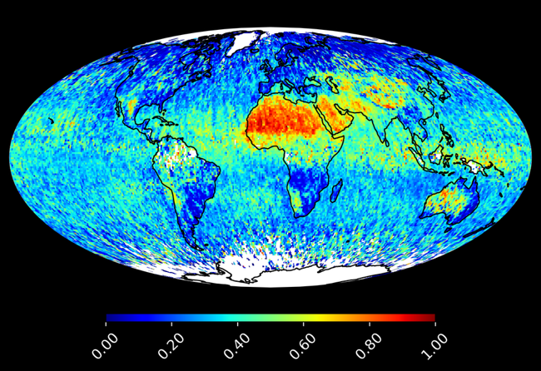

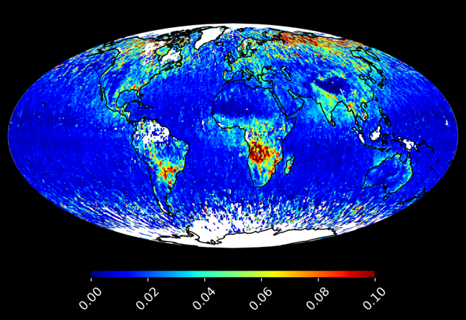
Chemical Composition
Small particles
Non-absorbing (in)organic
Black carbon & brown carbon
Desert Dust
Deserts regions:
Sahara
Middle-East
Namibia
Australia
Industrial and biomass burning regions:
India & South-East Asia
Africa, South-America & Siberia
Biomass burning regions:
Africa, South-America & Siberia

Slide 9

Follow us on LinkedIn or visit our website www.spaceoffice.nl

