Slide 1
CEOS Plenary 2025
Global Climate Observing System (GCOS) Update
Albert Fischer
WMO
Agenda Item 6.1
39th CEOS Plenary
Bath, United Kingdom
4 - 6 November, 2025

Slide 2

GCOS
Climate observations enabling climate science and services
GCOS works towards climate observations being enhanced and sustained into the future, to provide the evidence needed to understand and predict the evolution of the climate, to guide mitigation and adaptation measures, to assess risks and enable attribution of climatic events to underlie causes, and to underpin climate services.

Slide 3
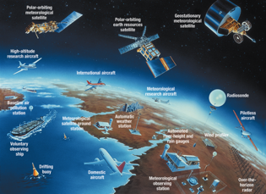
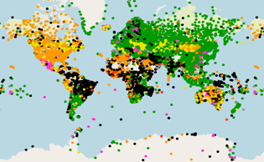
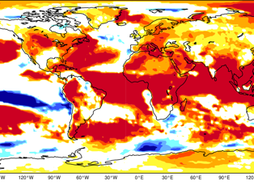

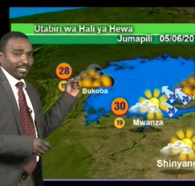
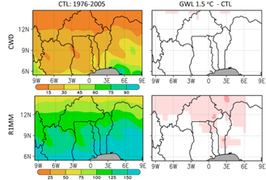
Successful delivery and use of climate services depends on all elements in the value chain working properly
Climate-related infrastructure – must be designed and managed globally
GCOS addresses
observations and
data exchange but is
informed by the
needs of the whole
value chain
Observations from the entire globe
International exchange of observations
Global climate modelling
GLOBAL ACTIVITIES
Effective decision making and action
Delivery of climate services
Local Data Processing, forecast, warning and advisory products
Last-mile activities undertaken at regional, national and local level

Slide 4
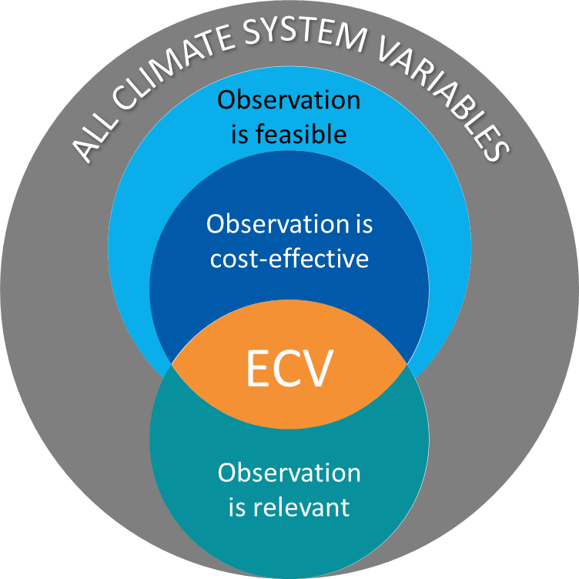
ECVs – Essential Climate Variables
GCOS developed and implemented the concept of Essential Climate Variables
(ECVs) which are widely endorsed by the community and scientific programs.
Essential Climate Variables (ECVs)
are physical, chemical or biological variables that critically contribute to the characterization of Earth’s climate.
are not stand-alone variables; they are part of a wider concept.
are founded on climate science and observational capability and infrastructure.
GCOS is acknowledged as the leading independent reference in defining
requirements for climate observations
Notes:
ECVs concept is widely used by space agencies to guide their mission planning

Slide 5
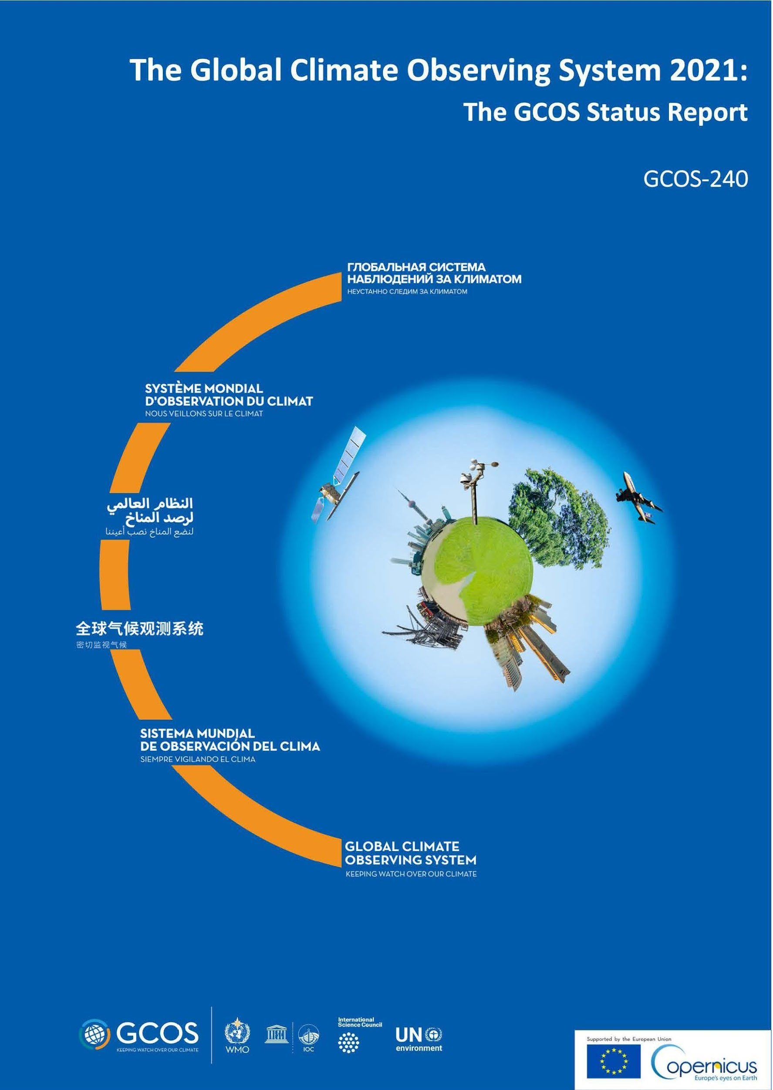
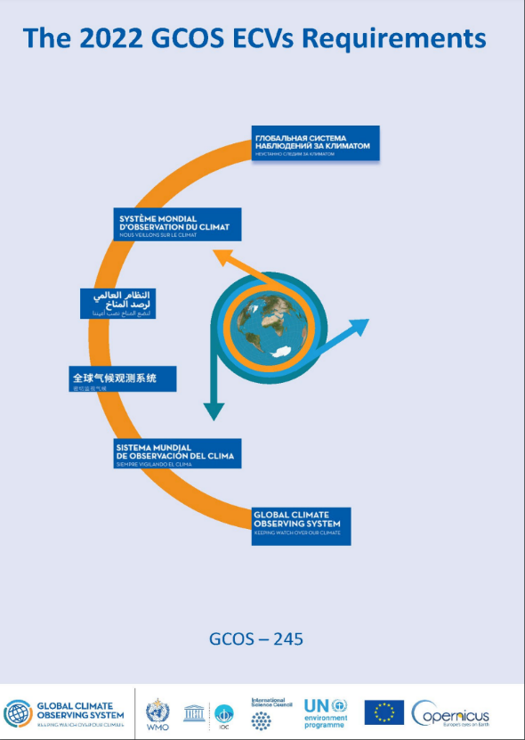
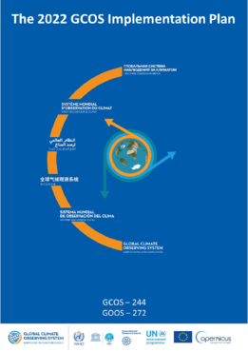
GCOS Reporting to UNFCCC
GCOS Status Report
Identify what we need to measure
≃ 5 years cycle
GCOS ECVs Requirements AND Implementation Plan
UNFCCC
Assess if the status of the observing system for climate meets those requirements
Propose actions to address gaps and improve the observing system for climate
Notes:
This slide summarises the “machinery” of GCOS, our three main activities: defining Essential Climate Variables and their requirements; assesing the status of the climate observing system, proposing actions to improve the system.. GCOS reports to UNFCCC and provides these reports every 5/6 years. These reports are also submitted and endorsed by WMO Members at WMO Congress. It reports to the Subsidiary Body on Scientific and Technological Advice (SBSTA) and thereby provides the UNFCCC with status reports and implementation plans, which are recognized by the Conference of the Parties (e.g. Decision 19/CP.22).

Slide 6
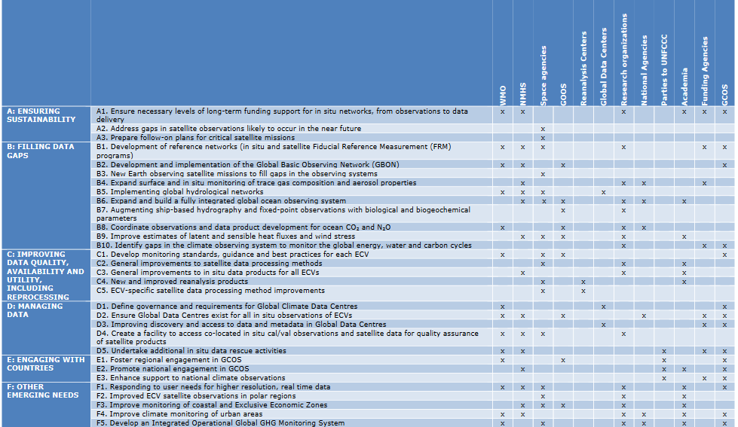
GCOS IP and Space Agencies
Theme Actions Implementing Bodies
31 actions
16 relevant to Space Agencies

Slide 7
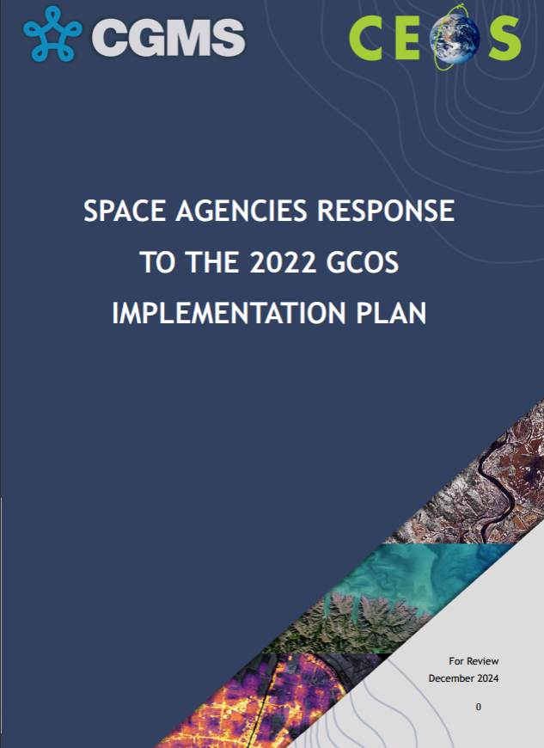
Space Agency Response to the GCOS IP
CEOS-CGMS JWG Climate coordinates the Space Agency Response to the GCOS IP
A collaborative effort between WGC and GCOS experts
Partially shared membership: WGC ex-officio members in GCOS Panels
Regular interactions between WGClimate chairs and GCOS Secretariat
Regular reporting on progress on actions by WGC to GCOS, using an agreed template

Slide 8
Main GCOS Activities 2025-2028
Status Report and the Implementation Plan in February 2027
ECV requirements will be updated in 2028
Joint Panel Meeting – February 2026 – Hosted by ESA (Harwell, UK) – Joint with WGClimate. Kick-off meeting for the preparation of the Status Report and Implementation Plan. Cross-cutting topics with WGClimate (CDR repository, Cal/val).
ECV Rationalization
GCOS Surface Reference Network (GSRN) implementation
iClimateAction – EU project - Coordination and increase of synergies among WMO, GEO, GCOS for fostering international climate action, including the assessment of the EO value chain for ECVs, identify gaps and shortcomings that limit their full exploitation
Ongoing activities:
GCOS National Coordinators
Network management: GSN, GSRN, GUAN, GRUAN, Baseline Surface Radiation Network, Global Terrestrial Networks.

Slide 9
Contribution to GCOS
The funding of core and re-current programme activities is reliant on annual contributions.
The planning and implementation activities for the Global Climate Observing System (GCOS) are funded through the:
WMO Regular Budget, which directly supports part of the remuneration costs of the position of the GCOS Secretariat Director (10%), part of the remuneration costs of the Programme Assistant (56%), (for a total around 130K CHF); Starting from 2026, WMO will not provide a Programme Assistant.
GCOS Climate Observing System Fund (COSF), administered under WMO Trust Fund regulations, which is provided by the Sponsors and other voluntary contributors, and which supports the core planning and programme activities of the GCOS Steering Committee, Panels, and Secretariat (total around 900K CHF).
GCOS Cooperation Fund (GCF), administered under WMO Trust Fund regulations, is provided through voluntary contributions from various sources and supports the System Improvement Programme. Contributions to the GCF have decreased significantly in the last years, with only Germany specifying that part of their contribution for 2024 can be used for the GCF.

Slide 10
Sustainability
Concerns about the sustainability of the GCOS programme
Currency exchange rates have led to an effective reduction in contributions to the trust fund of around 15 per cent over the past three years.
GCOS Trust Fund depends mainly on two contributors, the US (State Department and NOAA) and the EU. This puts at risk the sustainability of the GCOS programme.
Due to the political situation, there is a significant uncertainty regarding the US State Department contribution for 2025 and the following years.
Additionally, the EU has pledged to contribute for the next 3 years (2025-27), after which there is no commitment.
Annual expenditures in the 700-800 kCHF range for staff and activities.
A diversification of the contribution source would ensure a more stable situation.

Slide 11
Contingency Plans
Decrease expenses
Expenses are bigger than contributions for 2025-2028
Increase contributions
Decrease expenses (only some examples):
Option 1 – No mitigation – projected balance at end of 2027: 400,000 CHF
This will allow GCOS to deliver on the GCOS SR and GCOS IP and the EU project.
Option 2 – Reduce travel (keeping only key meetings) - projected balance at end of 2027: 460,000 CHF
Negligible difference
Option 3 - Reduce travel, NO GCOS Network Manager and only 2 Scientific Officer - projected balance at end of 2027: 880,000 While this option extends GCOS to the end of 2028, many activities will need to be scaled down.
SC-32 decided to focus on increasing contribution

Slide 12
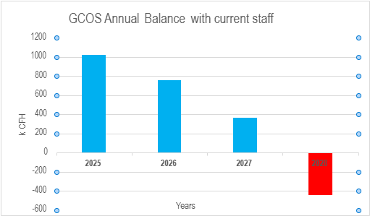
2025-2028 projection – no reduction in activities and staff
This projection will allow work to continue until end of 2027, this will allow the delivery of GCOS Status Report and Implementation Plan
It will also allow additional couple of months in 2028 for one-two staff to deliver against the EU iClimateAction project
Unknown: New financial period for European Commission starts in 2028. There is a possibility of additional fundings

Slide 13
Current Resourcing Activities
GCOS Secretariat together with the GCOS Chairs has prepared a letter to seek seek additional and urgently required support for the GCOS Secretariat to be able to continue operations and deliver the planned outputs.
Interaction with WMO Resources Mobilization
Interaction with SOFF
Informed GCOS National Coordinators
GCOS Steering Committee members and GCOS Director in charge of contacting philanthropic organizations, NMHS...
Raise awareness on the GCOS financial situation at COP30

Slide 14
THANK YOU

Slide 15
GCOS Budget with projected balance at end of 2025 (Revenues)
Balance at 31 December 2024: |  |  | 1,233,961
Details | Actual Revenue 2024 (CHF) | Contributions 2025 (CHF) - Committed (C) and Projected (P) | Contributions Received as of today (CHF)
Revenues - GCOS Voluntary Contributions
EC/Copernicus | 236,516 |  | 231,900
NOAA/Woods Hole | 134,487 |  | 140,119
EU Project “iClimateAction” | N/A |  | 219,309
US State Department | 297,500 |  | 0
WMO Contribution | 100,000 |  | 75,000
DWD | 28,221 | (P) 28,500 | Not committed
EUMETSAT | 18,753 | (P) 19,000 | Not committed
WCRP | 16,102 | (C) 9,393
Sub Total Revenue | 831,579 | 56,893 (not yet received) | 666,328

Slide 16
GCOS Budget with projected balance at end of 2025 (Expenses)
Details | Actual Expenses 2024 (CHF) | Projected expenses in 2025 (CHF) (presented to SC in 02/25
Expenses
Salaries (3 Officers) | 562,486 | 590,040
GCOS Network Manager (Salary + travels) | 69,507 | 98,000
Travel staff | 32,693 | 38,000
Meetings (experts travel) | 82,468 | 125,000
ICT and COS Facilities Charges | 36,696 | 38,000
GCOS Cooperation Mechanism - Solar Tracker Algeria | N/A | 50,000(*)
Sub Total Expenses | 783,850 | 889,000

Slide 17
Committed Voluntary Contributions 2025-28
Year | EC/Copernicus (Received in EUR) | EU/Project (Received in EUR) | Woods Hole (Received in USD) | WMO contribution (Received in CHF) | WCRP (Received in CHF) | Total projected/year in CHF
2025 | 231,900 | 219,309 | 140,119 | 75,000 | 9,393 | 675,721
2026 | 231,900 | 219,309 | 150,500 | 75,000 | 10,000 | 686,709
2027 | 231,900 | 219,309 | Not Committed | 75,000 | 10,000 | 526,209
2028 | Not committed | Not Committed | Not Committed | 75,000 | 10,000 | 85,000
Only committed contributions are considered
Notes:
EU project – 80% already received, contract signed
EC/Copernicus – no written contract but word of EC – New financial period for EC starting in 2028 so commitment not possible at the moment
Woods Hole – only committed to 2026
WMO – Contribution for 2025 already approved; contribution for 2026-2027 and 2028 – no written agreement
WCRP – Contribution to panel meetings

Slide 18
2025-2028 projection – no reduction in activities and staff
Year | Staff | GCOS Network Manager | Consultant for GSRN | Consultant for SR/IP | Travel | Staff Travel | ICT/Office | Total Expenses | Total Contributions (From Table 3) | Estimation of Balance for each year (end)
2025 | 590,040 | 98,000 | 0 | 0 | 125,000 | 38,000 | 38,000 | 889,040 | 675,721 | 1,020,642
2026 | 595,000 | 98,000 | 24,000 | 30,000 | 125,000 | 38,000 | 38,000 | 948,000 | 686,709 | 759,351
2027 | 595,000 | 98,000 | 24,000 | 0 | 125,000 | 38,000 | 40,000 | 920,000 | 526,209 | 365,560
2028 | 595,000 | 98,000 | 0 | 0 | 125,000 | 38,000 | 40,000 | 896,000 | 85,000 | -445,440
Comments
This projection will allow work to continue until end of 2027, this will allow the delivery of GCOS Status Report and Implementation Plan
It will also allow additional couple of months in 2028 for one-two staff to deliver against the EU iClimateAction project
Unknown: New financial period for European Commission starts in 2028. There is a possibility of additional fundings

