Slide 1
CEOS Plenary 2025
CEOS Agency Report: ESA
Eleni Paliouras, ESA
Agenda Item 6.2.1
39th CEOS Plenary
Bath, United Kingdom
4th - 6th November, 2025

Slide 2
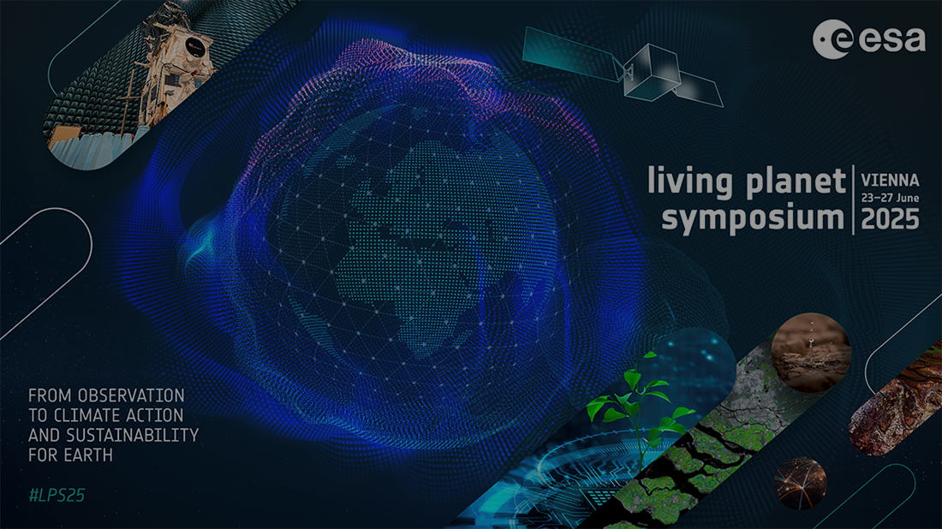






Living Planet Symposium in June 2025
7300 Registrations and 6900 onsite participants from 125 nationalities
57
Sponsors
250+ Sessions and 60+ Agoras
4200+ Scientific Presentations & Posters
800+ Members of the Scientific Committee
2200 Children at the School Lab & ca. 100 participants to the Open Day
https://lps25.esa.int/lps25-presentations/
2
Notes:
ESA’s Living Planet Symposium was a 2025 highlight taking place on 23-27 June in Vienna, Austria. In addition to record-number of registrations to the symposium, 2200 students took part in the Living Planet Symposium Education Activities over 3 days. All presentations and posters from the LPS are now available online: https://lps25.esa.int/lps25-presentations/
LPS25 vs. LPS22
Registered participants
7300 → +45%
Participants in presence
6900 → +58%
No show
6.5% → -50%

Slide 3
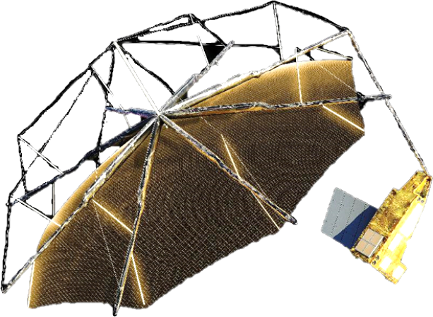
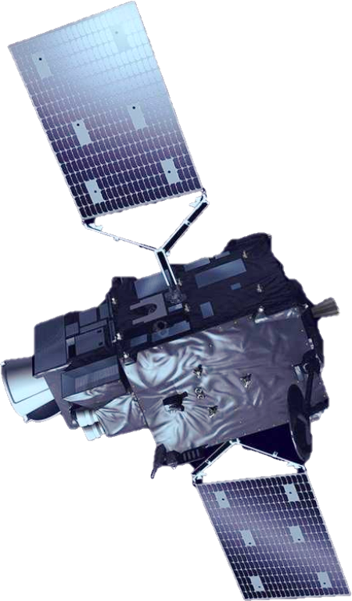
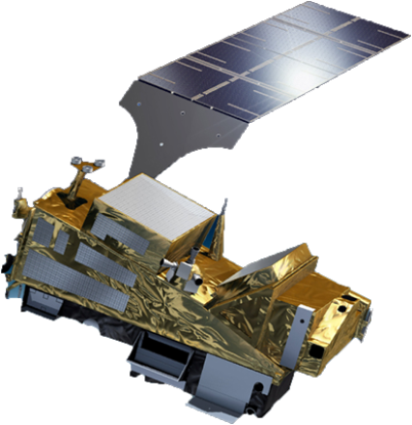
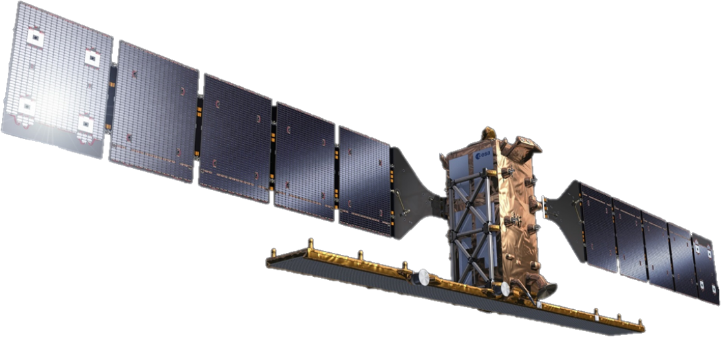
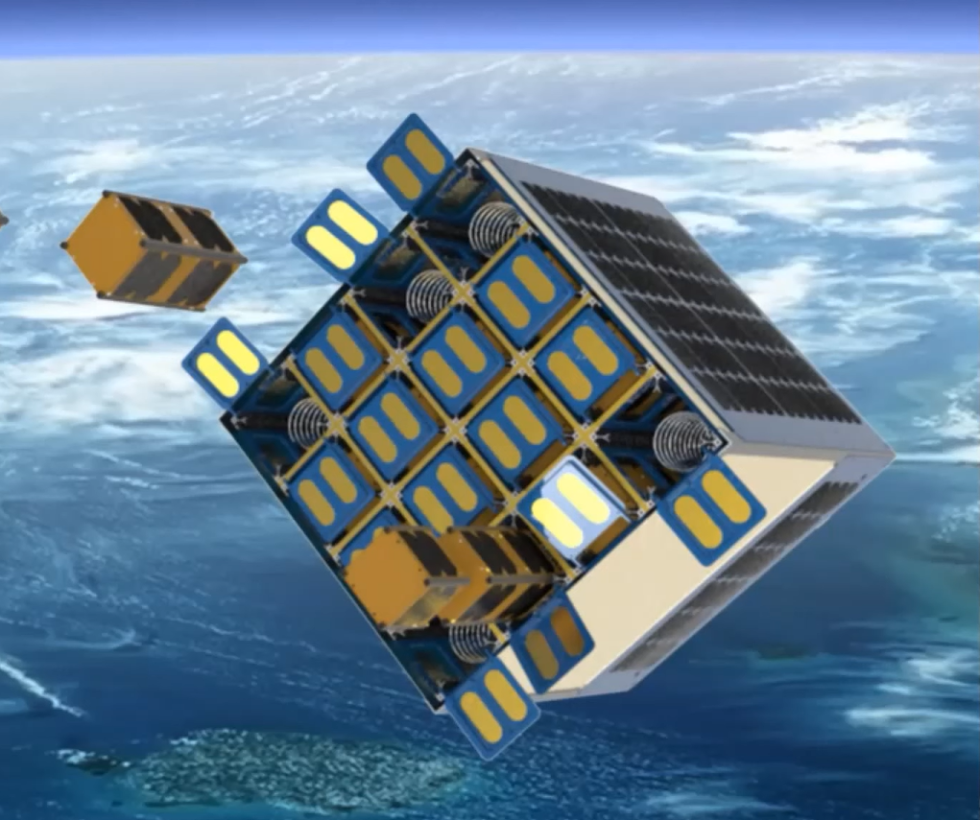
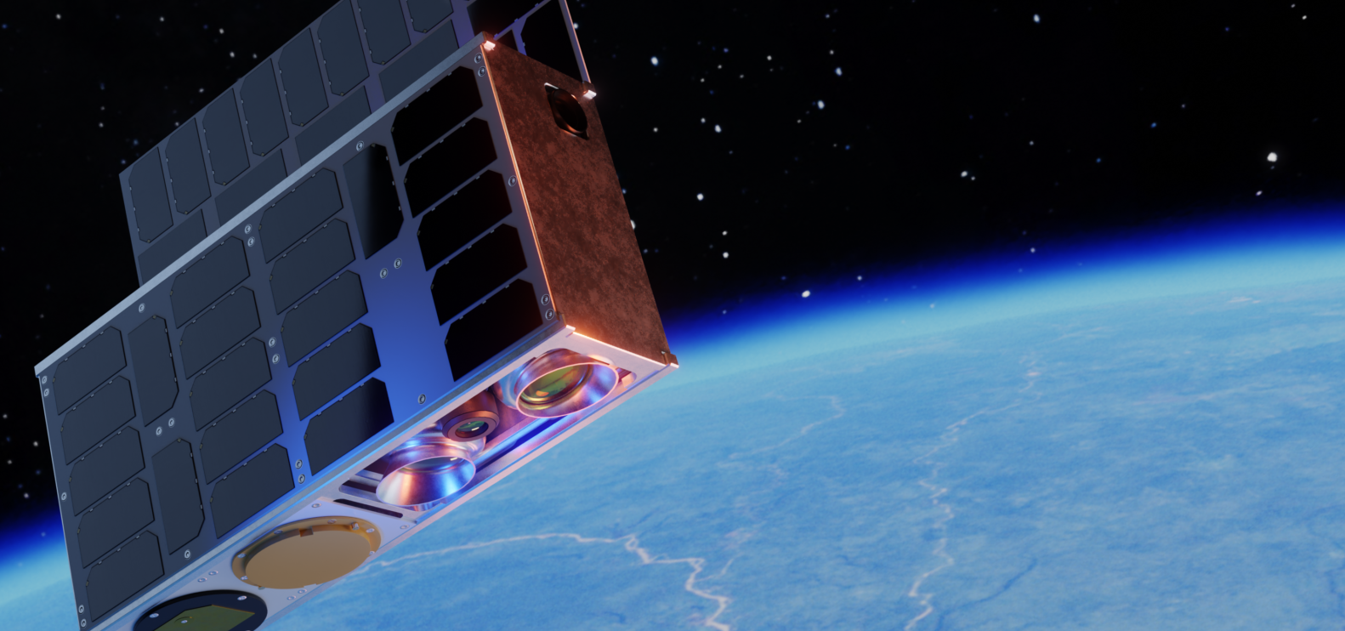
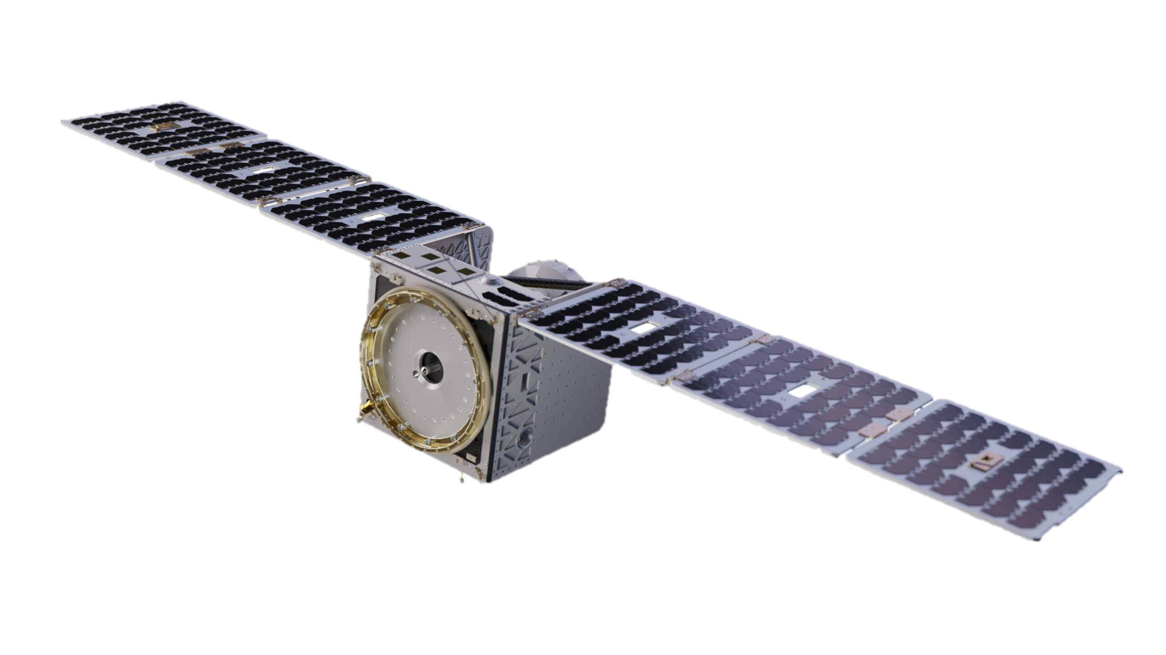
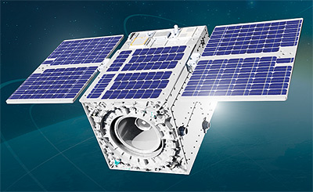
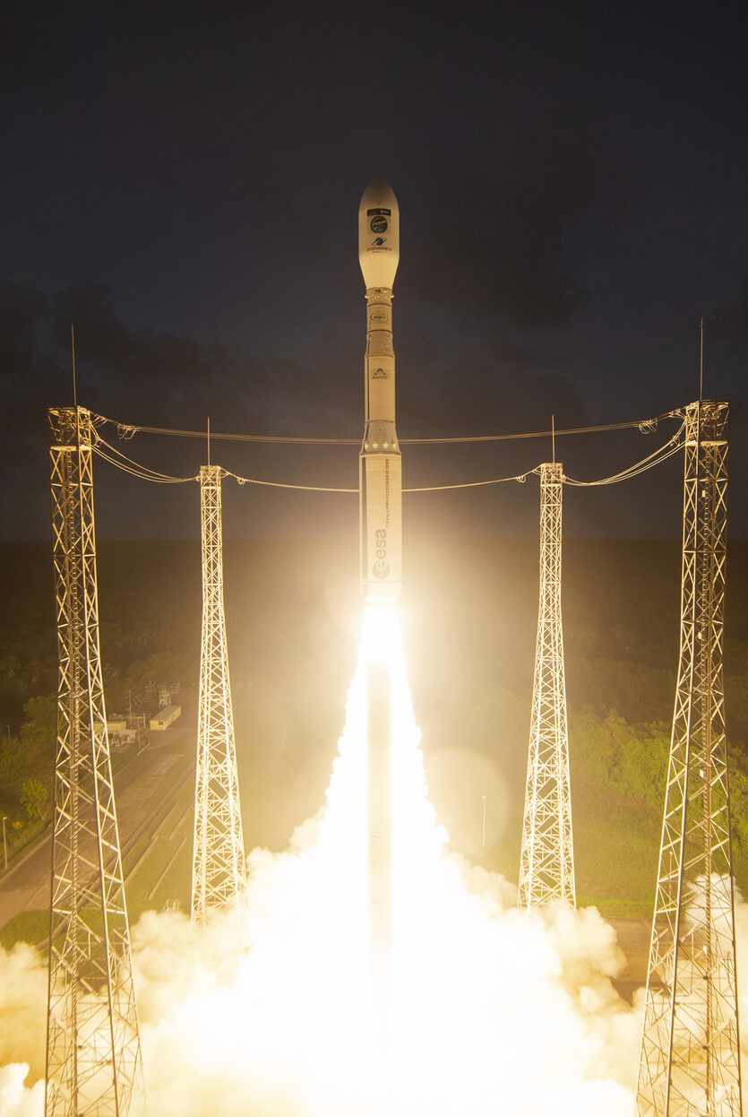
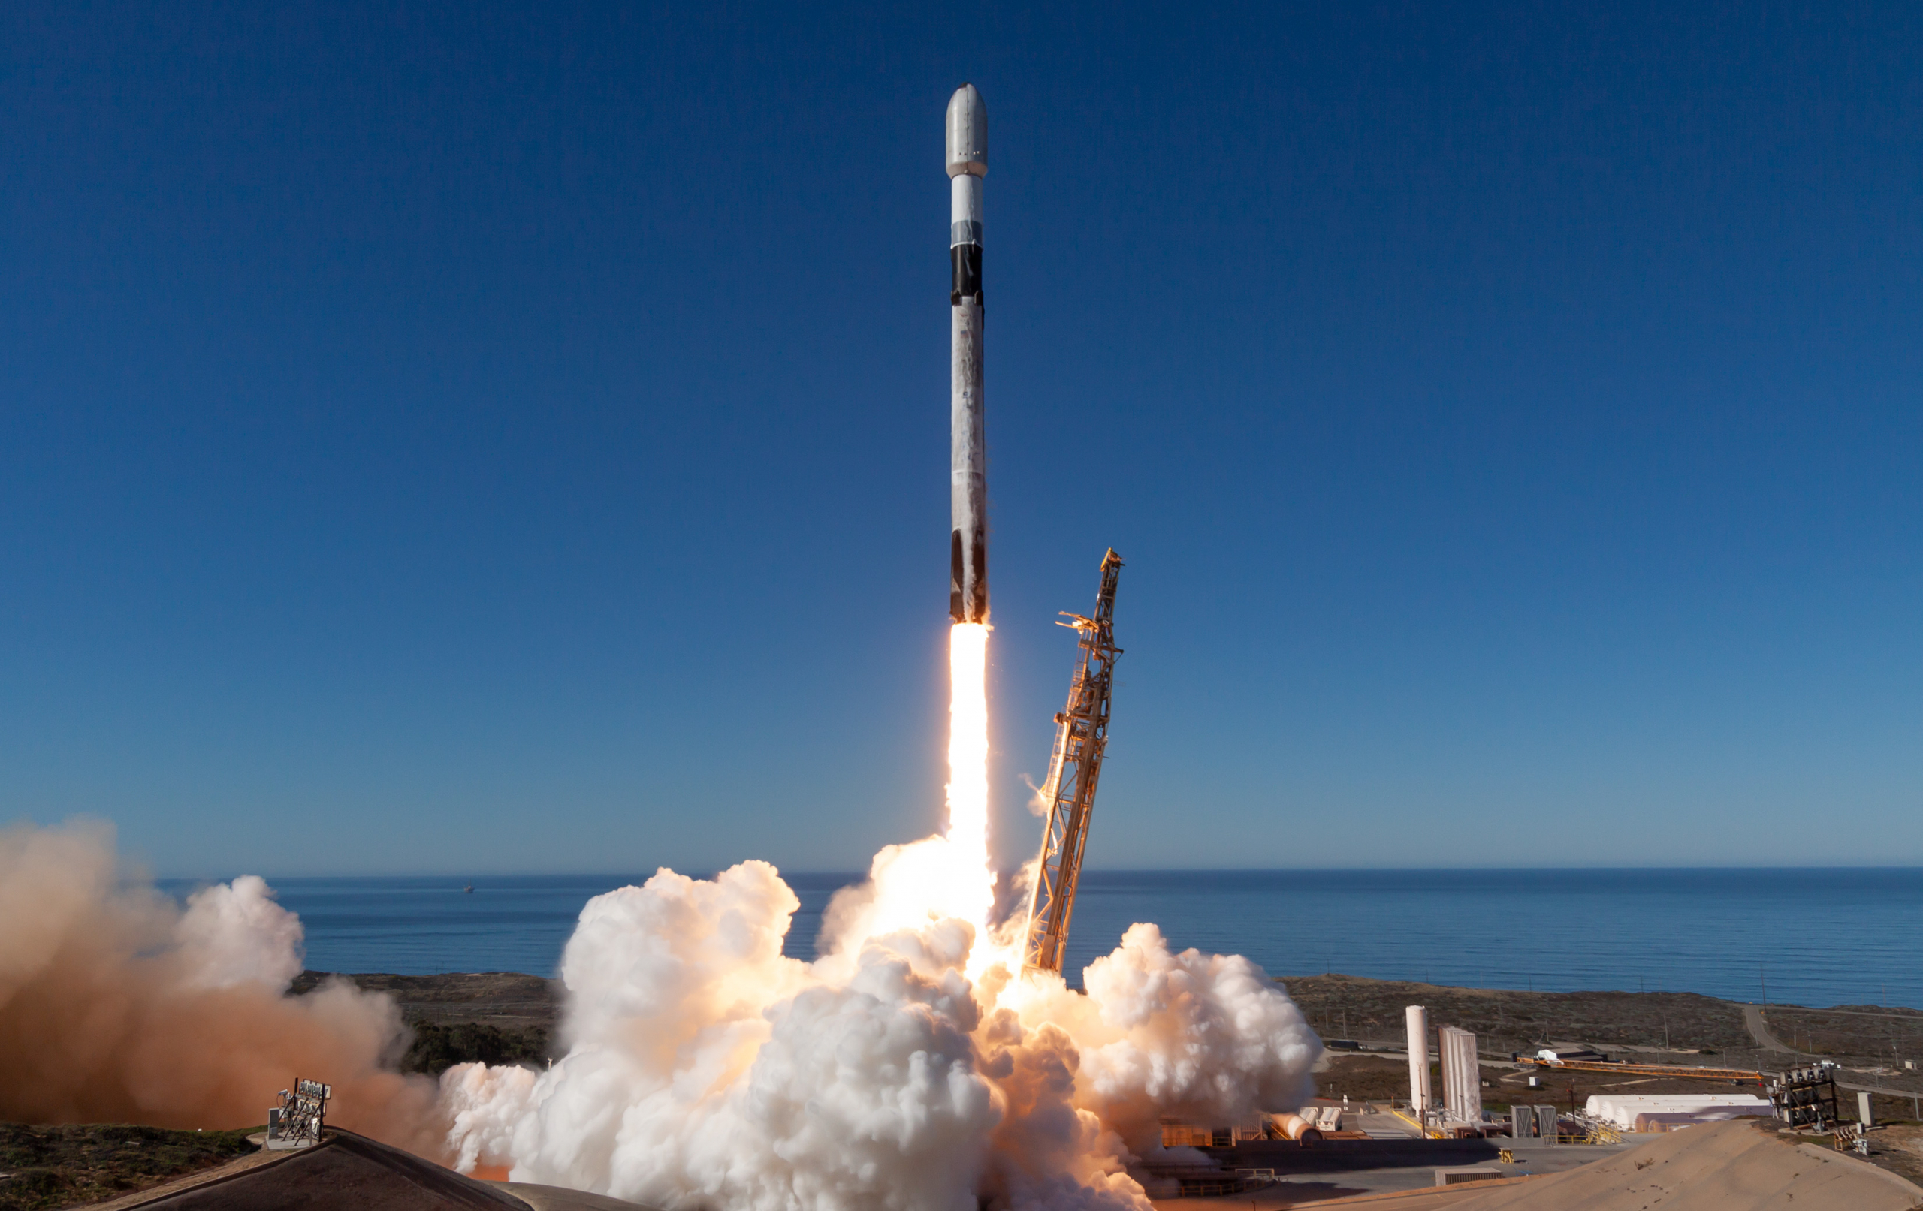
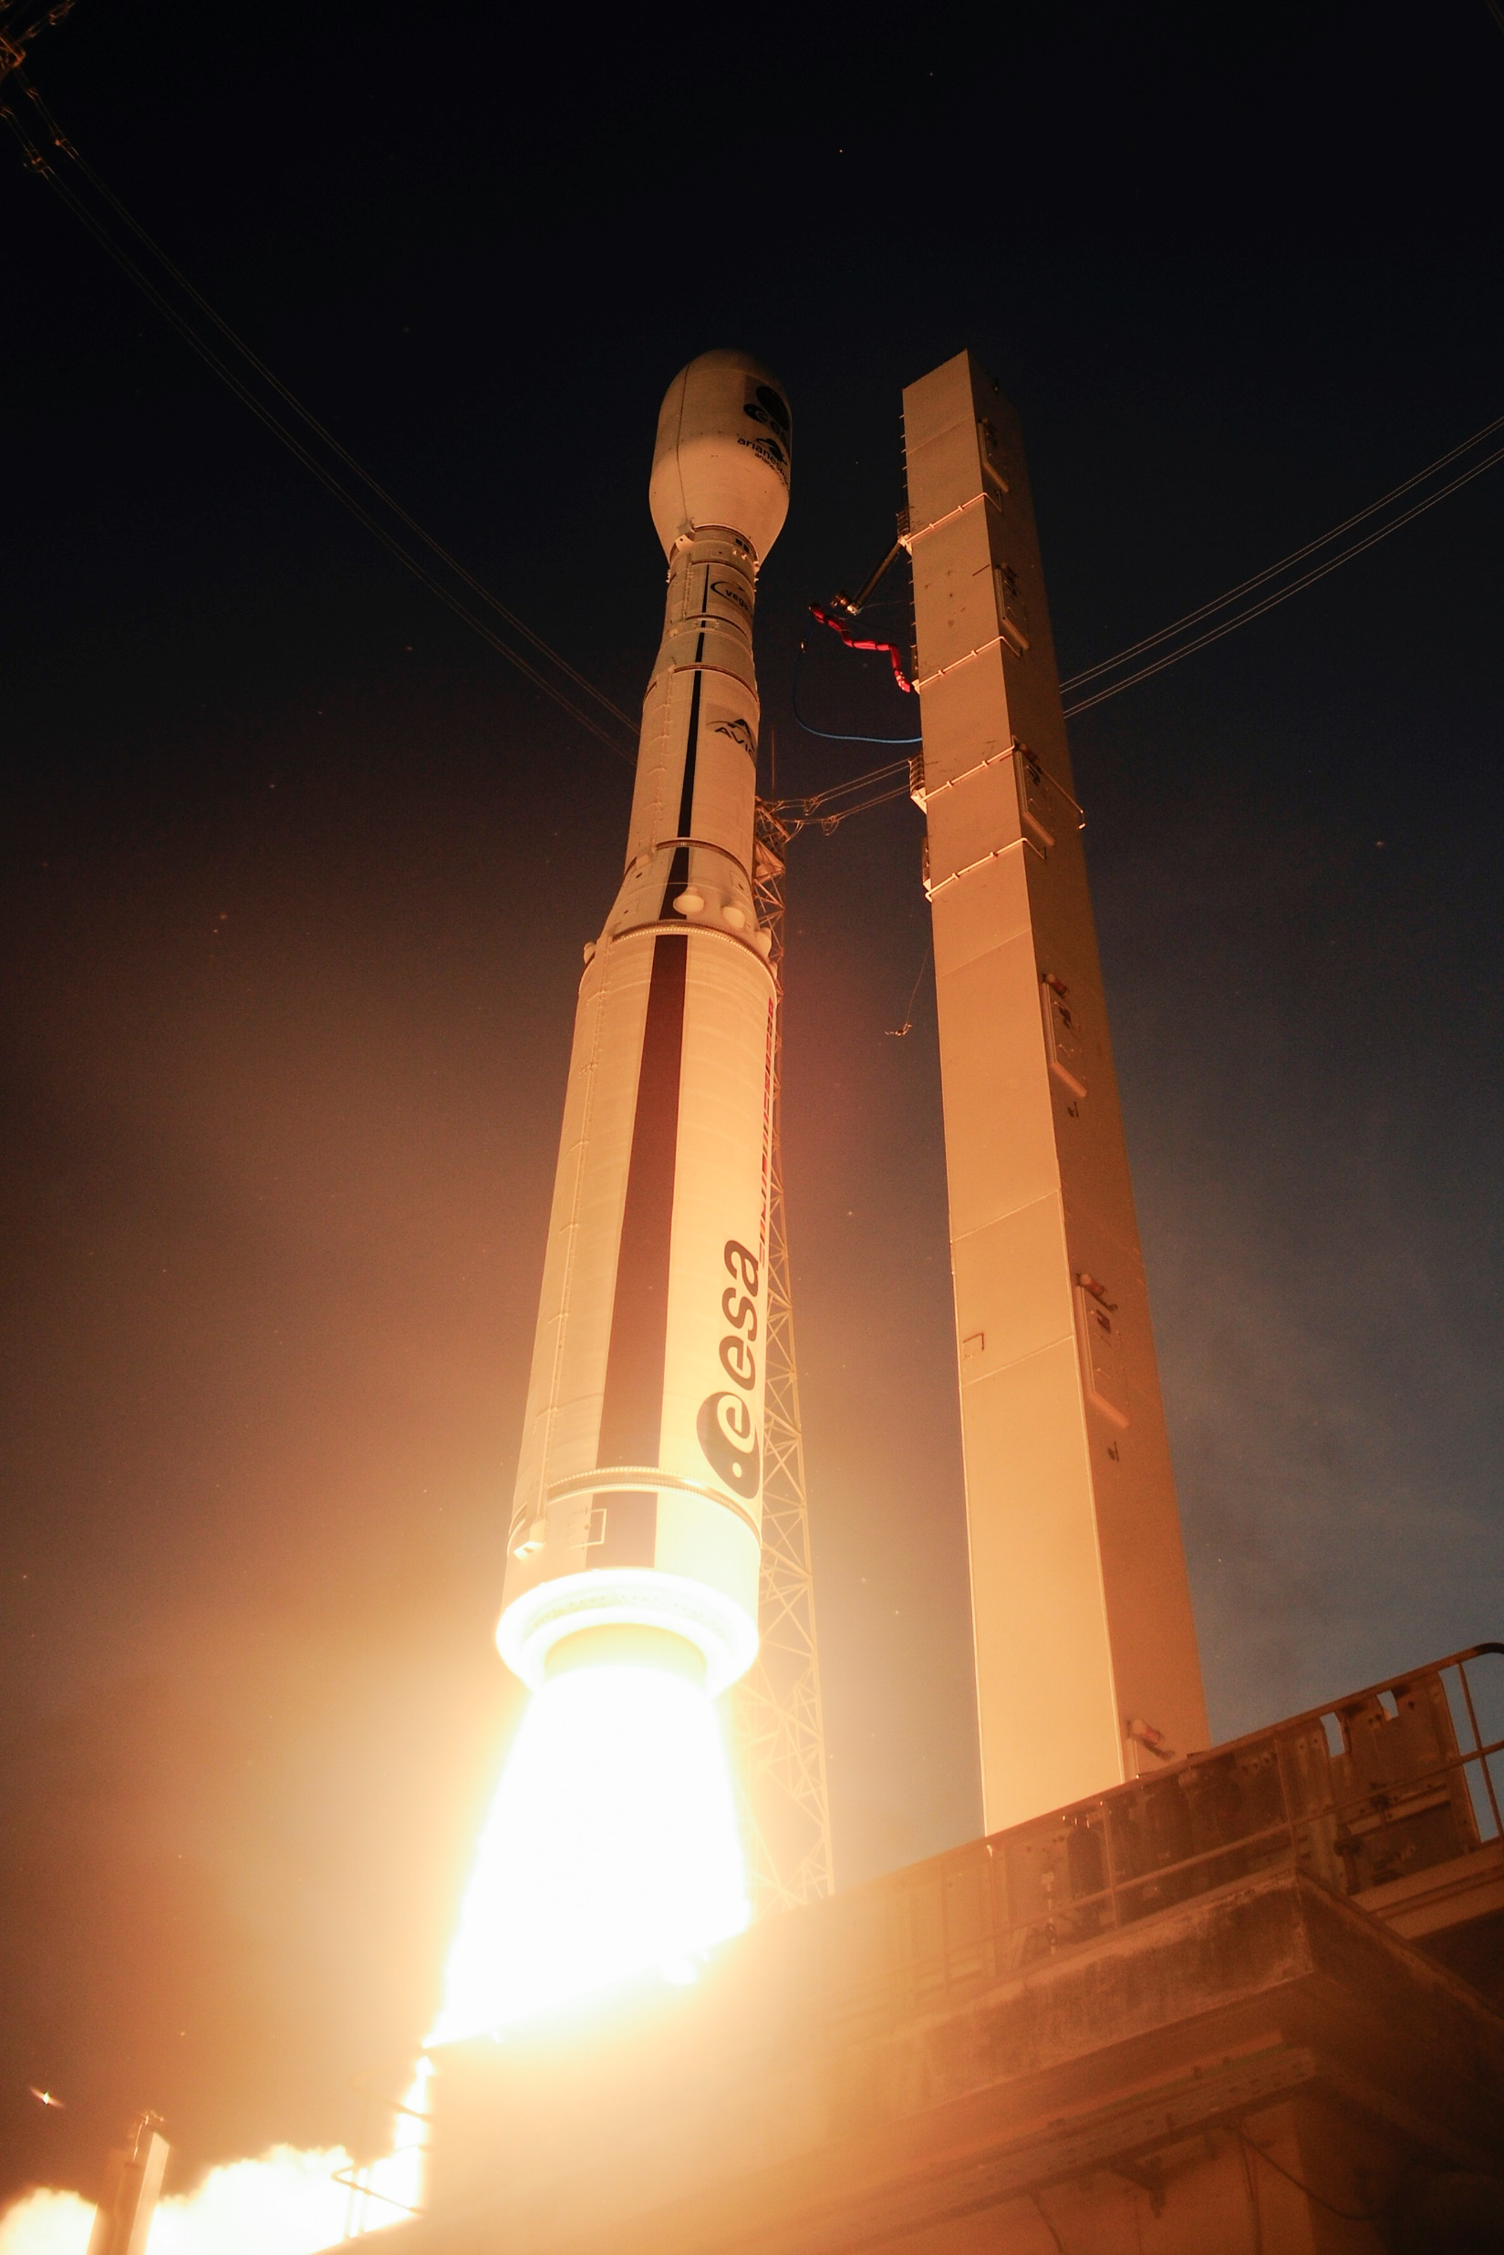
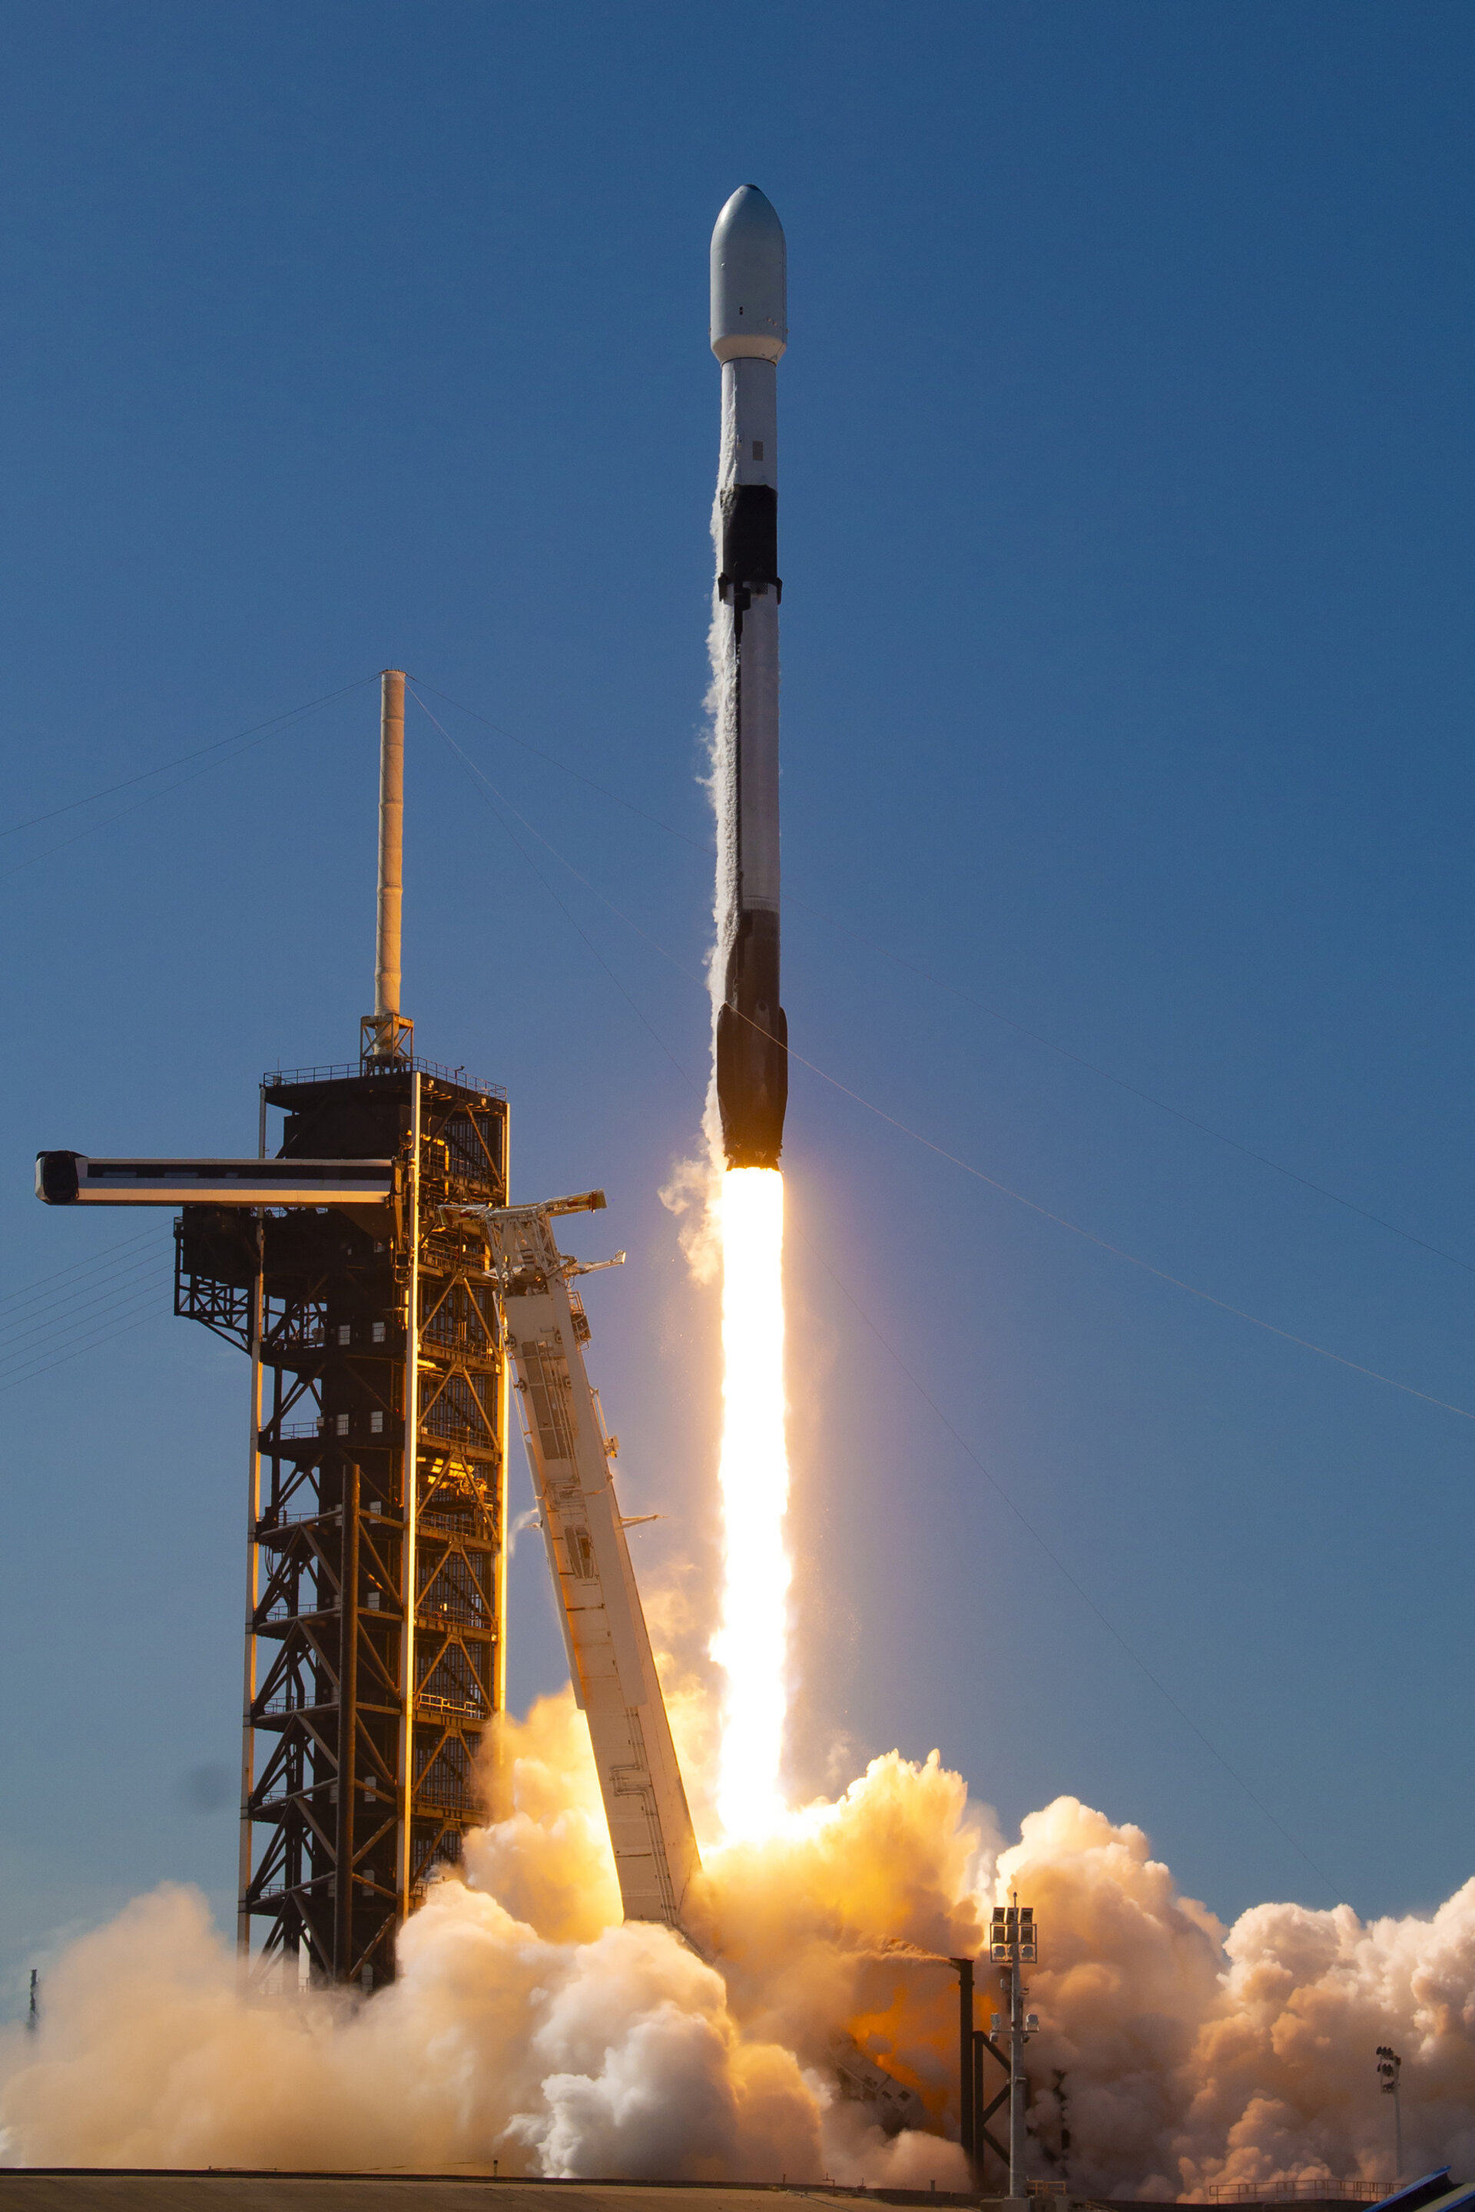
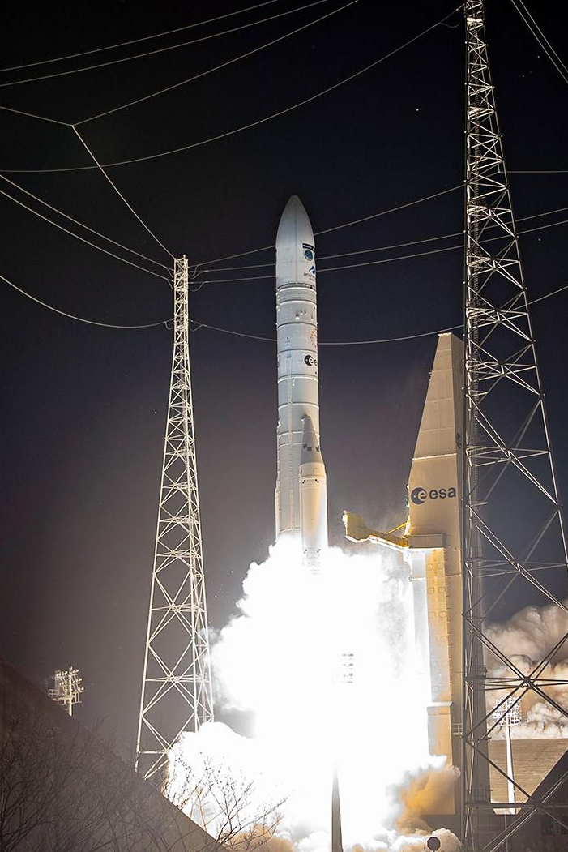
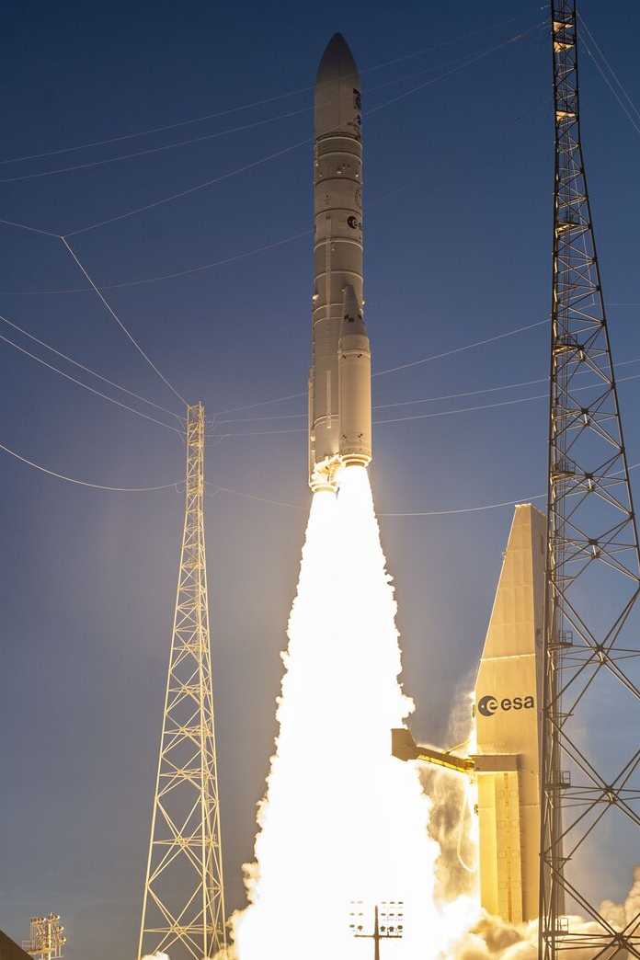

Successful Launches (Since last Plenary)
2024
2025
Sentinel-1C
5 December
AIX, Hive, Forest-3
(InCubed supported)
+ Pathfinder Hawk
(IRIDE precursor)
15 January
Biomass
29 April
MTG-S1 incl. Sentinel-4
1 July
MetOp-SG A1 incl. Sentinel-5
12 August
Sentinel-1D
4 November
3
Notes:
Sentinel-1C on Vega-C – 5 December 2024
Continuing High-resolution SAR imagery + introducing new capabilities for detecting and monitoring maritime traffic.
The launch also marked Vega-C’s ‘return to flight’.
3 InCubed supported Satellites + Iride precursor on Falcon-9 – 15 Jan. 2025
AIX (Planetek IT - smart in-orbit data processing),
Hive (constellr DE - part of a constellation that uses thermal-infrared instruments to gather data on land surface temperature)
Forest-3 (OroraTech DE - thermal-infrared imagers in low Earth orbit to detect wildfires)
+ Pathfinder Hawk - The first IRIDE satellite - (Argotec IT - microsatellite prototype for one of the six IRIDE constellations, tailored to provide information for a wide range of environmental, emergency and security services for Italy) In total there will be 25 Hawk satellites, 9 more were launched this year in June and 15 to be launched in 2026.
Biomass on Vega-C – 29 April
First satellite to carry a P-band radar capable of penetrating the forest canopy to provide unprecedented insights into the world’s forests and their crucial role in Earth’s carbon cycle.
Meteosat Third Generation Sounder-1 (MTG-S1) and the Copernicus Sentinel-4 mission – on Falcon 9 – 1 July
The MTG-S1 satellite will generate a completely new type of data product, especially suited to nowcasting severe weather events, with three-dimensional views of the atmosphere. It is the second in the MTG constellation and is equipped with the first European operational Infrared Sounder instrument.
Copernicus Sentinel-4 will be the first mission to monitor European air quality from geostationary orbit, providing hourly information that will transform how we predict air pollution across Europe, using its ultraviolet, visible, near-infrared light (UVN) spectrometer
MetOp-SG-A1 and the Copernicus Sentinel-5 mission – on Ariane 6 – 12 August
MetOp-SG-A1 is the first in a series of three successive pairs of satellites. The mission ensures the continuation of 20 years of global observations from polar orbit for weather forecasting and climate analysis with enhanced accuracy and resolution compared to the original MetOp mission and new measurement capabilities for a broader scientific reach.
Copernicus Sentinel-5 to deliver daily global data on air pollutants and atmospheric trace gases as well as aerosols and ultraviolet radiation.
Sentinel-1D – Ariane 6 – 4 November
Fourth satellite of the Copernicus Sentinel-1 constellation
Replacing Sentinel-1A, which has been serving since 2014, the new satellite ensures full mission continuity, greater system resilience, and an uninterrupted flow of valuable information to users worldwide.
With its Galileo-enabled receiver, Sentinel-1D will also ensure greater positioning accuracy and resilience, reinforcing Europe’s autonomy in space operations.

Slide 4
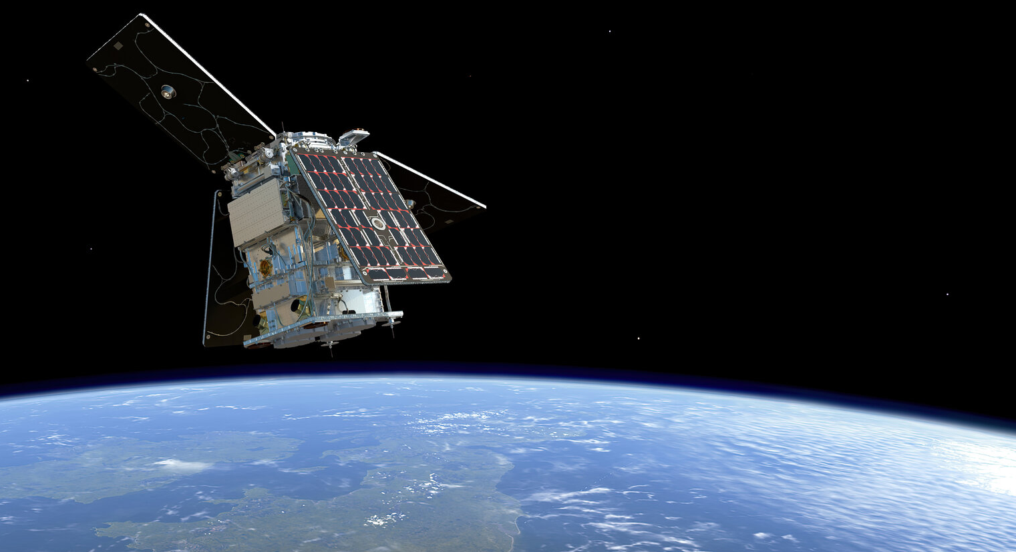
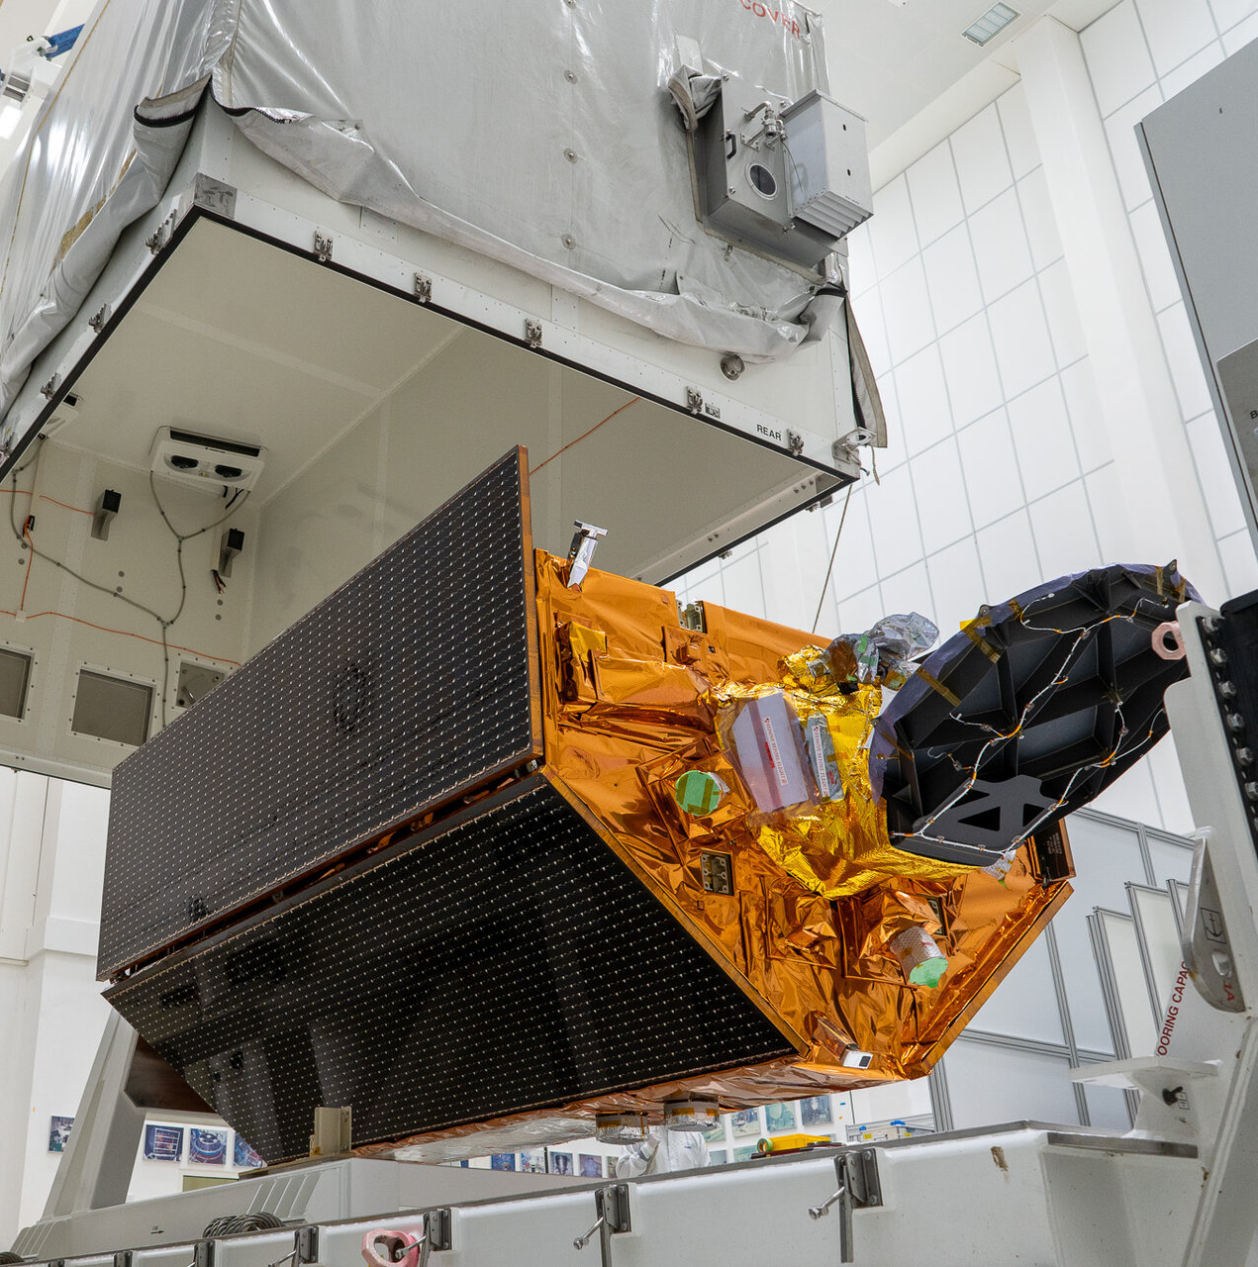
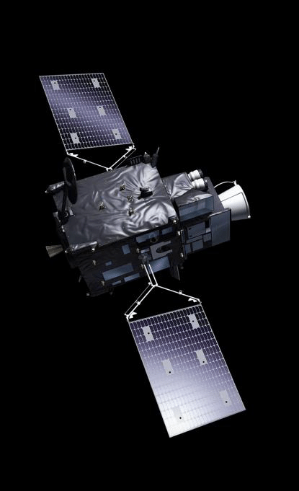
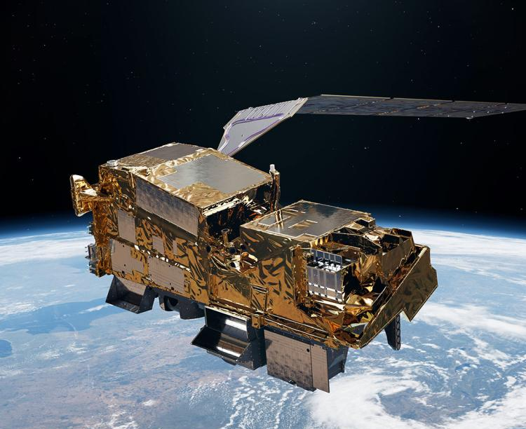
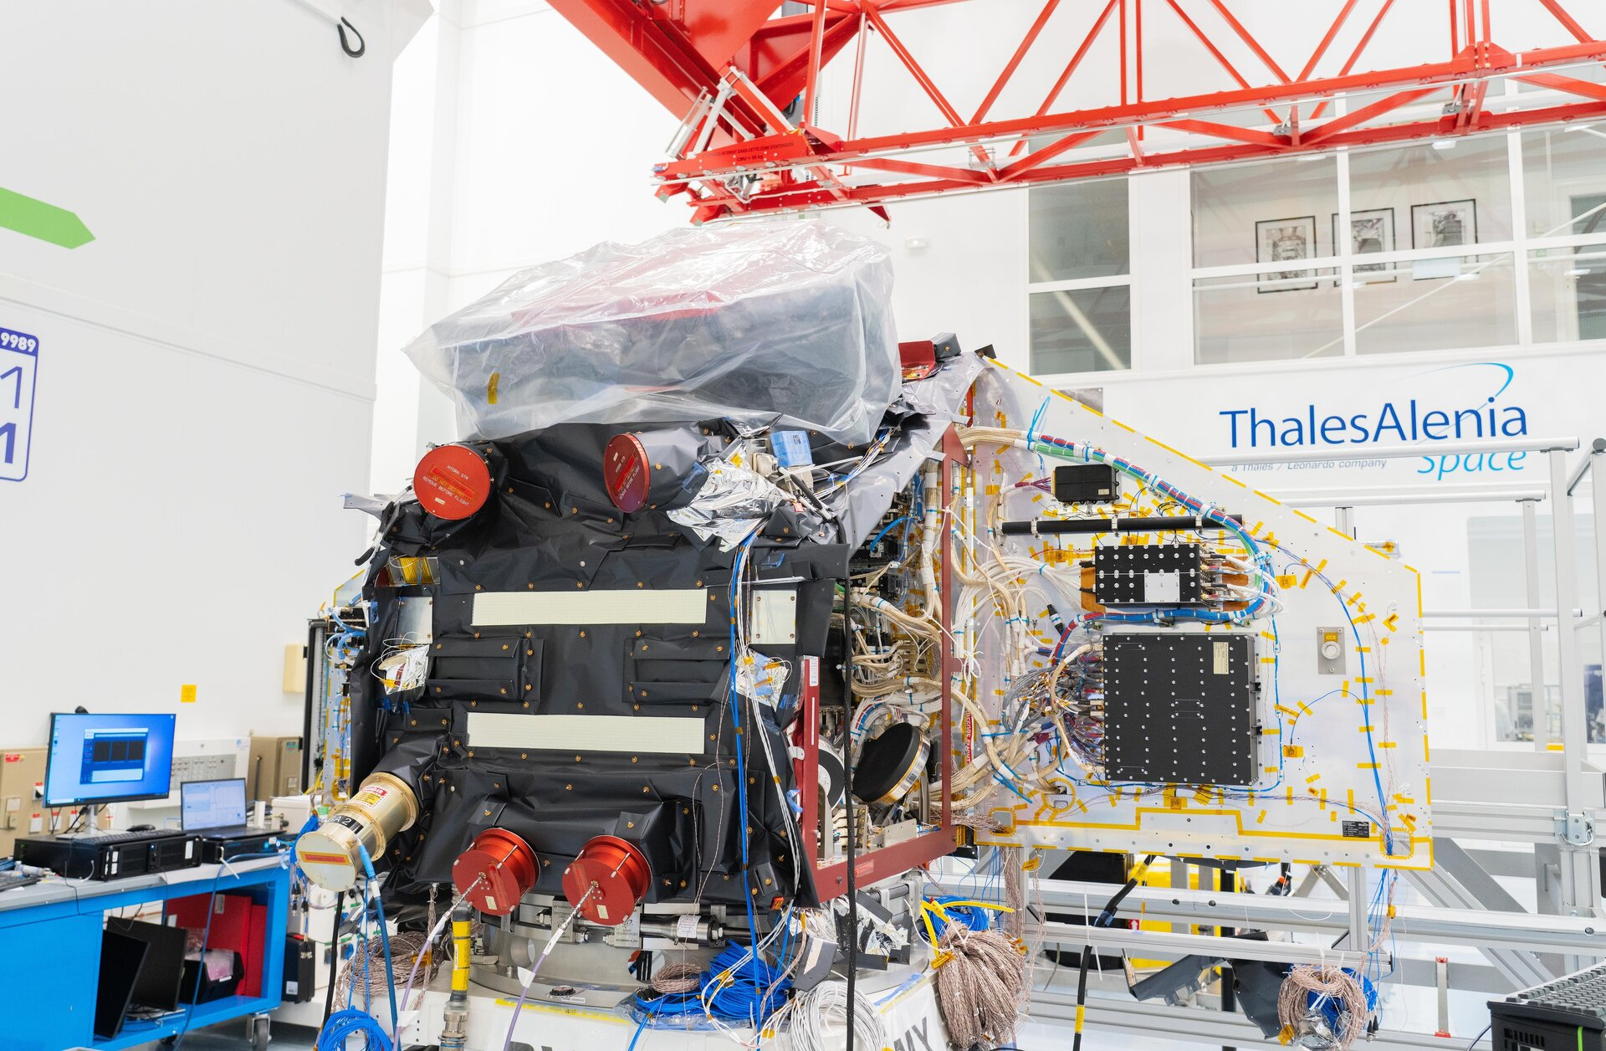
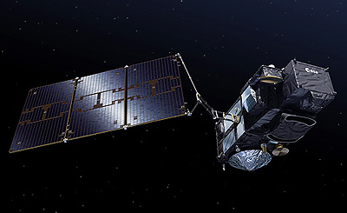
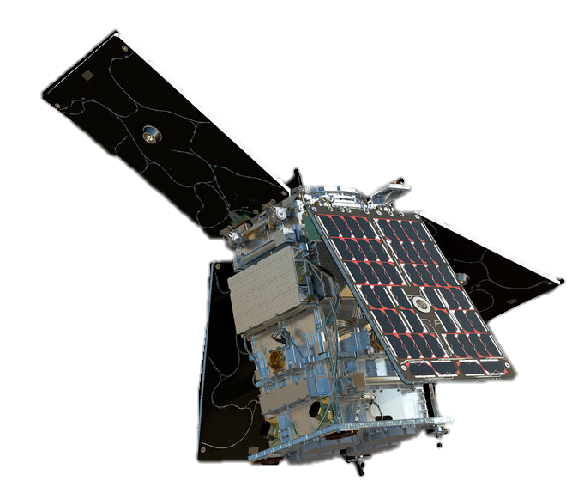
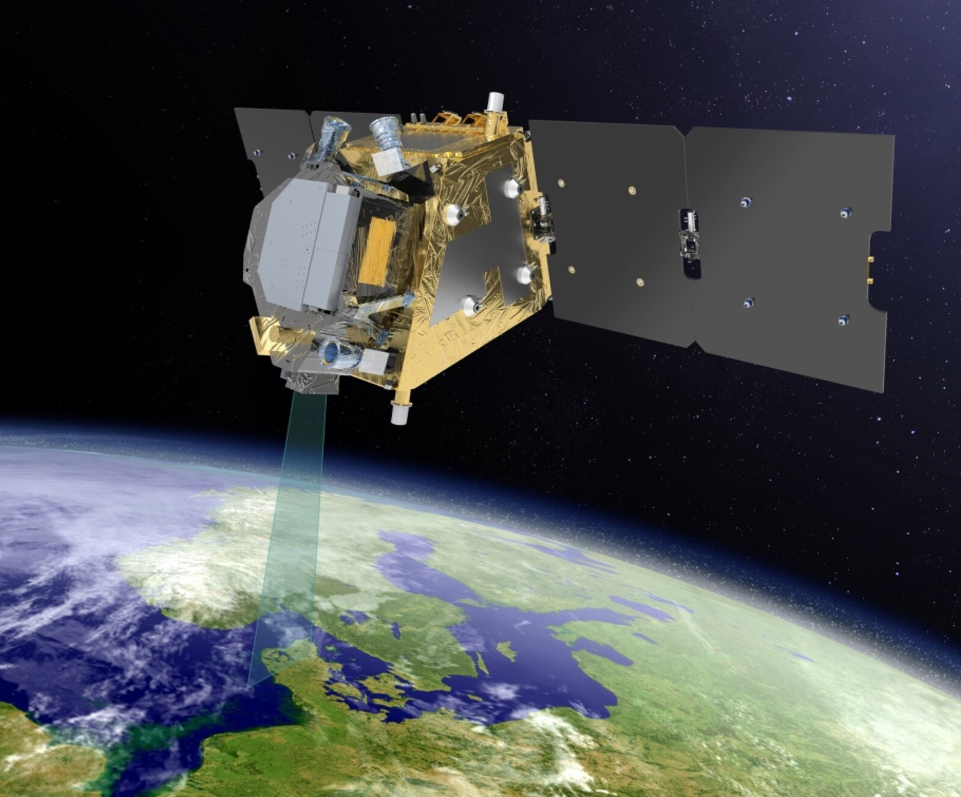
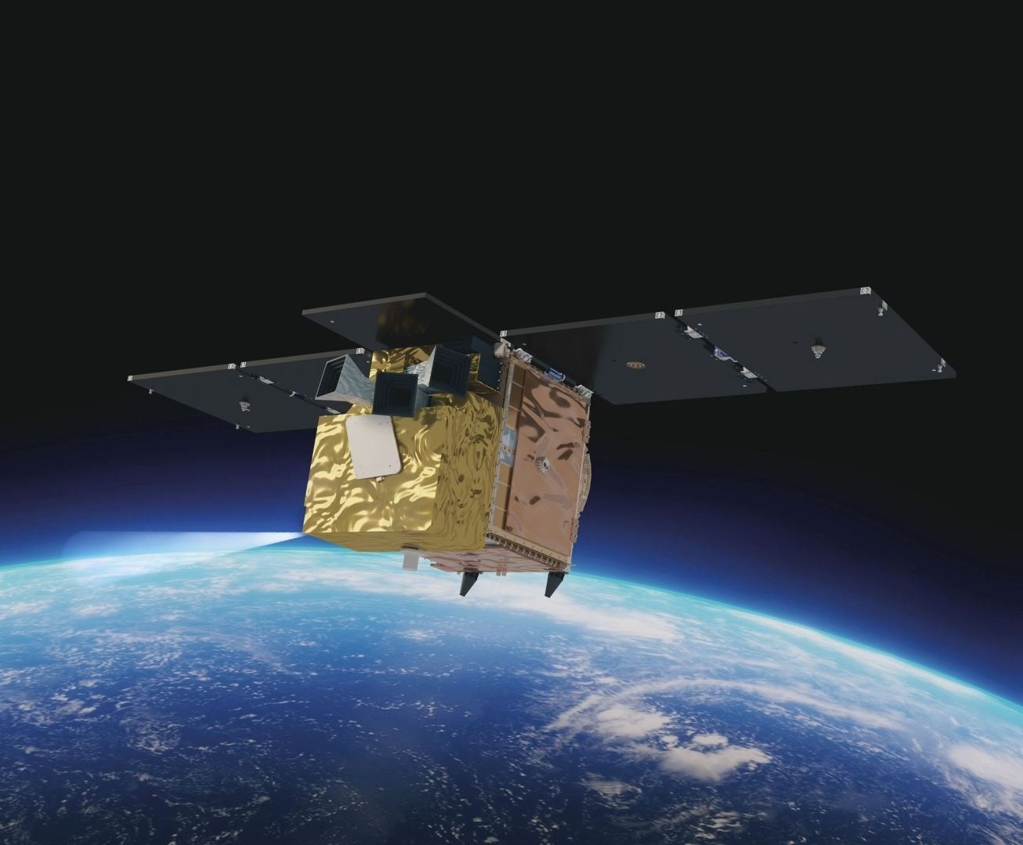
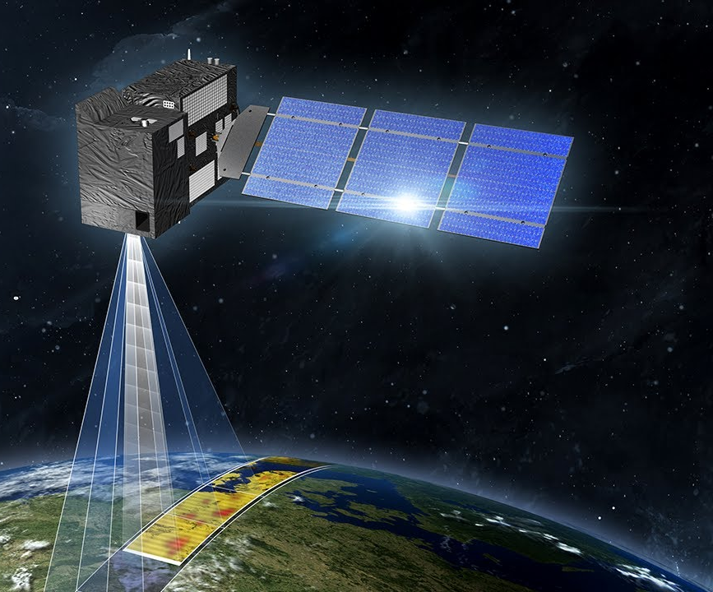
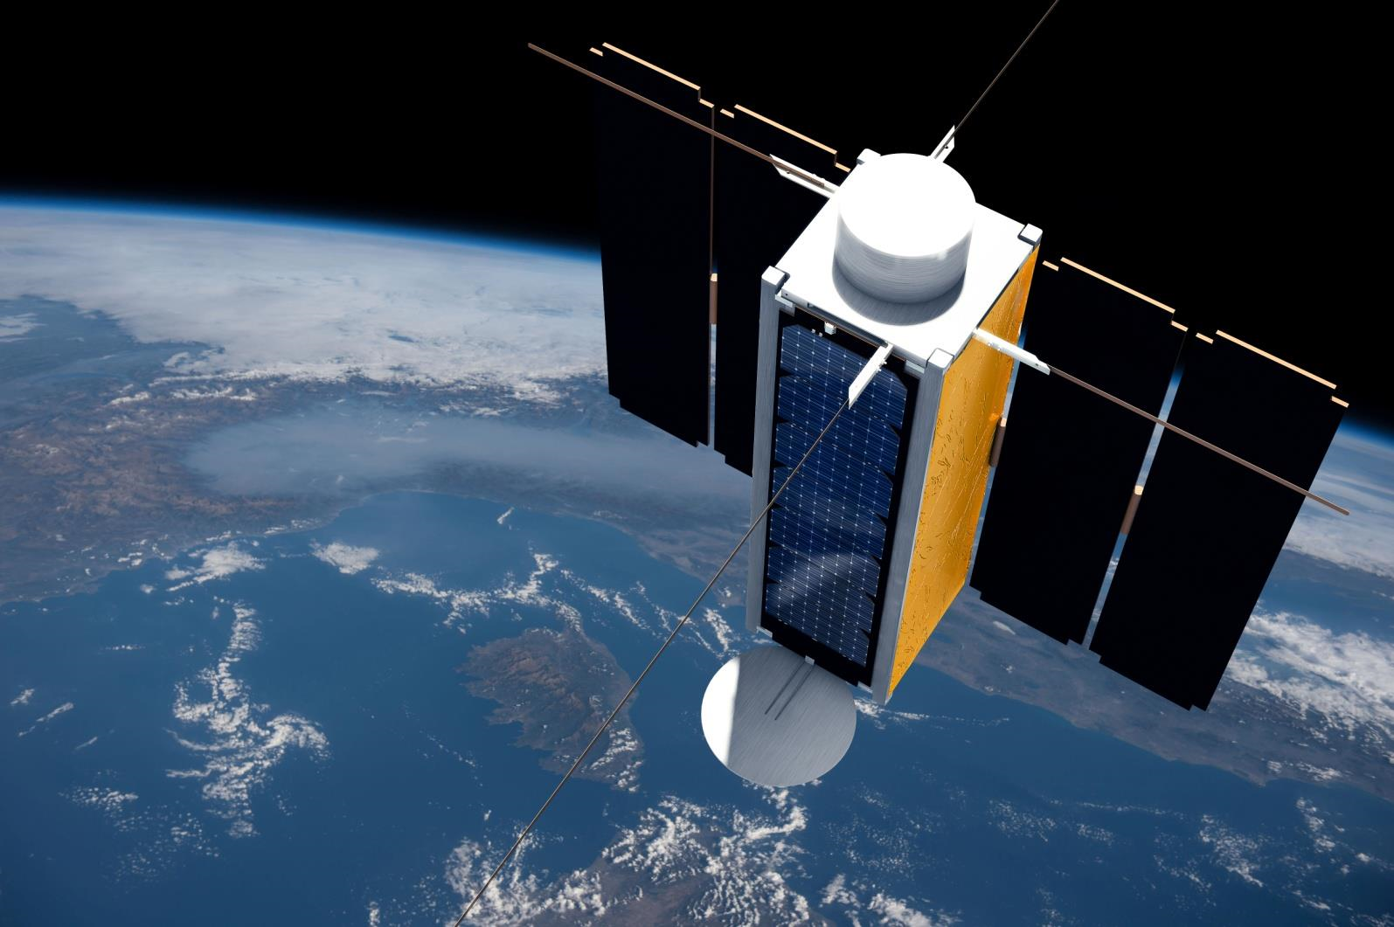
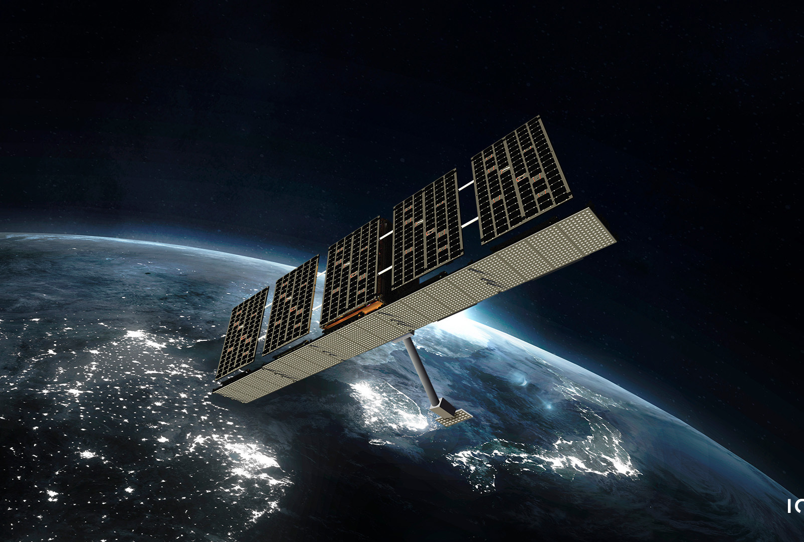
Upcoming Launches
2025
2026-2027 (tentative)
2 HydroGNSS +
8 Eaglet (IRIDE) + 2 Iceye
~10 November
Sentinel-6B
~17 November
MTG-I2, MetOp-SG B1, Sentinel-3C,
FLEX, Altius, CO2M-A
4
Notes:
2025
Transporter 15 Rideshare incl. 2 HydroGNSS (Scout), 8 Eaglet (IRIDE), 2 Iceye (Greek constellation) → Launch target 10 Nov. on Falcon 9
Sentinel-6B → Launch target 17 Nov. on Falcon 9
2026-2027 (tentative)
MTG-I2,
MetOp-SG B1,
Sentinel-3C,
FLEX,
Altius,
CO2M-A

Slide 5


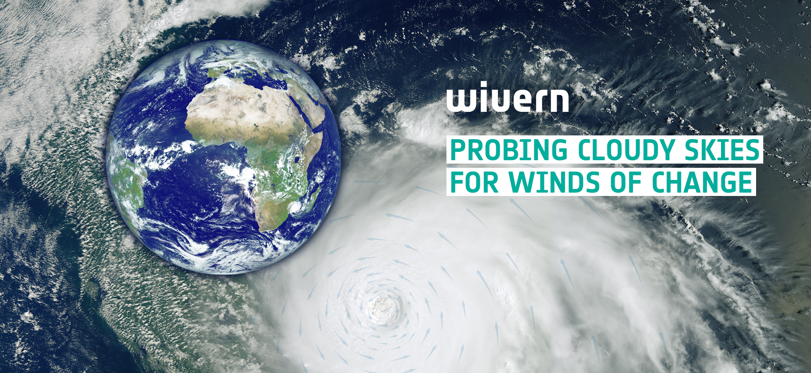

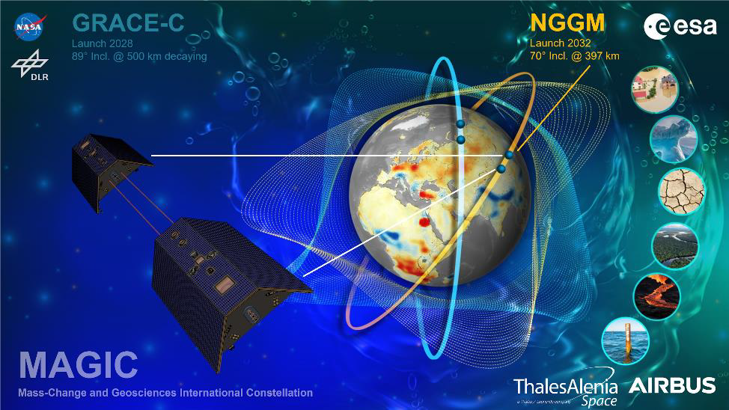
Programmatic Highlights (1/2)
WIVERN Selected as EE11
WInd VElocity Radar Nephoscope for observing global winds, clouds & precipitation
Earth Explorer 12
Phase 0 ongoing for 4 candidate missions, CryoRad, ECO, Hydroterra+, Keystone
Scout 2nd Cycle
Contracts signed for shortlisted missions, HiBiDiS, NAIAD, SIRIUS and SOVA-S
NGGM
Consolidated system design & Intermediate System Requirement Review on-going with industry
First space-based mission to provide in-cloud winds with additional high-resolution reflectivity profiles of rain, snow and ice water
5
Notes:
Earth Explorer 11:
WIVERN selected for implementation as 11th Earth Explorer mission
Earth Explorer 12:
Phase 0 activities ongoing for the 4 candidate missions, CryoRad, ECO, Hydroterra+ and Keystone, with Mid-Term Reviews held in Sept./Oct.
Scout 2nd Cycle
Contracts signed for shortlisted missions, HiBiDiS, NAIAD, SIRIUS and SOVA-S
NGGM
Consolidated system design & Intermediate System Requirement Review on-going with industry

Slide 6


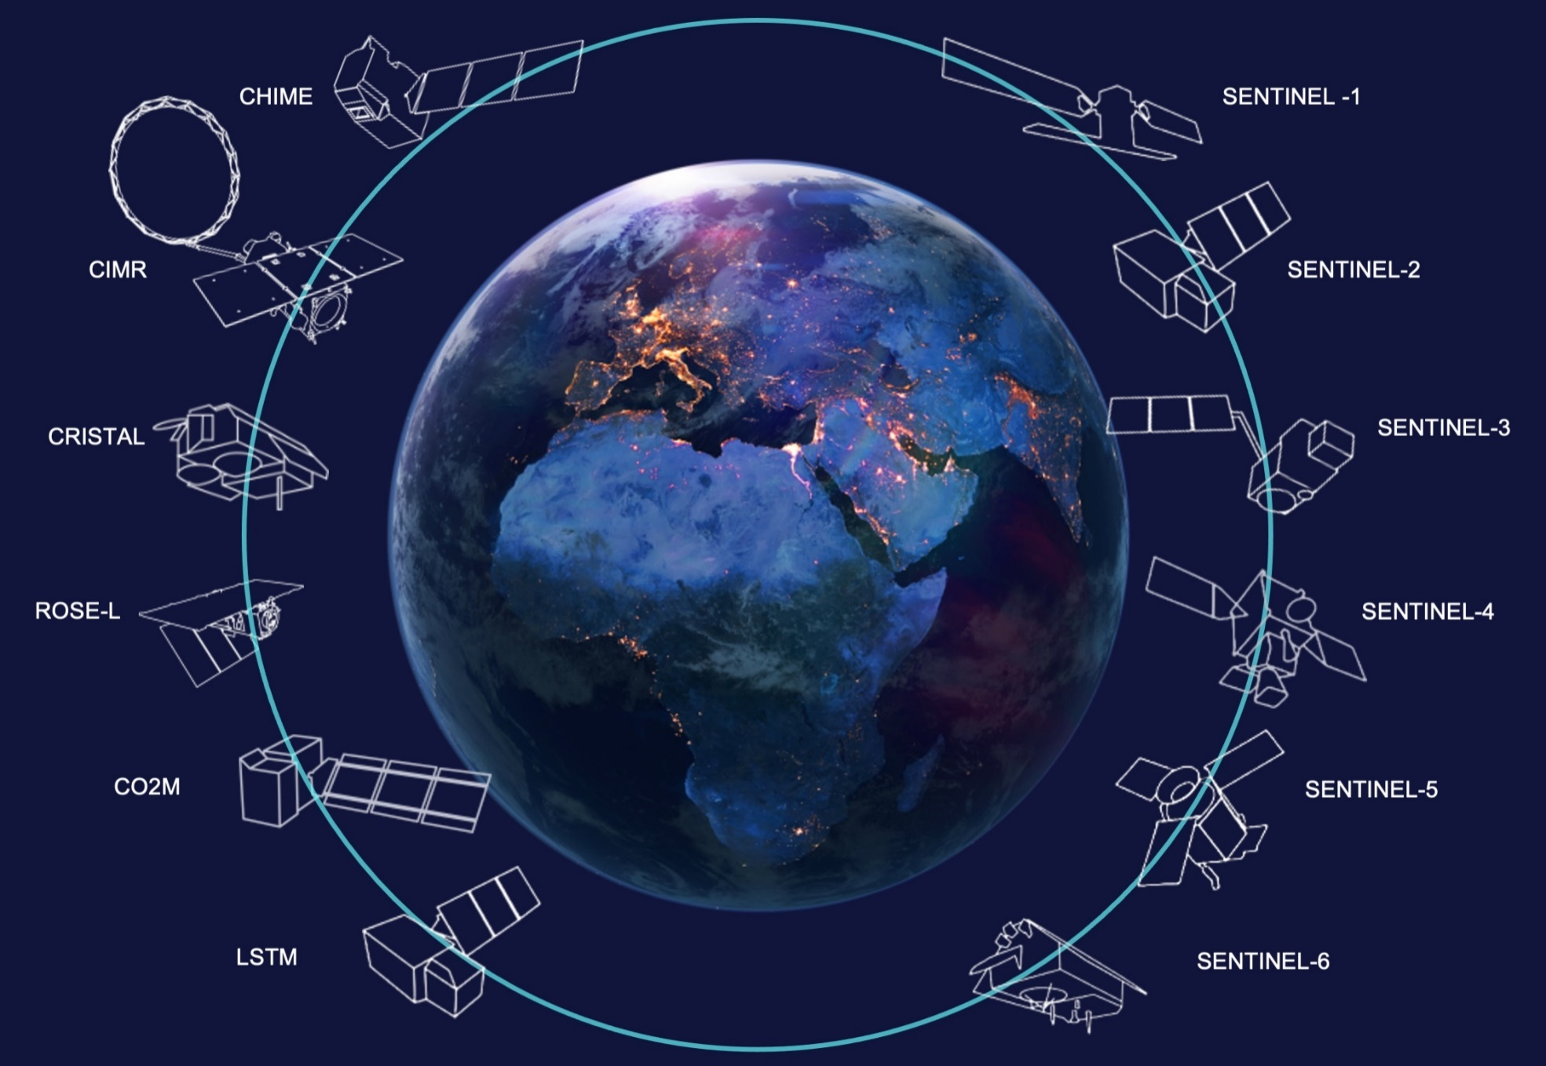

Programmatic Highlights (2/2)
Sentinels 1st Generation Status
S1A: Stable despite aging signs
S1C: Nominal operations
S2A: Extended campaign since March
S2B/C: Nominal operations
S3A/B: Nominal operations
S3C: Launch 1 Sep – 30 Nov ‘26
S4: Instrument verification started
S5: Instrument verification started
S6B: Launch preparations on track​
Sentinels Expansion & Next Gen. Missions
  CO2M: CO2I PFM development on-going
  CRISTAL: AMR-CR Radiometer PFM integrated
  CHIME: CDR ongoing, Board 8 October
  CIMR: Good progress on platform and LDRS
  LSTM: Instrument CDR closeout 10 July
  ROSE-L: System CDR Board 4 June
  S1-NG: proposal evaluation in progress
  S2-NG: Phase A/B1 progressing
  S3-NGT: B2/C/D/E1 ITT proposals due end Nov
  S3-NGO: PRR Board held in October
  S6-NG: System CDF completed
6
Notes:
Sentinels 1st Generation Status
S1A: Stable despite aging signs
S1C: Nominal operations
S2A: Extended campaign since March 2025
S2B/C: Nominal operations
S3A/B: Nominal operations
S3C: Launch 1 Sep – 30 Nov ‘26
S4: Instrument verification started
S5: Instrument iverification started
S6B: Launch preparations on track​
Sentinels Expansion & Next Gen. Missions
CO2M: CO2I PFM development on-going
CRISTAL: AMR-CR Radiometer PFM integrated
CHIME: CDR ongoing, Board 8 Oct
CIMR: Good progress on platform and LDRS.
LSTM: Instrument CDR closeout 10 Jul
ROSE-L: System CDR Board 4 Jun
S1-NG: proposal evaluation in progress
S2-NG: Phase A/B1 progressing
S3-NGT: B2/C/D/E1 ITT proposals due end Nov.
S3-NGO: PRR Board held in Oct
S6-NG: System CDF completed

Slide 7
2025 Events (selected)
Q1 | Q2 | Q3 | Q4
03-05/02 Digital Twin Earth Components: Open Science Meeting, ESRIN | 27/05 European Space Days, Gdansk (Poland) | 15/07 Dragon 6 symposium, Qingdao (China) | 7-10/10 EO for MRV of Carbon Removal, DGI Byen (Denmark)
11-12/02 European Earth Observation Ecosystem 2040+ workshop, ESTEC | 04/06 One Ocean Science Congress, Nice (France) | 29/09 BiDS | Big Data from Space 2025, Riga (Latvia) | 24/11 2nd Ocean Carbon from Space WS, Online
10-14/02 BIOSPACE25, Biodiversity Insight from Space, ESRIN | 23-27/06 Living Planet Symposium, Vienna (Austria) | 29/09-3/10 IAC, Sydney (Australia) | 1-4 /12 International Ocean Colour Science Meeting, Darmstadt (Germany)
7
Notes:
27-28 January 17th European Space Conference (EU Space Policy Conference)
Highlights:
Signature of Ariane 6 launch service contract for Sentinel-1D
Announcement of third CO2M satellite
Space & Ocean Dialogue partnership agreement
Copernicus Contributing Missions Onboarding
Signature of contribution agreement with DG-INTPA for African-EU Space Partnership Prog.

Slide 8
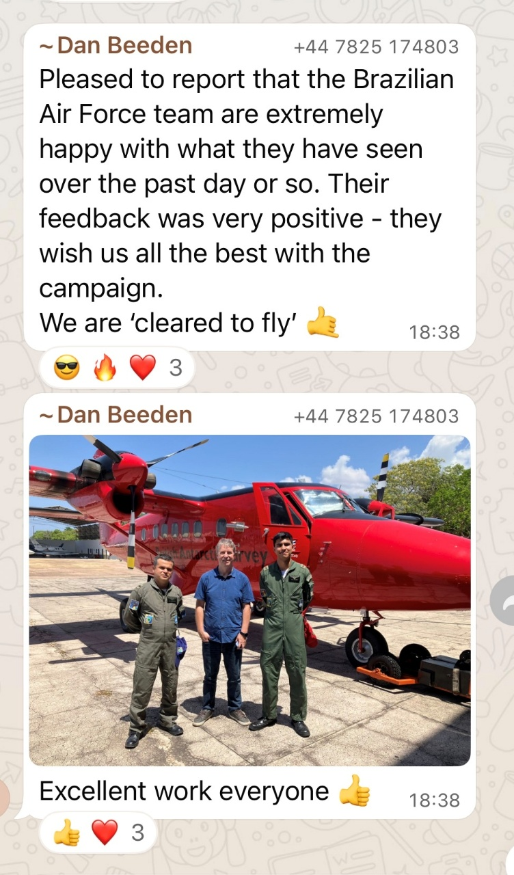
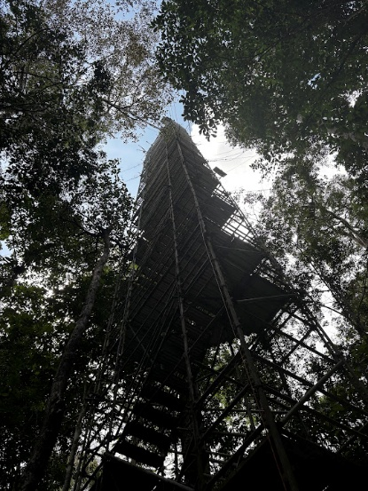
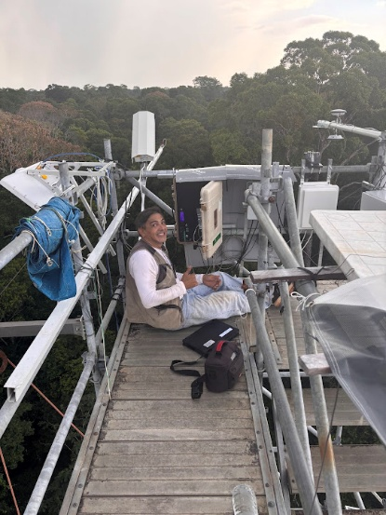
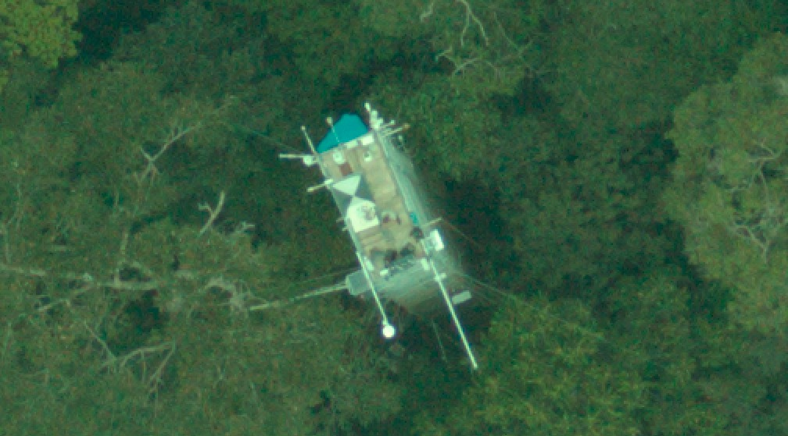
ESA-INPE CarbonARA Research Activity
Installation of long-term ground-based equipment completed in September
Twin Otter aircraft arrived in Santarem on 19th September
Cleared for flight on 26 September by the Brazilian Air Force after first test flight
Integrated ground (fixed and roving), airborne (GHG, Fire & vegetation), and satellite observations ongoing
Pretty much the only foreign airborne EO aircraft given permission to operate remote sensing in Brazil since the influential SCAR-B campaign with a NASA ER-2 in the mid-1990s
LBA KM67 flux tower in the Tapajos protected forest (left to right) from the ground, the top, and from the hyperspectral system from the aircraft
8
Notes:
Background
In its Strategy to Support the Global Stocktake of the UNFCCC Paris Agreement, the Committee on Earth Observing Satellites (CEOS) identifies the Amazon as a potential tipping point of terrestrial carbon emissions in the near future. Despite this, significant uncertainty remains regarding about the region’s current and projected greenhouse gas (GHG) emissions. To address these gaps, CEOS has called for a large-scale field experiment to provide new and detailed observations that improve scientific understanding of emission trends from natural sources in the Amazon Basin. Specifically, to better understand the carbon dynamics in carbon stocks and fluxes (CO₂, CH₄, N₂O) associated with different land cover types and fire.
➔ The Carbon Amazon Rainforest Airborne (CarbonARA) Research Activity is a direct response to this call.
The activity is a collaborative, field experiment delivering new insights into Amazon forest–carbon dynamics through integrated ground, airborne, and satellite observations, in partnership with ESA and INPE.
This study is led by King’s College London and is a collaboration between ESA, research institutions from ESA Member States and Brazil’s National Institute for Space Research (INPE) and Federal University of Western Pará (UFOPA).

Slide 9

THANK YOU www.esa.int
ESA UNCLASSIFIED – For ESA Official Use Only

