Slide 1

CEOS Plenary 2025
State of Play
Mauro Facchini
European Commission
Agenda Item 6.2.4
39th CEOS Plenary
Bath, United Kingdom
4th - 6th November, 2025

Slide 2




Use of Copernicus Data
@ Q2 2025
  955220 Copernicus users
  95167 TB of Sentinel data
  More than 1500 products in the service portfolio

Slide 3
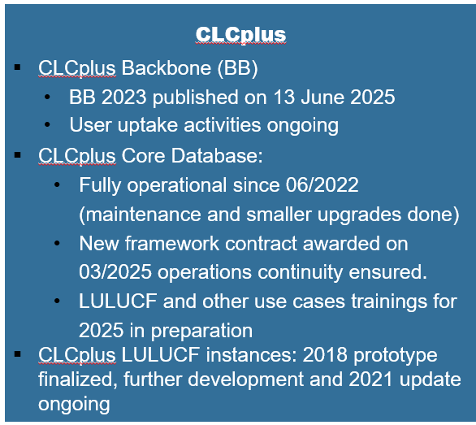




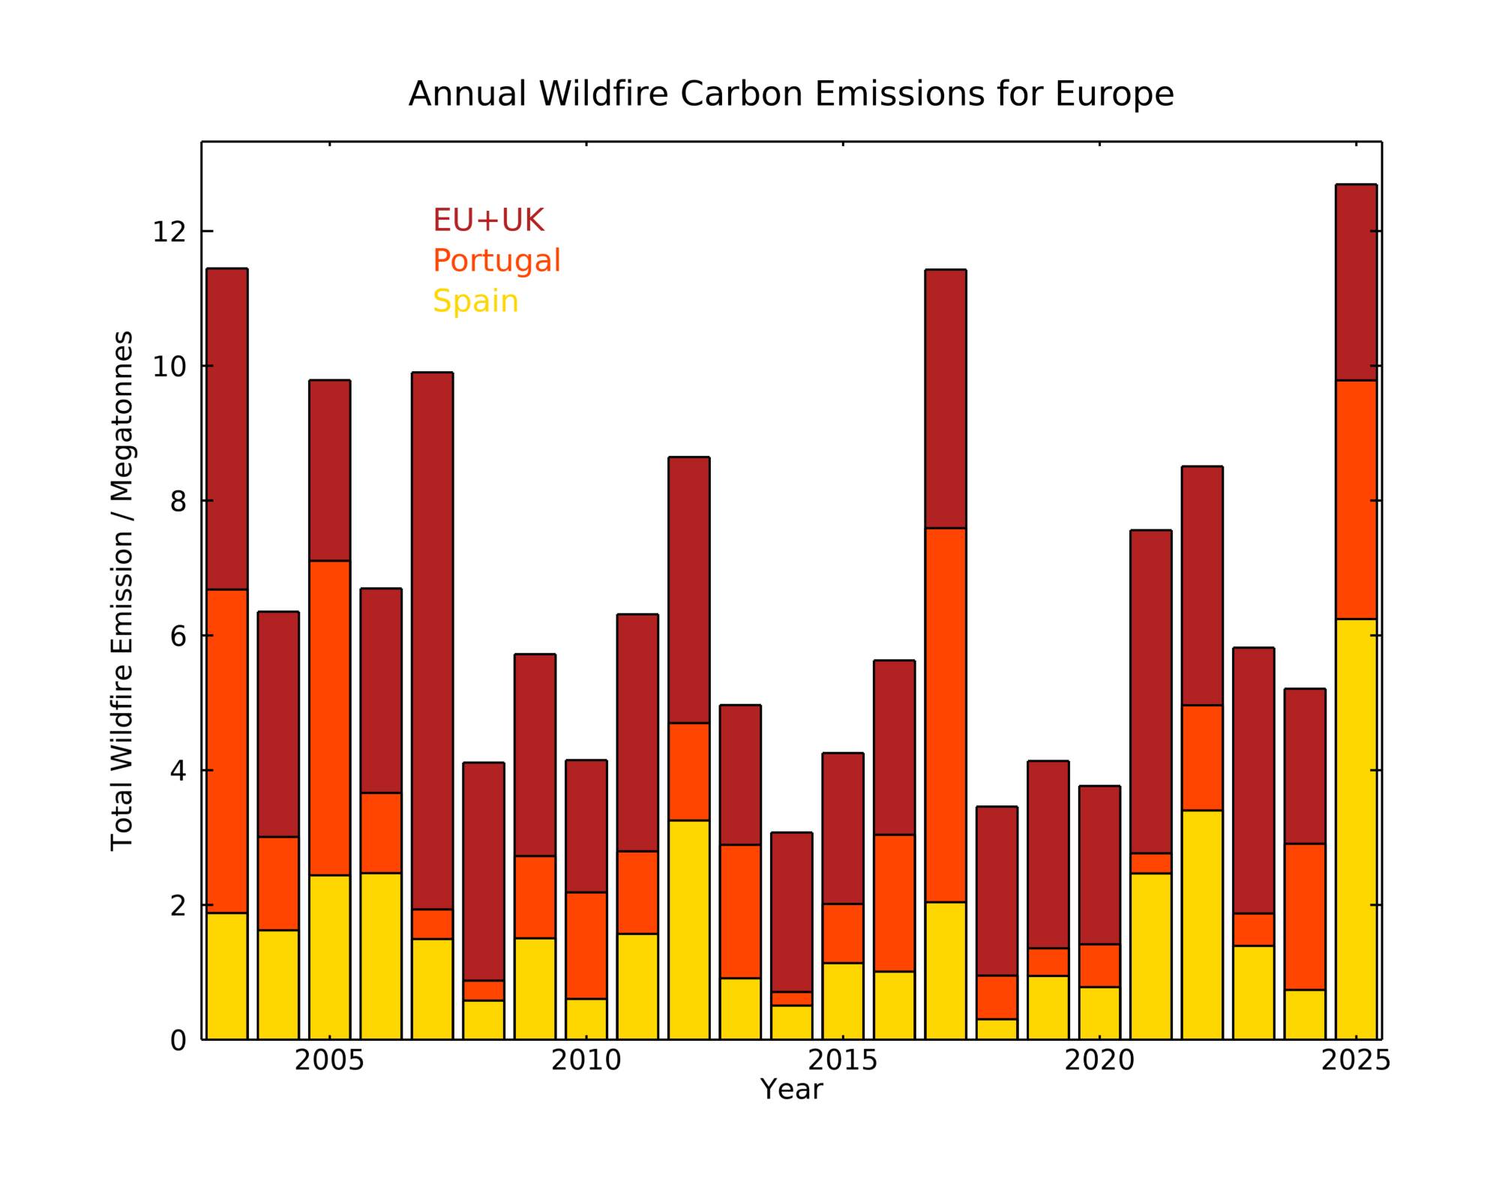
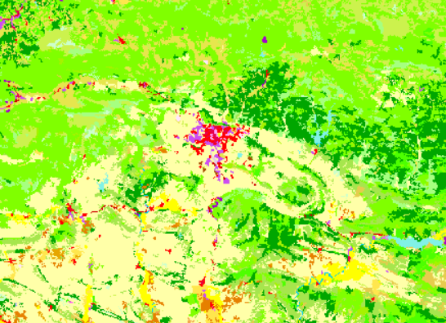


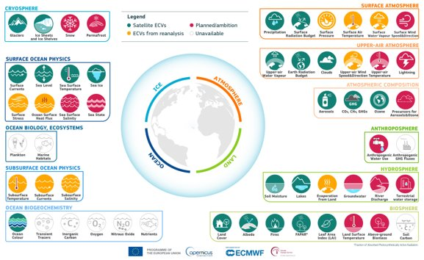
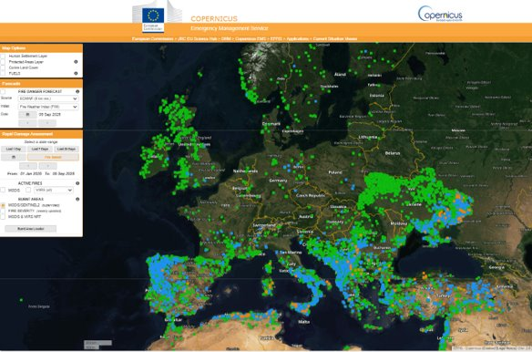
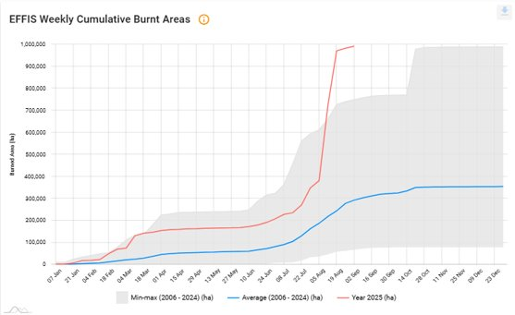
Copernicus products (examples)
Monitoring wildfires and their impacts
Essential Climate
Variables programme
Wildfire Early Warning & Monitoring
Emergency
Management

Slide 4

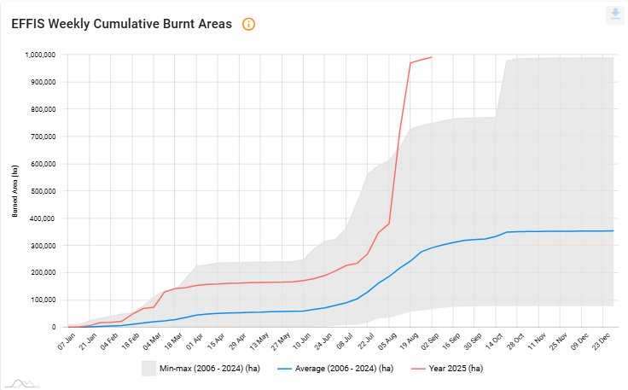
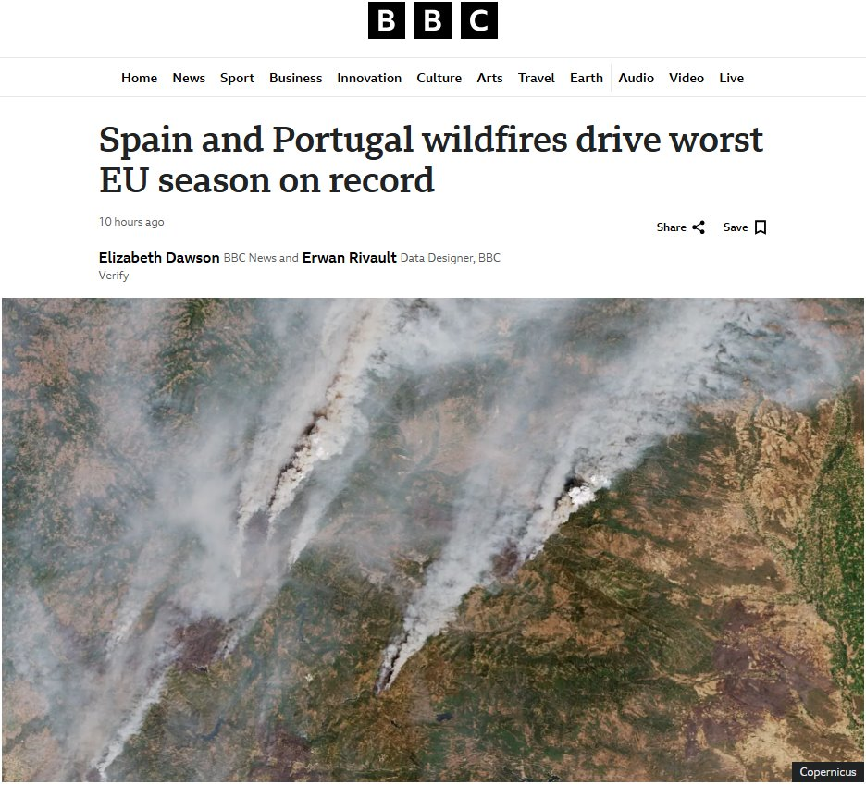
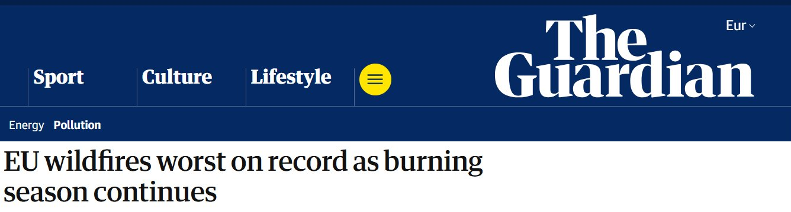
Emergency activations in 2025 and over the last 13 years
13 years of CEMS on-demand mapping
>1000 activations
>8500 products released
> 10000 images analysed
> 130 different countries served
In 2025 …
39 Rapid Mapping activations (29 wildfires) and 436 products delivered; 4 Risk and Recovery Mapping activations (3 for preparedness for floods and wildfires). ​
​
EFFIS mapped over 6570 wildfires in 2025 and over 1,026,449 ha burnt in the EU. The burned area represents an historical annual record in the European Union and CEMS EFFIS data had a very high media coverage.
Drought in Europe in August 2025 affected the UK, France, northwestern Iberian Peninsula, southern Ukraine, and large parts of south-eastern Europe - from Hungary to the Black Sea and Türkiye (report).

Slide 5
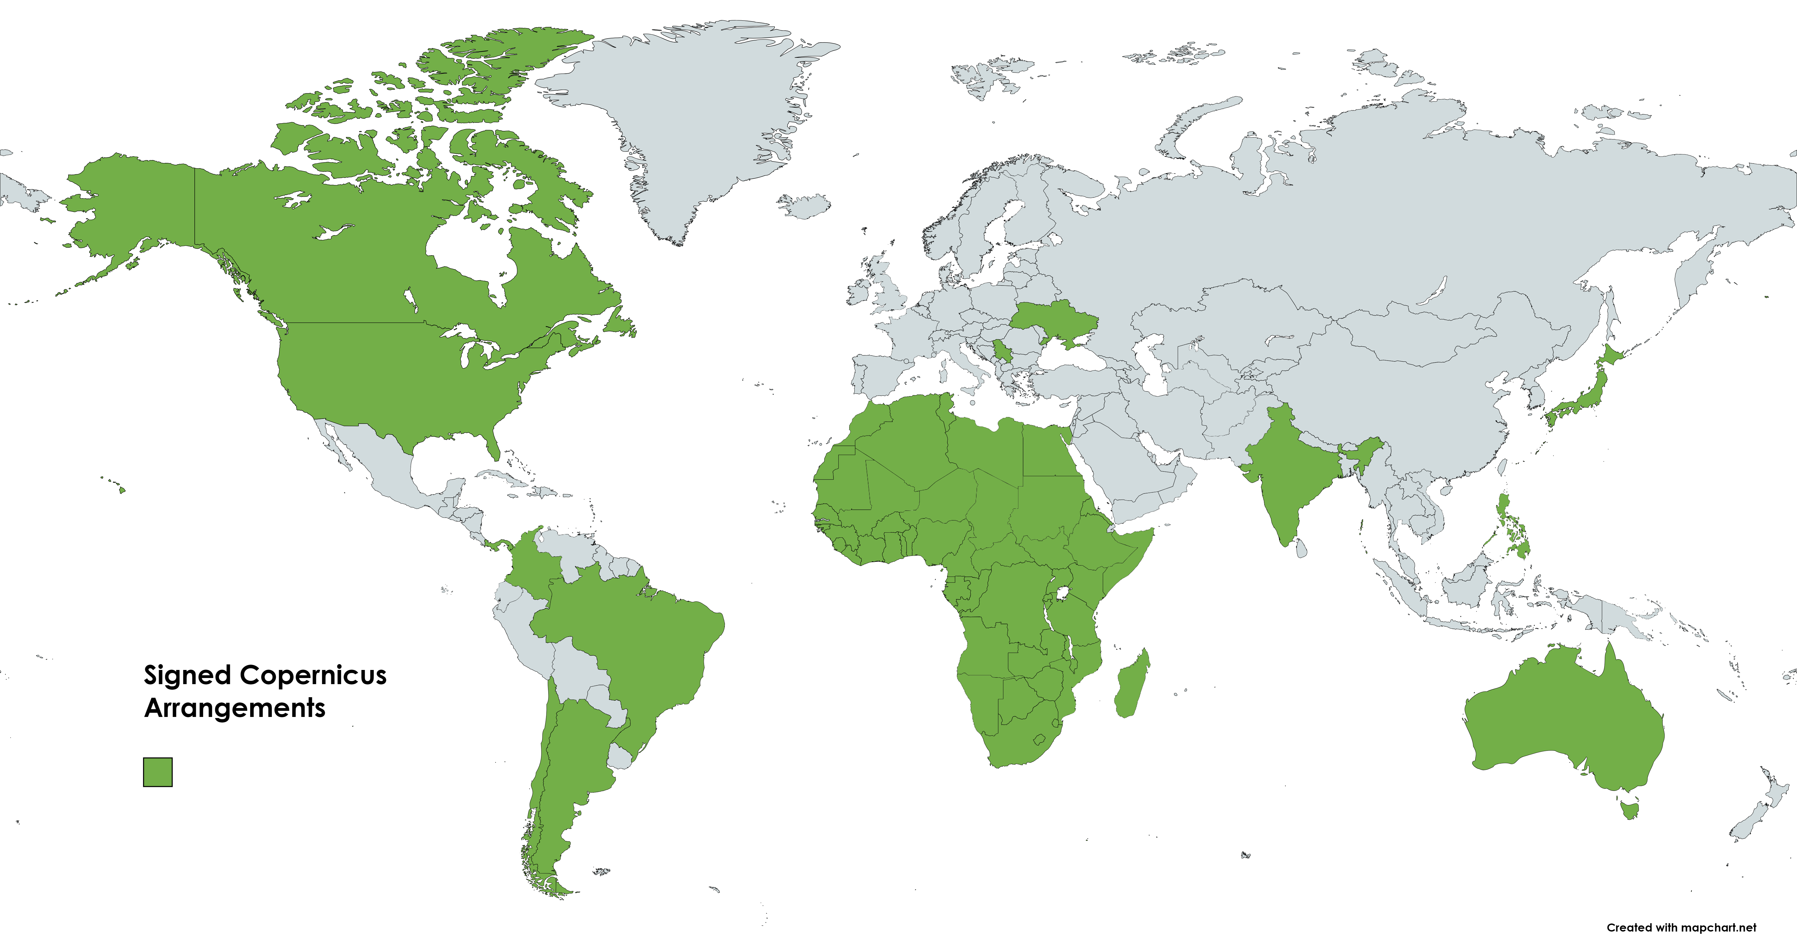
Copernicus Agreements

Slide 6

Copernicus Sentinels 1st gen deployment (tbc)
16th November
Sentinel 2C
Sentinel 1C
Sentinel 3C
Sentinel 2D
Sentinel 4A
Sentinel 3D
Sentinel 6C
Sentinel 5B
Sentinel 4B
Sentinel 5A
Sentinel 1D
Sentinel 6B
2024
2025
2026
…
2028
…
2030
2032
2034

Slide 7
Copernicus expansion missions deployment (tbc)
CIMR A
CHIME A
ROSE-L A
CHIME B
LSTM B
ROSE-L B
CIMR B
CO2M A
CRISTAL B
CO2M B
CRISTAL A
CO2M C
LSTM A
2026
2027
2028
2029
2030
2031
2032

Slide 8

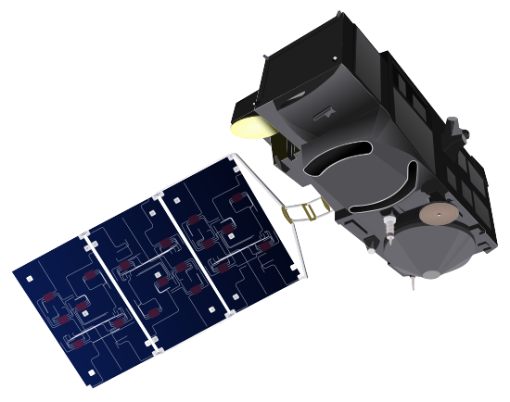
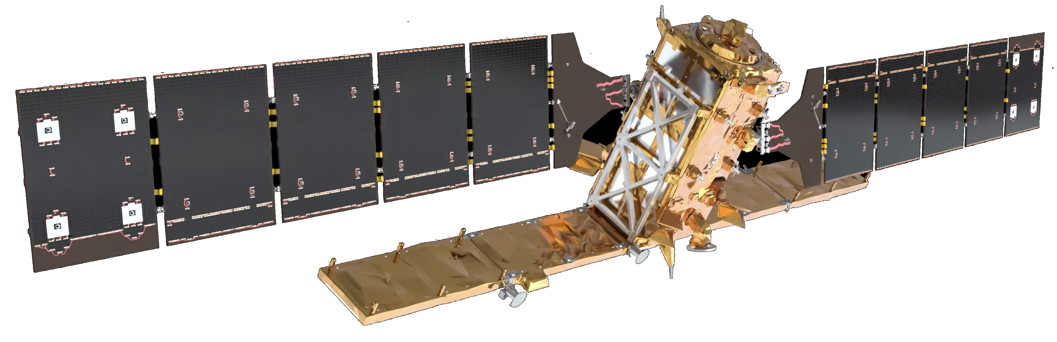
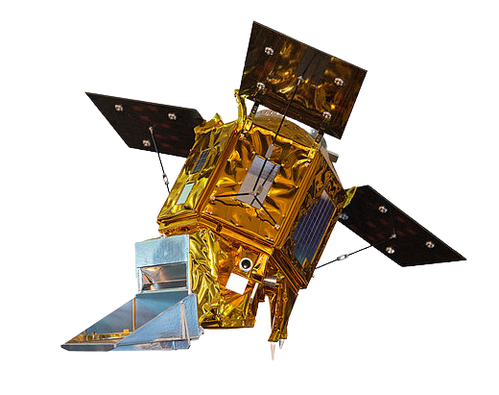
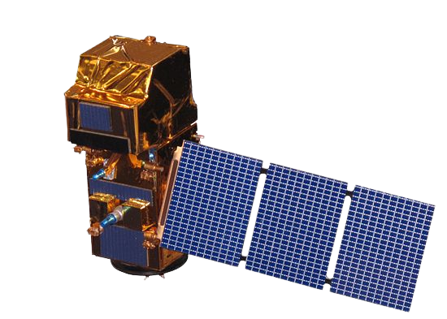
Immediately available data - Sentinels
Sentinel-1
  GRD SAFE-COG
  GRD SAFE (last year)
  OCN
  SLC
  L0 RAW (Europe full, ROW last year)
Sentinel-3
  OLCI L1/L2 NRT and NTC
  SLSTR L1/L2 NRT and NTC
  SYN L2 STC, NTC
  SRAL L1/L2 NRT, STC and NTC
Sentinel-5P
  Level-1B NTC
  Level-2 NRT and NTC
Sentinel-2
  L1C
  L2A
Sentinel-6
  ALT L1 STC, NTC
  ALT L2 NRT, STC, NTC
  MWR L2 NRT, STC, NTC

Slide 9

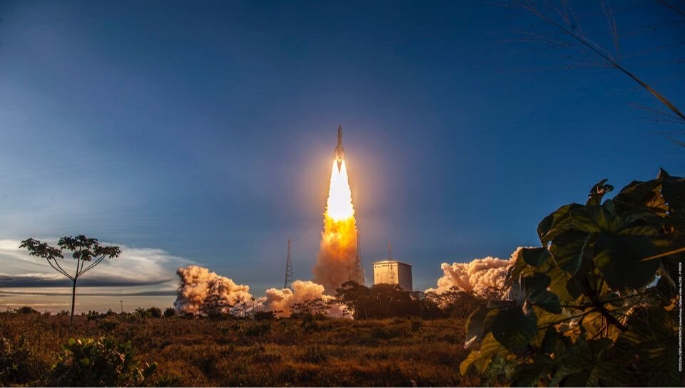
Thank you

