Slide 1
CEOS Plenary 2025
Report from German Space Agency (DLR)
Godela Rossner & Klaus Schmidt German Space Agency, DLR
Agenda Item 6.2.4
39th CEOS Plenary
Bath, United Kingdom
4th - 6th November, 2025

Slide 2
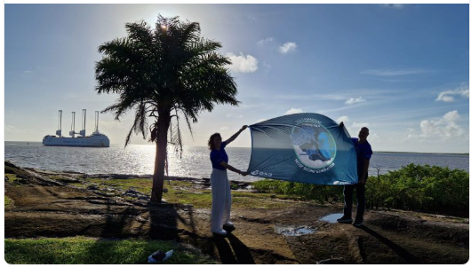

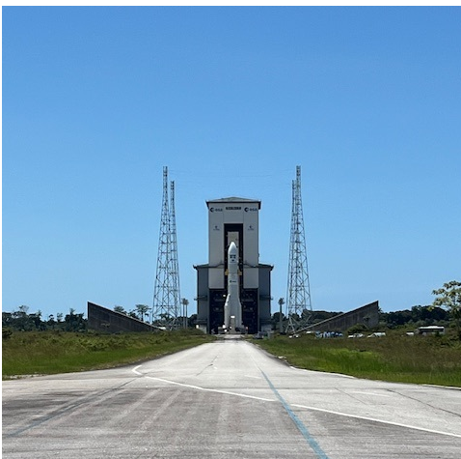
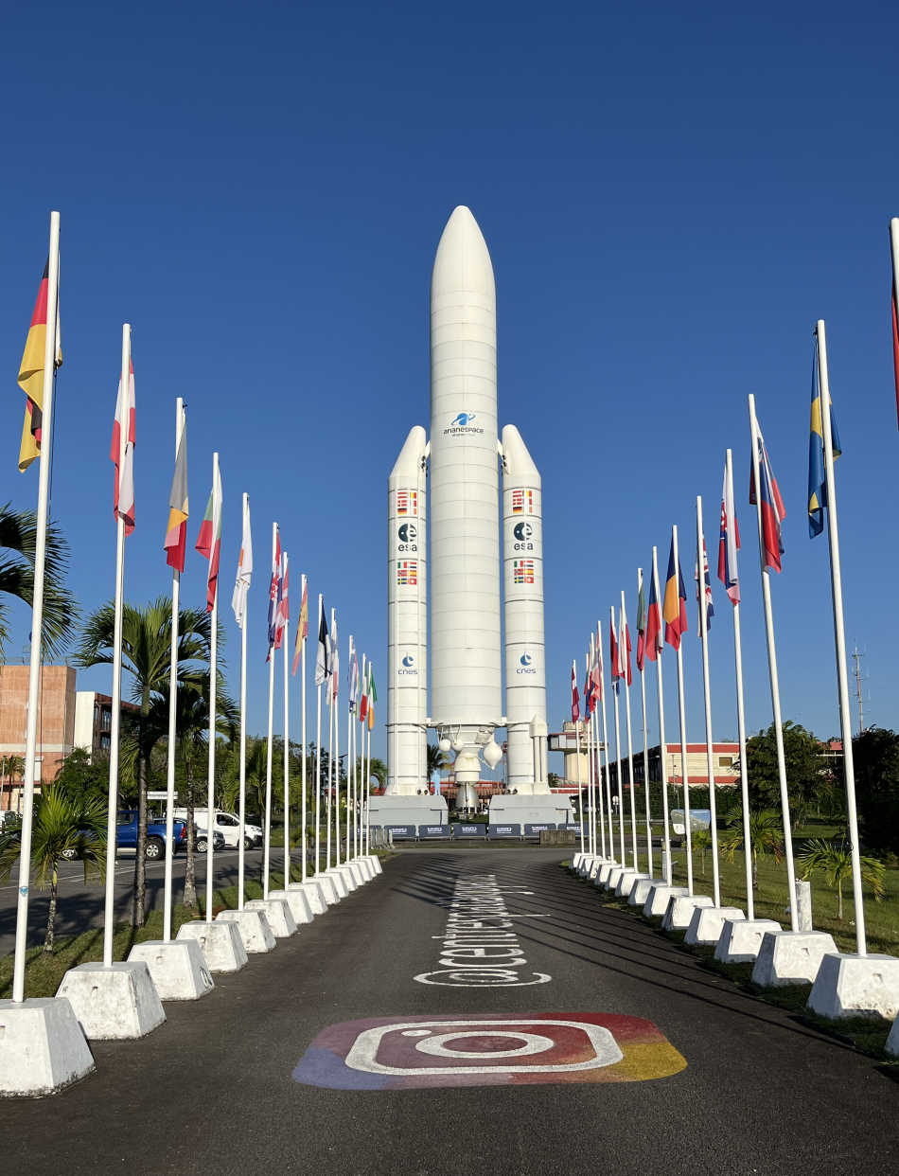
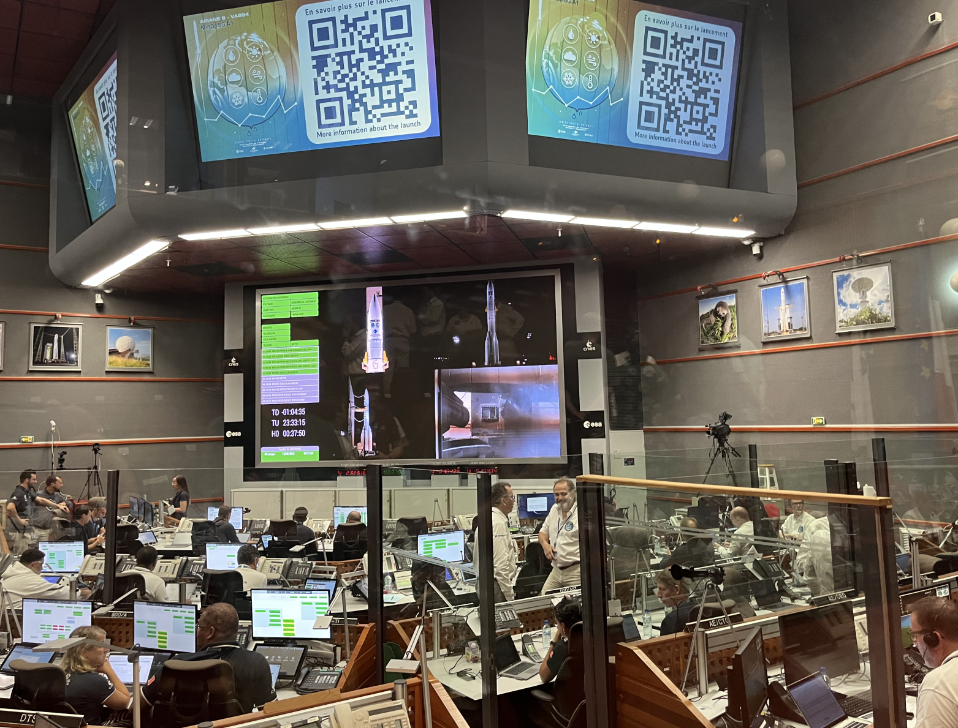
Launch und SIOV
Arrival of Metop-SG A in Kourou 16.6.2025
Launch from Kourou with Ariane 6.2 am 12. (13.) August 2025
SIOV ongoing
METimage Commissioning completed successfully
Performance verification in orbit ongoing
First light deliverd in very good quality

Slide 3
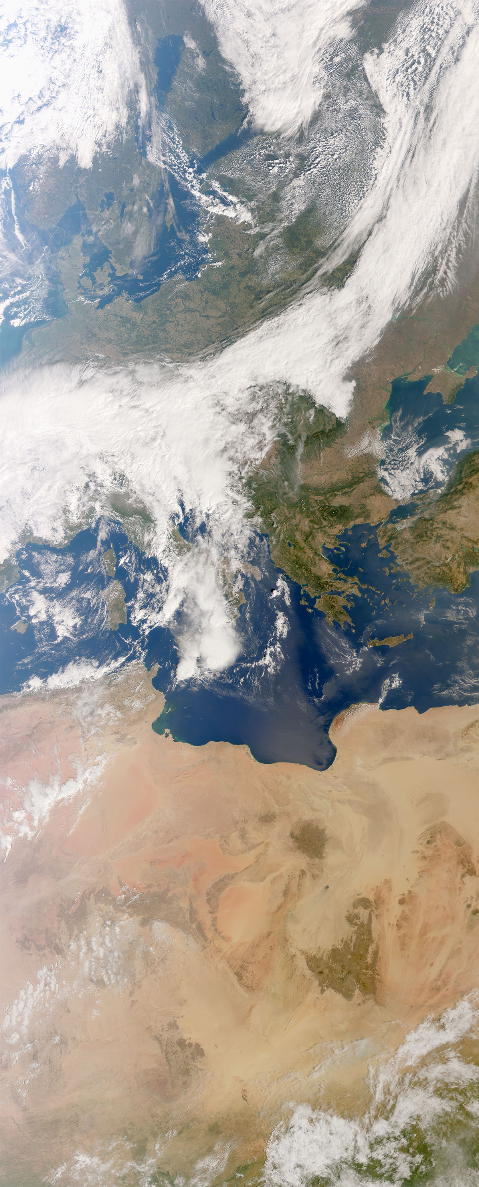
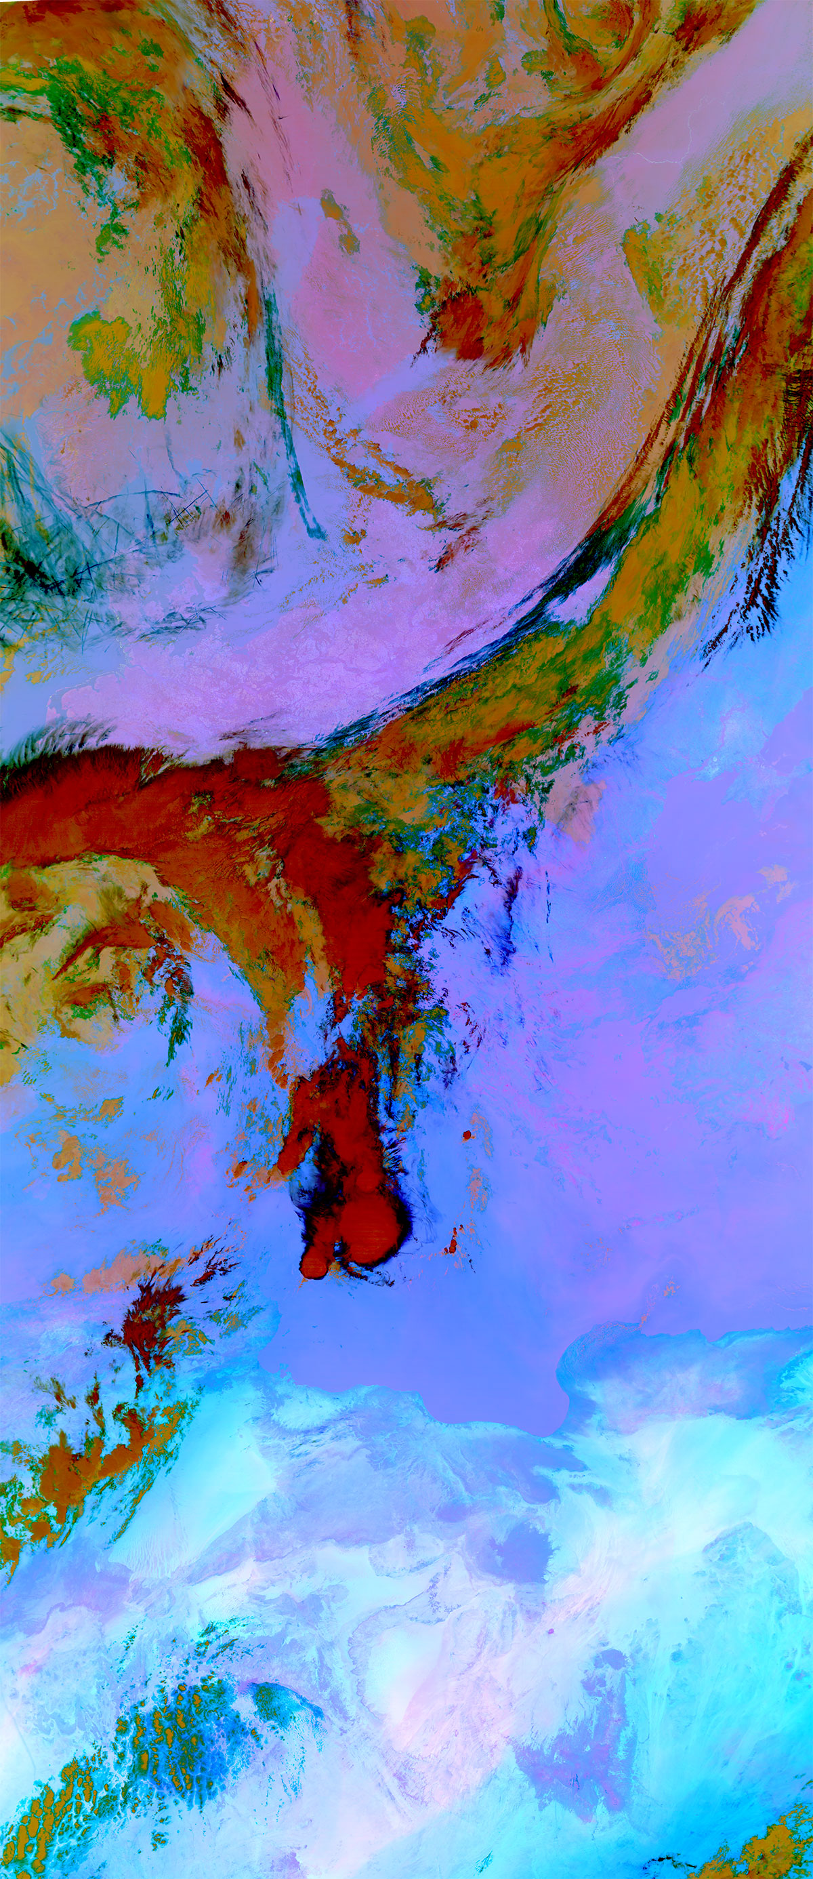
METimage First Light
METimage first light captured on 24 September
Left: „true colour“ RGB image
Right: Dust RGB from three thermal channels
Credit: EUMETSAT

Slide 4

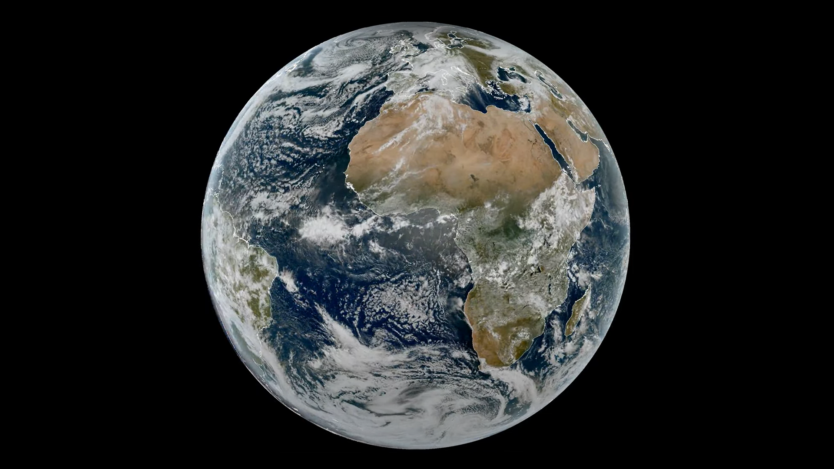



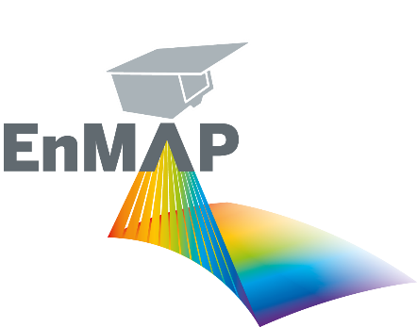



Missionen AO
2025
Land Surface & Topography
Atmosphere & Climate
Weather & Climate
2007
2010
2029
Hydrology / Gravity
2028
2022
Environment & Ressources
GRACE-FO 2018
GRACE 2002
Credit: EUMETSAT/ESA

Slide 5

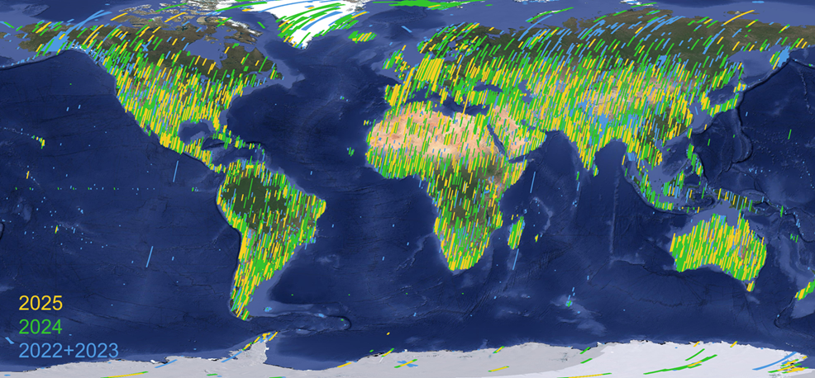
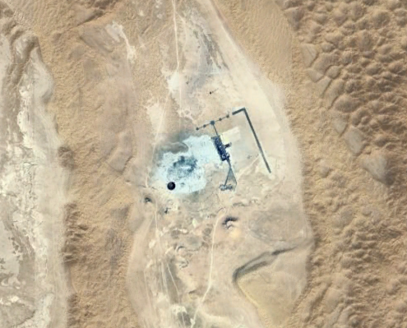
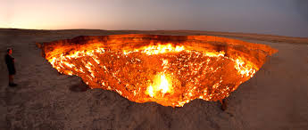

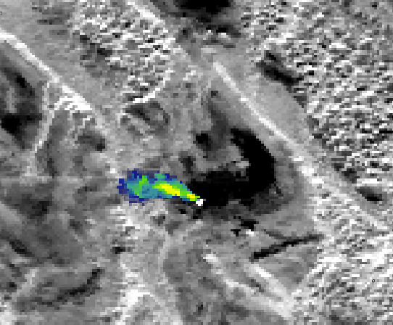
EnMAP – 3 years Routine Operations
Comissioning
phase
Routine operations
Launch
April 1st
Nominal lifetime
Extension envisioned
NOW
2022/11
2027-09
2022/04
Worldwide data archive
EnMAP transitioned from a pioneering science mission to a mature operational platform
Sophisticated tasking mission with strong user support
Excellent data quality demonstrated by science applications
Operational services in development
EnMAP is a pathfinder mission for ESA’s CHIME Mission: CHIME L2A products build on EnMAP
EnMAP-PRISMA Cooperation: Coordinated acquisitions and data fusion for enhanced EO applications
USGS Collaboration: Landsat Next Science Product development based on EnMAP
In 2023 scientific demonstration of EnMAP’s excellence capability
Since early 2024 systematic provision of selected scenes including incorporation of data tasking (foreground/background mission) into EnMAP operation & provision of updated / re-processed archived data
Today’s milestone: Interface to IMEO open for automatically L1B access allowing seamless processing chain for IMEO methane maps
International collaboration supported by EnMAP
>150.000 products archived
> 5.100 registered users from 130 different countries
Courtesy E. Carmona
Supporting IMEO
EnMAP 2024/09/22 - 07:40:11
Collaboration with IMEO
Darvaza gas crater - Turkmenistan
Courtesy Adriana Valverde-Iglesias (UPV)

Slide 6
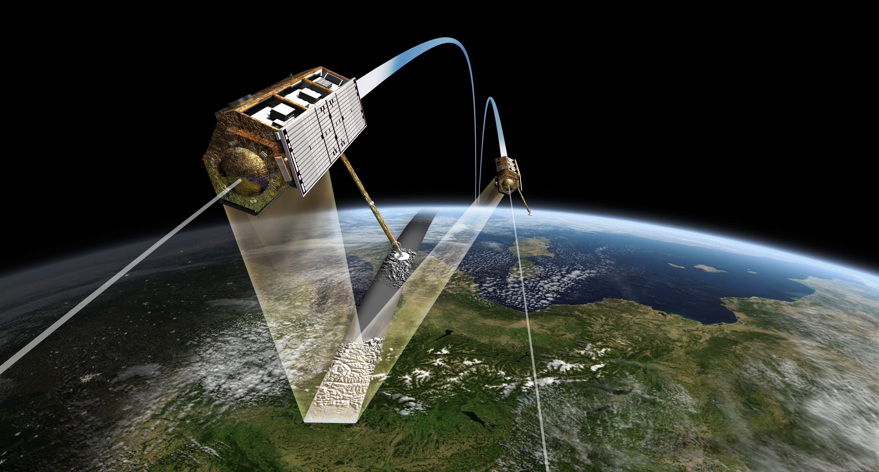


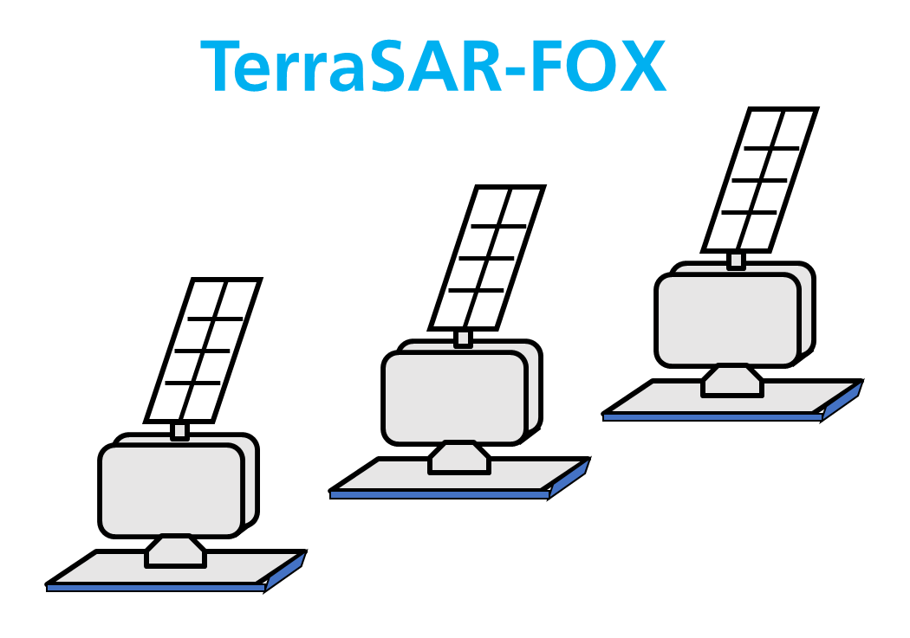
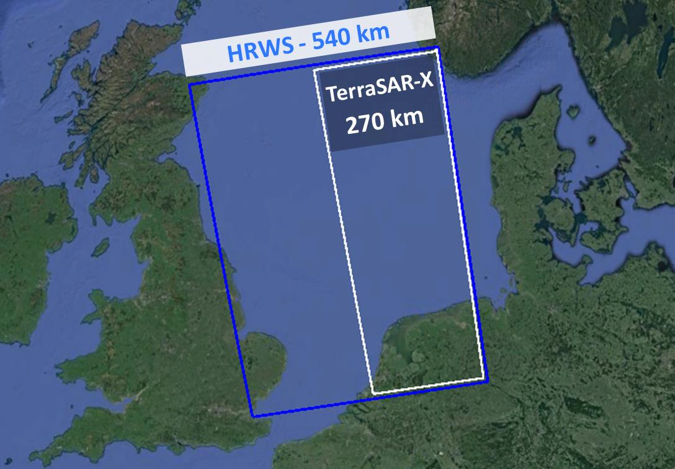
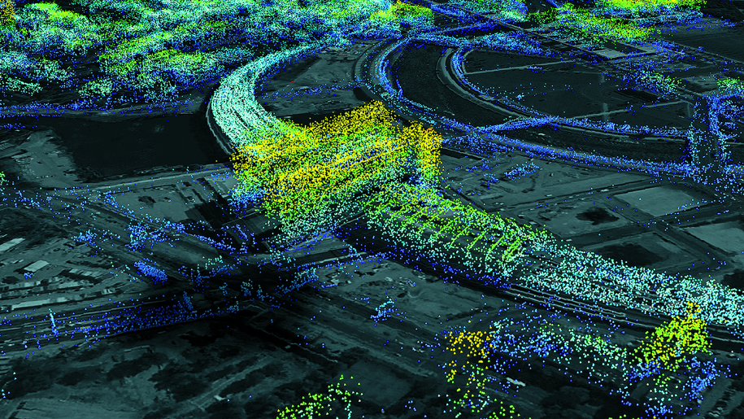
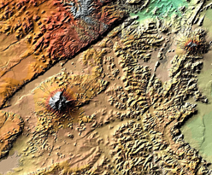
German X-Band and TerraSAR Follow-On X-Band Mission
2007
2010
2026
2028
2030
Now
TerraSAR-X
TanDEM-X
2024 | 2025 | 2026 | 2027 | 2028 | 2029 | 2030 | 2031 | 2032 | 2033
Now
OHB - Bremen
Phase 0
Phase A
B1
Phase B2/C/D
ADS - Friedrichshafen
Phase 0
Phase A
B1
Phase 0 successfully completed in July 2025
TerraSAR-FOX special features
Main features of the TerraSAR-FOX mission:
Multistatic mission → Enhanced SAR precision
Formation of 3 small/medium size satellites
Radar instrument → Pioneering SAR technology
SAR acquisitions over large regions
Very high data quality and precision
3D/4D capability &
Digital Elevation Models

Slide 7
Mission Preparation
Call for missions 09/2024
Directed at scientific, commercial & governmental institutions
Small Sat Missions (SM) &
Institutional Missions (IM) w/ different philosophies
23 submissions
6 concepts selected for studies
IM1: VeggieH - Vegetational carbon cycle
SM3: MUSE - Multispectral/TIR
SM4: Boltzmann - Multispectral/TIR
IM2: HyperEarth - Hyperspectral constellation
SM1: SENSORIS - Short-term gravitational variables
SM2: ODEM - AtOx in Thermo-/Mesosphere
Q4/25
Kick-Offs of Phase 0/ feasibility studies
Q3/26
Results of Phase 0/ feasibility studies
Q4/26
Evaluation of results and recommendation for implementation

Slide 8





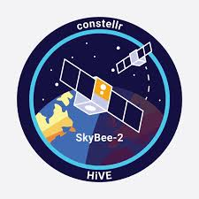
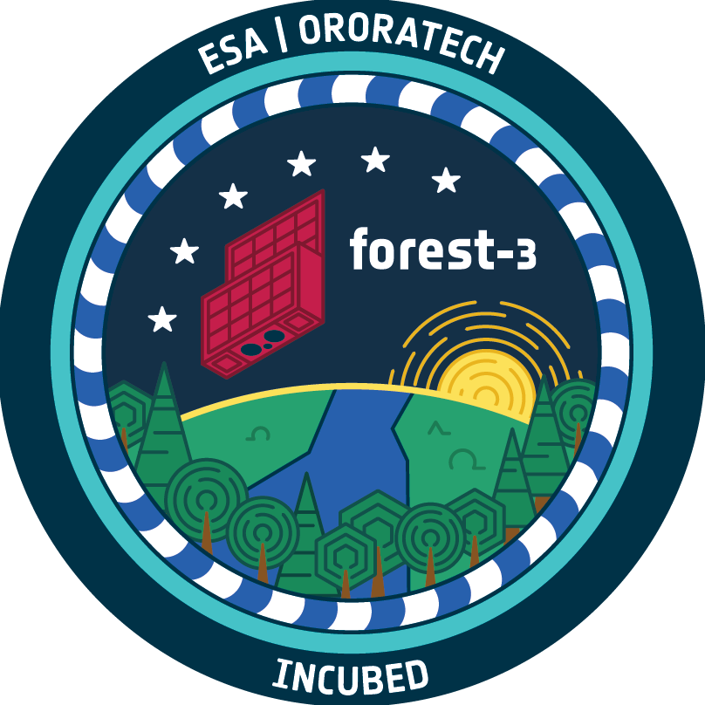
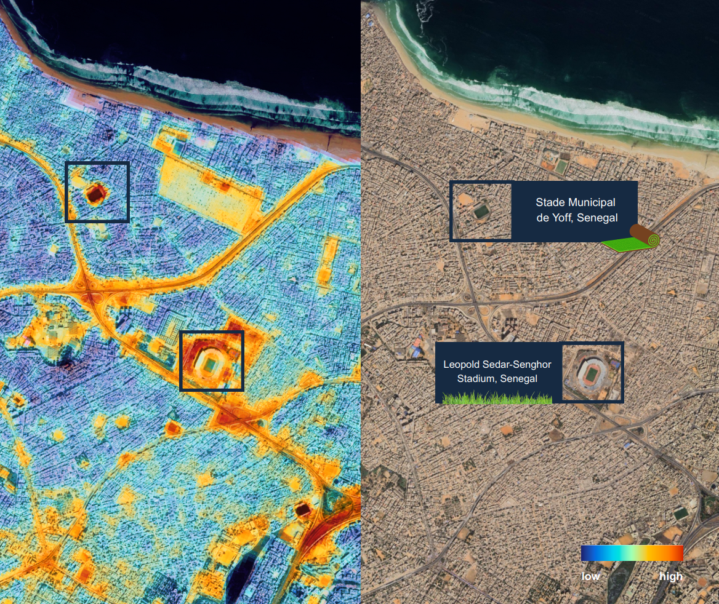
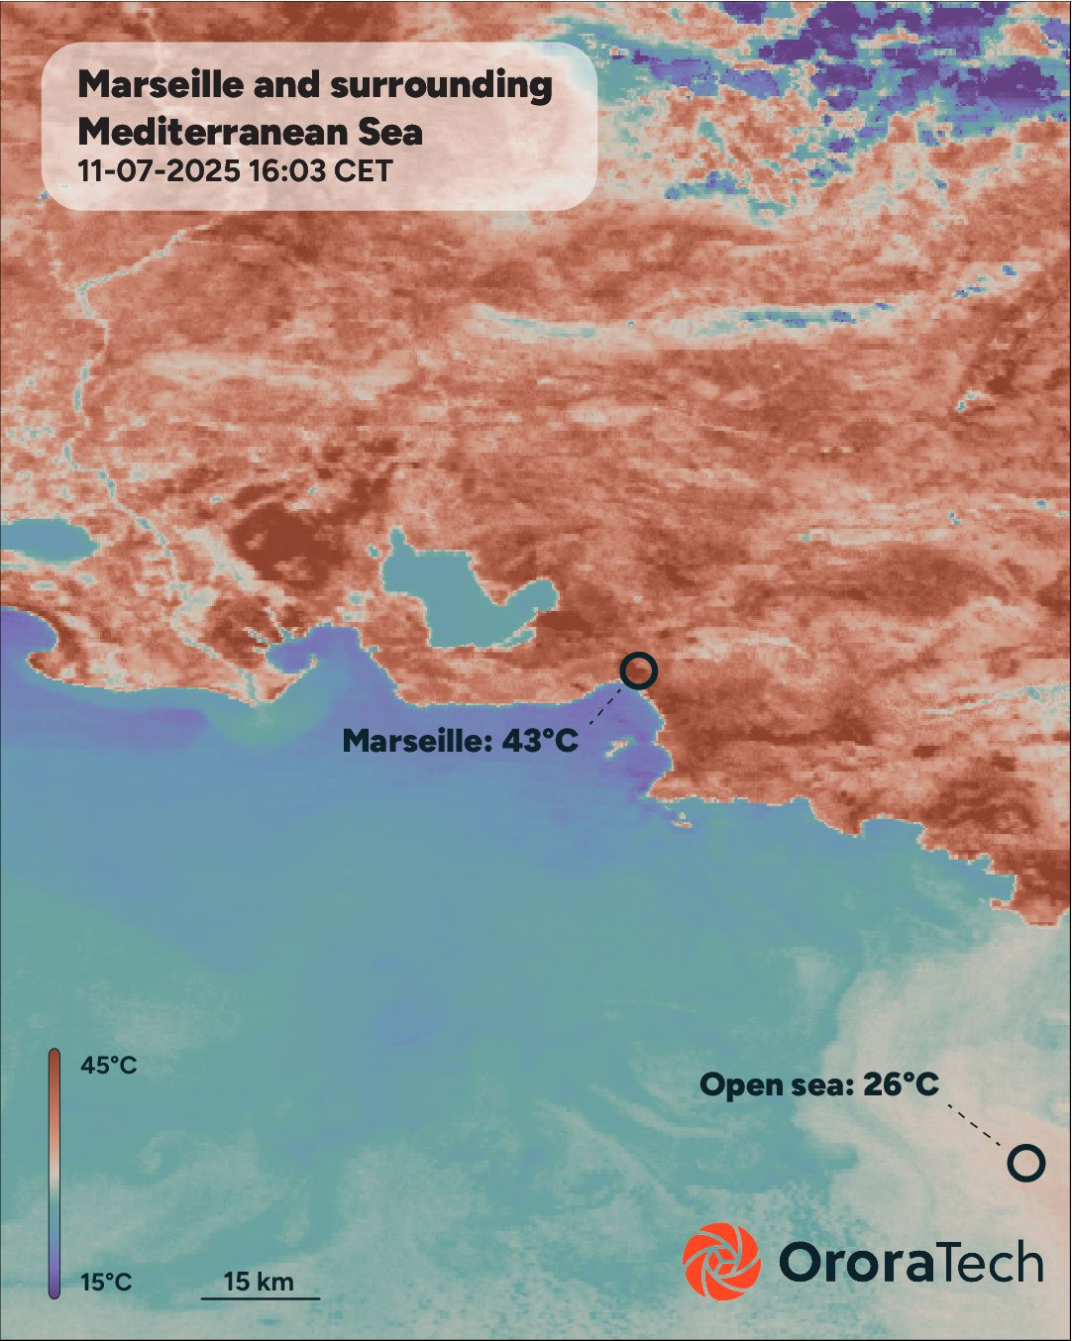
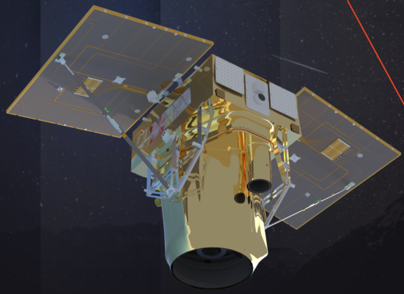
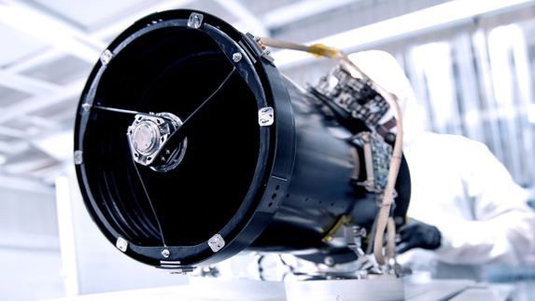
New Space „Made in Germany“
German New Space Start-ups supported by the German Space Agency through data purchase contracts and free data provision for science in Germany via the EO-Lab platform.
High spatial resolution thermal data
2 satellites launched as of 2025
Contract to freely provide monthly packages for scientific purposes
High temporal resolution thermal data
11 satellites launched as of 2025
Contract to freely provide individual scenes for scientific purposes
Very high resolution visual, near and short-wave infrared data
First launch in 2026
Evaluation of demand and potentials in science for possible contract
© Marbe Imaging, Scanway Space
© constellr
ALTERNATIV-BILD zu Marble, ich konnte es aber nicht im Internet finden und weiß nicht, ob es confidential ist
© OroraTech
Notes:
Ursprüngliche Überzeile, vielleicht mündlich: several german New Space Start-Ups aiming to become leading actors in different EO domains
Überblick zu Spezifiktationen der New Space Firmen und zu Vertragsumfänge:
constellr:
2 Satelliten im Orbit, 30 m Auflösung, etwa 4 Tage Wiederholrate, Schwad etwa 25 km, Temperaturgenauigkeit von 1 Kelvin bis 2 Kelvin
Vertrag für etwa 400k für 3 Jahre, Datenkäufe sowie technisch-inhaltlicher User support
Datenbereitstellung für Forschende mit genehmigtem Zugriffsantrag: 1 Jahresabo über Area of Interest, das vom DLR festgelegt wird, 6 Monatsabos über Zielgebieten, die von Forschenden selbst definiert werden können. Alle aufgenommenen Daten werden im Archiv gespeichert und stehen Berechtigten zur Verfügung
OroraTech:
11 Satelliten im Orbit, 200 m Auflösung, halbtägige Wiederholrate, Schwad bis etwa 400 km (mit Zwei-Kamera-System), Temperaturgenauigkeit etwa 3 Kelvin
Vertrag für etwa 400k für 3 Jahre, Datenkäufe sowie technisch-inhaltlicher User support
Datenbereitstellung für Forschende mit genehmigtem Zugriffsantrag: 12 Szenen über Area of Interest von etwa 200.000 km², das vom DLR festgelegt wird, 11 Szenen über Zielgebieten von über 200.000 km², die von Forschenden selbst definiert werden können. Alle aufgenommenen Daten werden im Archiv gespeichert und stehen Berechtigten zur Verfügung
Marble Imaging:
Bis zu 200 Satelliten bis 2032 je nach Nachfrage, Launch erster eigener Satellit in 2026, geplante räumliche Auflösung von 80-50 cm
Untersuchung zur Vorbereitung eines Datenvertrags ab 01.01.2026 über einen Zeitraum von 18 Monaten, Ziel dieser Untersuchung ist die Analyse u.a. die Erfassung von Nutzergruppen sowie die Ermittlung von Anforderungen und Anwendungsfällen mit Blick auf die Daten der Marble-Konstellation

Slide 9




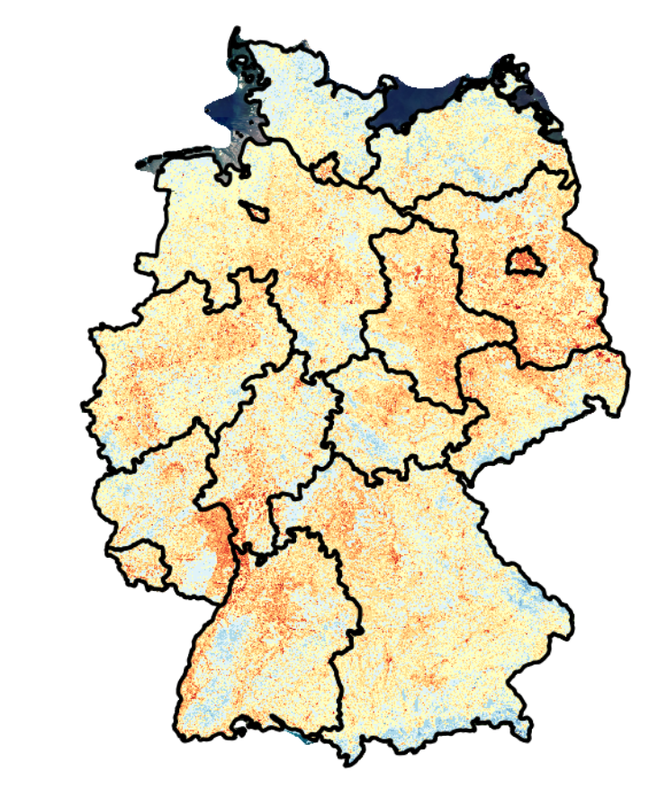

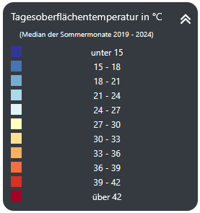



National Copernicus Implementation
National Network
Thematic coordinators increasingly sustained
New fields adressed (Transport, Urban, Energy)
Dissemination of information via national earth observation website
Regular National Copernicus Forum (every 1.5 years) with contiuous growth
UrbanGreenEye
Aim: Establish EO/Copernicus for climate adaptation as tool for action in municipalities
Daily surface temperature (median of the summer months 2019-2024)
Application development
Regular calls for pilot and flagship projects
34 pilot projects, 6 flagship projects
Data access and exploitation
National platform for Copernicus and EO data
Credit: https://urbangreeneye.lup-umwelt.de/
Daily surface temperature (median of the summer months 2019-2024)
Credit: https://urbangreeneye.lup-umwelt.de/
Notes:
National Copernicus Integration Programme
National measure in order to embed Copernicus in public landscape
Funded by Federal Ministry for Digital and Transport
Aim: Broad, sustainable use of Copernicus for an efficient and modern public administration

Slide 10










National EO Data Platform: Bringing Users to the Data
Data
Highlights for Phase 3:
Full availability of all Sentinel data + much more at your fingertips, including many unique datasets
Large free computing resources for German authorities and scientists
New technologies (improved data viewer, OpenEO)
Improved Federation with other offers (especially CDSE) → part of European EO cloud ecosystem
Full scalability of the whole system according to user needs
Surveying Data
Community Contributions
Infrastructure
Services
Large-Scale Hardware Infrastructures
Virtual Machines
Jupyter Lab
openEO
Processing on demand
Strong AI capabilities
Support/Helpdesk
Events/Webinars
Hackathons
E-Learning
3
Notes:
Scalability → bezieht sich insb. auf den geplanten Rahmenvertrag

Slide 11


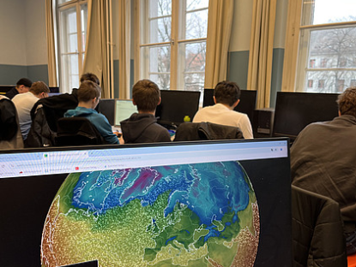
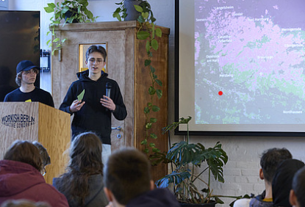
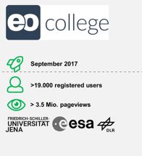
Capacity Building & Education
Climate Data Entrepreneurial Club
Main objective: Working with satellite data, building
expertise in data analysis and AI, promoting
entrepreneurship
Methods: open workshops (for teachers) and
hackathons (for students)
Achievements: Incorporation of Earth observation
and computer science/data analysis (including the
materials provided in the project) into the
curriculum in schools in Germany
EO-College
Main objective: Europe largest portal to free EO-MOOC‘s and learning material
Methods: Research into new learning methods
Achievements: Integration of online courses and research findings into university teaching
Partnerships: CEOS WGCapD, EOTEC DevNet

