Slide 1
39th CEOS Plenary Agency report: ECMWF
V.-H. Peuch, ECMWF
Agenda Item #6.2(5)
39th CEOS Plenary
Bath, United Kingdom
5-6 November, 2025

Slide 2
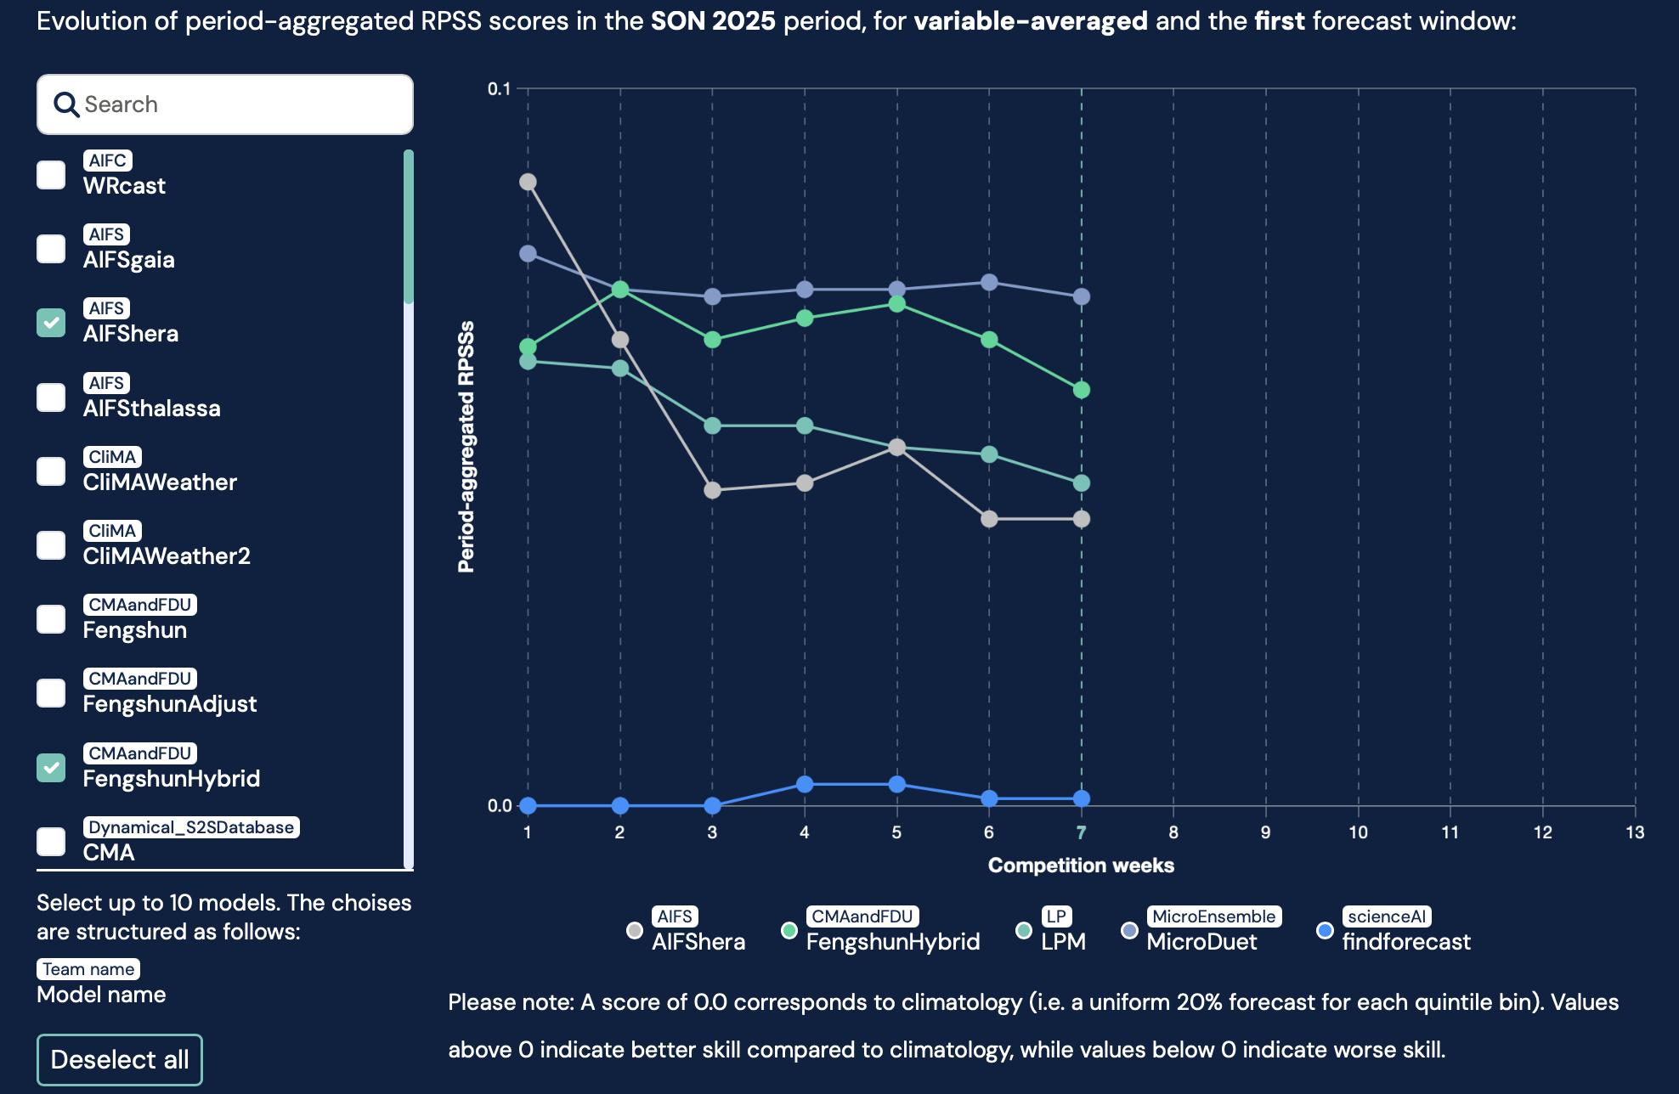
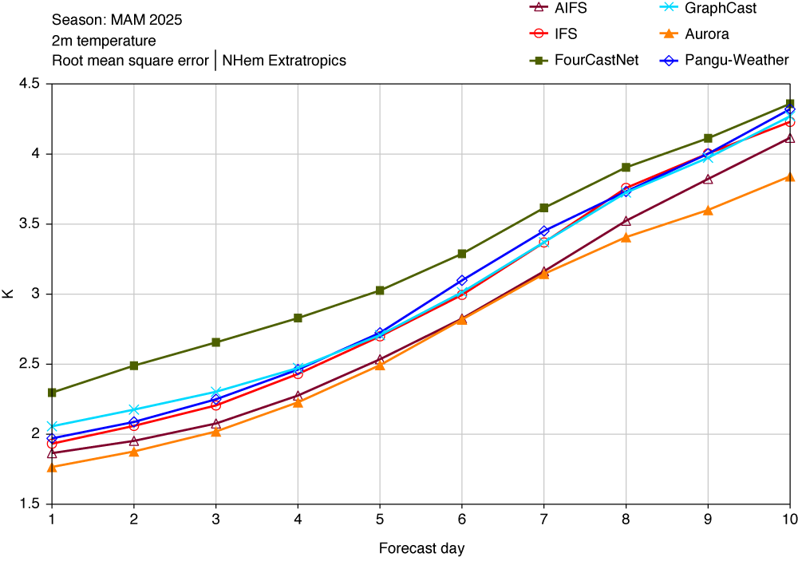
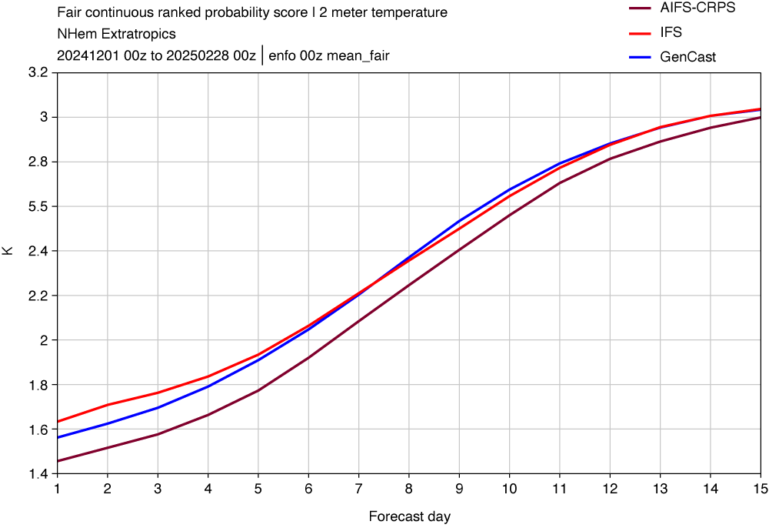
AI/ML
AI-based systems are now operational at ECMWF (AIFS single 25/02/2025; AIFS ensemble 01/07/2025)
IFS, AIFS single and other leading AI systems
IFS, AIFS ensemble and Google GenCast
Online open challenge: forecasting week 4 and week 5

Slide 3
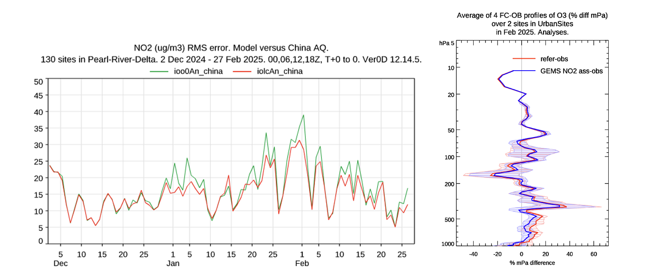
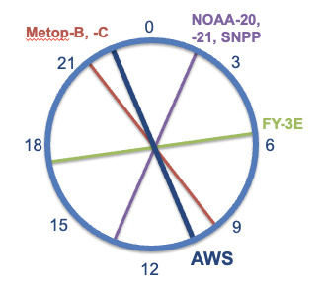
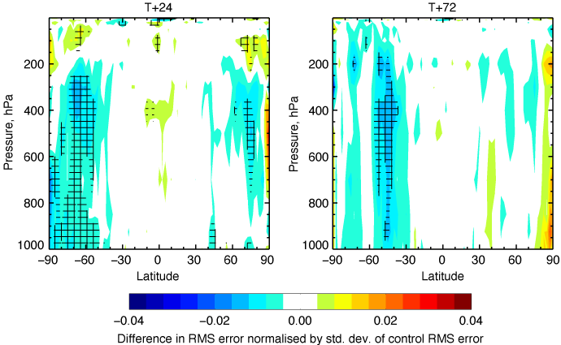
Assimilation of new satellite data
Assimilation of data from ESA’s Arctic Weather Satellite (AWS) – STERNA precursor
Deployment of the AWS complementary to the traditional orbital planes of LEOs.
Significant forecasts improvements up to day 3.
Assimilation of NIER’s GEMS NO₂ geostationary observations: impact on surface NO₂ and on the ozone profile – preparation of Sentinel-4 assimilation

Slide 4
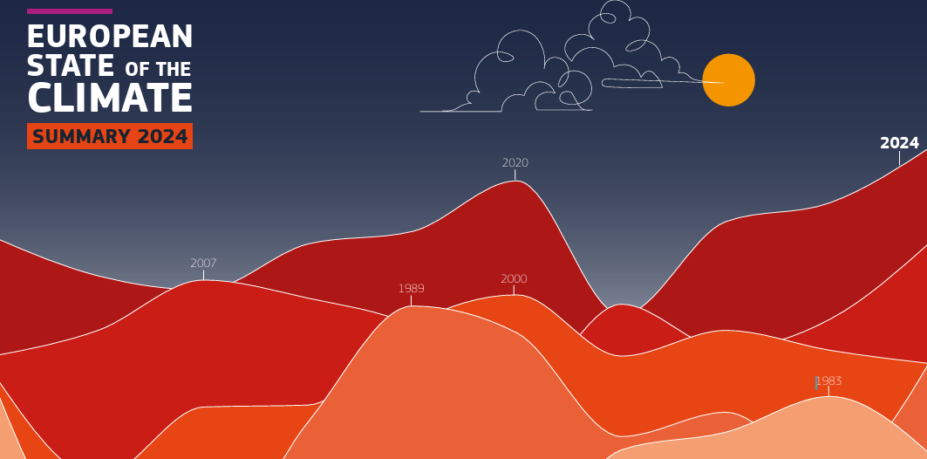
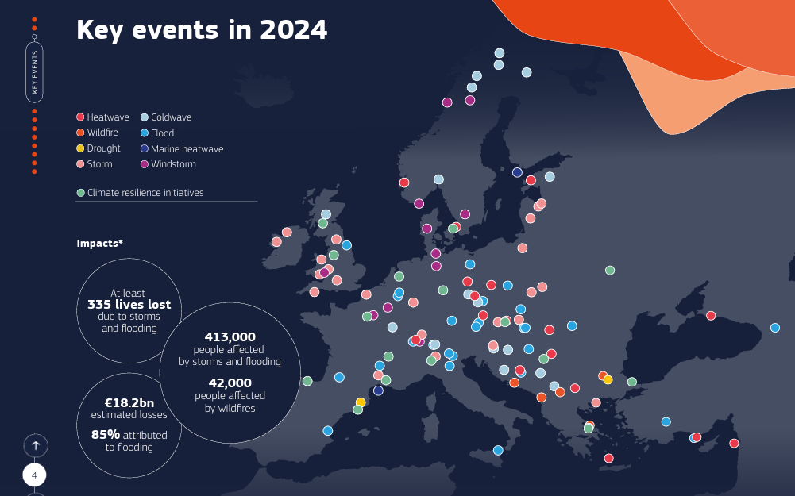
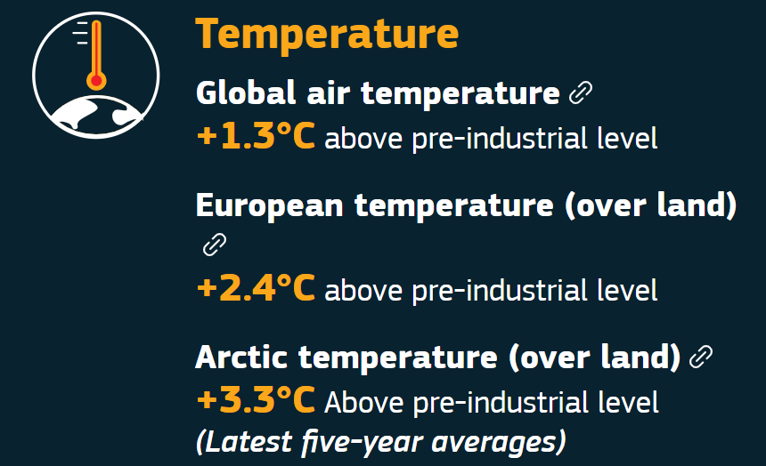
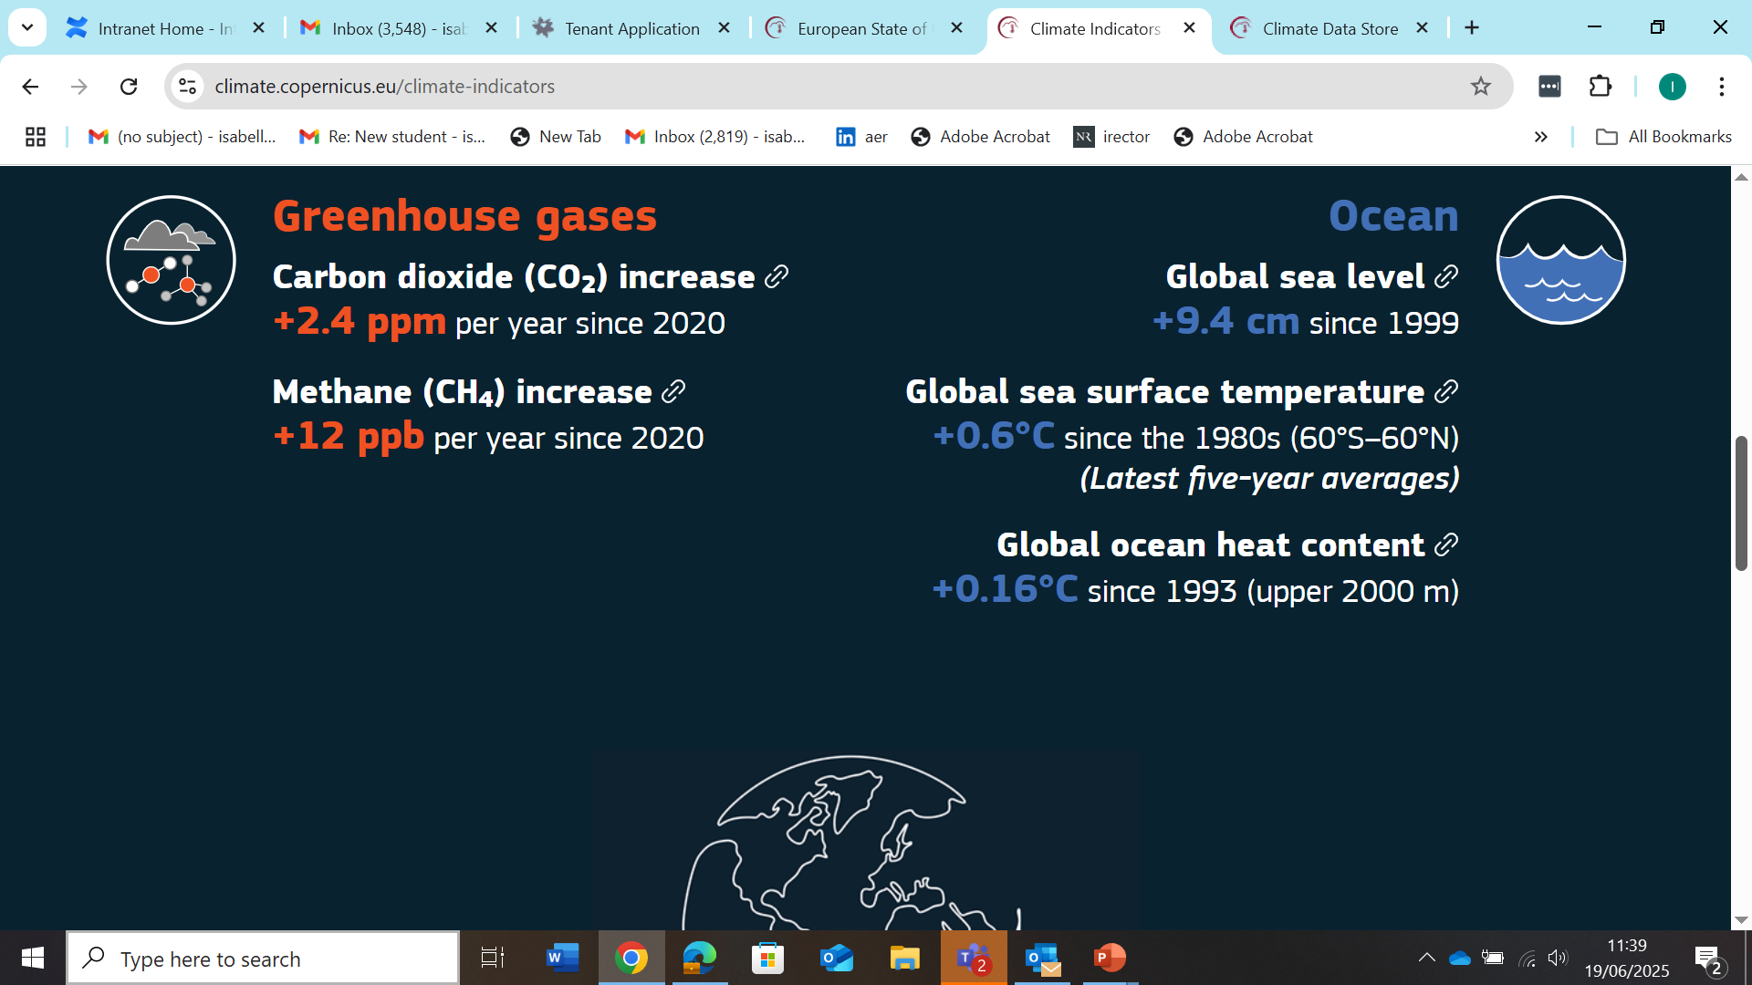
Copernicus
Climate Indicators
Growing impact of European State of the Climate (based on C3S reanalysis), joint with WMO.

Slide 5
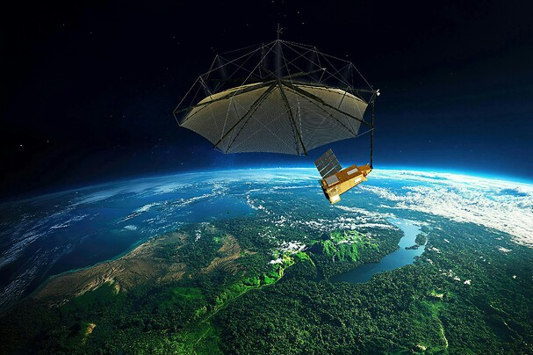
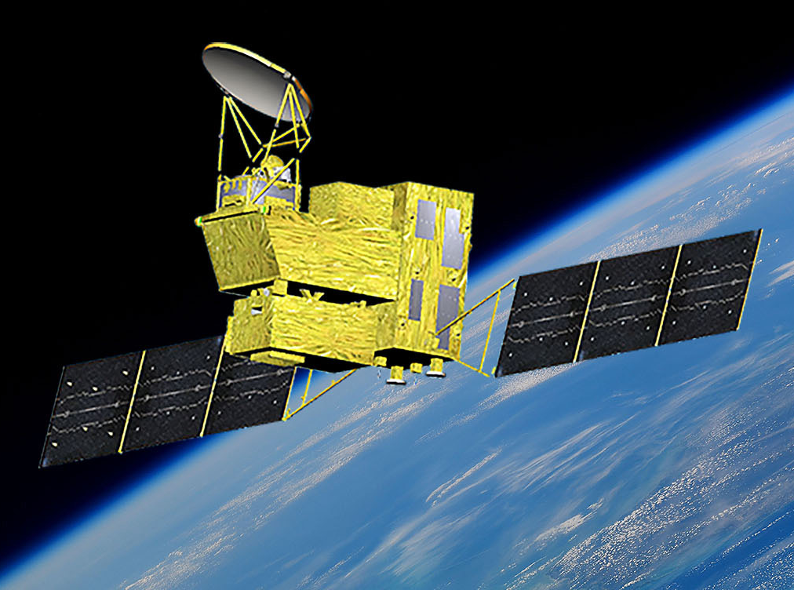
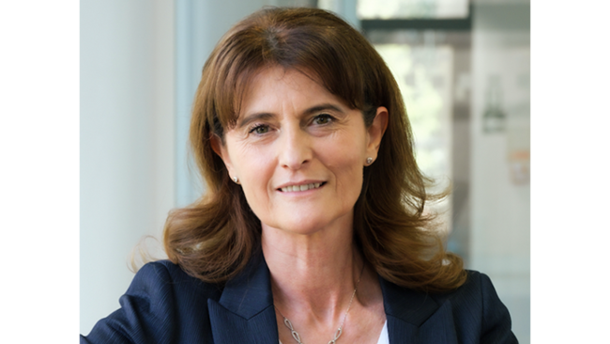
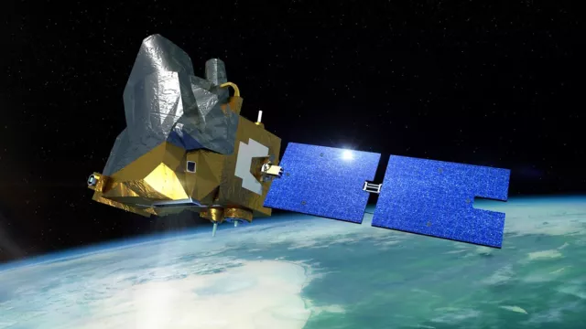
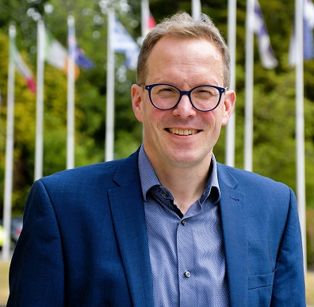
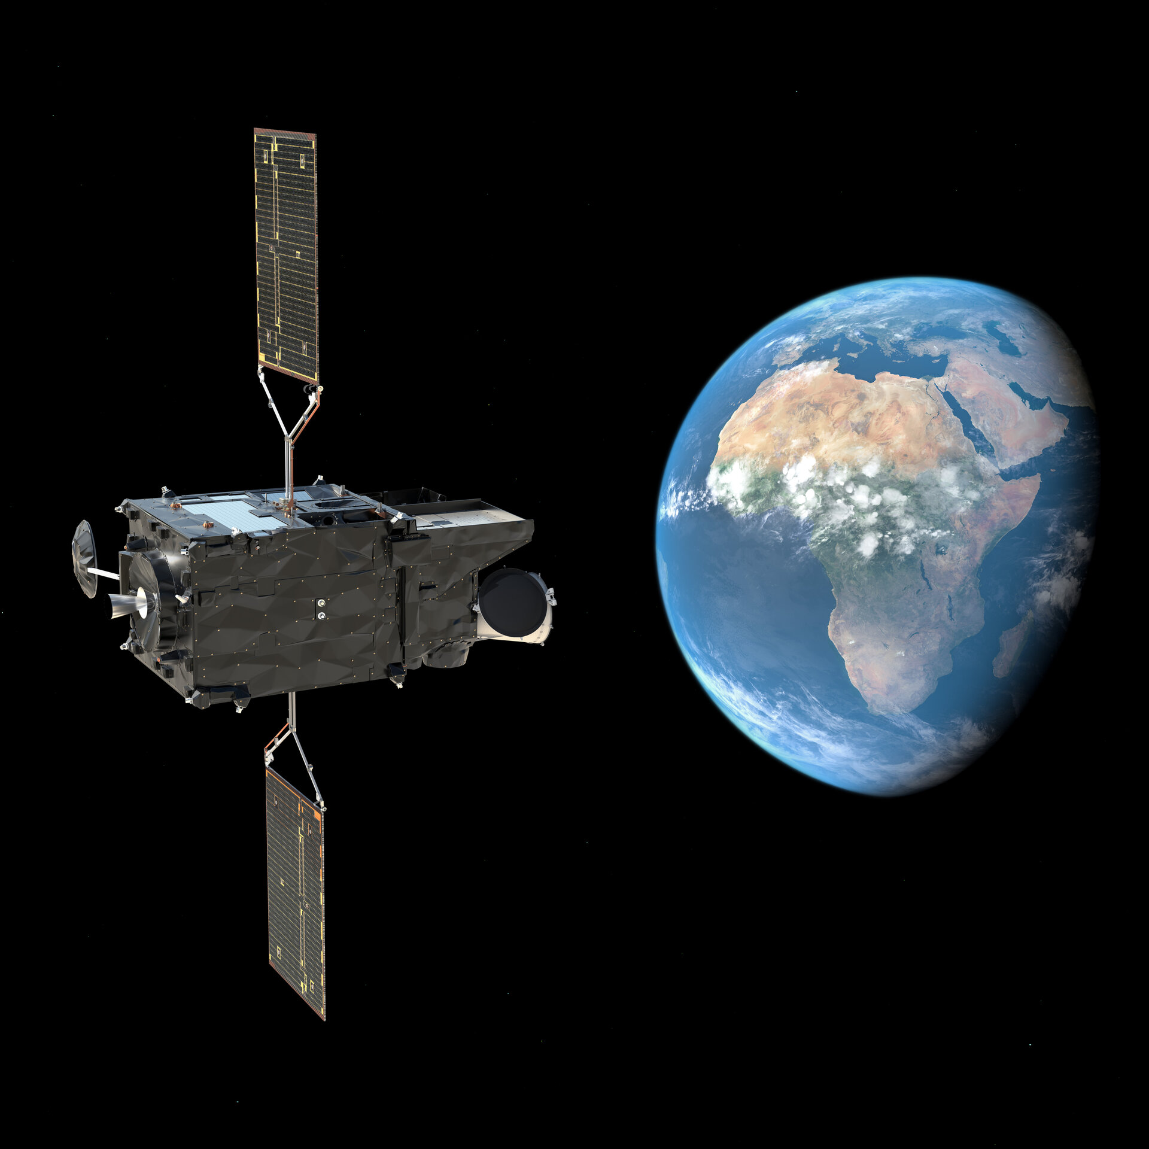
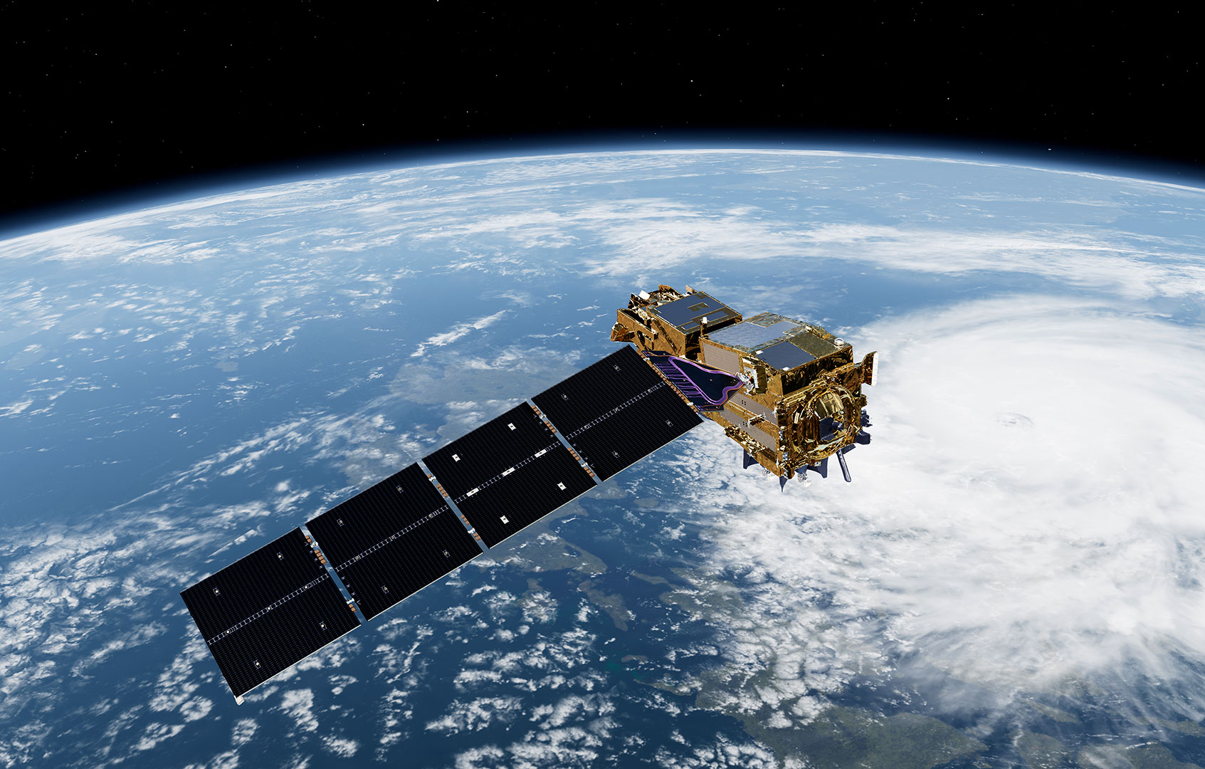
Forward look
BIOMASS
GOSAT-GW
Very excited to start working with new data and support commissioning (when possible).
MICROCARB
MetOp-SG-A1
01/01/2026, change of Director-General: Florian Pappenberger will succeed Florence Rabier.
MTG-S1

