Slide 1
CEOS Plenary 2025
UNOOSA – Hub advancing access to space benefits & promoting international cooperation
Lorant Czaran, UNOOSA
Agenda Item 6.2.8
39th CEOS Plenary
Bath, United Kingdom
4th - 6th November, 2025

Slide 2


GENERAL INTRODUCTION TO UNOOSA

Slide 3

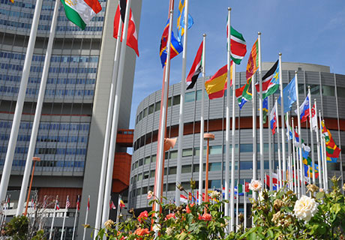



Overview
Established in NY in 1957
Moved to Vienna in 1993
Works across legal, policy, scientific & technological aspects of international cooperation in space
Closely connected to a rapidly growing global sector
Secretariat to the UN Committee on the Peaceful Uses of Outer Space (COPUOS) & its subcommittees

Slide 4
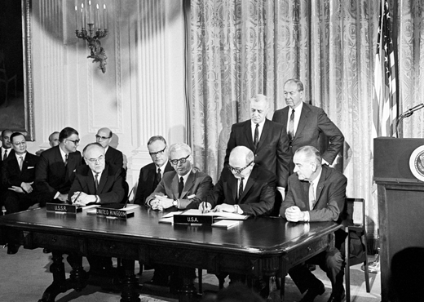

Space Multilateralism
18 states in 50’s
110 by 2026
Signing of the Outer Space Treaty, 1967
1967

Slide 5
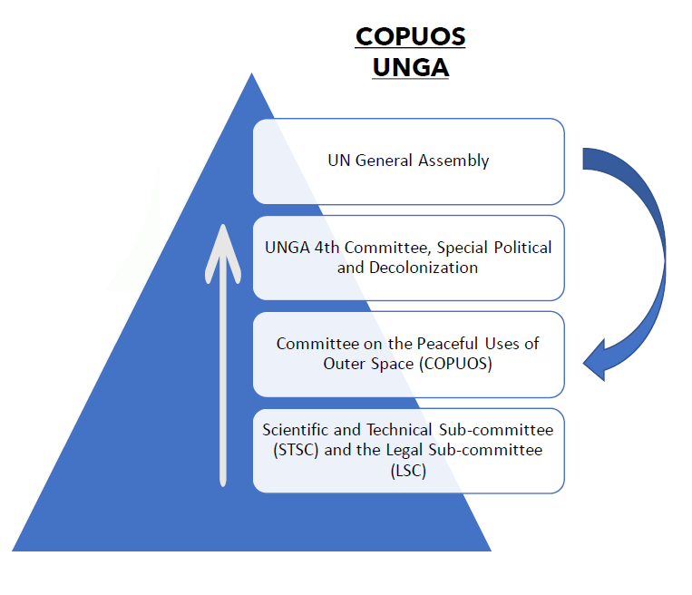
COPUOS Structure
Scientific and Technical Subcommittee 2 - 13 February 2026
Legal Subcommittee 13 - 24 April 2026
Committee on the Peaceful Uses of Outer Space 10 - 19 June 2026
Consideration by General Assembly Fourth Committee Usually end October-beginning November
(At UNGA80, 29-31 October 2025)
Action by General Assembly mid-December

Slide 6
COPUOS Membership
Algeria, Angola, Benin, Burkina Faso, Cameroon, Chad, Djibouti, Egypt, Ethiopia, Ghana, Kenya, Libya, Mauritius, Morocco, Niger, Nigeria, Rwanda, Senegal, Sierra Leone, South Africa, Sudan, Tunisia
Bahrain, Bangladesh, China, Cyprus, India, Indonesia, Iran (Islamic Republic of), Iraq, Japan, Jordan, Kazakhstan, Kuwait, Lebanon, Malaysia, Mongolia, Oman, Pakistan, Philippines, Qatar, Republic of Korea, Saudi Arabia, Singapore, Sri Lanka, Syrian Arab Republic, Thailand, United Arab Emirates, Uzbekistan, Viet Nam
Albania, Armenia, Azerbaijan, Belarus, Bulgaria, Czechia, Hungary, Latvia, Poland, Romania, Russian Federation, Slovakia, Slovenia, Ukraine
Argentina, Bolivia (Plurinational State of), Brazil, Chile, Colombia, Costa Rica, Cuba, Dominican Republic, Ecuador, El Salvador, Guatemala, Mexico, Nicaragua, Panama, Paraguay, Peru, Uruguay, Venezuela (Bolivarian Republic of)
Australia, Austria, Belgium, Canada, Denmark, Finland, France, Germany, Greece, Israel, Italy, Luxembourg, Netherlands (Kingdom of the), New Zealand, Norway, Portugal, Spain, Sweden, Switzerland, Türkiye, United Kingdom, United States of America

Slide 7
56 Observer Organizations
Access Space Alliance
African Association of Remote Sensing of the Environment (AARSE)
African Organization of Cartography and Remote Sensing (AOCRS)
African Astronomical Society
The Asia-Pacific Space Cooperation Organization (APSCO)
Association International Research Centre for the Development of the Atlantic
Association of Space Explorers (ASE)
Association of Remote Sensing Centres in the Arab World (ARSCAW)
CANEUS-International
Committee on Earth Observation Satellites (CEOS)
Centre Regional de teledetection des Etats de l'Afrique du Nord (CRTEAN)
Committee on Space Research (COSPAR)
European Association for the International Space Year (EURISY)
European Astronomical Society
European Organisation for Astronomical Research in the Southern Hemisphere (ESO)
European Science Foundation, represented by the European Space Sciences Committee (ESF)
European Space Agency (ESA)
European Space Policy Institute (ESPI)
European Telecommunications Satellite Organization (EUTELSAT-IGO)
European Union (EU)
For All Moonkind
Global Satellite Operators Association
Hague Institute for Global Justice
International Academy of Astronautics (IAA)
International Air Transport Association (IATA)
International Astronautical Federation (IAF)
International Astronomical Union (IAU)
Ibero-American Institute of Aeronautic and Space Law and Commercial Aviation
International Association for the Advancement of Space Safety (IAASS)
IIASA: International Institute for Applied Systems Analysis (IIASA)
International Institute for the Unification of Private Law (UNIDROIT)
International Institute of Space Law (IISL)
International Law Association (ILA)
International Mobile Satellite Organization (IMSO)
Inter Islamic Network on Space Sciences and Technology (ISNET)
International Organization of Space Communications (INTERSPUTNIK)
International Organization of Standardization (ISO)
International Peace Alliance (Space)
International Society for Photogrammetry and Remote Sensing (ISPRS)
International Space University (ISU)
International Telecommunication Satellite Organization (ITSO)
Moon Village Association National Space Society (NSS)
Open Lunar Foundation
Outer Space Institute
Prince Sultan Bin Abdulaziz International Prize for Water (PSIPW)
Scientific Committee on Solar-Terrestrial Physics (SCOSTEP)
Secure World Foundation (SWF)
Space Generation Advisory Council (SGAC)
Space Data Association
Space Rennaisance International
Square Kilometre Array Observatory
Three Country - Trusted Broker The Planetary Society (TPS)
UNISEC-Global: University Space Engineering Consortium-Global (UNISEC-Global)
WSWA: World Space Week Association

Slide 8
Restructured
Space Applications Section
Need to improve coordination across Programmes in light of UN80 and significant cuts in resources
UN-SPIDER
Portfolio
ICG Portfolio
(ICG Secretariat)
SAS-only Portfolio
(“old” Space Applications Section)
(United Nations Platform for Space-based Information for Disaster Management and Emergency Response)
Disaster risk reduction and emergency response
Vienna, Bonn and Beijing
Regional Support Officers
International Committee on GNSS (ICG)
Providers Forum
Working Groups
Global Navigation Satellites Systems (GNSS)
Space Weather
Programme on Space Applications
Basic sciences
Basic space technology and human space technology
Climate Change
Environmental monitoring, and natural resources management
Precision Farming and Agriculture
Global Navigation Satellites Systems (GNSS)
Space Weather
Access to Space
Space4Water
Space4Persons with Disability

Slide 9
UN-SPIDER
United Nations Platform for Space-based Information for Disaster Management

Slide 10
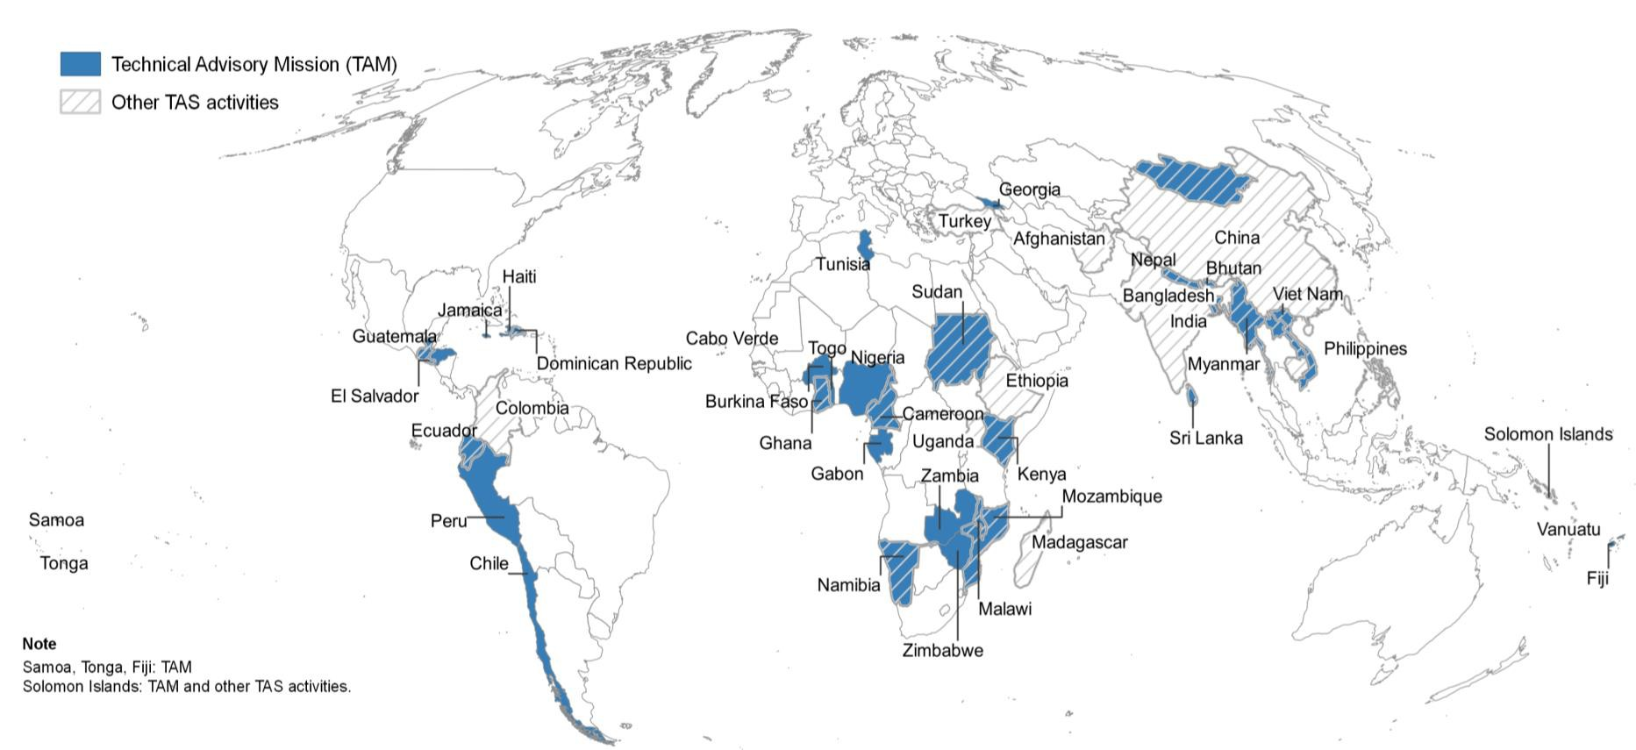


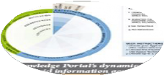



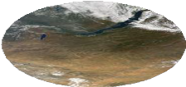
UN-SPIDER
55 (LMI/SID) States benefited from UN-SPIDER technical advisory services
41 formal Technical Advisory Missions and follow up
Over 100 technical support
and expert missions
Countries sponsored with data support, attendance at training workshops and relevant conferences
Emergency Response support with satellite data/mapping in over 30 countries
Funding from China, Germany, Austria, France, Türkiye, Japan, plus limited UN regular budget
Knowledge Portal
Fostering Cooperation
Strengthening Capacity
Technical Advisory Support

Slide 11
UN-SPIDER
Sri Lanka: National Spatial Data Infrastructure (NSDI), Sendai Framework monitoring tool and support during emergencies
Staff of government agencies of Sri Lanka mobilised to UN-SPIDER events
National Spatial Database Infrastructure (NSDI) implemented in Sri Lanka
DMC becomes an Authorized User of the Charter
Support to Sendai Framework monitoring continues, 2 officials to attend PG Diploma in Remote Sensing at CSSTEAP
Geospatial Dashboard to support Sendai Framework monitoring
Technical Advisory Mission
Mission: Training activity
Mission: Training activity
Mission: Training activity
2011
2012
2014
2017
2019
2020 - 2021

Slide 12
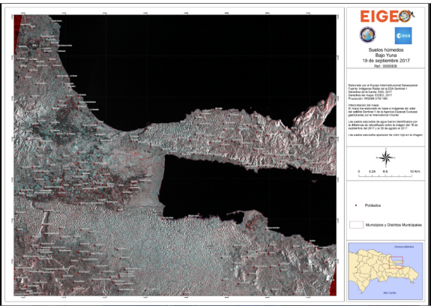
UN-SPIDER
Facilitating the incorporation of NDMAs as Authorised Users
Since 2014, UN-SPIDER has been encouraging National Disaster Management Agencies (NDMAs) to elevate requests to become Authorized Users of the International Charter.
26 NDMAs in Asia, Africa, Latin America and the Caribbean already acceeded as Authorised Users.
4 regional training courses with the Charter for potential Project Managers.
National Space Agencies in selected countries supporting as Project Managers.

Slide 13
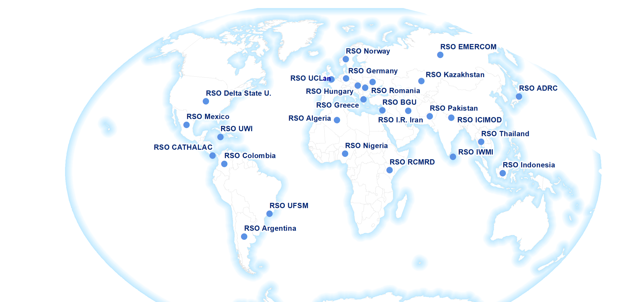
UN-SPIDER
RSO Network
(voluntary)

Slide 14
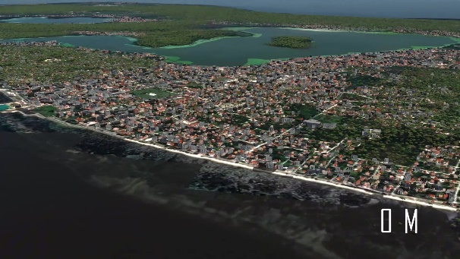
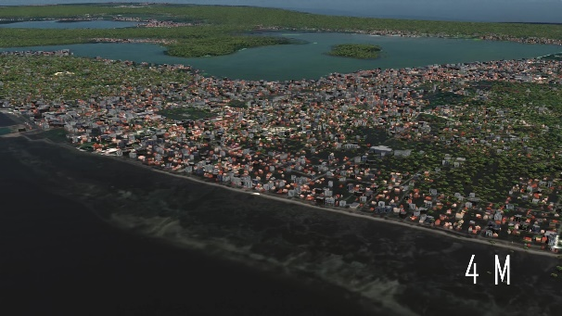
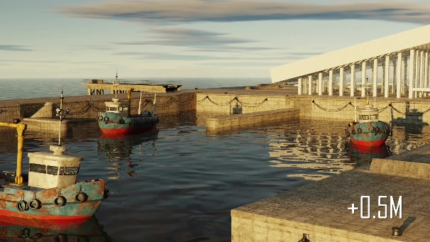
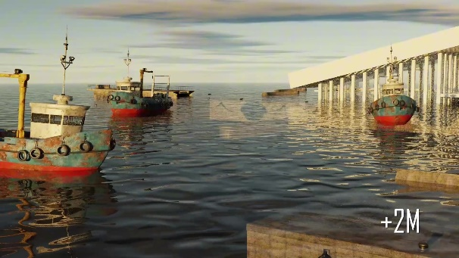
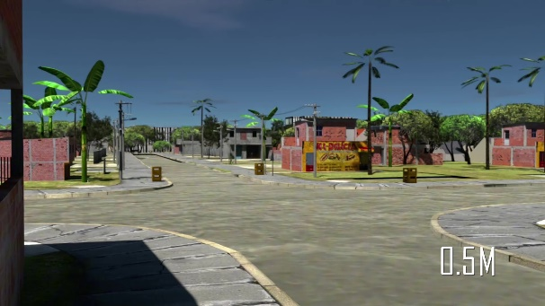
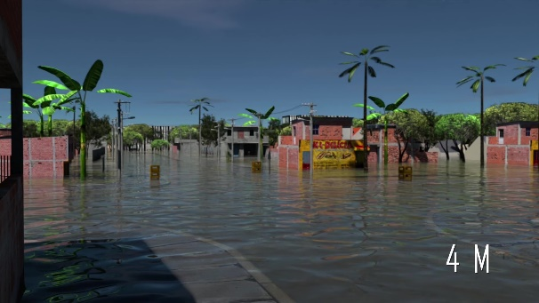
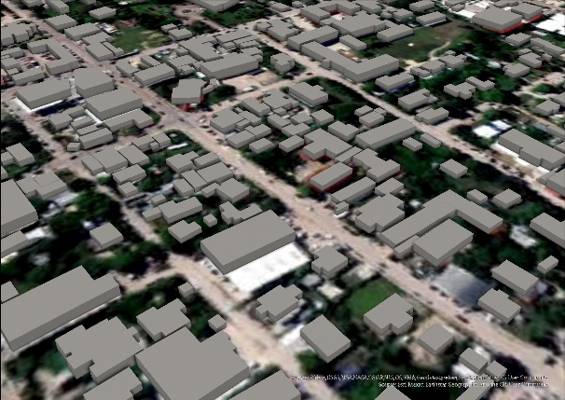
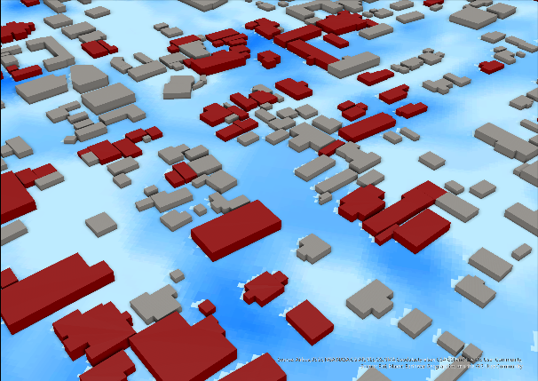
UN-SPIDER - TONGA Sea Level Rise & Flooding Simulation
UN-SPIDER - provides targeted capacity-building for:
Activating emergency response mechanisms (Int. Disaster Charter)
Embedding space data/services into disaster management cycle
Institutional strengthening missions to ensure “whole of government” approaches to disaster management
Working (also) with Private Sector to deliver support
3D Product | Flooding Simulation

Slide 15
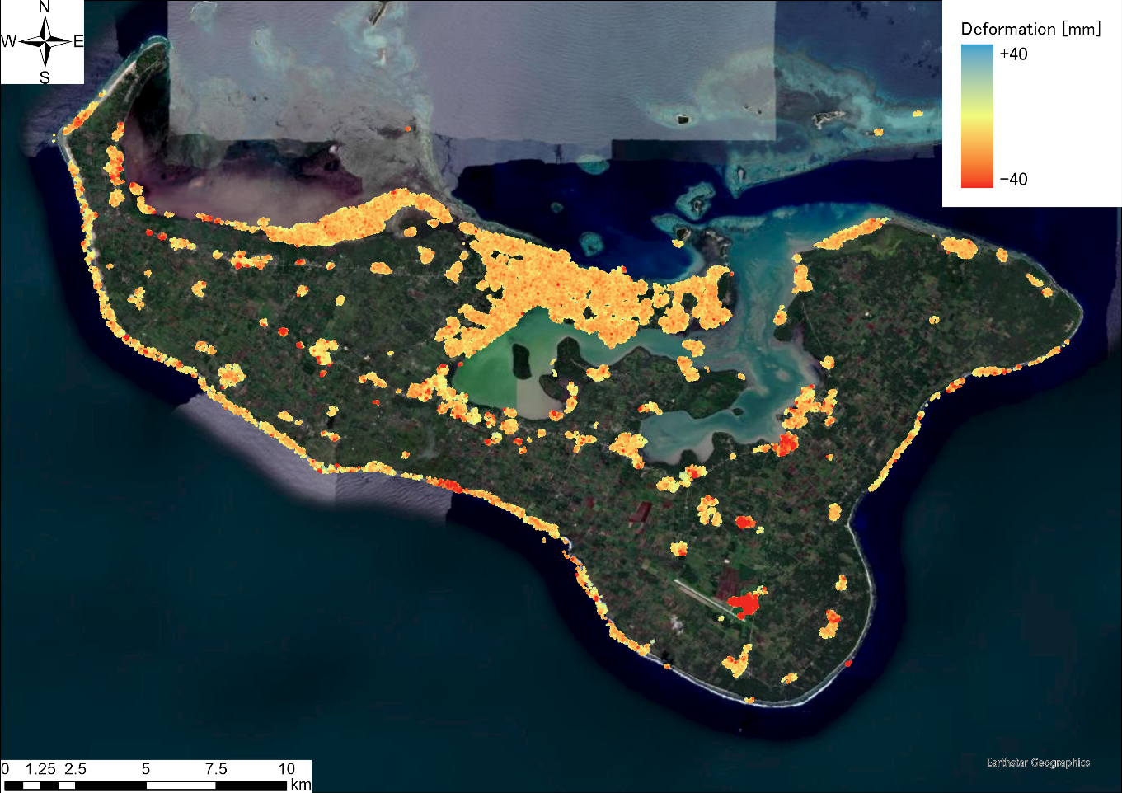
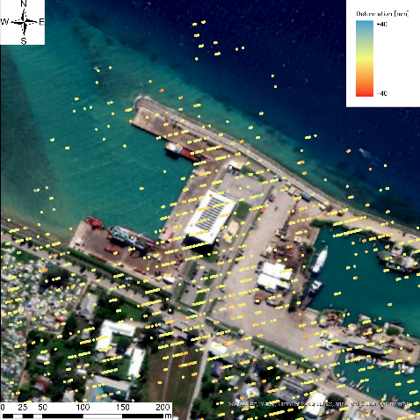
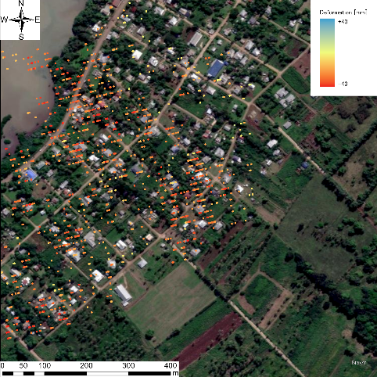
UN-SPIDER
Subsidence Analysis using Sentinel-1/CSK/ALOS
Multi-temporal InSAR analysis offers the land subsidence volume for the Tongatapu island. Because the Sentinel-1 (C-band) satellite is sensitive to build-up areas and bare grounds, the point results are valid only for those areas. The number of points are 234,674 points, indicating that some south-east locations are of concern, but mostly there are no significant land subsidence cases from Jan. to May 2024 on the island.
The town of Alaki and the Fua'amotu airport show land subsidence in these five months

Slide 16
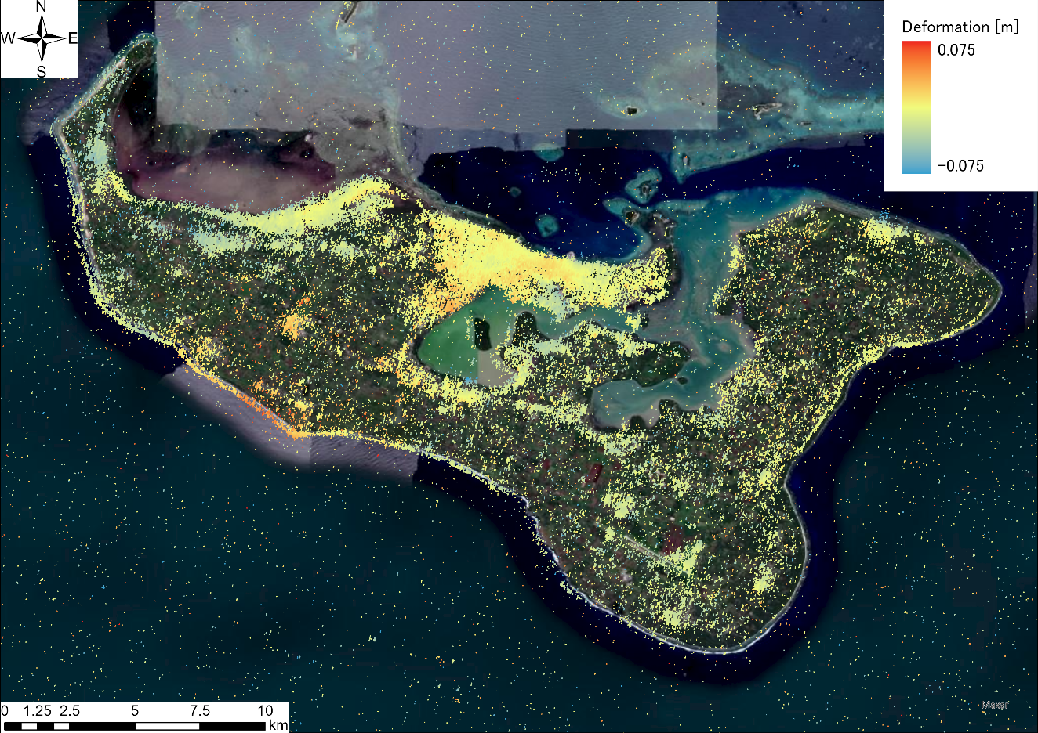
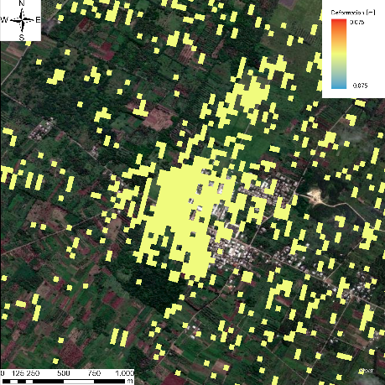
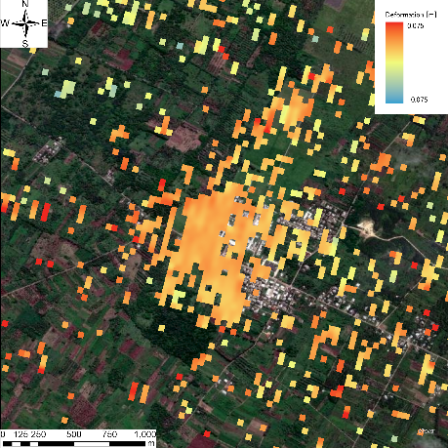


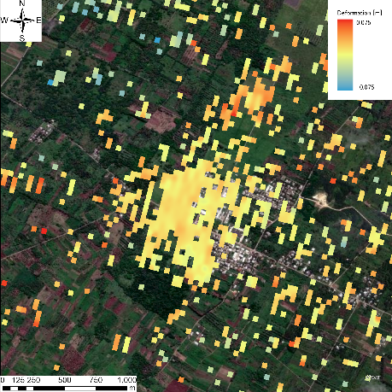
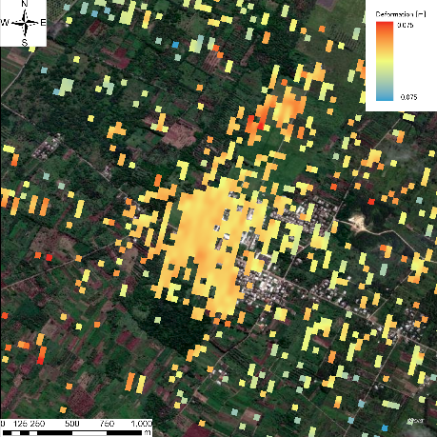
UN-SPIDER
Subsidence “as seen” by ALOS-2 SBAS
Another Multitemporal InSAR analysis using the ALOS-2 ScanSAR (Japan) dataset offers the land subsidence volume for Tongatapu Island. Because ALOS-2 has a longer wavelength, it can measure the land surface in vegetated areas. From the result, it shows no significant land subsidence. Also, due to most of areas being wet zones, even L-band satellite could not penetrate and therefore shows less coherence.
20180127
20180922
20181103
20190126
20191102
20191214

Slide 17
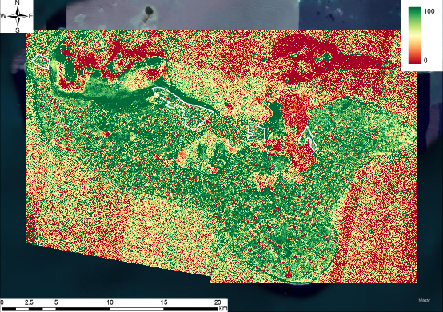
UN-SPIDER
Drought monitoring - results of VCI for Tongatapu using NICFI/Planet Labs data
The result shows that most parts of the island have higher VCI values which means that those areas are not affected by drought over the time analyzed.
We researched each of our Areas of Interest using a large number of Planet images:
Sopu: 37 images
Popua: 79 images
Nukuleka: 63 images
Ahau: 67 images

Slide 18
PROGRAMME ON SPACE APPLICATIONS

Slide 19


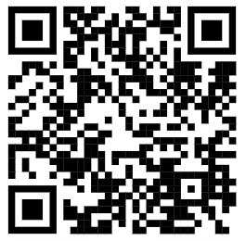

Space4Water
>180 members
118 stakeholders
58 (yong) professionals
7 Indigenous reprsentatives
Meets at Stakeholder Meetings​ 2x a year
Hands-on co-design of space-based solutions to address water challenges
Development of good practices
Conferences since 2008
Every 3 years fostering science diplomacy and informed decision-making​
User-friendly web portal for science communication​
>1200 knowledge resources​
Accessed by users world-wide
Monthly interviews with experts and thought leaders
Monthly technical articles (some translated to ES, FR)
Project partner:

Slide 20
PROJECTS

Slide 21

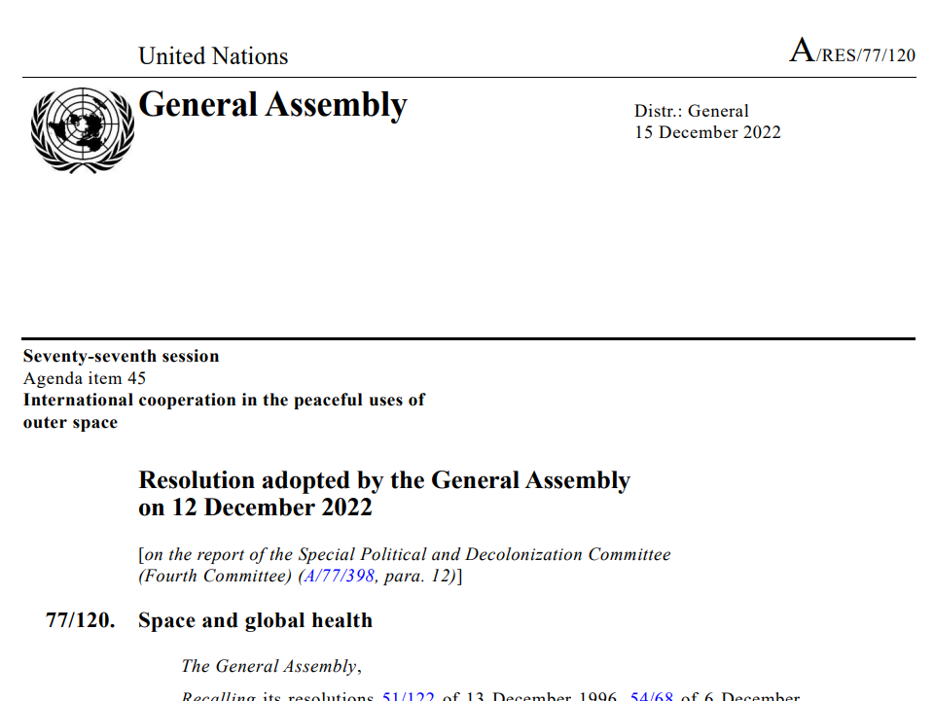
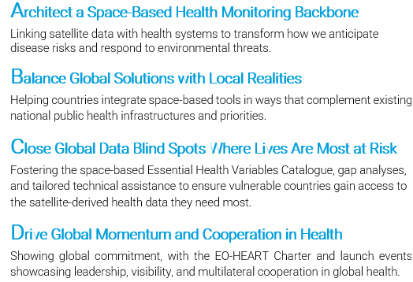

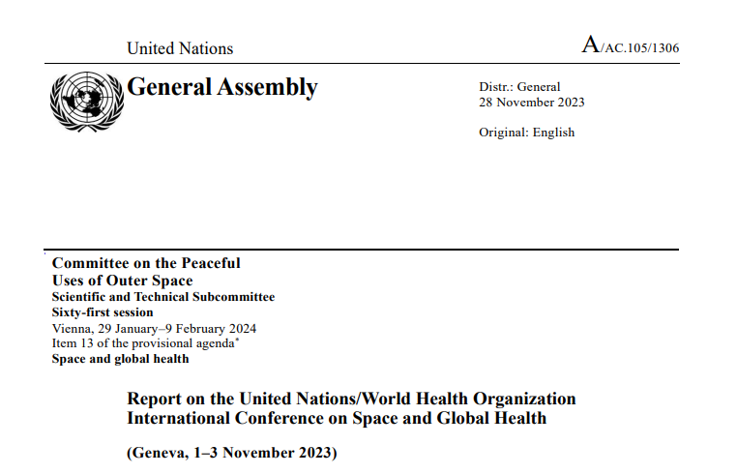
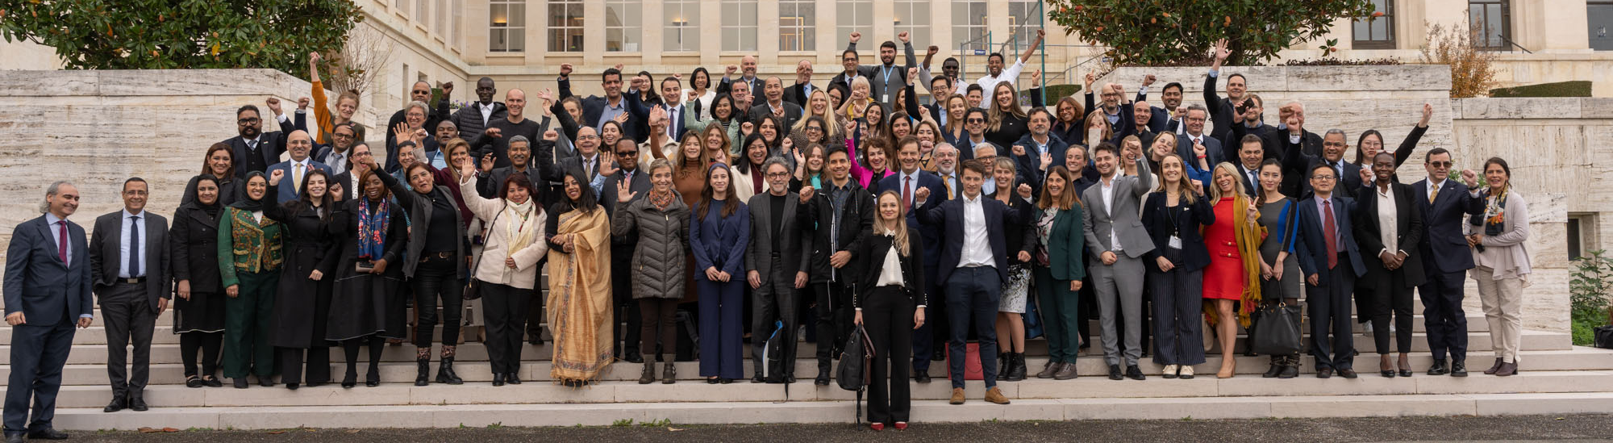
EO-HEART
Earth Observation Health Architecture

Slide 22



EO-FIELDS
Earth Observation for Food, Irrigation and Land Data Systems
Focus on national agricultural systems with satellite-based insights.
To develop a national monitoring frameworks (EO-FIELDS frameworks) to detect observational gaps, improve the use of space data and incorporate national data.
To deliver tailored technical assistance, guiding countries with actionable insights that complement ground-based information.
Enable solution scale-up by providing UNOOSA’s Space Economy initiative mentorship sessions to co-design solutions.

Slide 23



Acquisition/Sharing of Earth
Observation Data
ENHANCED OPERATIONAL SUPPORT
UNOOSA as Central Hub for VHR EO Data procurement:
Increase value for money for UN system (reduce expenses or increase geospatial data)
Make geospatial data available at right time in right format to whichever UN entity / end user needs it
Gain & provide access to archived data & global datasets for analysis & services for multiple applications
Unified, near-real-time EO data access for peacekeeping, humanitarian, climate & other missions
COST & EFFICIENCY GAINS
Consolidated demand, lower licensing cost & reduced administrative burden
LONG-TERM VISION
One coordinator for EO data supporting UN-wide operational capabilities

Slide 24

IPEO Mechanism
Private EO Data
Public EO
data
EO / HAPS services
Inter-Agency Hub for Procurement of Earth Observation Imagery (IPEO)
Enhanced
Functionality &
Synergies through Collaboration
Consolidated contractual terms, common licenses
Inter-Agency Hub for Procurement of Earth Observation Imagery (IPEO)
Interface / API access / distribution mechanism
UN entities / Offices using Geospatial Data

Slide 25






© NASA
Bringing the benefits of space to everyone, everywhere
Thank you
www.unoosa.org
@UNOOSA
@UNOOSA
#UNOOSA
@UNOOSA
@UN_SPIDER

