Slide 1
Biodiversity
Proposal for sustainable support for biodiversity in CEOS
Gary Geller, NASA
Jet Propulsion Laboratory
California Institute of Technology
Shaun Levick, CSIRO
Marc Paganini, ESA
Agenda item 7.1
39th CEOS Plenary
Bath, United Kingdom
4th - 6th November, 2025
© 2025. All rights reserved.

Slide 2
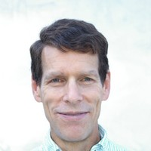
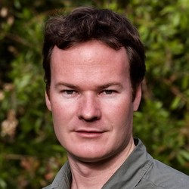
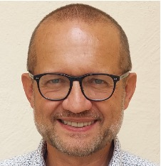
Introduction
Biodiversity Study Team was established at CEOS Plenary 2024
Co-leads:
Team Members: CNES, CSA, CSIRO, EC, ECCC, ESA, ISRO, JAXA, NASA, NOAA, UKSA, USGS
Gary Geller NASA
Shaun Levick
CSIRO
Marc Paganini
ESA

Slide 3
Content
Part 1 - Biodiversity Study Team Report & Recommendation
  What did the BST do?
  Options considered
  Recommendation
Part 2 - Initial Proposal: Biodiversity Virtual Constellation
  CEOS processes for VCs
  Mission, Objectives, & Activities
  Members, Leadership, & Resources

Slide 4
Biodiversity Study Team Mandate
Overall Task: Assess CEOS options for an enduring engagement with biodiversity
Phase 1: Stakeholder assessment
Phase 2: Explore connections with CEOS WGs and VCs
Phase 3: Assess options and make a recommendation

Slide 5
Stakeholder Assessment
GEO BON | GEO Biodiversity Observation Network
IOC/UNESCO | Intergovernmental Oceanographic Commission of UNESCO
IPBES | Inter-governmental Platform on Biodiversity and Ecosystem Service (analogous to IPCC)
Ramsar Convention on Wetlands | International treaty on Wetlands
TNFD (+) | Taskforce on Nature-related Financial Disclosures (“nature finance”)
UNCBD | UN Convention on Biological Diversity
UNCCD | UN Convention to Combat Desertification
UNSEEA | UN System of Environmental-Economic Accounting
Notes:
Ecosystem Extent spans all of the organizations and was included in the discussions
At high level, much overlap in user needs, including marine (which was not directly well-represented at this stage)

Slide 6
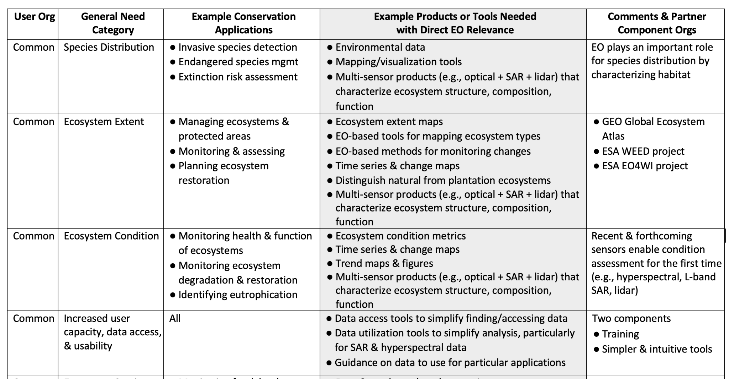
User Needs (sample)
Notes:
Other areas—all related to the above: Connectivity, species extinction risk, degradation and restoration

Slide 7
Options Considered
0) No action
Working Group
Virtual Constellation
Subgroup under the LSI-VC
Ad Hoc Team
Federated approach

Slide 8
Option Comparison (1/2)
Option | Benefits | Challenges
0) No action | None | Fails to address major societal need to which EO is essential
1) CEOS Working Group | Long-term commitments from Agencies Structured leadership model ensures continuity Strongest ties to international conventions (CBD, Ramsar, UNCCD) High visibility & influence | High resource requirement (sustained commitment from at least 4-5 Agencies) Highly structured leadership model Heaviest mandate (e.g., high international visibility) Heaviest reporting requirements Heaviest travel burden (e.g., annual meeting)
2) CEOS Virtual Constellation | Flexible structure for leadership and reporting Well-suited for changes in membership, expertise, & activities Manageable reporting and leadership responsibilities Focuses on coordination across CEOS (like a WG) Proven success model | Requires sustained Agency commitment to provide leadership Requires sufficient Agency support for expertise and continuity Other challenges similar to other options No challenges were identified that could not be addressed

Slide 9
Option Comparison (2/2)
Option | Benefits | Challenges
3) Subgroup in LSI-VC | Avoids creation of new WG or VC Simplifies startup Synergies with existing LSI-VC work Supports coordination with other CEOS terrestrial activities | Terrestrial: excludes extensive marine and coastal biodiversity Lacks alignment with Agency marine obs Diluted biodiversity visibility within CEOS New subgroup still required
4) Ad Hoc Teams | Low setup and admin burden Effective for addressing a specific topic or external requests Clear focus, outputs, and outcomes “Entry point” for CEOS Agencies | Lacks long-term relationship with users Narrow focus on a single topic; limited impact Finite duration
5) Federated Approach | Avoids creating a new WG or VC Avoids some governance overhead Leverages existing entities and expertise | Still requires coordination across CEOS entities Lacks strategic focus Weak CEOS identity and visibility Existing entities have limited biodiversity expertise Existing entities already have established priorities

Slide 10
BST Recommendation
Establish a Biodiversity Virtual Constellation
Viewed as the most effective and sustainable option for impactful CEOS engagement supporting Biodiversity
  Flexibility was key
Accommodates fluctuations in Agency resources, expertise, & activities
  Leadership
  Membership
  Enables Agencies to contribute regardless of size or expertise

Slide 11
Initial Proposal for a Biodiversity Virtual Constellation

Slide 12
Context: What Is a CEOS VC?
From the VC Process paper
“A set of space and ground segment capabilities operating together in a coordinated manner…”
Primary VC Goal: demonstrate the value of a collaborative partnership….
Seven specific goals, including…
  Enhance CEOS Agency mission coordination
  Improve utilization of the combined outputs of agency programs for specific applications
  Encourage and facilitate participation by all agencies, large and small
Addressed in BST Report, App 3

Slide 13
Process for Proposing New VC
Proposals are submitted to SIT Chair
Phase I –Initial Proposal
  Purpose: Convey scope and scale
  Format: Terms of Reference (4-6 pages)
  Decision: Proceed to Full Proposal?
Phase II – Full Proposal
  Final Terms of Reference
  Implementation Plan
  Decision: Should the proposed VC be approved? (SIT-41)

Slide 14
Mission Statement
Advance biodiversity understanding, monitoring, and conservation
for the benefit of society by strengthening the community’s use
of space-based Earth observations and data products

Slide 15
Objectives
Maximize Impact
  Maximize the societal benefit of space-based EO & derived data products
  Focus: biodiversity understanding, monitoring, and conservation
Engage Users
  Continue active dialogue with biodiversity stakeholders
  Track evolving user needs
  Adapt B-VC activities accordingly
Leverage CEOS’ Collective Capabilities and Resources
  Facilitate alignment across CEOS Agency missions, observations, data products, and services
  Coordinate with activities of other CEOS entities
Notes:
These are high level goals….

Slide 16
Membership & Leadership
Membership
  Primarily CEOS Agency personnel
  As needed, augmented with outside expertise
  Goal for geographic diversity and range of expertise
Leadership
  Two and no more than three Co-Leads
  Provided by CEOS Agencies
  Co-Lead positions will be reviewed every two years

Slide 17
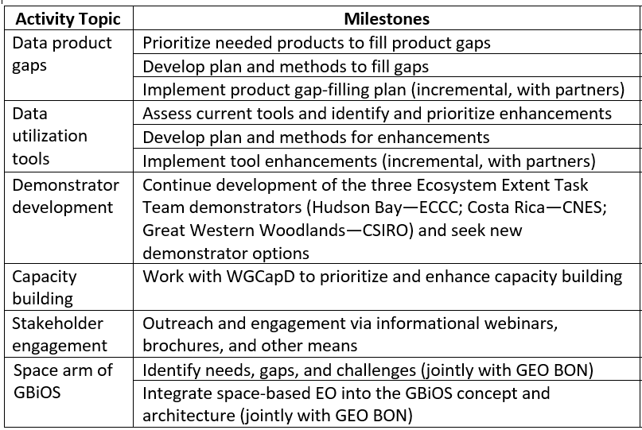
Activities
Services
Notes:
The Biodiversity VC mostly plays a facilitative role….

Slide 18
Resources
Team members
  In-kind support by CEOS Agencies (and CEOS WGs & VCs)
  Invited external experts as needed
Existing Agency Research and Development Programs
  Proposals for products, pilots, activities….
  Not new
  B-VC can amplify the reach and impact of these programs
Existing programs by outside organizations
  National government agencies, institutions, philanthropic orgs…
  Submitted by B-VC team members or outside experts
Notes:
Largely—just business as usual. R&D programs supporting development of new products and other activities.

Slide 19
Alignment with Priorities…
Resilience
  Climate
  Disasters
  Agriculture
  Ecosystem Services
Water
  Marine, GOOS BioEco
  COAST
  SST-VC, OCR-VC, OST-VC
  Ramsar
Enabling factors
  ARD/derived products
  Data Cube
  Capacity/utilization tools
  User engagement
  New Missions!

Slide 20
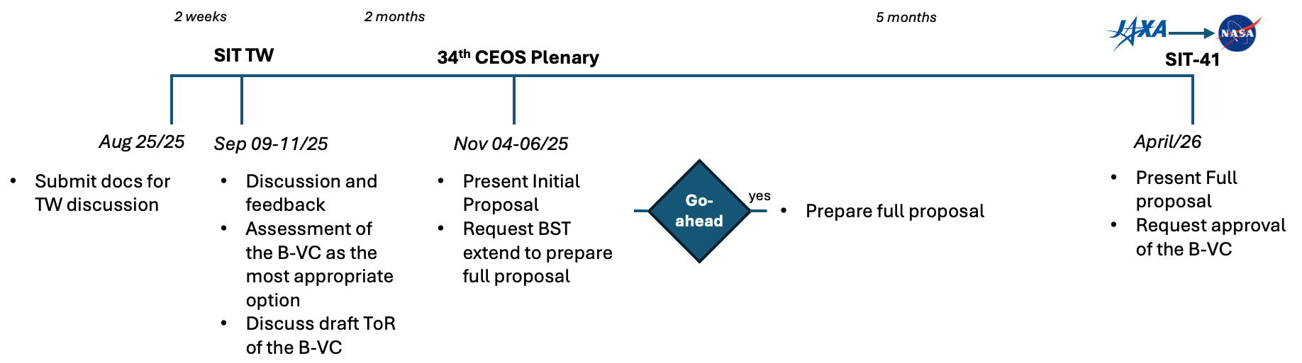
Looking Ahead

Slide 21
Request to Principals
Acknowledge that the BST has fulfilled its assigned tasks
Decision: Agreement with the proposal for a Biodiversity Virtual Constellation and to proceed with development of a Full Proposal for consideration at SIT-41.
Decision: Extend the Biodiversity Study Team through to SIT-41 to complete the Full Proposal and develop inputs to the Work Plan.
Invitation: We invite Agencies, including smaller agencies, to identify B-VC members.

Slide 22
Thank you

Slide 23
Backup

Slide 24
Road to Here
~2012: “Biodiversity Activity” initiated
~2020: Informal discussions on increasing engagement
  Triggered by biodiversity crisis
  Convention on Biological Diversity Global Biodiversity Framework (GBF)
2021: Biodiversity “Discussion Group” initiated
2022-2024: Ecosystem Extent Task Team
  Whitepaper
  Demonstrator studies
2024: CSA Chair theme
  BST established

Slide 25
Activities
Identify priority gaps in biodiversity observations and data products (including biodiversity indicators) and facilitate development of solutions to fill critical gaps.
Facilitate enhancement of data processing and utilization tools needed to increase utilization of EO for biodiversity applications.
Enhance existing CEOS biodiversity demonstrators, and explore possibilities for new ones, to provide useful exemplars and facilitate development and testing of needed EO capabilities.
Prioritize and implement Capacity Building initiatives through close collaboration with CEOS WGCapD.
Actively seek to increase biodiversity community engagement with EO and its applications for biodiversity understanding, monitoring, and conservation.
Coordinate with GEO BON and its Global Biodiversity Observing System (GBiOS) concept to facilitate the wider use of space-based EO.

Slide 26
Schedule
Activity Topic | Milestones | Timeframe
Data product gaps | Prioritize needed products to fill product gaps | Year 1
 | Develop plan and methods to fill gaps | Years 1-3
 | Implement product gap-filling plan (incremental, with partners) | Years 2-5+
Data processing and utilization tools | Assess current tools and identify and prioritize enhancements | Years 1-3
 | Develop plan and methods for enhancements | Years 2-4
 | Implement tool enhancements (incremental, with partners) | Years 2-5+
Demonstrator development | Continue development of the three Ecosystem Extent Task Team demonstrators (Hudson Bay—ECCC; Costa Rica—CNES; Great Western Woodlands—CSIRO) and seek new demonstrator options | Years 1, 2-5
Capacity building | Work with WGCapD to prioritize and enhance capacity building | Continuous
Stakeholder engagement | Outreach and engagement via informational webinars, brochures, and other means | Continuous
Space arm of GBiOS | Identify needs, gaps, and challenges (jointly with GEO BON) | Years 2-3
 | Integrate space-based EO into the GBiOS concept and architecture (jointly with GEO BON) | Years 3-7+

Slide 27
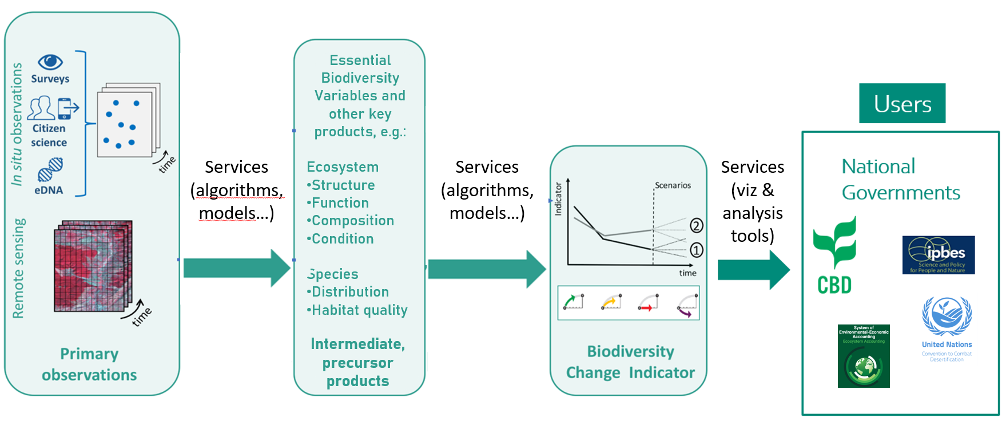
Product workflow has gaps…
Based on Navarro et al 2017

Slide 28
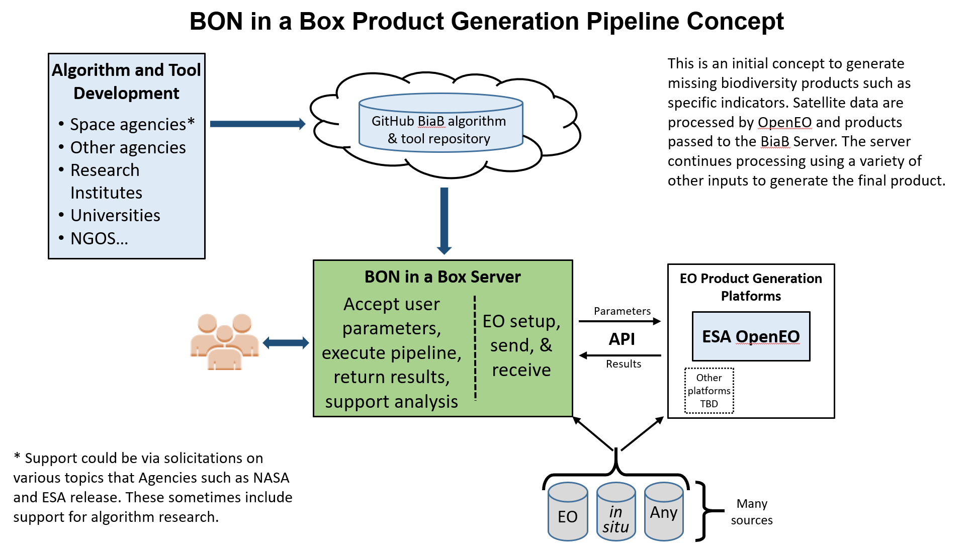
(Services)

Slide 29
Demonstrators & CEOS Analytics Lab
Analogous to the EETT demonstrators
Framework for B-VC activities
Data product and tool development testbed
  Including end user testing
User engagement vehicle
Idea generator
Cross-ecosystem algorithm transferability
Outputs & outcomes
  Products and tools for GitHub algorithm and tool repository
  “Real-world” experience (e.g., understanding end user constraints)
  Ideas

