Slide 1

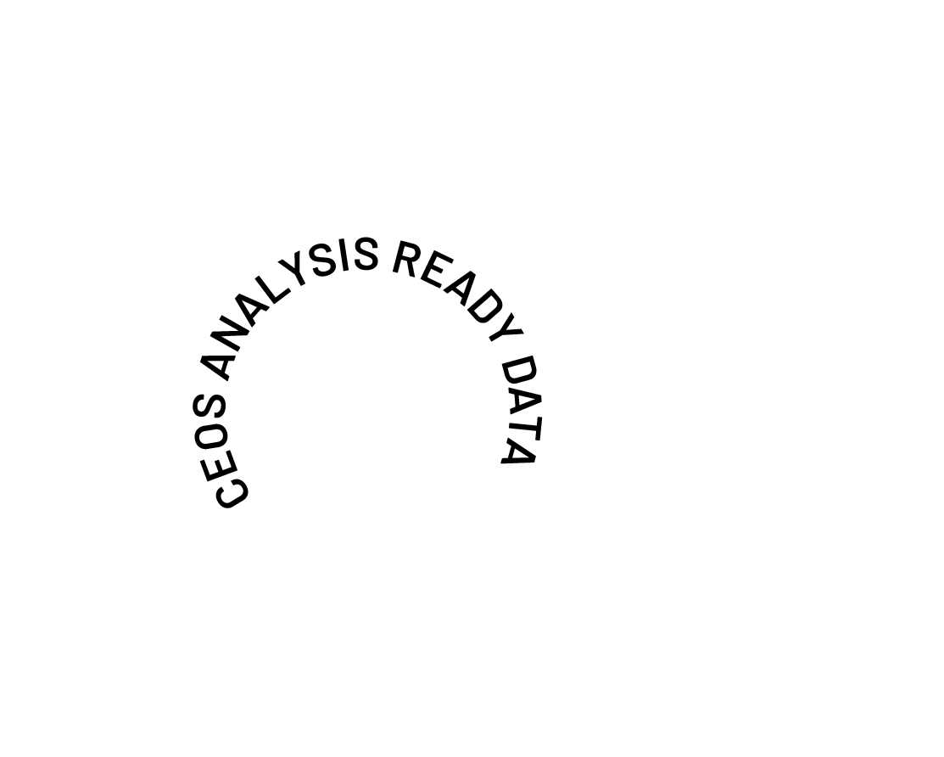
The Future of CEOS Analysis Ready Data
Ferran Gascon
ESA, CEOS-ARD Oversight Group Lead
Shaping the future of CEOS-ARD
CEOS Plenary 2025

Slide 2



Headline for today…
Seek a CEOS Plenary action to develop the CEOS-ARD Strategy 2026
For endorsement at CEOS Plenary 2026
The Strategy will define the actions, resources, and commitments required to deliver the next level of ambition for CEOS-ARD and meet community expectations – captured through the survey and consultation campaign in 2025 and summarised in the supplied Consultation Paper and Concept Note.
CEOS Plenary 2025

Slide 3
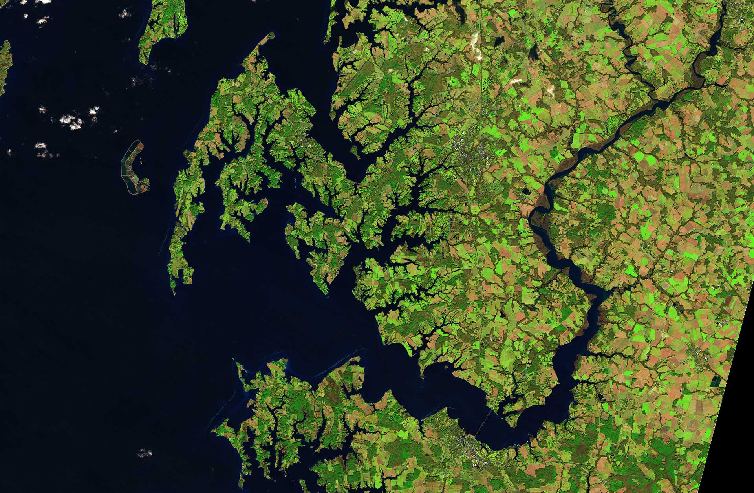
Background
CEOS Analysis Ready Data (CEOS-ARD) caused a significant and positive paradigm shift in the Earth observation community:
Making data more transparent and easy to use
Basis for improved interoperability.
Critical benchmark for non-CEOS data providers
Encouraged a more thoughtful approach to data provision
Ensuring non-experts can benefit alongside the scientific community
Democratising EO
CEOS Plenary 2025

Slide 4



Impact
For our Global Mangrove Watch (GMW) data workflow where we process thousands of images, the CEOS-ARD standard used for the JERS-1/ALOS/ALOS-2 SAR data from JAXA has simplified our processing chains with data now provided as GeoTIFFs and with standardised metadata. The specified pre-processing, including geometric rectification and radiometric terrain correction, has also been a significant help and reduced our internal data processing effort.
Dr Pete Bunting, Global Mangrove Watch Product Lead, Aberystwyth University, UK
By adopting CEOS Analysis Ready Data (CEOS-ARD) specifications, Digital Earth Africa is ensuring that satellite data is available, findable, accessible, and suitable for use by as many users as possible. Using CEOS-ARD, DE Africa is providing a rich source of information to better understand and address challenges of sustainable development in Africa. This information tells a story over time to support decision-making by governments, private sector and civil society.
Dr Adam Lewis PSM, Senior Advisor on the Global Team for Digital Earth Africa
Landsat Collection 2’s compliance with CEOS-ARD standards has been a game changer for the global Earth observation community. Users gain faster, more dependable insights for diverse applications from land cover change and agricultural monitoring to natural resource management and disaster response. CEOS-ARD compliance has truly unlocked the analytical power of the 50+ year Landsat archive, significantly enhancing USGS's contribution to our understanding and stewardship of the planet.
Dr. Christopher Barnes (KBR), Sustainable Land Imaging Partnerships, USGS EROS Center, USA
CEOS Plenary 2025

Slide 5





Since 2016, CEOS has developed nine CEOS-ARD Product Family Specifications (PFS)
CEOS Plenary 2025
* Combined SAR PFS includes: Normalised Radar Backscatter, Polarimetric Radar, Ocean Radar Backscatter, Geocoded Single-Look Complex, Interferometric Radar

Slide 6
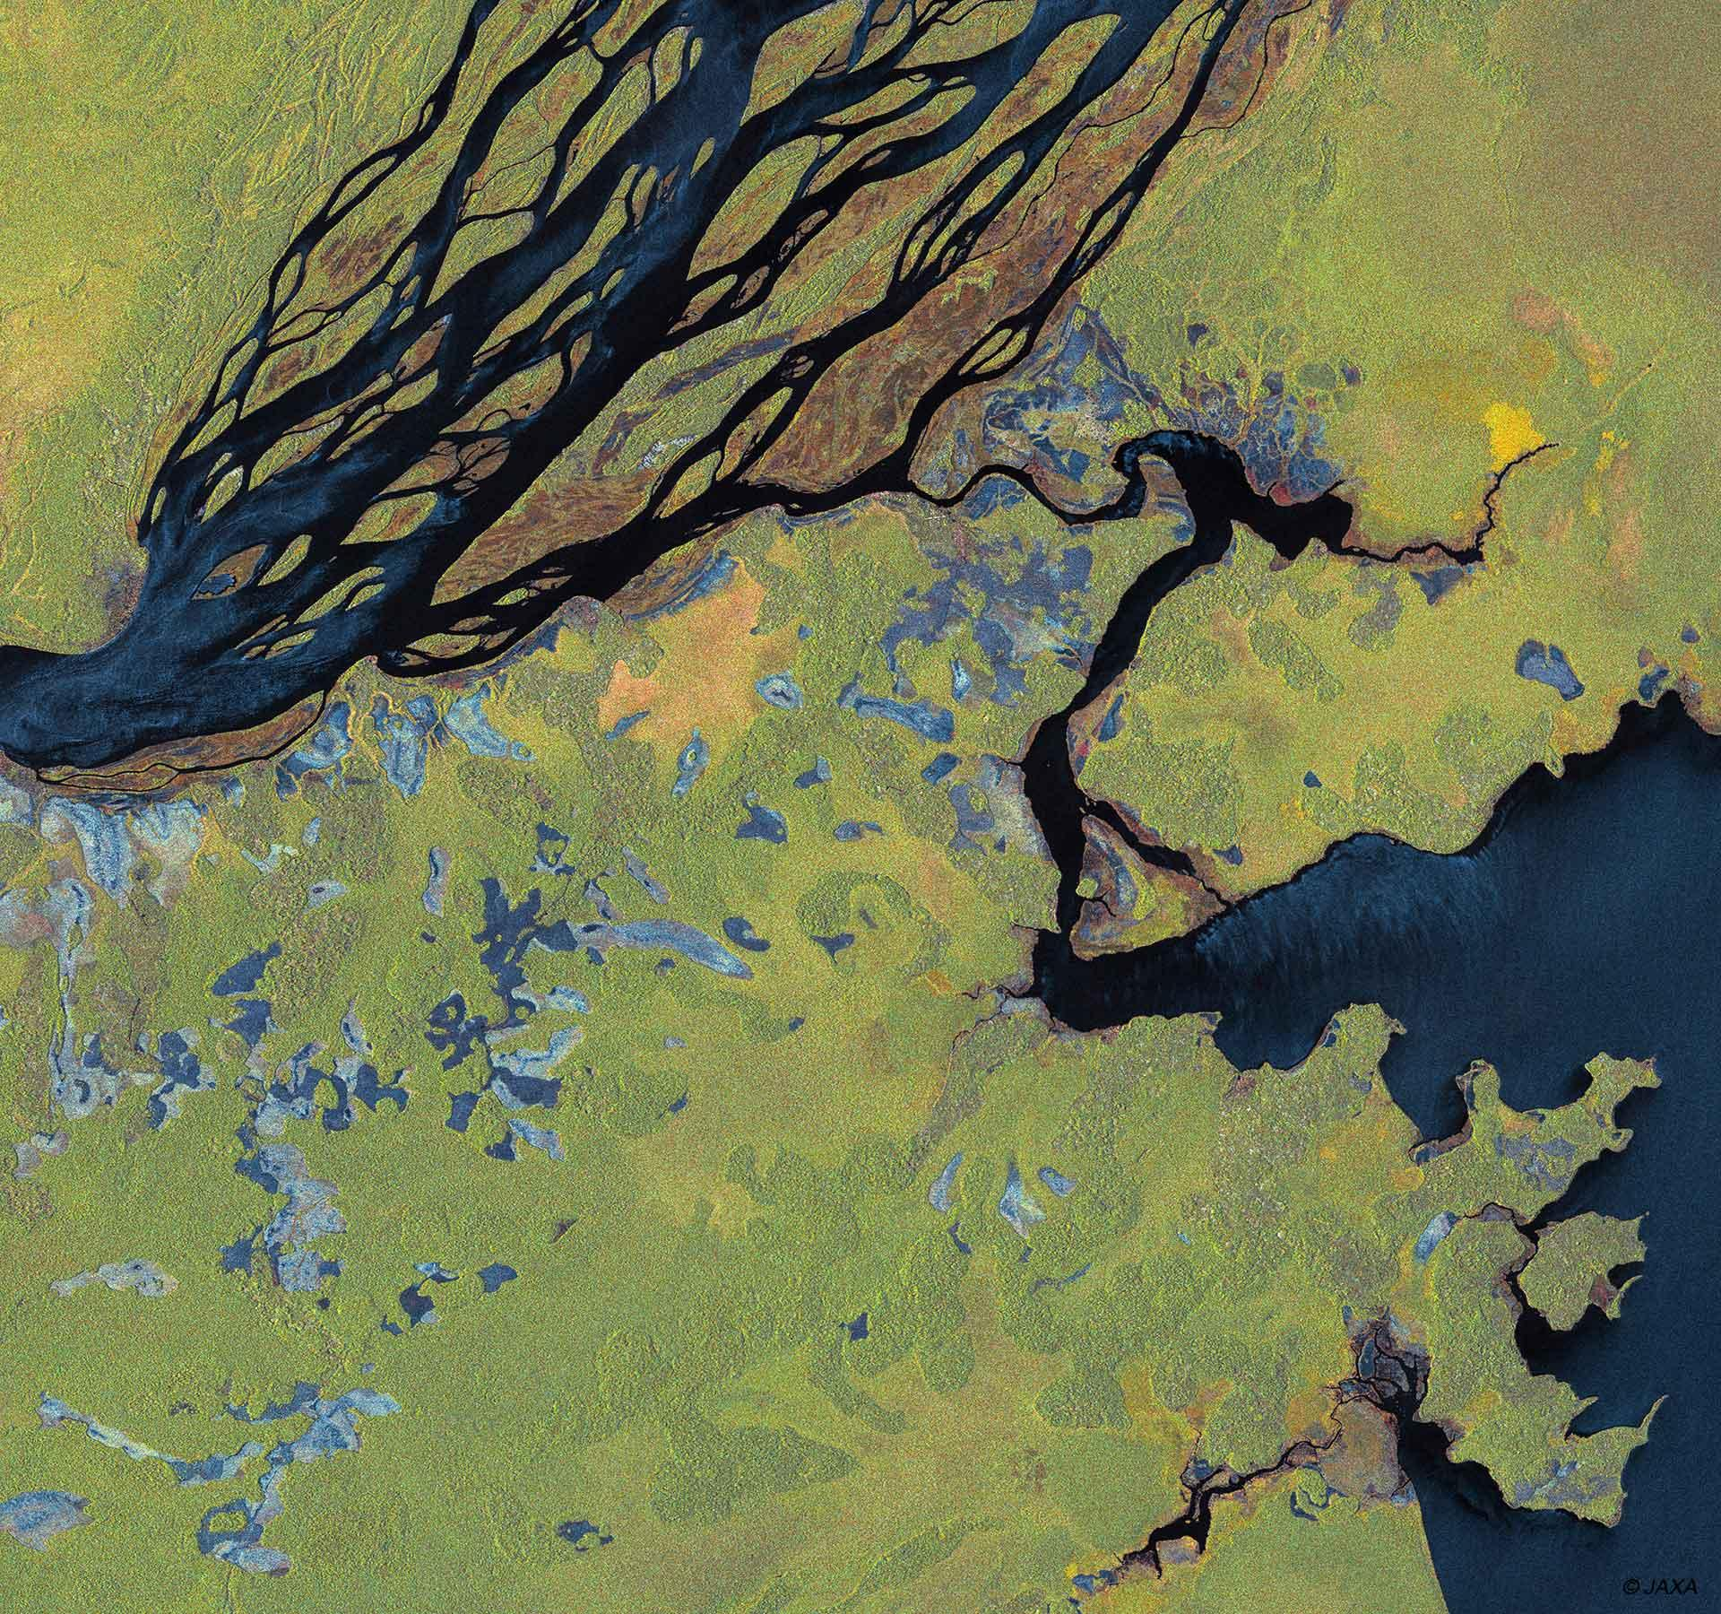
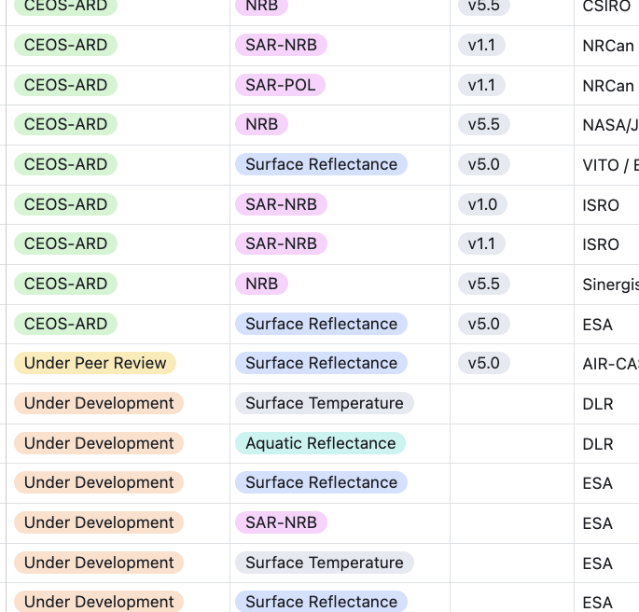
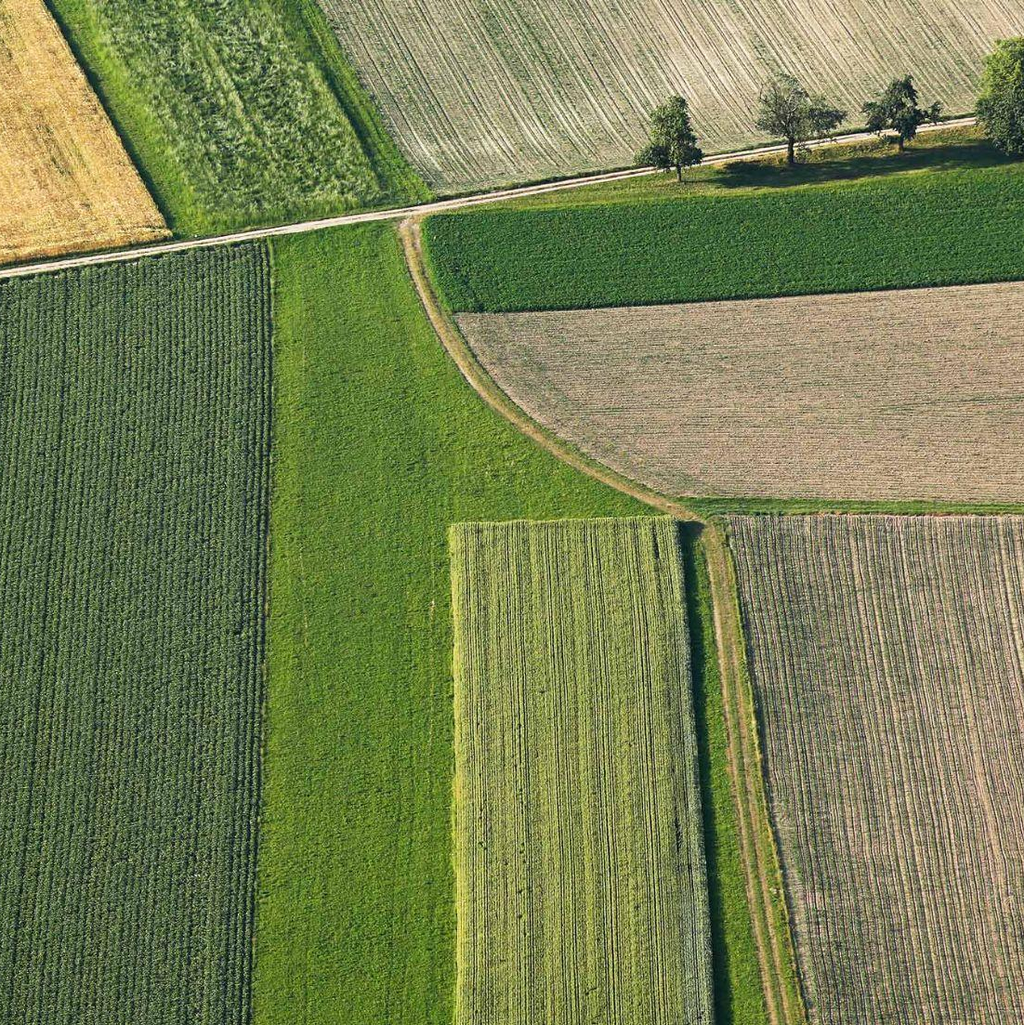
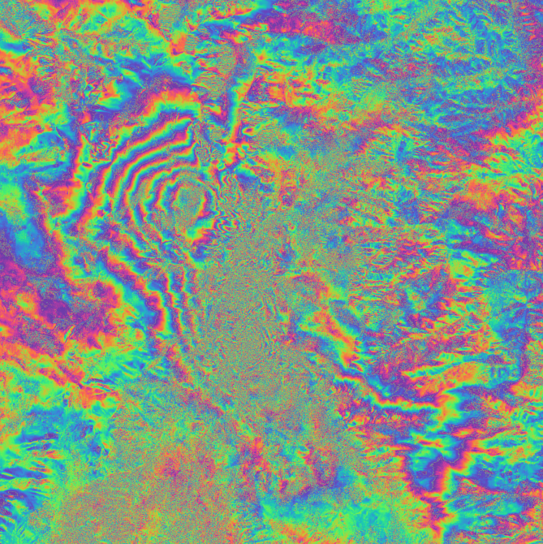
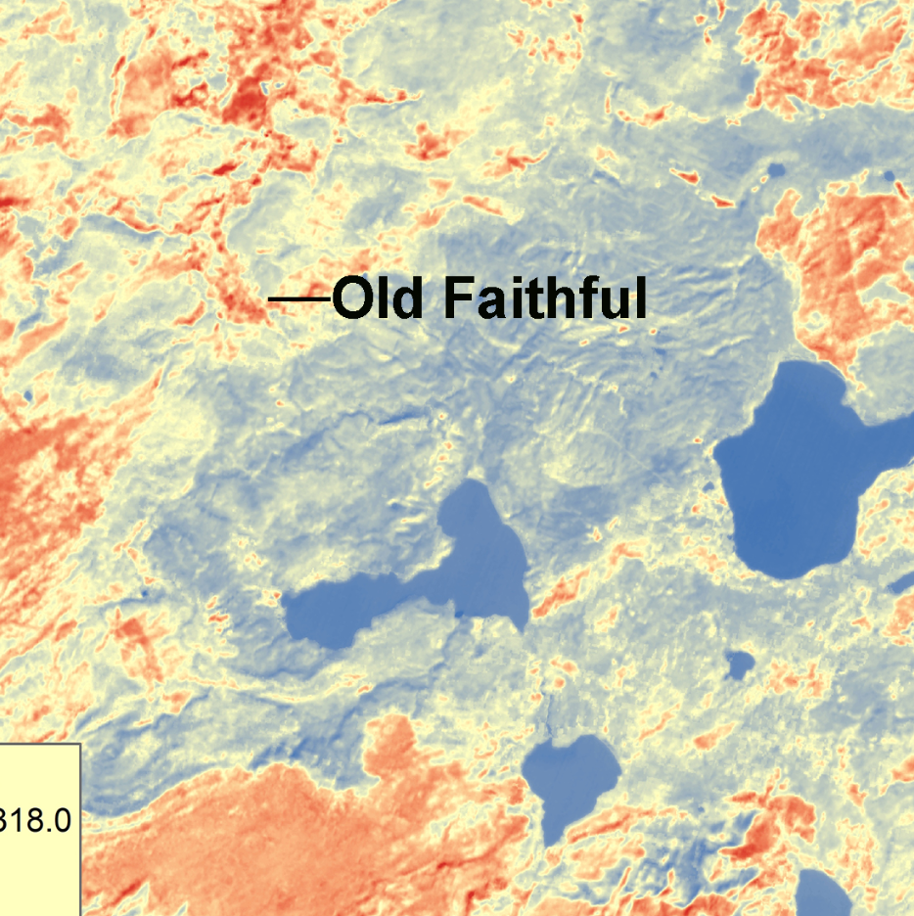

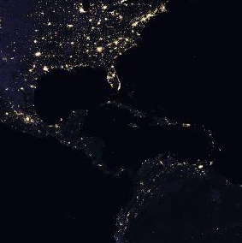
Where are we now?
CEOS-ARD Specifications have been powerful catalysts for progress:
USGS Landsat Collection 2
Copernicus Sentinel-2 Collection 1
ALOS-2 PALSAR-2 ScanSAR NRB and Global Mosaics
DLR EnMAP
ISRO RISAT-1A
And many more… See all datasets on ceos.org/ard
CEOS-ARD Product Family Specifications
Synthetic Aperture Radar
Normalised Radar Backscatter, Polarimetric Radar, Ocean Radar Backscatter, Geocoded Single-Look Complex, Interferometric Radar
Surface Reflectance
Nighttime Lights Surface Radiance
Surface Temperature
Aquatic Reflectance
CEOS Plenary 2025

Slide 7
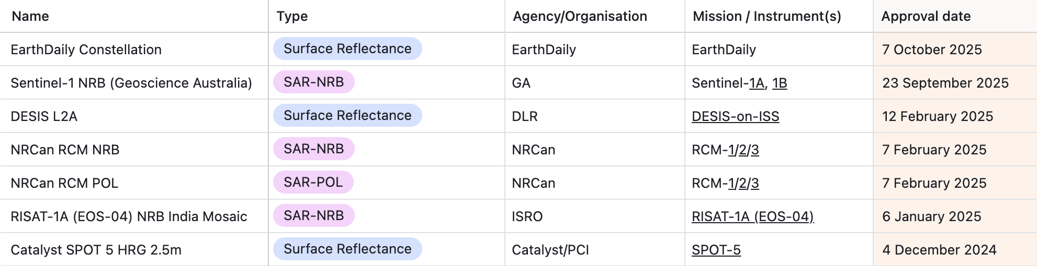






New datasets in 2025
See all datasets on ceos.org/ard
CEOS Plenary 2025

Slide 8
Some updates since SIT-40
2025 has been pivotal for CEOS-ARD community engagement (LSI, LPS, WGCV-55, IGARSS …)
EarthDaily, Ororatech, Planet, SatVu, Constellr, Aistech Space, Marble Imaging AG, SatSure, Catalyst, Synspective, Esri, Hyspace, SkyServe, Pixxel, SatSure, Synspective, and more
CEOS and industry are co-developing an updated Surface Temperature Specification and considering higher level products for e.g. fires
OroraTech, Constellr, Aistech, SatVu
Seeking synergies and efficiencies with NASA (CSDA) and ESA (EDAP) Joint Earth Observation Mission Quality Assessment Framework engagement
CEOS-ARD GitHub
New Aquatic Reflectance and INSAR PFS published
CEOS Plenary 2025

Slide 9
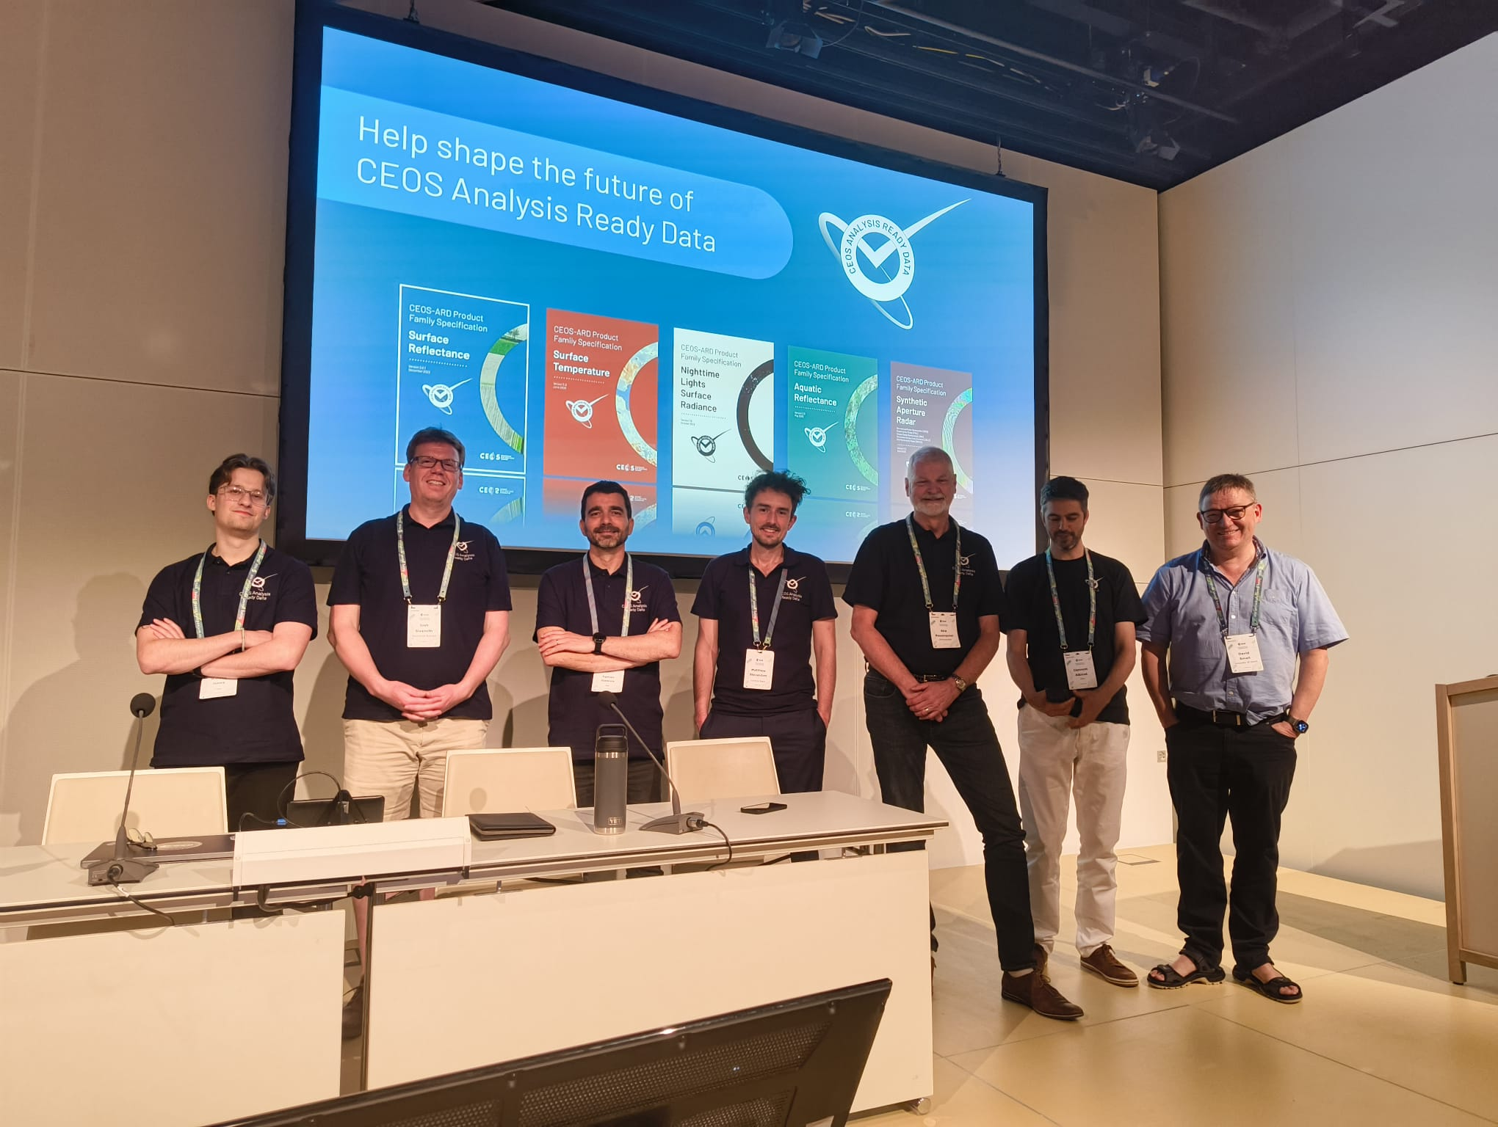
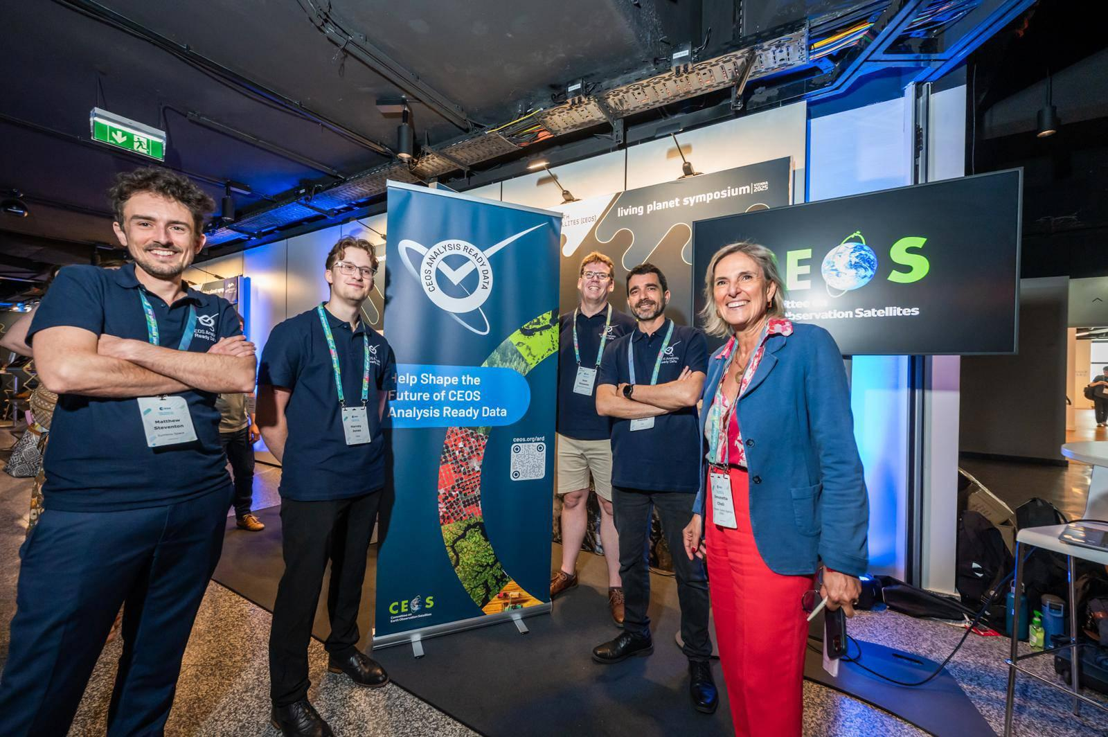
CEOS-ARD
@ ESA LPS 2025

Slide 10
Can we do more?
The Earth observation sector has come a long way since CEOS-ARD was first conceptualised:
Changing technology, including AI/ML, cloud-native
Evolving user base and expectations
Increasing demands for interoperability
Need CEOS-ARD to continue evolving
Ensure CEOS-ARD remains consistent with and relevant to the evolving user base and their expectations
Where are the opportunities to make CEOS-ARD better?
CEOS Plenary 2025

Slide 11
Future of CEOS-ARD
Goals for 2025:
Gather community feedback on the current state of CEOS-ARD
Understand priorities for future development
Present concept note for CEOS-ARD Strategy 2026 at CEOS Plenary 2025
Overall Aim: Ensure CEOS-ARD is working for the broadest group of stakeholders
CEOS Plenary 2025

Slide 12

Approach
CEOS-ARD Oversight Group tasked with maintaining CEOS-ARD Strategy
Updated every two years
In 2025 we have undertaken a community engagement campaign to understand needs
Particular focus on those outside of CEOS
Understand exactly how CEOS-ARD needs to evolve
Presence at key events such as ESA’s LPS, IGARSS, IAC, WGCV-55
Survey to gather feedback to “Help Shape the Future of CEOS-ARD” ceos.org/ard/survey
Social media campaign
LinkedIn particularly valuable
CEOS Plenary 2025

Slide 13

Findings are summarised in the paper provided for Plenary
Thanks to all contributors and the author team!
Identifies areas to develop further in CEOS-ARD Strategy 2026 and the CEOS dependencies / expertise needed
CEOS Plenary 2025

Slide 14
Author Team and Contributors
CEOS-ARD Oversight Group Lead: Ferran Gascon (ESA)
CEOS-ARD Secretariat: Matt Steventon, Harvey Jones
CEOS SEO: David Borges, Matthias Mohr
CSIRO: Neil Sims
ESA: Clement Albinet, Fabrizio Niro, Paolo Castracane, Valentina Boccia
European Commission: Peter Strobl
GA: Matthew Adams, Jonathon Ross, Medhavy Thankappan, Joshua Sixsmith, Maggie Arnold, Chris Penning
IEEE: Siri Jodha Singh Khalsa
ISRO: Santhi Sree, Hari Priya S, Suchandra Aich Bhowmick
JAXA: Takeo Tadono, Ake Rosenqvist
NPL: Nigel Fox
USGS: Cody Anderson, Christopher Barnes (KBR)
With substantial inputs from the CEOS-ARD Oversight Group, the Land Surface Imaging Virtual Constellation (LSI-VC), and the Working Group on Calibration and Validation (WGCV).
CEOS Plenary 2025

Slide 15
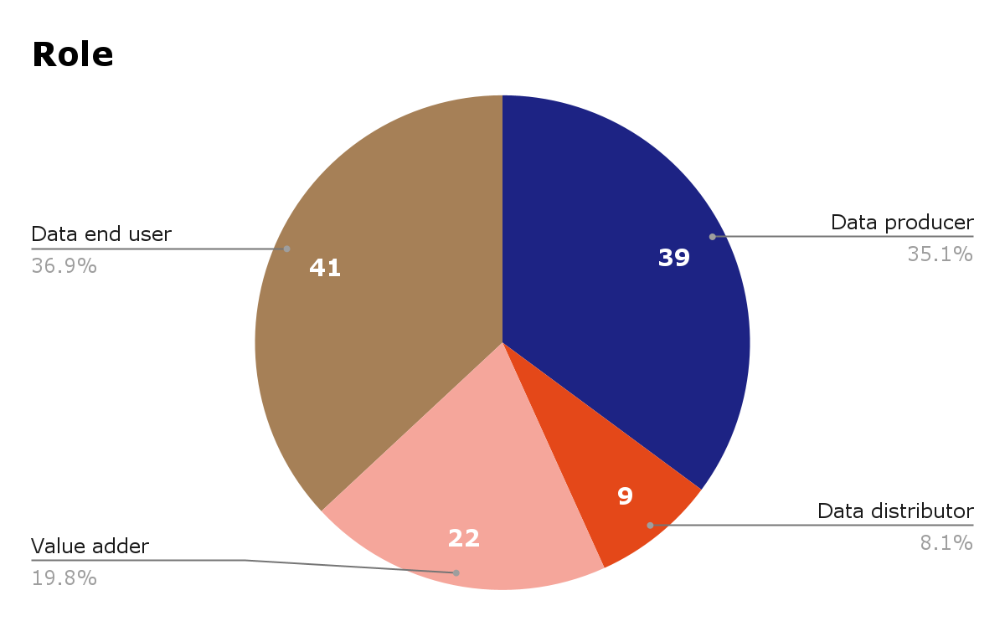
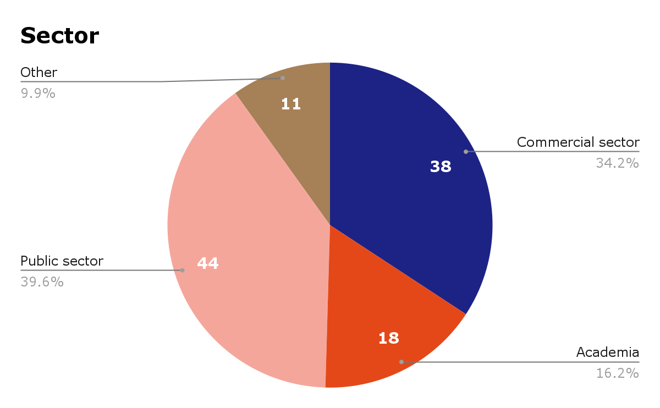
Survey Respondents
111 responses! 🎉
CEOS Plenary 2025

Slide 16
Survey Respondents
Commercial | Other
Airbus Defence and Space GmbH AISTECH SPACE, S.L. Arlula Pty Ltd Auspatious CATALYST (PCI Geomatics) Common Space Constellr EarthDaily ENVEO IT GmbH EOIntelligence Esri First Street GeoInsight GRASP Earth Marble Imaging AG Pixalytics Ltd Pixxel Planet Labs Riscognition GmbH Sarmap SA SatSure India Analytics Pvt Ltd SatVu Sparkgeo SpectralEO Telespazio UK USACE-AGC World from Space | Aberystwyth University Anna University Conicet Curtin University Kasetsart University KTH Royal Institute of Technology Landgate Natural Resources Canada OGC STFC Trier University UK Met Office UK Ordnance Survey Univ. Colorado, Boulder University of Maryland University of Tartu University of the Free State University of Venda
CEOS Plenary 2025

Slide 17
Headline Findings 1/2
Topics that a Future CEOS-ARD Strategy Should Consider:
Consistent and Enhanced Metadata Specifications
Data and Metadata Quality
Ongoing Quality Assurance and Integrity Monitoring
Fitness for Purpose
Increased Support to Scientific Applications and Environmental Adaptation and Resilience
​​Solidifying the Business Case and Increasing Commercial Relevance
CEOS Plenary 2025

Slide 18
Headline Findings 2/2
Topics that a Future CEOS-ARD Strategy Should Consider:
Tools to Aid Compliance Assessments and Peer Reviews
​​Supporting Opportunities and Reducing Risks Related to AI / ML
Measurand Consistency and Algorithm / Application Resilience
​​Alignment with the Software Ecosystem
​​Analysis Ready Data Standards
Thematic and Higher-level ARD Products
Training and Outreach
Capturing Use and Impact
CEOS Plenary 2025

Slide 19
Highlight 1: Data Quality
CEOS-ARD datasets might satisfy reporting requirements, but there are no quantitative bounds placed on the ‘quality’ of these characteristics.
There are no provisions in the CEOS-ARD framework for periodic/continuous monitoring of dataset compliance and ongoing monitoring of data ‘quality’
Opportunities:
‘High quality’ (definition to be subject to further discussion) CEOS-ARD will build trust and protect reputation.
For data providers, compliance with evolved CEOS-ARD will demonstrate and imply a high level of ‘quality’.
Establish mechanisms to assess data quality and integrity and assure users of the enduring quality of CEOS-ARD datasets
Some connections:
WGCV: Product Validation Platform
WGISS: Interoperability Handbook Quality Chapter
WGCV: Cal/val networks such as RadCalNet, SARCalNet, Hypernets, TIRCalNet;
WGCV: Maturity Matrix
CEOS Plenary 2025

Slide 20
Highlight 2: Commercial Relevance
Want CEOS-ARD to facilitate EO interoperability across all sectors (public and private)
Commercial business case for investment in CEOS-ARD needs to be clarified to increase commercial uptake
Product Family Specifications must be adapted for:
Very-high-resolution data
Constellations and mosaic/composite products
Availability of proprietary information and auxiliary data sources
Opportunities:
CEOS-ARD positioned as a baseline for agency/country commercial data procurement
Streamline assessments, avoid duplication of effort
Providing a consistent benchmark for quality and interoperability.
Engage the commercial sector in defining Product Family Specifications (already underway!)
Some connections:
Joint ESA-NASA Quality Assessment Framework
Engagement of the ESA Earthnet Data Assessment Pilot (EDAP) and NASA Commercial Satellite Data Acquisition (CSDA) teams
Copernicus Contributing Missions and the Mission Performance Clusters
JACIE and VH-RODA communities
Commercial sector participation in CEOS Working Group and Virtual Constellation meetings
CEOS Plenary 2025

Slide 21
Highlight 3: Thematic and Higher Level Products
Users and frameworks such as the Essential Agriculture Variables (EAVs) and Essential Biodiversity Variables (EBVs) are looking for CEOS-ARD to include Product Family Specifications for higher-level products, beyond the Level 2 specifications (e.g., surface reflectance) currently targeted by CEOS-ARD.
Opportunities:
Provide scope to increase support to CEOS priorities like agriculture and biodiversity.
Build relationships with communities using CEOS-ARD products – application-focused groups like GEO-LDN, GEO BON, and GEOGLAM, etc. aiding user needs elicitation and product refinement.
Harmonising contributions to essential variables (EAVs, ECVs, EBVs …)
Connections:
CEOS Agriculture, Forestry and Other Land Use (AFOLU) Roadmap Team (including Ramsar Convention connections through ESA and JAXA).
LSI-GEOGLAM Subgroup (Essential Agriculture Variables).
Biodiversity Study Team (connections to GEO BON, UN SEEA, Global Biodiversity Framework, GEO-LDN, etc.).
CEOS Agency operational platforms like the European Commission’s Copernicus Land Service.
CEOS Plenary 2025

Slide 22
Are there specific datasets you would like to see assessed and endorsed as CEOS-ARD?
Commercial data sources
Copernicus data and product portfolio
Sentinel-5P L2 data (e.g. NO2, O3, SO2, Cloud etc.)
MODIS
Thematic products for vegetation, biomass, SAR
Planetscope
PACE
VIIRS
Reanalysis model data such as ERA-5
Global elevation models like AW3D, Copernicus DEM
Low level (e.g. surface reflectance) products that involve multi-sensor integration
NISAR
CEOS Plenary 2025

Slide 23
Strategy Timeline
CEOS-ARD Strategy 2026 would be developed throughout 2026 by the CEOS-ARD Oversight Group in collaboration with various CEOS entities and in consultation with external stakeholders.
Initial outline to be presented at SIT-41 (April 2026)
Near complete draft then prepared for discussion at SIT Technical Workshop 2026
Presentation for endorsement at CEOS Plenary 2026 (hosted by Australia, Hobart)
Joint WGCV-56 and LSI-VC-19 meeting a critical and timely milestone for data quality topics
CEOS Plenary 2025

Slide 24
Closing
CEOS Plenary 2025 Proposed Actions | CEOS-ARD Oversight Group to develop the CEOS-ARD Strategy 2026 (for endorsement at CEOS Plenary 2026), which will define the actions, resources, and commitments required to deliver the next level of ambition for CEOS-ARD. CEOS Principals to consider nominations to the Strategy writing team, with particular consideration to the ‘CEOS Dependencies’ noted in the supplied Consultation Paper and Concept Note. Maintaining awareness and leadership of CEOS-ARD progress in global standards bodies (e.g. ISO, OGC) requires increased coordination between CEOS Agencies and national standards bodies to influence national representation and voting results. CEOS Agencies are asked to identify their national organizations within ISO and inform CEOS-ARD OG of any willingness to convey priorities to inform formal voting procedures. Clarify CEOS connection points to ISO | 31 December 2025
CEOS Plenary 2025

Slide 25
Closing
Thank you to everyone for supporting this effort!
Community reception has been extremely positive and encouraging
111 survey responses and counting (will remain open at: ceos.org/ard/survey )
Numerous valuable inputs through interaction at events
2025 has been pivotal for CEOS-ARD community engagement
CEOS Plenary 2025

Slide 26
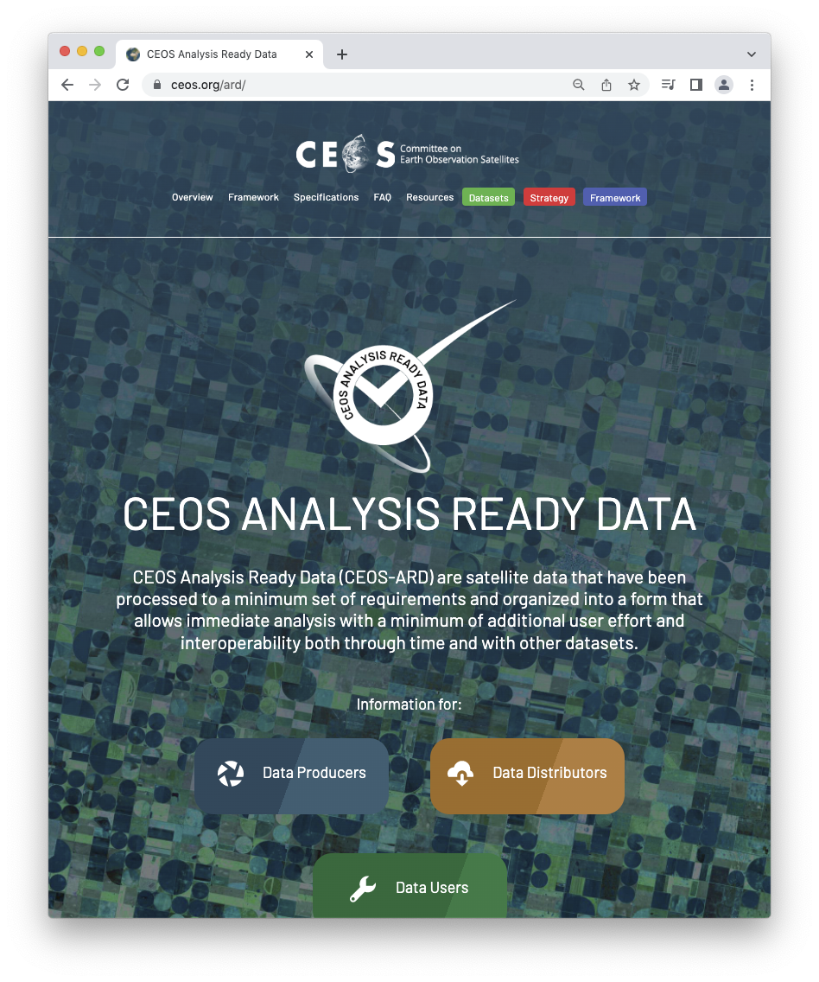
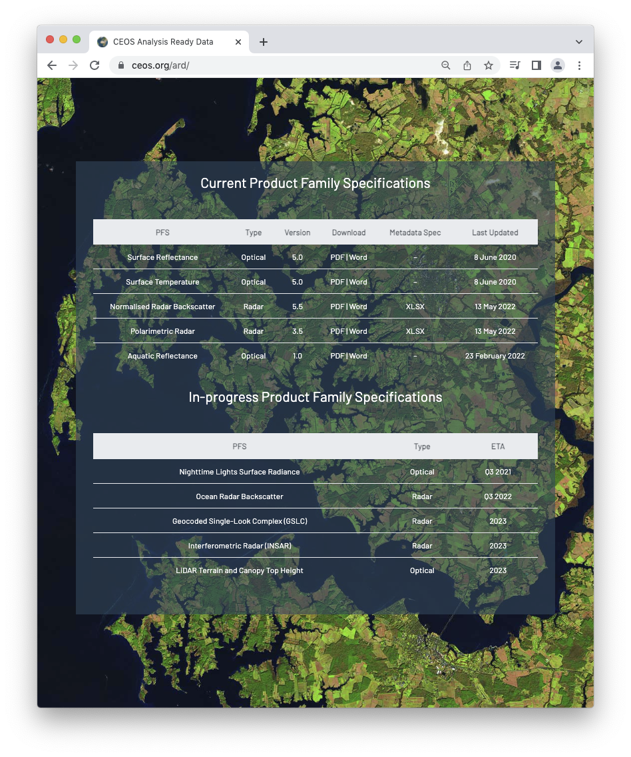
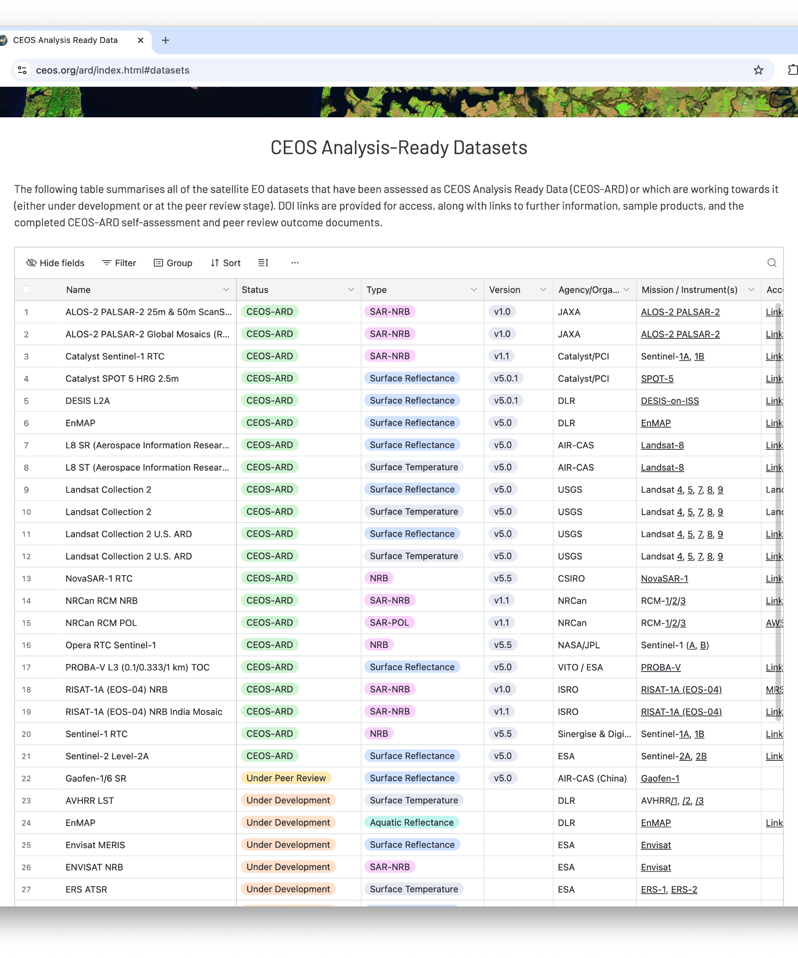
Connect
ceos.org/ard
Ferran.Gascon@esa.int
matthew@symbioscomms.com
CEOS Plenary 2025

Slide 27
Shaping the future of CEOS Analysis Ready Data

Slide 28
Appendix: Future of CEOS-ARD Survey Results
Shaping the future of CEOS-ARD
CEOS Plenary 2025

Slide 29
Future of CEOS-ARD Survey
ceos.org/ard/survey
Core questions and tailored questions for data producers, users, distributors;
Thoughts on characteristics needed to make an EO dataset 'Analysis Ready';
What they value most in the CEOS-ARD Framework and what should be prioritised for future development;
Whether they see a need for formal EO ARD standards or whether a ‘community standard’ approach like CEOS-ARD is sufficient;
What makes an EO dataset 'AI/ML ready';
To identify any barriers to use of the CEOS-ARD Framework / products;
Specific datasets they would like to see assessed and endorsed as CEOS-ARD;
Thoughts on opportunities to accelerate the uptake and impact of CEOS-ARD;
About their CEOS-ARD self-assessment plans.
CEOS Plenary 2025

Slide 30
Some Food for Thought
Could we be more ambitious?
Is the value proposition of CEOS-ARD clear and could it be better communicated?
The potential role of CEOS-ARD as a common benchmark for space agency / governmental data procurement processes.
Do we need to introduce minimum requirements for data quality? And what is the correct approach?
Can we better support users to find products that are fit for a specific purpose?
Supporting application resilience by increasing consistency and equivalence of CEOS-ARD products?
How might CEOS-ARD be made more interoperable and interchangeable? Do we need to be stricter in certain areas to drive practical interoperability?
CEOS Plenary 2025

Slide 31
Respondents
111 responses! 🎉
CEOS Plenary 2025

Slide 32
Survey responses
Commercial | Other
Airbus Defence and Space GmbH AISTECH SPACE, S.L. Arlula Pty Ltd Auspatious CATALYST (PCI Geomatics) Common Space Constellr EarthDaily ENVEO IT GmbH EOIntelligence Esri First Street GeoInsight GRASP Earth Marble Imaging AG Pixalytics Ltd Pixxel Planet Labs Riscognition GmbH Sarmap SA SatSure India Analytics Pvt Ltd SatVu Sparkgeo SpectralEO Telespazio UK USACE-AGC World from Space | Aberystwyth University Anna University Conicet Curtin University Kasetsart University KTH Royal Institute of Technology Landgate Natural Resources Canada OGC STFC Trier University UK Met Office UK Ordnance Survey Univ. Colorado, Boulder University of Maryland University of Tartu University of the Free State University of Venda
CEOS Agencies
+
CEOS Plenary 2025

Slide 33
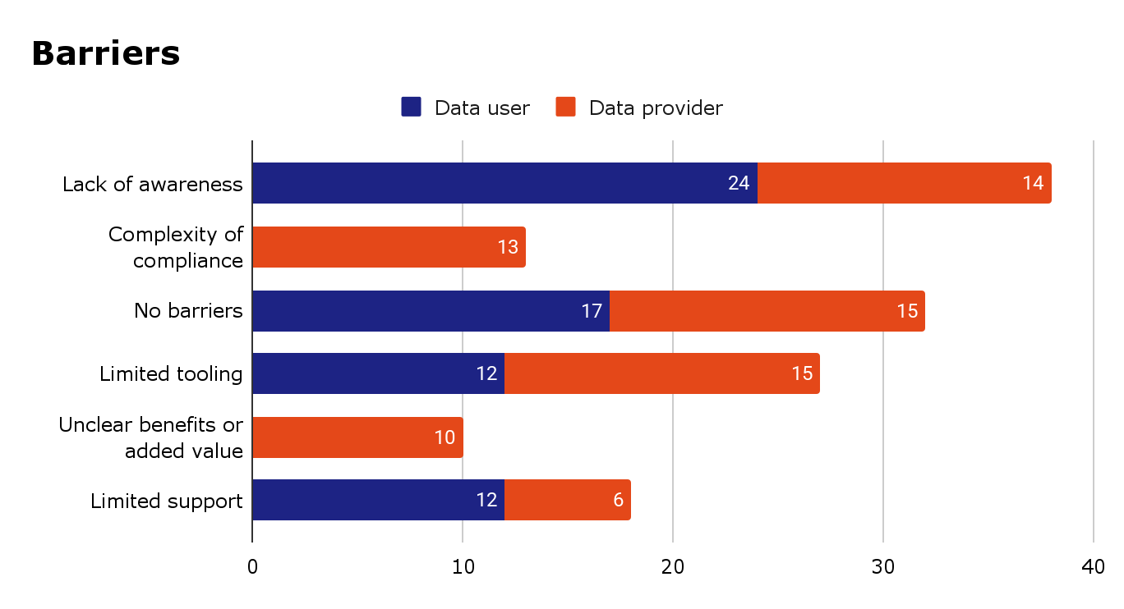
Future of CEOS-ARD
CEOS Plenary 2025

Slide 34
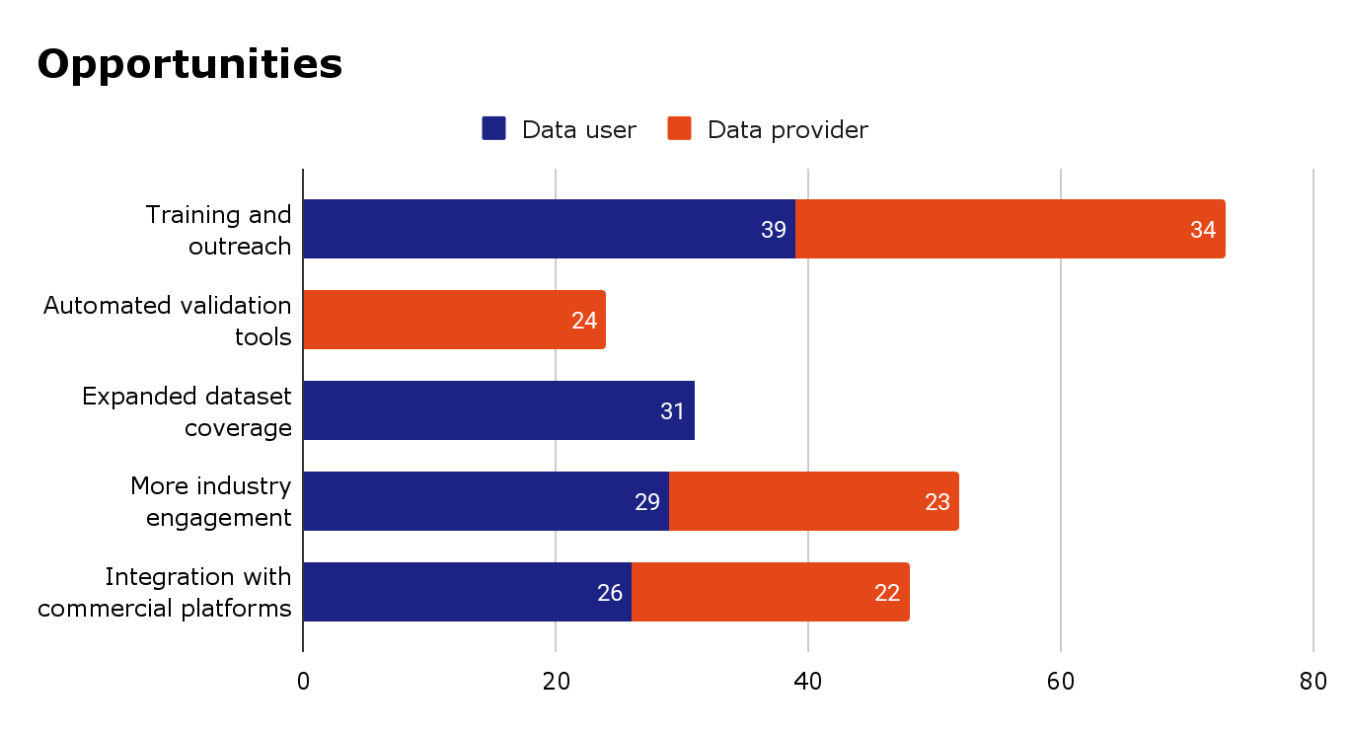
Future of CEOS-ARD
CEOS Plenary 2025

Slide 35
Top 10 Characteristics for Analysis Ready Data (multiple choice)
Rank | Characteristics sorted by ranking
1 | Consistent metadata specifications
2 | Machine-readability
3 | Interoperability through time (relative geolocation)
4 | Findable, Accessible, Interoperable, Reusable (FAIR) compliance
5 | Consistency (data has temporal and spatial consistency)
6 | Consistent terminology
7 | Accessibility
8 | Interoperability with other datasets
9 | Geometric correction using DEM (ortho-rectified)
10 | Fitness for purpose indicators (that the product fulfills the requirements of a specific application, e.g., land cover mapping, precision agriculture, etc.)
Respondents were also asked to provide additional characteristics and comments in a free text field. Feedback has been integrated into concept note.
Notably, quality characteristics were mentioned six times.
CEOS Plenary 2025

Slide 36
Top 10 Characteristics for AI/ML Ready Data (multiple choice)
Rank | Characteristics Sorted by Ranking
1 | Machine-readable formats
2 | Rich, consistent, useful and interpretable metadata
3 | Easy access via APIs or cloud providers
4 | Rigorous definition of data values/content (no ambiguities)
5 | High-quality data and continuous QA/QC
6 | Large-scale accessibility
7 | Temporal consistency
8 | Supply of training datasets that are consistently and accurately labelled
9 | Automated pre-processing
10 | Standardised acquisition parameters
Respondents were also asked to provide additional characteristics and comments in a free text field. Feedback has been integrated into concept note.
CEOS Plenary 2025

Slide 37
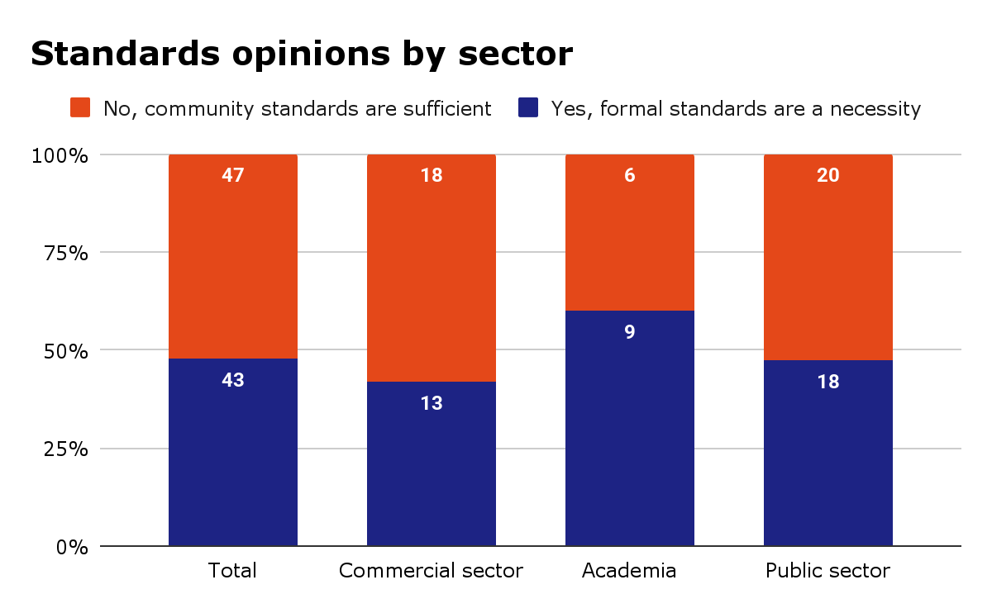
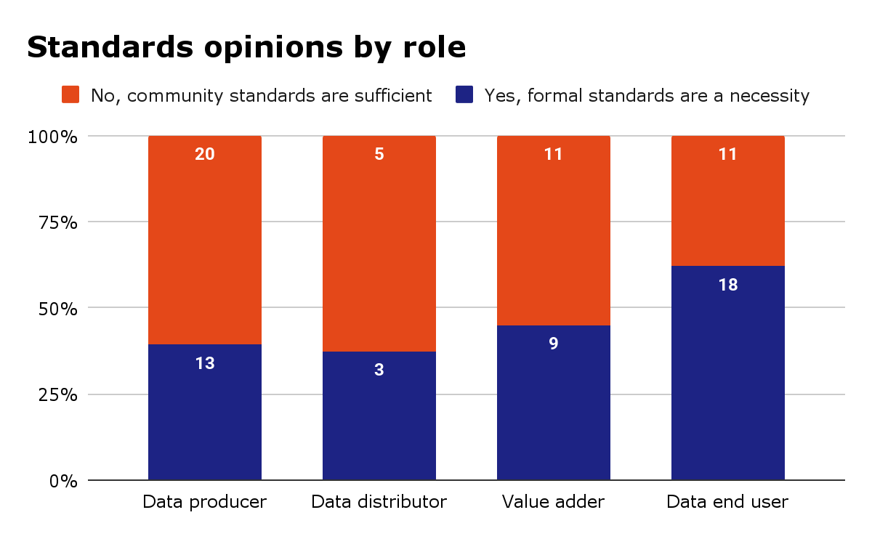
Opinions on ARD Standards
Respondents were divided on the topic of formal vs community standards
In the additional comments box, respondents advocated for free and open community standards – noting the need to be flexible
CEOS Plenary 2025

Slide 38
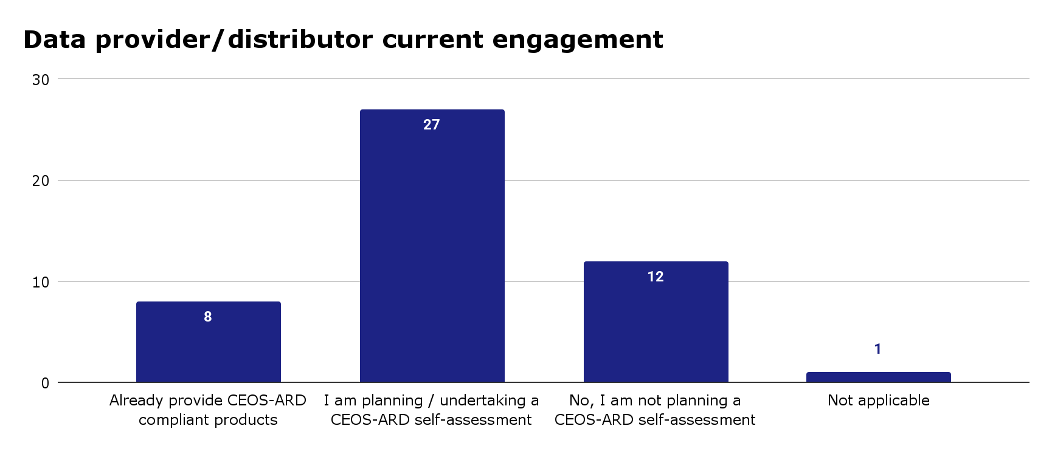
CEOS Plenary 2025

Slide 39
Are there specific datasets you would like to see assessed and endorsed as CEOS-ARD?
Commercial data sources
Copernicus data and product portfolio
Sentinel-5P L2 data (e.g. NO2, O3, SO2, Cloud etc.)
MODIS
Thematic products for vegetation, biomass, SAR
Planetscope
PACE
VIIRS
Reanalysis model data such as ERA-5
Global elevation models like AW3D, Copernicus DEM
Low level (e.g. surface reflectance) products that involve multi-sensor integration
NISAR
CEOS Plenary 2025

Slide 40
Connect
ceos.org/ard
Contact form on page
Or directly:
Ferran.Gascon@esa.int
matthew@symbioscomms.com
CEOS Plenary 2025

Slide 41
Help shape the future of CEOS Analysis Ready Data

