Slide 1
OST-VC White Paper
A Coordinated International Satellite Altimetry Virtual Constellation
E. Obligis, EUMETSAT
Y. Faugère, CNES
OST-VC co-chairs
Agenda Item #7.4
39th CEOS Plenary
Bath, United Kingdom
4th - 6th November, 2025

Slide 2
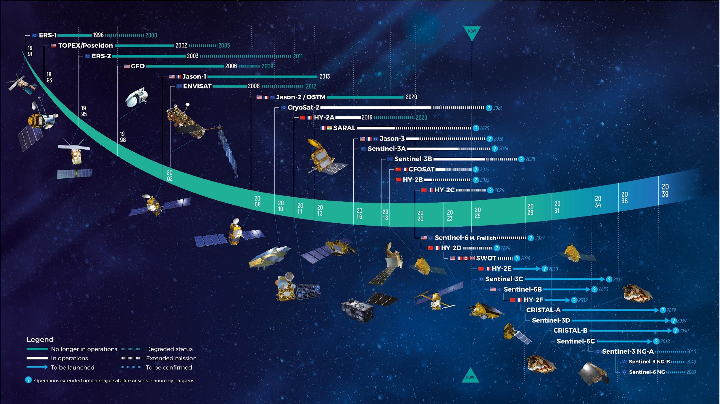
Current constellation
11 missions in flight
11 missions to come
And regular and consistent reprocessing of old missions
Courtesy of CLS

Slide 3
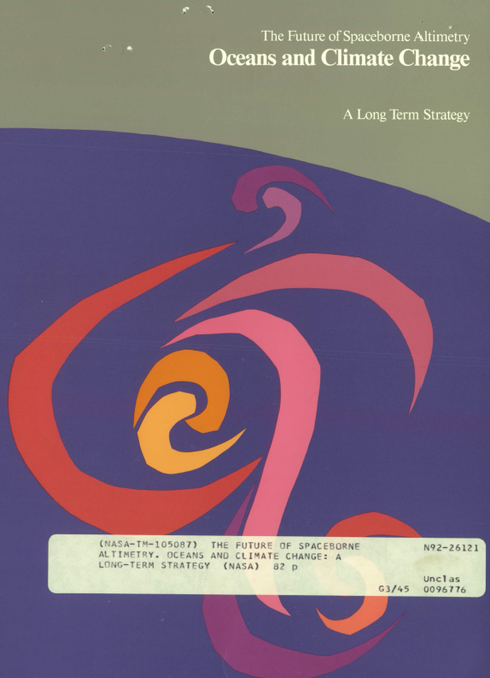
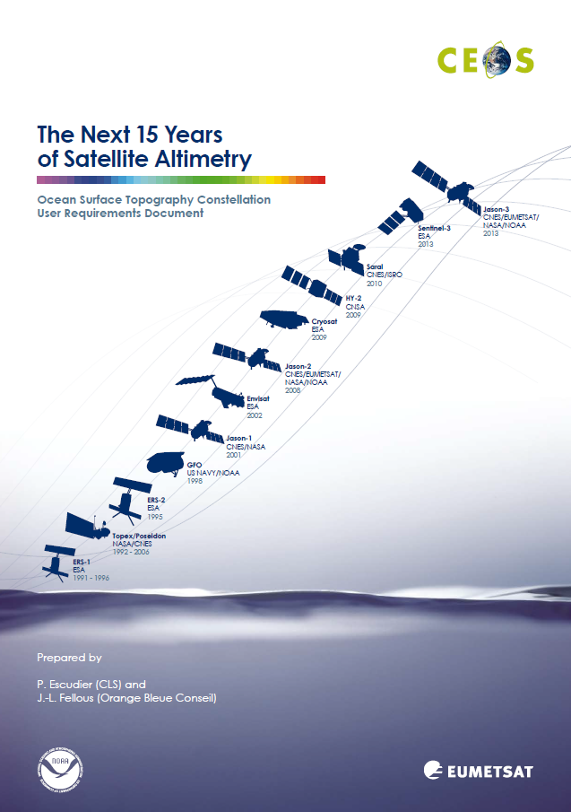
Scope
The future of Spaceborne Altimetry, also called the Purple book, was published in 1992.
Then, in 2006, CEOS initiated the gathering of user requirements for a satellite constellation in support of ocean surface topography monitoring for the years 2010 to 2025.
In 2009 the Assmannshausen report (Escudier and Fellous, 2009) was published under EUMETSAT and NOAA leadership.
All the high-level requirements from that document have since been implemented.
1992
2009

Slide 4
Purpose
Update needed to consider:
New emerging applications from historically “ocean missions”:
  Coastal applications, marine meteorology, waves and currents;
  Polar monitoring of sea level, ice thickness and glaciers;
  Hydrological applications such as lake, river and wetland levels, slopes, volumes and discharges;
  Climate monitoring, through the assessment of global and regional sea level change, its trend and acceleration.
New innovative technologies implemented on-board recent altimetry missions:
  The use of Ka-band as implemented in SARAL/AltiKa, SWOT/KaRin and planned for the CRISTAL mission;
  Synthetic Aperture Radar (SAR, also known as delay-Doppler) altimetry as implemented on CryoSat-2, Sentinel-3, and Sentinel-6;
  Wide-swath altimetry as demonstrated with SWOT and planned for Sentinel-3 Next Generation Topography mission.

Slide 5
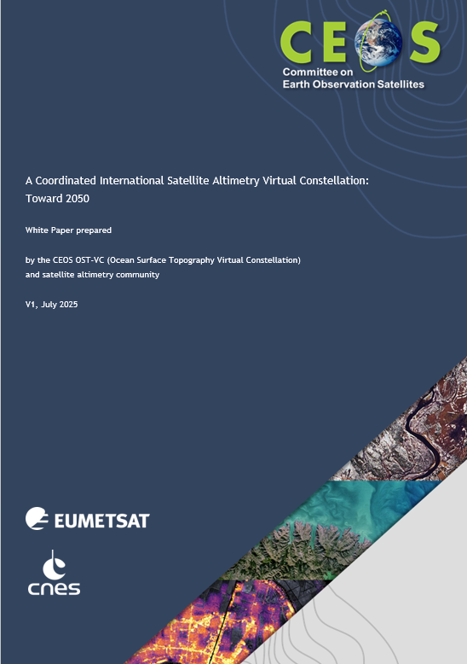
Purpose
“A Coordinated International Satellite Altimetry Virtual Constellation: Towards 2050”
        Inventory of current user needs* including emerging ones;
        Identification of gaps in the current international space constellation.
    (*) It is up to agencies, once the coordinated space programmes are decided, to set up mission requirements documents.

Slide 6
Authors
Editorial team: EUMETSAT - CNES
E. Obligis (EUMETSAT), OST-VC co-chair
Y. Faugère (CNES, FR), OST-VC co-chair
R. Scharroo (EUMETSAT), OSTST project scientist
P. Bonnefond (Observatoire de Paris for CNES, FR), OSTST project scientist
A. Sylvestre-Baron (CNES, FR), previous OST-VC co-chair
Contributors:
OST-VC members
Key experts from the altimetry community
* OSTST : Ocean Surface Topography Science Team

Slide 7
Summary of the user needs and gap analysis
For all applications:
Ocean Dynamics
Operational oceanography
Biology
Sea state and surface currents
Inland waters
Coastal and continental shelf waters
Ice
Geodesy
Extreme events
Weather monitoring and forecast
Climate Monitoring and Research
And transversal activities:
Calibration and Validation
Data and user service components
Application | Horizontal Resolution | Temporal Resolution | Delivery Timeliness | Accuracy |  | Stability
Open ocean mesoscale topography | 1-10 km | 1-5 days | few hours (for operational purposes) | 1 cm
Open ocean wind speed | <10 km | <1 day | < 3 hour | < 1 m/s (wind speed)
Open ocean SWH | <10 km | <1 day | < 3 hour | <10%
Open ocean currents | <10 km | 1 day | < 3 hour | 5 cm/s (currents
Open ocean directional wave spectra | 60-1000m < 20km | 1 day | < 3 hour | < 15%
Coastal waters (topography) | <100 m | < 1 hour | <1 hour | 1 cm
Inland Waters topography | <50m | 1 day | few hours (for operational purposes) | 10cm
Land ice topography | < 1 km | < 1 month | < 1 month | < 50 cm |  | 1 cm/yr
Sea ice thickness | < 1 km | < 1 day | < 1 day | < 10 cm
Geodesy | < 1 km | < 1 month | < 12 months | < 1 microrad
Extreme events | meters to kilometers | minutes to days | minutes (for events), months for baseline | phenomenon dependent
Global Mean Sea Level | < 100km | < 30 days | < 12 months | < 4 mm | <0.1 mm/yr (90% CL) over 10-year and longer periods, and an accuracy of the GMSL acceleration of 0.5 mm/yr/ decade (90% CL) over 20-year and longer periods
Regional Mean Sea Level | < 100km | < 7 days | < 12 months | < 1 cm | 0.3 mm/yr (90% CL) over 20-year and longer periods.

Slide 8
Key outcomes (1/3)
For most of the applications related to water level, both over sea and inland, relatively poor spatio-temporal sampling today (either lack in coverage or revisit time, or both). For example, ocean model resolution will soon reach a few kilometers at the global scale and 1 km or less at regional and coastal scales
  Need to fly swath altimeters : will be implemented with the Sentinel-3 Next Generation operational swath altimeters in the Copernicus programme
For the monitoring and understanding of climate change and its contributors
  Need to ensure the continuation of the now three decades long time series of reference altimeter missions, preferably maintaining the same ground track to ensure uninterrupted continuity (Sentinel-6 and Sentinel-6NG)
For sea state and surface currents considered a still underdeveloped domain of satellite altimetry
  Need to investigate SAR and swath altimetry to aid the disentangling between wind driven waves from swell as well as surface and geostrophic currents
  Need surface current observations for science (understanding of ocean-atmosphere interaction, the energy transport, …) and many applications

Slide 9
Key outcomes (2/3)
Relatively poor coverage of polar areas which is key to climate change monitoring
  Need to continue the observation of the poles with altimetry (potential gap between Cryosat-2 and CRISTAL missions if any should be minimized)
In-situ / FRM data for calibration and validation
  Need to maintain and further develop transponders, corner reflectors, tide gauges, drifting/profiling floats…
Gap and opportunity in developing higher level products in synergy with other satellite-borne sensors
  Need combination with SAR, scatterometers, radiometers, visible or infrared imagers, etc.) and/or other geophysical parameters (ocean color, sea surface temperature, ocean salinity, etc.)
Service to users could be improved to serve more applications and to reach a broader user community
  Need to follow the data distribution technologies for a larger user uptake, maintain open and free data policies, provide adequate and accessible documentation, develop further cloud/hosted processing

Slide 10
Key outcomes (3/3)
The international collaboration across continents has been key to the success story that is satellite altimetry (e.g. OSTST):
Most of the altimeter missions have been multi-national and multi-institutional;
Incredible user community that has historically been very open and collaborative, spanning an immense array of disciplines: oceanography, geodesy, weather monitoring and forecast, hydrology, space technology, and many more.
Strong expectation is that such transnational and transformative collaboration continues for the coming decades.

Slide 11
Way forward
Final draft version of the white paper delivered to CEOS in October 2025;
Presented to SIT WG on 11 September for information and discussion;
Presented today for recommendation;
Proposed to be presented to the community during the next OSTST, 16 November 2025.
Thank you

