Slide 1
CEOS Virtual Constellations
2025 Synthesis Report
JAXA SIT Chair Team
Agenda Item 7.6
39th CEOS Plenary
Bath, United Kingdom
4th - 6th November, 2025

Slide 2
CEOS Virtual Constellations
Objectives:
Coordinate space-based, ground-based, data delivery systems
Meet a common set of requirements within a specific domain
Leverage inter-Agency collaboration and partnerships
Address observational gaps, sustain the routine collection of critical observations
Minimise duplication/overlaps
Maintaining the independence of individual CEOS Agency contributions
Atmospheric Composition (AC-VC)
Coastal Observations Applications Services and Tools (COAST-VC)
Land Surface Imaging (LSI-VC)
Ocean Colour Radiometry (OCR-VC)
Ocean Surface Topography (OST-VC)
Ocean Surface Vector Wind (OSVW-VC)
Precipitation (P-VC)
Sea Surface Temperature (SST-VC)

Slide 3
Virtual Constellation Leadership
AC-VC: Emma Knowland (NASA) replacing Barry Lefer (NASA), Hiroshi Tanimoto (NIES), Ben Veihelmann (ESA)
COAST-VC: Paul DiGiacomo (NOAA), Rashmi Sharma (ISRO), Aurelien Carbonniere (CNES), Merrie Beth Neely (NOAA)
LSI-VC: Chris Barnes (USGS), Peter Strobl (EC), Jonathon Ross (GA), Takeo Tadono (JAXA)
OCR-VC: Marie-Helene Rio (ESA), Ewa Kwiatkowska (EUMETSAT), Jeremy Werdell (NASA)
OST-VC: Yannice Faugere (CNES), Estelle Obligis (EUMETSAT)
OSVW-VC: Paul Chang (NOAA), Stefanie Linow (EUMETSAT), Abhisek Chakraborty (ISRO), Suchandra Aich Bhowmick (ISRO)
P-VC: Chris Kidd (NASA), Takuji Kubota (JAXA)
SST-VC: Misako Kachi (JAXA), Christo Whittle (CSIR)

Slide 4
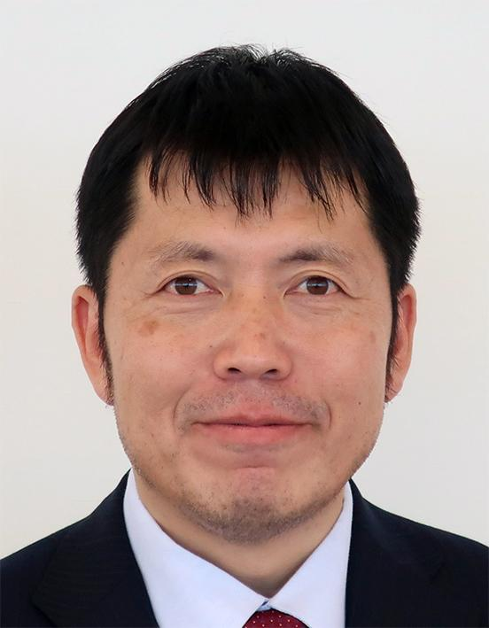

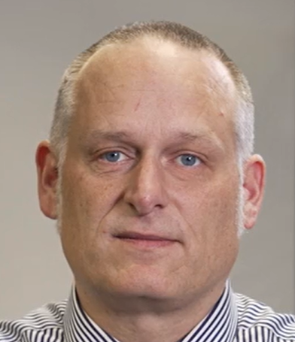
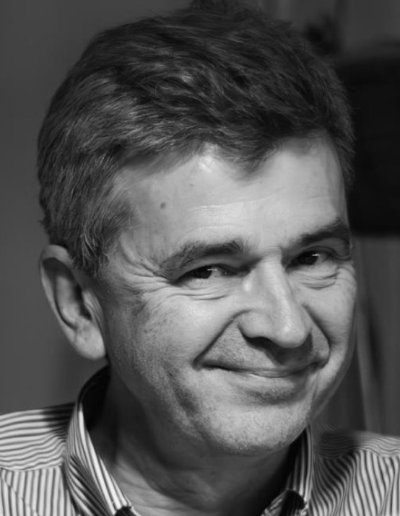
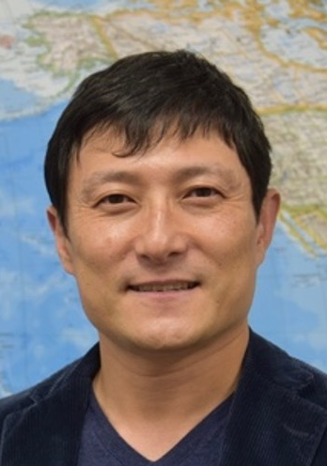

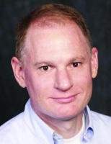
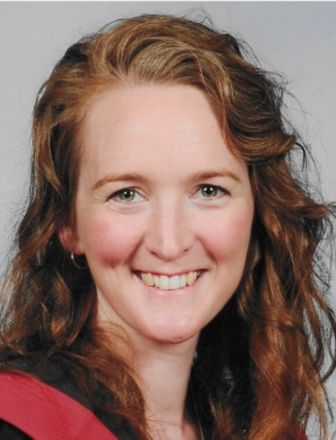
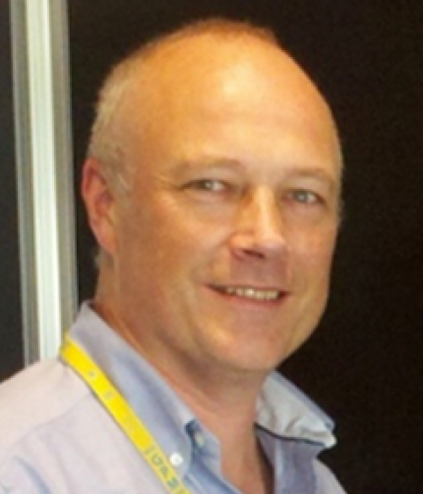
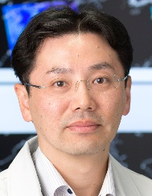
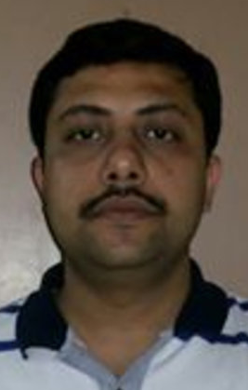



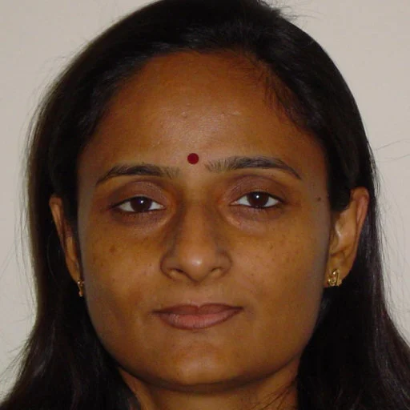

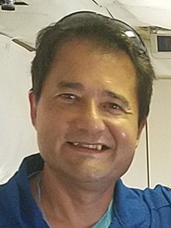


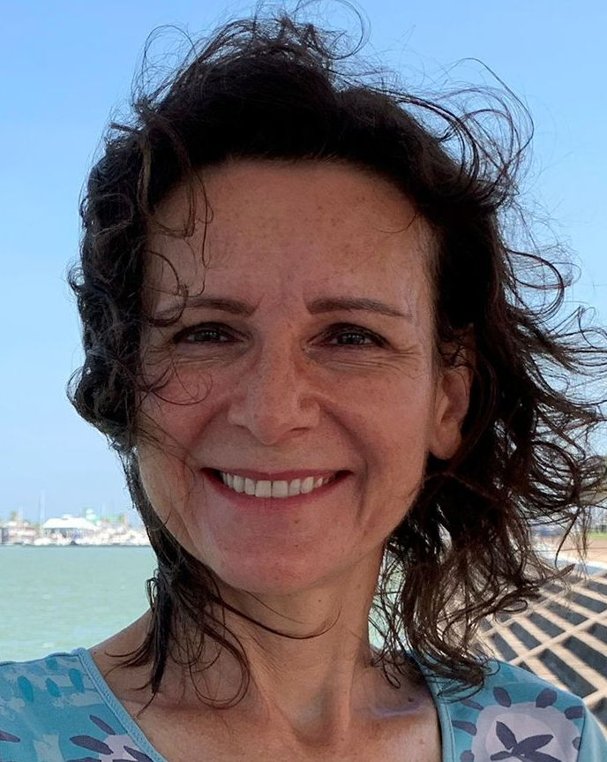
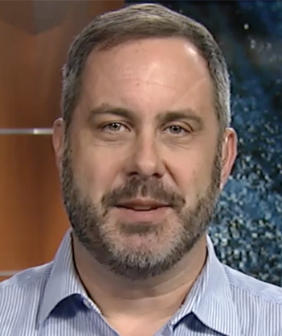
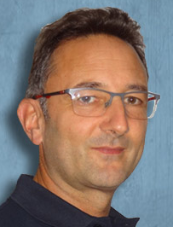
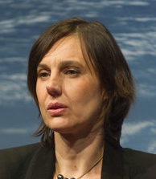

Virtual Constellation Leadership
LSI-VC
AC-VC
P-VC
Takeo Tadono JAXA
Chris Barnes USGS
Jonathon Ross GA
Peter Strobl EC
Hiroshi Tanimoto NIES
Ben Veihelmann ESA
Barry Lefer NASA
Emma Knowland NASA
Chris Kidd NASA
Takuji Kubota (JAXA)
OSVW-VC
SST-VC
COAST-VC
Misako Kachi JAXA
Christo Whittle CSIR
Rashmi Sharma ISRO
Aurélien Carbonnière CNES
Suchandra Aich Bhowmick ISRO
Paul DiGiacomo NOAA
OCR-VC
OST-VC
Paul Chang NOAA
Abhisek Chakraborty ISRO
Stefanie Linow EUMETSAT
Marie-Hélène Rio ESA
Ewa Kwiatkowska EUMETSAT
Jeremy Werdell NASA
Yannice Faugere (CNES)
Estelle Obligis (EUMETSAT)

Slide 5
Virtual Constellation Oversight
The CEOS SIT Chair has the responsibility to oversee and guide the work of CEOS Virtual Constellations
Leadership & Coordination: Guiding to ensure alignment with CEOS priorities and global initiatives.
Strategic Oversight: Coordination to CEOS activity areas, such as climate monitoring and SDGs
Facilitates Collaboration: Integration with other CEOS entities to maximize data impact
Progress Monitoring: Progress, addressing challenges and supporting new initiatives.

Slide 6
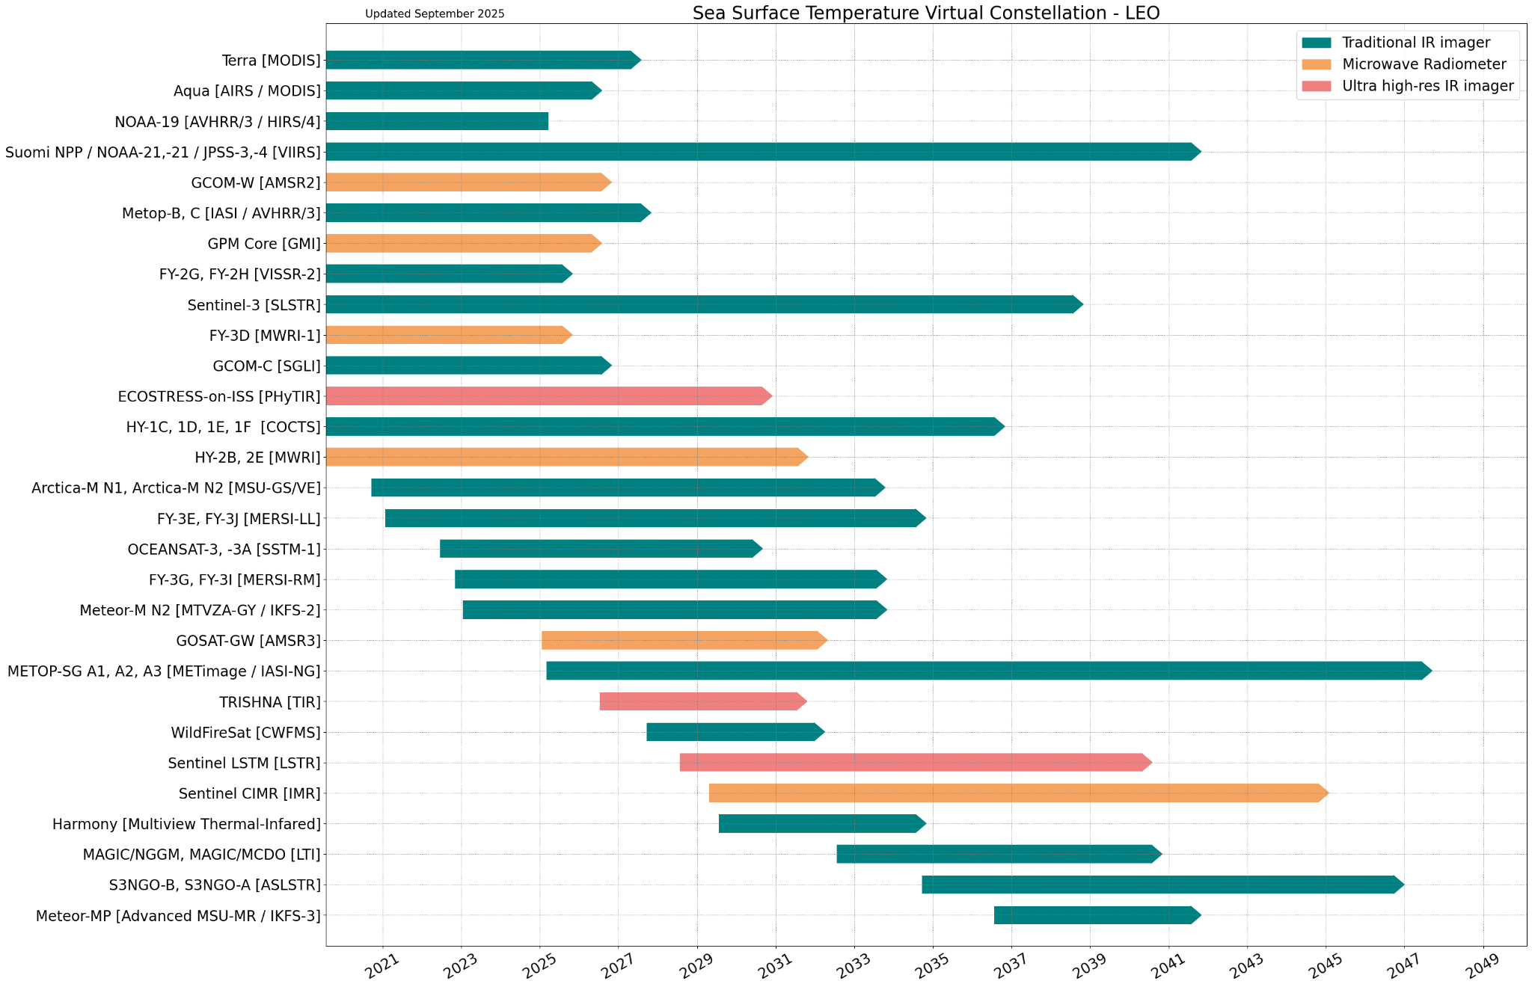
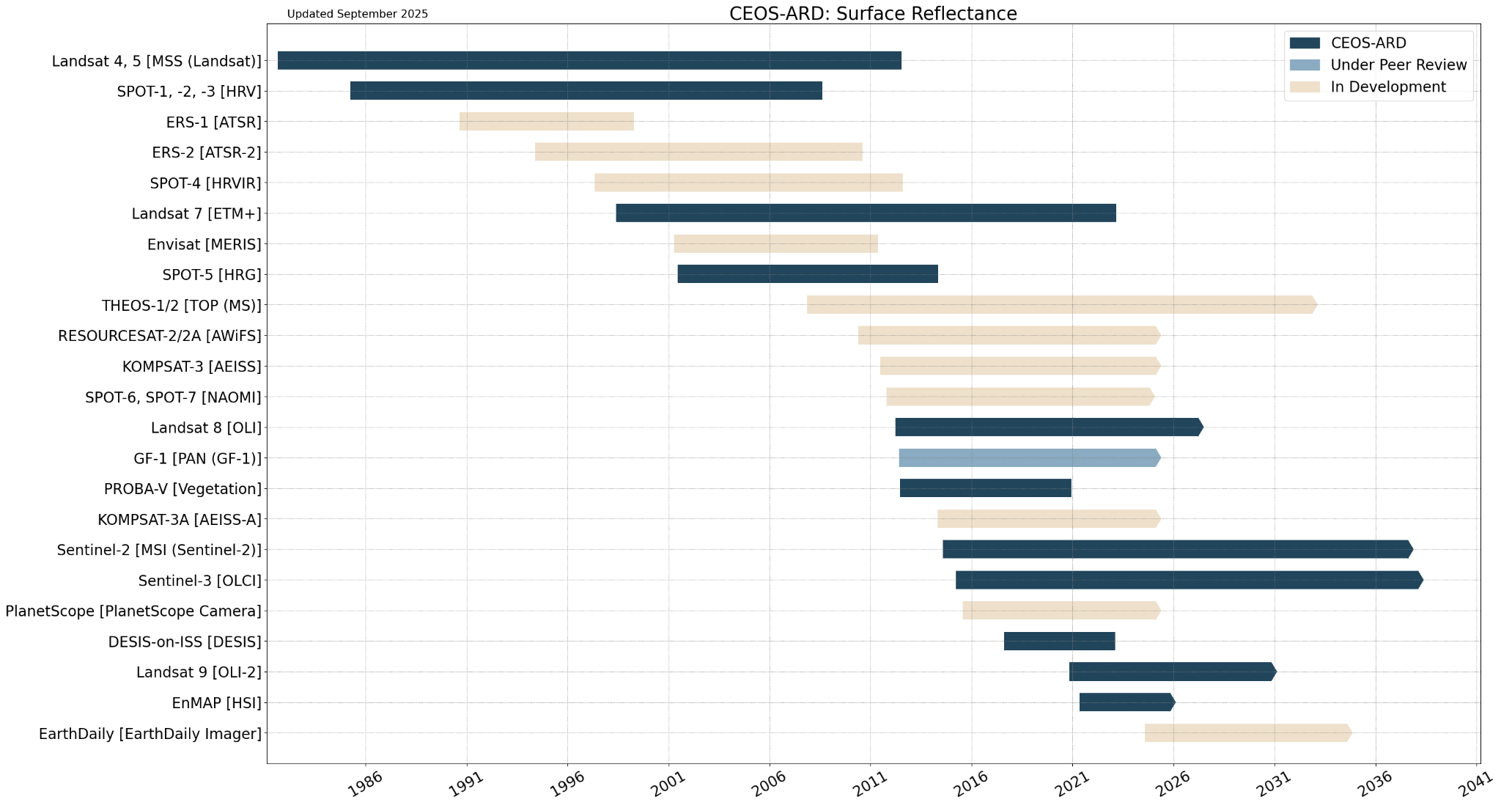
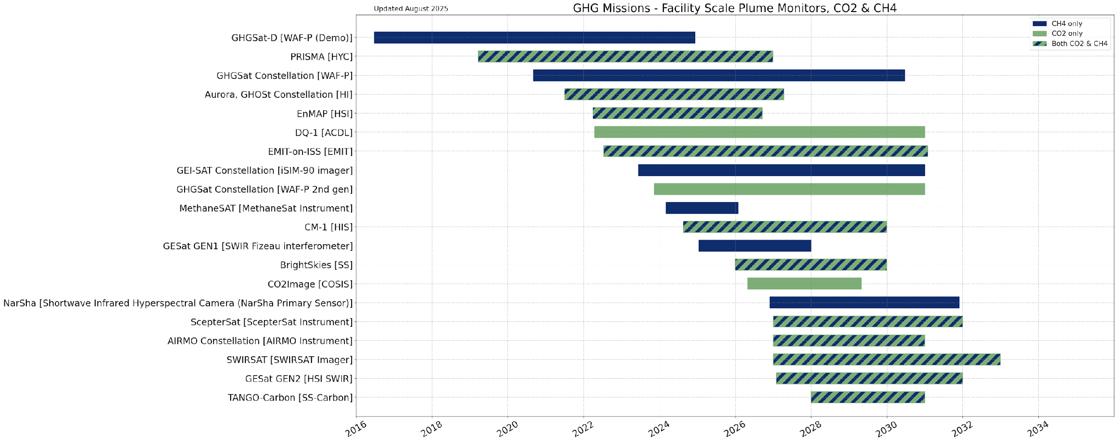
A Common format for VC Reporting
At SIT Technical Workshop 2025, the VC Co-leads trialled a common format to report on VC updates and the state of the observing system. These included:
Timelines of key missions produced with the CEOS MIM Database
Planning highlights: Continuity of observations, missions, and products; potential gaps in data supply through to the 2030’s
Issues for SIT attention: Issues engaging with satellite operators and the commercial sector; items for CEOS Principal attention / guidance
The digestible format was well received at SIT TW, although highlighted the need to retain the VCs’ flexibility

Slide 7
Atmospheric Composition
Planning highlights:
New missions in 2025: GOSAT-GW, MicroCarb, MetOp-SG-A1, & MTG-S1. MTG and MetOp will continue the long record of space-based AC data, alongside Sentinel-4 and -5, IRS, and the geostationary AQ constellation
There is interest to develop more operational GHG validation infrastructure, with plans to initiate a Level 2 intercomparison exercise for total column data. AC-VC submitted papers to the Phase-II Tropospheric Ozone Assessment Report (TOAR-II)
New AC-VC Co-lead Emma Knowland (NASA) replacing Barry Lefer (NASA)
The AC-VC Enhancing the role of satellites in PM2.5 monitoring white paper is at a consolidated draft stage, to be completed by the end of 2025.
AC-VC-21 meeting June 2025 jointly with IWGGMS and WGCV-ACSG in Japan: progress on GHG, tropospheric ozone, and air quality
AC-VC-22 meeting planned for June 2026 in Leiden, Netherlands

Slide 8
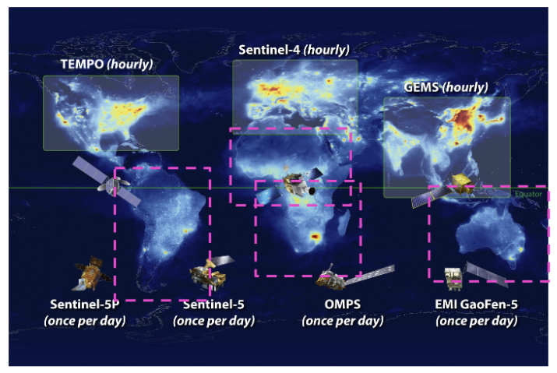
AC-VC White Paper: Expanding Geostationary Monitoring of Atmospheric Composition
There is concern about the potential ending of OCO-2 and OCO-3, as well as the de-scope of GeoXO ACX providing TEMPO continuity over North America. Operational continuity of Sentinel-5P is needed, alongside Sentinel-5
AC-VC is developing a white paper titled Expanding geostationary monitoring of atmospheric composition: Large parts of the globe are not covered by the current constellation of geostationary AC satellites. The white paper advocates for new satellites to fill gaps in coverage and complement the existing GeoAC constellation, requiring regional-level ownership and participation
Consolidated draft expected by the end of 2025

Slide 9
Coastal Observations Applications Services and Tools
Planning highlights:
New COAST-VC Member: CSA
A Coastal Satellite-Derived Bathymetry Working Group was established under COAST-VC in October, which will meet monthly
Coastal Data Gap Analysis activity commenced in October as a contribution to the CEOS Work Plan and the Space4Ocean Alliance. Volunteers from VC and WGs are invited to sign up to the mailing list
The Coastal Application Knowledge Hub (AKH) recently introduced improved intertidal bathymetry from GA and NOAA’s marsh mapping tools.

Slide 10
Coastal Observations Applications Services and Tools
COAST-VC highlights the importance of high resolution instruments for coastal observations, which also rely on OCR, OST, OSVW, and LSI measurements.
Welcoming expressions of interest for future COAST-VC Co-leads, following NOAA’s transition back to membership status in alignment with the proposed timeline
Collaboration highlights:
OCR-VC: COAST-VC is leading the drafting of coastal segments of the CEOS Aquatic Carbon Roadmap, with first drafts completed in early November
SST-VC: Developed the joint coastal masking recommendation
CoastPredict: Co-chairing a special session at AGU25
IOCCG & GOOS: Outreach and future collaboration discussions

Slide 11
Land Surface Imaging
Planning highlights
Successful launches of Biomass and NISAR missions and start of ALOS-4 data distribution
Compliance assessments for CEOS-ARD Surface Reflectance and SAR are being developed for NISAR (NASA & ISRO), SAOCOM-1 and SABIA-Mar (CONAE), THEOS (GISTDA), Landsat Collection 3 (USGS), and Kompsat-6 and -7 (KARI)
CEOS and industry updating the CEOS-ARD Surface Temperature Specification
Increasing scope for SBT products and higher level applications (Wildfires, Climate models)
Kick-off meeting held on 14 October 2025, participated by Landsat, LSTM, S-3, TRISHNA teams, alongside commercial sector. Looking for additional CEOS mission representation
PFS development for multi-source backscatter and VHR SAR to enable new product and commercial sector participation
Supportive of developing an official LSI-VC recommendation for DGGS (Discrete Global Grid System).

Slide 12
Land Surface Imaging
Challenges:
Land degradation neutrality efforts (GEO-LDN, UNCCD) require more long time series, global land cover data, and data harmonisation. SAR applications found for small islands, Biomass, disturbance; hyper-arid areas, and vertical profiles
AFOLU Roadmap actions need to identify more activities beyond NASA, ESA, JAXA
Need to map GEOGLAM EAVs to existing CEOS Agency products / activities
Support for closer collaboration with EO community was emphasised at Ramsar COP15, as EO is key to enabling more reporting. EO featured in COP15 Resolution 13.10
Community requests from the CEOS-ARD survey calling for additional CEOS-ARD from MODIS, PACE, NISAR, NovaSAR-1, Sentinel-1 and 3, among others, as well as better availability of high-resolution open DEMs to support RTC.
Commercial sector is keen to engage and learn from CEOS agencies, many engaging in LSI-VC
Review agency participation in LSI-VC: ASI, CSA, DLR, INPE, NASA, NOAA, VAST

Slide 13
Ocean Colour Radiometry
Planning highlights:
Progress on the Aquatic Carbon Roadmap
Dec 2025: a dedicated keynote, panel discussion, and breakout session at the International Ocean Colour Science Meeting (IOCS); preceded by the Ocean Carbon From Space 2025 Workshop
SIT-41 in early 2026: current target for completion
May 2025 endorsement of the CEOS-ARD Aquatic Reflectance PFS that covers all aquatic ecosystems, oceans, seas, coastal and inland waters
Other OCR-VC deliverables: System Vicarious Calibration in BAMS 2025; in situ measurement protocols, FRM4SOC2; IOCCG training & scholarships, FRM4SOC2 FICE
IOCS 2025 in Darmstadt, Germany, 1-4 Dec, IOCCG meeting co-hosted by EUM & ESA
Current IOCCG working groups and task forces
WGs: Benthic Reflectances, Primary Production, Optical Water Types, Lidar Applications
TFs: Marine Litter & Debris, Hyperspectral, Carbon, Long-Term Records, Sensor Calibration, SVC

Slide 14
Ocean Colour Radiometry
Challenges:
GEO-XO mission may lose the ocean colour sensor. Continuity of hyperspectral measurements needs to be seen into the future.
IOCCG tackling OCR requirements for consistent long-term time series. The requirements are complex and need guidance
Support for high quality in situ Fiducial Reference Measurements is needed. There is vulnerability around funding for SVC infrastructures and risk for missions
Coordination with in situ instrument manufacturers, calibration labs, metrology institutes
End-to-end uncertainty budget for OCR products and the OCR quality label
OCR-VC is leading the Aquatic Carbon Roadmap, and working on interfaces across the CEOS carbon roadmaps and implementing aquatic carbon in global carbon stock assessments
Developing water quality data products: roadblocks for using EO by water quality reporting agencies, and the private and commercial sector

Slide 15
Ocean Surface Topography
Planning highlights:
The current constellation of altimetry missions has 11 in flight and 11 planned. Sentinel-6B is planned for launch on 16 November 2025, providing continuity to the MSL record started in 1992 by TOPEX/Poseidon. Missions launching in 2026 include Sentinel-3C and HY-2E & 2F
Next generation missions: Sentinel-3 Next Generation Topography is under ESA procurement. An ad hoc expert group is in place to define user requirements for Sentinel-6 Next Generation
The upcoming OST Science Team meeting will coincide with Sentinel-6B launch on 16 November 2025, with OSTST26 scheduled for 22-26 June 2026.
OST-VC developed the Coordinated International Satellite Altimetry Virtual Constellation: Toward 2050 white paper, shared as a recommendation to CEOS from the science community
Challenges:
Sentinel-6C was identified in the EC Copernicus Long Term scenario, but there is a contribution risk to the mission.
Key role of Chinese missions (HY2) in the Virtual Constellation 🡪 participation of Chinese agencies in the VC would be welcome.

Slide 16
Ocean Surface Vector Wind
Planning highlights:
Continuity of ocean surface vector wind observations, with several upcoming missions, into the 40’s
E.g. upcoming EPS-SG SCA launch in H2/2026 which will improve high-winds capabilities
Coverage at different times during the diurnal cycle (5:00, 6:00, 7:00, 9:30 and 12:00), plus additional sampling in drifting orbits from NSOAS/CAST HY-2 series into the 30’s
OSVW observations deliver high societal impact, particularly for monitoring extreme winds, NWP, and time series. Complementarity with other instruments (e.g., SAR and microwave radiometers) should continue to be explored.
Challenges
VC Coordination through the IOVWST:
International Ocean Vector Science Team meeting
Location is alternating between US and Europe but attendance from various countries is becoming increasingly difficult
NASA funding until 2024, exceptional EUMETSAT funding in 2025

Slide 17
Precipitation
Current product status:
Agency/organisation products generally freely available in HDF5/netCDF formats.
New products based upon AI/ML are being developed (e.g. GPROF V08 precipitation retrieval product for release in 2026).
CEOS-ARD PFS for precipitation under development (primary agency/organisation products already in ARD-type formats).
Potential gaps in product availability
Products heavily dependent on the suitability and availability of data.
To 2030 - continued operations of core sensors (with some loss/gains).
Commercial (high frequency microwave ) data available (at a significant cost).
Post 2030 - GPM EoL, some new missions, but dominated by sounding instruments (which are less capable for surface precipitation estimation).

Slide 18
Precipitation
Satellite data provides key observations for mapping, monitoring and measuring global precipitation:
❖Critical gaps: possible (likely) lack of low inclination radar(s) and suitable low frequency radiometers for precipitation is now critical. (Precipitation-focused missions have been largely ‘research’ missions).
❖Coordination required: the continuation of a core set of precipitation-capable agency missions is vital - commercial missions are an added extra (albeit at a cost and reduced capability).
❖Societal impact: a reduction in the accuracy of satellite precipitation estimates impacts many aspects of our society from natural hazard mitigation to water resource planning.

Slide 19
Sea Surface Temperature
Planning highlights:
Version 3 of the GHRSST Data Specification (GDS) for SST products is planned to include ultra-high SST (sub 100 m) and sea ice surface temperature. There is interest in CEOS-ARD compliance and cloud optimisation.
GDS provides a common format for SST products adopted by about 20 agencies, more than 150 datasets and many more every year, and provides interoperability between GHRSST datasets and services.
Some commercial sector participation (Ororatech) joined GHRSST26 in June 2025 and interested in engagement with the community for possible ultra high-resolution SST from their satellite
Collaboration highlights:
Worked with COAST-VC to develop joint statement on recommended coastal coverages of future ultra high-resolution IR sensors.
Joined CEOS-ARD Surface Temperature PFS update kick-off in October, sharing SST perspectives and the potential GDS-aligned CEOS-ARD
Inputs to Biodiversity Study Team user needs assessment

Slide 20
Sea Surface Temperature
Challenges:
Gaps are foreseen in LEO microwave imaging capabilities beyond 2032
How does data supply look in 2030? – AMSR3 (2025-2032), HY-2E (2025-2028), CIMR-A (2029-2037)/-B(2034-2042)
How does data supply look in 2035? – Potentially CIMR-A & -B will be in operation. No confirmed successor for HY-2 nor AMSR – continuation needed
Issues with engaging satellite operators, for testing and validation of ultra high-resolution SST of upcoming missions to analyse value of resolving significant features in coastal area
SST-VC would benefit from coordination between parameter and area-focused VCs

