Slide 1
CEOS Plenary 2025
GEOGLAM
Alyssa Whitcraft
GEOGLAM
Agenda Item #7.6
39th CEOS Plenary
Bath, United Kingdom
4th - 6th November, 2025

Slide 2


GEOGLAM & Essential Agriculture Variables Reminders
GEOGLAM was established in 2011 by G20 (France) as a part of their Action Plan on Food Price Volatility and Markets
Mandate: develop bottom-up, consensus-driven outlooks on crop production as it impacts markets, food security, and increasingly/implicitly* sustainability
Who: Many members of the GEOGLAM community come from and serve national and regional authorities who monitor, measure, and report on agriculture.
Plus space agencies, contributing organizations whose work also interacts with and serves national, regional, and global monitoring activities
“Essential”: The GEOGLAM community’s consensus definitions, descriptions, and requirements for monitoring and measuring state and change and forecasting agriculture directly reflect these authorities.
What we agree is required to meet the G20 mandate and the objectives of the nations which comprise it is what we call “ESSENTIAL AGRICULTURE VARIABLES”
*based on the overarching G20 objectives

Slide 3
Proposed Plenary-39 Actions + Most Recent Actions
Action # | Proposed Deadline | Action Text | Rationale or Update/Comment
Plenary-39-? | SIT-41 | Agency Points of Contact Contribute to the Stocktake for 1st 5 Variables Subaction: CEOS LSI-VC supports an efficiency role that accounts for other land area variables (ECVs, EBVs, EWGs) and atmospheric variables (ECVs via WG Climate) | Action Rationale: We know we are not fully accounting for efforts already undertaken by the agencies related to observations and EAV development. Subaction Rationale: Reconciling minor differences in in-common variables specifications/requirements will maximize the efficiency of agency contributions and create clearer requests for high-priority observations, data services, and Essential Variable production.
Plenary-39-? | SIT-TW-41 | CEOS and GEOGLAM begin scoping an Ag Component for the MIM Database
SIT-TW-40-18 | SIT-41 | CEOS agencies without confirmed PoCs are asked to formally appoint a PoC to the GEOGLAM LSI-VC Subgroup | No new confirmations since SIT-TW Already Confirmed: ESA, ISRO, CSIRO, SANSA, Geoscience Australia, CONAE
SIT-TW-40-19 | SIT-41 | WG Cal-Val asked to work with GEOGLAM PoCs to scope “Joint Workshop on Good Practices for ET Validation” | No update
Notes:
Points →
These are the actions we will ask for today, I’ll describe them later
We are absorbing the old actions into the new actions

Slide 4
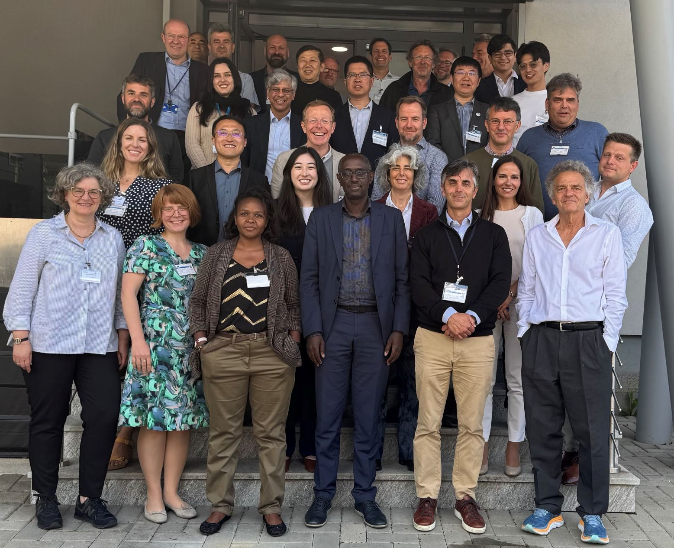
Major EAV Accomplishments 2025
Successful revival of the EAV Working Group beginning at EAV Workshop @ EU-JRC in May 2025
>50 people participated in 2025 EAV effort so far from dozens of organizations worldwide
Adopted a new framework for documenting EAVs, inc:
Definition + Descriptions
EAV Product Requirements
“Stocktake” of current and past products and related satellites
Assessment of gaps and prioritisation
Executed and refined framework for 5 variables:
Crop type
Crop yield
Field boundaries
Cover crop
Actual ET
Details available in the Phase 1 EAV Report

Slide 5
Key Findings + Example (1/2)
Consensus:
Revisions within the Phase 1 timeline allowed for improvements that clarified and improved the framework.
The framework is solid, logical, and valuable. Still, improvements can be made, perhaps by grouping variables as ECVs have done.
Challenges:
Ensuring active contribution in Phase 2
We need a greater level of effort to support the coordination of this activity
Stocktake is missing products - need more agency input
Stocktake is missing ECV, EBV, EWG cross-check - need more CEOS input
Example: Crop Type
Lead Steward(s) | Participants
Mariana Belgiu (U of Twente) Livia Peiser (UN FAO) | Herve Kerdiles (European Commission, EC) Miao Zhang (Chinese Acad Sci, CAS) Felix Rembold (EC) Michel Massart (EC) Shinichi Sobue (JAXA) Zoltan Szantoi (ESA) Pierre Defourny (UC Louvain) Jinlong Fan (Beijing Normal) Shunlin Liang (Hong Kong U) Laurent Tits (VITO) Arun Pratihast (Wageningen) Lorenzo De Simone (UN FAO) Lijun Zuo (CAS) Gilberto Camara (INPE) Rakhesh Devadas (Agriculture Australia)
4 distinct uses were ID’d for crop type, some similarities, some differences…

Slide 6



SINGLE SET FOR ALL USES
Reduce Complexity
Create Consistency
DISTINCT SETS FOR EACH USE
Representative of breadth of applications
Allows unpacking of sources of gaps
PRIORITISATION
Identifying most important gaps that can support the most improvement for each use and distilled for the most uses
Use 1
Product Requirements
“Threshold” and “Goal” Spatial, Spectral, Temporal, Accuracy, Latency
Stocktake - Products
List & Specifications of Past, Current, & Planned Products
Gap Analysis - Products
Performance of Products vs. Threshold & Goal Requirements
EAV Name
Definition
Units
Guidance: Typologies, Hierarchies, Accuracy Assessment etc.
Correspondence with Other EVs
Per Use Priorities
Stocktake - Missions
List & Specifications of Past, Current, & Planned Missions
Gap Analysis - Missions
Performance of Missions vs. Threshold & Goal Requirements
Distilled Priorities
Use …n
Product Requirements
“Threshold” and “Goal” Spatial, Spectral, Temporal, Accuracy, Latency
Stocktake - Products
List & Specifications of Past, Current, & Planned Products
Gap Analysis - Products
Performance of Products vs. Threshold & Goal Requirements
Per Use Priorities
Stocktake - Missions
List & Specifications of Past, Current, & Planned Missions
Gap Analysis - Missions
Performance of Missions vs. Threshold & Goal Requirements
Notes:
Points:
Single set = consensus
Multiple sets for uses = a realistic picture of how EO data are used
But at the end, we narrow and distill down
Missions piece is where we really need agency help - products are good too

Slide 7

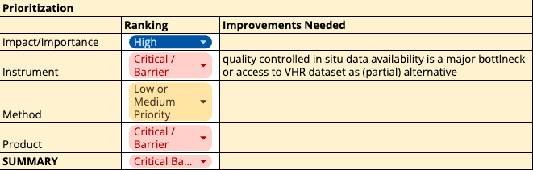
Example: Crop Type (2/2)
Variable: Crop Type
Use: National monitoring for food security water security, and early warning systems.
Attributes:
Findings from Stocktake & Gap Analysis:
Despite very high importance to GEOGLAM, its mandate, and food security in general, critical barriers existed specifically related to instrument suitability and the existence of products that were readily available for use.
Prioritisation: Product generation and availability
Reliant upon quality-controlled in situ data and/or well-calibrated very high resolution datasets.
Notes:
Focusing on this use here - but later we will distill

Slide 8
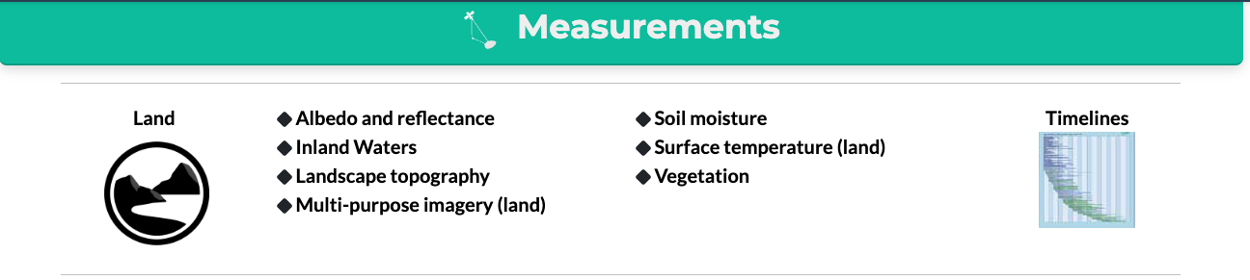

May 2025
Sep 2025
Nov 2025
April / Sept 2026
Nov thru April 2026
CEOS & Agencies do their Actions
CEOS & Agencies do their Actions
13-15 May 2025
GEOGLAM EAV Workshop
Hosted
By EU-JRC
Supported by EU DG RTD
SIT-TW-40
Report:
- Progress on EAVs
Discuss:
- “Roadmap” for EAVs over next 6+ months
Actions:
Agencies appoint PoCs to LSI-VC or stocktake
Scoping of Joint ET Workshop with Cal-Val
Plenary-39
Documents: - Phase 1 EAV Report for 1st Set of EAVs
Report:
- Key findings of Phase 1
- Proposed Cal-Val Workshop for ET
Actions:
Agencies Add to Stocktake for 1st 5 Variables
CEOS MIM Ag Component Database Design Scoping
SIT-TW-40 Actions
SIT-41 / SIT-TW-41
Documents:
- Phase 2 Report
- Agency feedback on level of interest in remaining EAVs
Report:
- EAV Req’s
- Agency Foci for next phase of EAV Stocktake
Action:
Agencies continue Stocktake based on their foci
WG Cal-Val Workshop “Green-light”
Fall or Winter 2026
GEOGLAM EAV WG + LSI-VC Subgroup Joint Workshop to Distill Priorities
Asynchronous work on Phase 1 EAVs
Complete + Submit Phase 1 EAV Report
Legend
Boxes = Events
Arrows = Work
Asynchronous Work on Phase 2 Def’s + Req’s for Other Variables
Plan / Execute (?) ET Workshop
Works on MIM
GEOGLAM
CEOS/Agencies
Shared
Notes:
By Plenary-39 → Review SIT-41 action - and set some deadline after which the ToR simply is assumed endorsed (?)
By Plenary-39 → Agencies to fill in the blanks on LSI-VC group
Beginning in the context of the stocktake support for the 6 actions
We could name the individual agencies who have been active in the past (see right pane)
April 14-16, 2026 - NASEM Beckman Center in Irvine, CA - https://www.nationalacademies.org/beckman-center
→ Agencies work on prioritized stocktake for 2 months (?)
→ More MIM
→ June-July period… GEOGLAM Prioritisation workshop (because full req’s + stocktake (as much as agencies want) + gap analysis can be complete) … outcome of this = prioritisation plan
Sept. 8-10, 2026 - NASEM in Washington, D.C. → review prioritisation plan
→ Plenary 2026… present final stocktake and operationalised MIM
April 20-22, 2027 - NASEM in Washington, D.C.
Sept. 7-9, 2027 – NASEM Beckman Center in Irvine, CA

Slide 9
Actions Requested
Action # | Proposed Deadline | Action Text | Rationale or Update/Comment
Plenary-39-? |  | Agency Points of Contact Contribute to the Stocktake for 1st 5 Variables Subaction: CEOS LSI-VC supports an efficiency role that accounts for other land area variables (ECVs, EBVs, EWGs) and atmospheric variables (ECVs via WG Climate) | Action Rationale: We know we are not fully accounting for efforts already undertaken by the agencies related to observations and EAV development. Subaction Rationale: Reconciling minor differences in in-common variables specifications/requirements will maximize the efficiency of agency contributions and create clearer requests for high-priority observations, data services, and Essential Variable production.
Plenary-39-? |  | CEOS and GEOGLAM begin scoping an Ag Component for the MIM Database
SIT-TW-40-18 | SIT-41 | CEOS agencies without confirmed PoCs are asked to formally appoint a PoC to the GEOGLAM LSI-VC Subgroup | No new confirmations since SIT-TW Already Confirmed: ESA, ISRO, CSIRO, SANSA, Geoscience Australia, CONAE
SIT-TW-40-19 | SIT-41 | WG Cal-Val asked to work with GEOGLAM PoCs to scope “Joint Workshop on Good Practices for ET Validation” | No update

Slide 10
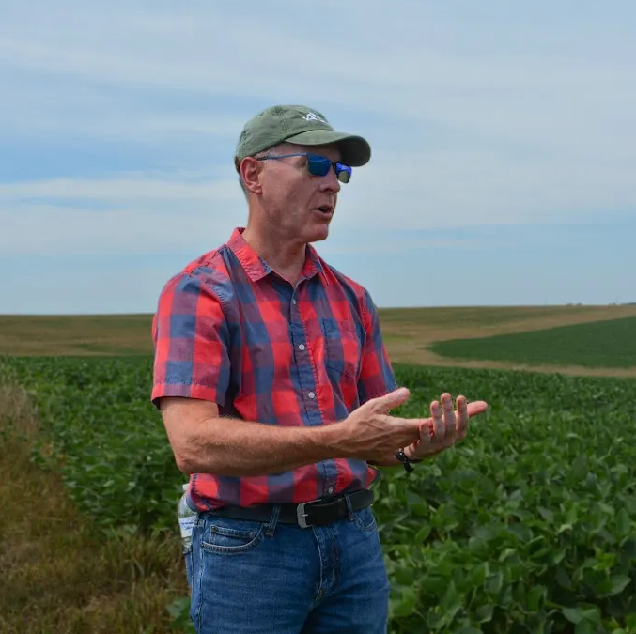

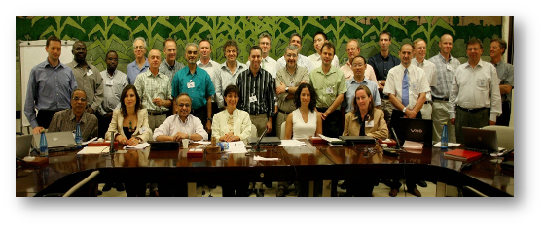
With Gratitude to Dr. Bradley Doorn
Brad Doorn retired from NASA in July 2025 after 40 years of government service
Highlights:
He started NASA’s Agriculture Applied Sciences Program in 2017, managed Water Resources 2008-2023
He served as (co-)lead of GEOGLAM Subgroup / AHWG from 2012 (far right, 2012)
He was one of GEOGLAM’s largest supporters (even when it was GEO Ag Task 07-03) (bottom, 2007)
What’s next? → he will continue teaching at Penn State University

Slide 11
Thank you
Contact:
Alyssa Whitcraft, GEOGLAM Programme Scientist - akwhitcraft@geoglam.org
Sven Gilliams, GEOGLAM Secretariat Director - sgilliams@geosec.org

Slide 12
Appendix
Appendix

Slide 13
GEOGLAM EAV Audiences & What to Show Them
Audience for GEOGLAM’s EAV Efforts | What GEOGLAM wants from them | What they want to know from GEOGLAM’s EAV efforts | What GEOGLAM EAV WG shows them
Funders / donors | Money for innovation research and in-situ data collection | What agriculture decision makers need (products, training, and underpinning materials) in order to achieve a desired impact | Constrained/time-limited funding ask which clearly link to impact that can be achieved from the innovation/in-situ data collection research in terms of human and environmental benefit.
Agriculture decision-makers | To serve them - which justifies the entirety of agriculture monitoring | Which decision-relevant, satellite-derived agriculture information products are available to them, where to find them, and how to use them | A list of the agriculture information products. Where the decision-makers are also funders, we show them the above as well.
Agriculture information product generators | Common definitions for the agriculture information products that agriculture decision-makers need | GEOGLAM itself - we want to collectively benefit from our varied perspective and expertise facilitated through the convening power of GEOGLAM. | The framework and clear boundaries/guidance for their efforts
Bio/geo/physical and hydrological product generators | Basic variables that are necessary for the agriculture information product generators to create the decision-relevant products | Which "input EAVs" to produce and with which specifications | The list of measurements and their requirements.
CEOS / Agencies | Suitable satellite observations | Spatial, spectral, temporal requirements that have a clear tie to what the agriculture decision-makers need. | Spectral, spatial, temporal, radiometric, accuracy, continuity, and latency requirements, with an indication of what concrete improvements will be achieved through their provision of satellites with the specified requirements.

Slide 14

MIM Database - We need to scope
Can add another Category “Agriculture” or add “Agriculture” under “Land”
Agriculture
Agriculture

Slide 15

GEOGLAM Priorities for CEOS LSI-VC Subgroup on GEOGLAM ToR Excerpt
SIT-TW-40 + Plenary-39 Ask → Scoping the breadth of activities, roles, and responsibilities between GEOGLAM and CEOS (SIT-39-06)
Confirming ToR for LSI-VC Subgroup on GEOGLAM (SIT-40-12)
Identifying communication modalities and procedures for GEOGLAM collaboration with other CEOS Working Groups and activities, including the AFOLU initiative, where EAVs already feature.
This was an objective of the GEOGLAM EAV Workshop that was not resolved
SIT-TW-40 Ask → Identifying engaged/active points of contact for each agency to serve on the LSI-VC Subgroup on GEOGLAM (SIT-39-05)
View ToR here: https://go.umd.edu/GEOGLAM-LSIVC_ToR
Embedded within SIT-TW-40 + Plenary-39 Ask → Undertaking a “stocktake” of (and formally documenting) past, current, and future EAV-related projects, activities, and missions/instruments, with CEOS agency participation.
Embedded within SIT-TW-40 + Plenary-39 Ask → Reflect on the stocktake to create a robust gap analysis related to the EAVs toward identifying 2-3 of the highest-priority gaps, their source (e.g. observation, method, product…), and opportunities to address them.
SIT-TW-40 Ask → Progressing the work already initiated with CEOS WG Cal/Val Land Product Validation.

Slide 16
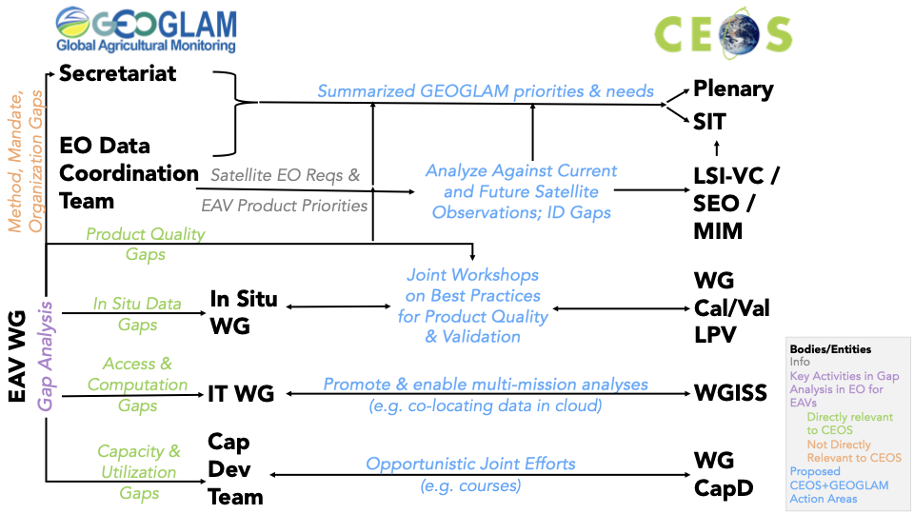
A sketch of logical GEOGLAM-CEOS interactions

Slide 17
Presenter Guidelines 1
Presenters should name their file using the following convention:
AgendaItemNumber_LastName_Subject_Version (e.g., 1.1_Bate_Welcome_v1)
Documents and presentations should be uploaded to the shared folder to allow for streamlined self service
Shared Presentation Folder (default view only, ask for upload/edit permission as required)
For support contact the CEOS Chair Team: uksa-ceos-chair-2025@googlegroups.com
Documents for decision should be submitted by 21 October
Presentations and documents for information should be submitted by 28 October
Reporting to engage discussion or decision is encouraged, but detailed reporting should be provided as pre-meeting reading material or in background slides.
Meeting website: https://ceos.org/meetings/39th-ceos-plenary

Slide 18
Presenter Guidelines 2
Please explicitly highlight the decisions, outcomes, or actions you are seeking. The more explicit you are, the better. i.e., feel free to provide text for a proposed action – it may be revised later, but this approach will help with the efficient preparation of the actions record of the CEOS Plenary.
Where relevant and possible, presenters are invited to highlight for the CEOS community, and especially for CEOS Principals and stakeholders, significant milestones and key accomplishments. Please reference the CEOS 2025-2027 Work Plan where relevant deliverables or other CEOS services and functions apply.

