Slide 1

SOUTH AFRICAN NATIONAL SPACE AGENCY
Prof Abel Ramoelo
Executive Director: Earth Observation Programme
CEOS Plenary
Apex Hotel Conference Centre
5 – 6 November 2025

Slide 2

“...Provide for the promotion and use of space and cooperation in space-related activities, foster research in space science, advance scientific engineering through human capital and support the creation of an environment conducive to industrial development in space technologies within the framework of national government policy...”.
OUR MANDATE
4

Slide 3
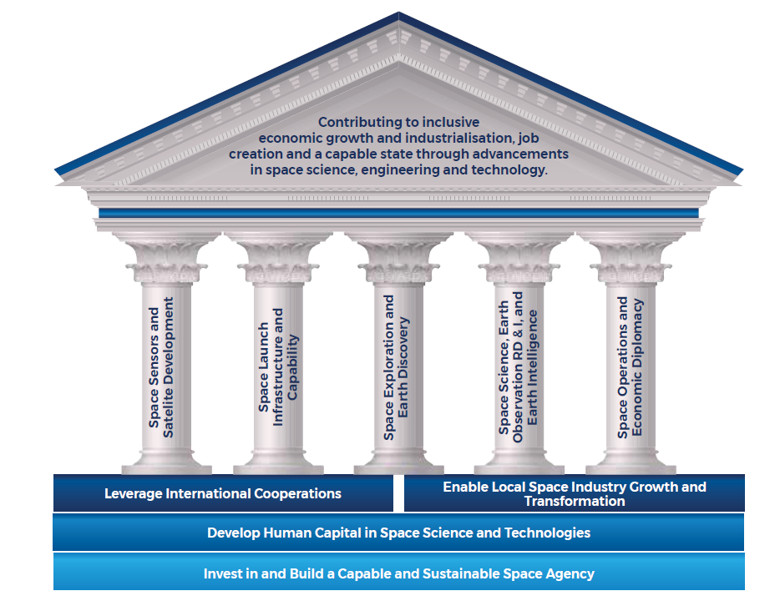
STRATEGIC FOCUS AREAS AND PILLARS OF THE RAMP-UP PHASE FOR 2025–2030
9
8

Slide 4

KEY PROGRAMMES

Slide 5
Earth Observation Programme @ SANSA
Data Products and Services
Research, Application and Development
Data Systems and Management
(infrastructure)
Space Education
Sector and Business Development

Slide 6
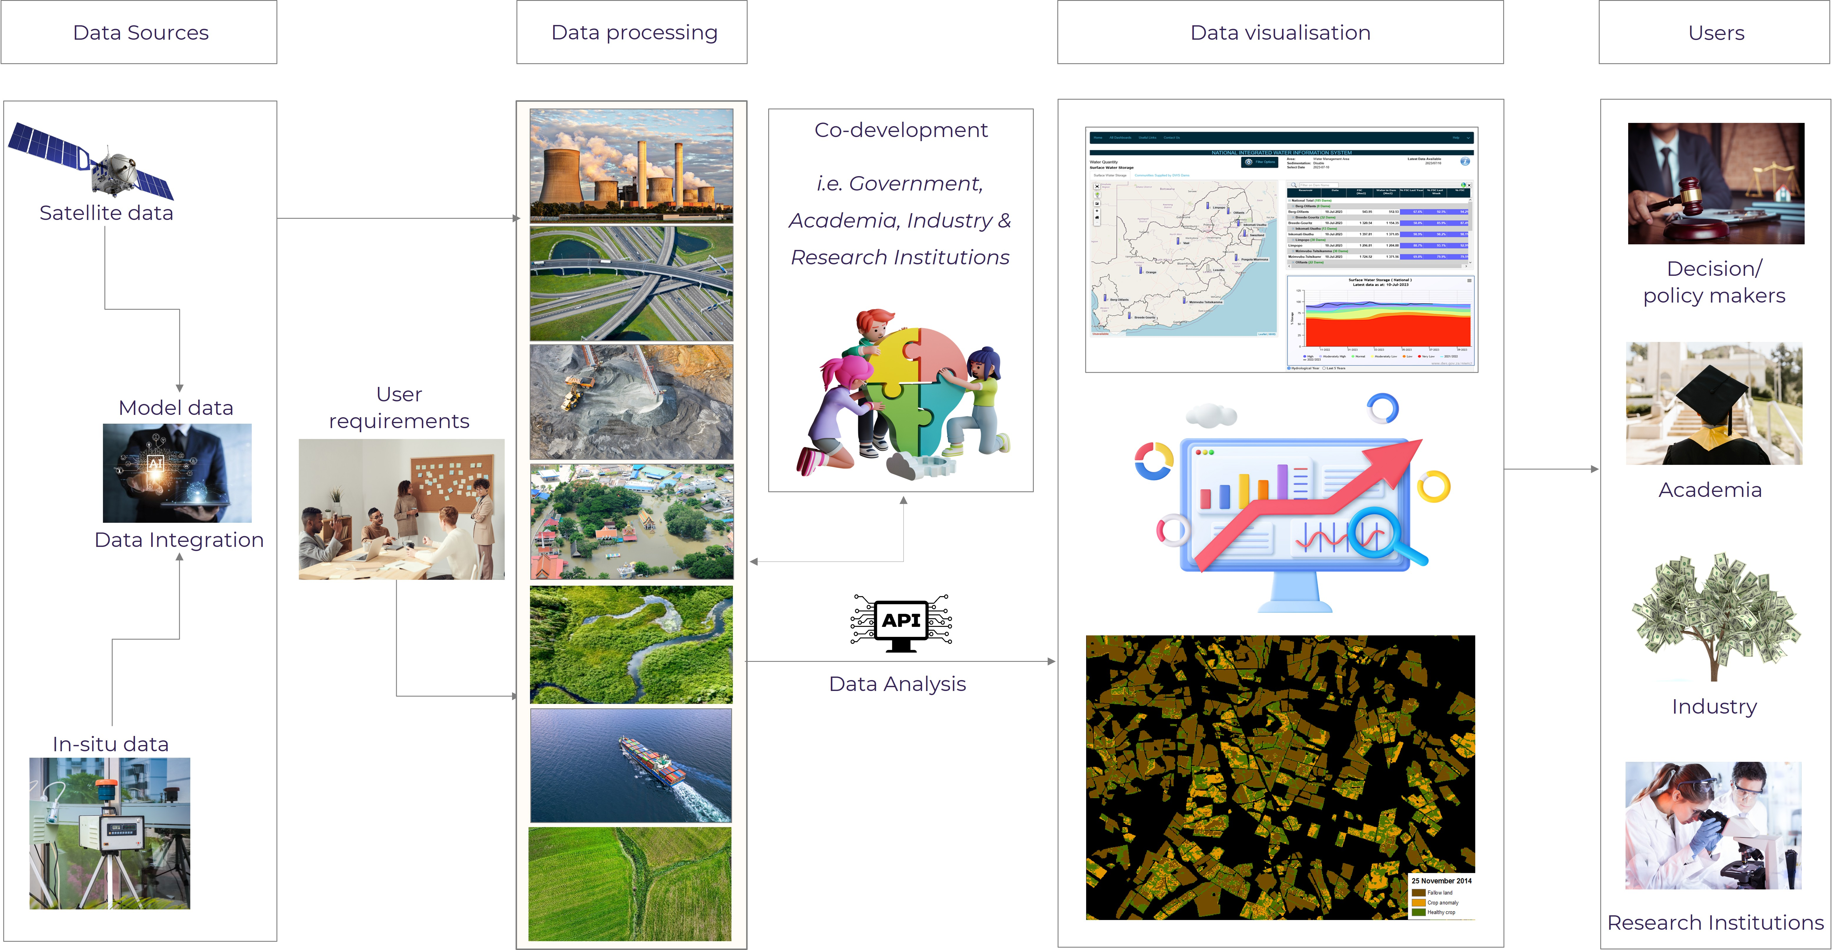
DEVELOPMENT OF DECISION SUPPORT TOOLS FOR VARIOUS THEMATIC AREAS

Slide 7
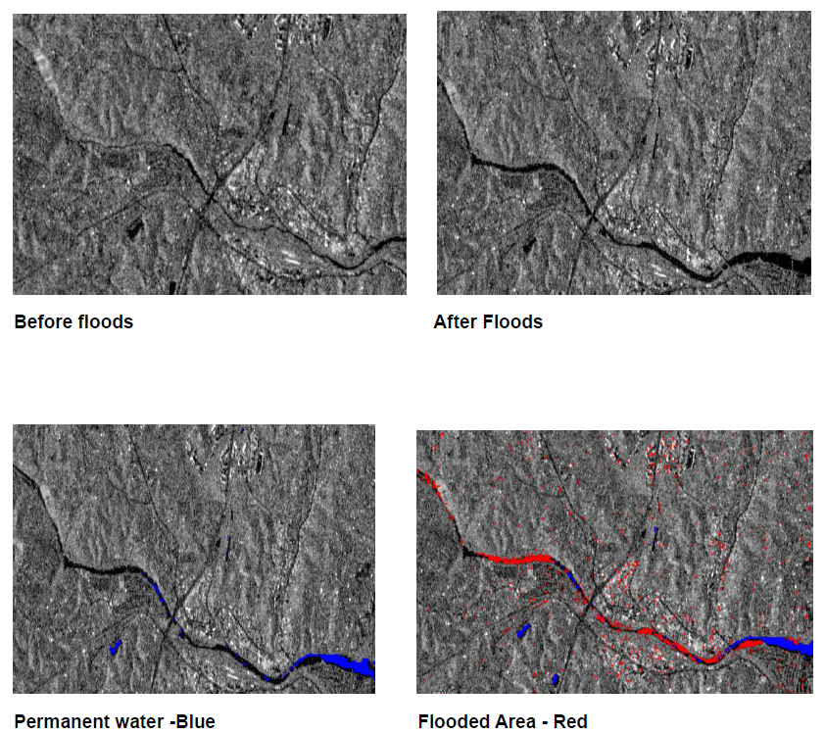
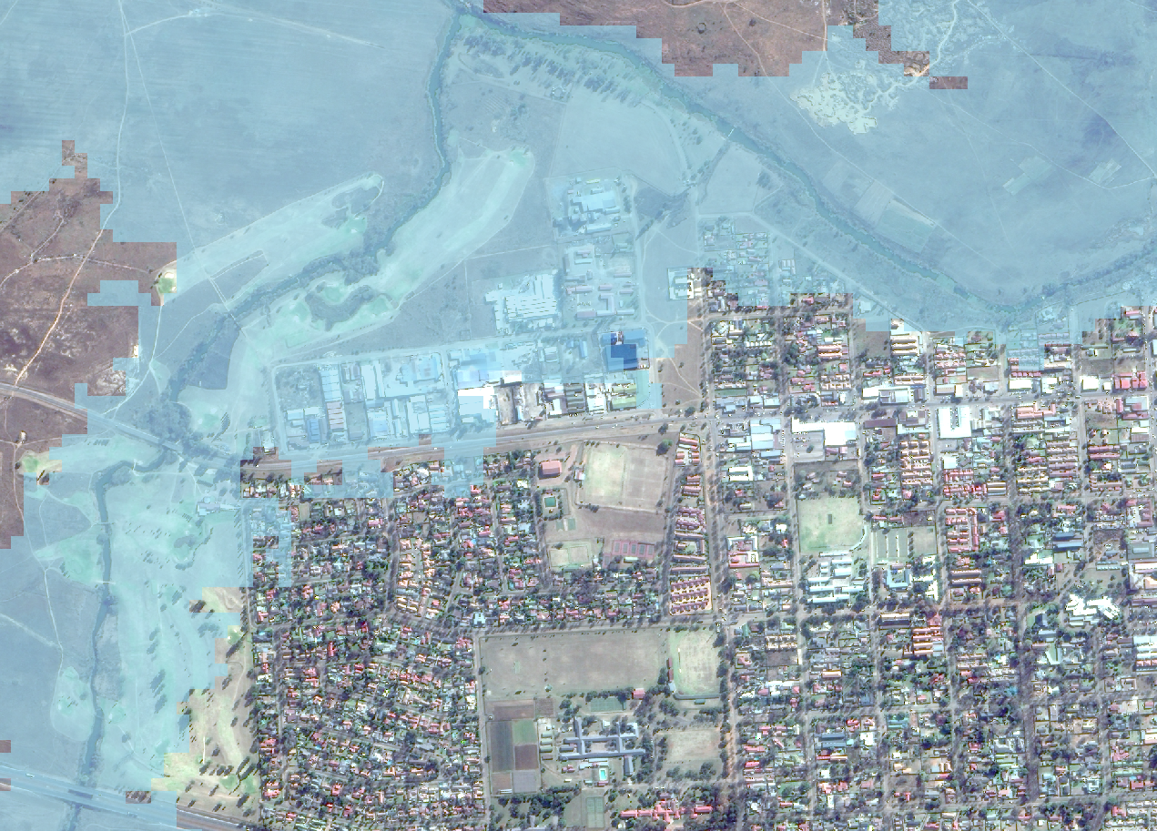
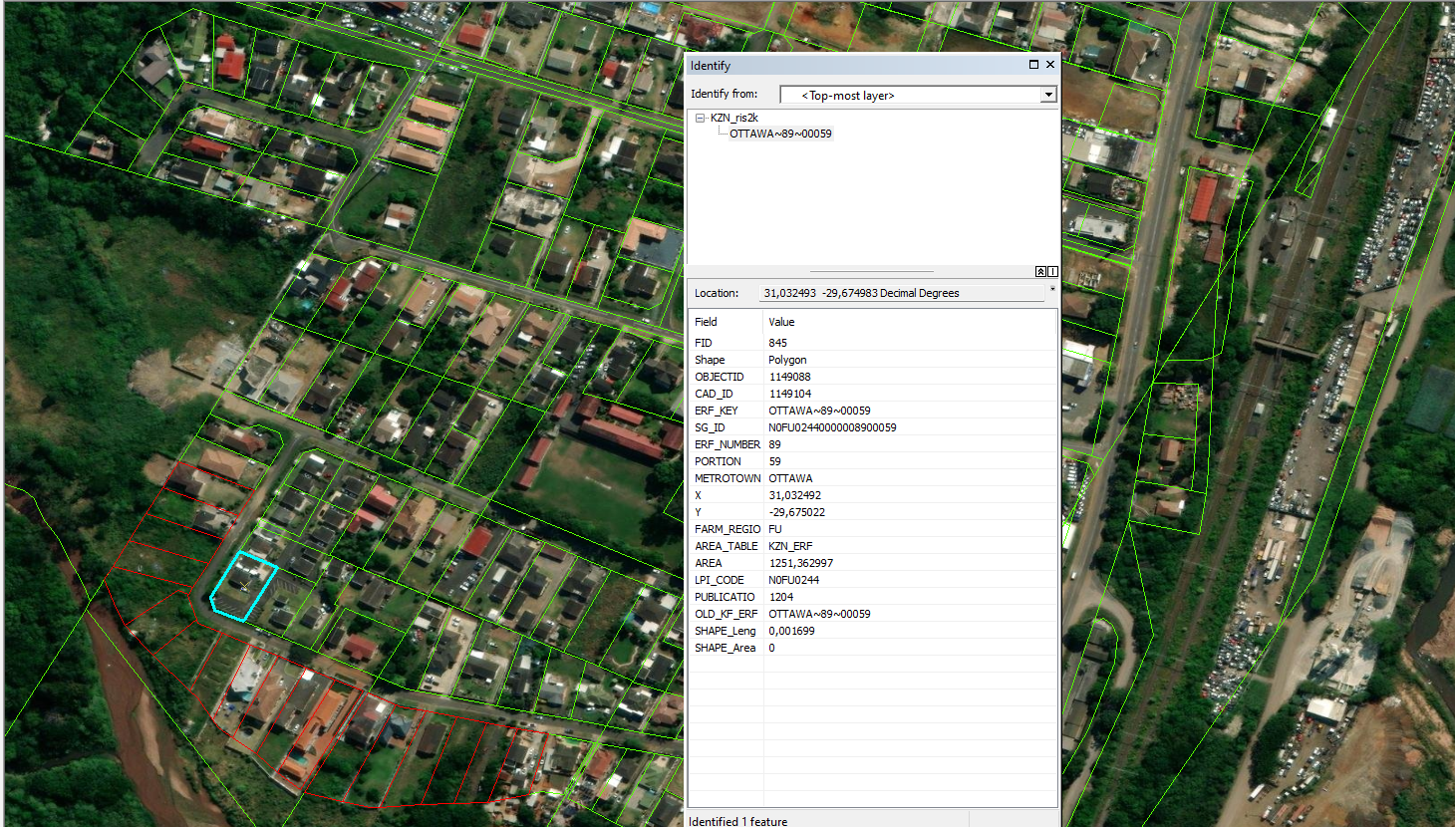
DISASTER MANAGEMENT SUPPORT TOOL (1)
Objectives: Web-based rapid flood mapping tool
  Frequency: ad-hoc (when flooding occurs)
Parameters monitored:
  Rainfall received over flooded areas
  Flooding extents
  Mudslide extent
  Human settlements, infrastructure affected
Umgeni River – Kwazulu-Natal Province; South Africa
Linking Flood Risk To Property Information
Notes:
Satellite technology allows us the opportunity to image the land surface even when there is heavy cloud cover. This enables us to map flooding as it happens, this imagery is one such image acquired during heavy rains. It demonstrate water discharge from a river that flooded Mozambique during the cyclone Idai.

Slide 8
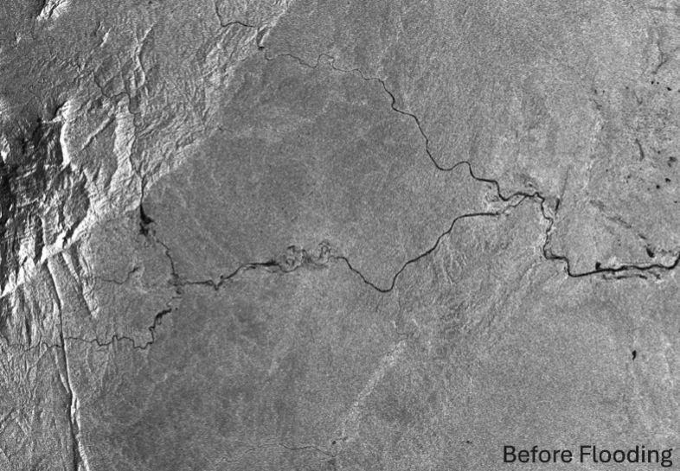
DISASTER MANAGEMENT SUPPORT TOOL (2)

Slide 9
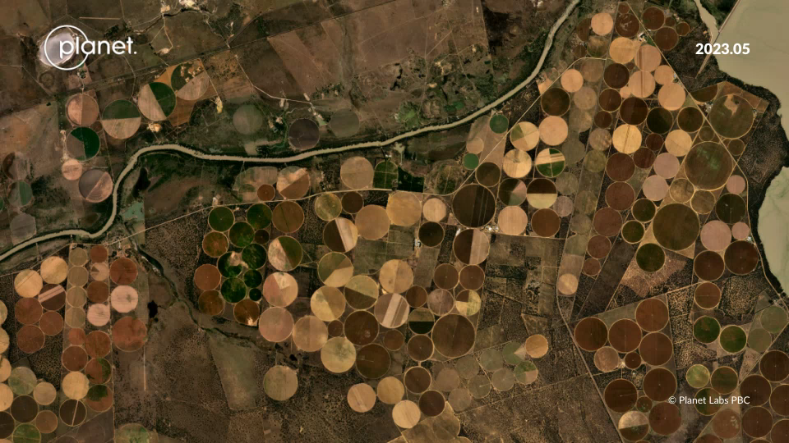
MONITORING OF AGRICULTURAL ACTIVITIES
Applications
Crop area
Crop Performance
Disease Detection
Yield Predictions
Climate Smart Agric

Slide 10
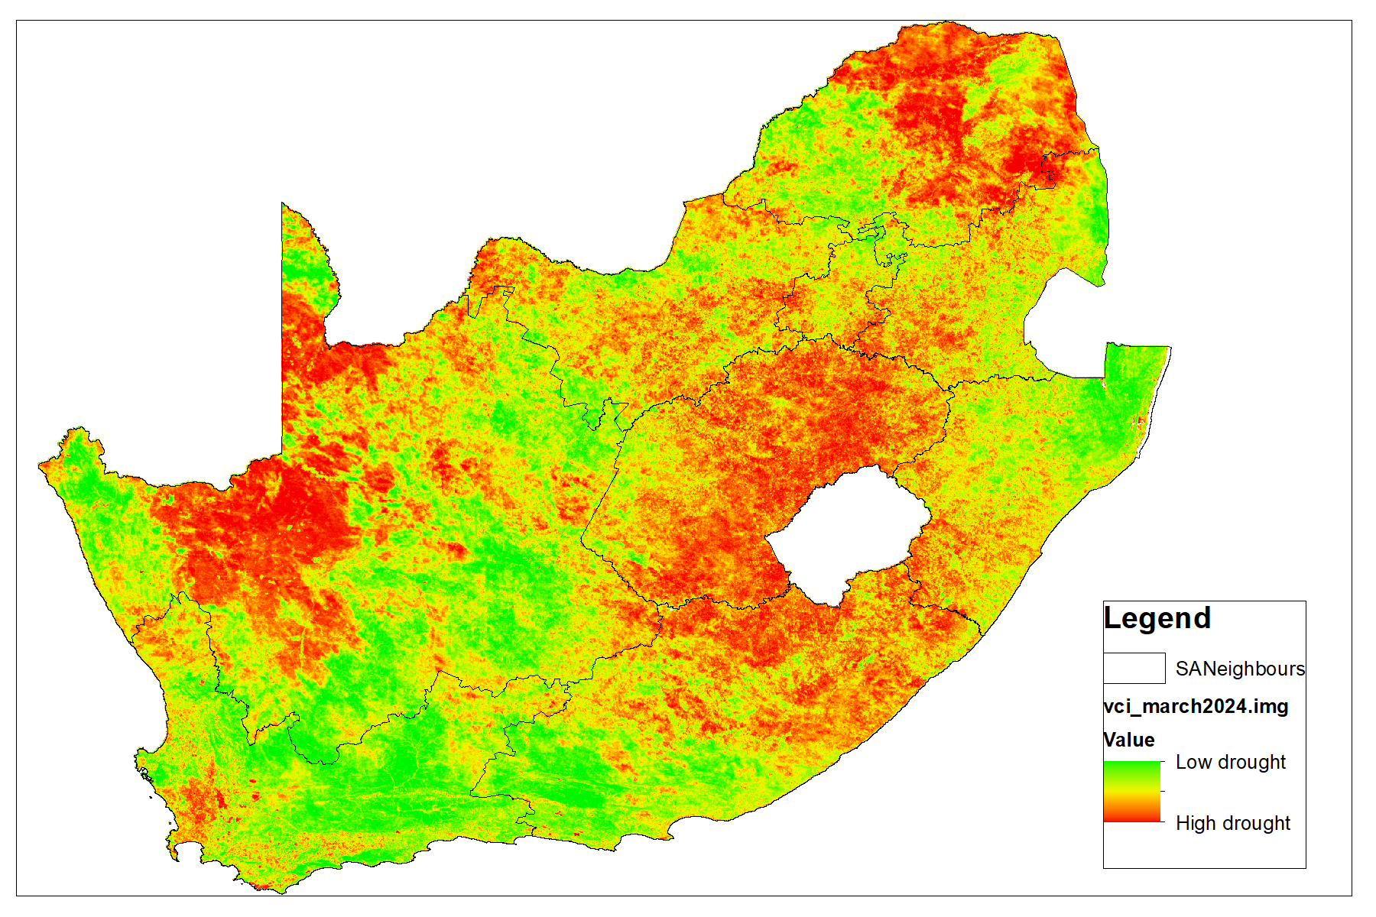
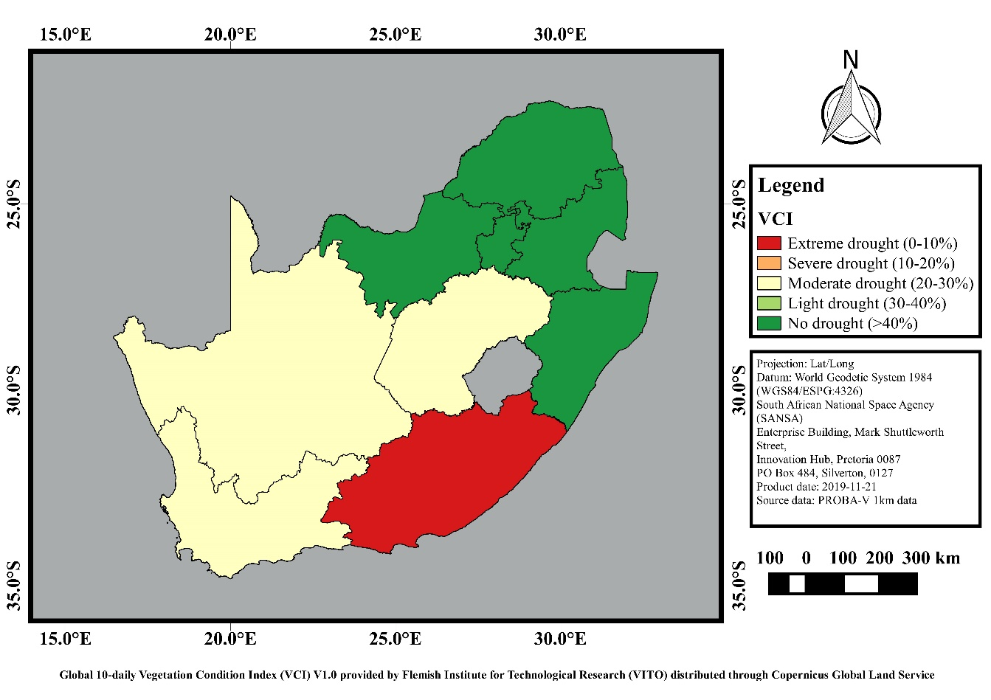
CURRENT INTELLIGENCE DROUGHT INDICATOR TOOL
Claim preparedness
Identification of areas at risk
Estimation of loss and damage
(crop yield, grazing capacity)
During claim processing
Assess previous usage of land
Estimate the previous yield
Mitigation (with clients)
Notes:
VCI is used to access the health and Vigor of vegetation, particularly in agriculture and natural ecosystems
VCI focuses on the impact of drought on vegetation and can provide information on the onset, duration and severity of drought by observing vegetation changes and comparing them with historical values.
VCI is a valuable tool for monitoring and assessing vegetation health and productivity, providing critical information for decision-making in various sectors including:
• Agricultural monitoring
• Forestry management
• Environmental monitoring
• Water resource management
• Flood Monitoring
• Drought Monitoring
VCI evaluates the current NDVI/EVI (Normalized Difference Vegetation Index/Enhanced vegetation Index )in relation to the range of values seen during the same time period in preceding years. The VCI provides a sense of where the observed value falls in relation to the extreme values (minimum and maximum) from prior years. Lower and greater values, respectively, represent poor and good vegetative state conditions.

Slide 11
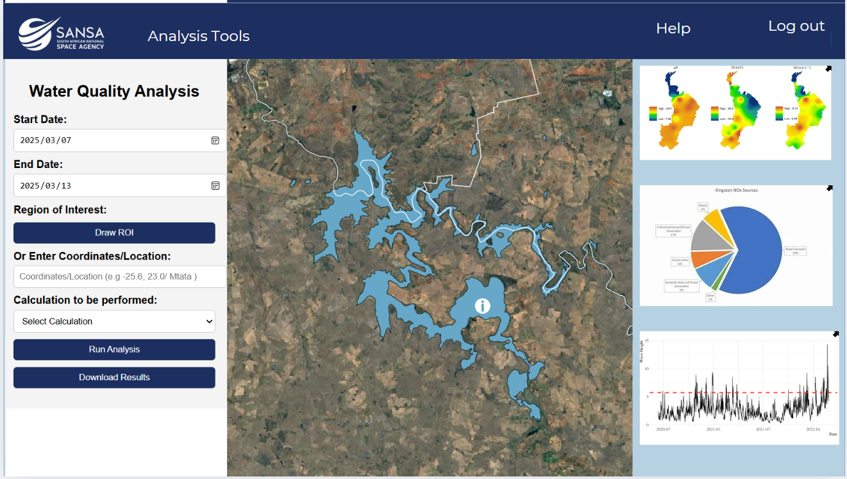
WATER INTELLIGENCE TOOL (WEB-BASED)
Product Name : Water Analytics
Frequency: monthly
Resolution 10m-300m
Parameters
Water extent
Normalized Difference Turbidity Index (NDTI)
Normalized Difference Chlorophyll Index (NDCI)
Surface Algal Bloom Index (SABI)

Slide 12



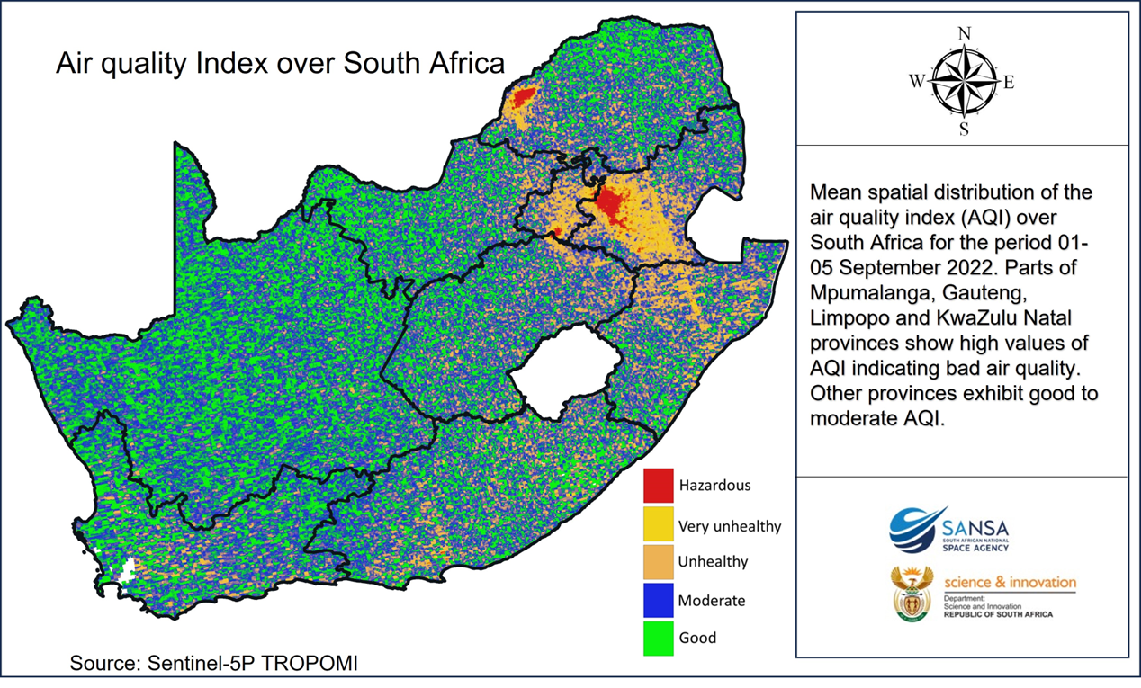
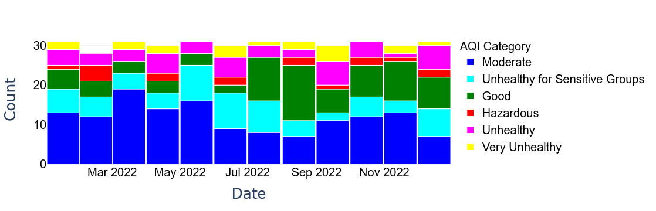
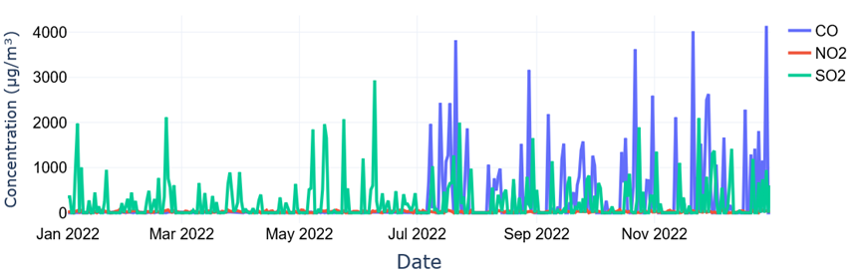
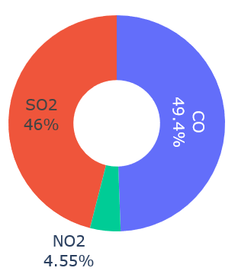
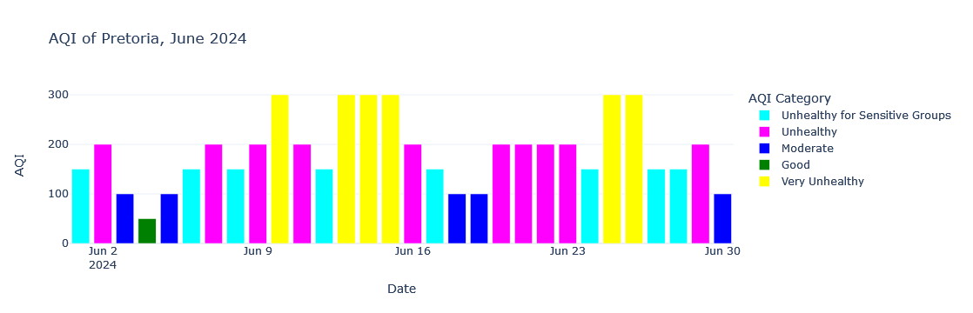
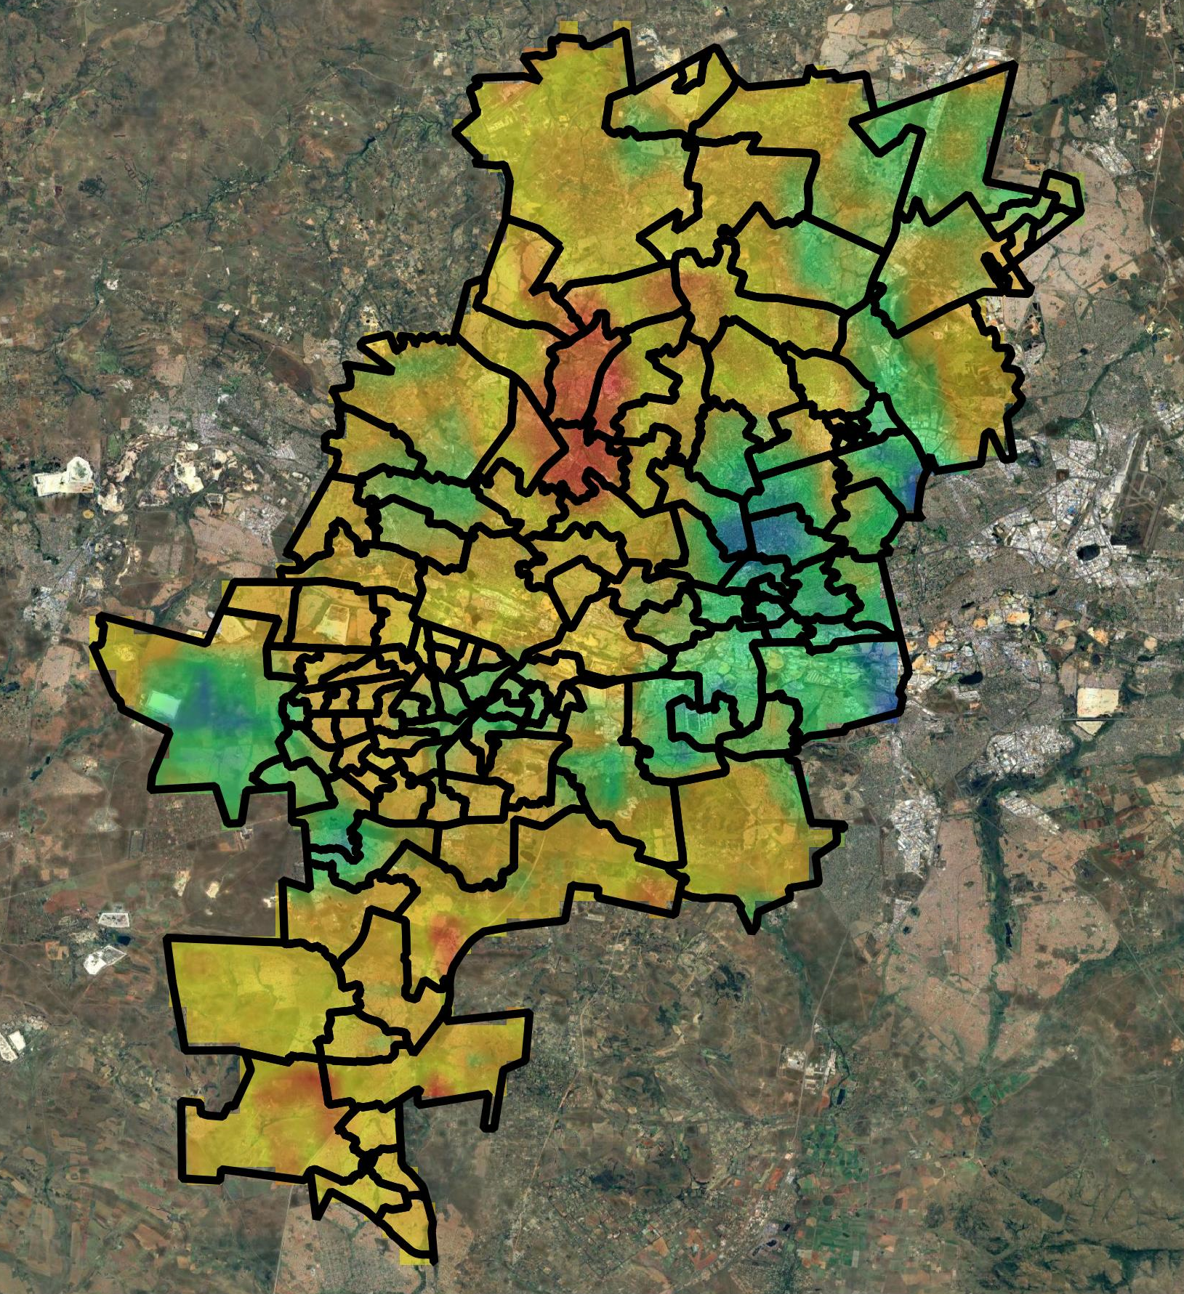
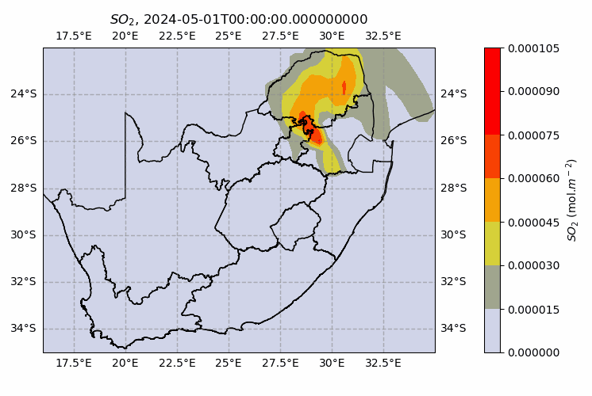
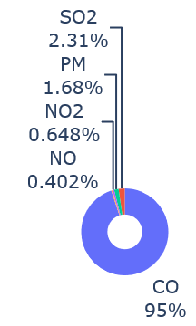
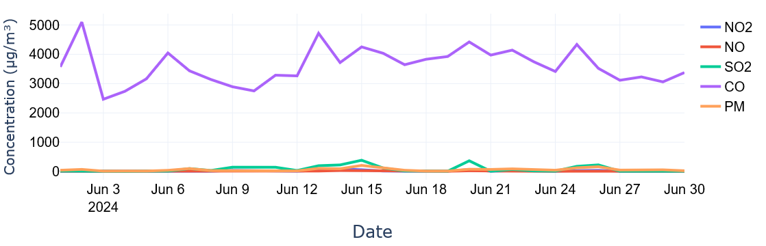
AIR QUALITY INTELLIGENCE TOOL

Slide 13
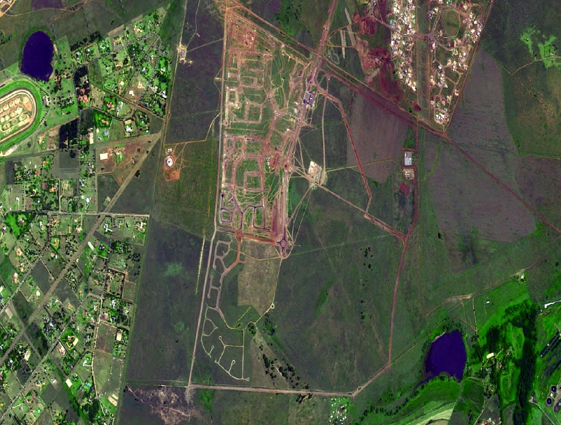
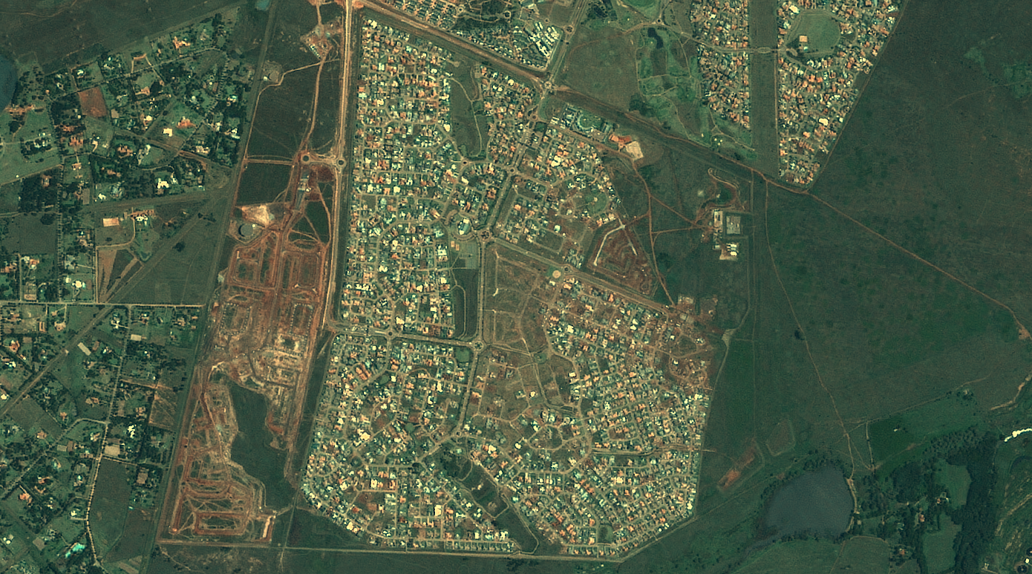
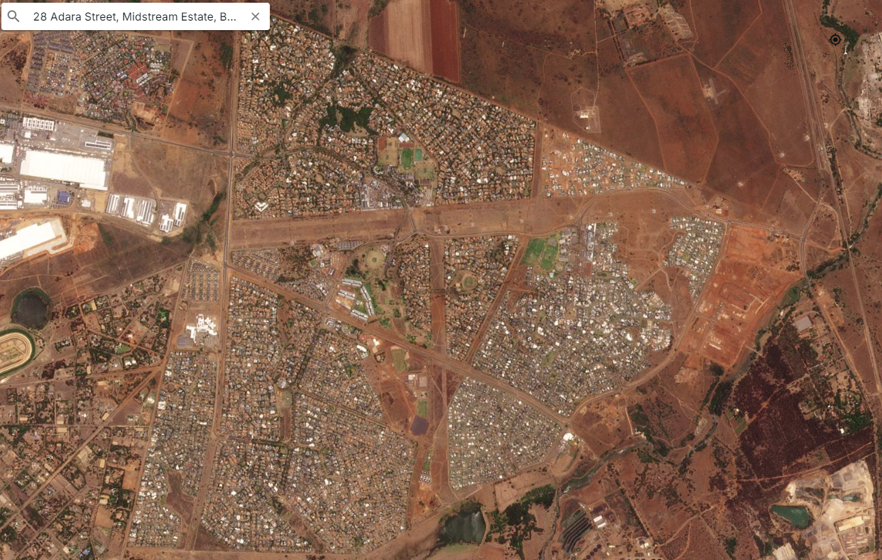
HUMAN SETTLEMENT DEVELOPMENTS
2007
2012
2024
Johannesburg

Slide 14
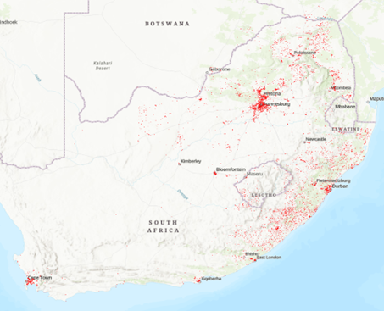
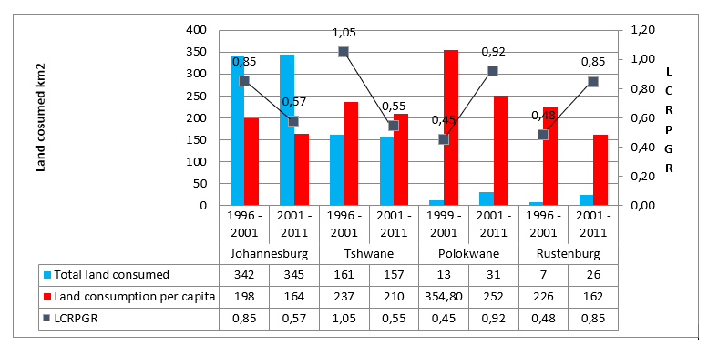

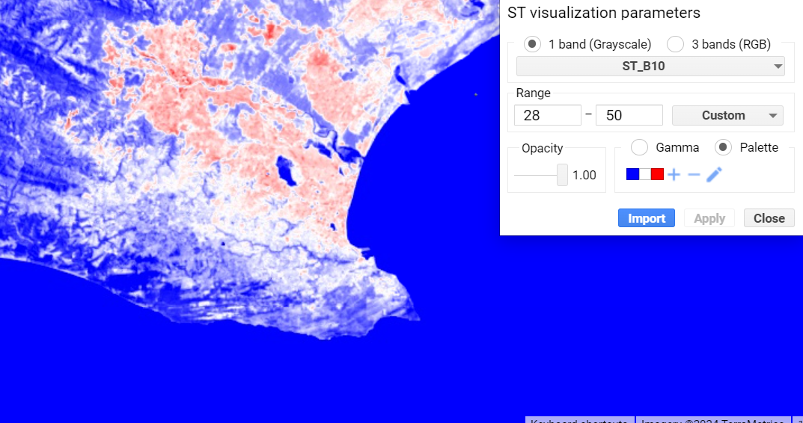
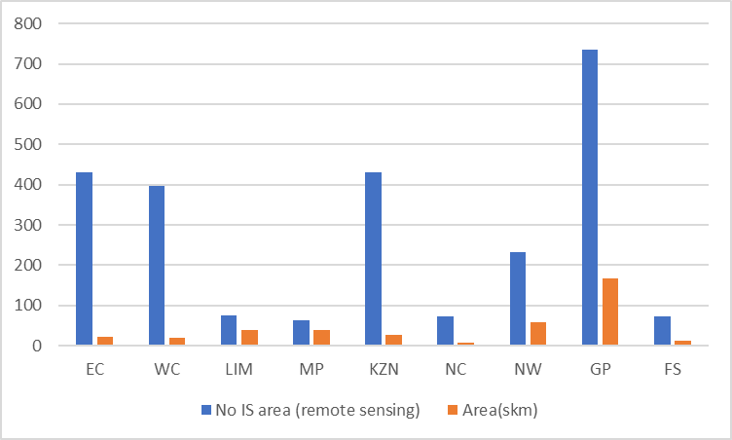
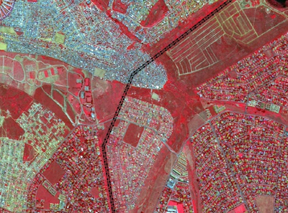
HUMAN SETTLEMENTS AND SPATIAL PLANNING
Mapping and Monitoring of
Human settlements
Monitoring and Evaluation
Understanding Informal Settlements and Vulnerability
Surface Heat Vulnerability
Infrastructure Management and Spatial Planning

Slide 15

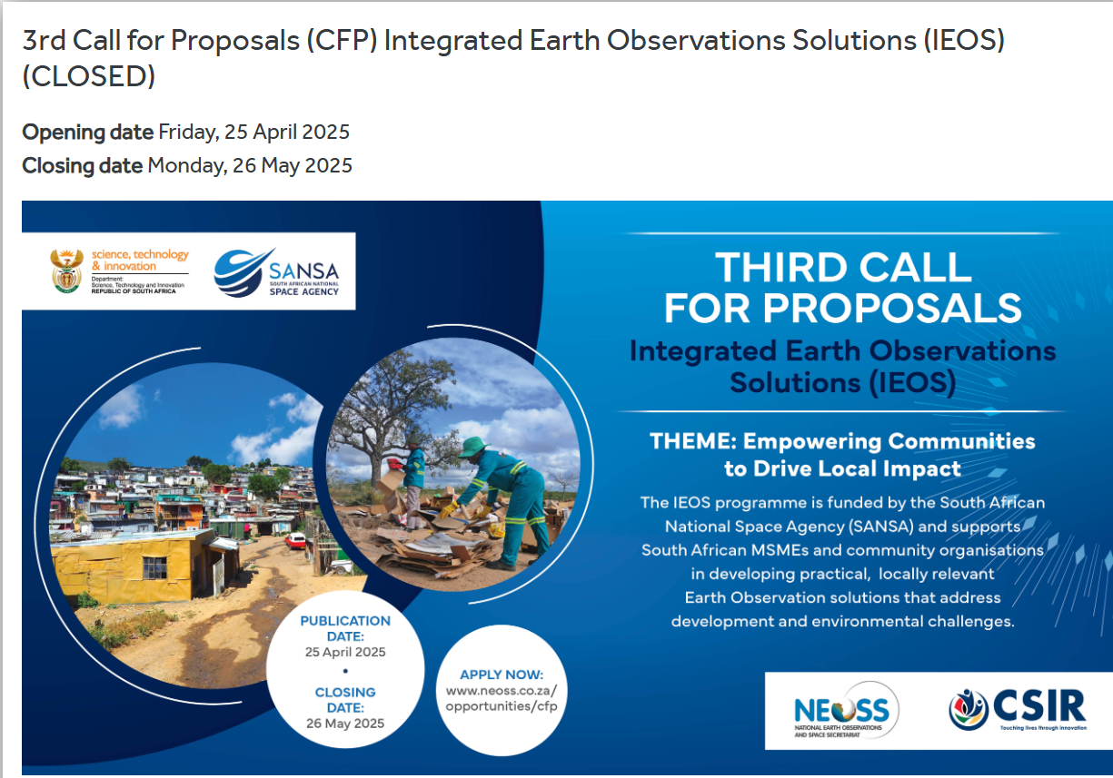
INNOVATION FUND FOR START-UPs and SMMEs
INDUSTRIAL DEVELOPMENT OR INNOVATION FUNDING
cccresource management

Slide 16
KEY PRIORITY AREAS, ACHIEVEMENTS AND A WAY FORWARD
Key Priorities (Development of EO based Decision Support tools)
Disaster management
Atmosphere (e.g. Air quality)
Water resource management
Agriculture
Ecosystem and Biodiversity
Build environment (incl. Human settlement, Infrastructure)
Energy
Mining
Marine and Maritime
Committed to Contribute to CEOS’ Working Groups and VCs
WGCapD (Dan Matsapola)
CEOS Working Groups - WGClimate; WGDisasters; WGISS; WGCV etc
Other achievements
  SANSA appointed as UN-SPIDER Regional Support Office for the SADC region in 2024.
  SANSA-UN-SPIDER training on the International Charter Space and Major Disasters in Pretoria, South Africa, September 2025.
  SANSA is a Signatory for Space Climate Observatory (SCO)
  SANSA launched the Natural Resources Management Programme – aligning with the CEOS Chair Theme on “Unlocking EO for Society”.

Slide 17
Thank you!
aramoelo@sansa.org.za

