Slide 1
CEOS Plenary 2025
CSIRO Agency Update
Amy Parker, CSIRO
Agenda Item 8.4
39th CEOS Plenary
Bath, United Kingdom
4th - 6th November, 2025

Slide 2
CEOS activities
WGCV
WGISS
LSI-VC PolSAR activity
CEOS Analytics Lab
Biodiversity Study Team.
SDG Coordination Group
Host 2026 WGCV SAR cal/val subgroup workshop with GA in Perth

Slide 3
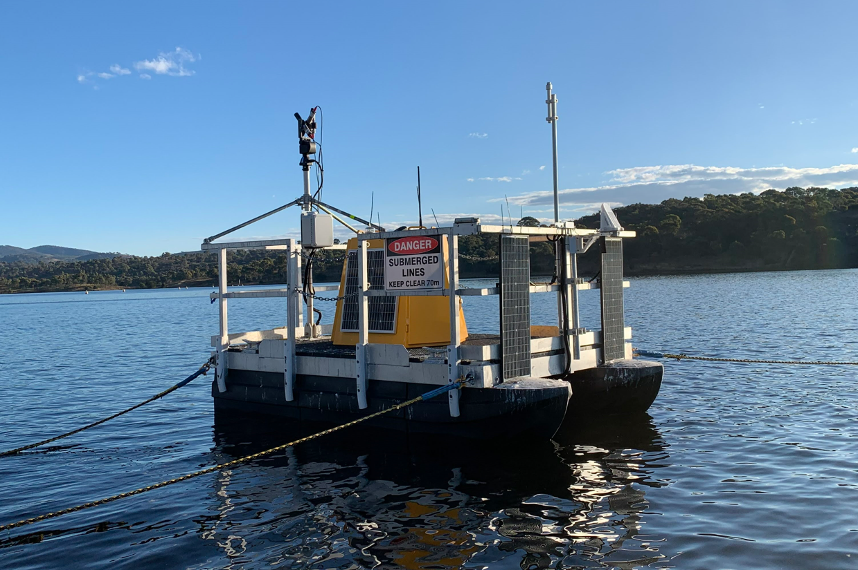
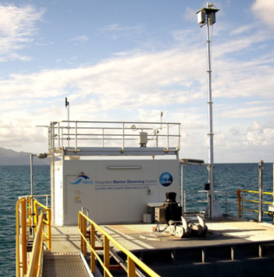
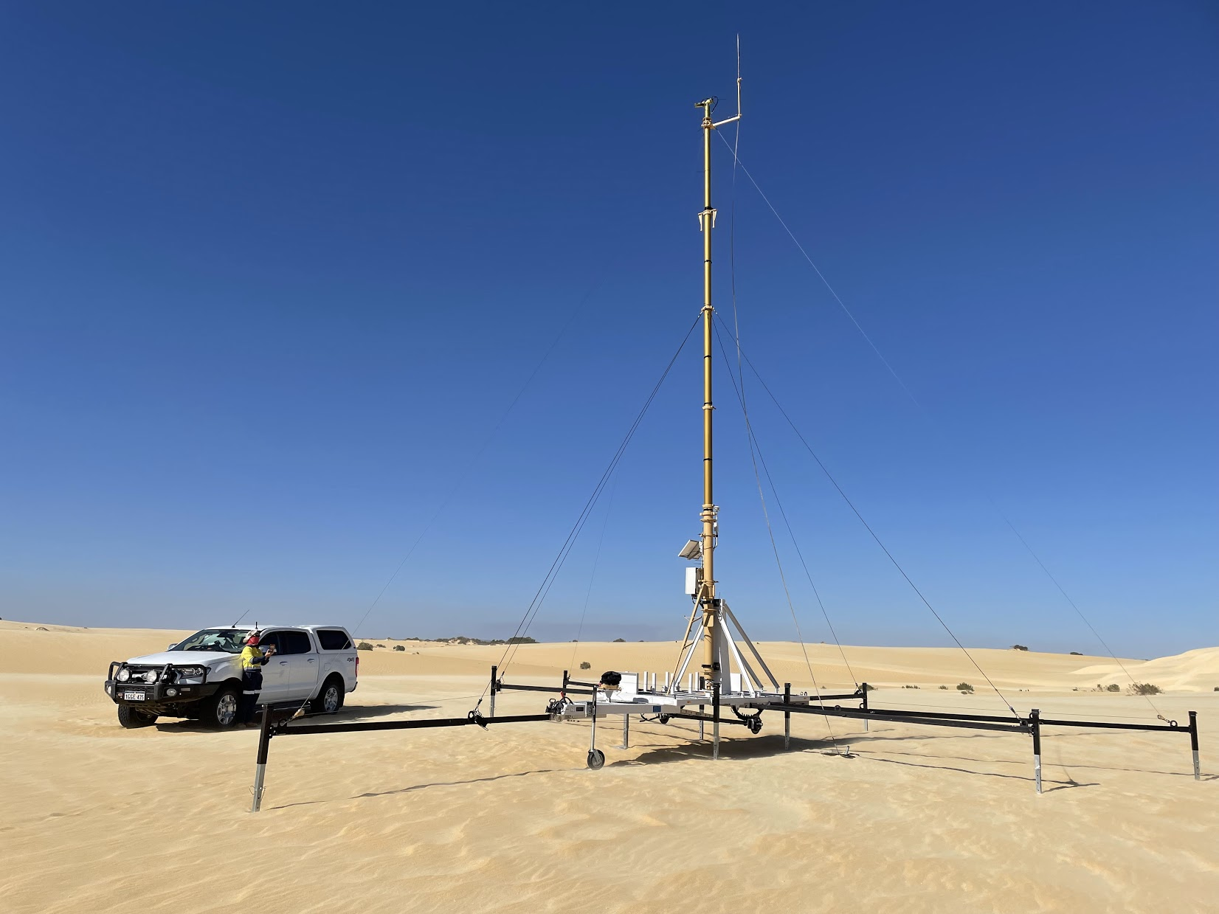
Calibration and validation
Working with Geoscience Australia to “operationalise” collection of in-situ data beginning with 3 existing permanent cal/val sites:
minimise down time due to system issues or scheduled maintenance
align to CEOS best practice protocols and standards (RadCalNet and FRM4SOC).
Googong Dark-water Inland Observatory Network (New South Wales)
Lucinda Jetty Coastal Observatory (Queensland)
Pinnacles Desert Optical Vicarious Calibration Site (Western Australia)

Slide 4
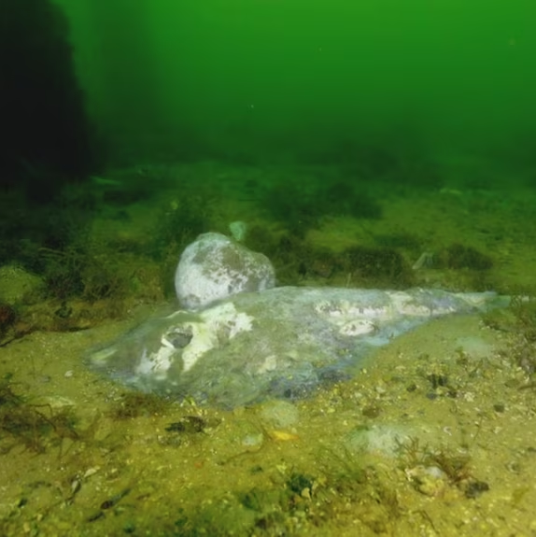
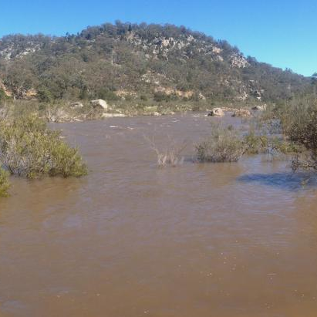
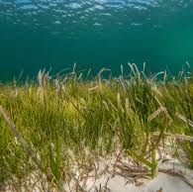
AquaWatch – Water Quality
South Australia HAB event
- Impacting environment, industry, tourism, recreation, human health - Partnering with state government to deliver detailed coastal water quality monitoring - Supporting the progression of AquaWatch’s early warning system
- Indonesia Inland Water Quality Monitoring Demonstrator - Working with Indonesian Government partners across policy and science to translate the science of AquaWatch into practical, useable products
AquaWatch4Lakes
- Provides crucial traceability for water quality monitoring using a JPL designed imaging spectrometer that combines high spatial, temporal and spectral resolution with high signal-to-noise ratios - Seeking to progress from concept towards reality
AquaSat-1

Slide 5
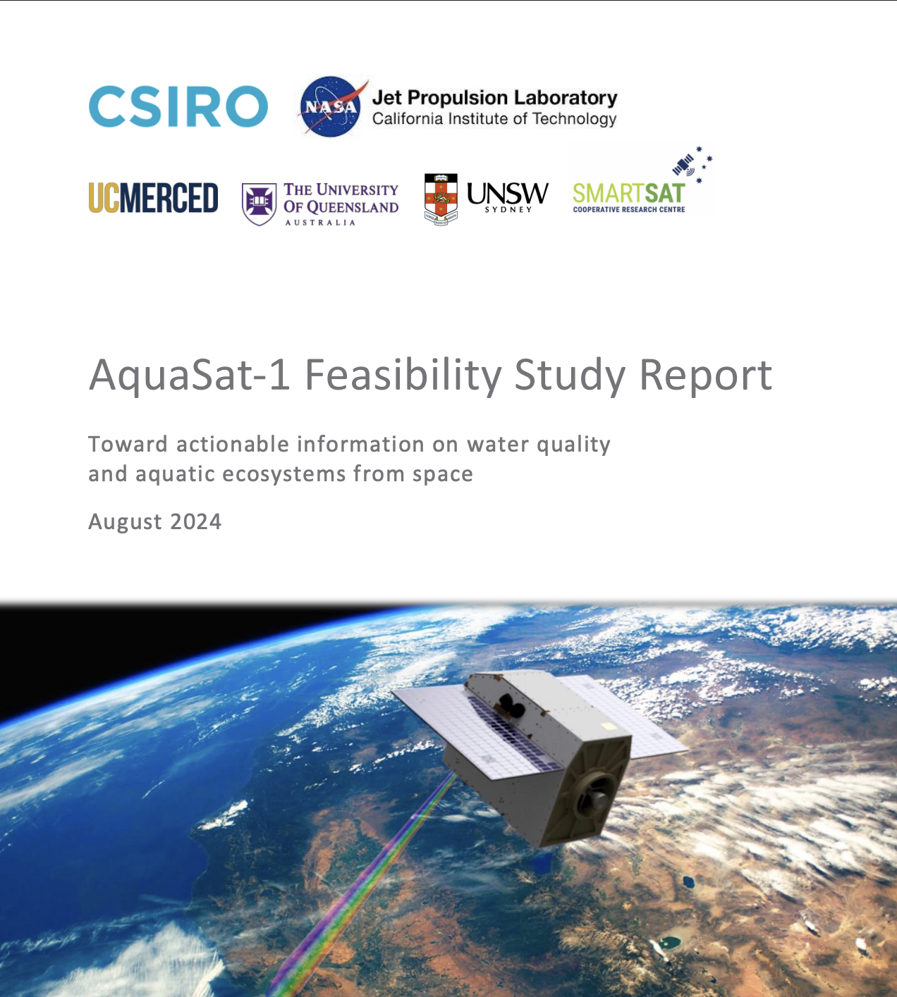
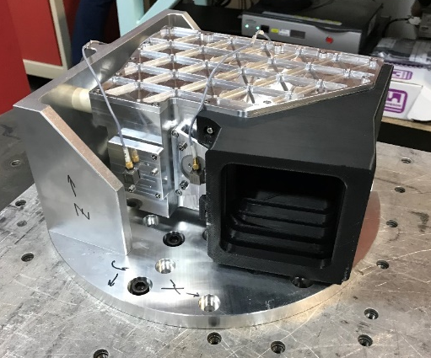
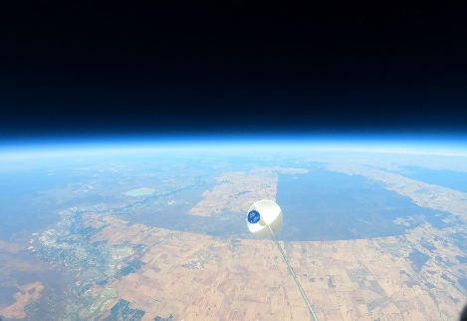
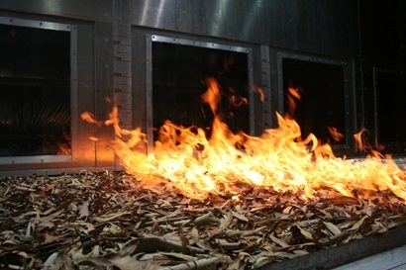
Optimising EO for Australia
Developing mission concepts and technologies to support critical EO needs in Australian in collaboration with partners in industry, universities, and international space agencies:
AquaSat-1: providing traceability for water quality monitoring needs using a JPL designed imaging spectrometer.
CyanoSense: custom hyperspectral payloads uplifting Australian manufacturing capabilities.
AquaWatch-UK: extension of the AquaWatch concept to the UK with industry and university partners (UKSA IBF).
Bushfire fuel watch: linking the spectral signatures of bushfire fuels with their combustibility and fire behaviour.
AquaSat-1 Report
CyanoSense instrument optics
High-altitude balloon flight trials of prototype payloads
CSIRO’s Pyrotron combustion wind tunnel

Slide 6
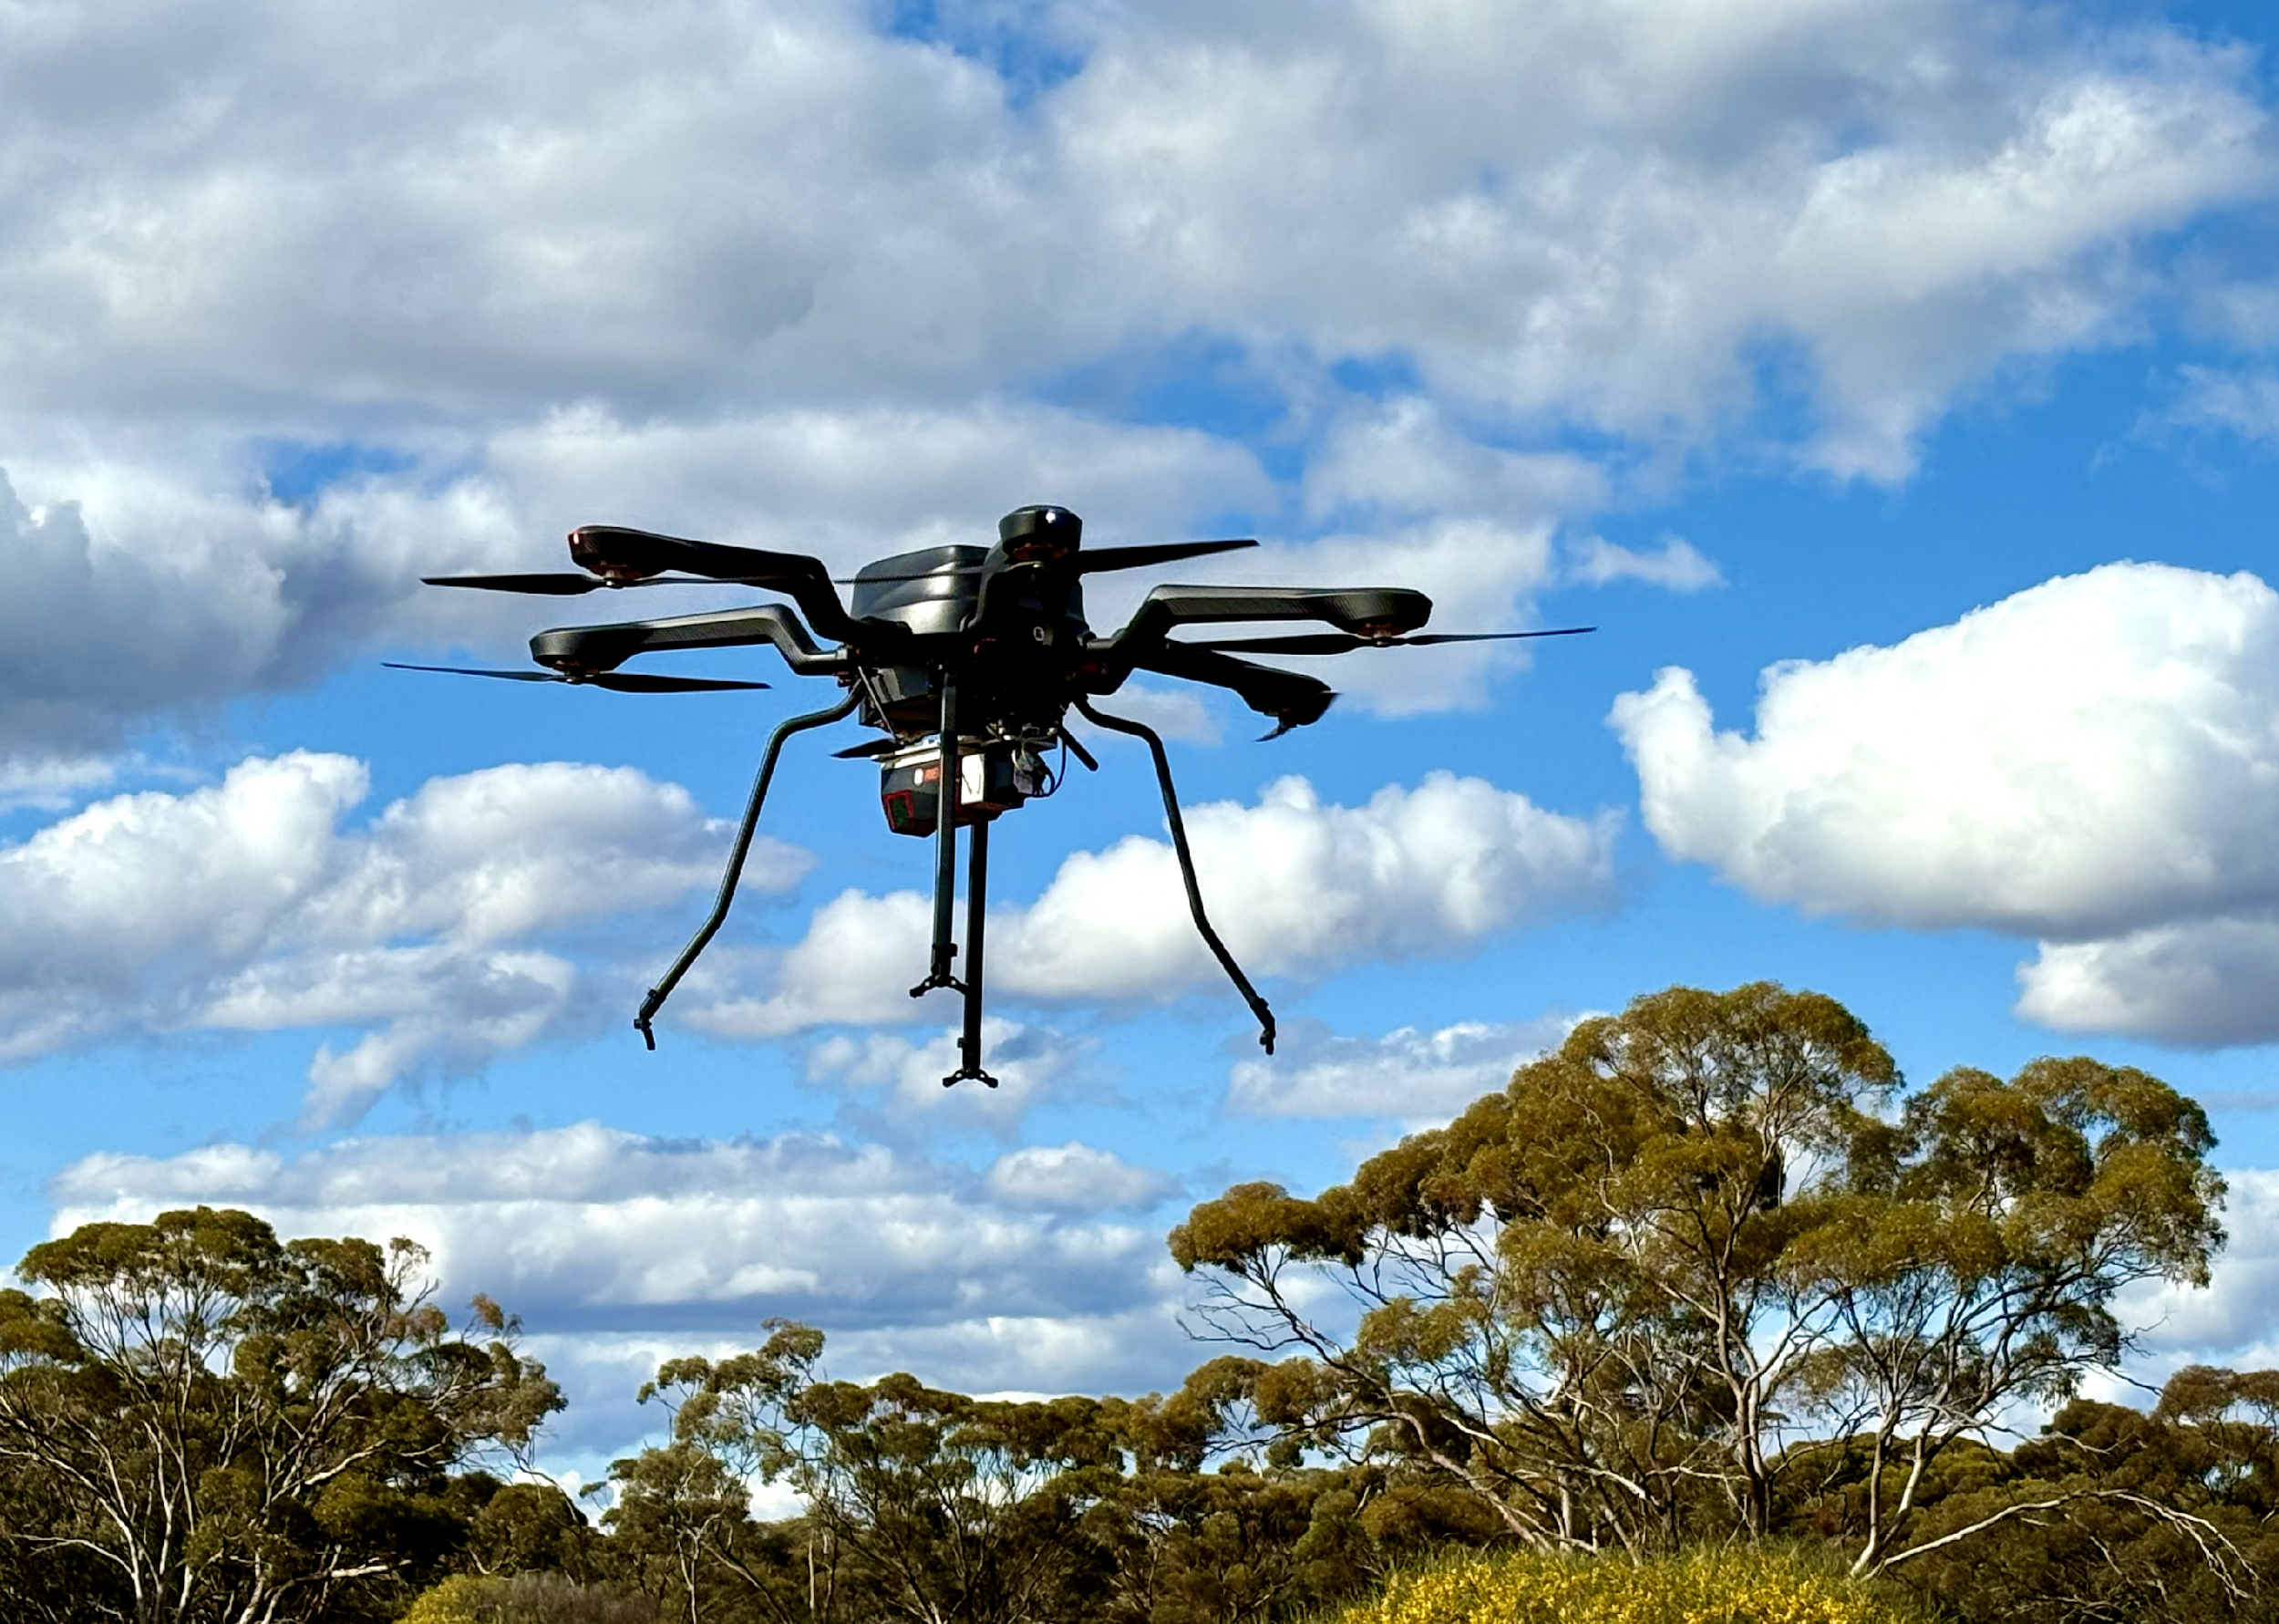
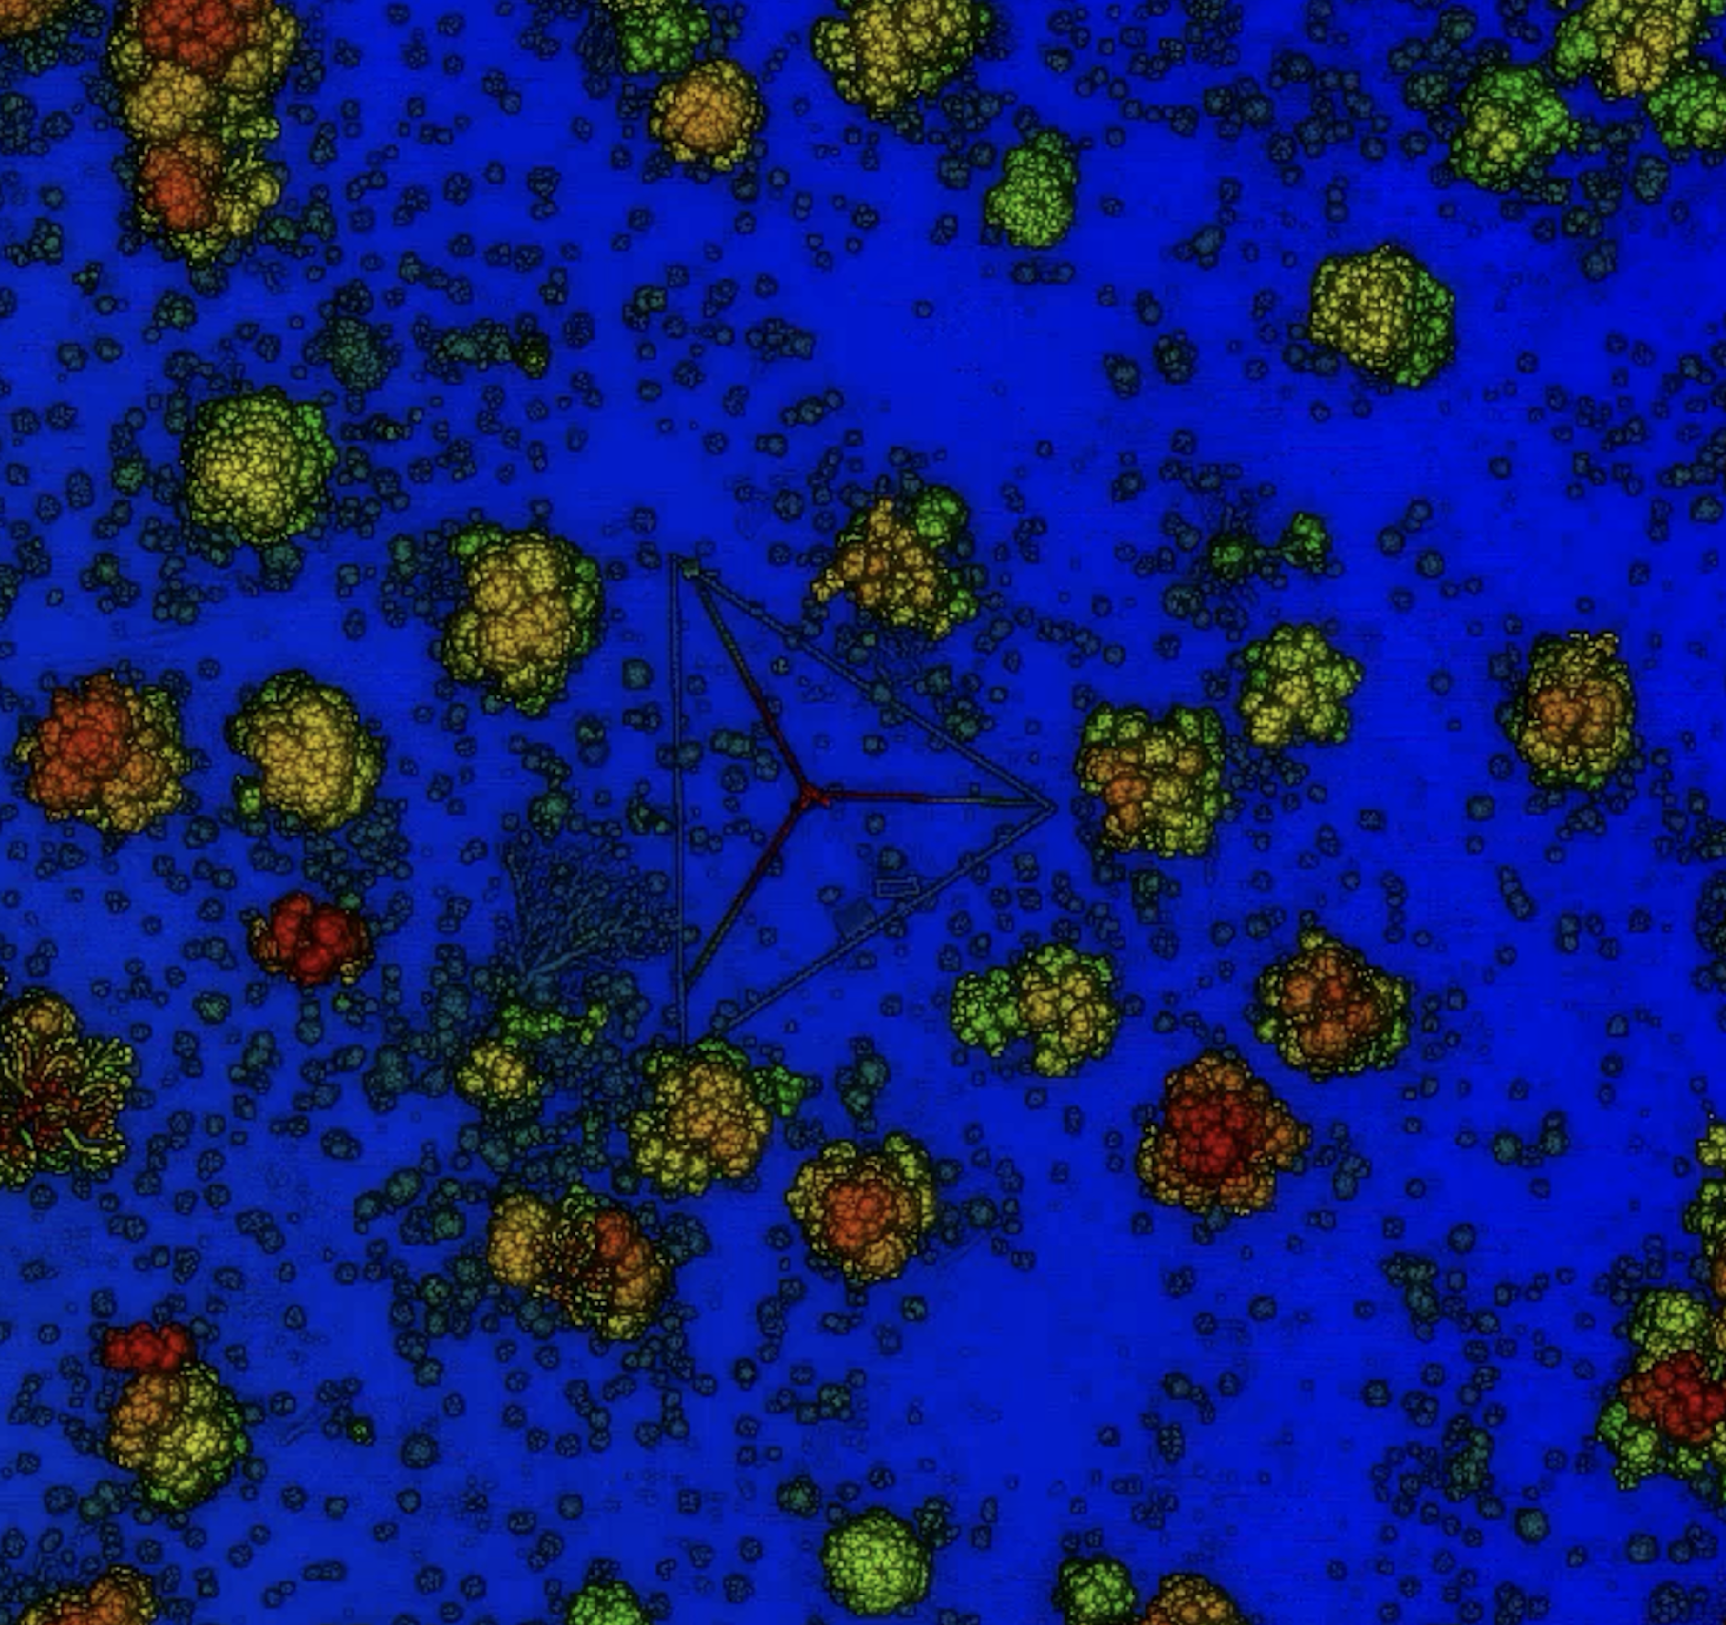
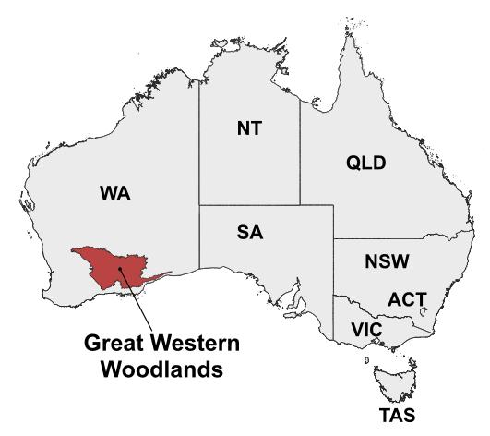
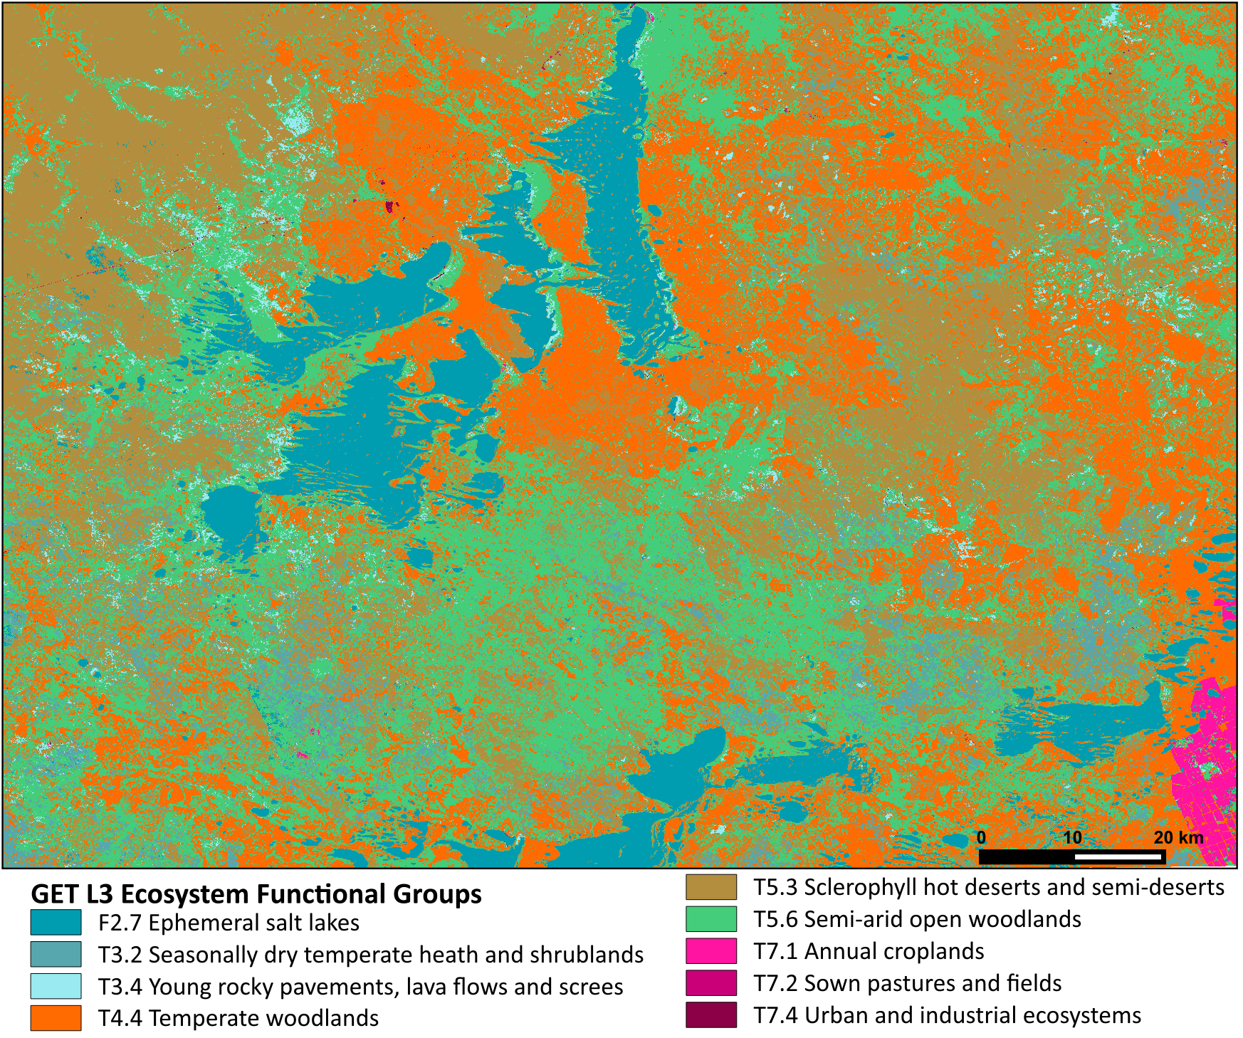
Biomass and biodiversity
Actively acquiring terrestrial and UAV laser scanning data across diverse ecosystem types to support global cal/val of vegetation biomass and structural products
GEO-TREES, NISAR, BIOMASS
Biodiversity Study Team demonstrator: advancing EO for Ecosystem Extent mapping in the Great Western Woodlands using multi-sensor data integration in EASI (ODC) with deep learning models

Slide 7
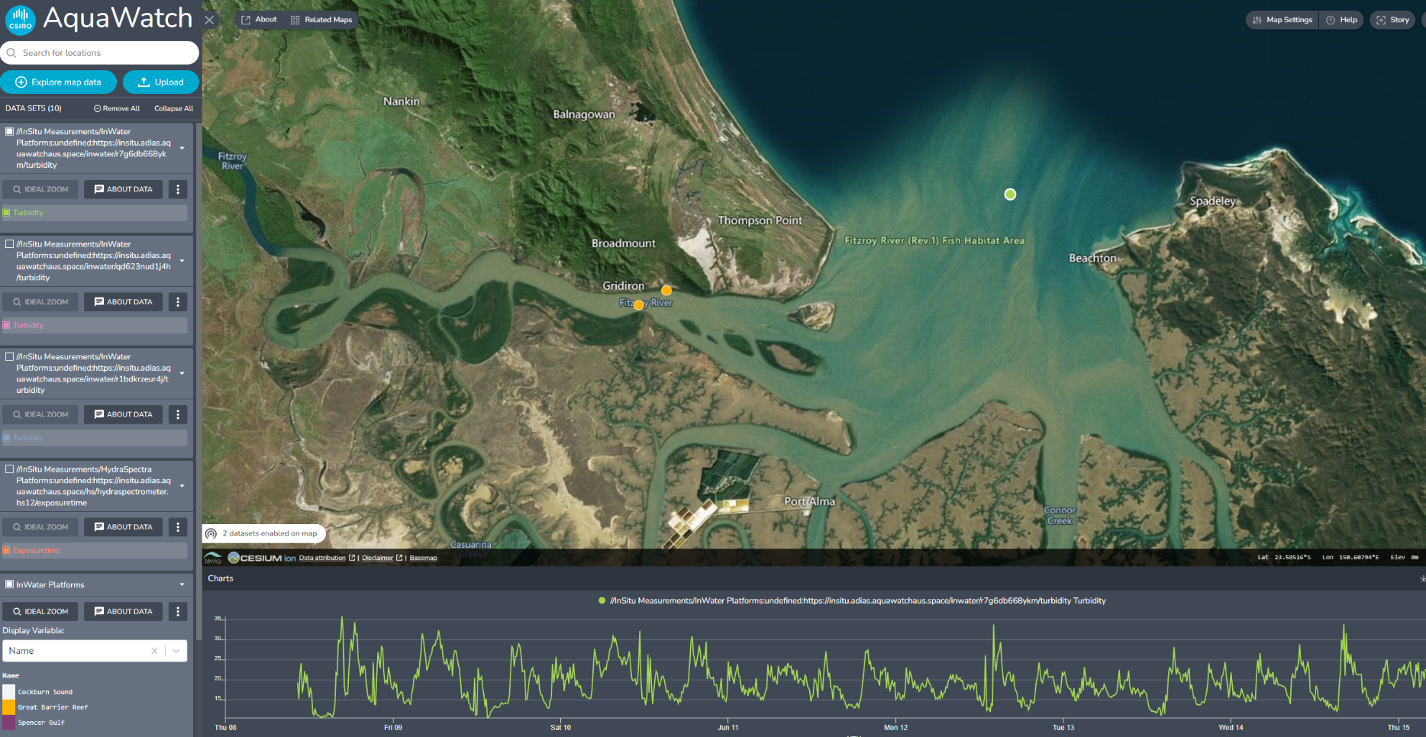
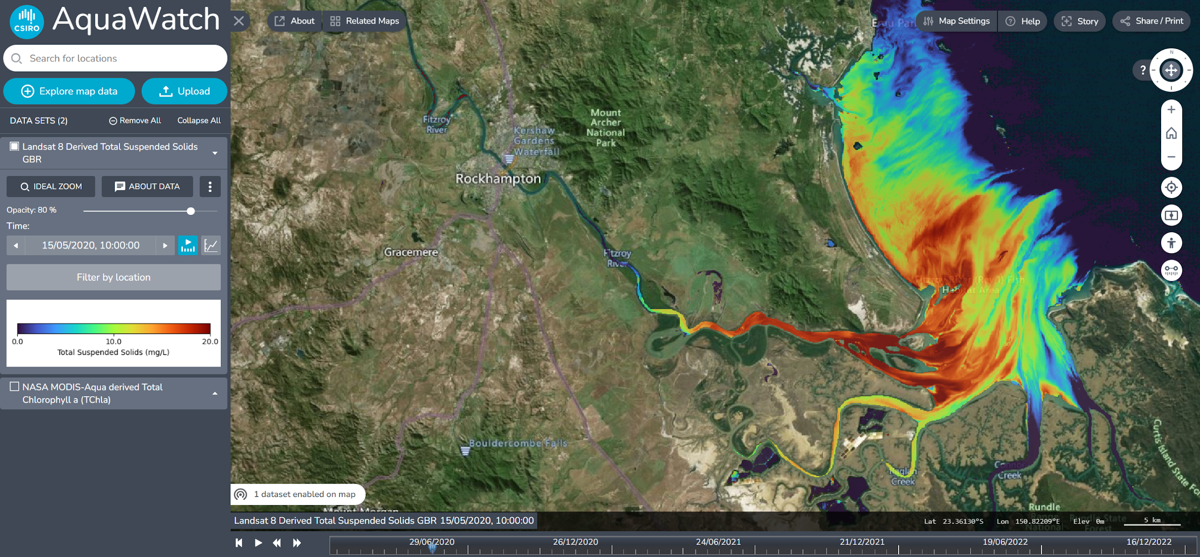
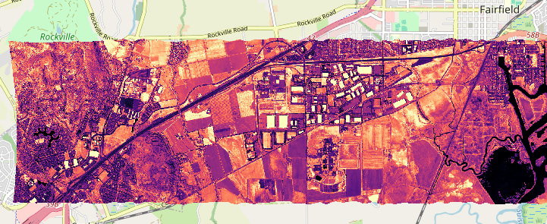
EASI and the Open Data Cube
Airborne
Planetary and other data
Hyperspectral
Gen AI
A 10,000x data problem. Developing EASI/ODC to accommodate hyperspectral beginning with NASA EMIT
Example: delivering AquaWatch products and services

Slide 8
Thank you

