Slide 1
CEOS: Earth Science Division Overview
November 6, 2025
Karen St. Germain, PhD
Director

Slide 2
Major Objectives in Implementing Earth Science
Drive Alignment with Presidential Priorities
Advance Gold Standard Science
Technology Innovation & Advancement
Economic Growth
Strengthen National, Regional and Local Preparedness and Resilience
Drive Efficiency and Focus on Impact
Improved fidelity of planning for DAAC transition to Science Enabling Teams
Consolidation of Flight Program Offices
Reduce programmatic complexity of ES Research and Applied and Responsive Earth Sciences
Multi-source Integrated Observatory refocused to maximize science & applications value from NASA & commercial missions
EarthRISE refocused to efficiently work with State, Local, and Private sector users for maximum impact

Slide 3



Earth Science to Action Strategy
Virtuous Cycle
User needs inform next iteration of programs, missions and initiatives
Public Understanding & Exchange
Put more scientific understanding into public sphere
Deliver applied science to users
Participate in multi-way info exchange
Use input to inform subsequent work
Solutions with Value to the Nation
Offer models, scientific findings and info through Open-Source Science principles
Support private sector development of applications of Earth observations
Provide science applications and tools to inform decisions
Earth System Science & Applied Research
Grow scientific understanding of Earth’s systems
Develop predictive models of dynamic Earth systems and tools to understand and adapt to changes
Foundational Knowledge,
Technology, Missions & Data
Technology innovation
Earth observations missions
Data collected from space, air and ground
04.29.2025

Slide 4
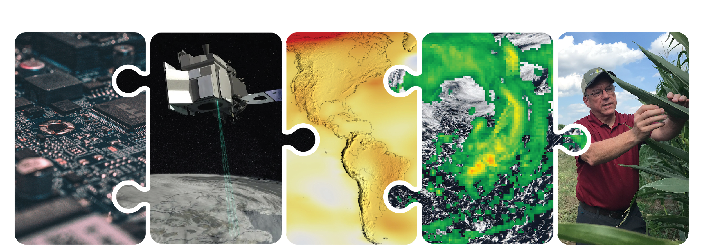

NASA’s End-to-end Earth System Science Capability
Technology
Flight
Research and Analysis
Data and Modeling
Earth Action
10 Tech Infusions/year
24 missions on orbit
1,330 Active Research Projects
48 States
Collect 160 TB/Day
Serving 600 TB/Day
>10M Users
World Class Models
Agriculture
Energy
Disasters
Wildfires
& more
10.31.2025
Notes:
R&A:
1330 research grants
Projects in 48 states

Slide 5
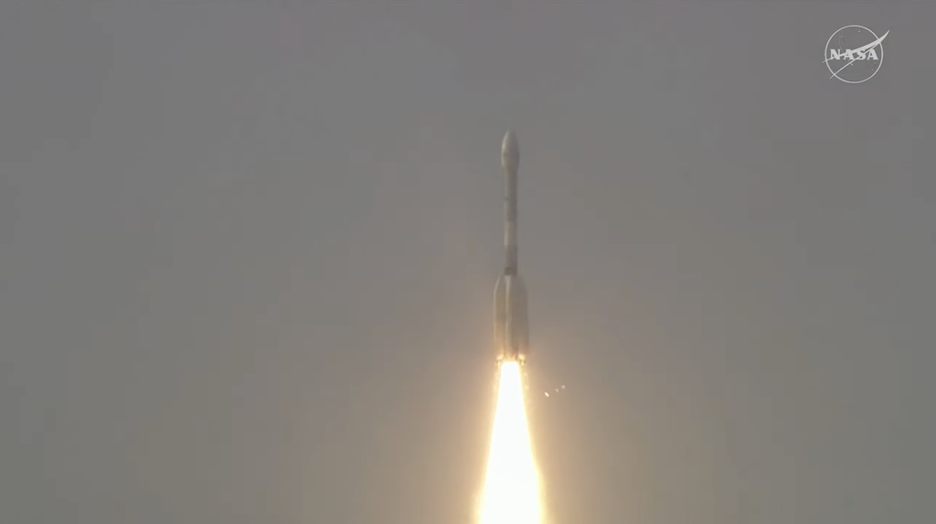
NISAR Launch
July 30, 2025
The NASA-ISRO partnership launched humanity’s first-of-its kind satellite
NISAR will provide actionable information in a wide range of areas: disaster response, infrastructure monitoring, land-use planning, farming and water management
The Indian Space Research Organisation’s Geosynchronous Satellite Launch Vehicle lifts off from Satish Dhawan Space Centre on India’s southeastern coast at 8:10 a.m. EDT (5:40 a.m. IST), July 30, 2025. Credit: ISRO

Slide 6

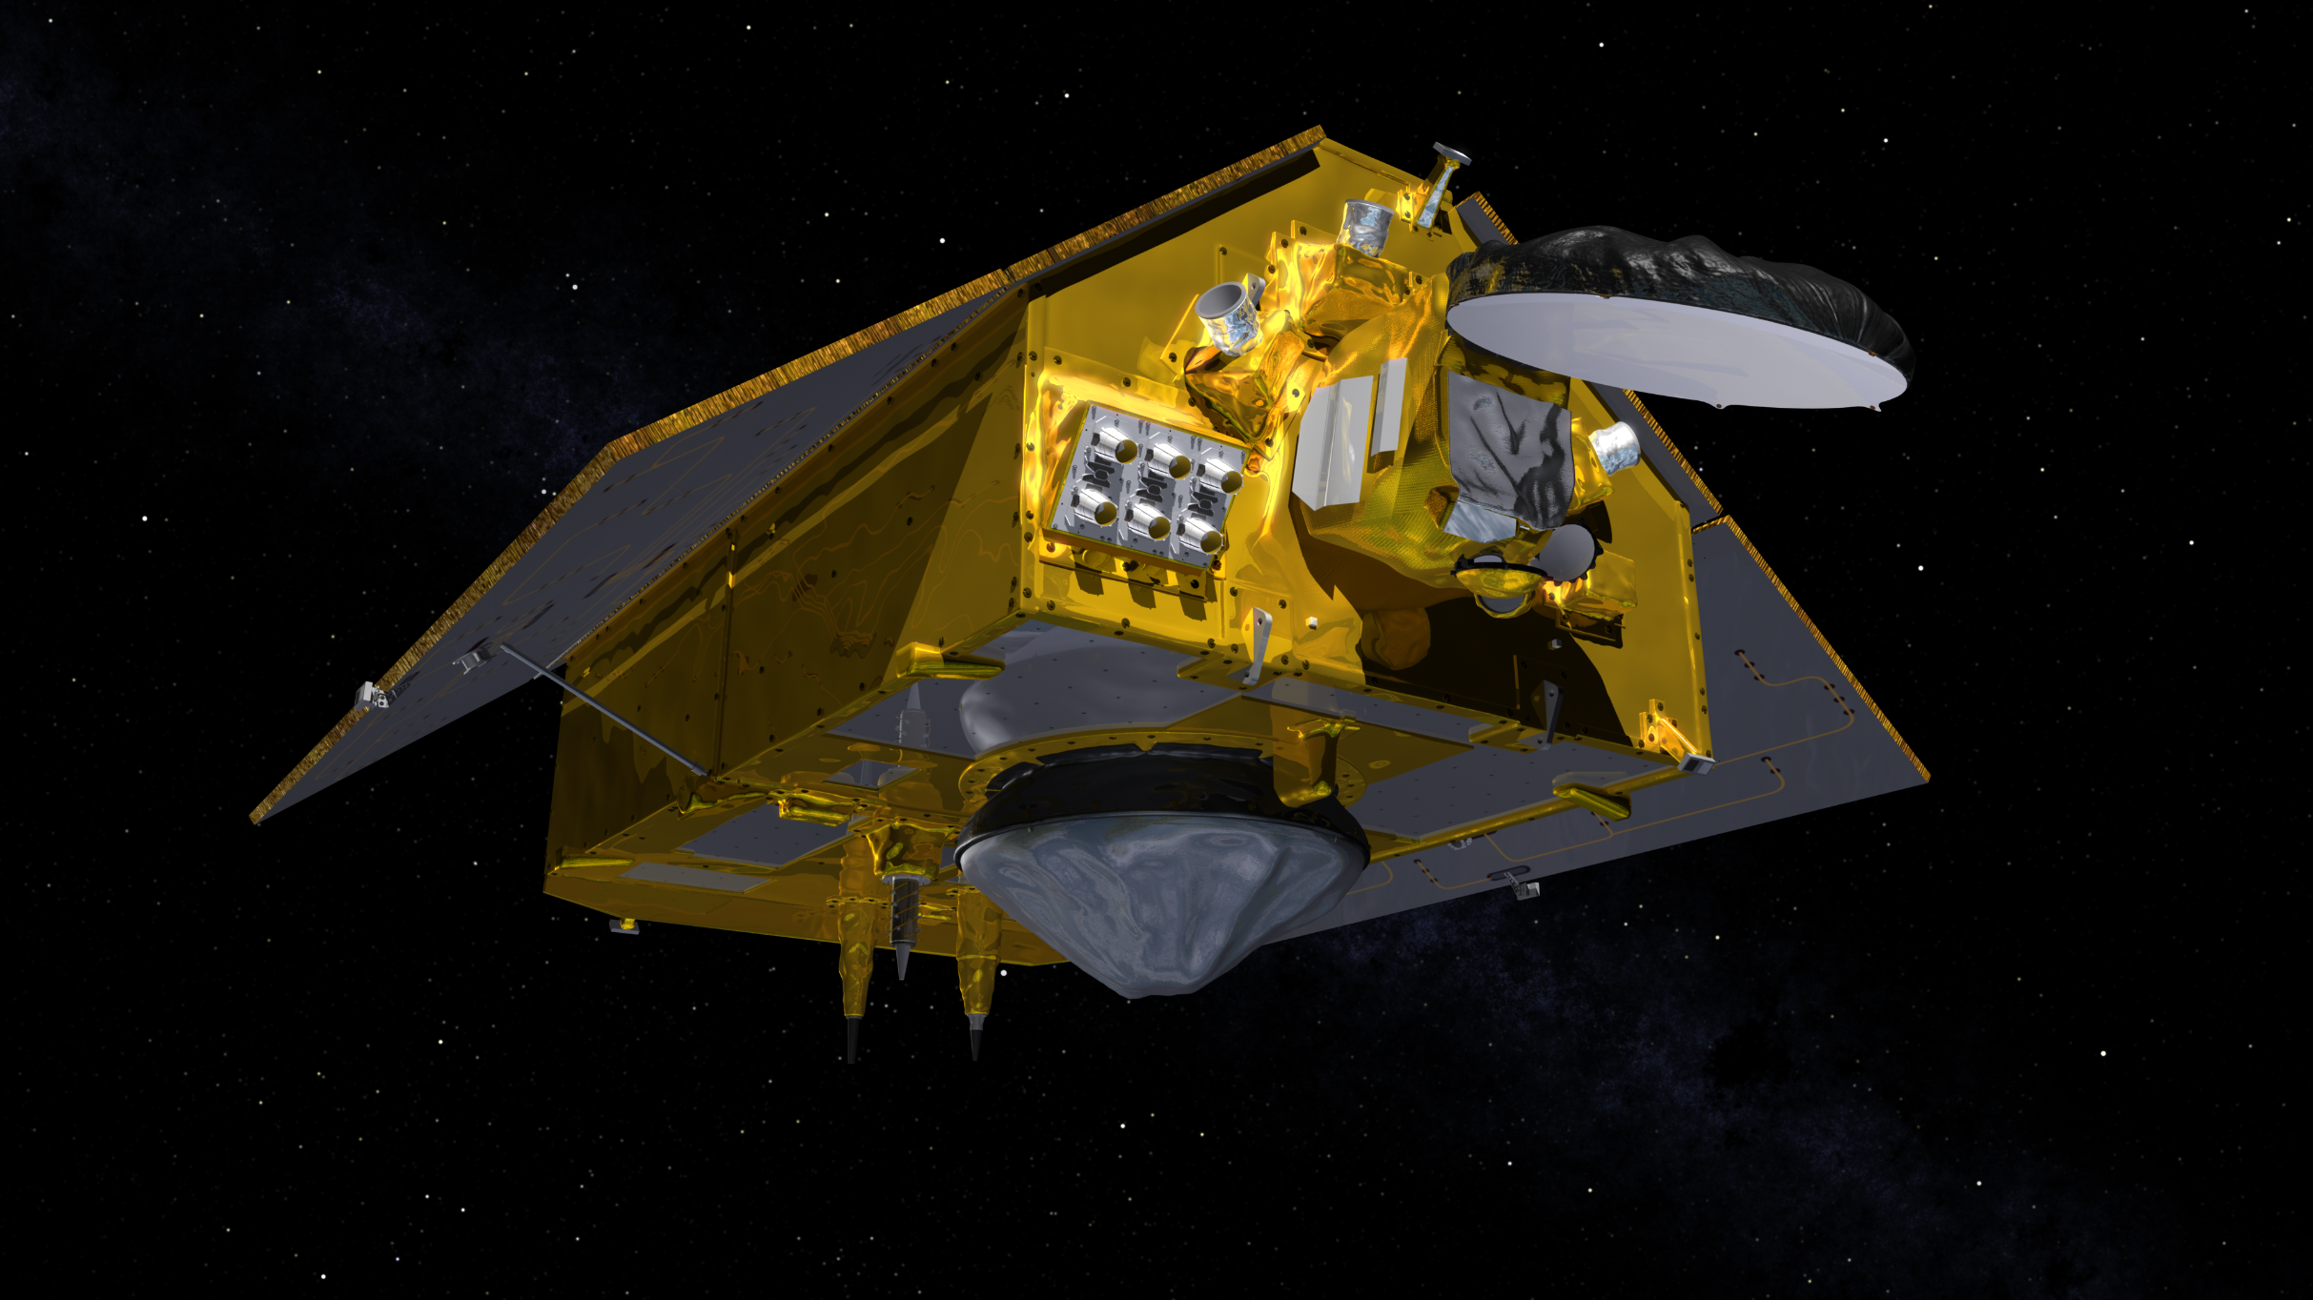
Upcoming: Sentinel-6B Launch
Launch no earlier than Nov. 16, from Vandenberg Space Force Base
History of collaboration with our international partners: ESA, EUMETSAT, with support from NOAA and CNES
Maintaining continuity of critical ocean observations
Approximately 13 orbits/day at altitude of 1,336 km
Prime mission expected to last 5 ½ years

Slide 7

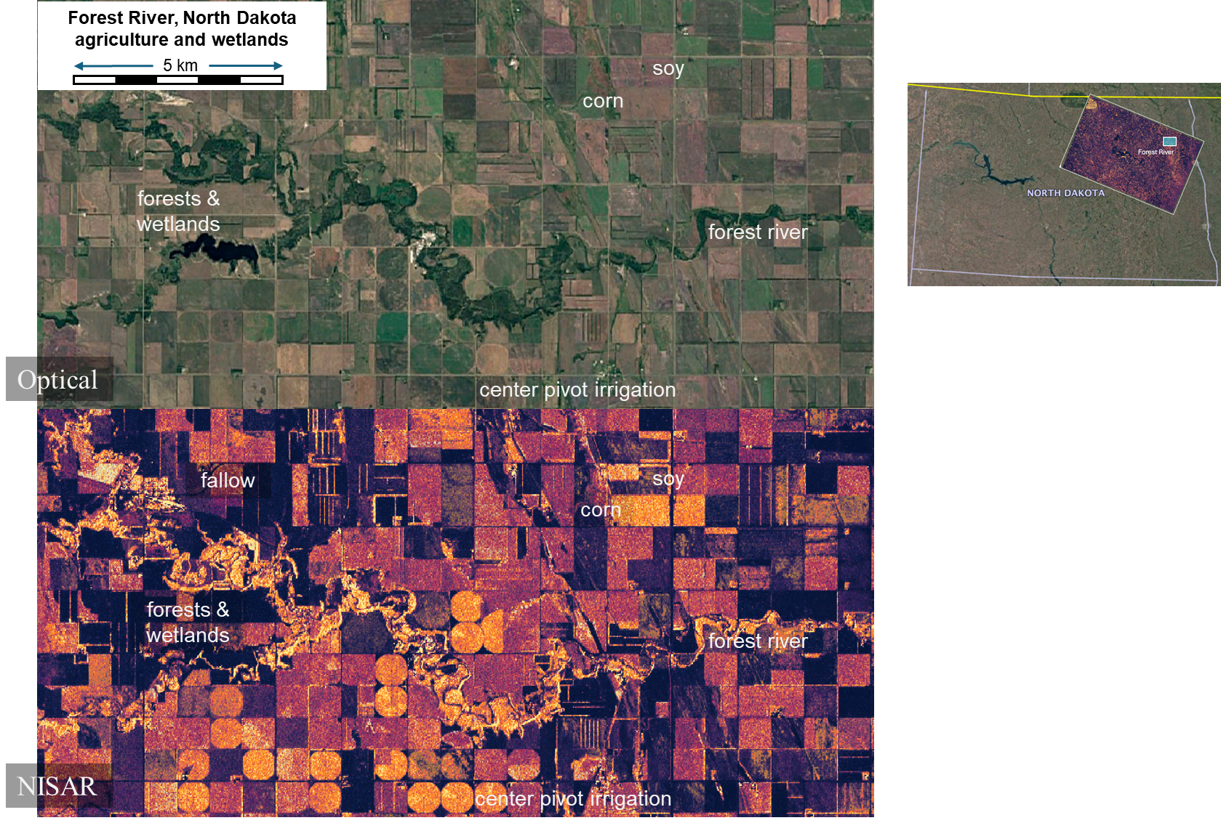

Slide 8
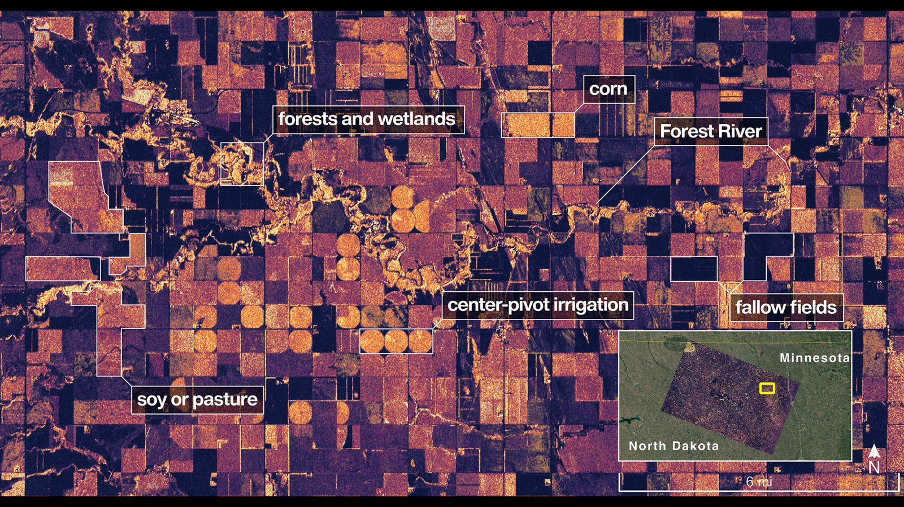

Slide 9
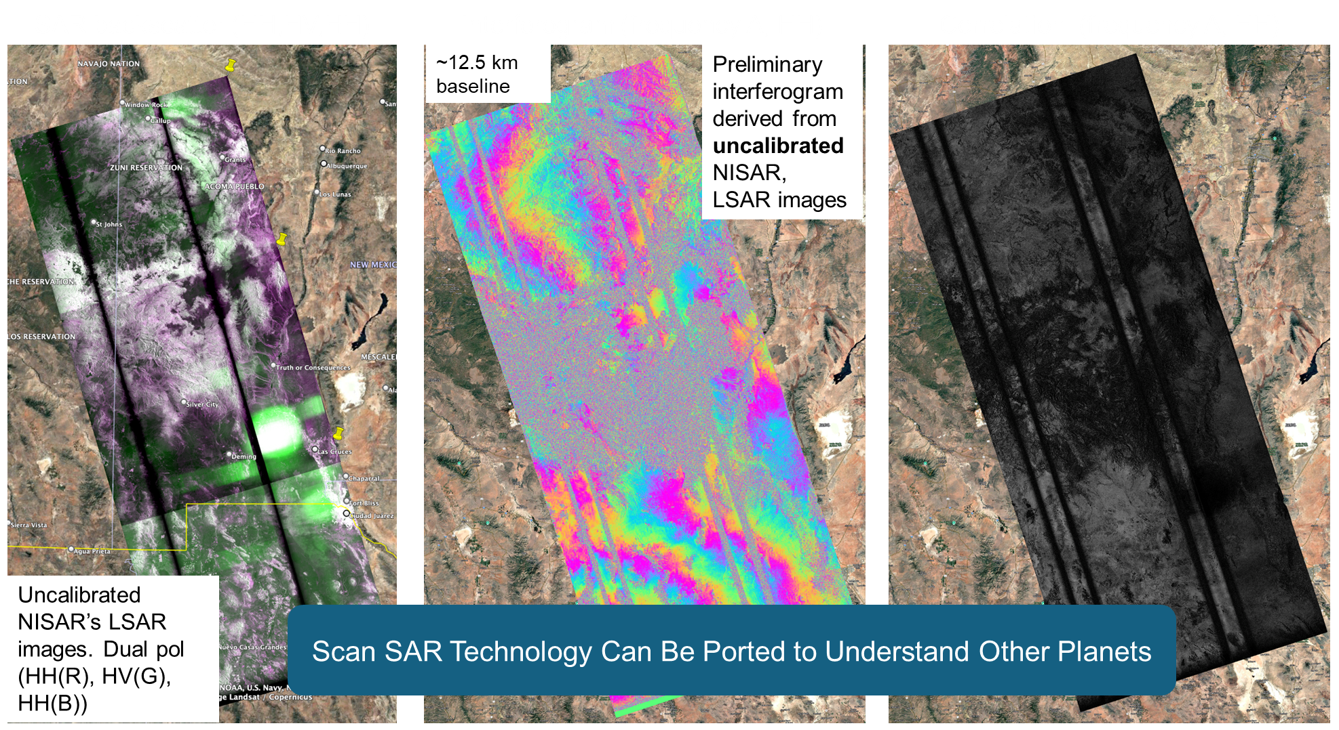
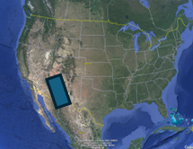
Reviewed and determined not to contain export controlled CUI

Slide 10










ESD Operates One of the Largest Open Archives on the Planet
EARTH DATA
End User Average Distribution Volume
600 TB/Day
ARCHIVE
Total Archive
Volume In Cloud Only
116.2PB
SUMMARY
FY 25
End User Distribution
Files incl. From Cloud
7.8 Billion
(4.3B in Cloud)
Total Number of Files Cataloged (On-Prem and Cloud)
4.6 Billion
Average Archive Growth
160 TB/Day*
Total Archive
Volume Including
in Cloud (not inc duplicate on-prem)
148.8 PB
Distinct Users of EOSDIS Data (not inc. estimated 20M from Services, e.g., Worldview and GIBS)
10 Million
Unique Datasets
18,755
Website Sessions
14.9 Million
EOSDIS Customer Satisfaction Index Score (2024)
78
*NISAR may add ~66TB/day

