Slide 1
CEOS Systems Engineering Office Report
David Borges, SEO
Agenda Item 9.1
Plenary 2025
Bath, UK
6 November 2025

Slide 2
SEO Updates
Mailing Lists Status
CEOS Analytics Lab (CAL)
CEOS Digital Object Identifier (DOI) Process Paper
Organizational GitHub Governance status

Slide 3
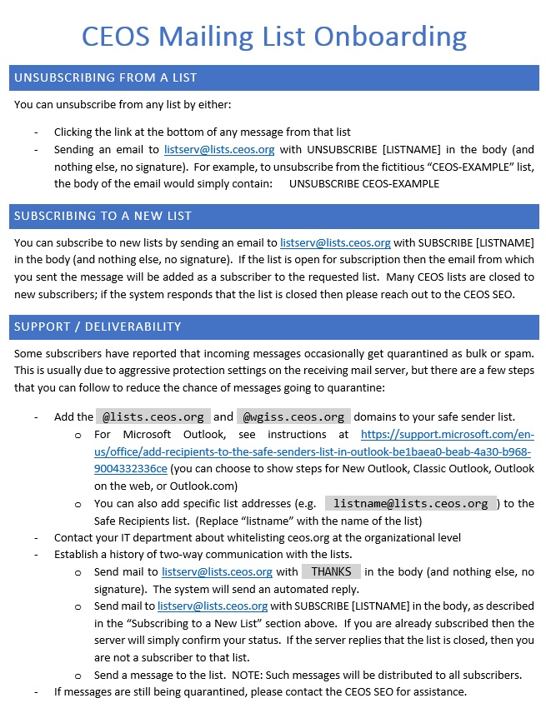
CEOS Mailing Lists
Some subscribers have reported that incoming messages are being quarantined as bulk or spam. This is due to protection settings on the receiving mail system and varies by provider.
What We’ve Done
Contacted our current mailing list provider (L-Soft) to confirm DNS and listserv configuration.
Worked with IT at NASA (one of the affected groups) to examine headers and quarantine rules.
Used diagnostic tools and automated checks to confirm mailing list configuration
What We’re Doing
Investigating alternative mailing list providers, including Groups.io.
Created a small test list and completed a deliverability test of Groups.io
Currently deploying an enterprise-level test of Groups.io for a complete end-to-end test.
Investigating alternative technologies and self-hosted solutions.
Created an onboarding document with steps that users can take to maximize deliverability.
Potential Solutions
Groups.io seems to be a good replacement with high feature-parity to Listserv. It also will allow us to easily transition the current lists to the new provider with very little disruption.

Slide 4
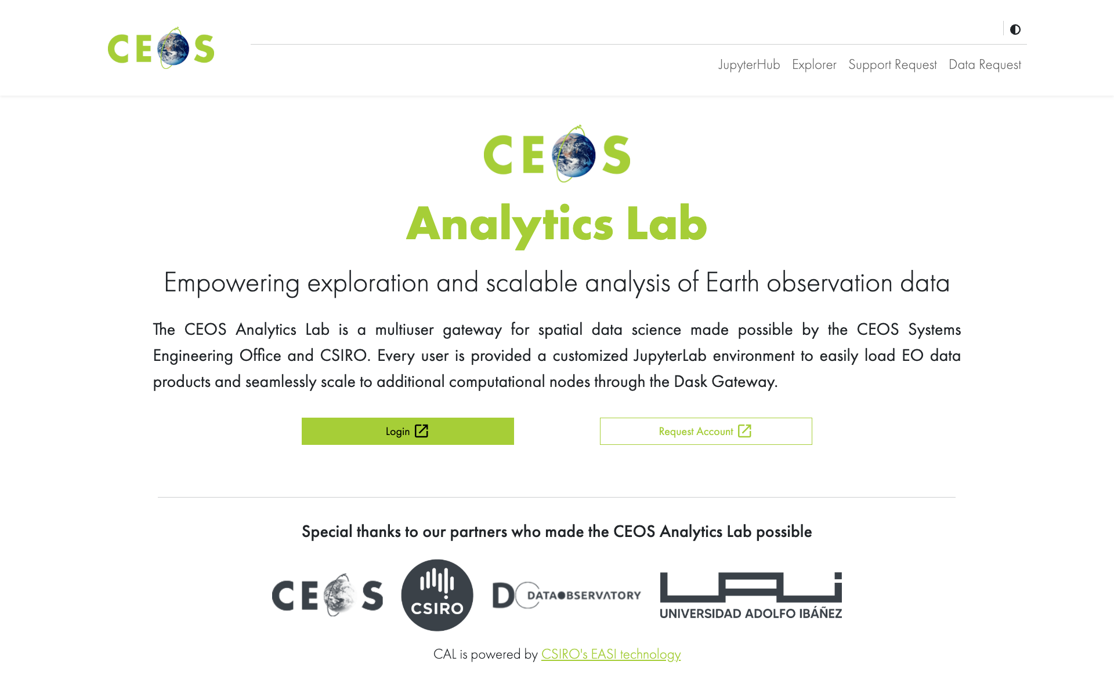
CEOS Analytics Lab (CAL)
Cloud native geospatial analysis platform available to all CEOS activities that might otherwise not have group access to similar resources
Resource to showcase the art of the possible when EO data is made cloud native and observes interoperability best practices

Slide 5

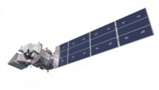

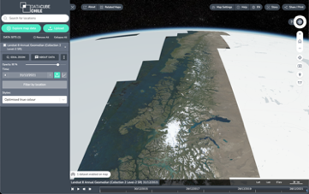

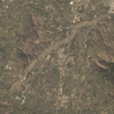
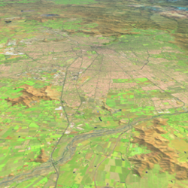
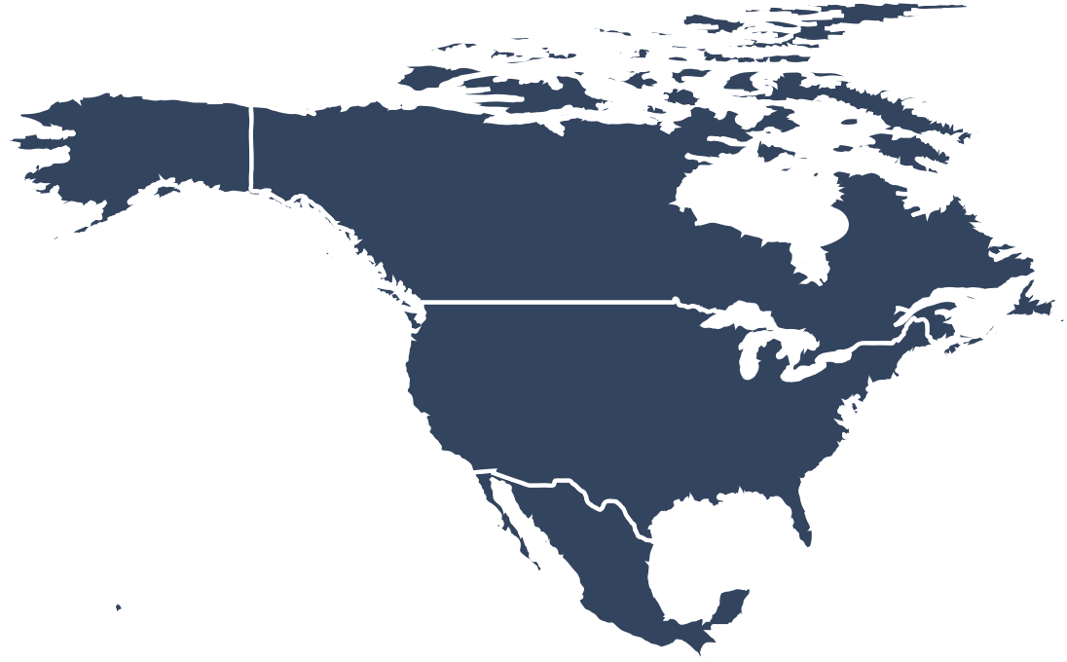


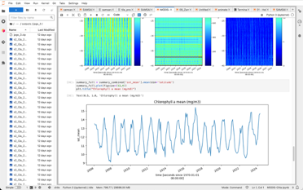

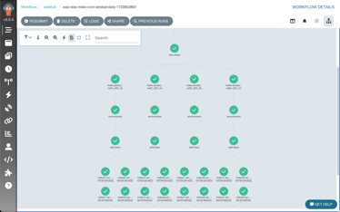
CEOS Analytics Laboratory
Analytics Laboratory
from pilot or project
to national or continental
ARD & ARCO
Visualisation
Analysis Ready:
Landsat 5/7/8/9
Sentinel 1/2/3
MODIS
VIIRS
ALOS
Elevation
Small sats
Commercial
…
Exploratory analysis
1 computer or 200
30GB RAM or 6TB
8 CPU or 1600
Scalable workflows
ARCO = Analysis Ready, Cloud Optimized

Slide 6
























Elastic Kubernetes Service
Analytics Laboratory
OGC Web Services
Data visualisation
https://cal.ceos.org
WMS, WMTS and WCS
Horizontal Pod Autoscaler (HPA) adjusts to user demand
Customisable, on-the-fly functions and calculations
Handles OGC, ESRI, other map services and geospatial files
2D, 3D and 4D visualisations
Above and below ground
Charting and time-series
OWS
Storage
Data for visualization
Public
Amazon S3
Amazon EC2 Auto scaling
Amazon EC2 Auto scaling
Dask Worker
ARCO data formats
(e.g. COG/Zarr)
Dask Worker
Metadata queries
Analytics environment
Flexible, scalable workers
Metadata
(eo3/STAC)
32GB, 8CPU default capacity
>500 pre-installed python libraries
Optional extra CPU/RAM
Optional GPU
Metadata and data response
Powerful parallel processing
Optional GPU, extra CPU or extra RAM (per worker)
Amazon S3
Amazon RDS
Argo Workflows
Powered by:
Data updates and new product generation
(ARCO data formats and eo3 metadata)
Powerful workflow engine
Hugely scalable
Automated data and product updates
Customised, on-demand data workflows
In addition to:
Automation and orchestration with:
Amazon Cognito
Amazon EFS
Amazon DynamoDB
Amazon CloudFront

Slide 7

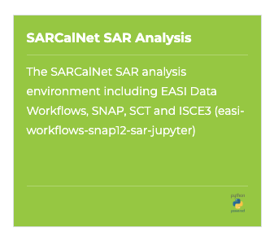
CAL Support to WGCV-SAR & SARCalNet
New custom CAL environment for WGCV-SAR & SARCalNet users (on top of 500+ existing libraries)
Includes a range of SAR-specific tools and libraries for processing and analysis, including:
Can be expanded on request
SNAP (GPT, esa_snappy)
ISCE3
SAR Cal Toolbox (SCT)
SCT subtools
PolSARTools
PolSARPro being explored
Sardem
NISARQA
KARIOS
S1etad
PyroSAR

Slide 8
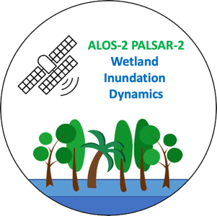
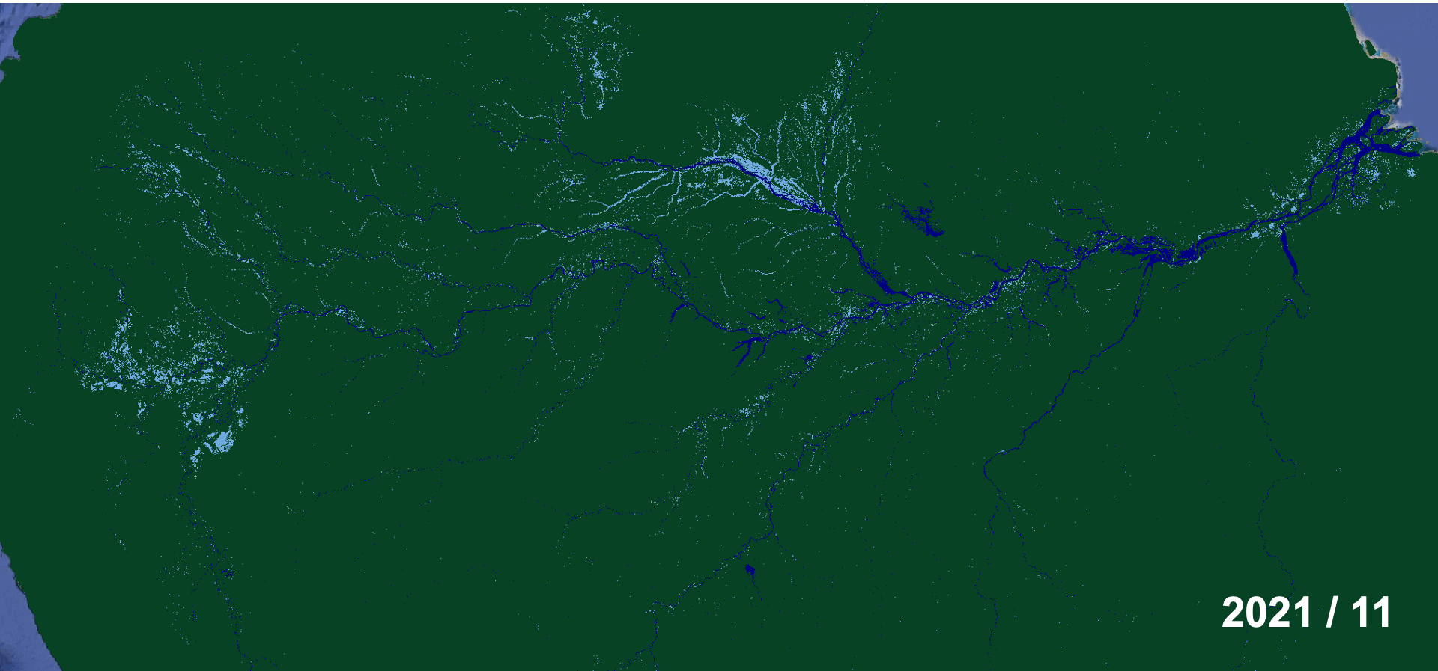

CAL Processing Case Study:
ALOS-2 Forested Wetlands Inundation Mapping
Processing intensive:
Amazon basin (8 Mkm²), >10 years of data
Processing time using local desktop (8 CPU, 48 GB RAM): ~800 h
Cloud-based (CAL) solution:
JAXA update of global archive of CEOS-ARD NRB ALOS-2 ScanSAR data on AWS (THANK YOU JAXA!)
CEOS Analytics Lab used to parallelise the existing workflow
Processing time improved from 800+ h to less than 10 h

Slide 9
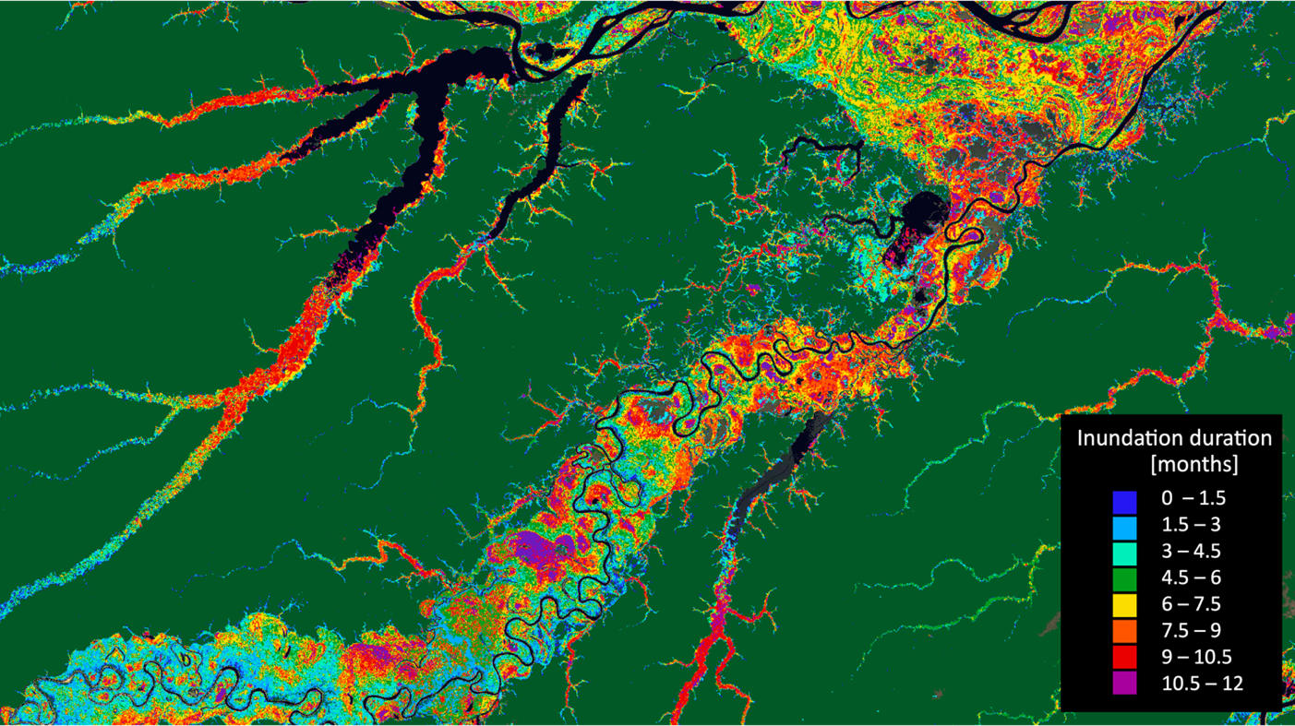

CAL Processing Case Study:
ALOS-2 Forested Wetlands Inundation Mapping
← Inundation duration map for 2022.
Colours indicate the number of times a pixel has been classified as “flooded” in the 2022 time-series.

Slide 10
CAL benefits and limitations
Sits outside of any agency infrastructure – directly on AWS
CEOS SEO team can help provide training and advice
Scales up when you need it and down when you don’t
For normal use, very few limitations. For large-scale or very compute-intensive jobs, there are limits, but we can help make your code faster
How can we help?
Access to CAL if available free of charge for CEOS activities
Tell us what your team needs: specific data, python packages, training, scale?
Hosting environment for Interoperability Demonstrator(s)?

Slide 11

CEOS DOI Process Paper
Demand: SEO has received many requests for a CEOS-specific Digital Object Identifier (DOI) process
In Development: New CEOS DOI Process Paper
Plan: Request endorsement at SIT-41
Value of DOI Registration
Long-term preservation and persistent access to CEOS documentation
Enhanced discoverability through standardized metadata practices
Professional credibility and citation tracking for CEOS outputs
Support for open access mission - aligning with CEOS commitment to open Earth observation data

Slide 12

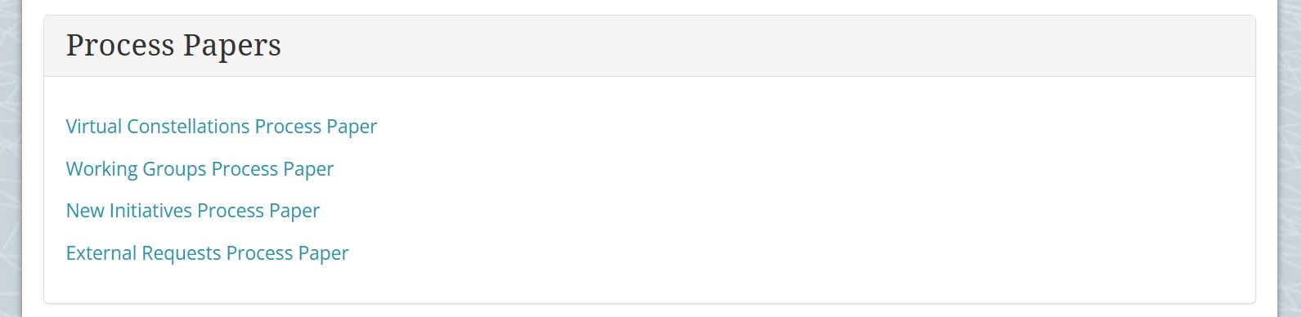
CEOS DOI Process w/ Zenodo
Why Zenodo is the Right Choice
Free, open-source platform backed by CERN and OpenAIRE
Built-in community features enabling dedicated CEOS collection space
Flexible content types - supports reports, datasets, software, and presentations
GitHub integration for seamless technical documentation workflows
CEOS Implementation Approach
Selective application – CEOS approval ‘For Endorsement’ or ‘For Publication’ requirement
Standardized metadata with mandatory CEOS keywords and affiliations
Working Group oversight - submissions require appropriate WG approval
Quality standards - professional formatting with clear Earth observation context
Community coordination through designated Implementation Lead and Technical Coordinator

Slide 13

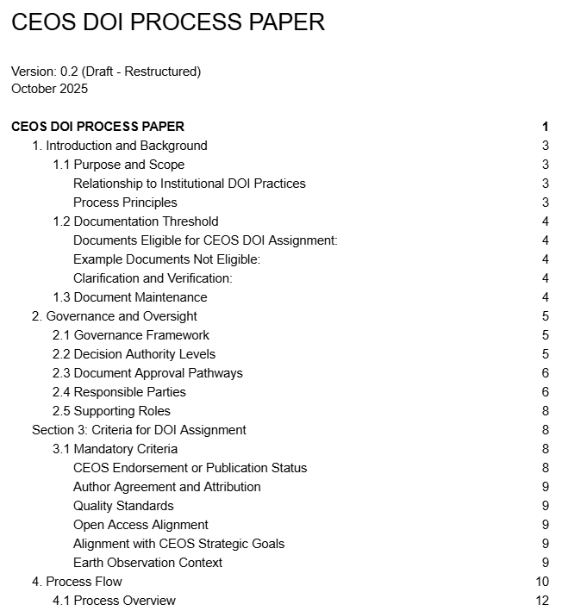
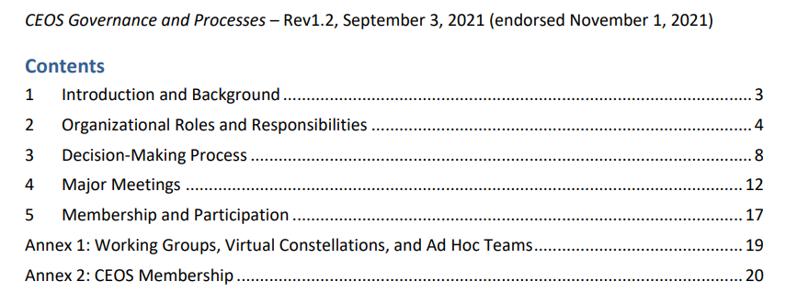
CEOS Governance and Process Paper
Alignment with ongoing discussions regarding “Clarification of CEOS Decision Types” and any version updates to the CEOS Governance and Processes Paper

Slide 14

CEOS GitHub Governance
CEOS GitHub Organizational Governance [Draft] under development
Current Status
Organization Scale: 30 members, 17 repositories, 8 projects
Shape current activities within Github Free tier
Key Governance Decisions under discussion
Ownership Criteria: Establish clear guidelines for owner designation (institutional representation, technical leadership)
Membership Standards: Define requirements for organization membership (meeting attendance, project management, institutional teams)
Team Structure: Implement dual-axis approach organizing by WG/VC and institutional affiliation

Slide 15
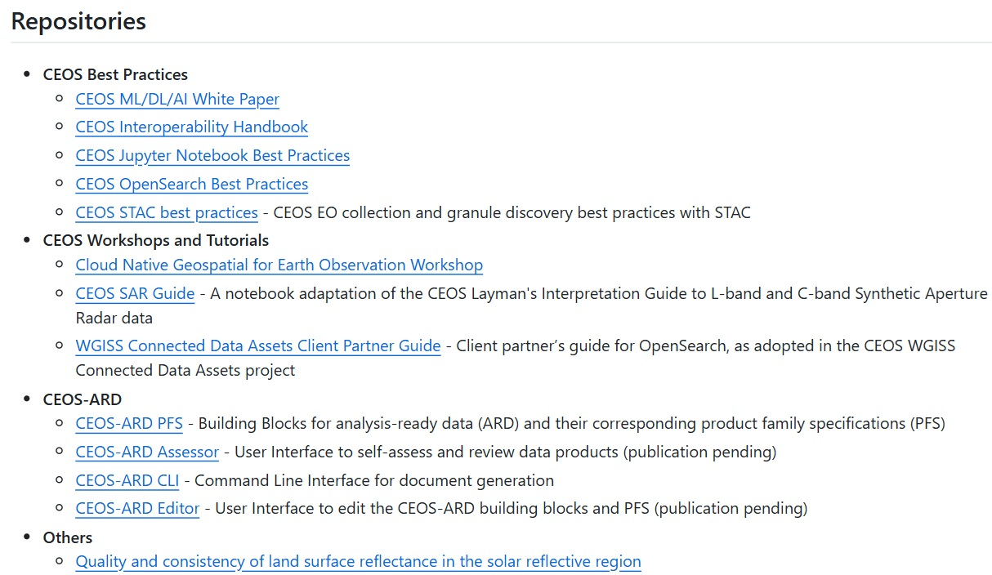

CEOS GitHub Governance
Technical Framework
Permission Hierarchy: Organization → Team → Repository levels
Repository Standardization: Templates for code projects, Jupyter notebooks, and document publishing
Legal Structure: Organization-wide Contributor License Agreement
Implementation Priorities
Immediate: Define owner and member criteria, deploy repository templates, establish team structure
Medium-term: Comprehensive training curriculum, interactive sandbox repository, onboarding workflows
Tools: GitHub Desktop for GUI adoption, external training resources

