Slide 1
CEOS Communications
Team
Update
Dave Borges, NASA
Agenda Item 9.2
39th CEOS Plenary
Bath, United Kingdom
4th - 6th November, 2025

Slide 2


CEOS Communications
SEO leads CEOS Communications Team
Website maintenance
Social media
Outreach (e.g. Exhibition Booths)
Supported by small CEOS Comms Team:
CEOS Executive Officer
JAXA Newsletter Team (Toshi Kamei,Satoshi Uenuma)
Chris Barnes (USGS)
Marie-Claire Greening (ESA)
Adria Schwarber & Mary Ann Kutny (NOAA)
Flora Kerblat (CSIRO)
ceos.org
@CEOSdotORG

Slide 3
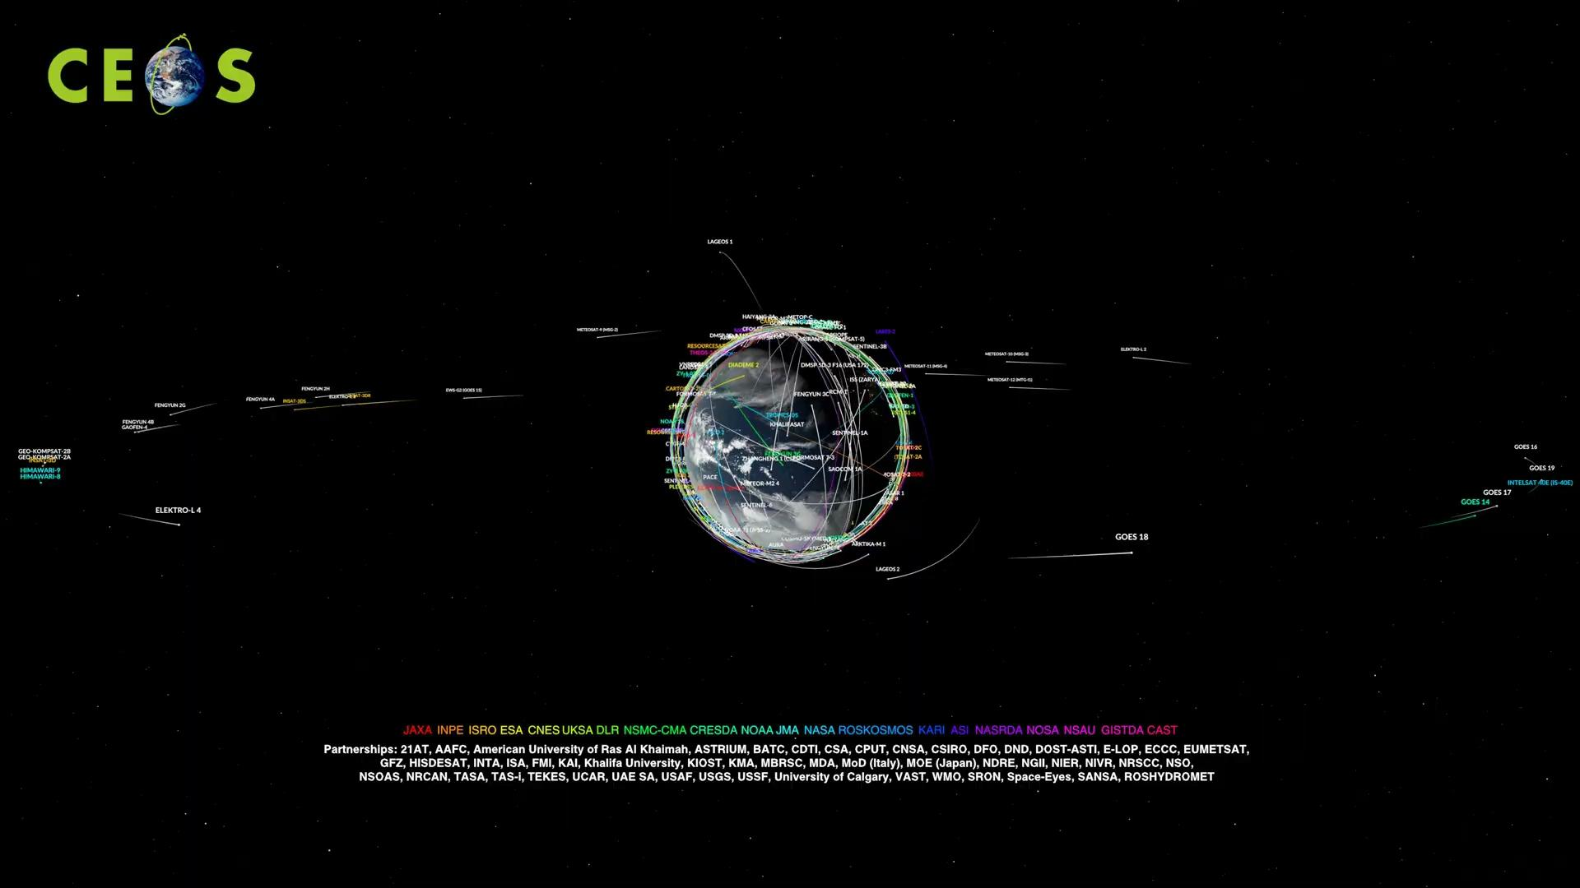

Slide 4
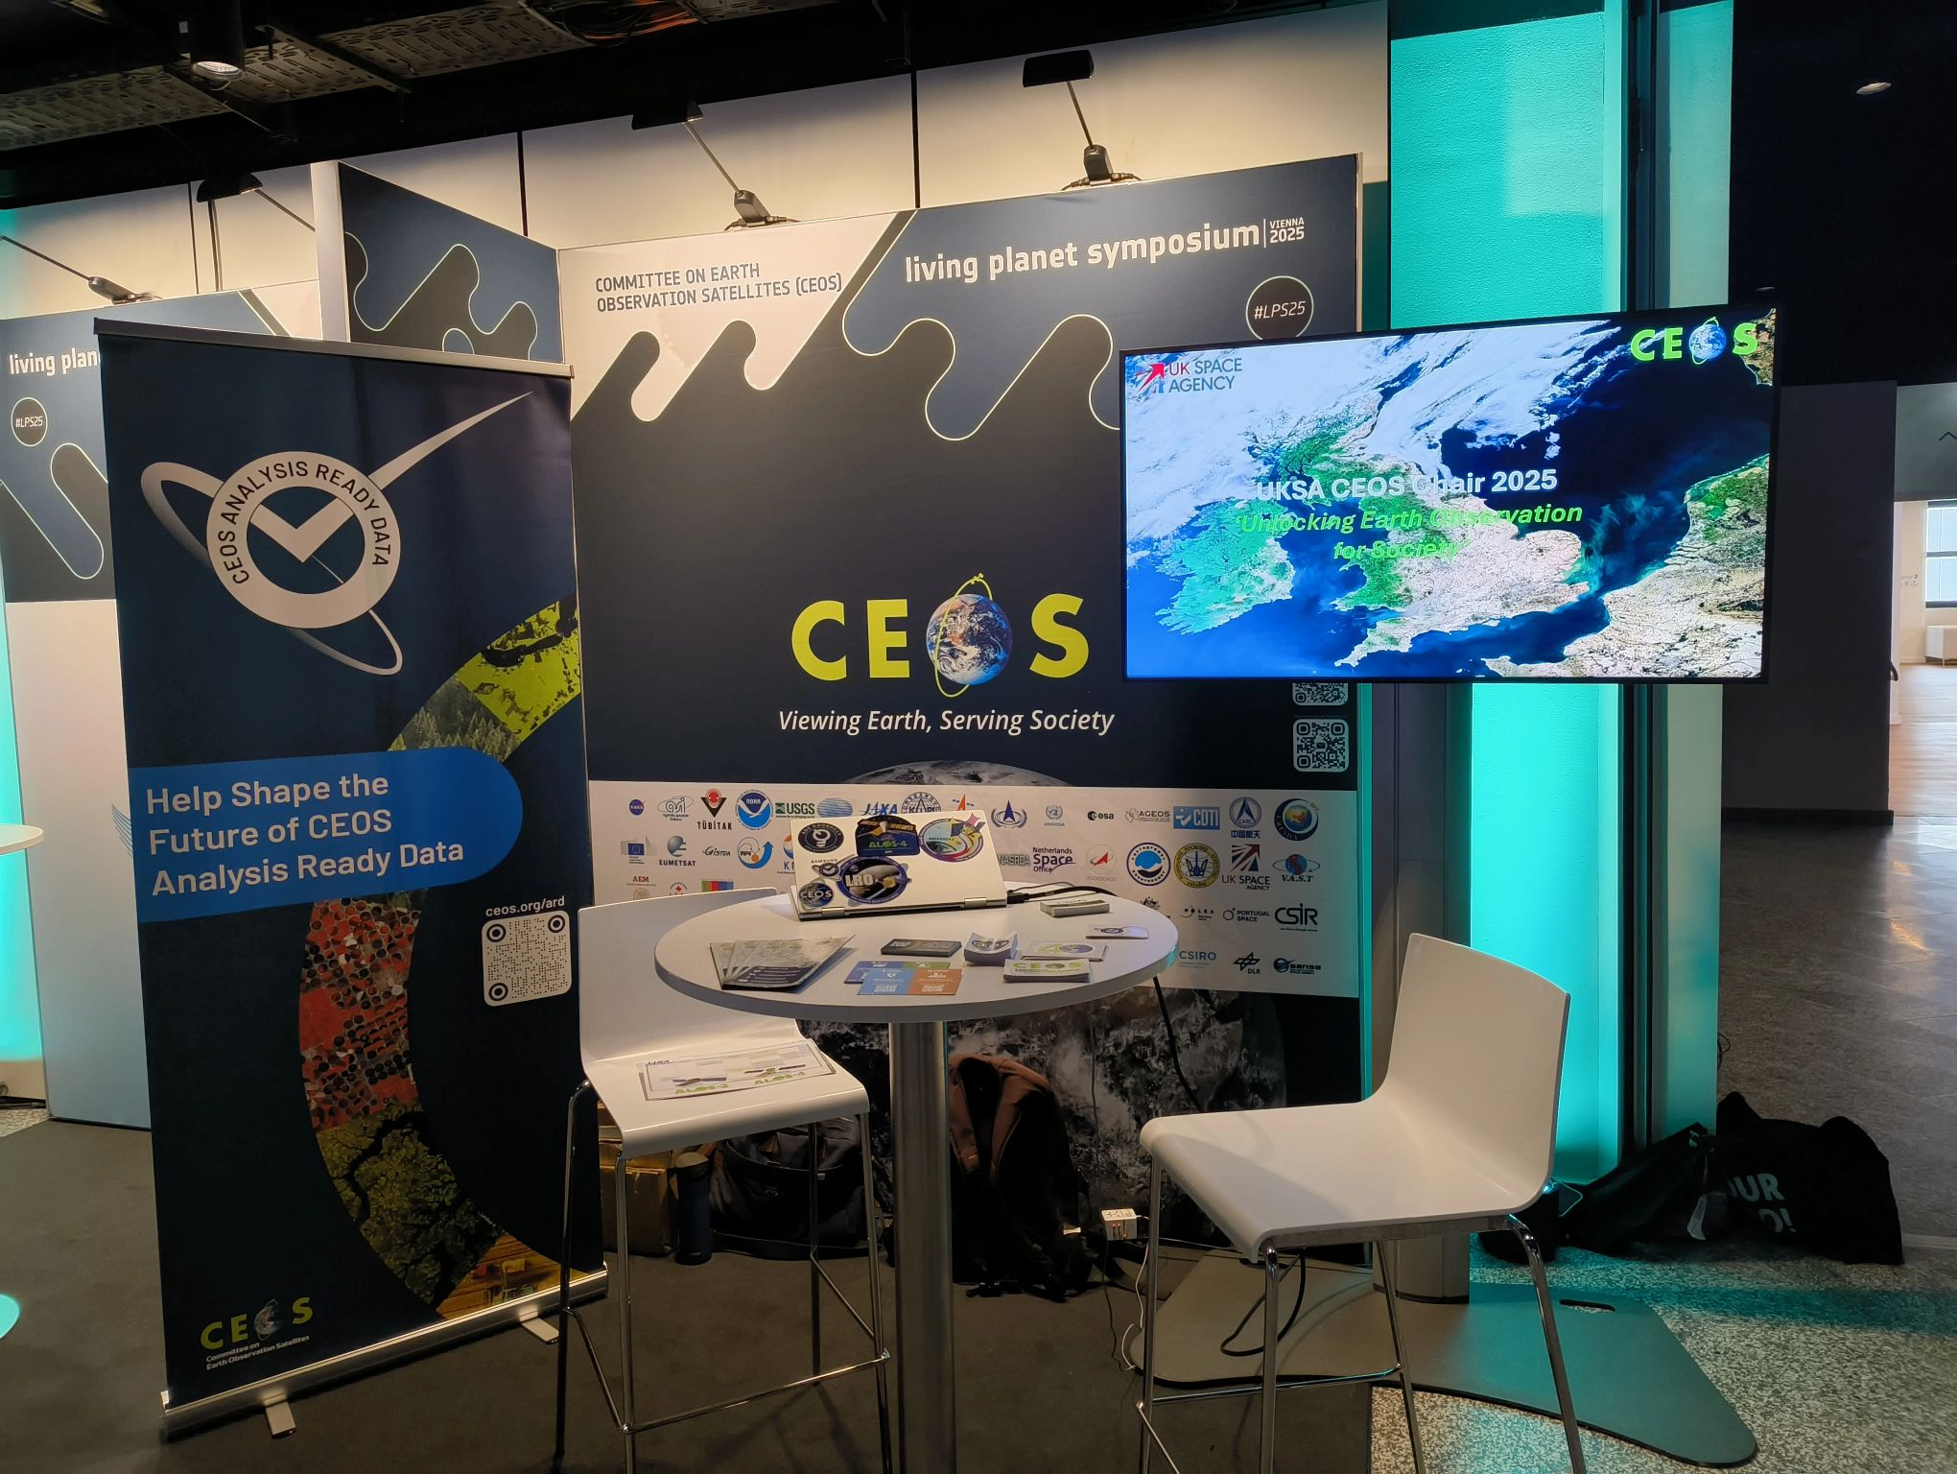
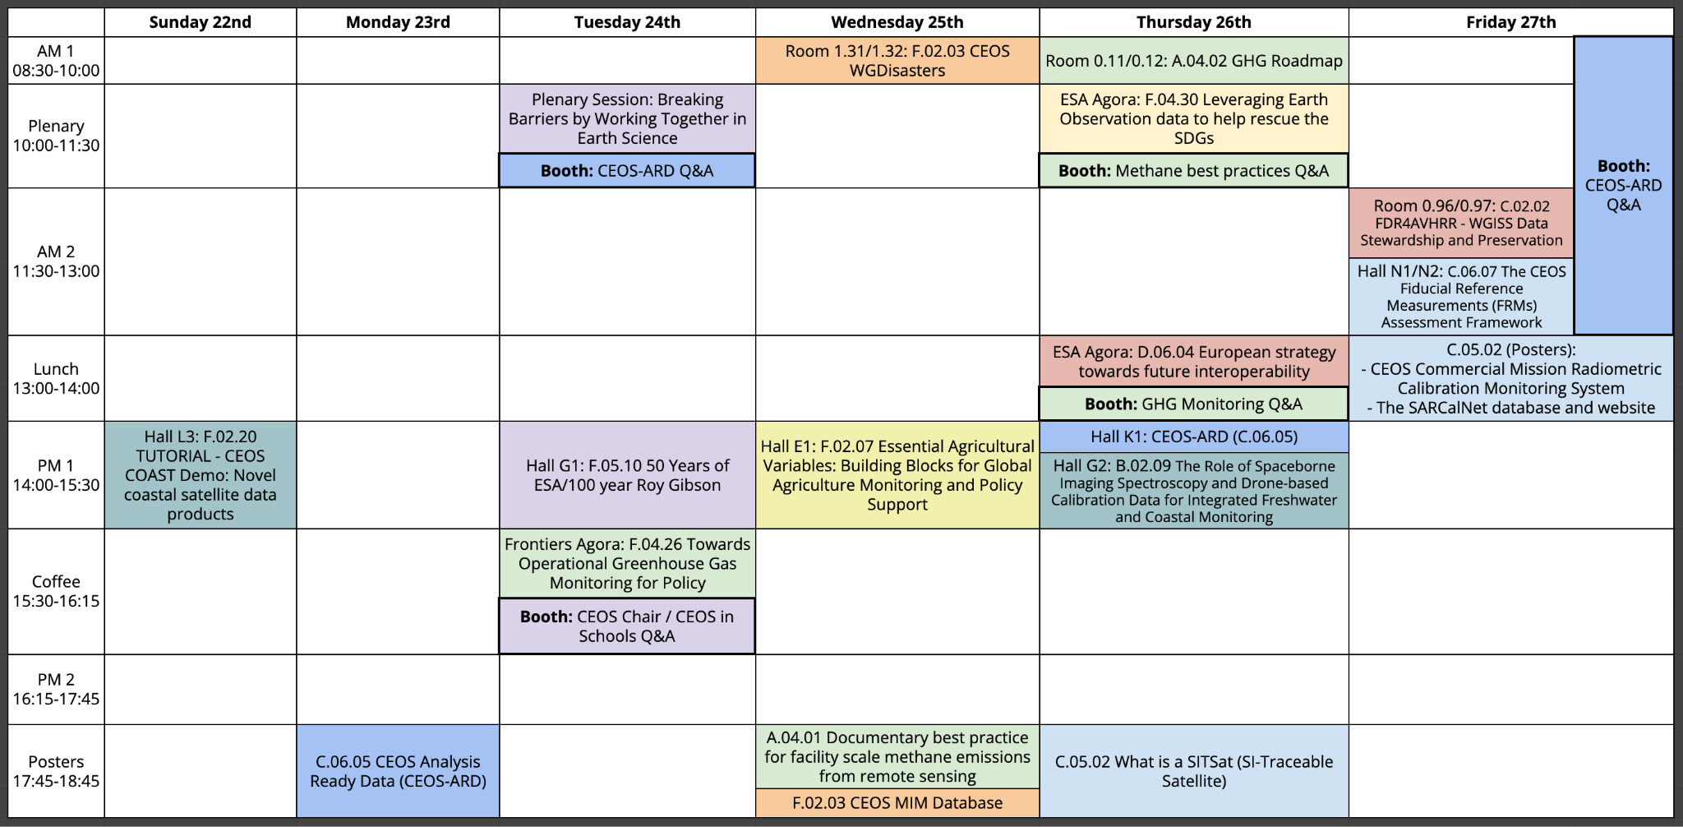
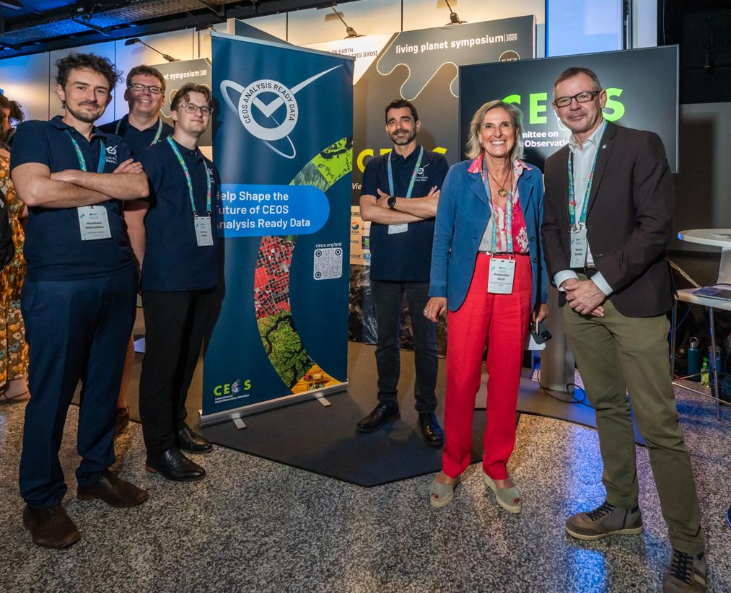
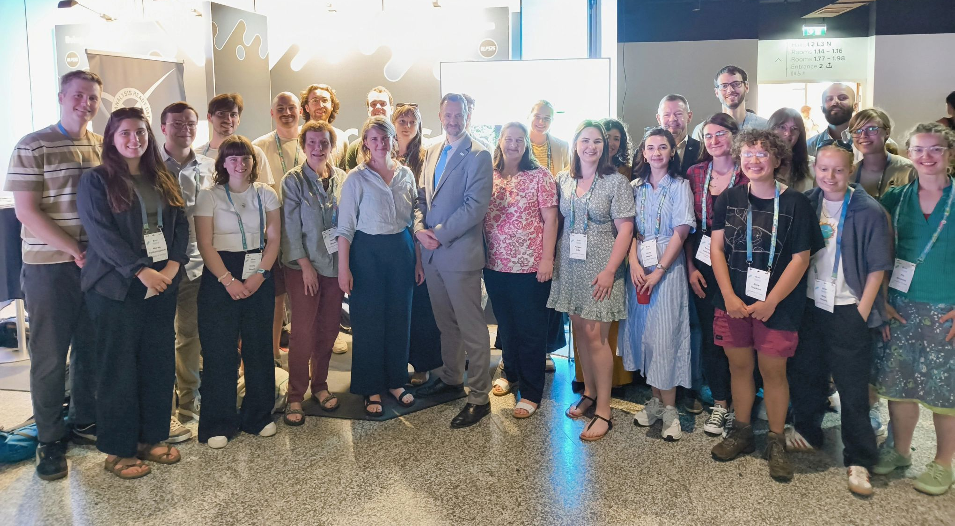
Living Planet Symposium
LPS Booth - thank you ESA!
CEOS-ARD highlighted
Q&A’s hosted throughout the week

Slide 5
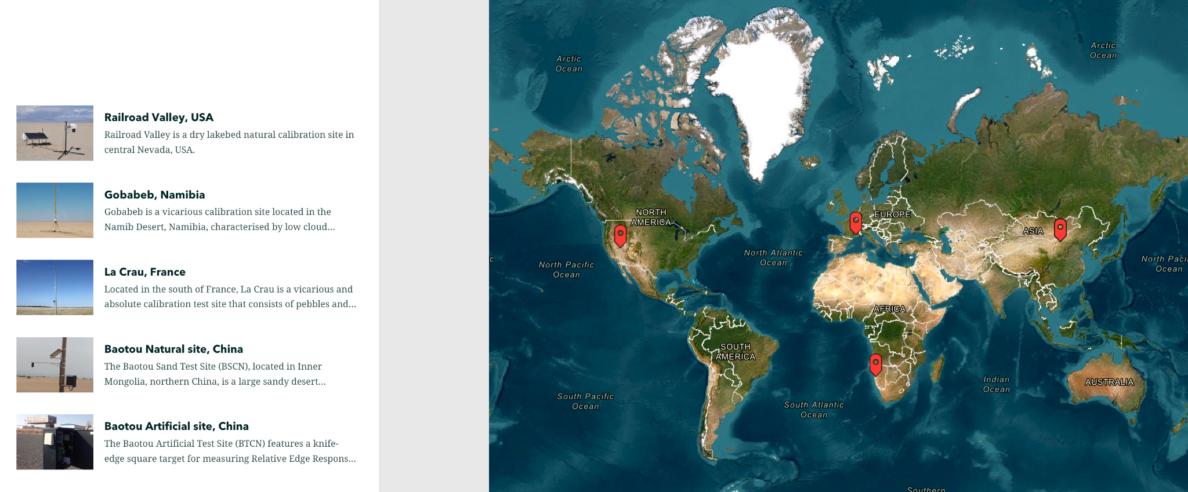

Interactive Content: Storymaps
Esri Storymaps - interactive articles highlighting CEOS tools and services:
RadCalNet
SARCalNet
EO Support Sheets
Impact of CEOS

Slide 6



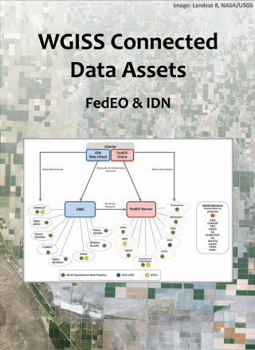


News Articles
28 Jan 2025
WGClimate
24 Feb 2025
Biodiversity Study Team
17 Feb 2025
WGISS/WGCV
4 Jun 2025
WGISS
3 July 2025
WGISS
29 Aug 2025
LSI-VC/OCR-VC
Upcoming:
Wildfire Pilot Outcomes (WGDisasters)
CDR Inventory (WGClimate)
FRM Assessment Framework (WGCV)
Data Loss Prevention Procedure (WGISS)
Suggestions for articles always welcome!

Slide 7

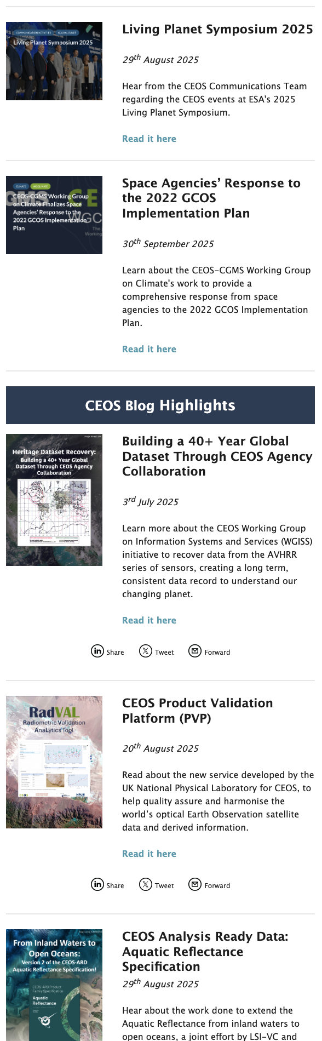
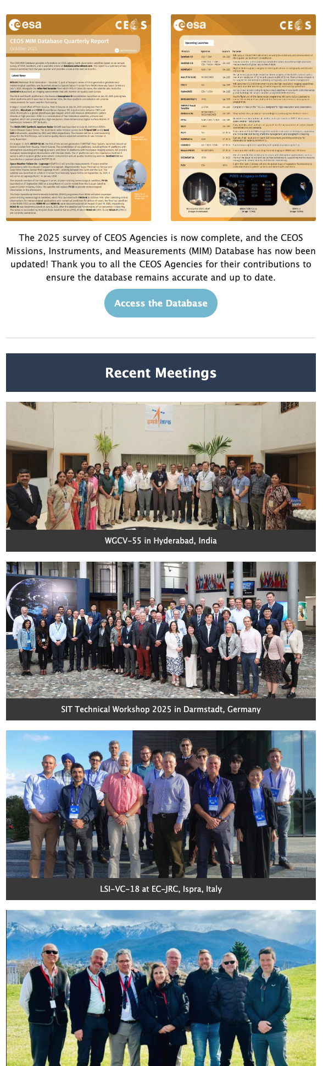


Quarterly Revisit
Published once every three months
Includes:
Message from CEOS community leader
Recent Newsletter article
Recent Blog posts
CEOS Database Quarterly Report
Recent Meeting photos
Upcoming Meetings
Upcoming Training Events
Great way to catch up on what is happening in CEOS
Sign up!
http://eepurl.com/ij_2z1

Slide 8
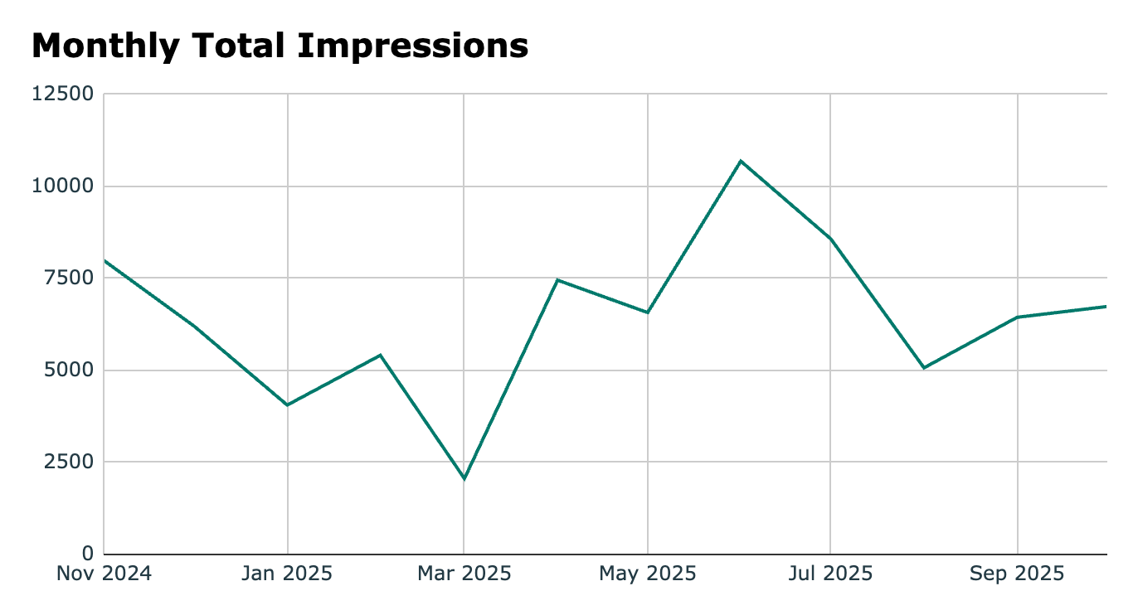
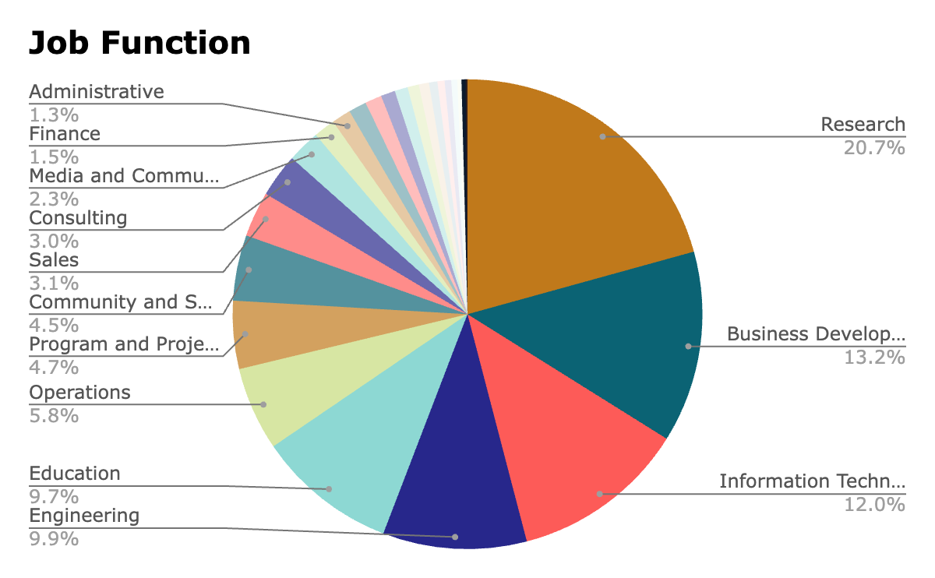
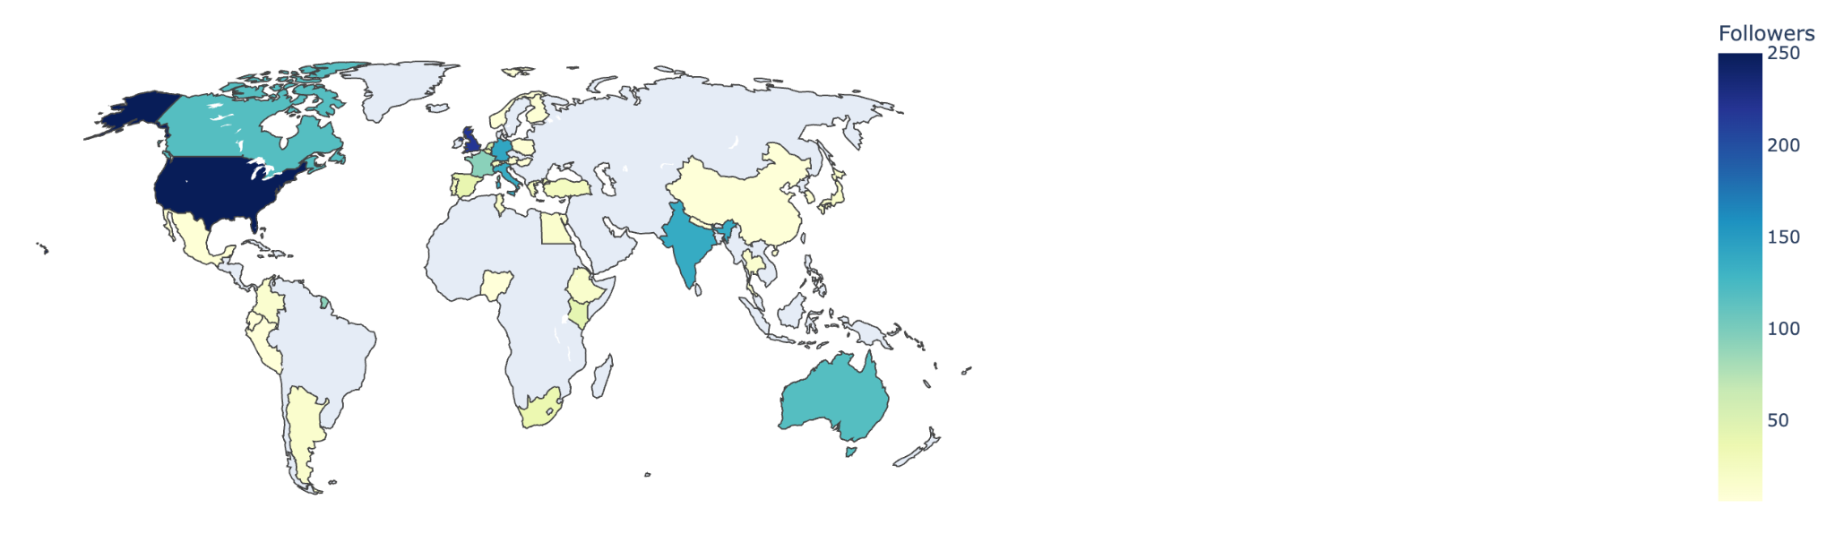
LinkedIn Metrics
Peak due to LPS (posting each day)
For Oct 2024 - Oct 2025:
68 posts
1,146 new followers (total 3,073)
80,000 impressions
2,000 reactions
55 comments
44 reposts
LinkedIn Followers

Slide 9
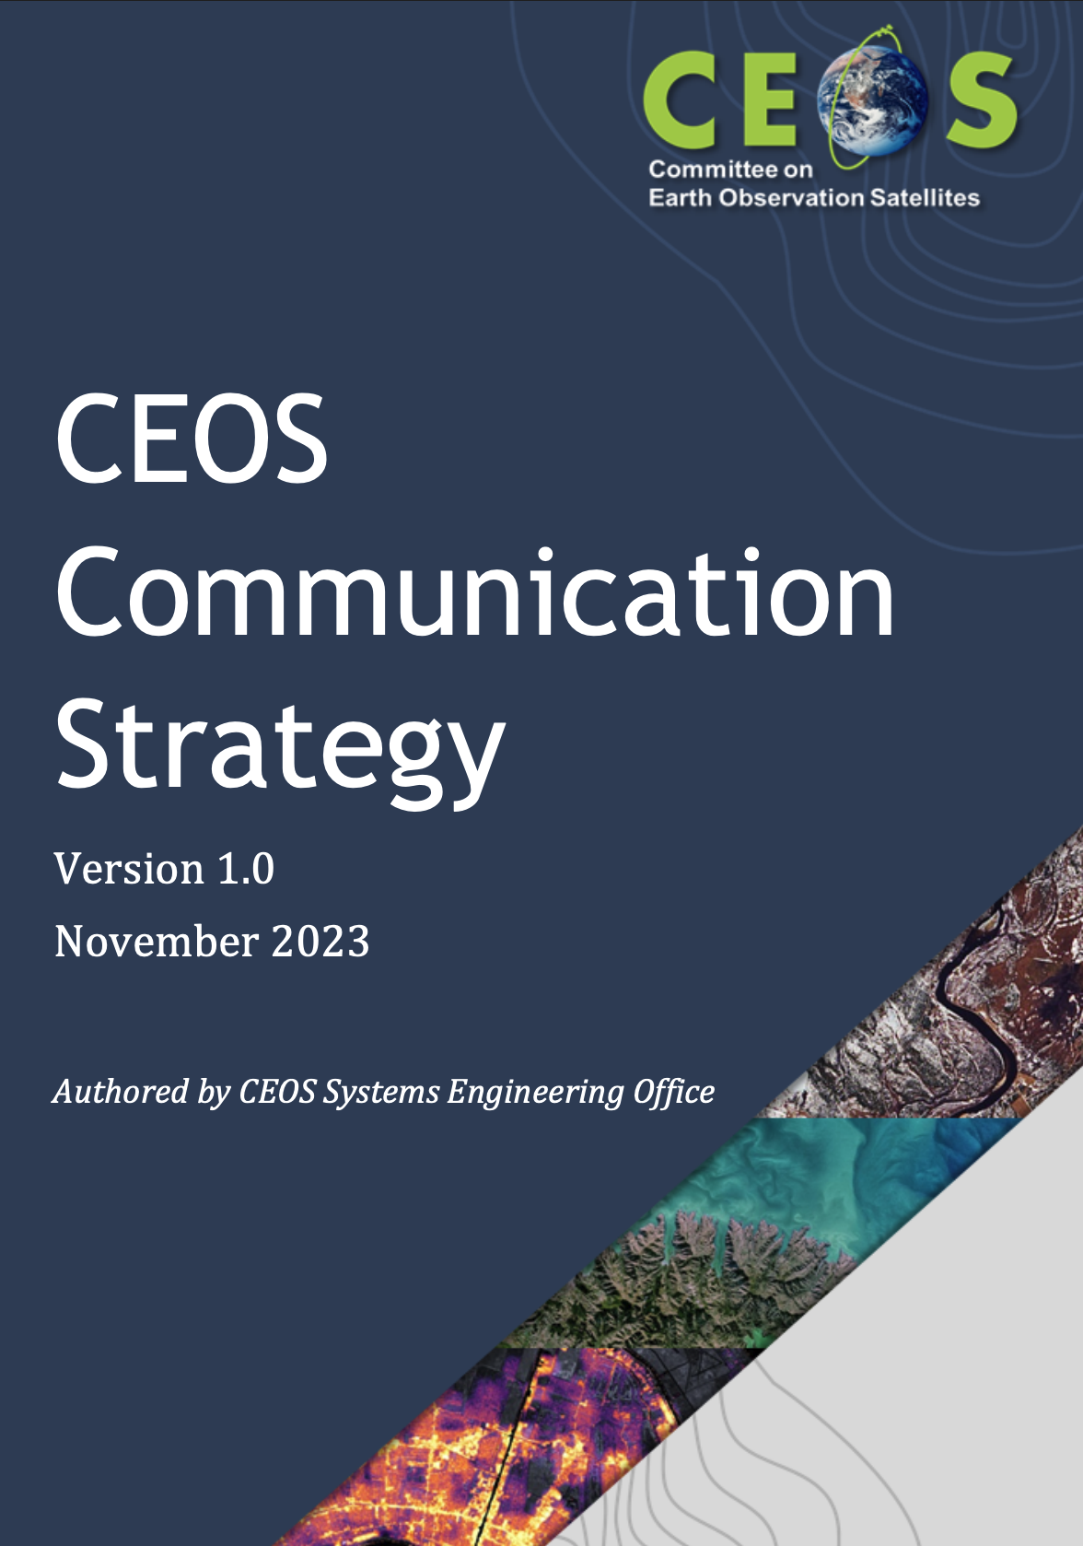
CEOS Communications Strategy
2023 CEOS Communications Strategy
Major update to the previous strategy
Included outlines for campaigns aligned with 2024-2025 CEOS and SIT Chair themes
Needs several Updates
Revise target audiences
New campaigns to align with 2026-2027 CEOS and SIT Chair themes & priorities
Addressing CEOS Value Chain
CEOS Comms Team can be amplification
of your own Agency communications team!

Slide 10

Target Audiences
Understanding your target audience is key for effective communications
Comms Team encourages all CEOS entities to consider target audience when creating new pieces of work
Who are you doing this for? How will they receive it?
Aiming to be more specific with the target audiences defined in the 2026-2027 Communications Strategy

Slide 11
Target Audiences
Internal CEOS Audiences
Audience Group | CEOS Principals | CEOS Working Teams
Description | Nominated individuals from each CEOS Member or Associate who are executive officials. Responsible for making all major decisions within CEOS, including on leadership, organisation structure, and work plan items | Working Groups, Virtual Constellations, Ad-hoc teams and other entities in CEOS. Formed of experts in their specific topic, and often include individuals who are leading programmes within their organisation.
Goals | Provide overview of CEOS work Share information to help decision making within agencies, including mission planning | Share cross-cutting work between teams Topic-specific items
Methods | CEOS mailing lists | Email, social media, news posts, CEOS Communications Quarterly Revisit

Slide 12
Target Audiences
External CEOS Audiences
Audience Group | Data Providers & Distributors | Data Users | Decision Makers
Description | Technical space agency staff, as well as commercial satellite operators and data providers | Experts who use and analyse satellite data to gain insights into the Earth’s environment | Use the results of analysis of EO data to make decisions regarding policies
Goals | Share knowledge about best practices and other technical work developed by CEOS groups | Share information about data products produced by CEOS agencies and new applications | Promote the use of space-based EO to support global agendas, climate insights
Level of understanding of EO data | High | Medium | Low
Methods | News posts, Exhibition booth interactions, community events (e.g. VH-RODA, JACIE) | News posts, Exhibition booth interactions, scientific community events (e.g. IGARSS, LPS, GEO Global Forum) | Connections through agencies, briefing packs for delegates at UN meetings
Relevant Social Media Accounts | Space Agencies, commercial data providers | Thematic groups, e.g. GEO initiatives | UN bodies (UNFCCC, UNCBD, etc.)

Slide 13
Campaigns
A campaign is a targeted series of communications, with specific goals and audiences in mind
Build on the success of the CEOS-ARD campaign to gather inputs for the survey
Coordinated messaging
In-person presence (LPS)
Coordinated branding across slides & social media
For 2026, working to define campaigns for:
Interoperability
Alignment with CEOS Chair and SIT Chair themes
Water Quality Workshop
Promotion in the lead up, and highlighting outcomes
Campaign definition template
Goals | e.g. Encourage stakeholders to provide feedback on CEOS-ARD via the survey
Target Audience | e.g. Data providers and users
Tagline | e.g. “We’re building better ARD. Tell us what better looks like.”
Key Messages | e.g. “Help Shape the Future of CEOS-ARD”
Methods | e.g. CEOS social media channels, Targeted emails, CEOS-ARD newsletter mailing list
Materials | e.g. Slide deck, image cards for social media

Slide 14
Proposed Action
CEOS Agencies and entities are invited to review the proposed target audiences and 2026 campaigns, to be included in the 2026-2027 CEOS Communications Strategy.

Slide 15



Engage with CEOS
X/Twitter: @CEOSdotORG
Facebook: @socialceos
LinkedIn: @CEOSdotORG
YouTube: @CEOSdotORG
CEOS Communications Quarterly Revisit
Quarterly Newsletter Mailing list
Sign up!
http://eepurl.com/ij_2z1

