Slide 1
CEOS Newsletter 2025 Report
Satoshi Uenuma
SIT Chair Team
Agenda Item 9.3
39th CEOS Plenary
Bath, United Kingdom
4th - 6th November, 2025

Slide 2

CEOS Newsletter
The CEOS Newsletter is one of a key means of communicating CEOS activities and accomplishments
The Newsletter is published and maintained by JAXA as a contribution as CEOS Regional Secretariat.
The Newsletter provides regular updates on the activities of CEOS, Working Groups, Virtual Constellations, and Ad Hoc Teams, etc..
Major CEOS activities such as the outcomes of key CEOS Meeting
and other Event, are also featured in the Newsletter.
    The Newsletter is accessible at CEOS Website.
    Or https://earth.jaxa.jp/ceos-newsletter/
Accessible at
CEOS website.

Slide 3
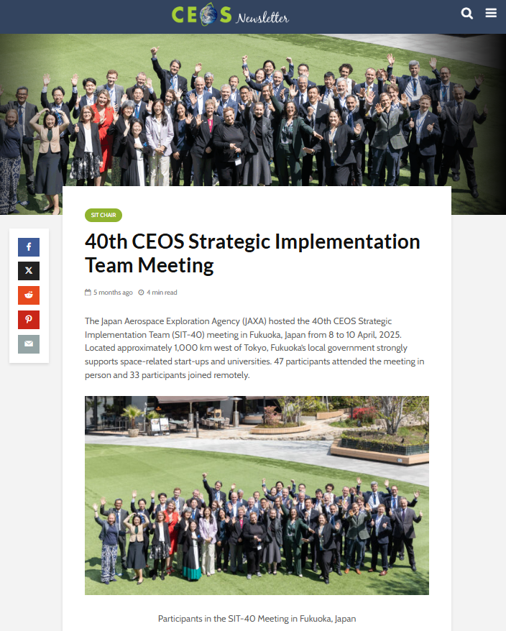
Objectives and Audience
  Target audiences
                Users and stakeholders outside CEOS
                CEOS community
  The CEOS Newsletter is intended not only for outreach to the EO community and other external audiences, but also for internal CEOS community, while CEOS.org/news is more externally focused.
  Topics are activities that are promoted through the multilateral cooperation of CEOS.
  Articles are expected to be posted once a month.

Slide 4
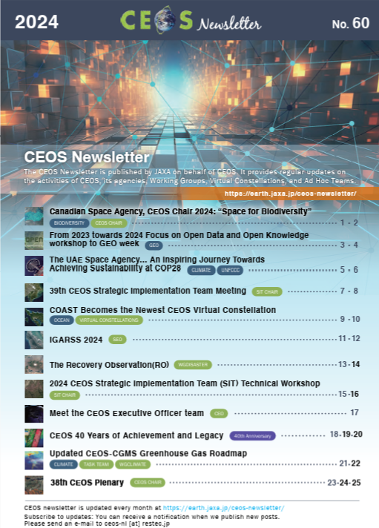
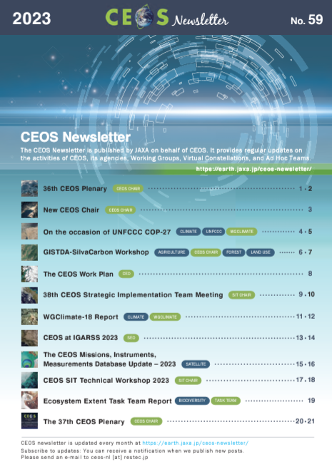
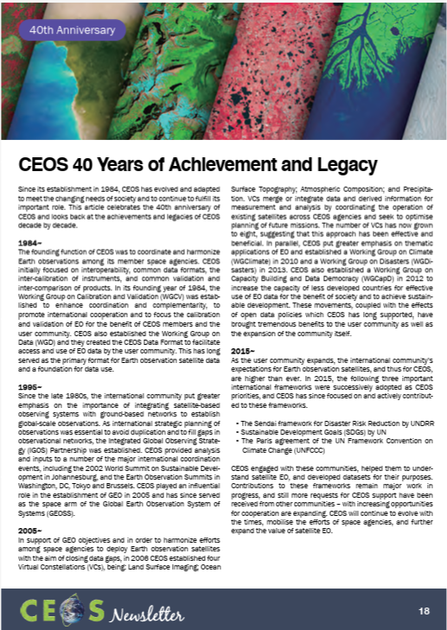

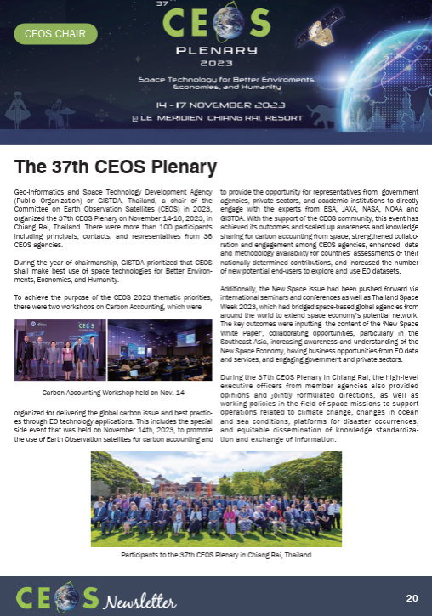
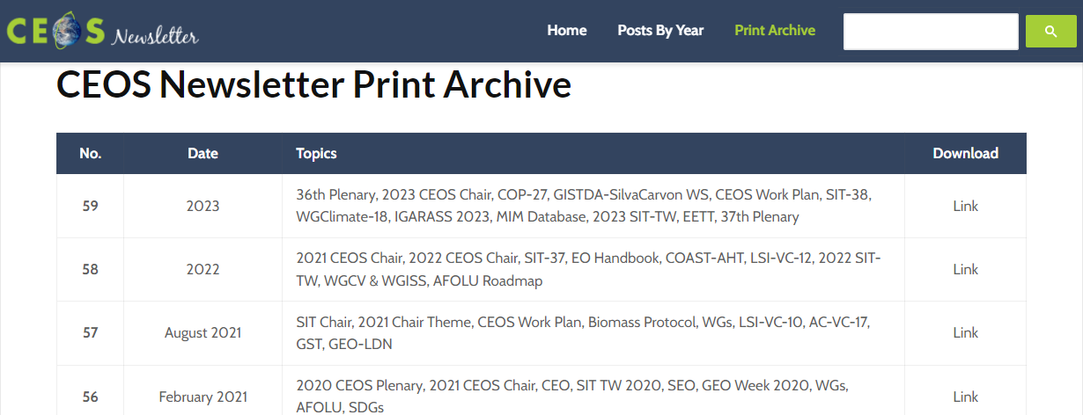
Annual Roundup
  Each year, approximately 12 articles published throughout the year are compiled into a single PDF file and posted on the website as an annual roundup article.
  The past newsletters since 1993 are also available online.

Slide 5
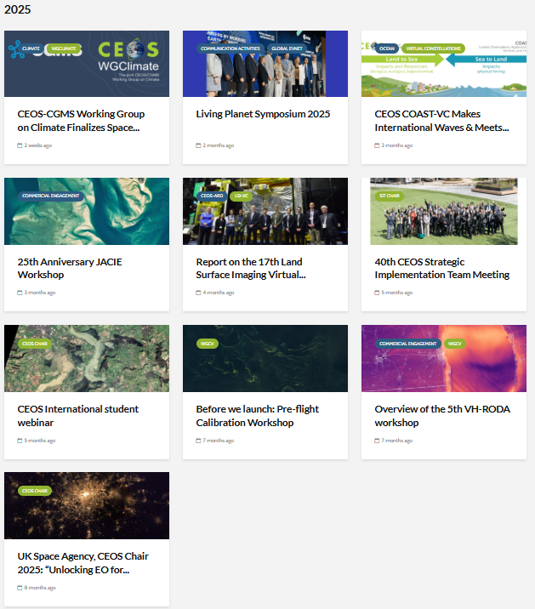
2025 Activity
  10 articles were published in 2025 including SIT-40, LPS, VH-RODA WS, UKSA International Student Webinar etc. .
  The following articles will be published in 2025.
      SIT Technical Workshop (Sep )
      39th CEOS Plenary including CEOS Youth Event (Nov)
  2025 Annual Round-up will be issued in late January 2026.

Slide 6
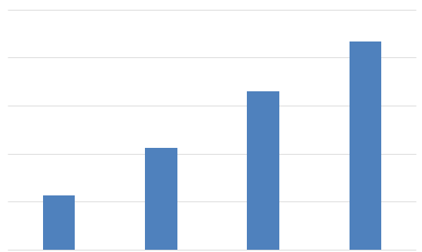
Growth in Website Visits
Trends in CEOS Newsletter website pageview
The Number of Pageview
The number of pageviews has steadily increased every year.
The total number of pageviews in 2025 (until October) has already exceeded last year's total.
25,000
20,000
15,000
10,000
5,000
0
21,692
16,489
10,667
5,689
2022
(from Mar)
2023
2024
2025
(until Oct)

Slide 7

Subscription
We notify the subscribers of new posts by e-mail.
We received subscription requests each year.
  2022 : 3
  2023 : 19
  2024 : 13
Currently, we have 170 subscribers.

Slide 8
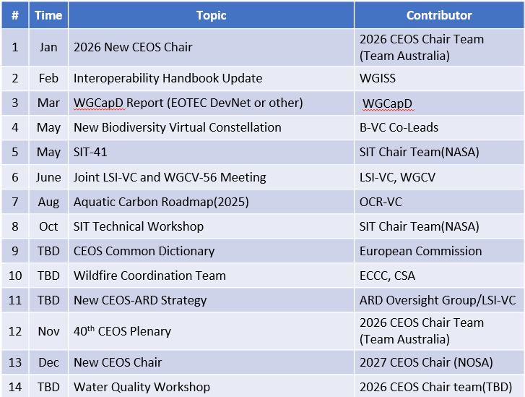
Planned Articles in 2026
  In 2026, JAXA will continue to publish articles on various topics and key events in coordination with CEOS community contributors.
  Many thanks to all who have contributed and will contribute.

Slide 9
Thank you for Attention
Ideas/Suggestions and Contribution for articles are welcome!

Slide 10
BACKUP

Slide 11
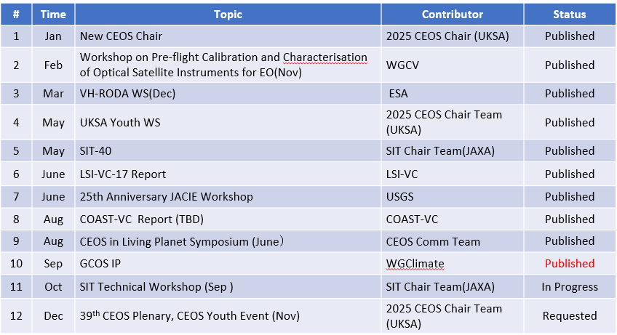
Published and Planned Articles in 2025

