Slide 1
CEOS Plenary 2025
WGISS Connected Data Assets ​
Overview​
D. Guerrucci, ESA
Agenda Item 9.4
39th CEOS Plenary
Bath, United Kingdom
4th - 6th November, 2025

Slide 2
Overview
Data Access Interest Group
Data Access Assets
Engagement and Integration Process
Contacts

Slide 3
A. Data Access Interest Group
The WGISS Data Access Interest Group (DAIG):
Ensures data users have easy and efficient ways of discovering and accessing data and associated services through the exploitation of standard protocols and the harmonising of search and data retrieval processes
Explores scenarios for a federated authentication and authorisation mechanism
By:
Constant evolution of CEOS Catalog components for demonstrating, validating and implementing new interfaces
Defining best practises and guidelines for increasing interoperability
Supporting organisations in testing and opening their catalogues
Enlargement of metadata ingestion for dataset of CEOS members
Leadership - D. Guerrucci (ESA)
Current members: CNES, CSIRO, DLR, ESA, EUMETSAT, GISTDA, ICHEC, INPE, ISRO, JAXA, NASA, UKSA, USGS

Slide 4
A. DAIG / Workplan
Current activities
Federated Authentication and Authorization White Paper definition
Connected Data Assets and Data Discovery registration (Recurrent)
Data in the Cloud (WGISS-60 Open discussion)
Cooperation with larger CEOS goals where possible…
CEOS-ARD collaboration on common topics (Data discoverability, Interconnection of access points, Data format, etc.)
STAC & Zarr, workshops and cooperation (LSI-VC, CEOS ARD, Copernicus)
Cooperation with TEIG and SEO for possible Authentication mechanism
Contribution into CEOS Common Dictionary (KCEO) for Data Access related terms

Slide 5
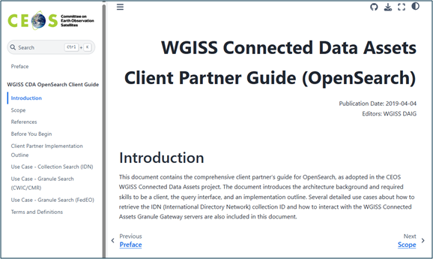
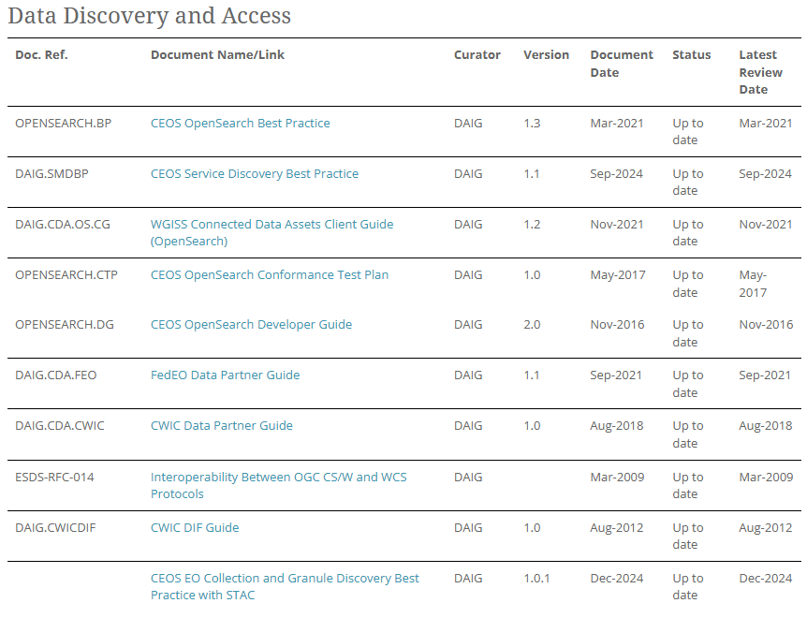
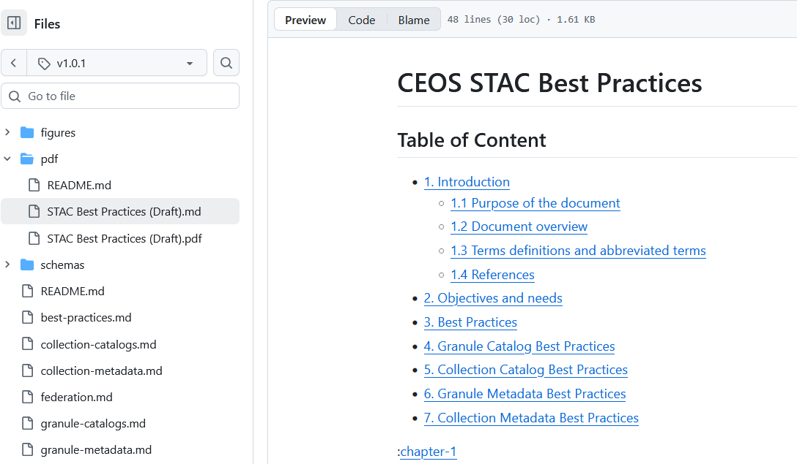
A. DAIG / Deliverables
Best Practices and Guides | CEOS | Committee on Earth Observation Satellites

Slide 6
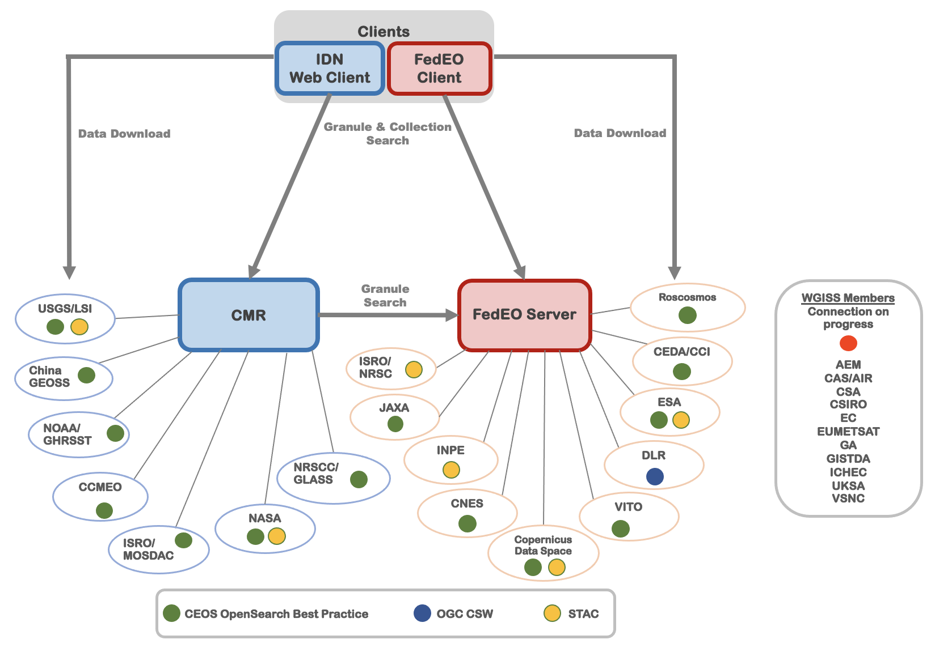
B. Data Access Assets / Architecture
Federated Earth Observation Gateway (FedEO)
D. Guerrucci (ESA), Y. Coene (Spacebel/ESA)
Provides a unique entry point to a growing number of scientific catalogues and services for EO missions.
International Directory Network (IDN)
D. Newmann (NASA), M. Morahan (KBR/NASA)
Assists researchers by providing free, online access to information on scientific datasets (metadata) in the Earth sciences domains.
The ingested metadata describes data held by university departments, government agencies, multinational organizations, and other organizations all over the world.

Slide 7
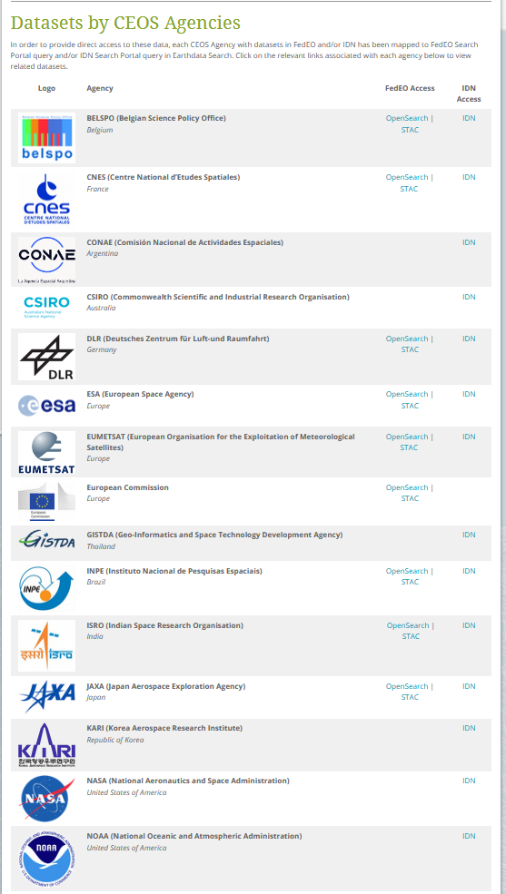
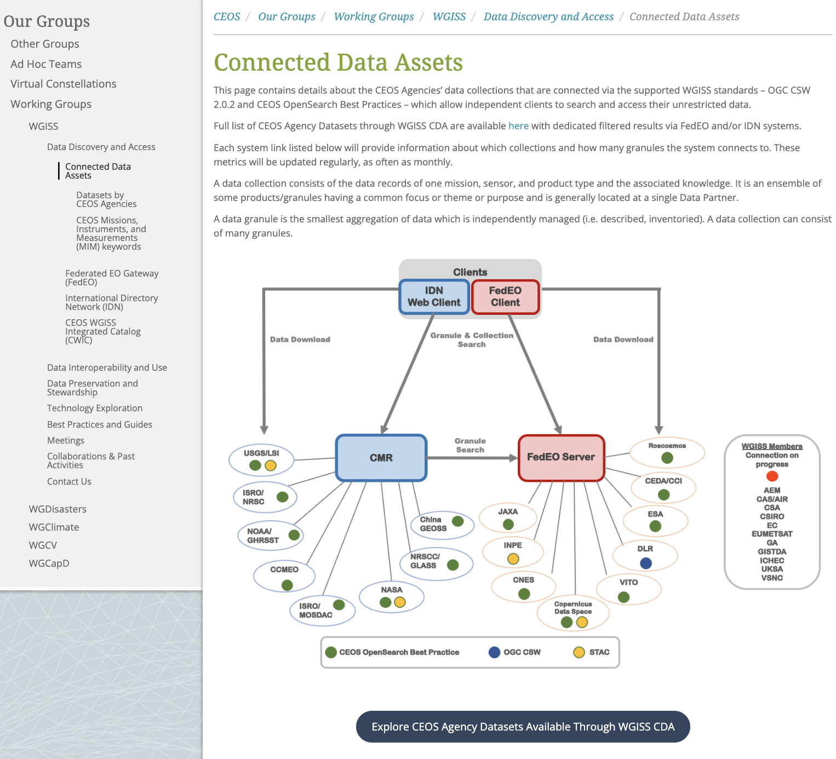
B. Data Access Assets / Website

Slide 8
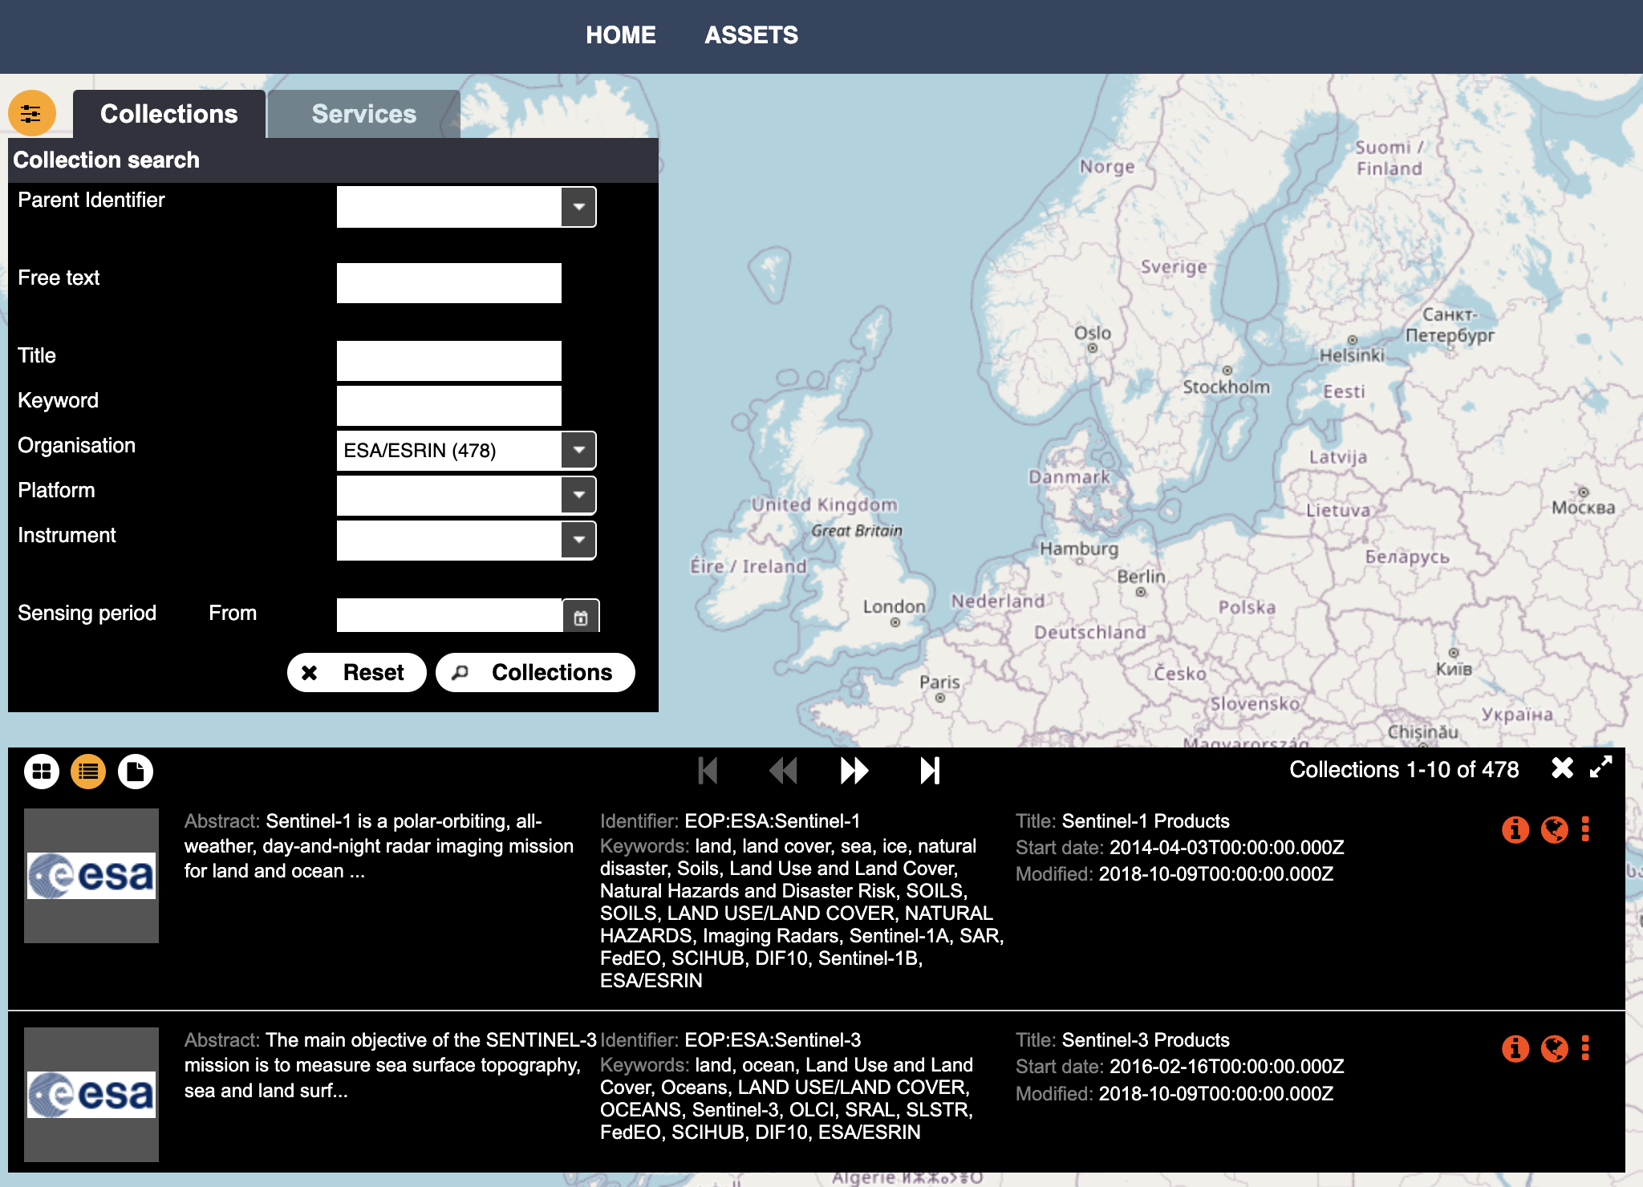
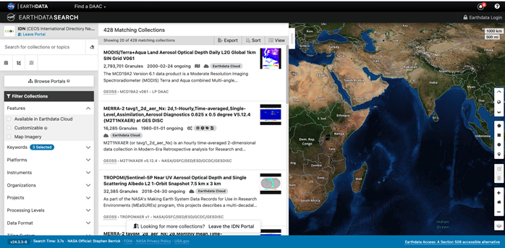
B. Data Access / Catalogue Clients

Slide 9
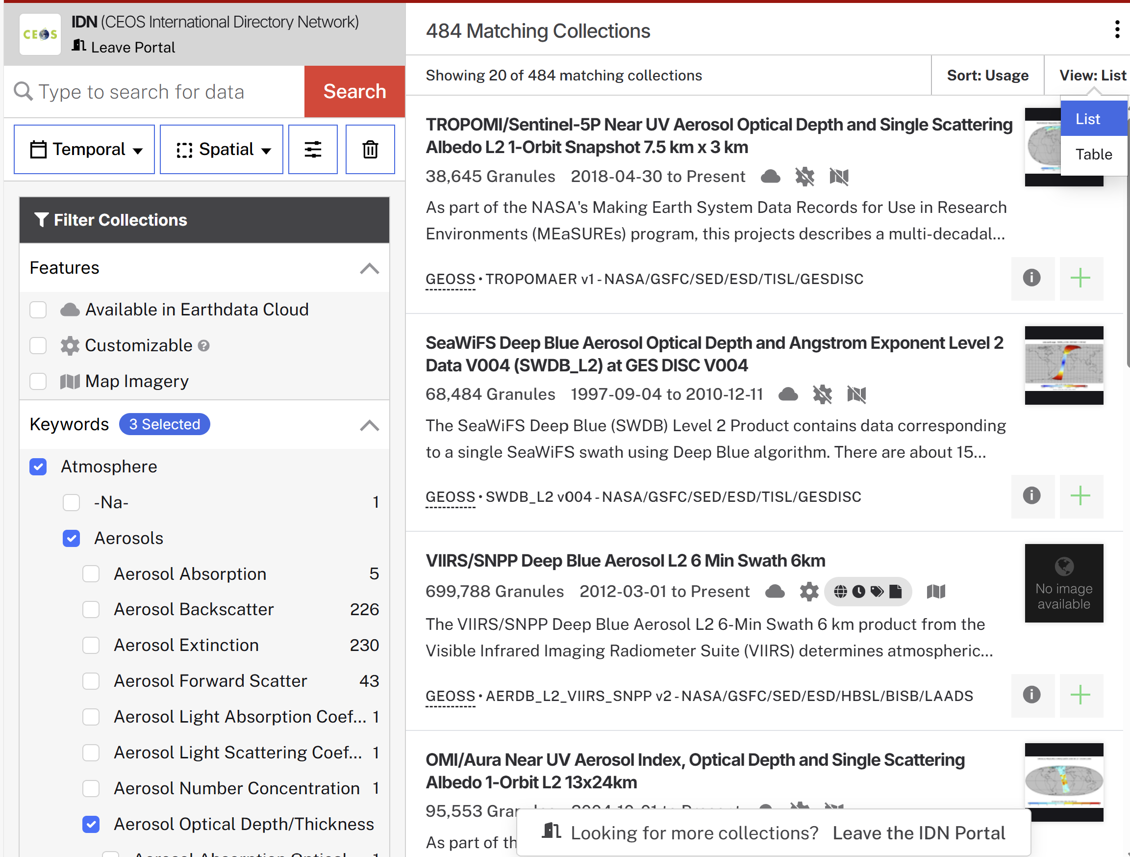
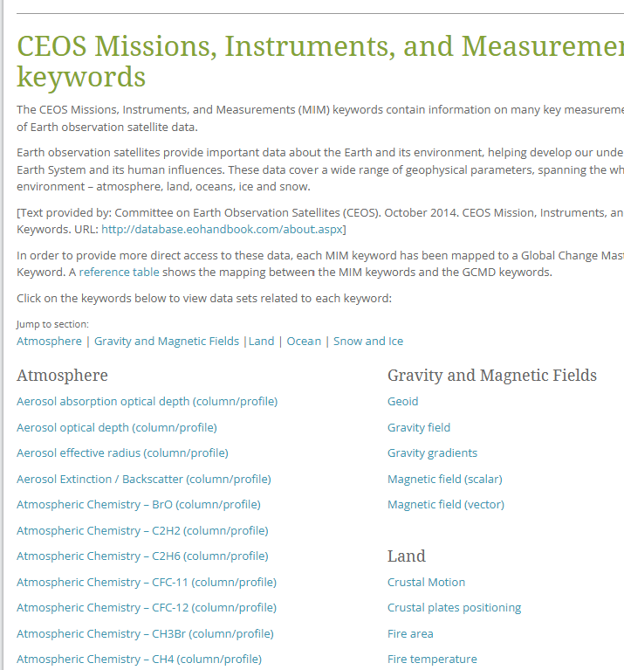
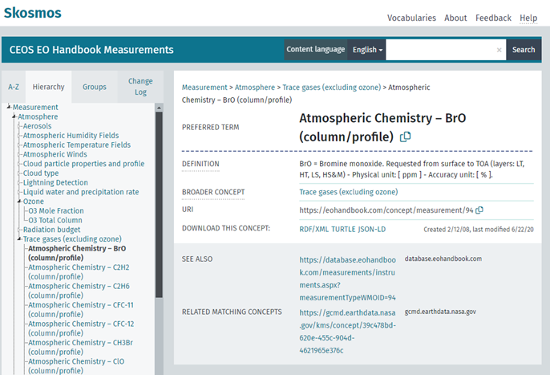
B. Keywords Management
CEOS Mission, Instruments, and Measurements (MIM) keywords from CEOS database export
Collections indexed and discoverable with CEOS MIM keywords (e.g. thematic)
MIM keywords are mapped to GCMD Science keywords to allow direct search on IDN

Slide 10



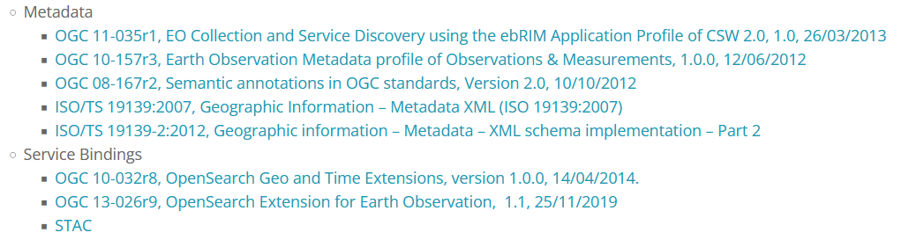
B. Data Access / Backend Interfaces
Search API to client applications, decoupled from the original backend search API
Supports:
CEOS OpenSearch Best Practices (two step search)
STAC API (including two step search and cross-collection search)
Static STAC Catalogs
Harvesting interface for CEOS IDN
Makes available interface information for all collections (incl. OpenSearch binding) in DIF10 format, e.g. to IDN
GCMD platform, GCMD instrument, GCMD science keywords compatibility

Slide 11
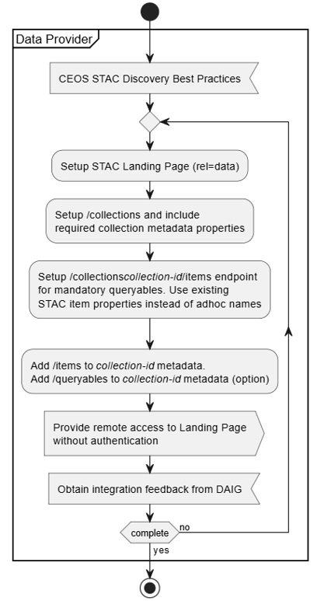
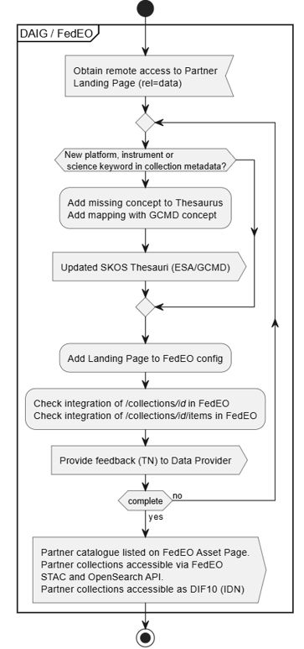
C. Integration process
(1) Partner (data owner) makes Catalogue endpoint accessible​
(2) Feedback from DAIG team to Partner about integration results and issues (if any)
(n) Iteration until ingestion completed
Once integrated, updates to contents are automatically captured by catalogues

Slide 12
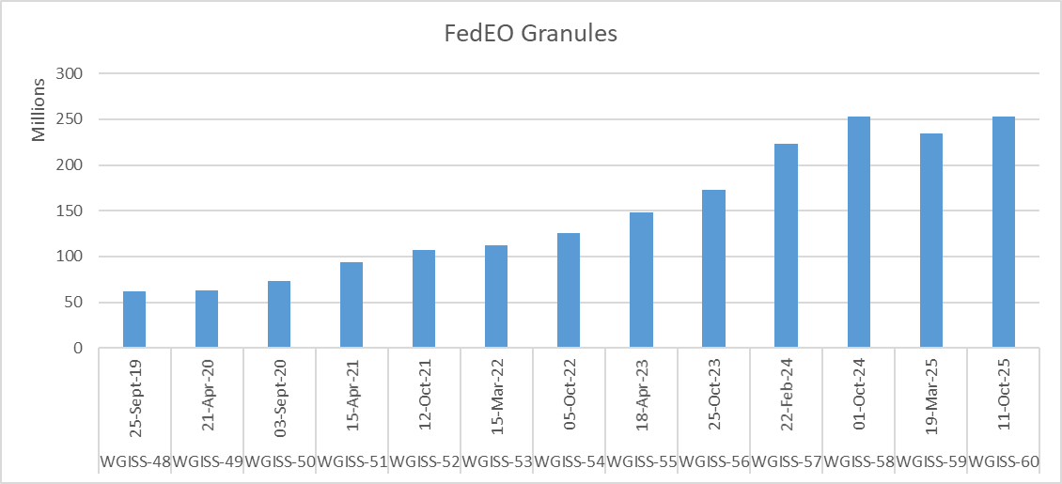
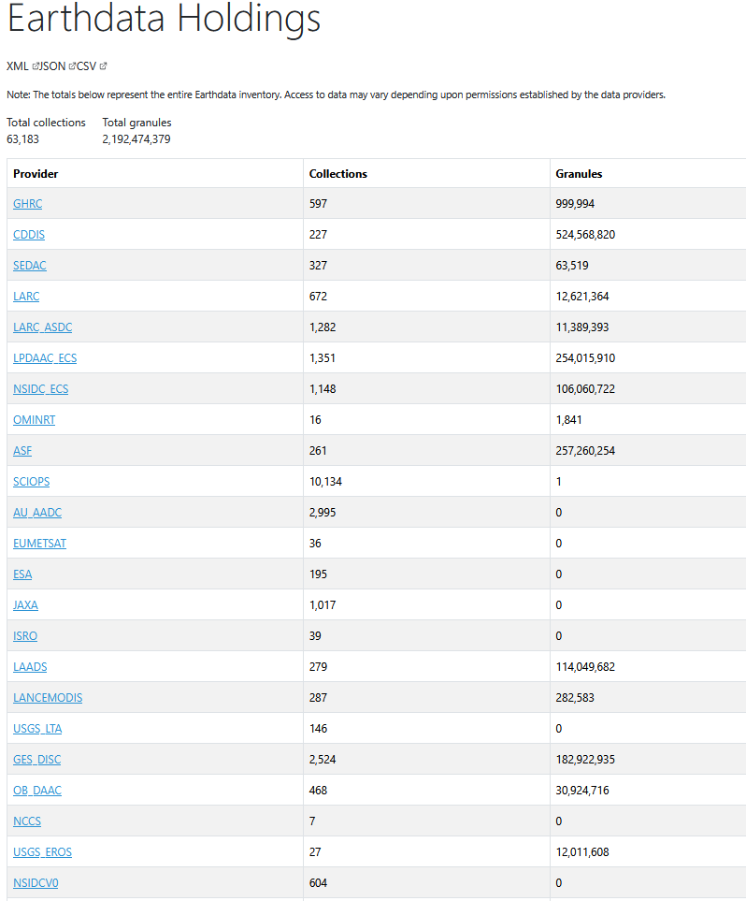
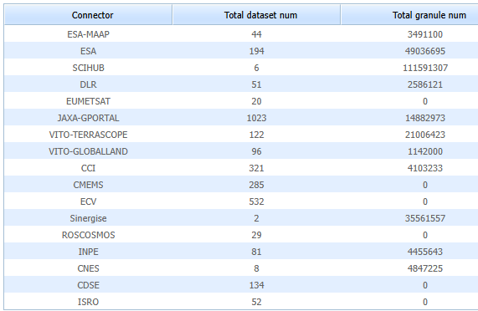
C. Continuous Integration
Granules
Collections
252 million granules (was 234 in Mar 25)*
3000 collections (was 2698 in Mar 25)
(*) not all granules can be automatically counted (e.g. CDSE).

Slide 13
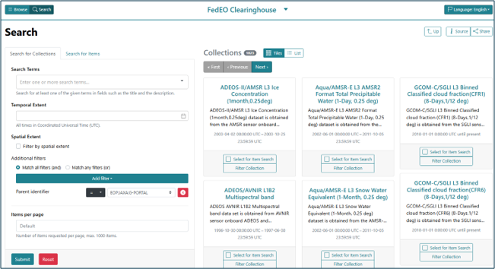
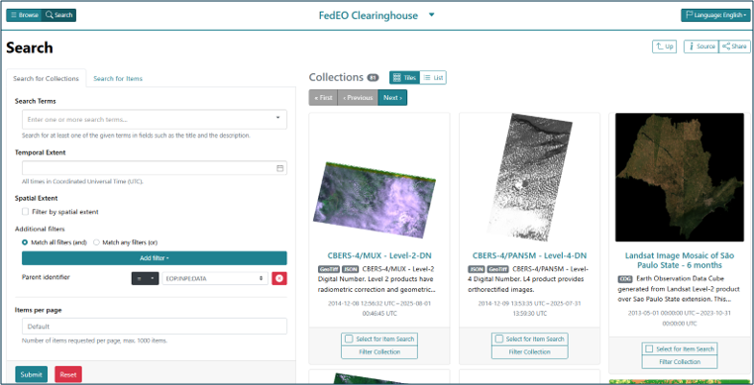
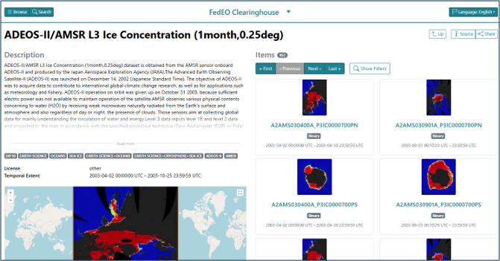
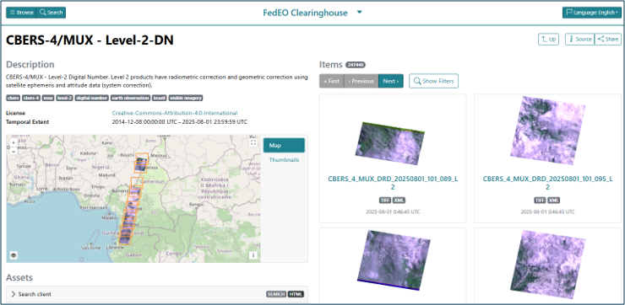
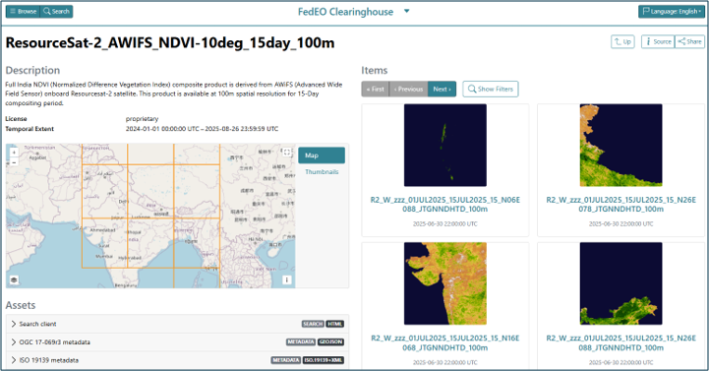
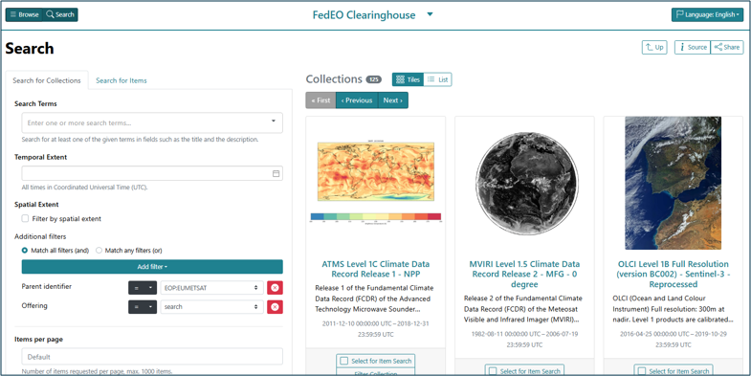
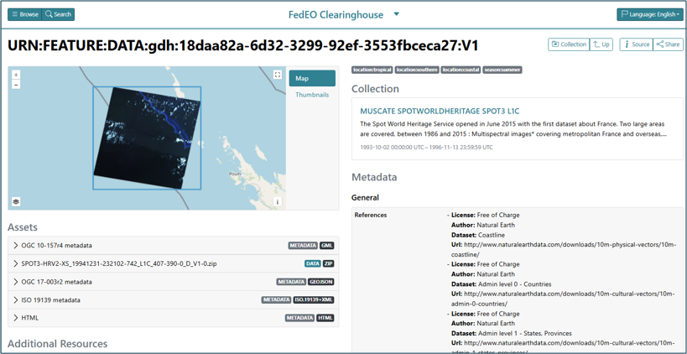
C. Some Recent Integrations
JAXA (1023)
INPE (81)
ISRO (52)
EUMETSAT (641)
CNES (48)

Slide 14
Integration Use Cases
Examples:
ESA EOCAT
ESA CCI (CEDA)
JAXA G-Portal
VITO
EUMETSAT
…
Use Case 1: OpenSearch Member Catalogue (Atom)
FedEO Server
IDN Server
Pull DIF-10 collection metadata (e.g. monthly)
Daily:
Collection OpenSearch (e.g. Atom)
Collection metadata (e.g. ISO19139-2)
Collection OSDD
Real-time (distributed):
Granule OpenSearch
Granule metadata (e.g. O&M or Atom)
WGISS Member Catalogue

Slide 15
Integration Use Cases
Examples:
INPE
Copernicus CDSE
ISRO NRSC
ESA MAAP
[ESA EOCAT]
CNES (in progress)
DLR (in progress)
CSIRO (in progress)
Use Case 2: STAC Member Catalogue
FedEO Server
IDN Server
Pull DIF-10 collection metadata (e.g. monthly)
Daily:
STAC /collections (rel=“data”)
STAC Collection metadata
Real-time (distributed):
STAC /collections/<id>/items/<id>
WGISS Member Catalogue

Slide 16
Integration Use Cases
Use Case 3: Collection Searches through FedEO
Examples:
pystac_client - https://fedeo.ceos.org/stac.html
STACBROWSER
https://fedeo-client.ceos.org/
Any OpenSearch Client
Any STAC Client
Local (enriched) collection metadata
Searchable using GCMD platform, instrument, science keywords
OSDD (OpenSearch)
STAC Collection Search Extension
FedEO Server
WGISS Member Catalogue
Collection search requests not distributed to Member Catalogue

Slide 17
C. Integration Use Cases
Use Cases: Granules Searches through CEOS Catalogue
Example Clients:
CMR (OpenSearch)
FedEO Client (OpenSearch)
pystac_client
STACBROWSER (STAC)
Any OpenSearch Client
Any STAC Client
OpenSearch
FedEO Server
STAC
Granule search requests distributed to n Member Catalogue(s) via collection-id
WGISS Member Catalogue
WGISS Member Catalogue
WGISS Member Catalogue
WGISS Member Catalogue

Slide 18

D. Contacts
Data Discovery Access Interest Group - DAIG
Access-SysTeam-Help@wgiss.ceos.org
Damiano Guerrucci
damiano.guerrucci@esa.int
Filippo Marchesi
filippo.marchesi@solenix.ch

