Slide 1
CEOS Missions, Instruments & Measurements Database
Marie-Claire Greening, ESA
Agenda Item 9.5
39th CEOS Plenary
Bath, United Kingdom
4th - 6th November, 2025

Slide 2
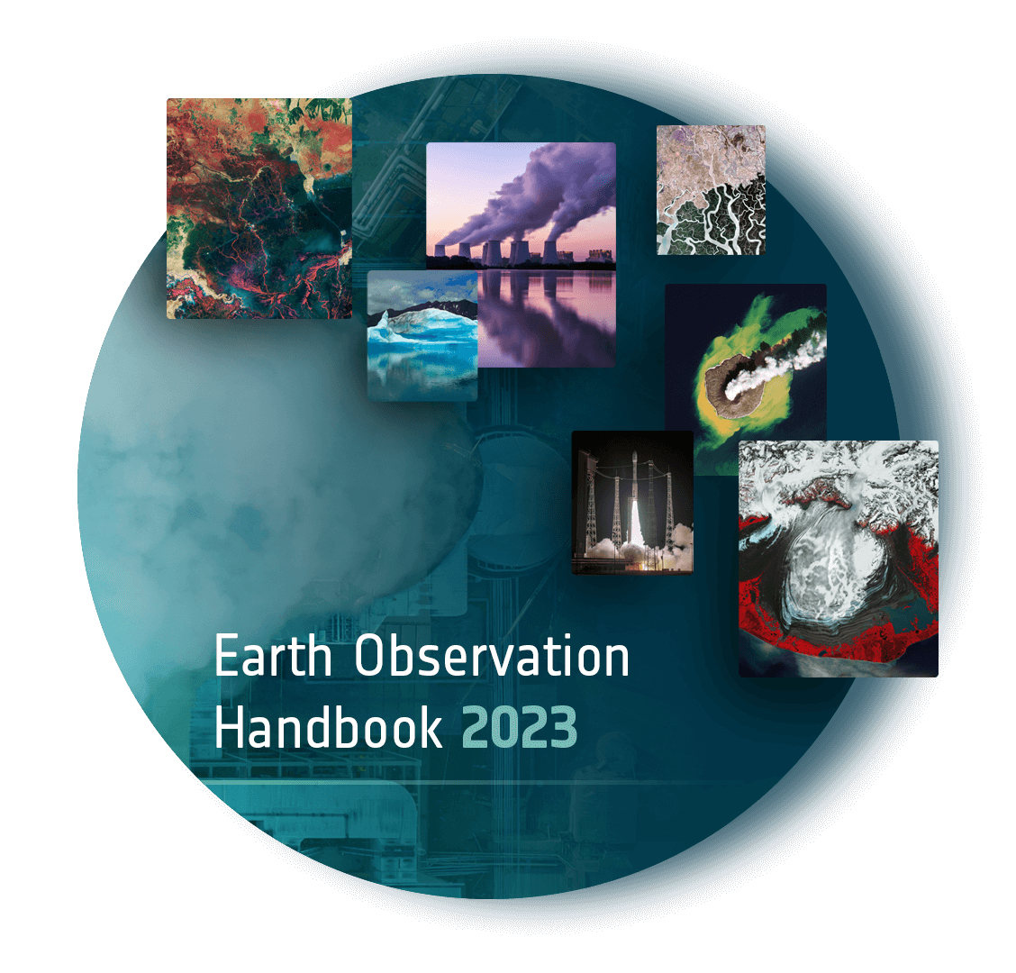
CEOS MIM Database
CEOS Work Plan item, section 3.12
Provided by ESA for CEOS for over 30 years
Supplements the EO Handbook
Most recent edition published in 2023: Space Data For The Global Stocktake
Official consolidated statement of CEOS Agency programmes and plans
Mappings from missions → instruments → measurements critical for gap analyses
Including ESA Science Strategy, NASA Decadal Survey

Slide 3
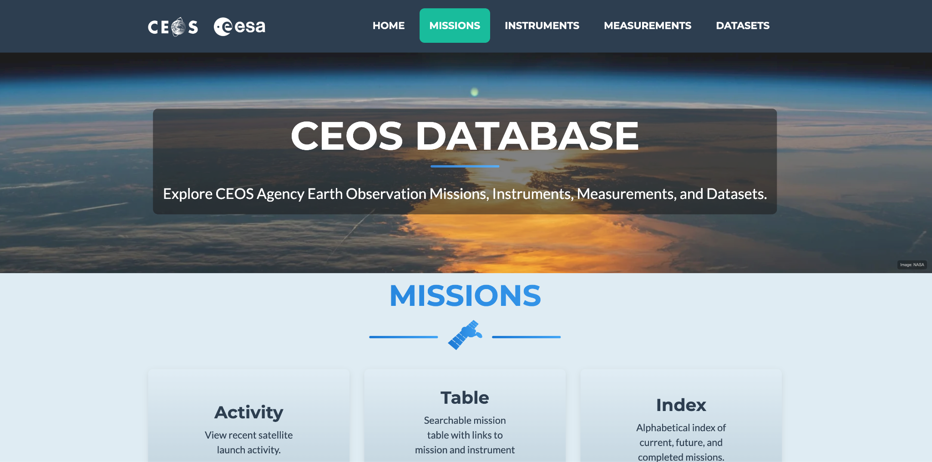
New Website Design
database.eohandbook.com

Slide 4
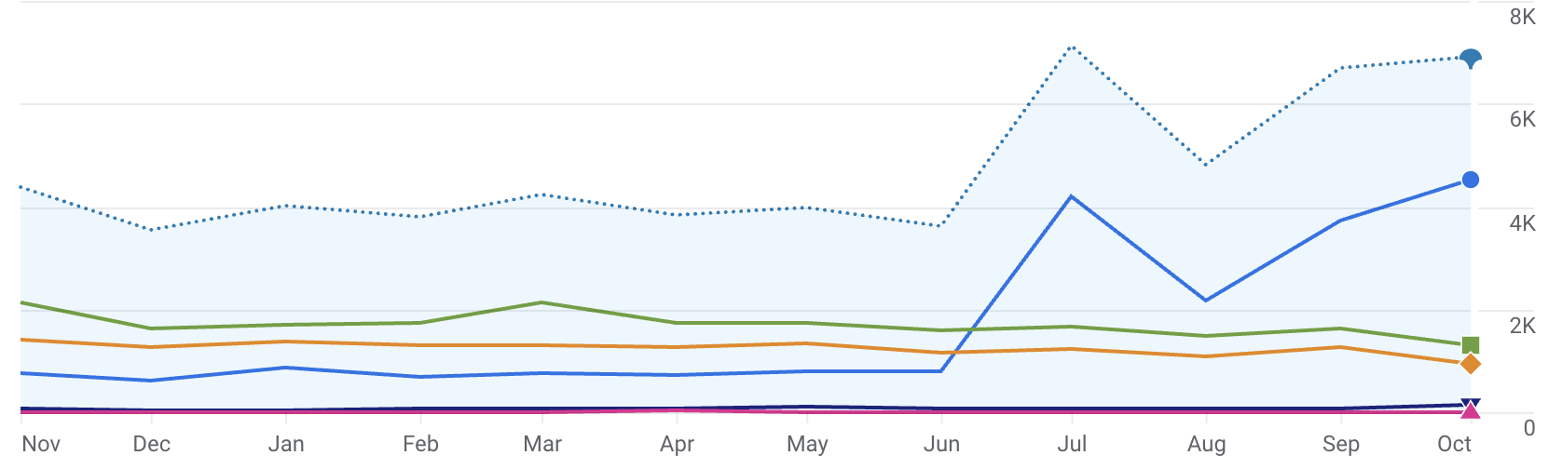
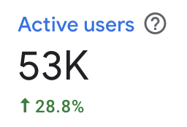
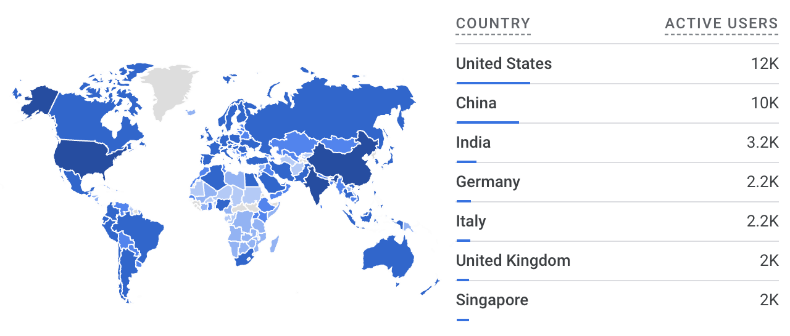
Website Audience - 2025
CEOS DB and EOHB websites combined
Total users since Nov 2024: 53k
Monthly Users Nov 2024 - Oct 2025
Growing global audience

Slide 5
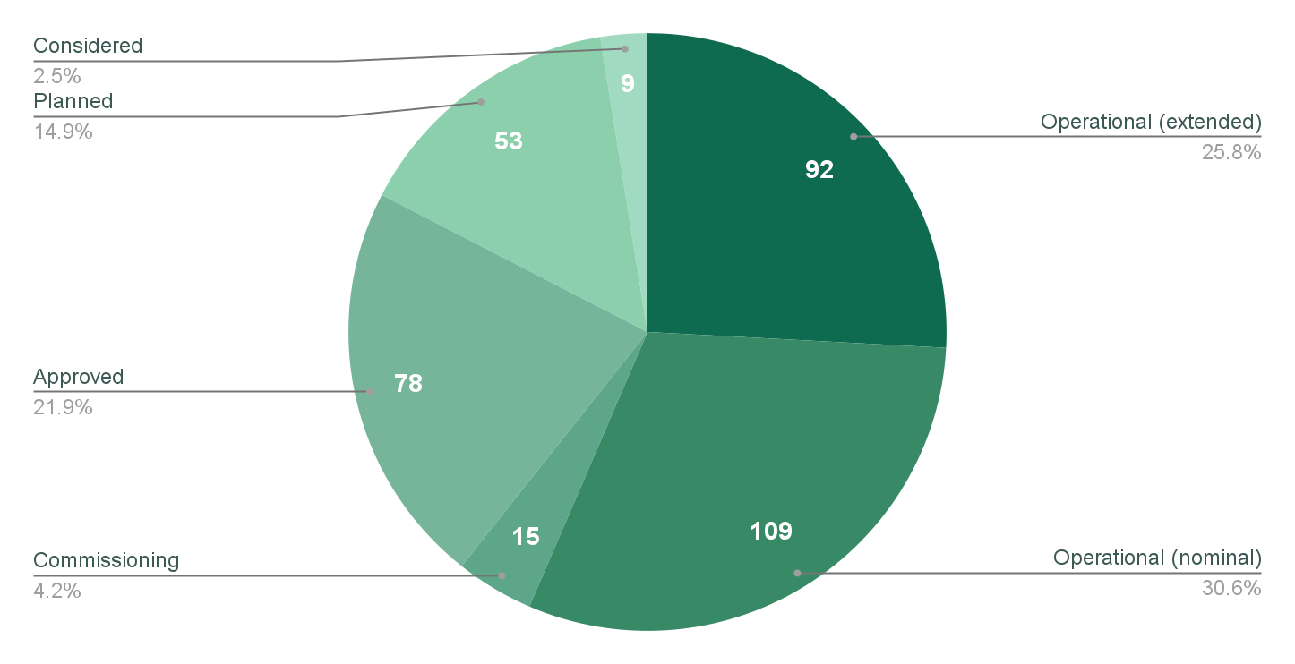
2025 Survey
Annual Survey of CEOS Members critical to providing an accurate statement of programmes and plans
Updates received from 33/40 agencies contacted (82.5%)
New missions added include:
ISRO: G20 Satellite
KARI: GEO-KOMPSAT-5
NASA/DLR: GRACE-C
Total Current: 216
Total Future: 140
Notes:
Input from China on the Met missions, but welcome additional inputs on other Chinese missions

Slide 6
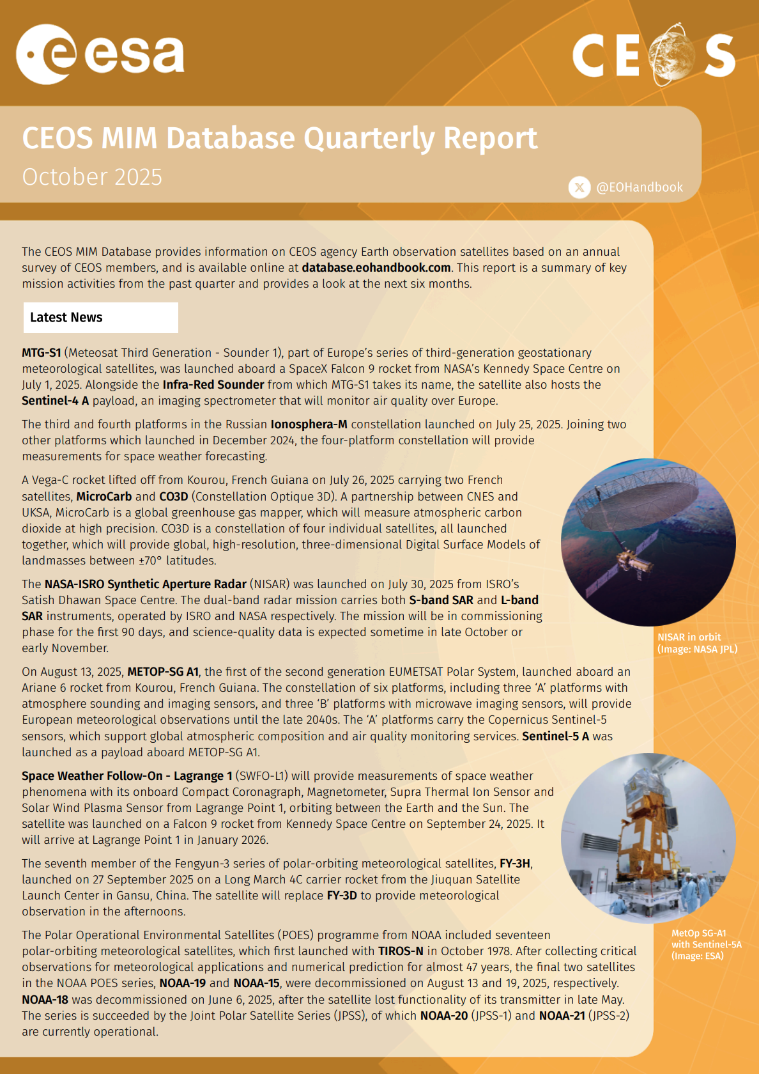
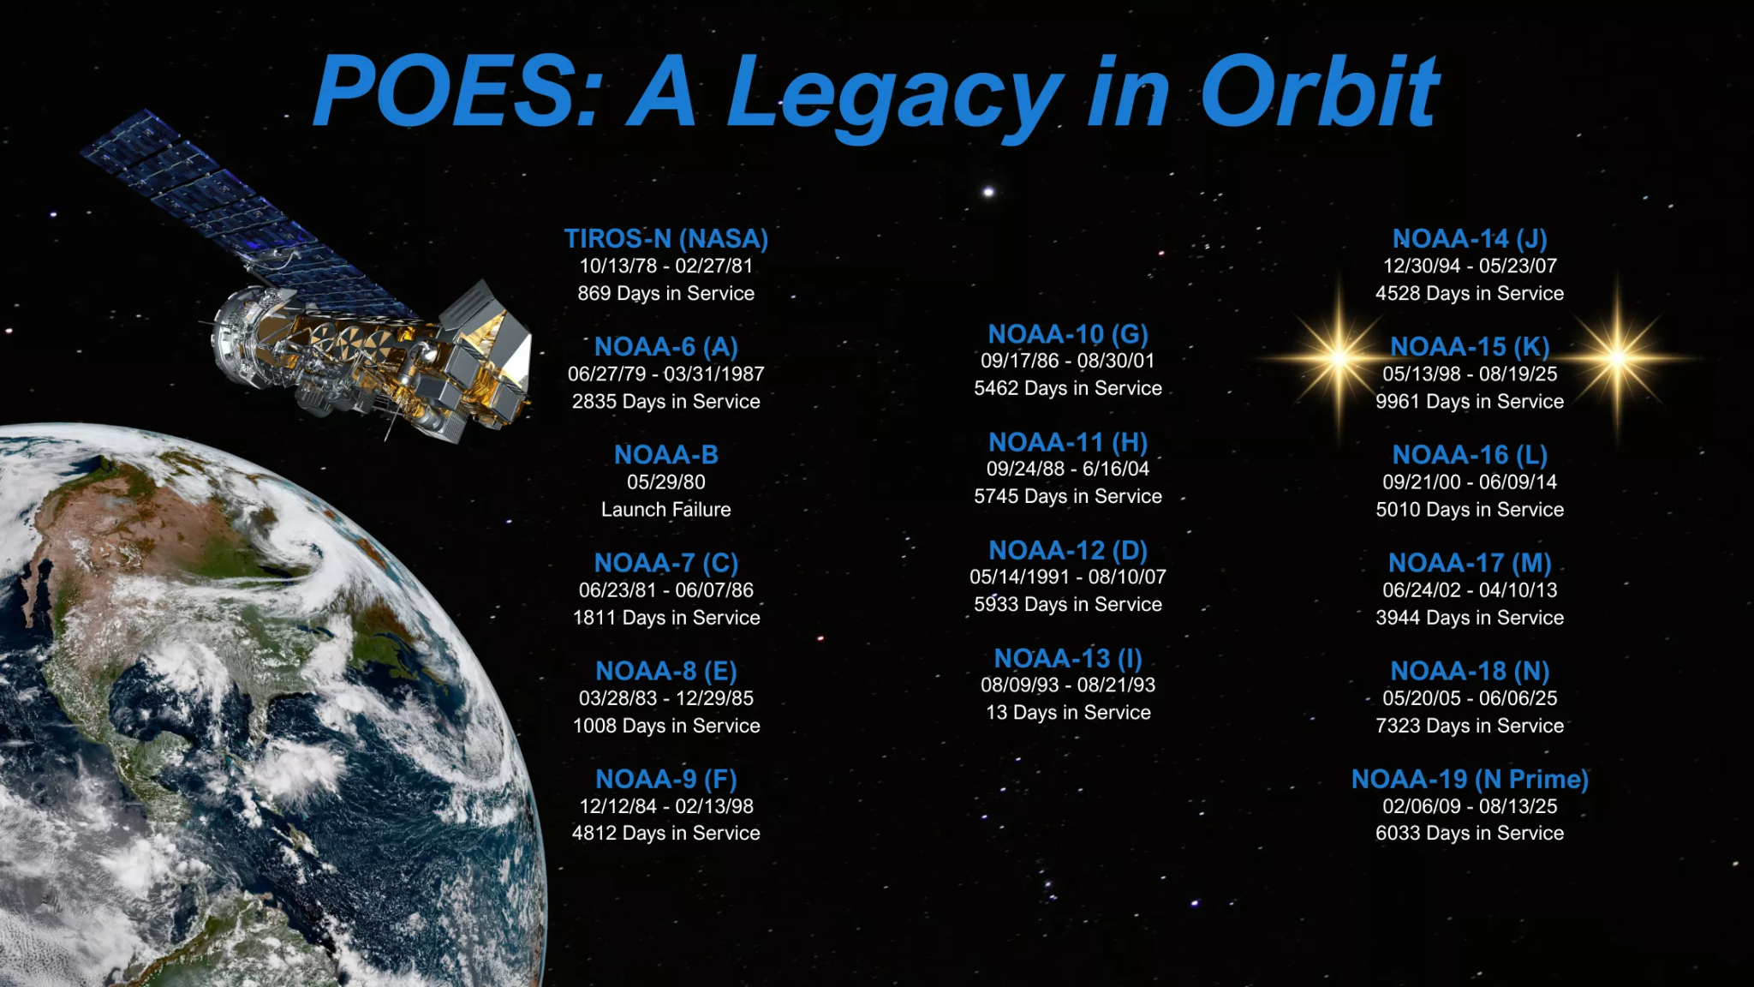
Quarterly Reports
Latest news and upcoming launches
Q3 2025 Report Published 20 Oct 2025
11 launches!
Plus the decommissioning of the final two satellites which make up the 47 year NOAA POES mission series
Report archive available at ceos.org/mim-reports-archive
Shared with WMO OSCAR/Space colleagues for their review and alignment

Slide 7
2025 CEOS Agency Launches
15 CEOS Agency launches to date in calendar 2025
11 further launches forecast for 2025 in the database
Last 3 years:
2024: 16
2023: 12
2022: 20
November | Sentinel-1D
September | FY-3H (NSMC-CMA / CNSA), SWFO-L1 (NOAA / NASA), Ionosphera-M N3 and N4 (ROSKOSMOS / ROSHYDROMET), METOP-SG A1 (EUMETSAT / DLR / COM / CNES / ESA), Sentinel-5 A (ESA / EUMETSAT / COM), MTG-S1 and Sentinel-4 A (EUMETSAT / COM / ESA)
July | CO3D (CNES), MicroCarb (CNES / UKSA), NISAR (NASA / ISRO)
June | GOSAT-GW (JAXA / MOE (Japan) / NIES (Japan))
April | Biomass (ESA)
January | NorSat-4 (NOSA / NDRE)
Forecast Launches:
November | HydroGNSS, Sentinel-6 B, KOMPSAT-7, HY-2E, HY-2F, Daqi-2, FORMOSAT-8
December | COSMO-SkyMed SG 3, Oceansat-3A, Elektro-L N5, THEOS-2 SmallSat

Slide 8
OSCAR
Clear adjacency - different mandates and constituencies
Continuing periodic correspondence with the OSCAR team
Sharing information and the updates from the quarterly report process

Slide 9
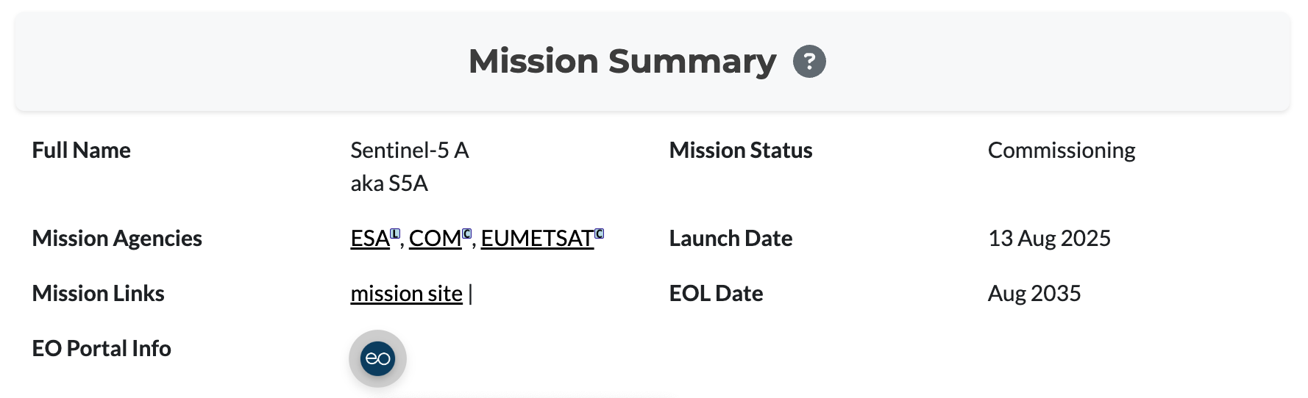
EO Portal
eoportal.org
EO Portal metadata powered by the CEOS Database
Independent ‘sister site’ - with more in depth information about the missions, in particular spacecraft and instrument structure
Scope of EO Portal broader than CEOS Database - includes information about commercial and non-governmental missions alongside CEOS Agency missions

Slide 10
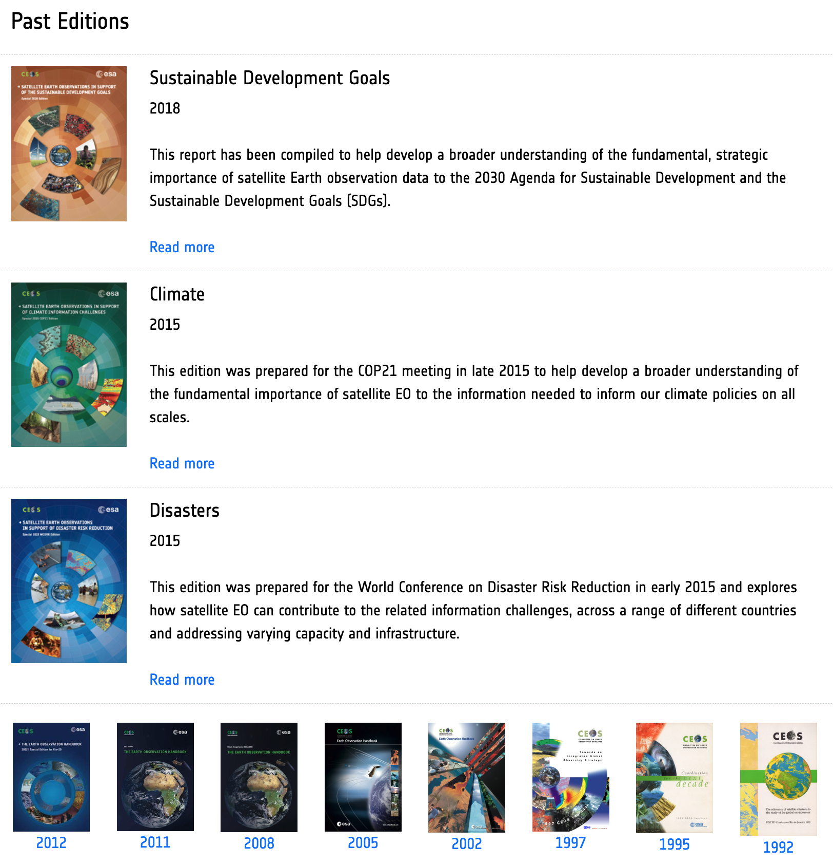
EO Handbook Archive Updates
Full PDF archive is now available: eohandbook.com
Thanks to GA for digitising the oldest editions in 2025!
12 EO Handbooks published over 33 years

