Slide 1
CEOS Plenary 2025
NASA SIT Chair Priorities
Julie Robinson
Erin Urquhart
Eleanor Pierel
39th CEOS Plenary
Bath, United Kingdom
4th - 6th November, 2025

Slide 2
NASA SIT Chair Priorities
Priority 1: Water Planet- Seeing Earth's Water from Space
Advance understanding of Earth's water cycle by monitoring terrestrial waters, coastal regions, and oceans from space. Transform this knowledge to actionable insights to enhance water use efficiency, improve water quality, and enhance resilience to water-related hazards such as droughts, floods, and storms.
Priority 2: Connected Data for Community Resilience
Advance community-level resilience by leveraging CEOS disaster risk reduction successes and partnerships to enhance cross-collaboration, data interoperability, and actionable information.

Slide 3
Priority 1: Water Planet
Erin Urquhart​
39th CEOS Plenary​
Bath, United Kingdom​
4th - 6th November, 2025

Slide 4
NASA SIT Chair Priorities
Priority 1: Water Planet- Seeing Earth's Water from Space
Advance understanding of Earth's water cycle by monitoring terrestrial waters, coastal regions, and oceans from space. Transform this knowledge to actionable insights to enhance water use efficiency, improve water quality, and enhance resilience to water-related hazards such as droughts, floods, and storms.
Priority 2: Connected Data for Community Resilience
Advance community-level resilience by leveraging CEOS disaster risk reduction successes and partnerships to enhance cross-collaboration, data interoperability, and actionable information.

Slide 5
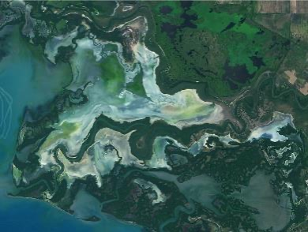
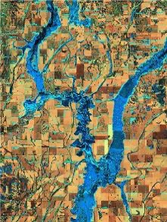
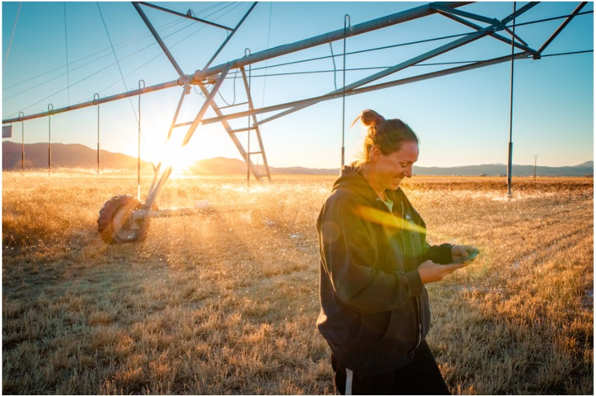
SIT Chair Priority 1: Water Planet
Water Planet- Seeing Earth's Water from Space
Water is fundamental to life on Earth yet increasing pressures on global water resources—combined with rising exposure to water-related extremes such as droughts and floods—demand innovative solutions to ensure a sustainable future. ​
Satellite observations play a critical role in advancing our understanding of the water cycle and monitoring changes over time. These observations provide essential data needed to address challenges in water availability, accessibility, quality, and hazards. ​

Slide 6
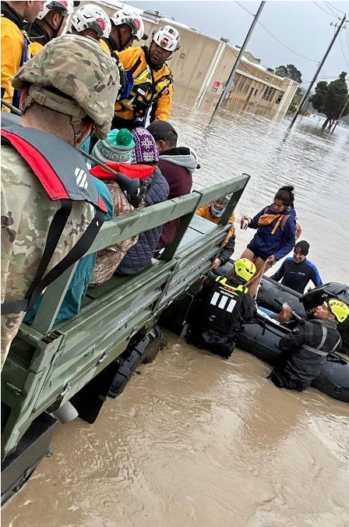

SIT Chair Priority 1: Water Planet
By integrating the capabilities of legacy and new missions, this priority focuses on delivering tailored water data and information designed to support research, inform water management decisions, and enhance preparedness for water-related hazards at a global scale.
CEOS offers valuable assets and collective strength to deliver multisource, integrated data and a user-driven approach to address Earth’s most pressing water challenges.

Slide 7

Priority 1: Key Objectives
Coordinated Water Observations
Accessible and Interoperable Water Data Products
User-Center Solutions for Water Challenges
Assessment of Socio-Economic Benefits

Slide 8
Priority 1: Water Planet
Key Objective 1: Coordinated Water Observations
Strengthen coordination across CEOS Agencies to promote the acquisition, integration, and delivery of diverse water-related data through a multisource, integrated approach to improve understanding of the global water cycle and deliver impactful water solutions through collective efforts:
Perform gap analyses to assess priority data needs, adequacy of existing cal/val infrastructure, and address observational gaps across CEOS.
Provide guidance on combining multiplatform and multispectral data for improved water variable derivation, accuracy, and application impact.
Noting CEOS Strategy for Water Observations from Space, 2015

Slide 9
Priority 1: Water Planet
Key Objective 2: Accessible and Interoperable Water Data Products
Enhance, align, and share open-access, interoperable CEOS analysis-ready (ARD) water products to support research, decision-making, and resilience-building efforts across diverse stakeholder groups:
Collaborate with agency and partner initiatives such as OpenET, AquaWatch, CyAN, and GEOGLOWS to co-develop decision-ready water products that address challenges such as water scarcity, water quality, and water-related hazards.
Build on existing user needs assessments across CEOS to identify shared applications requirements, Level 3-4 product needs, and address any ARD data gaps for water.
Contribute a water thematic section to updated CEOS-ARD strategy (in collaboration with CEOS Chair).

Slide 10
Priority 1: Water Planet
Key Objective 3: User-Centered Solutions for Water Challenges
Co-develop tailored solutions using Earth observation data to address pressing water challenges such as water scarcity, degraded inland and coastal water quality, and related hazards:
Align and promote EO driven tools such as early warning/forecasting systems for droughts, floods, declining groundwater, reduced streamflow, and degraded water quality, while emphasizing CEOS's collective strength in delivering impact.
Provide resources and training opportunities for EO water observations and applications in coordination with the CEOS Chair proposed Water Quality Workshop.
Co-develop guidance for scaling and transitioning EO data into actionable water solutions to better support impactful, water resilience-building efforts across regions and sectors.
“CEOS Strategy for Water Applications from Space”

Slide 11
Priority 1: Water Planet
Key Objective 4: Assessment of Socio-Economic Benefits
Demonstrate the socio-economic impact of Earth observations and CEOS collaboration by showcasing tangible benefits, such as cost savings, improved decision-making, and enhanced water resilience at multiple scales:
Survey sector-specific impact assessments to deepen understanding of socio-economic benefits derived from existing CEOS water and resilience activities, identify lessons learned, and enhance the value of CEOS assets.
Evaluate socio-economic benefits across sectors (e.g., agriculture, resource management, fisheries, ecosystems, and industry) to inform future strategies and guide investments.
Co-develop use cases demonstrating the application of EO water data in community resilience activities, with a focus on mitigating water-related hazards and improving community outcomes (with Priority 2 Team).

Slide 12
Priority 1: Deliverables
Impact Assessment Report on CEOS Water and Resilience Activities (in collaboration with Priority 2 Team)
Best Practice Guidance on Combining Multiplatform and Multispectral Data
Contribute a water thematic section to updated CEOS-ARD strategy (in collaboration with CEOS Chair)
Stakeholder Engagement & Capacity Building Initiatives
Water Quality Workshop (co-led with CEOS Chair; 2026)
Best Practice Guidance for Scaling and Transitioning EO Data Into Actionable Water Solutions
Use Cases Illustrating Socio-economic Benefits and Applicability of Satellite-based Water Solutions Across Regions and Sectors
Notes:
Best Practice Guidance on Combining Multisource Data: Develop comprehensive best practice guidance for combining optical and SAR (Synthetic Aperture Radar) data to derive critical water variables. Include integration protocols for multisource datasets as part of an integrated water observatory framework.
Establish and promote a roadmap for the development of a multisource integrated water observatory. This will support the seamless integration of past, present, and future observational missions, combining diverse datasets to improve understanding of the global water cycle over time.
CEOS Analysis-Ready Data (ARD) for Water Strategy and Implementation Plan: Create and deploy a CEOS-ARD for water strategy and implementation plan to guide the delivery of interoperable, open-access water data and products tailored to user needs. Include standards for analysis-ready datasets that integrate optical, SAR, and other satellite data to support global and regional water cycle monitoring.
Stakeholder Engagement Initiatives: Strengthen collaboration with OpenET, AquaWatch, CyAN, GEOGLOWS, and other partners through joint projects and stakeholder forums. Develop pilot projects to test tailored applications, such as water information systems or hazard monitoring tools, with direct community involvement.
Water Quality Workshop for Community and Stakeholder Engagement: Co-host a water quality-focused workshop, providing education and resources to increase community uptake of satellite-based data and solutions. Engage key stakeholders to develop clear application guides and materials aimed at enhancing water quality monitoring and decision-making.
Best Practice Guidance for Transitioning EO Data into Actionable Water Solutions: Provide guidance on leveraging Earth observation data to create decision-focused solutions for resilience to water-related hazards.
Use Cases Demonstrating Socio-Economic Benefits Across Sectors and Regions: Develop sector-specific and regional use cases that illustrate the socio-economic benefits of satellite-based water variables. Focus areas could include agriculture, emergency response, transportation, insurance, natural resource management, and energy. Demonstrate the applicability and value proposition of satellite-based water information by showing tangible socio-economic impacts. They bridge the gap between raw data or models and actionable solutions—helping a wide range of stakeholders understand the data's relevance and usability.

Slide 13
Priority 1: Deliverables Timeline
Seeing Earth’s Water from Space
SIT TW
2025
Plenary
2025
SIT-41
SIT TW
2026
Plenary
2026
SIT-42
SIT TW
2027
Plenary
2027
Objectives
Gap analysis of water variables
Adequacy assessment of in-situ networks and cal/val infrastructure
Coordinate and promote multisource integrated water observatory products
Develop guidelines on integrating multiplatform & multispectral sensing to derive water variables.
Coordinated Water Observations
Accessible & Interoperable Water Data Products
Collect specific data needs and requirements for water applications
Advance CEOS-ARD for water
Enhance interoperability of multisource integrated water products
Align and promote user-driven tools for water resource management and resilience
Promote and coordinate resources & training opportunities on EO for water
User-centered Solutions for Water Challenges
Develop guidelines and best practices on transition of EO data into actionable water solutions
Assess socio-economic benefits
Impact assessment of existing CEOS activities related to water and resilience (with Priority 2)
Assess the socio-economic benefits of EO-based water variables (e.g., through use cases) for specific regions, sectors, and challenges

Slide 14
Priority 1: Initial Steps
Develop a Water Planet 2-pager to summarize intent and invite CEOS member participation.
Catalog ongoing opportunities and identify new activities to coordinate efforts across agencies and CEOS WG/VCs to strengthen implementation of Water Planet via an impact assessment questionnaire in coordination with Priority 2 Team.
Create, disseminate, and kick-off Water Planet Roadmap.
Prepare SIT-41 Water Planet activities & Water Quality Workshop in coordination with the CEOS Chair.

Slide 15
Priority 2: Connected Data for Community Resilience
Eleanor Pierel
39th CEOS Plenary​
Bath, United Kingdom​
4th - 6th November, 2025

Slide 16
Proposed NASA SIT Chair Priorities
Priority 1: Water Planet- Seeing Earth's Water from Space
Advance understanding of Earth's water cycle by monitoring terrestrial waters, coastal regions, and oceans from space. Transform this knowledge to actionable insights to enhance water use efficiency, improve water quality, and enhance resilience to water-related hazards such as droughts, floods, and storms.
Priority 2: Connected Data for Community Resilience
Advance community-level resilience by leveraging CEOS disaster risk reduction successes and partnerships to enhance cross-collaboration, data interoperability, and actionable information.

Slide 17
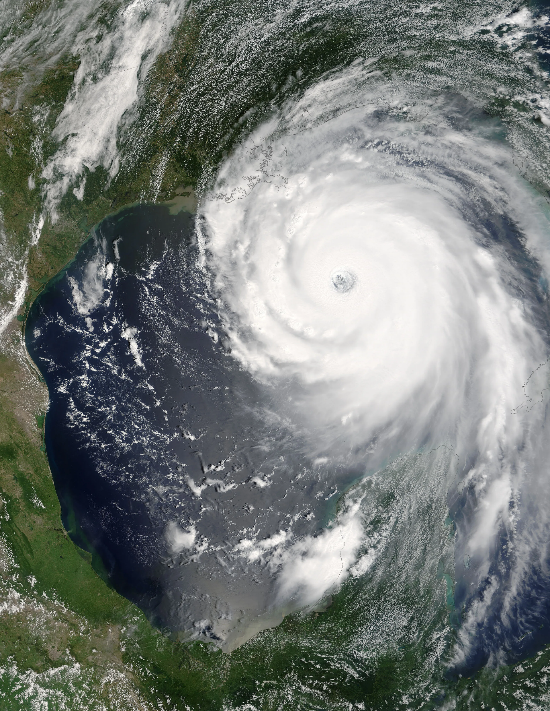
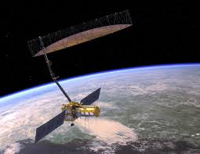
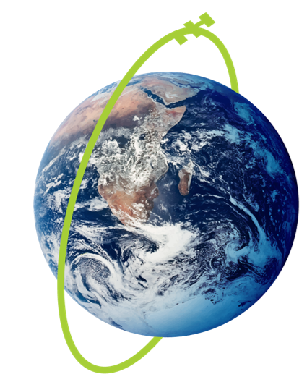
SIT Chair Priority 2
Connected Data for Community Resilience
CEOS works across a data-driven value chain, from observations to impact.
Increasing extreme weather events and disasters demand enhanced support to community resilience
Growing data volume, variety, and complexity require improved coordination and data fusion
In response, CEOS will advance existing capabilities and provide actionable information to support community-level resilience

Slide 18
Priority 2: Key Objectives
Understand and enhance cross-CEOS collaboration towards impactful data value chain
Assess impact of existing activities and end user requirements to build community resilience
Enhance existing interoperability efforts to address data user needs
Improve capabilities to deliver actionable information built on resilience community input
Impacted communities
Resilience data partners
CEOS
WGs
VCs
Co-develop

Slide 19
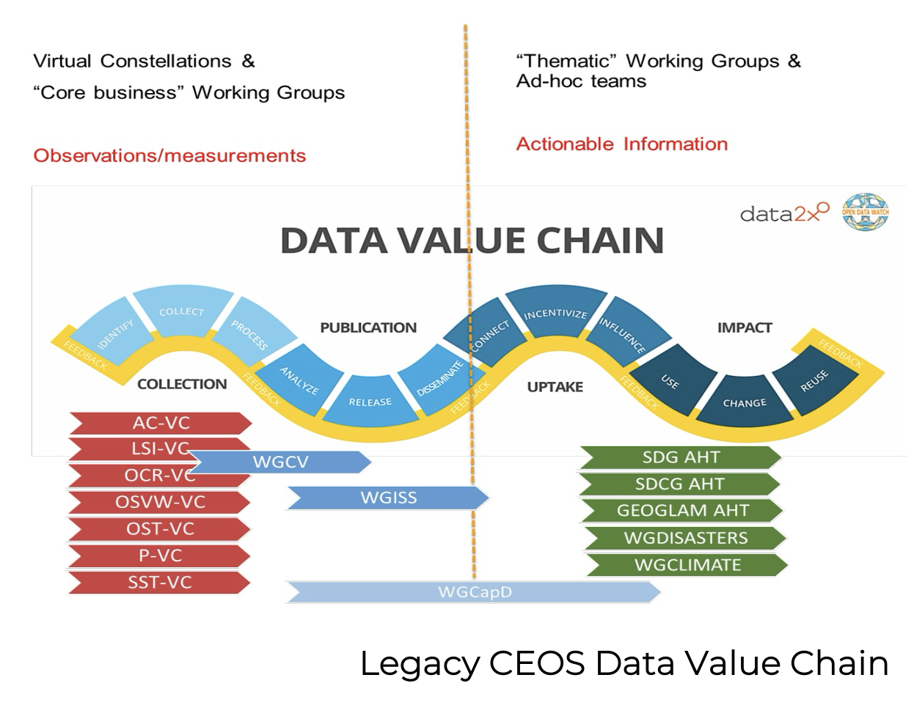
Priority 2: Connected Data for Community Resilience Key Objectives – Detail
Key Objective 1: Understand and enhance cross-CEOS collaboration towards impactful data value chain
Leverage the existing CEOS expertise to collaborate across CEOS WGs and VCs​
Lead the delivery of connected data for community resilience products including:​
The impact assessment of existing activities and opportunity lessons learned report​
Improved data value chain to include co-development​
Interoperability demonstrator
Resilience Data Partner workshop
Resilience Findings

Slide 20
Priority 2: Connected Data for Community Resilience Key Objectives – Detail
Key Objective 2: Assess impact of existing activities and end user requirements to build community resilience
Conduct an impact assessment of key existing resilience-related activities
Include input from CEOS and CEOS partners
Identify opportunities for further demonstrations and data interoperability (w/ Priority 1 team)

Slide 21
Priority 2: Connected Data for Community Resilience Key Objectives – Detail
Key Objective 3: Enhance existing interoperability efforts to address data user needs
Support ongoing CEOS Interoperability Framework implementation. The framework contains six factors (Vocabulary, Architecture, Interface, Quality, Policy). Utilize the Framework to unite all relevant, but sometimes siloed, CEOS efforts related to interoperability.
Contribute to CEOS-ARD Strategy 2026 and include resilience-related components
Support ongoing and emerging Civil/Commercial space Cal/Val & data quality standards collaboration meetings and services
Work with WGISS and partner(s) to identify and deliver a Resilience Interoperability Demonstrator (in collaboration with Priority 1 Team)

Slide 22
Priority 2: Connected Data for Community Resilience Key Objectives – Detail
Key Objective 4: Improve capabilities to deliver actionable information built on resilience community input
Host a workshop with key resilience data partners (e.g. EW4ALL, ESRI, etc.) to demo existing activities and inform Resilience Findings
Produce a Resilience Findings deliverable to guide efforts to scale resilience-focused applications based on the results of impact assessment, workshop, and demonstrator
CEOS Impact assessment & gap analysis w/ partner input
Update Data Value Chain
Resilience Interoperability Demonstrator
Resilience Data Partner Workshop
Resilience Findings

Slide 23
Priority 2: Deliverable Timeline
Connected Data for Community Resilience
Objectives
SIT TW
2025
Plenary
2025
SIT-41
SIT TW
2026
Plenary
2026
SIT-42
SIT TW
2027
Plenary
2027
1. Understand and enhance cross-CEOS collaboration towards impactful data value chain
2. Assess impact of existing activities and end user requirements to build community resilience
3. Enhance existing interoperability efforts to address data user needs
4. Improve capabilities to deliver actionable information built on resilience community input
Cross-CEOS team focused on resilience coordination across WGs, VCs, etc.
Conduct an impact assessment of key existing resilience-related activities and identify opportunities for further demonstrations and data interoperability (w/ Priority 1 team)
Improved data value chain
Support ongoing and emerging Civil/Commercial space Cal/Val & data quality standards meetings and services
Ongoing: CEOS-ARD Strategy 2026
Support ongoing and new Interoperability demonstrators in coordination with Priority 1 team
Host a workshop with key resilience data partners (e.g. EW4ALL, ESRI, etc.) to demo existing activities and inform Resilience Findings
Ongoing: Interoperability framework implementation
Deliver Resilience Findings: Scaling CEOS member impact

Slide 24
Priority 2: Main Deliverables
Impact assessment of key existing resilience-related activities (in collaboration with Priority 1 Team)
Updated data value chain to include co-development​
Interoperability Demonstrator (in collaboration with Priority 1 Team)
Resilience Data Partner workshop
Resilience Findings

Slide 25
Priority 2: Initial Steps
Convene a team of interested CEOS members to focus on cross-collaboration
Develop a Connected Data for Community Resilience 2-pager to summarize intent and invite CEOS member participation
Conduct an impact assessment of key existing resilience-related activities and identify opportunities for further demonstrations and data interoperability
Frame and Finalize workshop details with key resilience data partners to demo existing activities and inform Resilience Findings

Slide 26
Open Discussion

Slide 27
Discussion
What challenges and opportunities have not been addressed by the proposed SIT Chair priorities?
What groups within CEOS should be involved in the cross-collaboration team?​
Please send the name(s) of your representatives for these efforts 1) Water Planet and 2) Connected Data for Resilience to: nasa-sit-chair-2026-27@googlegroups.com.

