Slide 1
Non-prescriptive thinking on
Satellite fire product endorsement
David Roy, Michigan State University, USA
Member of
  NASA MODIS Land Science Team
  NASA Suomi National Polar-orbiting Partnership (NPP) Land Science Team
  NASA GEDI Science Team
  NASA Land-Cover/Land-Use Change Science Team
  USGS NASA Landsat Science team
  GOFC-GOLD Fire Implementation team

Slide 2
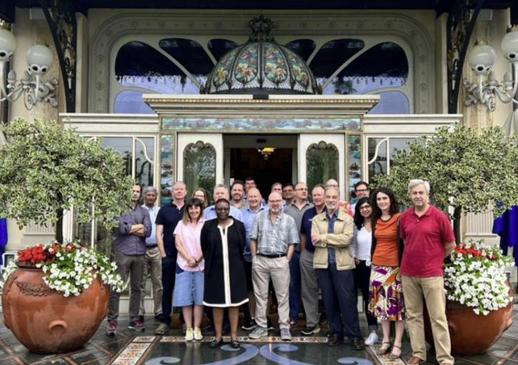
Previous GOFC-GOLD Fire / GWIS meeting
June 2022, Stresa, Italy

Slide 3
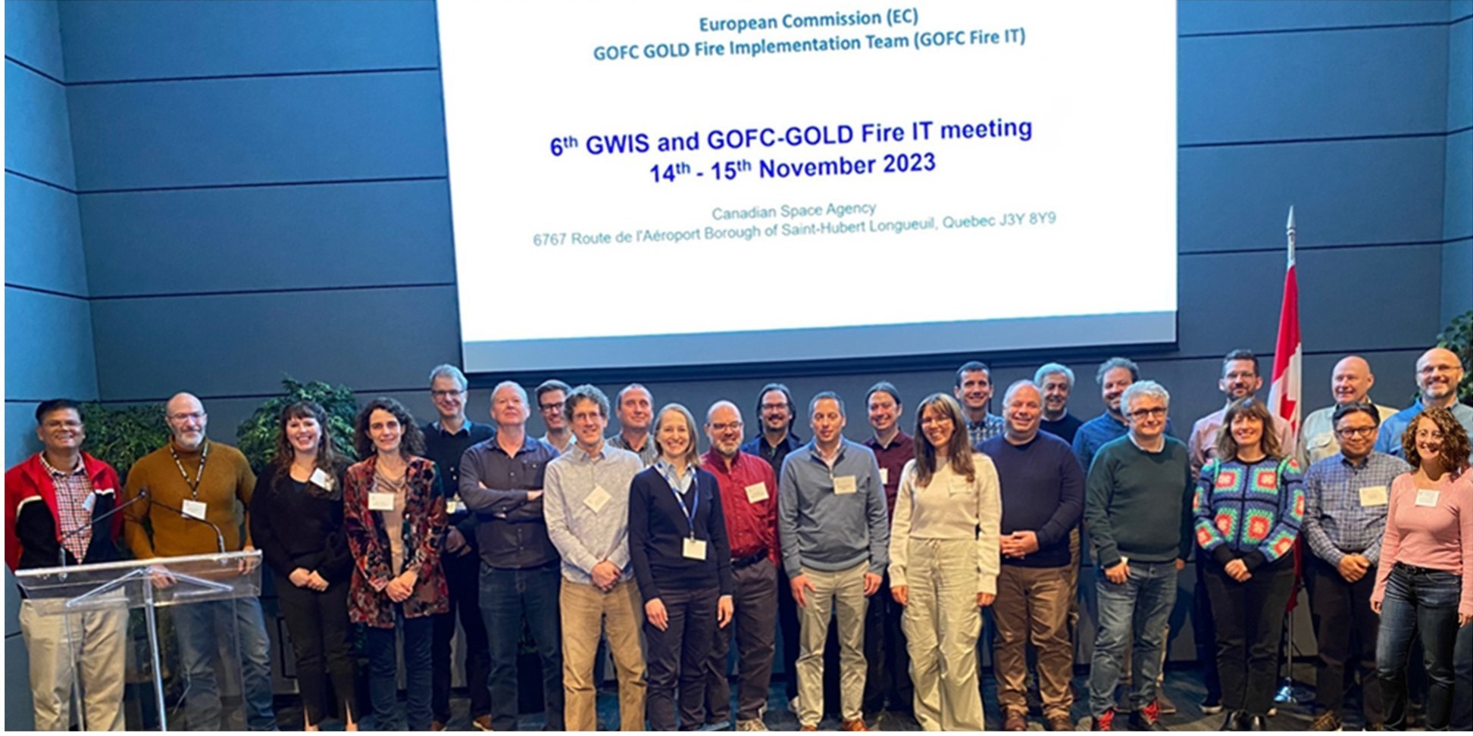
Previous GOFC-GOLD Fire / GWIS meeting
November 2023, Canadian Space Agency, Quebec
joint with Canadian WildFireSat stakeholder meeting

Slide 4
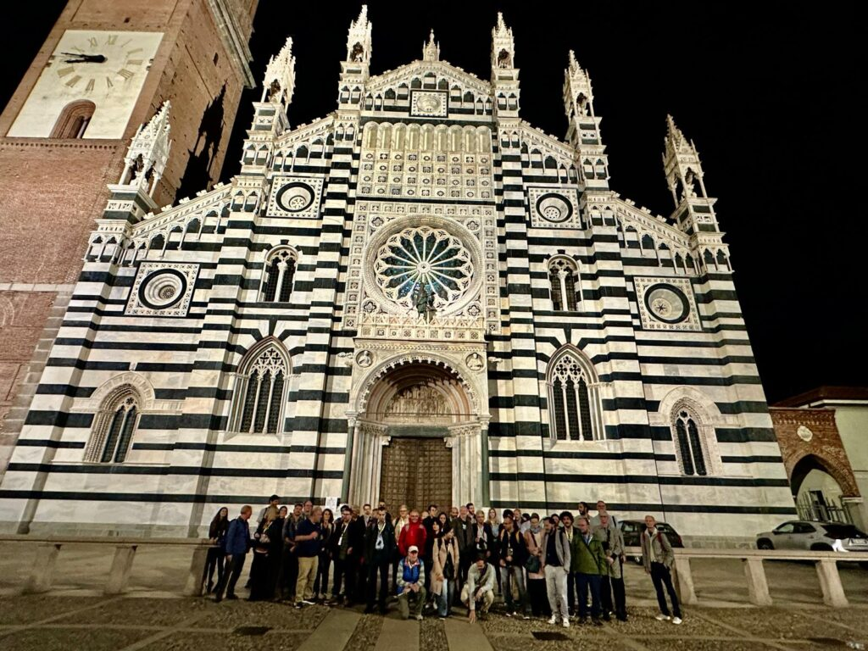
Most Recent GOFC Fire / GWIS meeting
September 17-18 2024, Milan, Italy

Slide 5
GOFC/GOLD Fire Implementation Team priorities
(support R&D / advocate / share information / provide platform / do)
small area & low Fire Radiative Power (FRP) fires
continuity of global fire product record
product continuity characterization (among mission/sensor continuity ad hoc.)
meaningful validation of new and existing fire products, new opportunities provided by commercial satellite data, product QA then validation concern
develop an independent fire product endorsement process
develop community briefing on current status of fire systems and global/large area products & optimal fire monitoring system of systems
advocacy for future satellite fire mission capabilities
fire modelling and fire regime change research, deep learning revolution provides new opportunities
fuel load and fire consumption
fire product policy relevant information service in the post-MODIS era
strengthen fire-related GOFC/GOLD regional networks

Slide 6
GOFC/GOLD Fire Implementation Team priorities
(support R&D / advocate / share information / provide platform / do)
small area & low Fire Radiative Power (FRP) fires
continuity of global fire product record
product continuity characterization (among mission/sensor continuity ad hoc.)
meaningful validation of new and existing fire products, new opportunities provided by commercial satellite data, product QA then validation concern
develop an independent fire product endorsement process
develop community briefing on current status of fire systems and global/large area products & optimal fire monitoring system of systems
advocacy for future satellite fire mission capabilities
fire modelling and fire regime change research, deep learning revolution provides new opportunities
fuel load and fire consumption
fire product policy relevant information service in the post-MODIS era
strengthen fire-related GOFC/GOLD regional networks

Slide 7
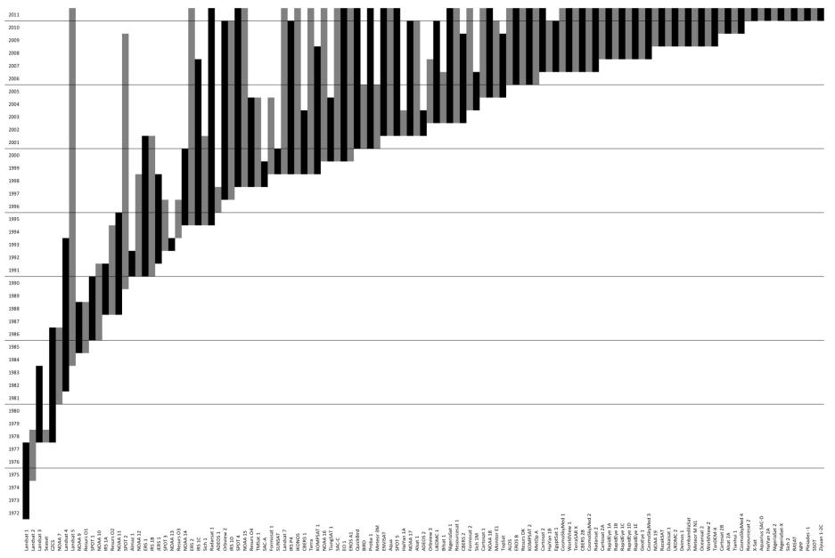
Many Environmental Remote Sensing Systems launched since 1972
Increasing number of systems designed for fire monitoring
Landsat-1
(Belward and Skøien, 2014)

Slide 8
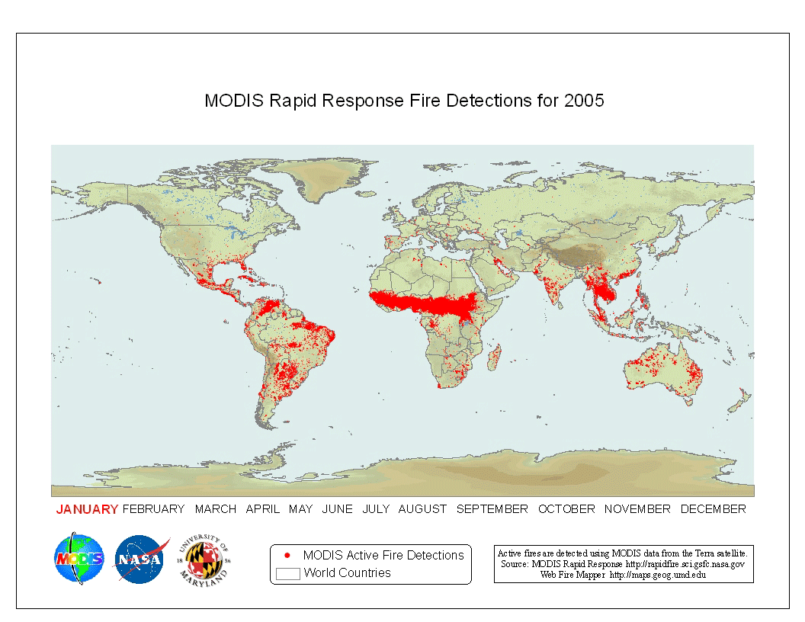
NASA MODIS global 1 km active fire product derived from
Terra and Aqua satellites since 2000
Except in sparsely populated regions fires are predominantly lit by people

Slide 9
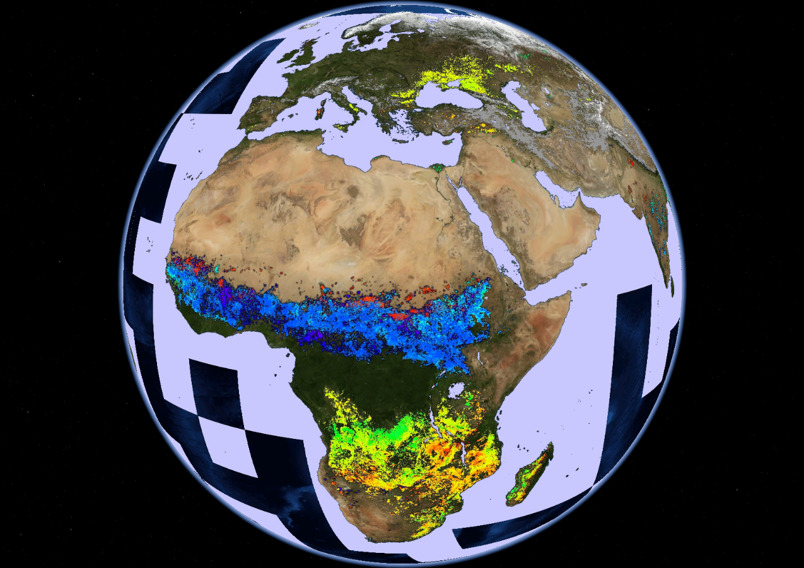
NASA MODIS
global monthly
500 m burned area product from
Terra and Aqua satellites since
2000
Giglio et al. 2018, RSE

Slide 10
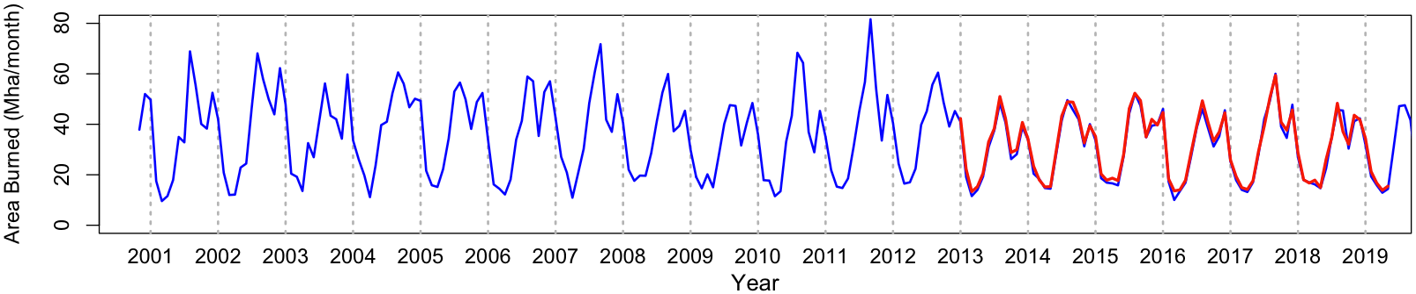
MODIS satellites end of life 2026/27
NASA VIIRS 500 m burned area product developed
to extend the record
Global monthly burned area (Mha)
MODIS
VIIRS
(Giglio, Boschetti, Roy, et al. RSE, 2026)

Slide 11
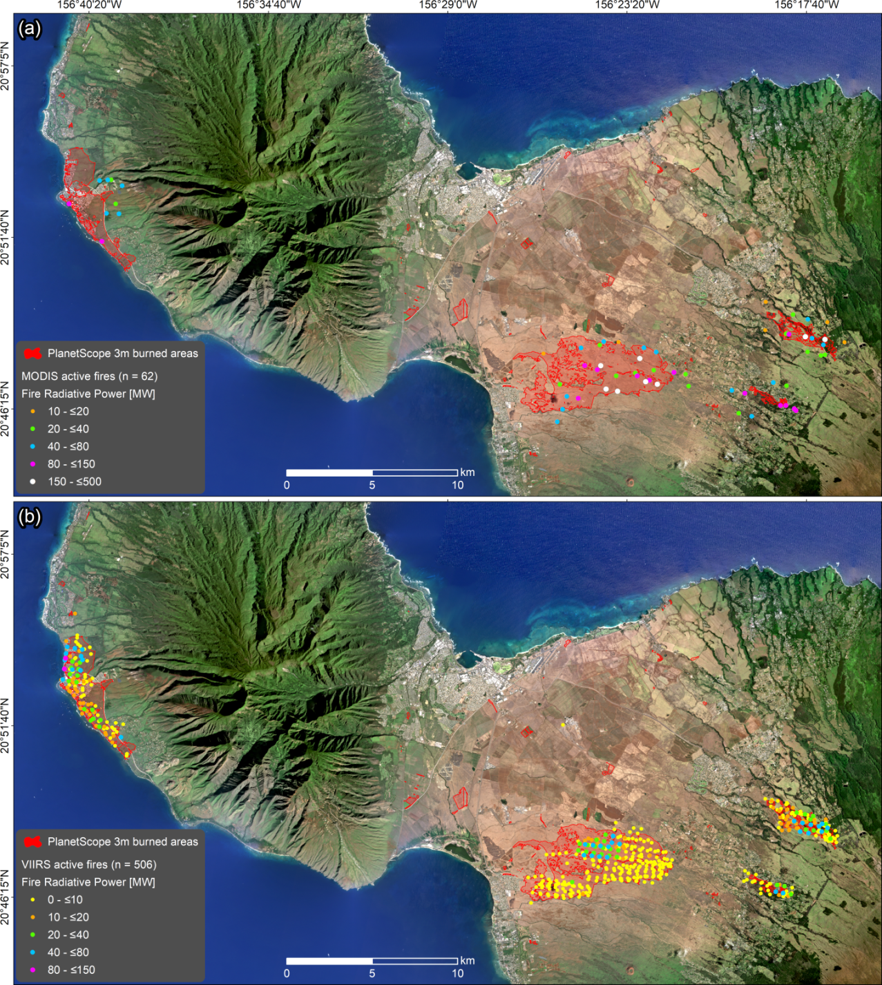
MODIS & VIIRS active fire detections & FRP values
different
Maui Fire Disaster August 2023
Roy et al. Science of RS 2024

Slide 12
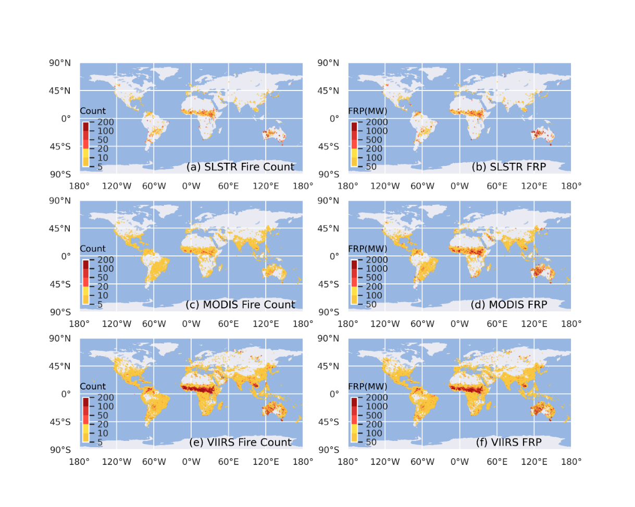
Active Fire Counts FRP Totals
ESA Sentinel-3 detects fewer active fires than MODIS, & far fewer than VIIRS, &
different FRP values
S3B SLSTR
Terra MODIS
NPP VIIRS
(Wooster)

Slide 13
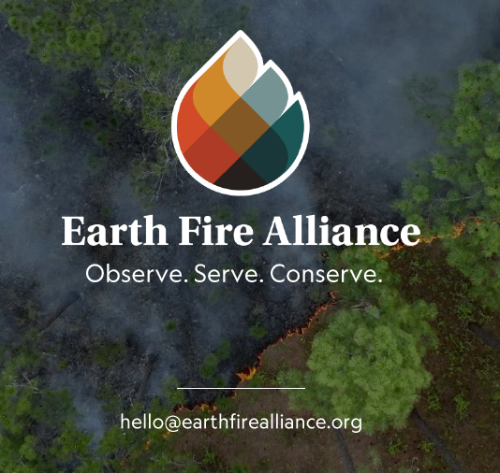
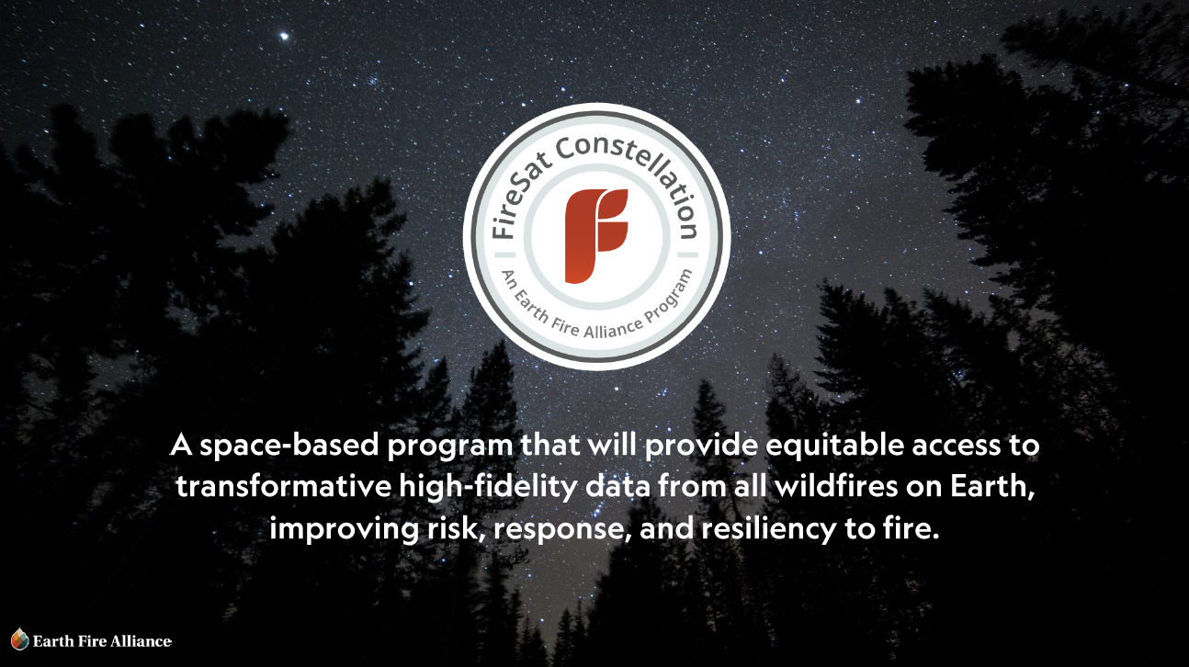
New philanthropic/commercial fire satellites
Global nonprofit coalition committed to delivering transformative data and insights from all wildfires on Earth, in collaboration with Muon Space and Google Research

Slide 14
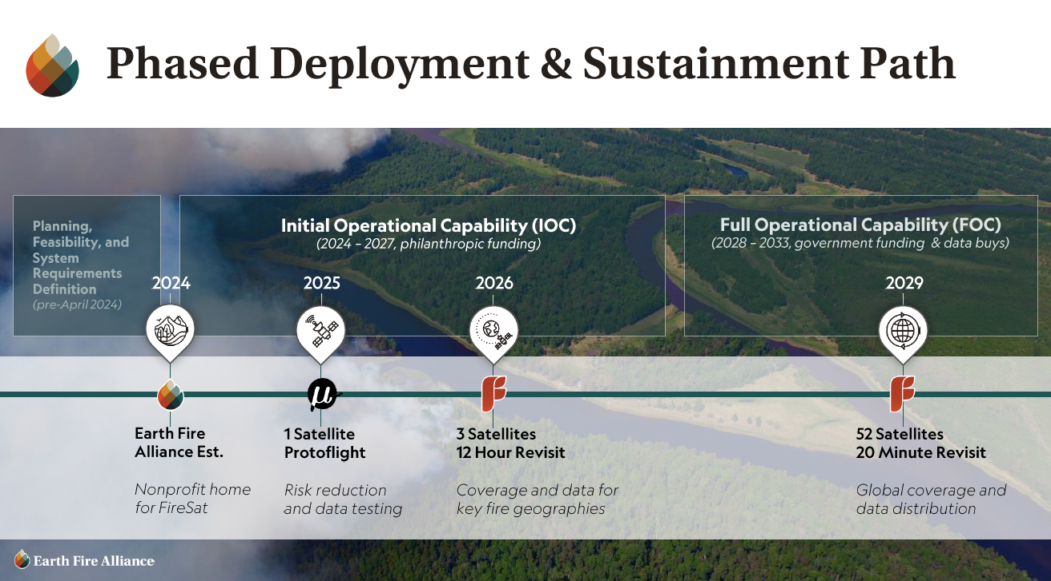

Slide 15
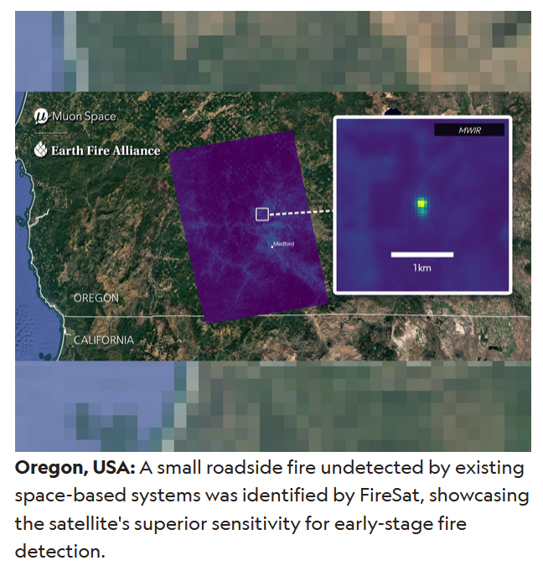
July 2025
Fit for purpose ?

Slide 16

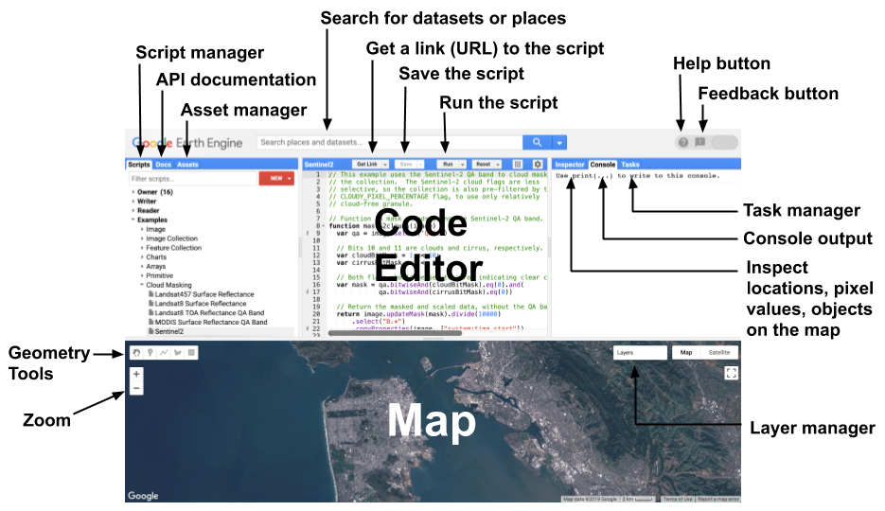
Cloud computing and ARD reducing barriers
to global scale satellite product generation

Slide 17
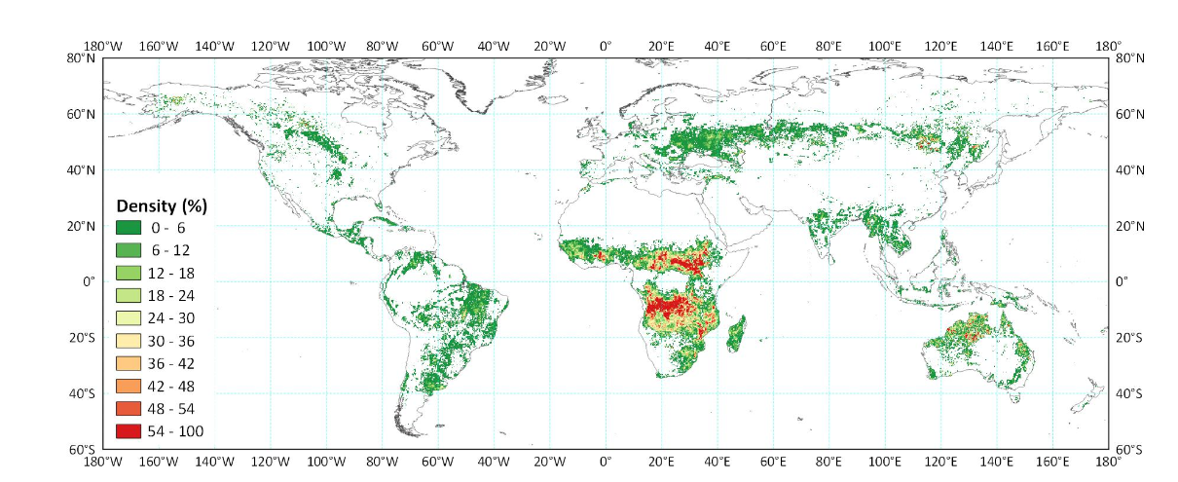
Cloud computing and ARD reducing barriers
to global scale satellite product generation
Published Google Earth Engine Landsat-8 burned area product looks good at this scale

Slide 18
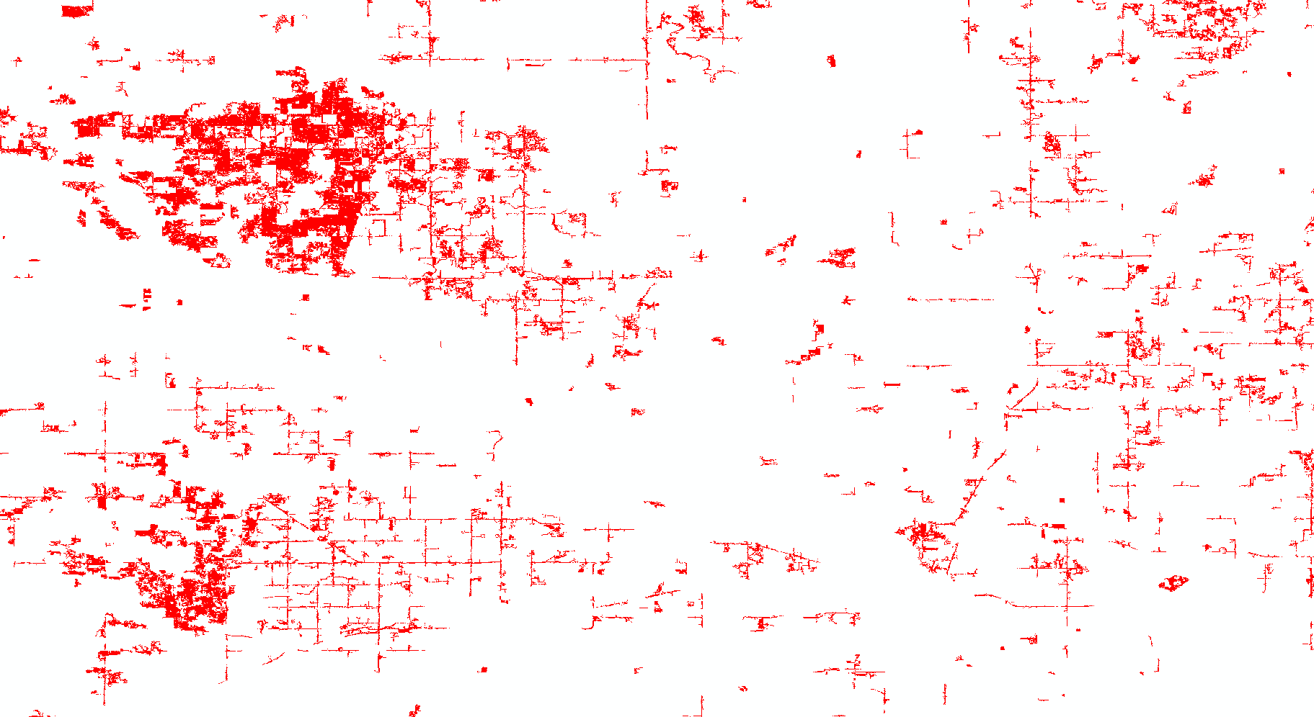
Cloud computing and ARD reducing barriers
to global scale satellite product generation
Published Google Earth Engine Landsat-8 burned area product looks good at this scale
30m burned areas in S.W Minnesota ?!

Slide 19
Algorithms Established
25 years ago in the NASA MTPE era …
NASA template to develop and then operationalize products
Validation procedures established and applied
Specification of requirements
Observations available
(as data sets)
Product adopted, generated, distributed by operational agency
Routine quality assessment & periodic validation
Research/ prototype product created
Further improvements needed to meet requirements?
(Chris Justice)

Slide 20
Product Quality Assessment (in one slide)
Evaluate product scientific quality with respect to intended performance
Performed by examination of products, usually without inter-comparison with other data
A routine near-operational activity
Results are stored in the product as per-pixel flags and metadata at the product file level (written in the production code)
The QA process is the first step in problem resolution, may lead to
  update of production codes
  science algorithms
  reprocessing
  to rectify issues identified through QA
Users should ideally check QA results when ordering and using products to ensure that the products have been generated without error or artifacts
Roy et al. RSE 2002

Slide 21
Product Validation (in one slide)
Quantify product accuracy/uncertainty over a range of representative conditions
Performed by comparison of product samples with independently derived data that include field measurements and remote sensing products with established uncertainties
Typically periodic/episodic activities e.g., field validation campaigns
Results published in the literature and on web sites ~years after product generation
Results define the “error bar” for the entire product collection and are not intended to capture artifacts and issues that may reduce the accuracy of individual product granules
Users should ideally consider validation results with respect to the accuracy requirements of their applications
Morisette et al. RSE 2002

Slide 22
Why validate global land products ?
Good science and resource management require understanding of product accuracy/uncertainty
Explicit statements of accuracy/uncertainty fosters an informed user community and improved use of data
As more, and similar, global products are produced, inter-use will require characterization of each product’s accuracy/uncertainty
Use of products for policy analysis implies products may be independently evaluated and possibly challenged

Slide 23



Now International Recognition for Validation
CEOS
Committee on Earth Observing Satellites
WGCV
Working Group on Cal/Val
LPV
Land Product Validation Subgroup

Slide 24
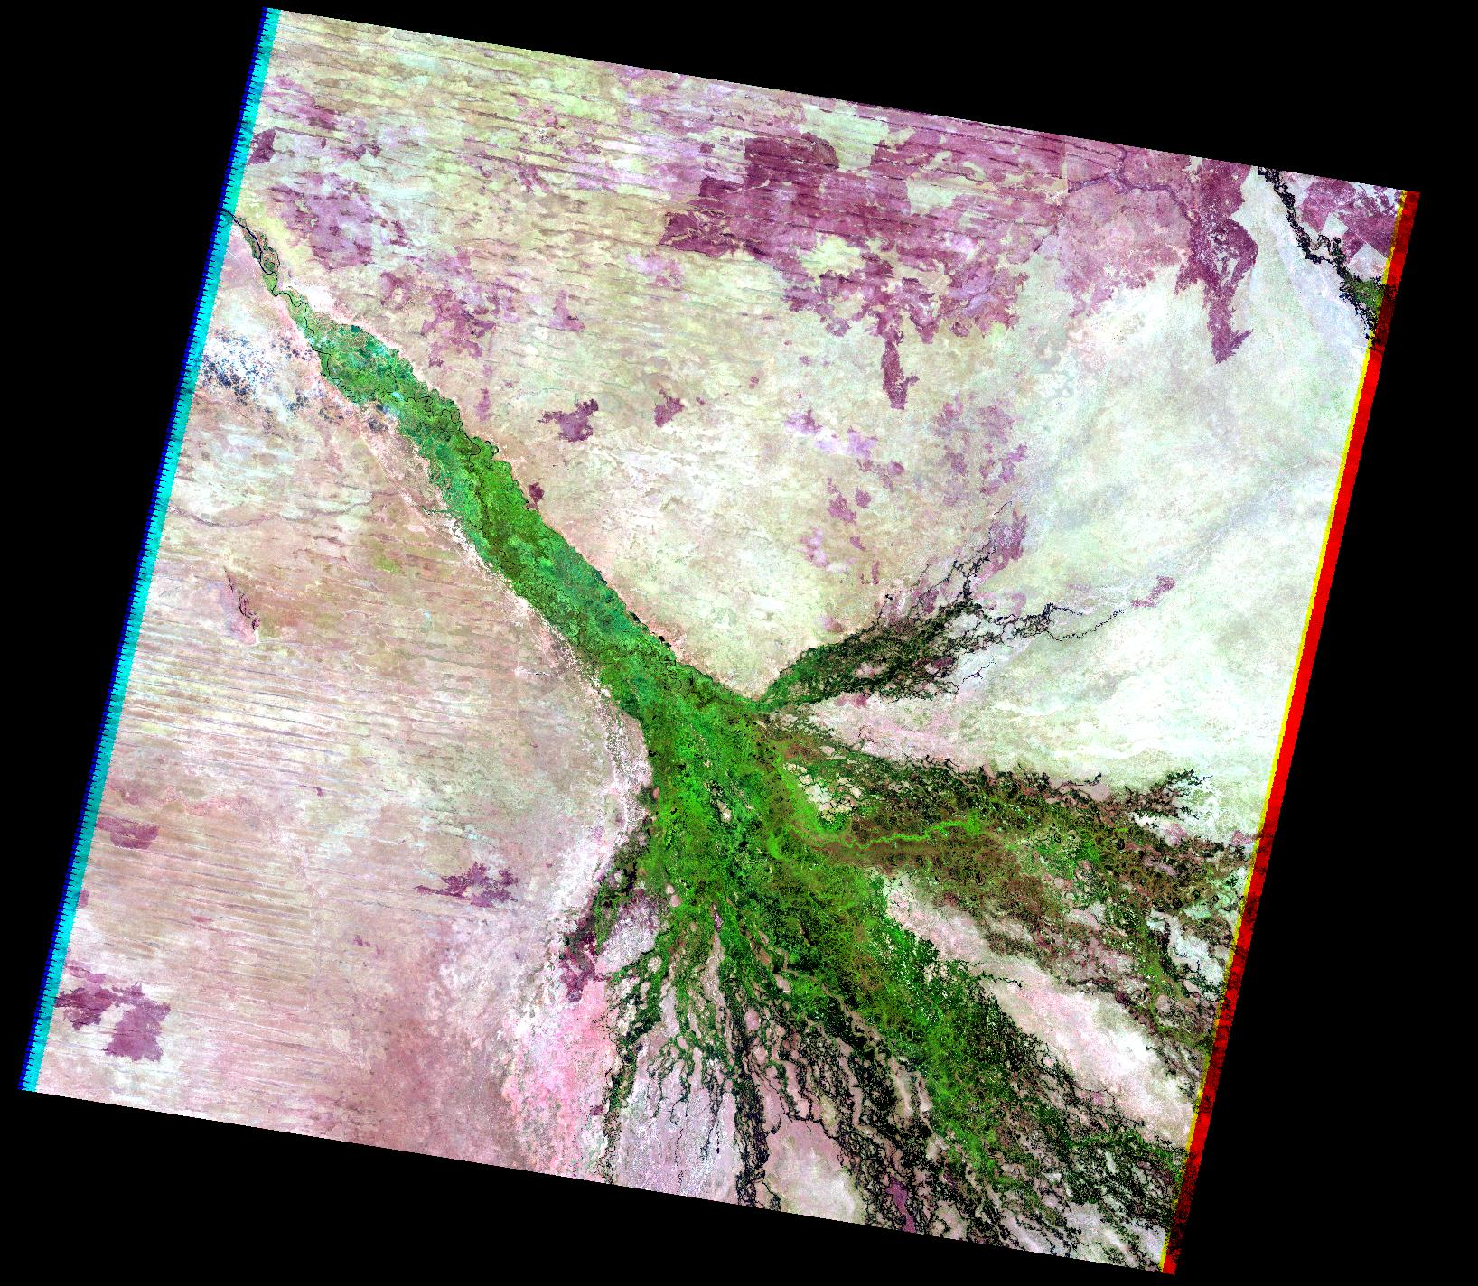
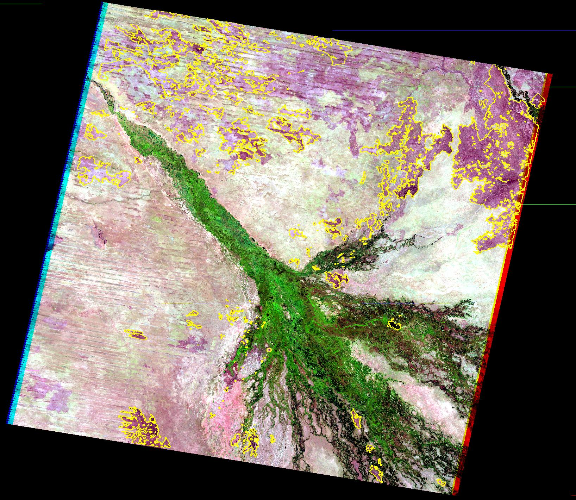
Burned Area Product Validation – Established CEOS protocol
Burned areas interpreted from contemporaneous higher spatial resolution satellite data

Slide 25
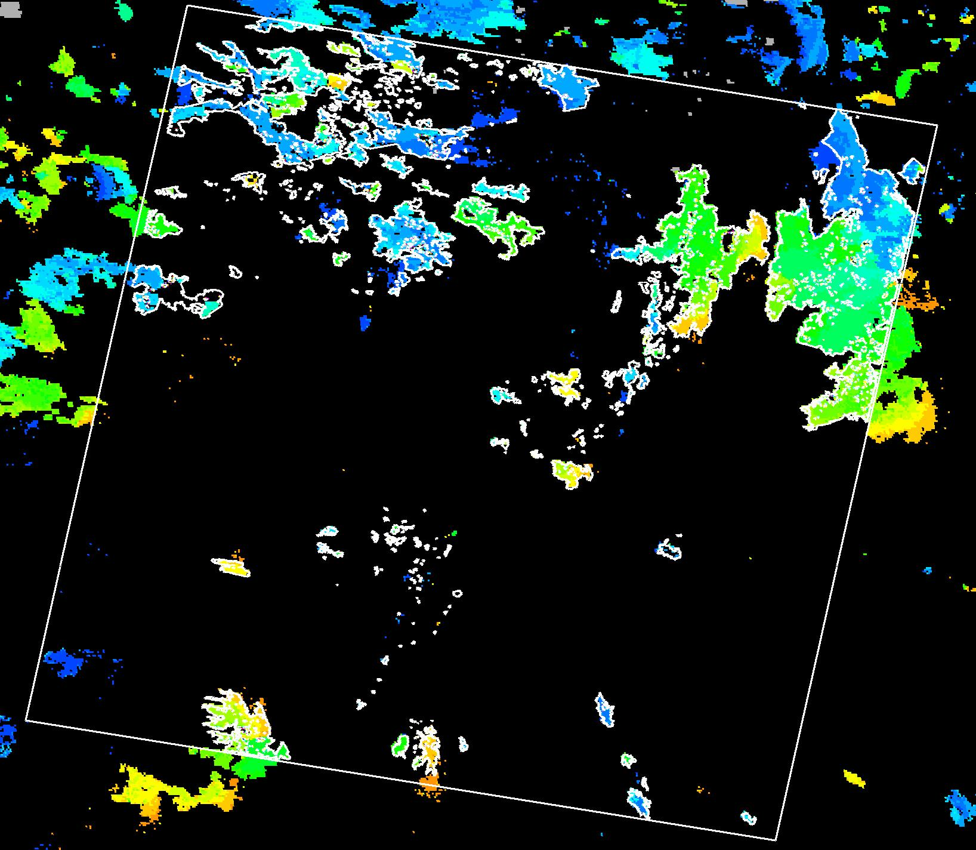
Burned Area Product Validation – Established CEOS protocol
Burned areas interpreted from contemporaneous higher spatial resolution satellite data
Compare with the burned area product to quantify its accuracy

Slide 26
How representative are product validation results ?
The CEOS 3 Stage Validation Reporting Hierarchy
Stage 1 – Product accuracy has been estimated using a small number of independent measurements from selected locations and time periods
Stage 2 – Product accuracy has been assessed by a number of independent measurements, at a number of locations or times representative of the range of conditions portrayed by the product
Stage 3 - Product accuracy has been assessed by independent measurements in a systematic and statistically robust way representing global conditions

Slide 27
Stage 1 Validation: Small number of independent measurements from selected locations and time periods
Dependent variable
being
Validated
e.g.,
Burned area
Small sample, over less representative
range of conditions
Independent
reference
“truth” data

Slide 28
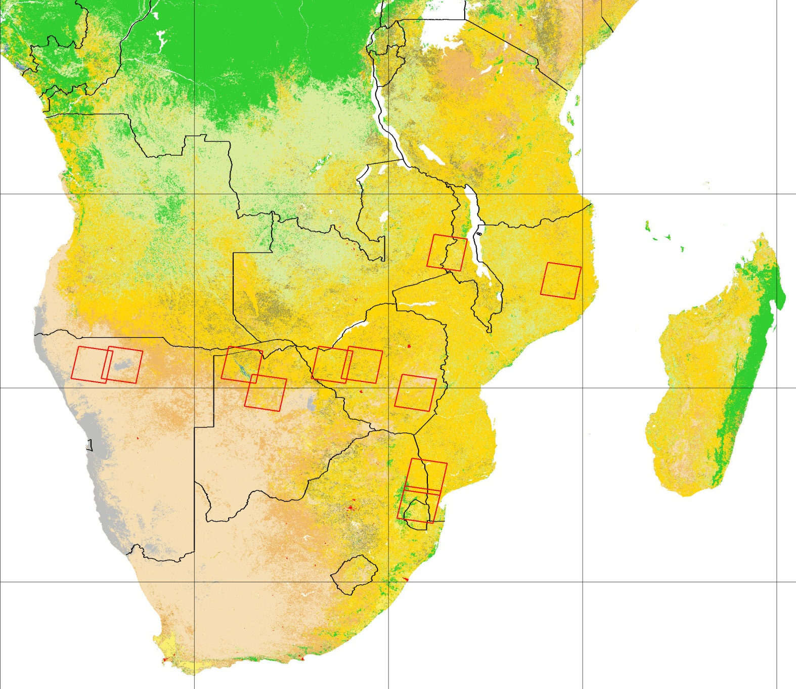
Early MODIS Burned Area Product Validation undertaken at 12 Landsat scenes distributed from dry savanna to wet miombo woodland – not globally representative
ETM+ scene
~185 * 185 km
Each ETM+ scene has a local GOFC collaborator
~3% of southern African surface
MODIS Burned Area Product
Stage 1 Validation
MODIS 1km land cover product: of the 17 MODIS land cover classes, predominant classes illustrated include: evergreen broadleaf forest (dark green), barren or sparsely vegetated (gray), woody savannas (light green), open shrublands (cream), grasslands (light brown), savannas (orange), croplands (yellow), cropland/natural vegetation mosaic (olive brown), urban (red).
Roy et al. 2005 IJRS

Slide 29
Stage 2 Validation: Sampling distribution representative of the conditions over which the product was made
Dependent variable
being
Validated
e.g.,
Burned area
Large sample, over
more representative
range of conditions
Independent
reference
“truth” data

Slide 30
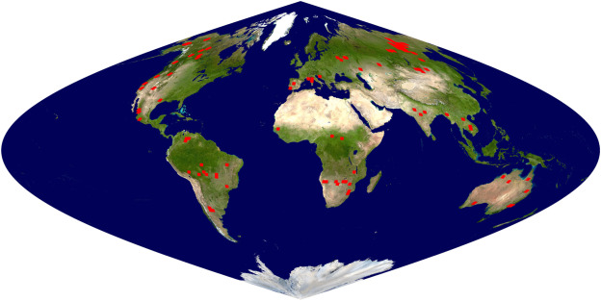
MODIS Burned Area Product
Stage 2 Validation
Locations of 108 Landsat two date image pairs that were visually interpreted into burned, unburned, and unmapped classes
Giglio, Boschetti, Roy, Humber, Justice, RSE, 2018

Slide 31
Stage 3 Validation: Product accuracy has been assessed by independent measurements in a systematic and statistically robust way representing global conditions
Dependent variable
being
Validated
e.g.,
Burned area
Random sample
over all conditions
Independent
reference
“truth” data

Slide 32
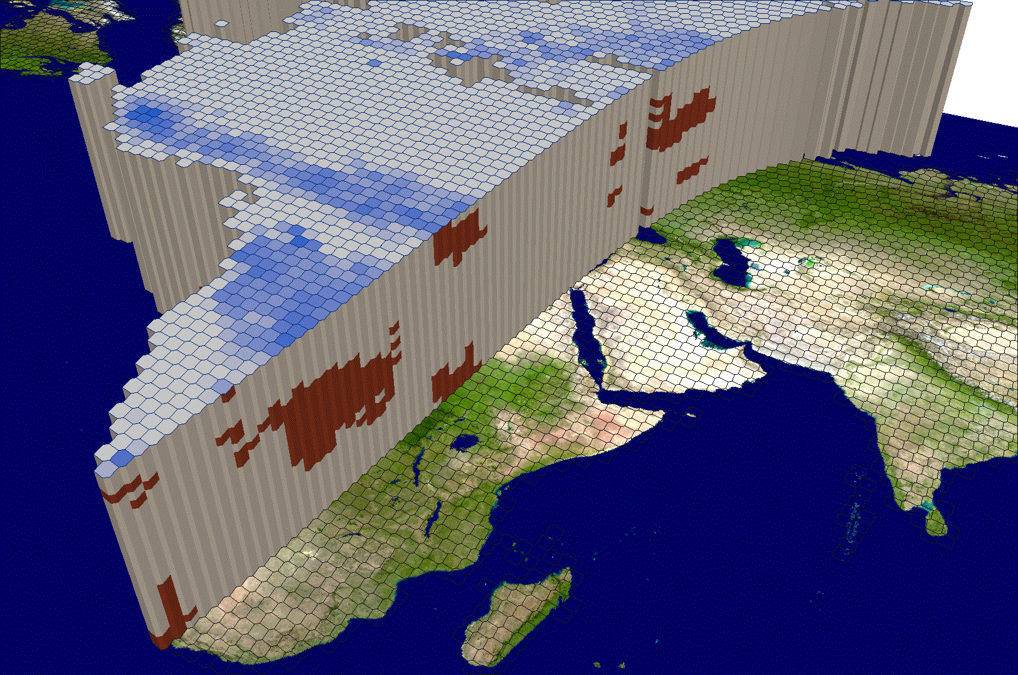
Stage 3 Validation: Difficult, as how many independent reference data and how to statistically sample independent reference data to capture all conditions ?
3D representation of the distribution of MODIS active fires in space and time, using voxels as the sample unit
For fire products need to sample independent reference data in time also

Slide 33
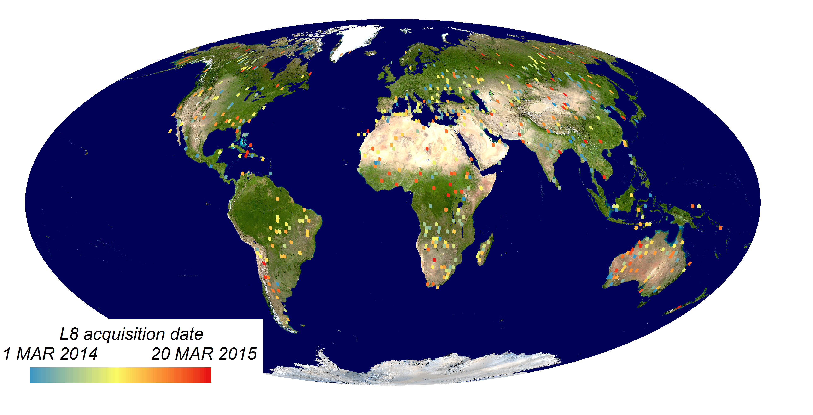
MODIS Burned Area Product
Stage 3 Validation
Took years and a team of students to collect the
Landsat validation data
Boschetti, Roy, Giglio, et al. RSE, 2019
Locations of 558 two date Landsat image pairs selected by stratified random sampling in space and time; pairs were visually interpreted into burned, unburned, and unmapped classes

Slide 34
Burned Area Product Validation protocol adopted widely but some underwhelming products and unreliable validation reporting …. for reasons including
Producers
not undertaking sufficient product QA
using insufficient number and distribution of independent reference data for CEOS Stage 3 validation
using the same spatial resolution independent reference data as the product
However, commercial high (<10 m) spatial resolution data provide new opportunities for independent reference data generation needed for validation of coarser resolution burned area products

Slide 35
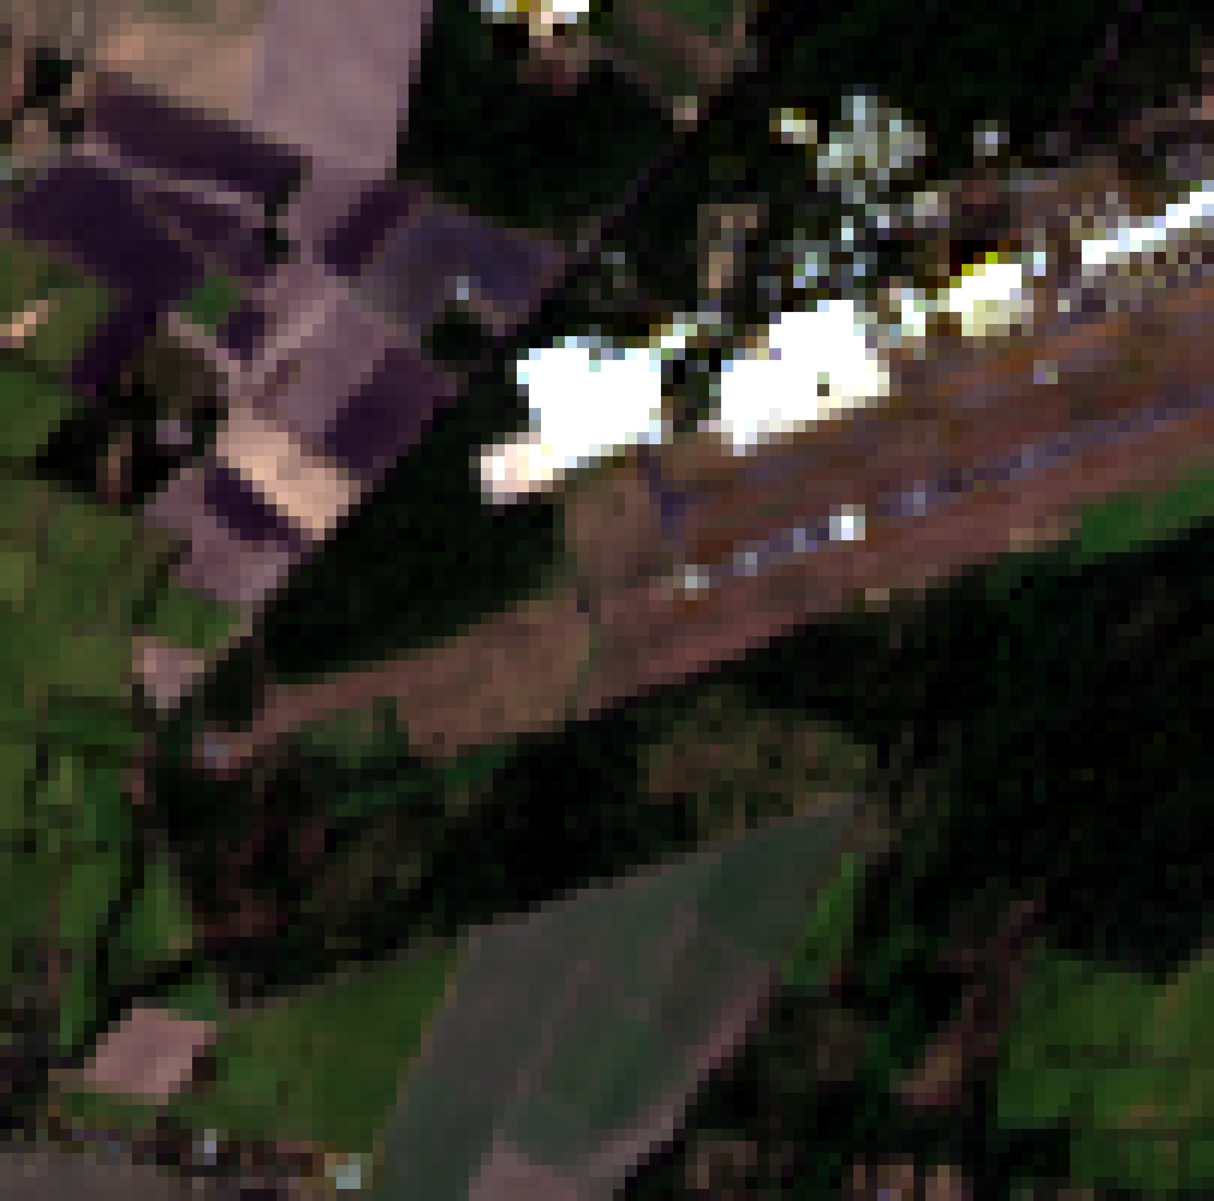
Sensor: Landsat 9
Spatial Resolution: 30 m
Date: 2022/01/12
Time: 16:18:34 UTC
Solar Elevation: 46°
Location: SAL Airport, San Luis Talpa, La Paz, El Salvador
Dimension:
100 x 100

Slide 36
Sensor: Planetscope
Spatial Resolution: 3 m
Date: 2022/01/05
Time: 17:01:25 UTC
Solar Elevation: 51°
Location: SAL Airport, San Luis Talpa, La Paz, El Salvador
Dimension:
1000 x 1000

Slide 37
Sensor: BlackSky
Spatial Resolution: 1 m
Date: 2022/01/05
Time: 16:03:37 UTC
Solar Elevation: 44°
Location: SAL Airport, San Luis Talpa, La Paz, El Salvador
Dimension:
3000 x 3000

Slide 38
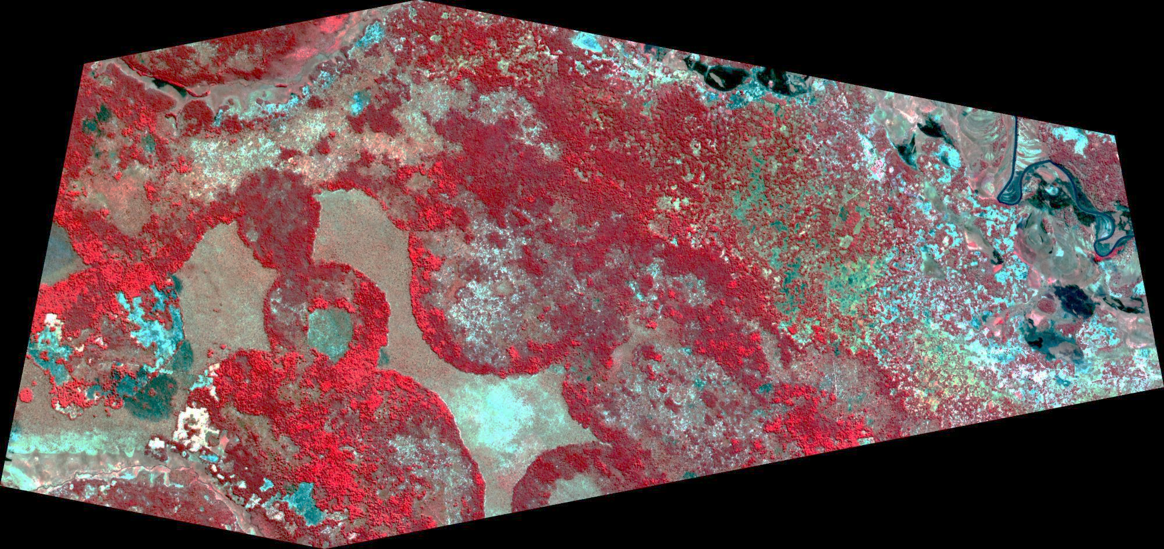
PlanetScope 3m 2019-07-01
False color NIR/RED/GREEN
17.31 x 8.18 km

Slide 39
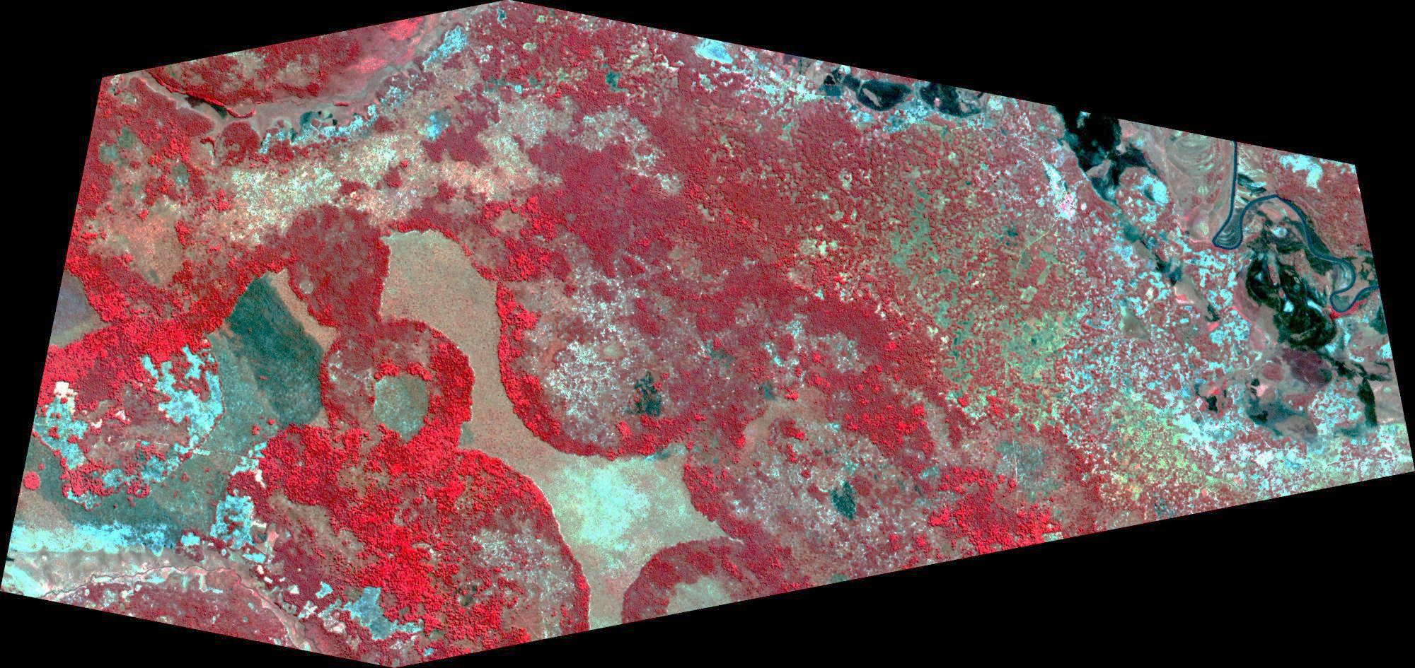
PlanetScope 3m 2019-07-13
False color NIR/RED/GREEN
17.31 x 8.18 km

Slide 40
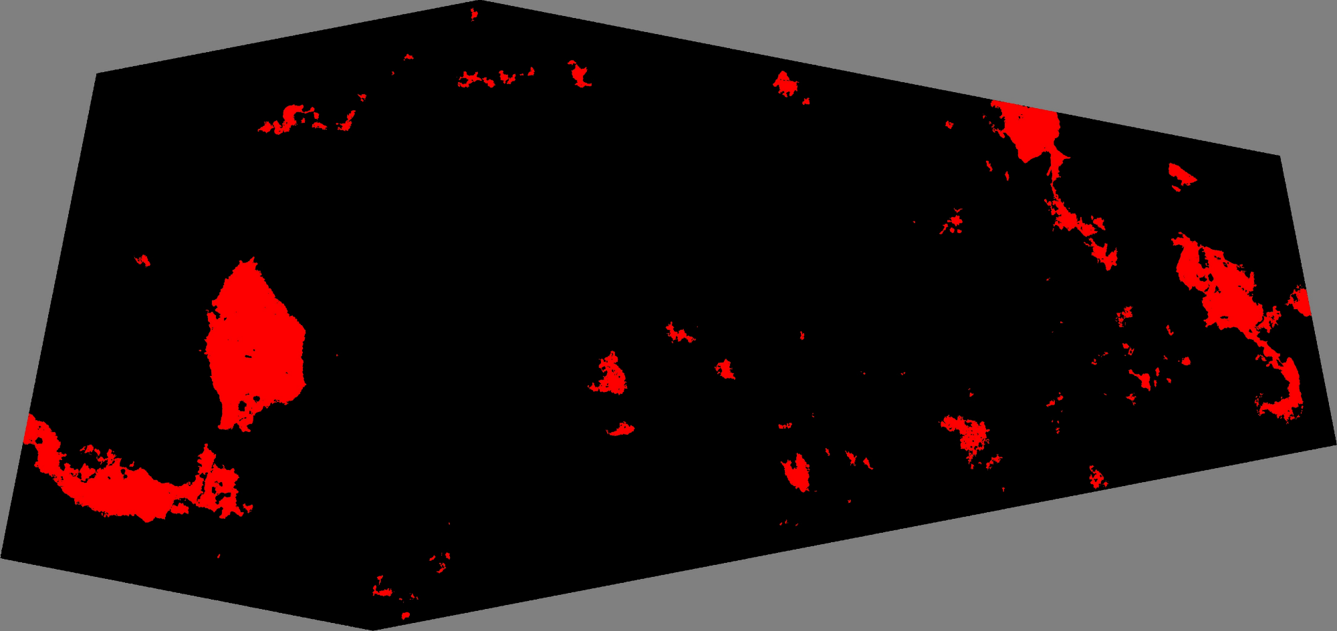
Deep Learning 3 m Classification
17.31 x 8.18 km

Slide 41
Active Fire and FRP product validation challenging
Active Fire
For MODIS established comparison with contemporaneous QA’d active fire detections from ASTER, Landsat, Sentinel-2
definition of “contemporaneous” observations TBD
(ballooned from ± minutes to ± ~8 hours)
validation of high resolution active fire detection products challenging
FRP
more challenging due to limited availability of reference data (airborne data and field campaigns) and need for “contemporaneous” obs. within ± minutes
(Roberts & Giglio, CEOS LPV Plenary: 28-29 September 2022)

Slide 42

Growing user and producer desire for an independent satellite fire product endorsement process
Business as usual, i.e. producers validate their products, is a classic case of “Foxes in the hen house”
One solution is a fire product endorsement “clearing house”
  Independent of producers
  Authoritative
  Providing traceable / reproduceable evidenced-based endorsement

Slide 43
Growing user and producer desire for an independent satellite fire product endorsement process
One solution is a fire product endorsement “clearing house”
  Independent of producers
  Authoritative
  Providing traceable / reproduceable evidenced-based endorsement
Endorsement process …
  Not only a pre-launch doc. and ATBD review exercise
  Not only a Stage 1-3 validation (not simple for AF and FRP anyway)
  Implemented on a periodic basis given on orbit (detector calibration, geolocation, overpass drift etc.), reprocessing, and algorithm changes
  Tiered endorsement for different communities e.g. "Fit for Science Usage“ e.g. “Fit for fire event detection applications”
Ongoing discussion …. Please comment

Slide 44
Coordination of Global Earth Observation for Wildfire Monitoring
39th CEOS Plenary
Bath, United Kingdom
4th - 6th November, 2025

