Slide 1
Coordination of Global Earth Observation for Wildfire Monitoring
Mark de Jong &
Joshua Johnston
Natural Resources Canada
39th CEOS Plenary
Bath, United Kingdom
4th - 6th November, 2025

Slide 2
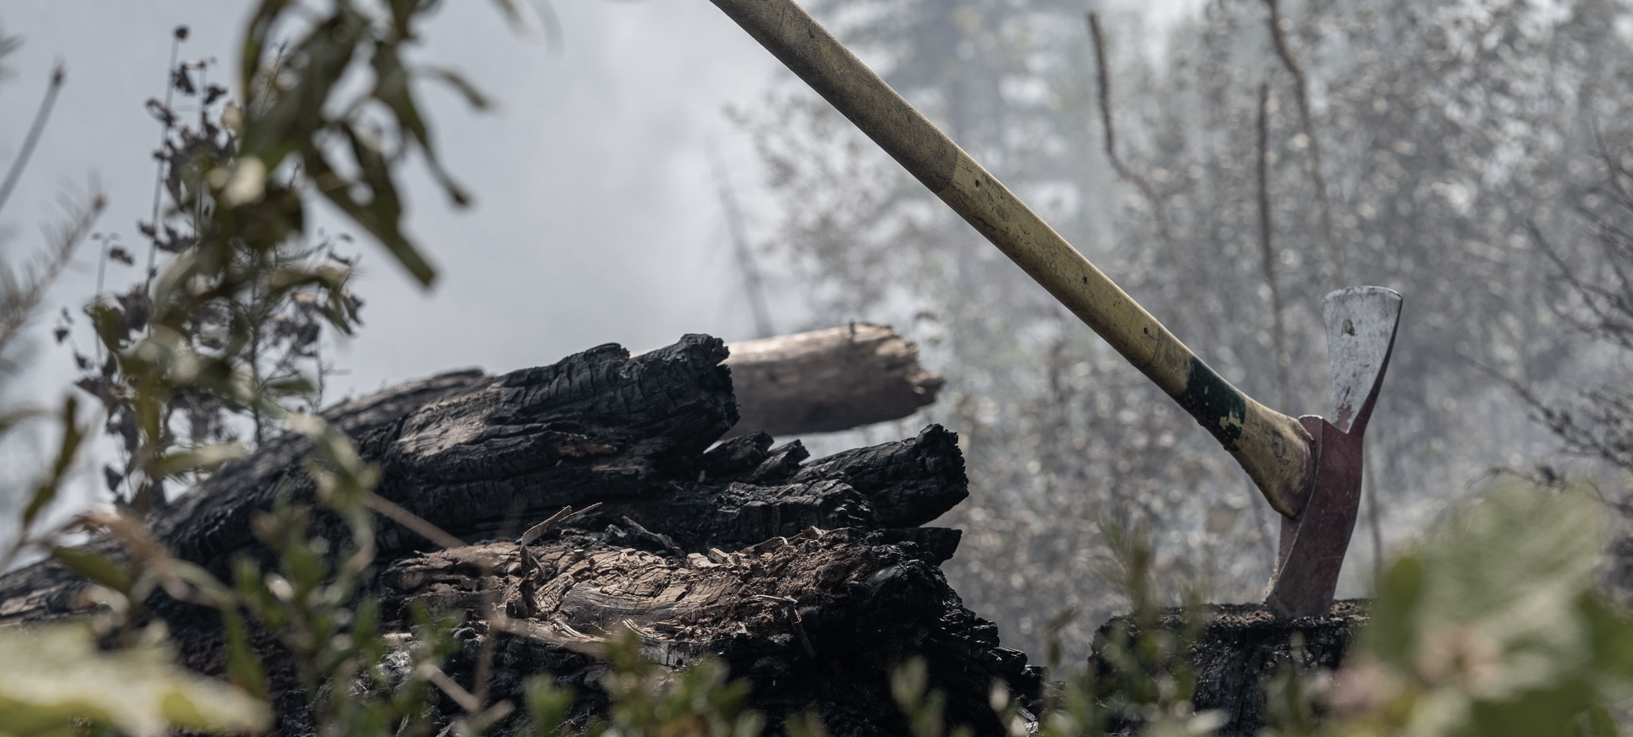
Agenda
Canada’s proposal to CEOS
Context to problem
  Global wildfire: challenges & EO active fire monitoring
  Canada’s WildFireSat Mission
  CEOS Working Group Disasters - Wildfire Pilot
Preliminary vision for coordination of global fire EO
Discussion
Potential EO fire product endorsement process
  D. Roy, MSU & GOFC GOLD Fire
Discussion
Active Contributors:
NRCan: C. M^{c}Fayden, M. Crowley, E. Hope, A. Magistrale, L. MacPherson, J. Dobbin
CSA: D. Dufour, L. Philpott, M. Patel, F. Fournier
NASA: D. Morton
ANU: M. Yebra
Past Contributors:
H. van Mierlo (CSA), P. Moore (FAO)

Slide 3
Our Proposal to CEOS
Aim: to establish a group to better coordinate global EO-based wildfire monitoring
  Proposed members:
    space agencies,
    scientific product developers,
    commercial/philanthropic wildfire satellite EO data providers
An opportunity for CEOS? We want your feedback
Notes:
We are doing this
Originates from CEOS – opportunity to continue in a new form under ceps

Slide 4
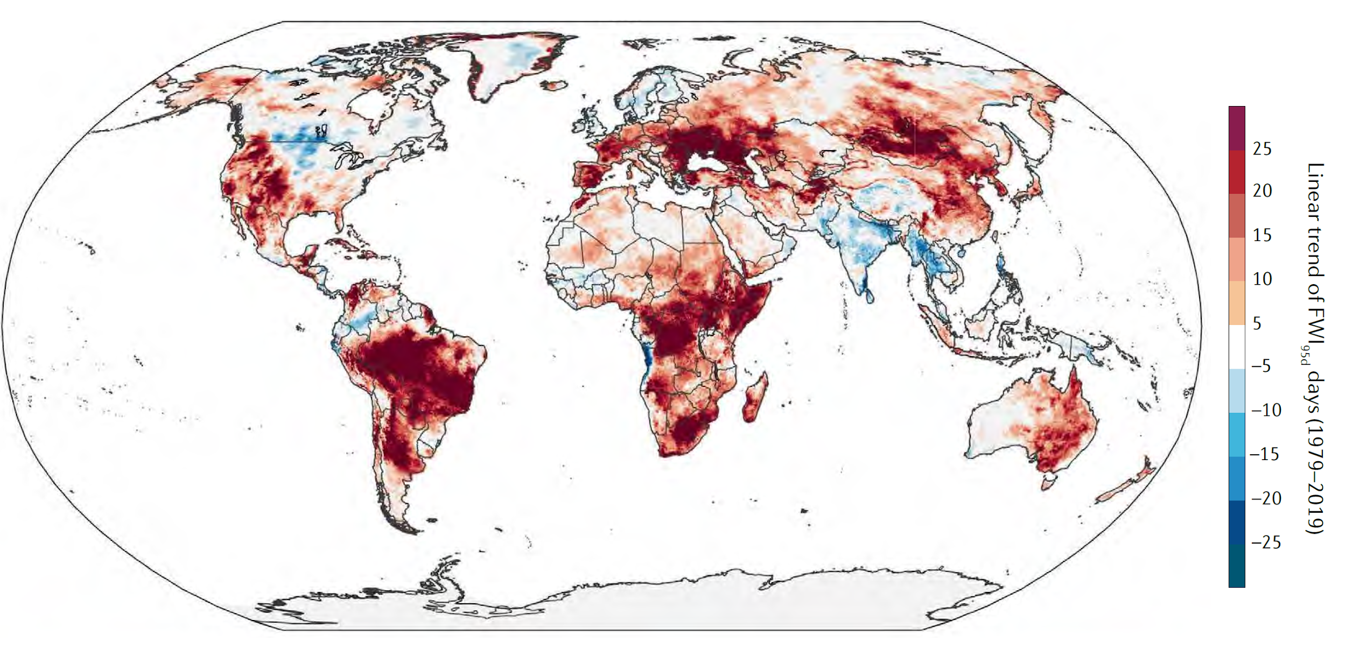
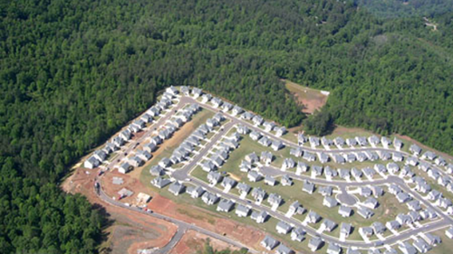
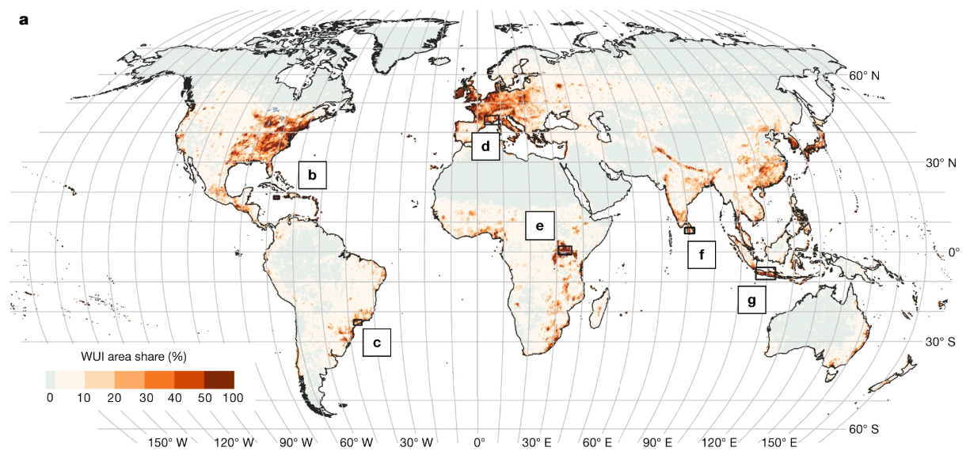
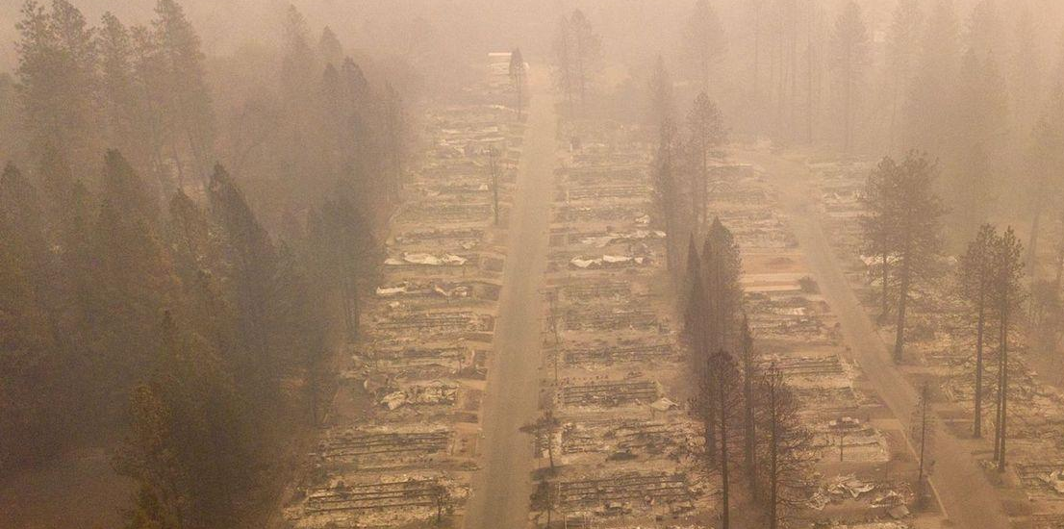
Context – Global Fire Challenges
Wildfire is an important natural disturbance agent, but poses management challenges
Management challenges exacerbated by:
  climate change: longer fire seasons, more extreme weather conditions
  Land use change: increasing wildland urban interface,
  Human behaviour: influences ignitions and suppression
EO based monitoring is important for pre-during-, and post-fire phases
Trend in extreme fire weather conditions in recent decades (1980s-2010s) Bowman et al., (2020)
Wildland Urban Interface texaswildfirerisk.com
Paradise Fire, USA 2018 (cnn.com)
Area share (%) of the Wildland-Urban Interface, 2020
Schug et al (2023) https://doi.org/10.1038/s41586-023-06320-0

Slide 5
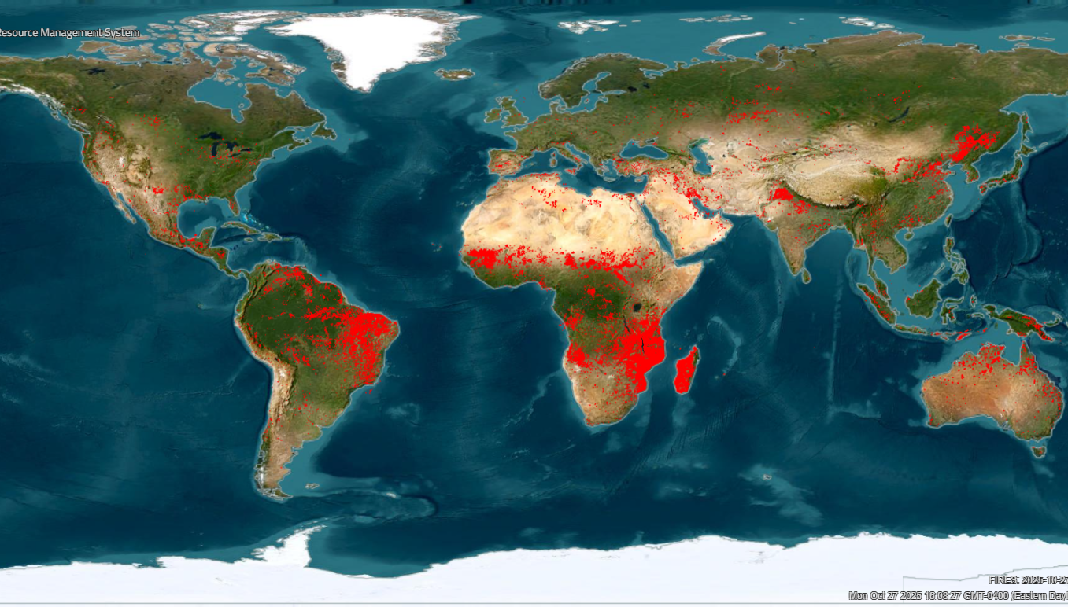
Context – Active Fire EO
Short (2.2µm) to mid-wave (3.7µm) IR Earth observation widely used for active fire detection at time of satellite observation
Active fire detection is used for:
  science: human-ecological-climate research questions
  applications: operational wildfire management
Pioneered with NOAA AVHRR in 1980s
NASA MODIS Terra & Aqua: first global coverage polar orbiting satellites with dedicated active fire detection capability
  25 years of active fire products
Current generation of LEO satellites with dedicated active fire products:
  EUMETSAT (near real time) and ESA (non-time critical) Sentinel-3 SLSTR
  NOAA JPSS VIIRS
Wildland Urban Interface texaswildfirerisk.com
Global wildfire activity detected using satellite Earth Observation on 2025/10/27. Data from NASA FIRMS

Slide 6
Context – Active Fire EO
Challenges & opportunities
MODIS Terra & Aqua - end-of-life 2026, with no direct replacement
  many users use MODIS data as if it were an operational mission
New opportunities from commercial and philanthropic wildfire satellite EO data providers – but how do we navigate this?
Overall: unclear future capability & continuity to meet global science & application needs
Wildland Urban Interface texaswildfirerisk.com
Global wildfire activity detected using satellite Earth Observation on 2025/10/27. Data from NASA FIRMS

Slide 7
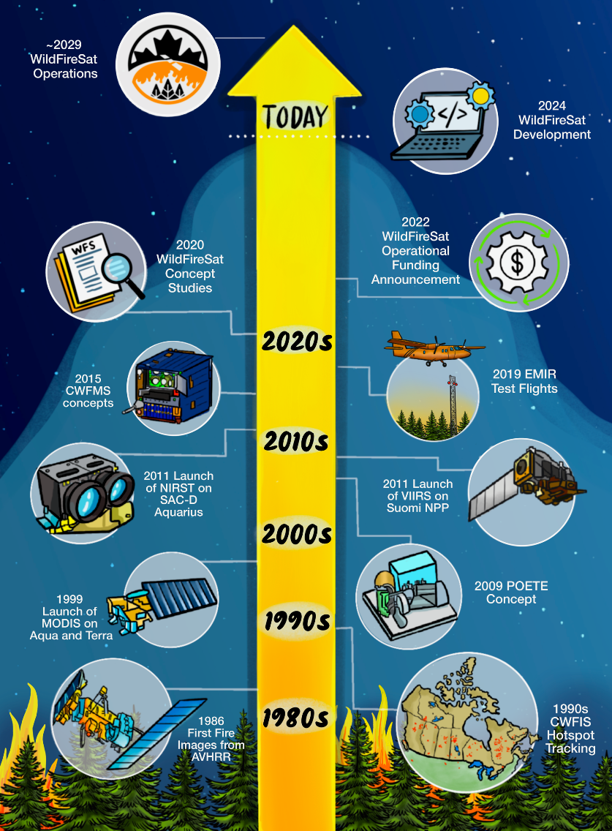
Context – WildFireSat
Canada has been working on a dedicated active fire monitoring mission for many years, building on international experience
WildFireSat – a purpose built, government funded wildfire monitoring mission will provide free and open global active fire monitoring & Level 1B data
  launch date ~2029
Wildland Urban Interface texaswildfirerisk.com

Slide 8
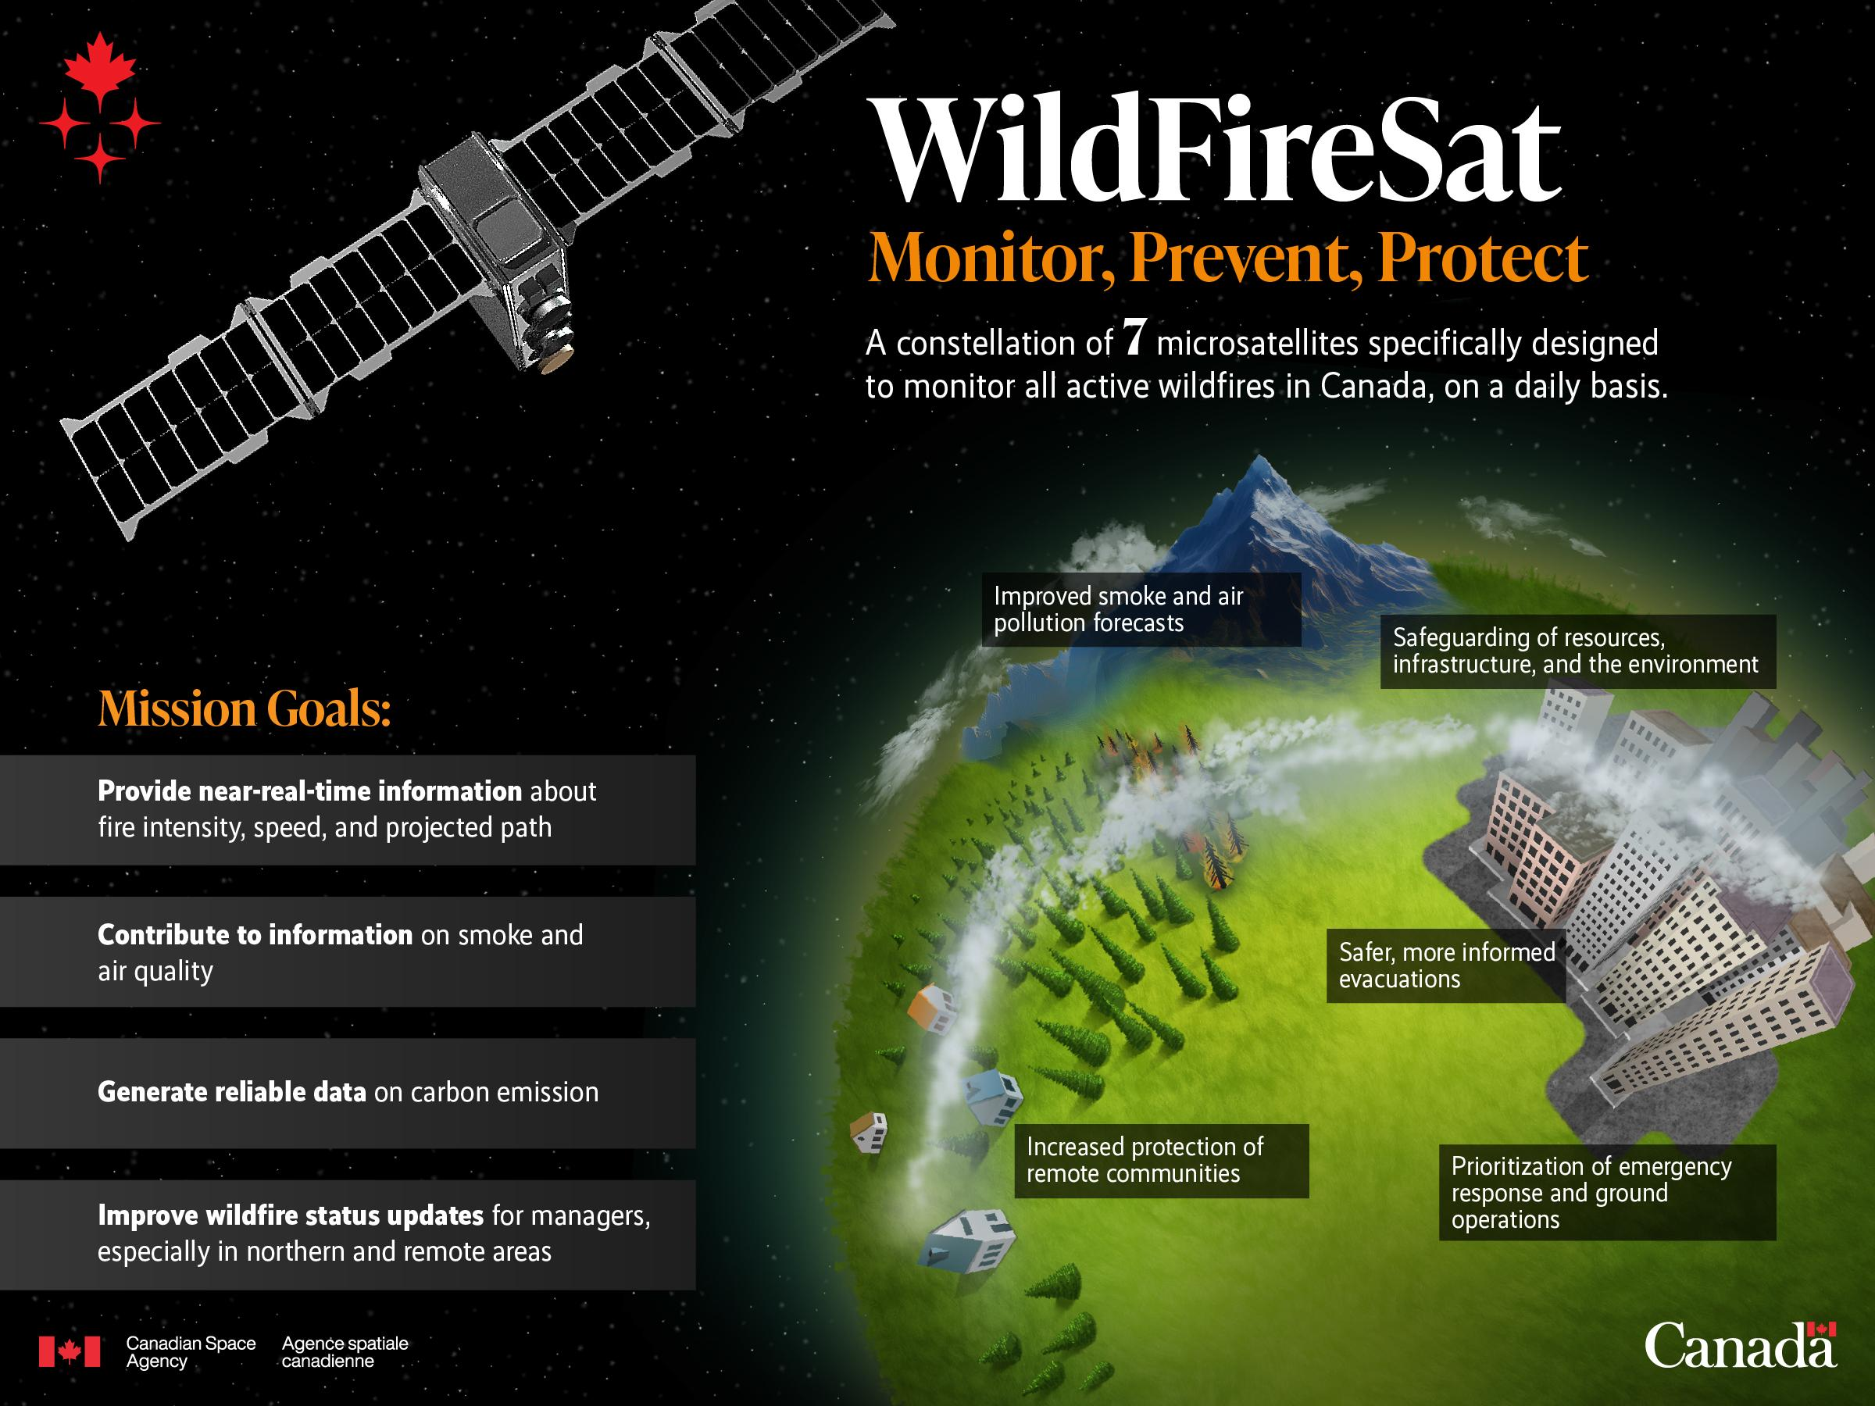
Context – WildFireSat
Wildfire managers will be given unprecedented strategic intelligence on all active wildfires, daily, and in near-real-time
Air quality, smoke, and carbon emissions from wildfires will be able to be better forecast and monitored in near-real-time
Through (1) and (2) wildfire and emergency managers will have improved information to help better manage the risks associated with the threat of wildfires
The WildFireSat Misson now
has a global scope

Slide 9
Context – CEOS WG Disasters Wildfire Pilot
Canada co-led the CEOS WG Disasters (WGD) Wildfire Pilot
  Pilot co-leads:
    Natural Resources Canada
    Canadian Space Agency
    USA’s National Aeronautics and Space Administration
    UN Food and Agriculture Organization
  Initiated 2021, finished 2025
Provided a comprehensive gap analysis of civil space agency missions for active fire earth observation
‘Supply’ side analysis:
Gap analysis of existing & future
active wildfire monitoring systems
‘Demand’ side analysis:
who is using active fire
products for management?
Wildland Urban Interface texaswildfirerisk.com
Recommendations:
Define user requirements for
active fire missions
How can we better coordinate global active fire monitoring?

Slide 10
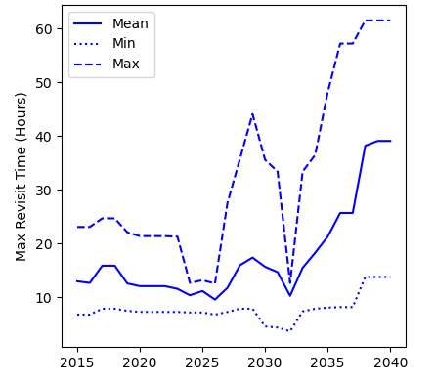
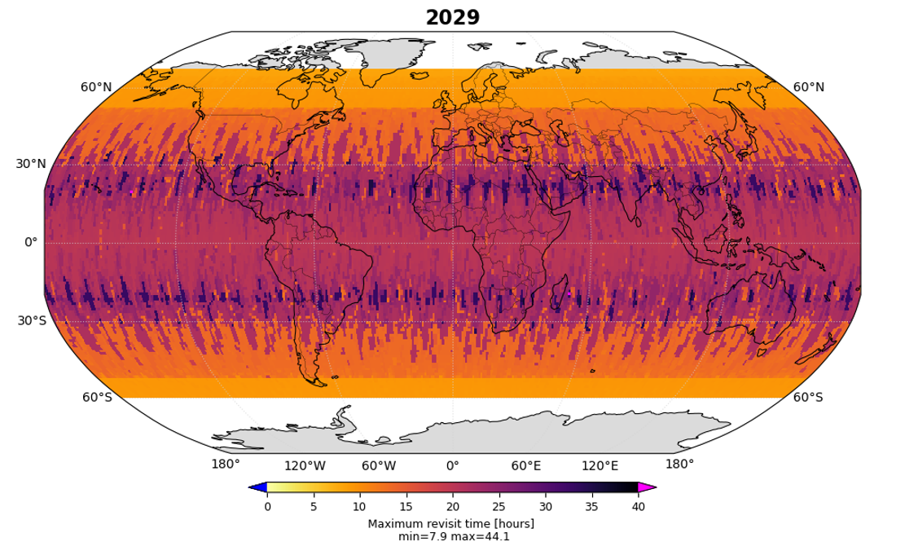
CEOS WGD Wildfire Pilot – Findings (1)
‘Supply’ side analysis
Gap analysis of existing and future active fire monitoring systems using the CEOS Missions, Instruments & Measurements Database and STK modelling
Primary findings:
Global monitoring capabilities are unstable out to the mid-2030s
Coverage (revisit times) does not get better in future.
Coverage could be improved if we could better leverage existing & committed capabilities of CEOS member agencies
Figure 1. Maximum revisit time (global aggregation)
baseline scenario for fire monitoring/detection
Wildland Urban Interface texaswildfirerisk.com
Figure 2. Maximum revisit time in 2029
baseline scenario for fire monitoring

Slide 11
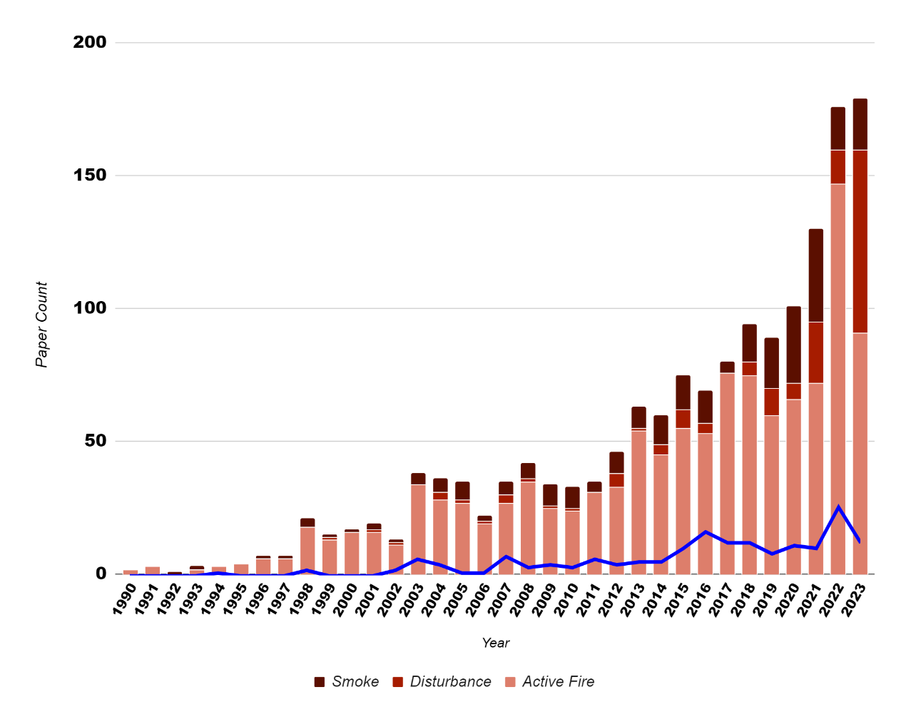
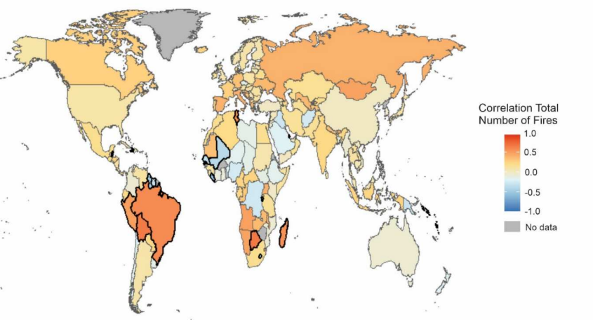
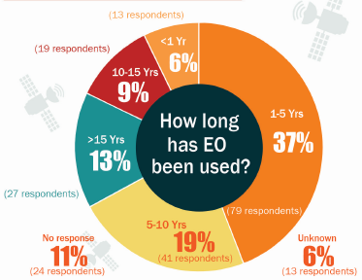
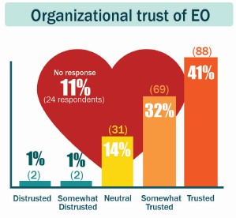
CEOS WGD Wildfire Pilot – Findings (2)
‘Demand’ side analysis
who is using active fire products for fire management?
Mixed methods analysis:
  Global wildfire management user survey
  Active fire web platform user traffic analysis
  Bibliometric analysis
Primary findings:
Recent increase in active fire EO usage for wildfire management
Wildfire managers have a high degree of trust in this data (McFayden et al., 2024)
Diverse use cases for active fire data exist globally (Hope et al., 2024)
Figure 1. Number of
publications per year, active fire EO (Crowley et al., in prep.)
Figure 2. total weekly use counts vs. # fires. Outliers with strong or weak relationships are bolded (Hope et al., 2024)
Wildland Urban Interface texaswildfirerisk.com
Figure 3. Global end user survey outcomes (M^{c}Fayden et al., 2024)
Hope et al., (2024) https://doi.org/10.1080/17538947.2024.2420821
McFayden et al. (2024) https://ostrnrcan-dostrncan.canada.ca/handle/1845/275072

Slide 12
CEOS WGD Wildfire Pilot – Summary
High and increasing use of EO active fire systems in operational wildfire management
Not guaranteed that global coverage over the next decade from civil space agency missions will continue at the level we are accustomed to in terms of data accessibility, transparency, and appropriate calibration and validation
Coverage and reliability might get worse during some time periods
  may lead to the loss of important intelligence for wildfire management
  implications for end user uptake and trust
Better global coordination, access and interoperability of data from existing and future missions could help alleviate these issues
Wildland Urban Interface texaswildfirerisk.com

Slide 13
Need for Global Coordination
At the G7 Leaders Meeting in June 2025, the Prime Minister of Canada announced the signing of the Kananaskis Wildfire Charter
  The WildFireSat Mission was expanded from Canadian -> Global scope
G7 announcement also included a mandate to support international working groups to improve co-ordination on the use of satellite data for wildfire management
  Canada will provide long term funding and support for this initiative
Canadian government agencies have a vested interest in preserving & expanding public access to wildfire data
  Some value-added WildFireSat products depend upon active fire data from other satellite missions
  A WildFireSat Mission operating principal is to foster stakeholder usage & scientific transparency of active fire products
Wildland Urban Interface texaswildfirerisk.com

Slide 14
Global Coordination – Two Aspects
Support a Science Working Group (SWG)
GOFC-GOLD Fire
by
i) funding annual GOFC-GOLD fire meetings that are currently funded by the European Commission GWIS project
ii) fund expanded activities
GOFC-GOLD Fire
Co-chairs: David Roy (MSU, USA), Martin Wooster (KCL, UK), Fernando Sedano (EU JRC, Italy)
Unpaid voluntary network – annual international meetings
Focus:
            help refine/articulate international wildfire observation requirements
    help make the best possible use of fire products from existing and future satellite observing systems
Supports:
wildfire management
policy decision-making
global change research

Slide 15
Global Coordination – Two Aspects
Support a Science Working Group (SWG)
GOFC-GOLD Fire
by
i) funding annual GOFC-GOLD fire meetings that are currently funded by the European Commission GWIS project
ii) fund expanded activities
Establish a new international wildfire EO Coordination Working Group (CWG)
Aim: ensure coordination between the various EO data producers who generate (or could generate) wildfire products and the science & applications community
Proposed members:
1 ) Space agencies
2) Commercial & philanthropic satellite fire data providers
3) Science Working Group (GOFC-GOLD Fire) representatives

Slide 16
Proposed Structure
Coordination Working
Group
Science Working Group
(GOFC GOLD FIRE)
CWG Chair
CWG Secretariat
SWG Chairs
International GOFC GOLD Fire Membership
Relevant CEOS Agency Reps.
SWG Rep.
SWG Secretariat
Commercial & NGO Reps.

Slide 17
Coordination WG Objectives
Purpose
A venue to help coordinate public and non-public, current and planned, wildfire EO missions and provide documented feedback with input from the Science Working Group
Some potential objectives
Discuss the future of the existing implicit constellation of fire monitoring satellites
Document the case for sustained, refined & improved fire EO products
Support interoperability of fire EO products
Support the development of harmonised user & mission requirements for wildfire monitoring
Support the development of a fire EO product endorsement/accreditation process
Act as a forum where fire EO data producers and users can communicate

Slide 18
Next Steps
DISCUSSION
Should the global wildfire EO Coordination Working Group live under CEOS?
What form should it take?
  Virtual Constellation? Initiative? something else?
  CEOS - Coordination Group for Meteorological Satellites (CGMS) Joint Task Force?
formation would follow appropriate approach set out in CEOS process papers
Wildland Urban Interface texaswildfirerisk.com

