Slide 1
CEOS Disaster Risk Management
<CEOS Work Plan section reference>
Ivan Petiteville, ESA
Disasters, and Disaster Risk Management

Slide 2
Accomplishments since the 2012 Plenary: Action 1
3 initial themes selected: floods, seismic risks and volcanoes
3 Pilots defined by 3 teams of Experts (see next slides and detailed example with Flood Pilot)
35 experts from 10 CEOS Agencies; 26 from non-CEOS organisations representing the user community at local/national or regional levels (e.g. academia, civil protection, UN agencies, operational resource management agencies, ..)
In addition, extension of “Recovery Observatory” concept proposed by CNES, following experience in Haiti
../..

Slide 3
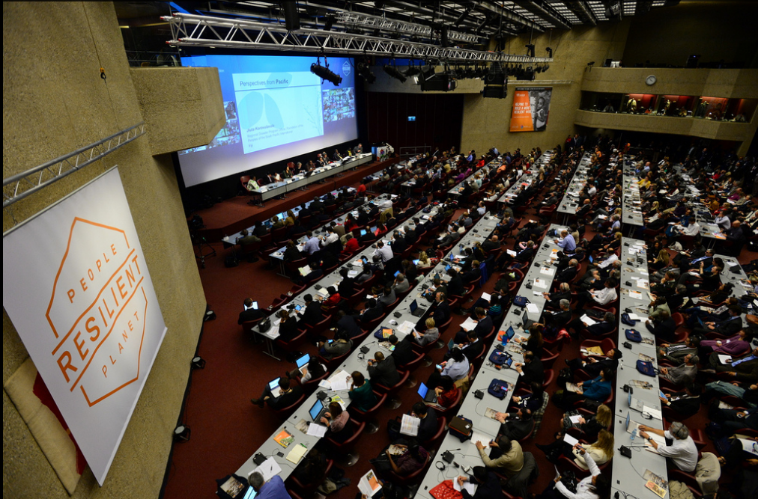
Accomplishments since the 2012 Plenary: : Action 5
Positioning of EO from Space in future Hyogo Framework for Action (2015-2025)
Direct interface established with UN ISDR
Active participation to 2013 Global Platform;
last major event before the World Conference on Disaster Risk Reduction in Japan in 2015. 5,000 participants
CEOS DRM activity mentioned at Plenary session.
Explicit mention of use of space-based technology in Chair’s Summary.
Inputs to GAR 15 Report

Slide 4
Overall Status on Pilots
Generation of EO requirements for the 3 pilots to address the users needs for all DRM phases.
EO Requirements based on real user needs e.g.:
1. Flood:
Global: Univ. Maryland, Dartmouth Flood Observ., Deltares
Caribbean: CIMH
Southern Africa: Namibia Department of Hydrology
Southeast Asia: Mekong, MRC-IKMP, Java, Indonesian Ministry of Public Works
2. Seismic Risks & Volcanoes: Geohazard Supersites & Natural Laboratories
Preliminary identification of satellite missions / instruments to respond to EO requirements.

Slide 5
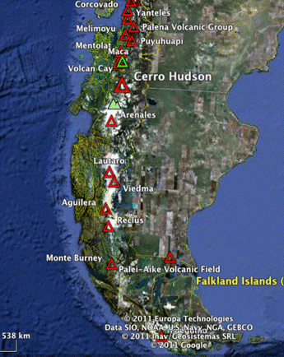
Pilots Overview – Regional Geographical Coverage
Type of Hazard | Thematic Team co-Leads | Regional Geographic Areas of Focus
Floods | Stu Frye, NASA Bob Kuligowski, NOAA | Caribbean (focus on Haiti) Southern Africa (focus on Kvango and Zambezi basins) Southeast Asia (Mekong basin and Java)
Seismic Risks | Philippe Bally, ESA Joern Hoffmann, DLR | Portion of the global seismic belt (TBD - interest in Alpine-Himalayan Belt, Central America), Areas covered by GSNL, 4 to 6 earthquakes of interest (>M5.8) per year 2014-2016.
Volcanoes | Michael Poland, USGS, Simona Zoffoli, ASI | Latin American volcanic arc (Mexico though southern Chile, including the Antilles) for regional monitoring; Supersites of the GSNL; Sites of major volcanic events 2014-2016

Slide 6
Recovery Observatory
Space agencies already
organise the “response” part of the cycle (International Charter, Sentinel Asia)
propose an “ad-hoc” approach on scientific requirements for a specific zone or disaster/theme (better understanding of hazard phenomena, modelling, etc.)
After the initial response, space agencies have little or no coordination for the post-crisis part of the disaster management cycle
What is a “Recovery Observatory”?
Infrastructure(s) providing access to EO data of use in the Recovery phase (non profit activities)
Data should include that acquired during the response and a regular (every several months) acquisition during Recovery
Links to local users and to international organisations

Slide 7
Recovery Observatory
Proposal is to
set-up and agree all organisational aspects (including procedure to decide on the creation of an RO following a major event)
create ONE pilot RO following a major event during the CEOS DRM activities
Example of “Kalhaiti” RO established by CNES following Haiti earthquake, Jan 2010
integration of large quantity of EO data acquired during the Charter activation (approx. 3Tb – 69000 files)
regular acquisitions during Recovery period (<150 images since 2010)
large community of local and international users
Next steps: tiger team established with ESA, NASA, JAXA to further detail organisational aspects; update at Plenary

Slide 8
Detailed Example: Floods Pilot
Goal: demonstrate the effective application of satellite EO to the full cycle of flood management at global and regional/local scales
Pilot Objectives:
Integrate info from existing NRT global flood monitoring and modeling systems in a Global Flood Dashboard;
Deliver EO-based flood mitigation, warning and response products and services through regional end-to-end pilots in:
The Caribbean (with focus on Haiti);
Southern Africa, incl. Namibia, South Africa, Zambia, Zimbabwe, Mozambique and Malawi;
Southeast Asia (with focus on lower Mekong Basin and Java, Indonesia).
Encourage regional in-country capacity to access EO data and integrate into operational systems and flood management practices.

Slide 9
Detailed Example: Floods Pilot
Relies partly on existing initiatives:
e.g. objective B relies on existing GEO flood monitoring activities over Caribbean and Namibia, led by NASA (Stu Frye) and on a NASA / USGS activity over the Lower Mekong River Basin Project
EO requirements incl. geographical zones (polygons) defined and potential candidate missions satisfying EO requirements, pre-identified (see next two slides)

Slide 10
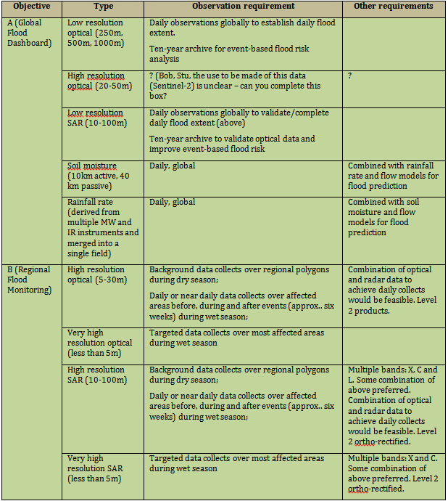
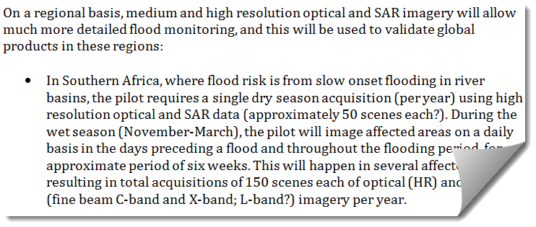
Detailed Example: Floods Pilot – High Level Requirements
GLOBAL (extract)
REGIONAL (extract)

Slide 11
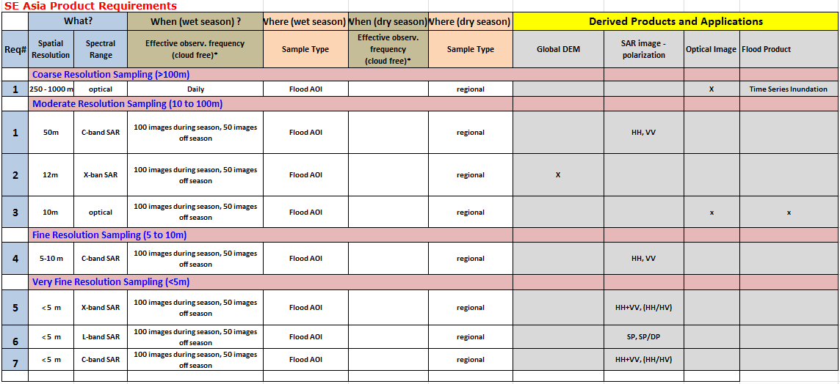
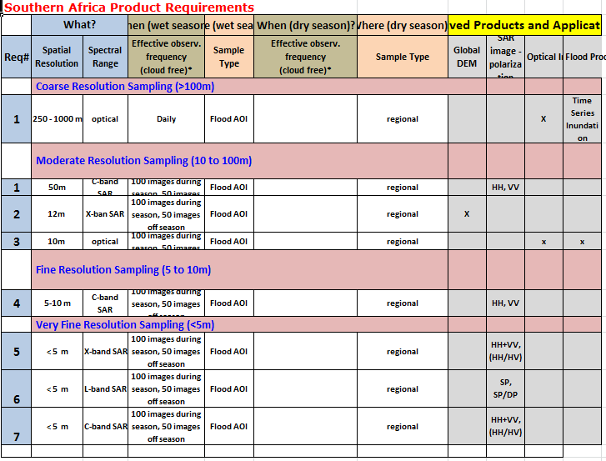
Detailed Example: Floods Pilot – Detailed EO Requirements
STILL UNDER CONSOLIDATION
until 2014 Spring SIT meeting

Slide 12
Seismic Risks Pilots
Goal: long-term goals as defined by users & practitioners in the Santorini Report on satellite EO and geo-hazards
Pilot Objectives:
Support the generation of globally self-consistent strain rate estimates and the mapping of active faults at the global scale by providing EO InSAR and optical data and processing capacities to existing initiatives, such as the iGSRM,
Support and continue the GSNL for seismic hazards and volcanoes,
Develop and demonstrate advanced science products for rapid earthquake response.
EO requirements incl. geographical zones (polygons) defined and potential candidate missions satisfying EO requirements, pre-identified

Slide 13
Volcanoes Pilots
Goal: long-term goals as defined by users & practitioners in the Santorini Report on satellite EO and geo-hazards
Pilot Objectives:
Demonstrate the feasibility of integrated, systematic and sustained monitoring of Holocene volcanoes using space-based EO;
Demonstrate applicability and superior timeliness of space-based EO products to the operational community (such as volcano observatories and VAACs) for better understanding volcanic activity and reducing impact and risk from eruptions;
Build the capacity for use of EO data in volcanic observatories in Latin America as a showcase for global capacity development opportunities.
EO requirements incl. geographical zones (polygons) defined and potential candidate missions satisfying EO requirements, pre-identified

Slide 14
Future remaining activities and milestones
Issue the CEOS DRM Observation Strategy (1st issue at SIT WS, 2nd issue at CEOS Plenary) incl.:
Pilots definition,
Pilots EO Requirements;
Preliminary response to EO requirements i.e. list of relevant satellite missions/instruments and products.
Finalize CEOS DRM Observation Strategy i.e. consolidate response to EO requirements (Spring SIT meeting)
Issue Recovery Observatory proposal (1st issue at SIT WS, 2nd issue at CEOS Plenary, final issue at 2014 Spring SIT)
Issue paper for GAR 15 prepared (to be used for HFA2) (31 Dec 2013)

Slide 15
2015 WC DRR and HFA-2
Recent announcement for the 2015 World Conference on DRR hosted by Japan (Sendai) in March 2015.
Fantastic opportunity for CEOS Agencies to advocate for a greater use of EO data from space for DRR
Active support from JAXA required to interface with the relevant Japanese entities (government, agencies, ..) involved in the preparation of 2015 WCDRR to ensure that :
the right messages (from the point of view of space agencies) are properly passed to the politicians and decision-makers and inserted in WCDRR Declaration
the contribution of Satellite EO is appropriately promoted in the HFA2.

Slide 16
CEOS DRM at CEOS Plenary and 2014 GEO Plenary / Summit
Proposed as new GEO Disaster component for next revision of GEO Work Plan
to be endorsed at next GEO Plenary – Jan. 2014
Contribution to GEO Ministerial Summit to be defined.
Information on any decision(s) that need to be made at CEOS Plenary:
Endorse the pilots definition and their EO requirements (response to EO requirements to be consolidated with relevant CEOS Agencies and to be presented at 2014 SIT meeting)

Slide 17
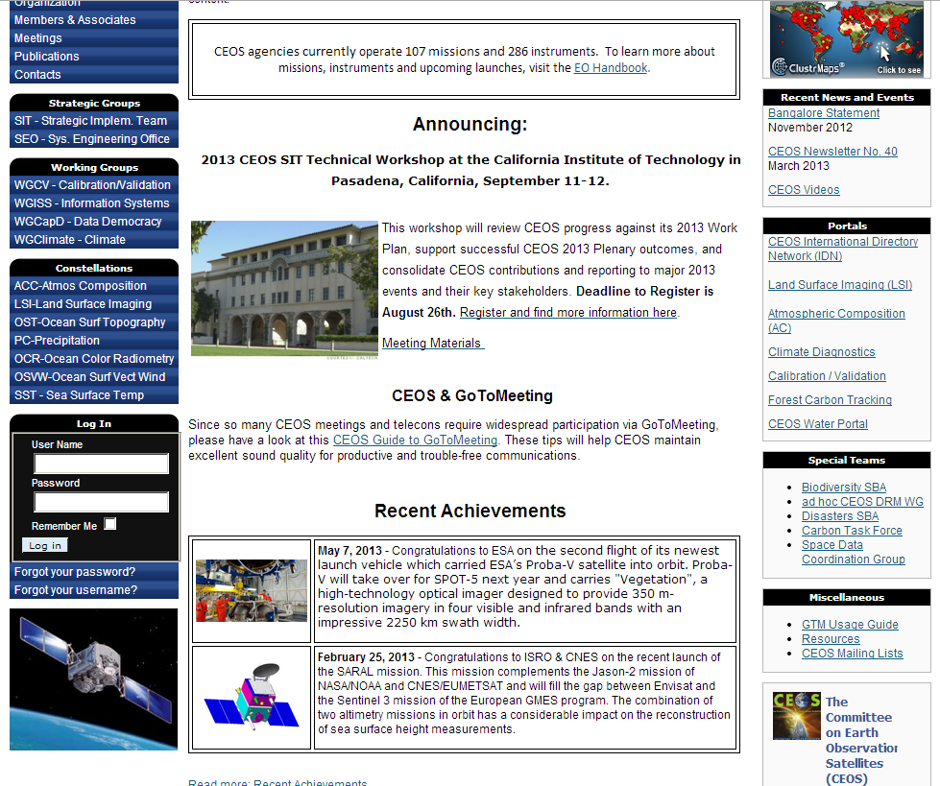
Other relevant activities
WGISS GA4D (Karen Moe, NASA)
CEOS contribution to task DI-01 of the GEO WP.
For more details on pilots, please refer to the “Ad Hoc CEOS DRM WG” page, on CEOS web site

Slide 18
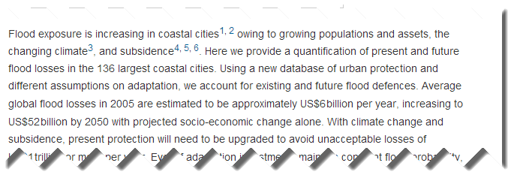
Thank you !!!!
© article “Future flood losses in major coastal cities” by Hallegatte, Green, Nicholls, Corfee-Morlot
Published in Nature Climate Change (Aug. 18, 2013)

