Slide 1
CEOS Strategic Response to GEOGLAM Requirements
Brian Killough
CEOS SEO, Member of the CEOS ad hoc WG on GEOGLAM
SIT Workshop Agenda Item #13
CEOS Work Plan: AGRI-2, AGRI-4, AGRI-5, AGRI-6
CEOS SIT Technical Workshop
EUMETSAT, Darmstadt, Germany
17th-18th September 2015

Slide 2

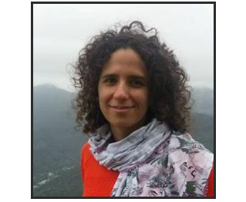

GEOGLAM:
Programmatic Updates
Community Centric Dynamic Implementation
  GEOGLAM, as a system of systems, moves at the pace of its activities (communities) – our implementation is dynamic to keep pace with growing community of practice
New “Distributed” Secretariat Staffing
Dr. Michel Deshayes
GEOGLAM Coordinator
(Geneva)
mdeshayes@geosec.org
Dr. Inbal Becker-Reshef
Crop Monitor Coordination
(France)
ireshef@geoglam.org
Dr. Alyssa Whitcraft
EO Data Coordination
(Netherlands)
akwhitcraft@geoglam.org

Slide 3
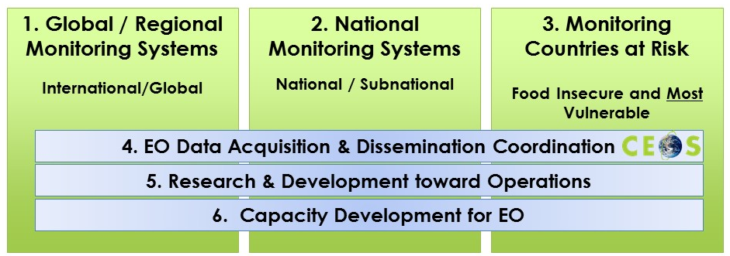
GEOGLAM:
Programmatic Updates
Activities Since March 2015
Preparations for Advisory Committee Meeting, 9 November 2015
  Membership from USA*, Canada, China, Japan, European Commission^{++,} South Africa; AMIS, CEOS, WMO, WFP, GEO, FAO, African Union⁺⁺; BMGF
  Formulation of a GEOGLAM Package
  Growth of GEOGLAM Community of Practice
Revision of GEOGLAM Component Structure:

Slide 4
Ad Hoc WG Updates Since SIT-30
CEOS representative to the GEOGLAM Advisory Committee confirmed as incoming CEOS Chair Alex Held (CSIRO)
  First meeting to be convened at GEO Plenary XII, Mexico City, 9 November 2015
  GEOGLAM Side Event at GEO Plenary XII on 10 November 2015
AGRI-4: Revision of the “CEOS Strategic Response to GEOGLAM Requirements”
  Called “The Strategy” herein. Summary to follow
Development of a new “Scope of Work” document for the Ad Hoc WG
  Summary to follow
AGRI-2: JECAM Annual Report. CLOSED. Report posted at JECAM website
AGRI-5: Data Services Prototypes and Lessons Learned Report. OPEN. To be completed by the SEO for the CEOS Plenary. Focused on Asia-Rice and JECAM.
AGRI-6: Common Data Sharing Strategy for JECAM. CLOSED. NASA and CSA completed a common data sharing agreement for Radarsat-2 (called a MURF).

Slide 5
CEOS Strategic Response (AGRI-4)
Summary of Main Changes to the Strategy Being Proposed
Updated from a full-length requirements document to one emphasizing CEOS response to the GEOGLAM requirements
  2013-14: CEOS Acquisition Strategy for GEOGLAM
  2015: CEOS Strategic Response to GEOGLAM Requirements
New accompanying document: “Scope of Work” of the Ad Hoc WG:
  Emphasizes that activities go beyond acquisition coordination
  Also encompass strategic relationships, data access, availability, dissemination, and usability.
Discussion of Ad Hoc WG’s “sunset” goals & post-sunset CEOS support to GEOGLAM via existing CEOS entities (e.g. LSI-VC, CEOS SEO, CEOS Working Groups, etc.)

Slide 6
Scope of Work Document
Scope of Work is a brief 2-page document which outlines the full current and proposed breadth of the Ad Hoc WG.
It Addresses These Questions
What is GEOGLAM and with whom are its key relationships?
What are the goals and activities of the Ad Hoc WG?
What has CEOS done for GEOGLAM in the past?
What can CEOS continue to do for GEOGLAM in the future? (ONGOING)
What new activities can CEOS do for GEOGLAM in the future? (NEW)

Slide 7
When is the Ad Hoc Working Group for GEOGLAM finished?
Annually, the group reviews whether is has met these goals ...
GEOGLAM is satisfied that most of its EO requirements are being and will continue to be met, recognizing the future will bring emerging needs and mission changes.
GEOGLAM is satisfied it has valid global baseline datasets (e.g. crop area & type masks, and crop calendars) and can use CEOS-coordinated EO to make regular (3-5 years) updates.
GEOGLAM is satisfied it has a plan for storing, processing, and analyzing space-based EO data through cloud-based or local solutions, and scene-based or data cube solutions.
GEOGLAM is satisfied it has a baseline user agreement that will allow sharing of restricted data for R&D among many users and sites.
Once these goals are complete, we propose ....
Future support to GEOGLAM, including the coordination of data acquisition, can be provided through the Land Surface Imaging Virtual Constellation (LSI-VC) and Systems Engineering Office (SEO).
The LSI-VC will evaluate new EO requirements and missions, communicate availability of new EO datasets, and facilitate access to datasets.
GEOGLAM will appoint a POC to sit on the LSI-VC.
The SEO will maintain open source tools to support data management including the provision for Data Cubes and will conduct systems analyses, as needed.

Slide 8
Decisions Required
The Ad Hoc Working Group Will Ask Plenary To
Endorse the updated 2015 CEOS Strategic Response to GEOGLAM Requirements
Endorse the new CEOS Ad Hoc Working Group on GEOGLAM Scope of Work
Renew the mandate of the Ad Hoc Working Group for another year with consideration for the proposed transition arrangements

Slide 9
Background Materials

Slide 10
Way Forward
Actions from SIT (April 2015)
Endorse a CEOS candidate for the GEOGLAM Advisory Committee - COMPLETE
Test data services prototypes and report lessons learned – ONGOING
Define JECAM data requests to CEOS Agencies – ONGOING
Report on the progress of new missions (Sentinel) and new programs/partnerships (EWCM, RAPP, SIGMA, Sen2Agri) and the impact to GEOGLAM – ONGOING
  Proposed synergy between AgMIP test sites and JECAM sites
Press on with archival data connections, query, and data requests – ONGOING
New or Upcoming Actions
      Review GEOGLAM CapDev ⬅➔ CEOS WGCapD
      Get space agency support for rapid processing of archival data
      Get space agency support for production of “analysis-ready” data
      Evaluate options to meet requirements for new activities (EWCM, RAPP, AgMIP)
Notes:
Establish guidelines & system for communicating specific GEOGLAM data requests to Space Agencies through CEOS
Improve coverage; improve access to data including early access to new mission datasets
GEOGLAM works with Space Agencies to open up data licensing to community
Form Working Group to develop and implement cross-site SAR experiment

Slide 11
GEOGLAM: Crop Monitor
Activities Since March 2015
Continued Success of GEOGLAM Crop Monitor for AMIS
AMIS request to formalize relationship with GEOGLAM
Regular improvement of information products (crop calendars, crop type mask; pie charts by production & export…)
GEOGLAM internal survey carried out on Crop Monitor to guide improvements
Prototyping of National Crop Monitors
Interest from Ministry in Tanzania to develop a monthly Crop Monitor bulletin as part of the STARS project
Similar interest from South Africa and SA Development Community
Prototyping of the Early Warning Crop Monitor
Based off of success & experience of CM for AMIS
First full run → September 2015

Slide 12
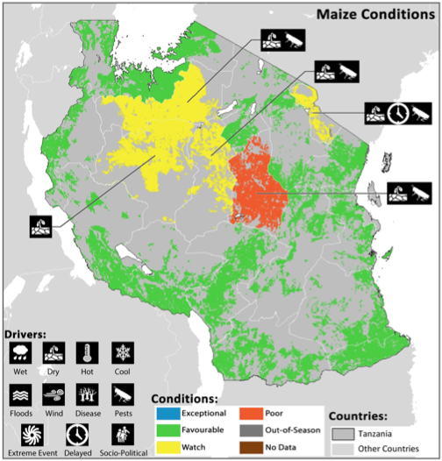
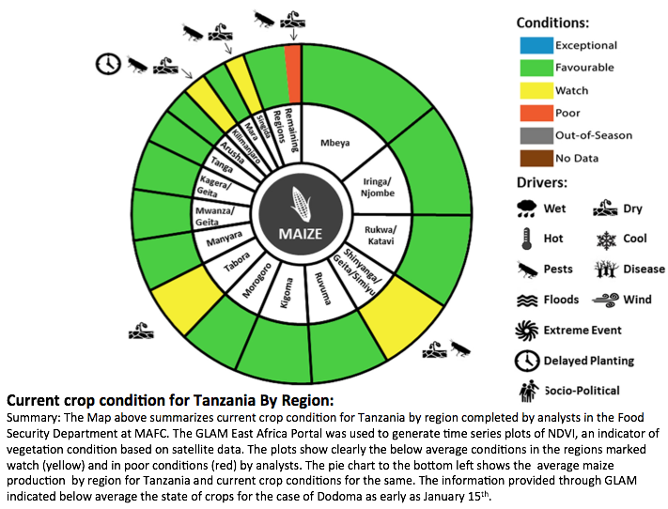
GEOGLAM:
National Crop Monitor for Tanzania
Interest from Ministry in Tanzania to develop a monthly Crop Monitor bulletin as part of the STARS project
Similar interest from South Africa and SADC

Slide 13
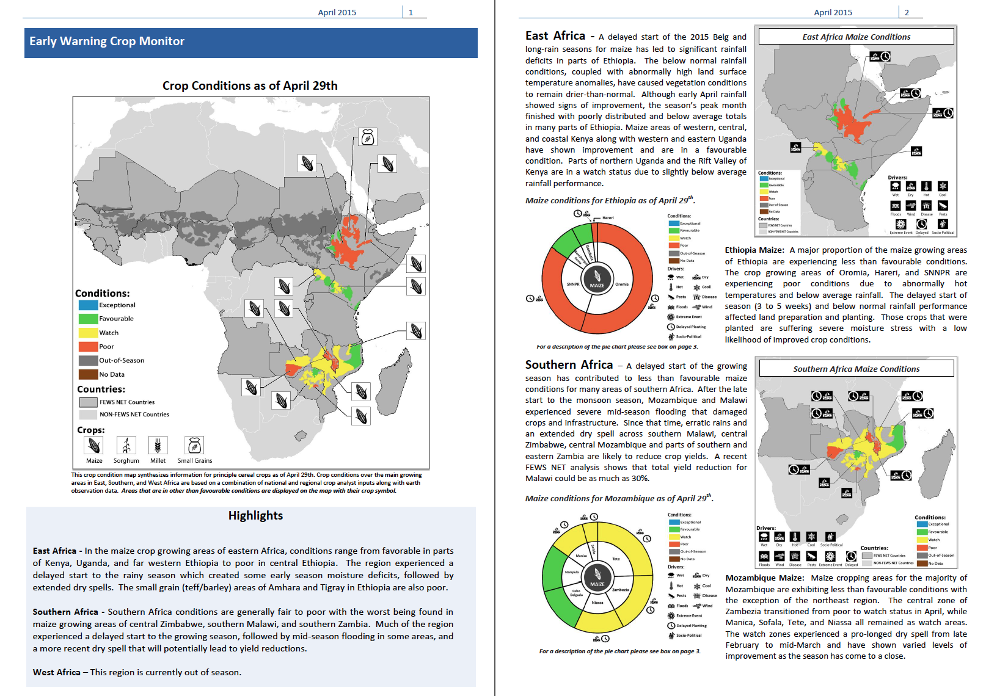
GEOGLAM:
Early Warning Crop Monitor
Full prototype will be run at the end of September, open to EW community
Notes:
The prototype for FEWSNET, from April 2015

Slide 14
GEOGLAM:
Rangeland and Pasture Productivity
Activities Since March 2015
3rd Workshop held in Campinas, Brazil, 20-22 July 2015
Agreement to form an internal working group to develop requirements for pasture monitoring – adapted from GEOGLAM’s cropland example
Growing network of pilot sites for data products and model intercomparison – follows JECAM approach
GEOGLAM RaPP global dashboard under development
Will provide visualizations and querying of global rangeland and pasture cover and biomass from RS
Two CSIRO staff visited Uni of Maryland in June to learn from GLAM and Crop Monitor experience and increase collaboration
New lead / Point of Contact for RAPP: Juan Guerschman (CSIRO)
More info: http://www.geo-rapp.org/

Slide 15
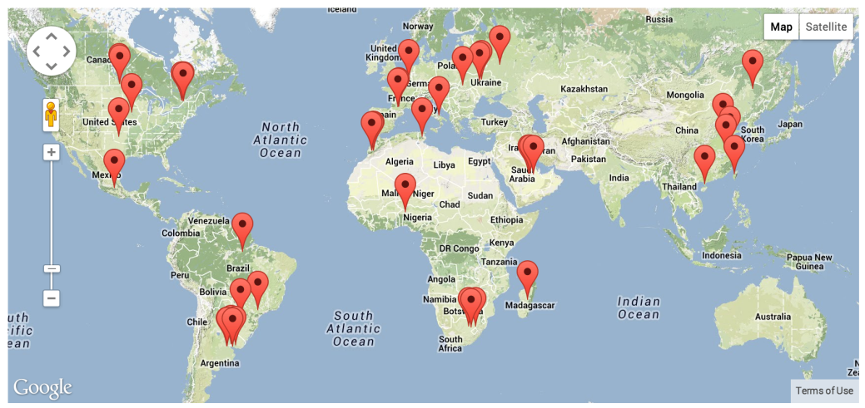
JECAM: Joint Experiment for Crop Assessment & Monitoring
  R&D for operational agricultural monitoring systems
  A global network of 33 sites
  2014 Annual report on the JECAM website
  Annual meeting November 16-17, Brussels
Minimum Dataset Guide Documents
  Guidelines for site definition & minimum EO data
  Guidelines for in-situ data collection
  Multi-User Agreement for Radarsat 2 Data
  To support multi-site inter-comparison studies
  Proposed - Dedicated cloud-computing storage & tools and processing capabilities
Next 2 years:
  Multi-site SAR experiment building on Minimum Dataset exercise
  & NASA prototype and support for SIGMA optical inter-comparison research
  Optical inter-comparisons, tools and computing capacity (Sen2-Agri and SIGMA Project)
  Proposal (AAFC and CSA) – JECAM/Commercial Data Providers Workshop
www.jecam.org
Notes:
15

Slide 16


Asia-RiCE Team Highlights
2015 Achievements
CEOS agencies data acquisitions
X/C/L SAR data from CSA/MDA, ESA, ASI, DLR, ISRO and JAXA
High resolution optical data utilization (CNES)
2. Data analysis
Time series SAR data from multiple sources to estimate rice planted area, growing status, etc.
Provision agro-meteorological information derived from satellites
Worked with ASEAN food security information system (AFSIS) to provide crop condition overview information and outlooks for FAO AMIS through GEOGLAM
Test bed
The JAXA/RESTEC teams developed the INAHOR (rice crop planted area estimation software) and JASMIN (agro-met information provision system for outlook) tools
NASA/CEOS SEO developed and tested a cloud computing SAR processing (INAHOR) platform for Indonesia
Rice Phenological Stages Classification using Radarsat-2 Data (VH_VV)
29 July 2014 (Subang Area, West Java) by MOA, LAPAN with JAXA

Slide 17
Asia-RiCE Team Highlights
2016 Plans & Anticipated Challenges
1. 2016 Plans
Continue working with Phase 1A/1B TDS to generate target products using Radarsat-2, Sentinel-1, ALOS-2, CSK, TerraSAR-X , RISAT, etc. (Continue working closely with CSA, ESA, JAXA, ISRO and other CEOS agencies to ensure continuity of data supply for the TDS)
Continue Sentinel-1 reference site coordination with ESA/IRRI/RIICE/NCU, and work with ESA to explore the possibility of further expansion to other SE Asian sites during the ramp-up phase of the mission.
Continue working with CESBIO to maximize the potential outcomes from the ESA DUE Innovator III program.
Initiate integrated usage of HR optical instruments with SAR for crop analyses through SPOT 5 Take 5 in 2015 and Venus in 2016 with Landsat and Sentinel-2, and with coarse resolution satellites such as MODIS and GCOM-C in 2016.
2. Challenges
Sustained observations & easy data access: Share observation / acquisition plan of multiple satellites at one site to conduct information validation for rice growing and production estimation (especially for wall-to-wall (whole country))
Support ICT environment with applications; Expand SDMS for end users such as Min of Ag.
Promote EO data and related information sharing (especially ground data and base line datasets)
Promote cross validation for outlook and rice crop growing and production estimation

Slide 18

Data Services Prototypes:
Status & Lessons Learned
JECAM Data Services Project
  Sites: Ukraine, Belgium, South Africa, Argentina, Germany, Canada
  Datasets: Radarsat-2, TerraSAR-X, and other optical datasets.
  Dedicated and cloud-based storage and SAR processing capabilities
  Secure access and data sharing within guidelines of license agreements
  STATUS: Under planning with Agri-Food Canada. Exploring the use of Amazon Web Services for hosting.
  LESSONS: Hosting of restricted datasets (Radarsat-2) requires careful planning and understanding. Users should pay for hosting.
Asia-RiCE Data Services Project for Indonesia.
  Secure access for JAXA and Indonesia Asia-RiCE science users.
  Dedicated storage for up to 35 Radarsat-2 images (provided by CSA) and cloud processing of SAR datasets using INAHOR tool.
  STATUS: Data Services tool functioning well. No issues.
  LESSONS: Cloud-based services operate better when they are close to the user. Moving server to Singapore helped performance.

Slide 19
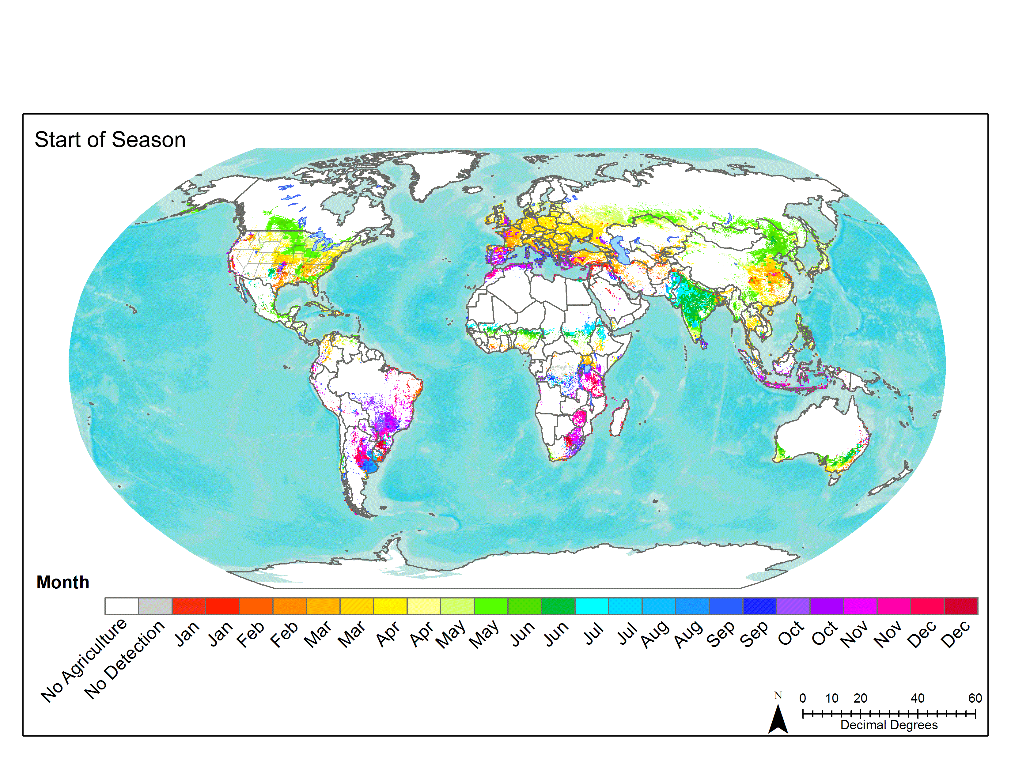

Archival Data Links Update
Archive Data for Baseline Product Generation
The accuracy of baseline datasets (e.g. crop type & calendars)
could be improved through the use of fine to moderate resolution (<100 meter) archive data.
Benefits for progress toward implementation:
  Establishes data request process
  Facilitates evaluation of new data streams
  Supports future data acquisition planning.
Current Growing Season Calendars
How?
Obtain direct access to archive metadata (via COVE tool) STATUS: Ongoing; Links to Landsat, SPOT, Radarsat, Pleaides already in place; Sentinel-1, RapidEye (late 2015) upcoming
Request access to those which comprise a sufficient data record for baseline dataset generation (e.g., crop maps, crop calendars)
STATUS: Upcoming once archive links are complete & once we have support from space agencies for rapid processing of archival data

Slide 20
What has CEOS done for GEOGLAM in the past?
Activities below have been accomplished via the Ad Hoc Working Group for GEOGLAM:
Assisted in identifying and evaluating missions to meet GEOGLAM’s Earth Observation (EO) data requirements, as well as in completing detailed assessments of global coverage, measurement gaps, and cloud cover impacts, together with GEOGLAM scientists.
Helped GEOGLAM organize its baseline long-term acquisition requirements.
Coordinated EO data for JECAM (GEOGLAM R&D project), for Asia-RiCE, and for GEOGLAM Activities (e.g. Sentinel-1A data).
Provided a cloud-based space data management system for Asia-RiCE testing of radar data. Initiated a cloud-based data management system for a radar intercomparison study.
Added features to the COVE (CEOS Visualization Environment) tool to support agriculture data acquisition and applications. These include links to past acquisition metadata, addition of a coverage analyzer tool, land cover classification overlays, and revisit analyses overlays with cloud cover constraints.
Developed, with GEOGLAM, a multi-user, multi-site user agreement to utilize Radarsat-2 restricted data for JECAM.
Engaged commercial satellite agencies to contribute data to JECAM (e.g. RapidEye)
Initiated development of a new prototype data management service based on a Data Cube to address challenges related to data storage, internet connectivity, and processing.

Slide 21
What can CEOS do for GEOGLAM in the future?
Respond to GEOGLAM requirements as they evolve.
Evaluate new datasets relevant to GEOGLAM EO requirements, including the European Sentinel missions, other CEOS missions, small satellites, and commercial space assets.
Further develop and test the data management system prototypes to support JECAM, Asia-RiCE, and other GEOGLAM activities.
Expand the use of multi-user, multi-site user agreements for the distribution and use of restricted-use datasets from multiple space agencies.
Maintain flexibility within the Ad Hoc Working Group to address challenges related to data acquisition and dissemination as they evolve and grow.
Provide input to the GEOGLAM Advisory Committee.
Evaluate acquisition metadata archives using the COVE tool and request archival data for GEOGLAM production of improved baseline datasets (e.g. crop area & type masks, and crop calendars).
Support Space Agency rapid processing of archival data (open and restricted) and delivery to GEOGLAM for baseline datasets.
Support Space Agency provision of analysis-ready data products (open and restricted). Remove processing burden on users. Collaborate with GEOGLAM on the development of standardized preprocessing requirements for analysis-ready data for agriculture monitoring.
Complete and test a prototype national Data Cube and user interface to support agriculture applications. Space Agency support to ingest analysis-ready data layers.
Evaluate EO requirements for emerging agriculture activities and initiatives (e.g. Rangelands and Pasture Productivity-RAPP, Early Warning Crop Monitor).
ONGOING
NEW

Slide 22













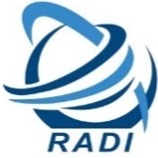










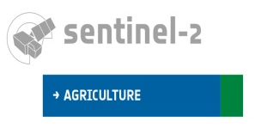





























GEOGLAM Actors
GEOGLAM Community of Practice
Open Community made up of international and national agencies concerned with agricultural monitoring including Ministries of Ag, space agencies, universities, & industry
22 / 21

