Slide 1
CEOS Work Plan 2015-2017 And looking forward to 2016-2018
Committee on Earth Observation Satellites
CEOS Executive Officer Team
Agenda Item 20
CEOS SIT Technical Workshop
EUMETSAT
17th to 18th September 2015

Slide 2
Brought to you by …
The CEOS Minions!

Slide 3
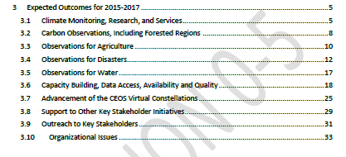
“The purpose of this document is to set forth near-term objectives and deliverables designed to achieve the goals outlined in the CEOS Strategic Guidance document”

Slide 4
How do we track?
Ceos-deliverables.org updates
Entered by you
Captured from VC/WG TagUps
Updates in your ‘backup slides’
Updates from this session

Slide 5
How are we tracking?
General impressions of progress towards objectables due before or shortly after Plenary 2016
 |  | Due by Q4 2015 | Due by Q4 2016
 | Completed or on track | 39 | 14
 | Material Delays | 9 | 2
 | No progress or other issues | 1 | 3
 | No update | 2 | 1

Slide 6
General comment
Lesson for the day
Monitoring progress is easier where there are clear steps.
Break (It) Down
Break
Break
Suggest more use of the ‘Actions’ function of the Deliverables Tool.

Slide 7
Timeline for work plan update
Early Nov 15
Late Nov 15
Late Jan 16
Mid Feb 16
28 Feb 16
New
Initiatives
Updated Priorities
MilestoneChanges
Refinement
Concurrence
CEOS-29
v0
V0.5
Pre-V1
V1.0
Discontinued Objectables
Status
Updates
Add/Remove
Objectables
Validation
Major Slips
Plenary
Outcomes
Revise
Rationale
WGs/VCs/AHTs
CEO Team
SEC
CEO Team
Chair Team
WGs/VCs/AHTs
Principals
(Virtual Endorsement)

Slide 8
Frequently Asked Questions
Deliverable Tracker
Who needs to update the information?
Responsible Entities – Typically WG Chairs, VC Co-Leads, Ad-Hoc Team Leads
When does it need to be updated?
Suggest monthly, at least quarterly.
And when something significant (positive or negative) occurs.
How can we learn this new system?
For new users (e.g. new Chairs) and those who are perhaps a bit rusty … contact the SEO for very helpful advice.
Who do we talk to for support?
Content – The CEO Team.
Functionality/technical – The SEO Team.

