Slide 1
WG Disasters, VCs and Hydromet Hazards
Committee on Earth Observation Satellites
Ivan Petiteville, ESA
Juliette Lambin, CNES
VC / WG Day
EUMETSAT, Darmstadt, Germany
16th September 2015

Slide 2
The Context
A large portion of disasters – over 90% by some assessments – are linked to hydrometeorological hazards.
Climate change is expected to lead to an increase in the intensity and frequency of some of these hazards (number of extreme weather events x3 by 2100).
Disasters induced by hydromet hazards: all types of floods, coastal hazards, landslides,..

Slide 3
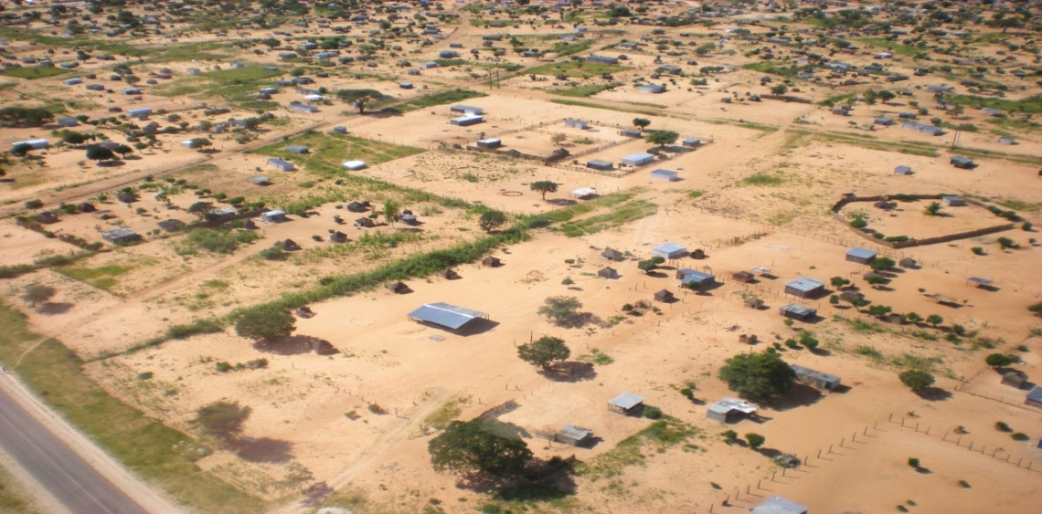
Single & Multi Hazard
Pilot Projects
1. Series of on-going end-to end projects to demonstrate benefits of satellite EO to ALL DRM phases, with strong user involvement:
Floods, Volcanoes, Seismic Hazards (end in 2017)
Recovery Observatory (multi hazard – not yet triggered)
2. New pilot focused on Landslides following a multi-hazard approach (geohazards, hydromet hazards)
3. New multi-hazard GEO initiative proposed to the GEO community:
GEO-DARMA
NASA staff with two Namibian agents (Namibian Department of Water Affairs and Forestry) and one villager
Courtesy NASA.
Notes:
ESA with NASA are exploring the value of a multi-hazard landslide pilot, which includes
- Primary triggers from other hazards (wildfires, rainstorms, earthquakes, volcanoes, permafrost degradation, sedimentation, high stream flows, and inundation) and man-made development activity;
- Secondary cascading hazards from slope failures, mudslides, diverted or blocked streams, dam burst floods, debris flow, displacement waves and tsunamis; and
- Infrastructure impacts such as damaged roads-rail lines and utilities

Slide 4
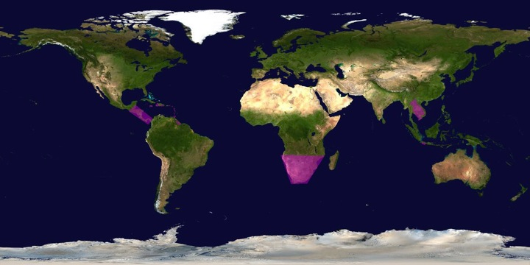
Flood Pilot
Both global and regional activities.
FLOODS

Slide 5
CEOS Flood Pilot Overview
Goal: demonstrate effective application of EO to the full cycle of flood management at all scales by:
Objective A: Integrating information from existing NRT global flood monitoring / modeling systems into a Global Flood Dashboard;
Objective B: Delivering EO-based flood mitigation, warning, and response products and services through regional end-to-end pilots in:
Caribbean/Central America (focus on Haiti)
Southern Africa (inc. Namibia, South Africa, Zambia, Zimbabwe, Mozambique, and Malawi);
Southeast Asia (focus on lower Mekong Basin and Java)
Objective C: Encouraging at least base-level in-country capacity to access EO and integrate it into their operational systems and flood management practices

Slide 6
Flood Pilot:
Data Acquisition Status
Detailed EO Requirements for each Pilot approved at 2013 Plenary; acquisition allocations approved at 2014 Plenary
Individual requests from each Pilot coordinated by co-leads and detailed on consolidated request form
Mission / Instrument | Repeat or Revisit | Swath | Resolution | Agency | Image Counts
 |  |  |  |  | Annual Quota | Last 6 months | Total
Optical - Coarse Resolution (>100 m)
Terra / MODIS | 1 day | 2230 km | 250, 500, 1000 m | NASA
Aqua / MODIS | 1 day | 2230 km | 250, 500, 1000 m | NASA
NPP / VIIRS | 1 day | 3000 km | 375, 750 m | NASA
Optical - Moderate Resolution (10 to 100 m)
Sentinel-2A / MSI | 10 days | 290 km | 10, 20 m | ESA | ? | N/A | N/A
EO-1 / ALI | 204 days | 185 km | 10, 30 m | NASA | 300 | 42 | 112
Landsat-8 / OLI | 16 days | 183 km | 15, 30 m | USGS | 730 | ? | ?
Optical - High Resolution (<10 m)
SPOT (archive only) | 26 days | 60 km | 1.5 and 6 m | CNES |  | 0 | 0
Pleiades | 26 days | 20 km | 50 cm and 2 m | CNES | 50 | 0 | 0
C-Band SAR
Sentinel-1A / SAR | 12 days | 80, 250, 400 km | 9, 20, 50 m | ESA |  | 15 | 15
Radarsat-2 / SAR-C | 1-6 days | 8-500 km | 0.8 to 100 m | CSA | 500 (3 yr) | 110 | 200
ALOS-2 / PALSAR-2 | 14 days | 25 to 490 km | 10 to 100 m | JAXA | 100? | 0 | 0
X-Band SAR
Cosmo Sky-Med / SAR-2000 | 5 days | 10-200 km | 1 to 100 m | ASI | 300 | 67* | 67*
* 50 of the 66 CSK images were archive images that counted toward the 2014 quota

Slide 7
Floods Pilot: How Data Are Being Exploited
Geographic Area | Product | Value Added Partner
Haiti | Flood extent maps, flood risk maps, landslide maps, flash flood guidance / threat maps, integrated risk assessment platform | SERTIT, CIMA, INGV, Altamira, CIMH, RASOR FP7, NOAA/HRC
Other Caribbean islands, Central America | Flood damage maps, change detection products, co-registered map overlays | CATHALAC, CIMH, NASA/GSFC
Namibia | Flood extent maps, flood warning products, co-registered map overlays | Namibia Hydrology Dept, Namibian Water Authority, NASA
Zambezi basin | Flood extent maps, flood forecast models, flood hazard maps, flood depth forecasts | Lippmann Institute (PAPARAZZI, HAZARD, WATCHFUL), DELTARES, NASA/JPL
Mekong | Flood extent maps, flood risk maps, flash flood guidance / threat maps | Mekong River Commission, NASA, NOAA/HRC, USGS, University of South Carolina, Texas A&M
Java (Bandung, Jakarta, Cilacap) | Flood risk maps, subsidence maps tied to flood risk, tsunami risk maps (Cilacap only), flood extent maps | SERTIT, Deltares, CIMA, Altamira, INGV, RASOR FP7
Products used by: national end users, civil protection agencies, World Bank,
Red Cross, World Food Program, River Commissions (Kavango, Zambezi,
Mekong)

Slide 8
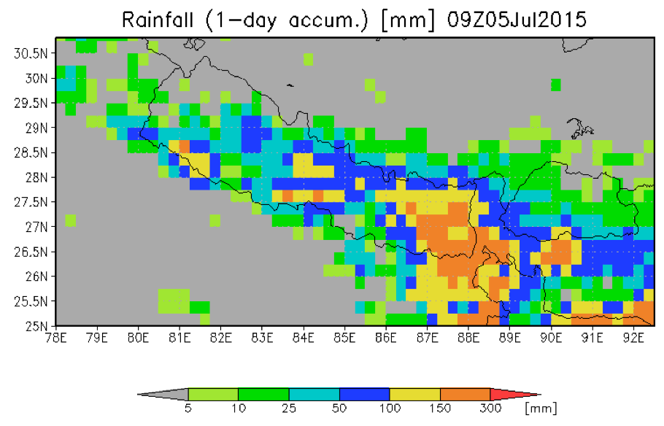
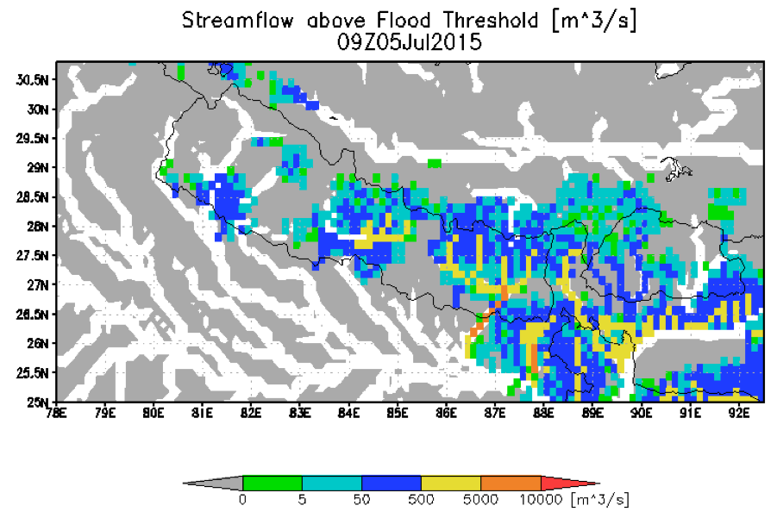
Floods Pilot: Obj. A Global Component : GFMS
GFMS cited by UN World Food Program:
"The Global Flood Monitoring System (GFMS) provides one key step further by indicating how an excess rainfall event will impact river flow, and also whether there is a potential for flooding downstream away from the heavy rain event," said E.Niebuhr, World Food Program. "We check the GFMS nearly every single day to monitor current flood concerns, and also to assist in discovering new flood events that may not have been reported yet or are developing”.
Nepal Department of Hydrology and Meteorology and ICIMOD used GFMS data after the Nepal earthquake

Slide 9
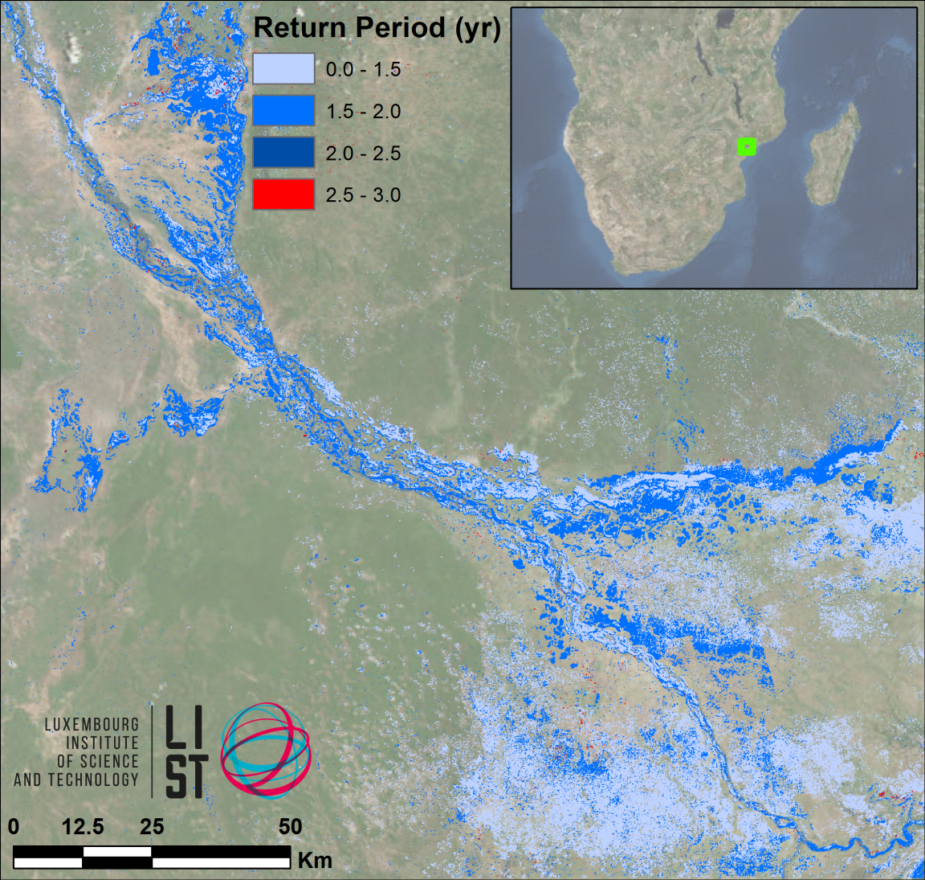
Floods Pilot: Obj. B - Southern Africa
LIST flood hazard maps determine flood severity by comparing flood extent in a SAR image with computed extent / return period from simulated historic floods
The UN World Food Programme has shown interest

Slide 10
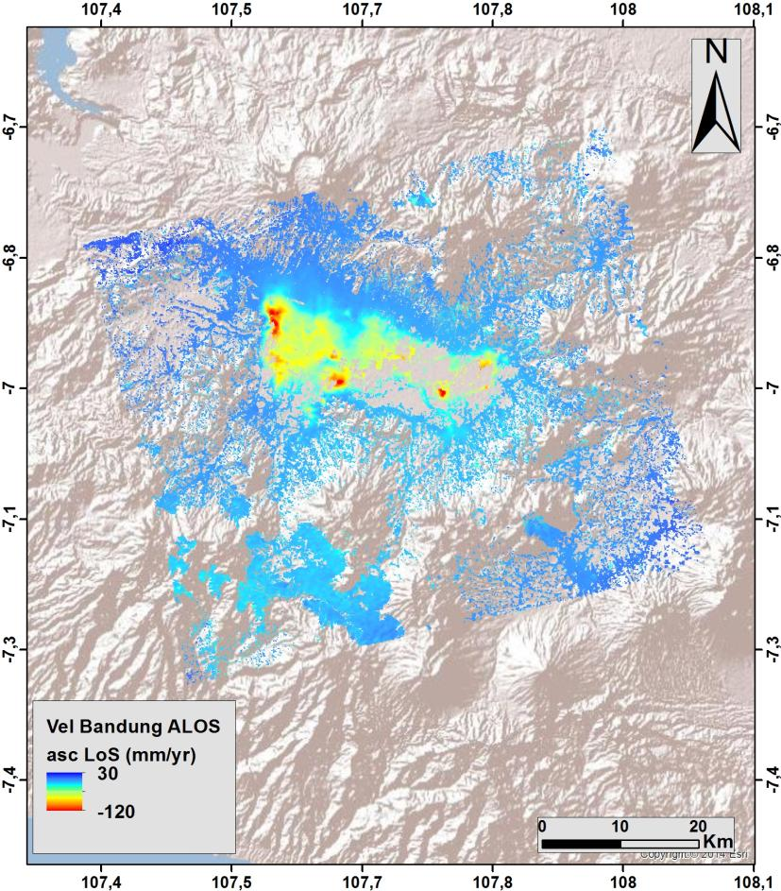
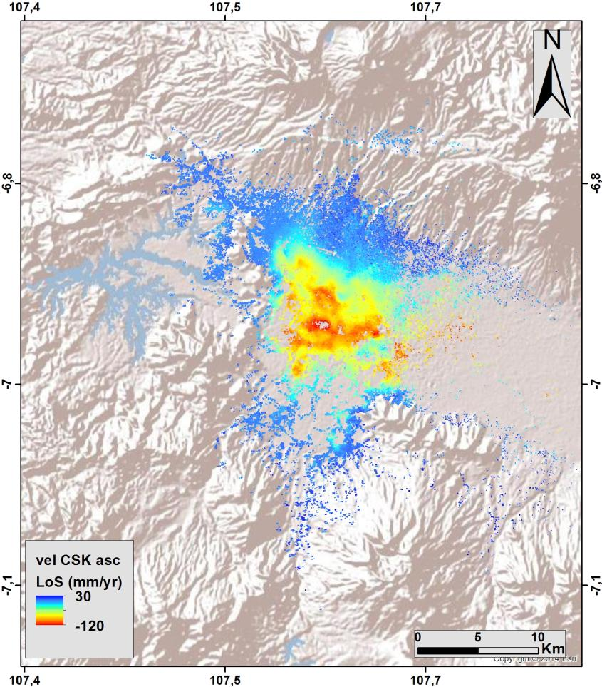
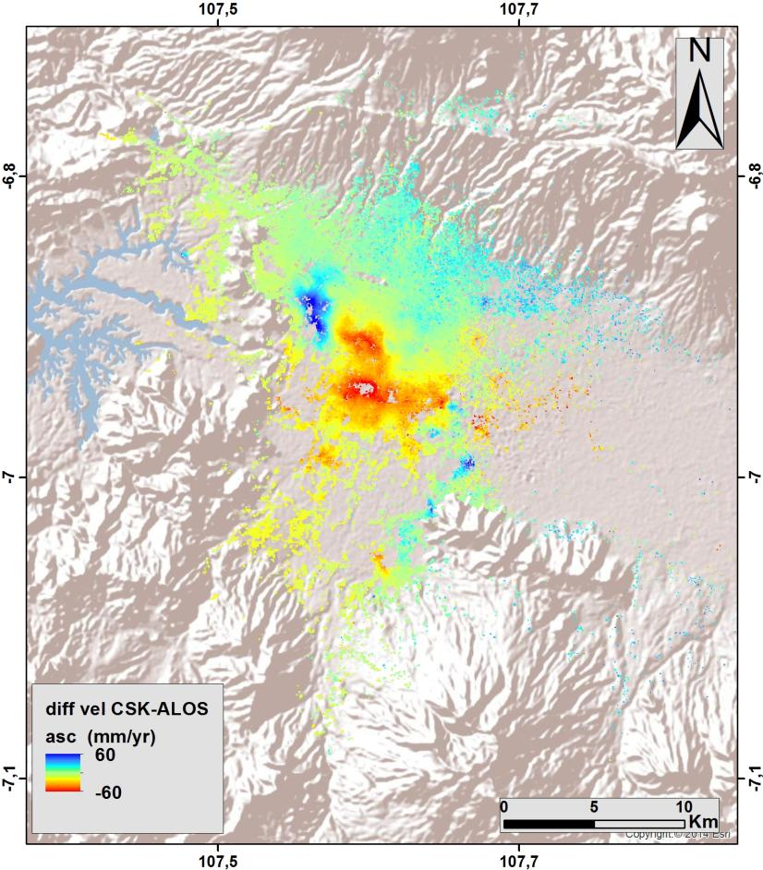
Floods Pilot: Obj. B - South-East Asia
ALOS ascending (2007-2011)
CSK ascending (2013-2015)
Difference (CSK-ALOS)
(red = increased rate of subsidence)

Slide 11
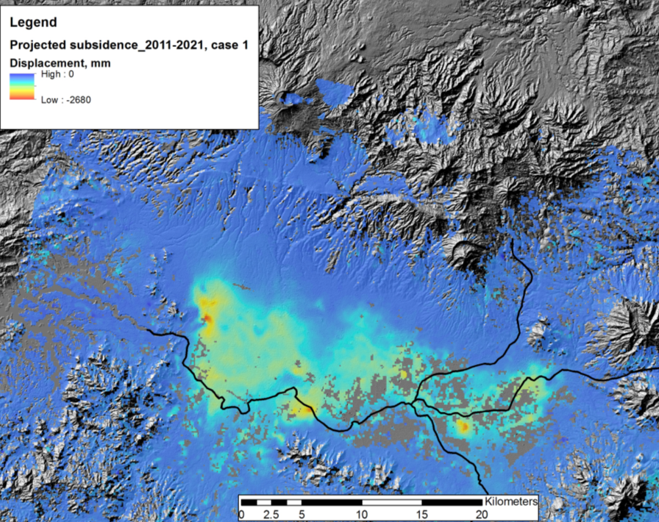
Floods Pilot: Obj. B - Subsidence Projection
Other Activities:
Consultations on new pilot
products with UN, World Bank, and ICRC
Asian Disaster Preparedness
Center (ADPC, Bangkok
Thailand) to setup instance of
flood modeling and monitoring
processing and distribution
software installed under
cooperation with SERVIR and
USAID Oct-Nov 2015
Projected total subsidence by 2021 of up to 2.2 m along main drainage areas.
© INGV
11

Slide 12
Floods Pilot: Obj. B - Texas
Data provided: EO-1, ASTER, COSMO-SkyMed, Sentinel-1, and LANDSAT, plus high-resolution GFMS forecasts
Users: FEMA, US Forest Service, EPA, Texas Water Development Board and Texas Commission on Water Quality, plus briefings by UT-Austin personnel to Texas Emergency Operations Center and Governor’s Emergency Management Council
Feedback from Theresa Howard and Gordon Wells (UT-Austin):
“The imagery offered a detailed view of inundation impacting agriculture in rural areas, which is information that can be difficult to obtain from other sources. The imagery also helps to fill in the coverage gaps between stream gages that are monitored for current and forecast conditions.”

Slide 13
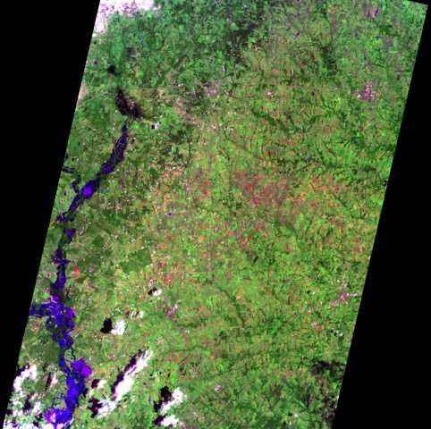
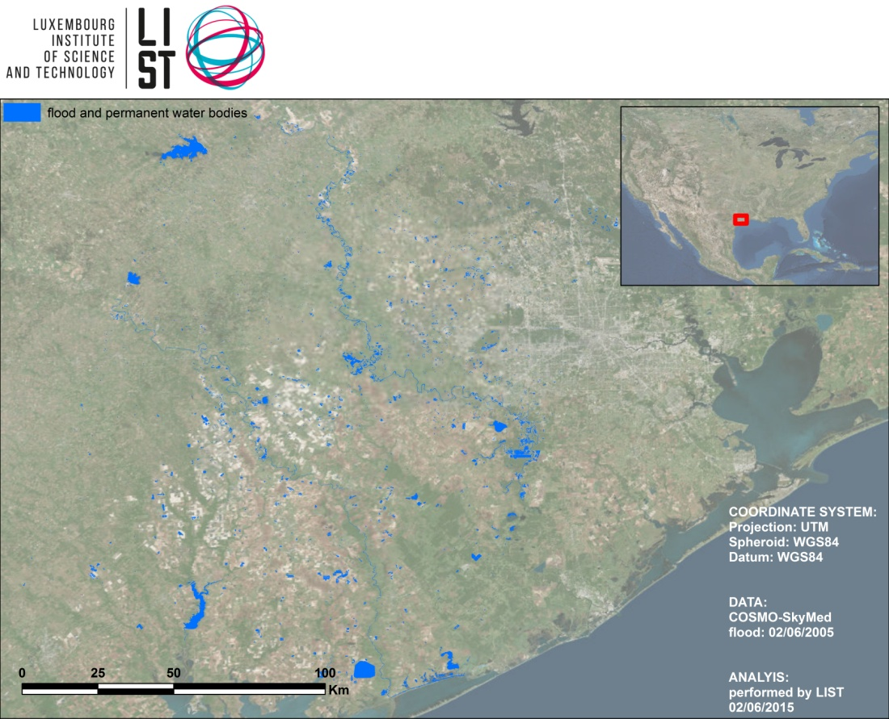
Floods Pilot: Obj. B - Texas
COSMO-SkyMed, 2 June 2015 as processed and analyzed by LIST
EO-1, 1045 CDT 27 May 2015
Imaged processed by Texas partners

Slide 14
Main Flood Pilot Issues
Data acquisition: all negotiated acquisition agreements are being honored by the data providers for limited periods that have to be renegotiated every 2 years.
Data access: access to some data is limited because of licensing issues (commercial customers have priority over Flood pilot and data unavailable to pilot)
Notes:
Data Access: A non-CEOS agency (which had declined to join the Pilot) is acquiring data (mainly Radarsat-2) that the Pilots would like to use, but their licensing agreements are (unintentionally) making these data inaccessible to the Pilots and preventing the Pilots from demonstrating their (added) value.

Slide 15
WGDisaters, VCs and Hydromet Hazards
WGDisasters currently cooperate with WGCapD and WGISS on respectively Capacity Building activities and on the Recovery Observatory.
Currently no specific activities with VCs though VCs are key to climate change studies and in particular several VCs focus on phenomena related to hydromet hazards.

Slide 16
WGDisaters, VCs and Hydromet Hazards (cont’)
Question 1:
Do some VCs conduct activities directly related to disasters ?
Question 2:
Are there areas of cooperation that could benefit to the WG Disasters ? Either related to on-going activities (e.g. Flood, Recovery observatory, Landslides) of future ones (e.g. GEO-DARMA)

