Slide 1
Incoming Themes for 2017
Committee on Earth Observation Satellites
Frank Kelly, USGS
SIT Tech Workshop 2016 Agenda Item #3
CEOS Strategic Implementation Team Tech Workshop
Oxford, UK
14th-15th September 2016

Slide 2
2017 Initiatives
Presentation Overview
2017 Objectives
Context
Process and Initiatives Paper
Initiatives
Implementation of the Future Data Architectures report recommendations.
An initiative on moderate resolution sensor interoperability

Slide 3
2017 Objectives
Maintain and build upon current processes and accomplishments
Ensure continuity and coherence of CEOS activities
Ensure that the priorities and themes identified by the current Chair (CSIRO) and the current SIT Chair (ESA) are supported and further developed through 2017
Pursue conclusions and recommendations of the two ad hoc teams which have been operating in 2016
Future Data Access & Analysis Architectures
Non-meteorological Applications for Next Generation Geostationary Satellites

Slide 4
Context – Established Themes
2016 initiatives and themes established by CSIRO and ESA
Future data access and analysis architectures.
Non-meteorological applications for next generation geostationary satellites.
Consideration of future partnerships and priorities for CEOS, notably with GEO, the UN system, development banks, and the big data players.
Expediting existing CEOS thematic acquisition strategies – in relation to forests, agriculture, disasters, climate, carbon and water.

Slide 5
Context – Priority Topics
Analysis Ready Data (ARD) definition and development of a CEOS strategy, and reducing obstacles facing users interested in EO satellite data uptake and application.
CEOS Data Cube in support of existing CEOS activities and as part of a solution to the challenges.
Trial implementations of these activities demonstrating utility for CEOS and its agencies building on efforts already underway.
Interoperability of moderate resolution optical data products in parallel to ARD efforts, pursue progress on interoperability among key data streams for maximum benefit from the multitude of instruments now operating.

Slide 6
Process and Initiatives Paper
Short paper to communicate to the CEOS community the USGS proposals for its activities and priorities as Chair in 2017
Paper serves as a focus for discussion and debate in the lead-up to the SIT Technical Workshop and the CEOS Plenary
Aims is to establish support and consensus among CEOS agencies for these proposals and to harvest feedback in order to best shape and direct the plans for 2017

Slide 7
Implementation of FDA Recommendations
Finalization of the CEOS ARD definition by the SEO and LSI-VC.
Systematic availability of ARD from multiple CEOS agencies.
Consultation with the big data players to maximize ARD uptake.
Advance Data Cube 3-Year Work Plan and implementation arrangements.
Further development of existing Data Cube and ARD prototypes.
Address opportunities and challenges raised by the GFOI Global Data Flows study.
Deployment mix in support of CEOS and agency objectives.

Slide 8
Moderate Resolution Interoperability
Generally applicable framework for land moderate resolution interoperability
Radiometry, geometry, data formats, metadata, and data access, and metrics and reporting
Case study focused on Landsat-Sentinel-2 interoperability
Document, publish, and communicate clearly to the community the objectives and intended uses of the interoperable products
Case study to be conducted in concert with WGCV
Evaluating processors for atmospheric correction and surface reflectance retrievals
Defining calibration protocols
Moderate resolution = 10 – 100m

Slide 9
Approach within CEOS Organization
In order to maintain momentum and continuity, the intention is that both initiatives will be taken forward within existing Ad Hoc Teams, Working Groups, and VCs
No new CEOS organizations or structures being proposed, but coordination with existing structures is required
Groups may include:
CEOS SEO
WGCV
WGISS
LSI-VC
FDA Ad Hoc Team (future to be discussed)

Slide 10
Next Steps to Plenary
Consultation on initiatives to continue in the lead up to their presentation for endorsement at Plenary.
Initiatives paper circulated for comment before SIT Technical Workshop – feedback still welcome.
Proposed SIT Technical Workshop ACTION: CEOS agencies to provide the USGS CEOS Chair Team with comments on the Proposed 2017 CEOS Chair Initiatives paper by Friday 30 September.

Slide 11
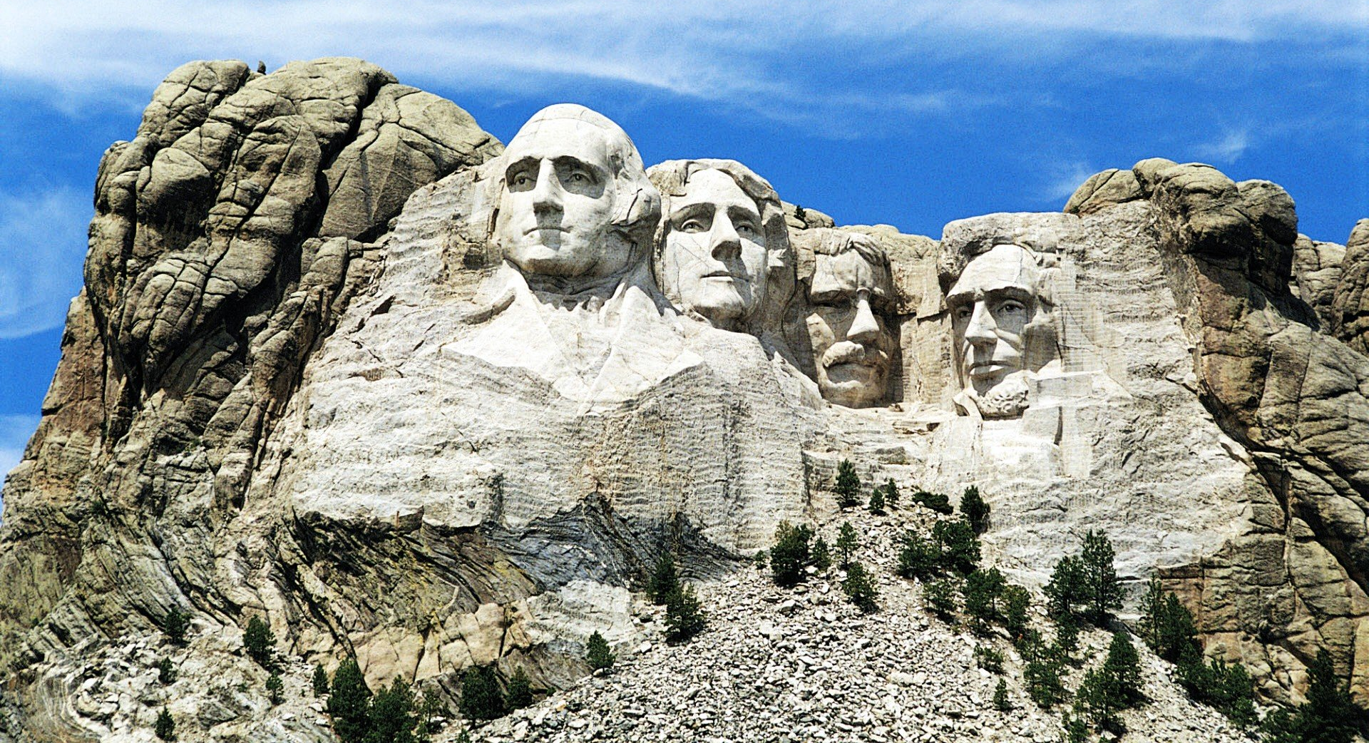
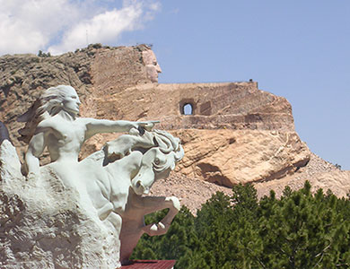
Questions?
We look forward to welcoming you to Rapid City, South Dakota and the Black Hills National Forest – 18th-20th October 2017!

