Slide 1
CEOS Data Cube Initiative
Committee on Earth Observation Satellites
Brian Killough NASA, CEOS Systems Engineering Office
SIT Tech Workshop 2016 Agenda Item #5
CEOS SIT Technical Workshop
Oxford, UK
14th-15th September 2016

Slide 2
The Latest Trends
Free and open data
Growing data volumes
Improved computing technologies
Open source software
Pre-processed products

Slide 3
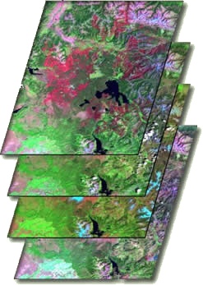
What are Data Cubes?
Data Cube = Time-series multi-dimensional (space, time, data type) stack of spatially aligned pixels ready for analysis
Proven concept by Geoscience Australia (GA) and the Australian Space Agency (CSIRO) and planned for the future USGS Landsat archive.
Shift in Paradigm ... Pixels vs Scenes
Analysis Ready Data (ARD) ... Dependent on processed products to reduce processing burden on users
Open source software approach allows free access, promotes expanded capabilities, and increases data usage.
Unique features: exploits time series, increases data interoperability, and supports many new applications.
TIME
Data Cubes are an example of a Future Data Architecture

Slide 4
Data Cube Architecture
Working with CEOS Space Agencies to develop plans for sustained provision of Analysis Ready Data (ARD)
Landsat, Sentinels, MODIS, climate data and more ....
Data
Open source software, developed and sustained by CEOS
Support for diverse datasets
Deployment via local computers, regional hubs (e.g. SERVIR), or computing cloud (e.g. Amazon)
Connections to common GIS tools (e.g. ArcGIS, QGIS)
Advanced Programming Interfaces (APIs) for users
Data Cubes
Working prototype in Colombia with more planned
Developing and testing user interfaces for custom mosaics and water management
Capacity building options (SilvaCarbon, World Bank, SERVIR)
Users

Slide 5
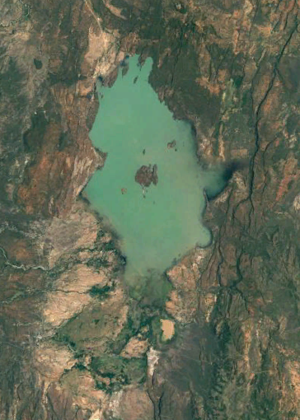
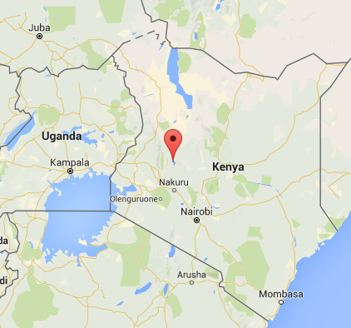
Water Detection Tool
Kenya
Lake Baringo National Park

Slide 6
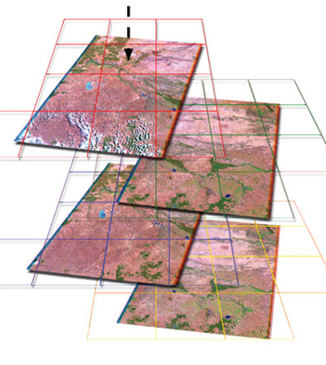
Data Preparation and Analysis
Data Preparation
Landsat 7, 2005 to 2016 (11 years)
169 original scenes (202 GB of data)
1x1 degree Data Cube “stack” with annual storage unit “chunks”
3710 x 3710 x 169 = 2.3 billion pixels total
37 GB NetCDF data volume (5:1 compression)
Data Analysis
3.5 GHz Intel processor (4-core), 64GB RAM, Linux computer
Modified Australian water detection algorithm (WOFS) uses multiple Landsat bands for 97% accuracy
~30 minutes for a full time series analysis

Slide 7
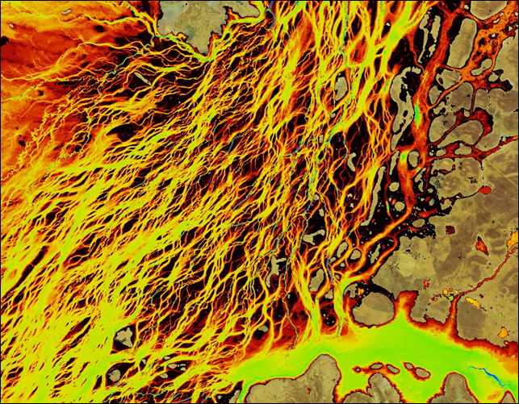
Australian WOFS Algorithm
WOFS = Water Observations from Space
Example: Braided river network of Coopers Creek in Queensland, Australia
Blue = permanent water
Red/Yellow = infrequent flood events
CEOS has implemented the 23-step WOFS algorithm to produce results similar to those shown here
Braided river networks and flood extent are very difficult to map with traditional methods

Slide 8
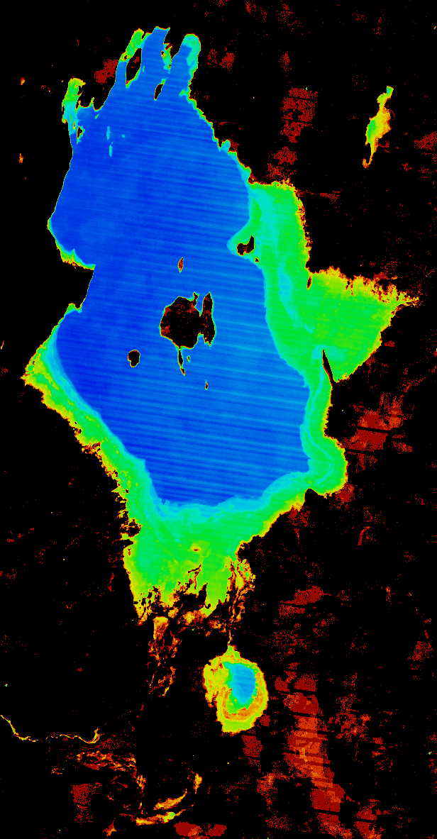
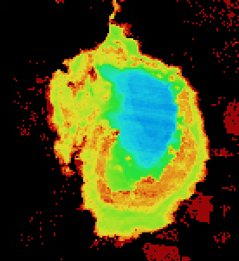
Lake Baringo, Kenya 11-year Time Series Results
The final product shows the percent of observations detected as water over the 11-year time series (water observations vs. clear observations).
Blue = frequent water
Red/Yellow = infrequent flood events
Flood risk can be easily inferred from the analysis results. 30-meter Landsat resolution allows detailed assessments that are far better than MODIS (250-m).

Slide 9
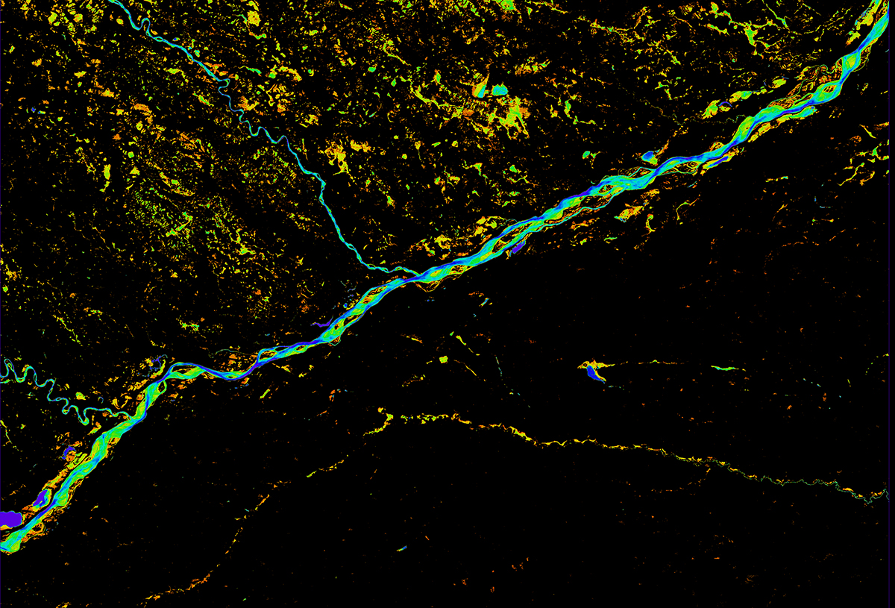
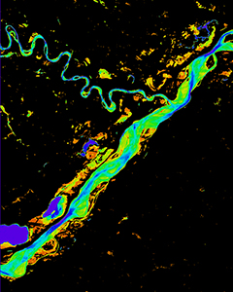
Meta River, Colombia 15-year Time Series Results
The final product shows the percent of clear observations detected as water over the 15-year time series
Blue = frequent water
Red/Yellow = infrequent flood events
Many regions do NOT have persistant water. Infrequent water above the Meta River is due to the annual rainy season.

Slide 10
Data Cube Work Plan
Provides a reference for internal and external Data Cube activities as there is great interest in Data Cubes and Future Data Architectures (FDA)
Provides a reference for CEOS agency contributions and discussion by CEOS leadership regarding coordination to ensure outcomes
Formal endorsement by CEOS to be discussed.
The majority of the work is managed and funded by the SEO with significant contributions by CSIRO and GA.
The SEO works closely with Australia to utilize elements of the AGDC development and communicates with USGS regarding its plans for LCMAP.
The document captures expected outcomes, task descriptions and target dates of completion.
Version-1 (Sept 2016) released.

Slide 11
Work Plan Outcomes
There are 5 major categories of Data Cube (DC) outcomes:
(1) Core Technology
General Software Development – ingestors, APIs
Interfaces with GIS tools (e.g. ArcMap, QGIS)
User Interface (UI) tools (e.g. cloud-free mosaics, water)
(2) Data Preparation and Formatting
Analysis Ready Data (ARD) definition – supported by LSI-VC
New v2 ingestor configurations (MODIS, SRTM, ALOS, SPOT-5, climate data)
(3) User Requirements and Engagement
GFOI and FAO – future end-to-end country demo (Colombia), SEPAL integration
GEOGLAM – possible Asia-Rice demo, RAPP demo in Caramagua, Colombia
(4) Capacity Building
Data Cube Documentation and Training (deployment, use)
World Bank – heavy interest, primary focus on water, possible prototypes
CEOS WGCapD – planning to discuss regional training coordinators at 2017 meeting

Slide 12
Work Plan Outcomes continued
(5) Prototypes
Colombia – The government (IDEAM) and Andes University teams have made considerable progress in learning how to create and use Data Cubes! Land change detection and water detection are the primary application needs. Future plans will add many more datasets and applications. SEO and CSIRO are supporting.
Kenya – Recent changes in the government have caused uncertainty in the plans for a Data Cube project in 2017. Australia and Clinton Foundation have terminated their work.
Lake Chad, Africa – Considerable interest from World Bank in using a Data Cube for time series analysis of land and water in the Lake Chad region. Possible project to begin in mid-2017, pending approval. SEO is leading.

Slide 13
Work Plan Outcomes continued
Asia Mekong – Investigating possible project with SERVIR and JAXA to serve Data Cubes to the Mekong region. CSIRO leading with SEO support.
Balkans – Recent proposal submitted to World Bank to develop a Data Cube to support multiple applications in Albania. Proposed start by mid-2017. SEO is leading.
Switzerland – SEO approached by UNEP GRID Geneva and the Univ. of Geneva to develop a Data Cube pilot project. Significant computing and programming resources exist, so little effort is needed to get them started. They are running fast ... SEO is leading.
Disasters Pilot – Recent discussion with David Green (NASA Disasters Lead). Evaluating the potential to test the SLIP-DRIP landslide analysis code with a Data Cube. SEO is leading.

Slide 14
Leading to Plenary
CEOS Plenary Decisions
Endorsement of the 3-year Data Cube Work Plan
Other items of interest leading to the CEOS Plenary ...
How should we manage this effort in the future? Is this a SIT or CEOS Chair task? Should SEO continue to lead with high support from GA, CSIRO, and USGS?
Additional contributions are welcome from other CEOS agencies in support of Data Cube tasks. To date, this effort is supported by the SEO, GA, CSIRO and USGS. We need new data ingestors, regional trainers, application tools and prototype support.

