Slide 1

Overview of progress on Japanese Engagement Activities with UNFCCC/IPCC
Committee on Earth Observation Satellites
Akiko Suzuki, Japan Aerospace Exploration Agency
UNFCCC/IPCC Engagement Side Meeting
SIT Tech Workshop 2017
ESA/ESRIN, Frascati, Italy
12th September 2017

Slide 2





“Road to IPCC Guidelines”
Support coordination with IPCC
IPCC Guidelines
（to be refined in 2019）
Methodology document
Satellite-based GHG Data
Develop methodology document to support for national statistician to use GHG data for the accuracy of the greenhouse gases inventory.
Provide high accurate data set and documents (ATBT)
Calibrations and validation for quality control
CEOS
Provide and share GHG data
Space Agencies
Ministry of Environment/NIES
Ministry of Education, Sports, Culture, Science and Technology
JAXA
GOSAT/
GOSAT-2(*)
NASA
OCO-2
GeoCarb
ESA
Sentinel-5p,
FLEX
CNES
IASI, MicroCarb, MERLIN
DLR
MERLIN
CMA
TanSat
*GOSAT/GOSAT-2 are joint projects by Ministry of Environment, NIES and JAXA .

Slide 3
Background
SIT-32 in Paris in April 2017
  JAXA held a side meeting to share information about refinement schedule of the IPCC guidelines on National Greenhouse Gas Inventories and Japanese efforts for the guidelines; and to discuss how satellite GHG data support accuracy of National GHG inventories
  CEOS agreed to provide review of and input to, via the AC-VC, “Methodology Document” developed by MOE/NIES.
13th CEOS AC-VC Meeting in Paris in June 2017
  JAXA reported Japanese contribution to the IPCC guidelines on National GHG Inventories and requested the AC-VC members to review “Methodology Document” developed by MOE/NIES.

Slide 4
Summary of Progress
“Road to IPCC Guidelines”
Support coordination with IPCC
IPCC Guidelines
（to be refined in 2019）
D
Efforts for Engagement with International Bodies
CEOS Review
Methodology document
Satellite-based GHG Data
A
Develop methodology document to support for national statistician to use GHG data for the accuracy of the greenhouse gases inventory.
Provide high accurate data set and documents (ATBT)
Calibrations and validation for quality control
Drafting “Methodology Document”
B
CEOS
WGCV
Efforts for Quality Control and Accuracy of GHG Data
Provide and share GHG data
Ｃ
Space Agencies
Ministry of Environment/NIES
Ministry of Education, Sports, Culture, Science and Technology
JAXA
GOSAT/
GOSAT-2(*)
NASA
OCO-2
GeoCarb
ESA
Sentinel-5p,
FLEX
CNES
IASI, MicroCarb, MERLIN
DLR
MERLIN
CMA
TanSat
Cooperation with Space Agencies
*GOSAT/GOSAT-2 are joint projects by Ministry of Environment, NIES and JAXA .

Slide 5
Summary of Progress
“Road to IPCC Guidelines”
  Drafting Methodology Document
    NIES is drafting the methodology document for its release for review at the end of September.
  Efforts for quality control and accuracy of GHG data
    In July, JAXA conducted annual GOSAT – OCO-2 Joint Vicarious Calibration in Nevada in cooperation with NASA.
    JAXA proposed WGCV a protocol based on knowledge accumulated by 8-year GOSAT – OCO-2 Joint Vicarious Calibration Campaign.

Slide 6
Summary of Progress
“Road to IPCC Guidelines” (2/2)
  Cooperation with Space Agencies
    JAXA shared concept of “Road to IPCC Guidelines” with ESA, CNES and DLR and each Head of Agencies agreed to cooperate.
    JAXA, ESA, CNES and DLR recognized that enhancement of accuracy of satellite GHG data through cross calibration and validation was essential for engagement with IPCC.
  Efforts for engagement with international bodies
    JAXA shared concept of “Road to IPCC Guidelines” with the Secretary General of WMO.
    Government of Japan stressed to engage and support specific policy mandate, such as Paris agreement, supported by CEOS during the GEO Program Board meeting in August. Planning Paris Agreement workshop was determined for outreach to broad community such as GCOS, UNFCCC, WMO.
Notes:
・9月13日には、東京でThelma Krug IPCC副議長が気候変動シンポジウムに登壇（hosted by 環境省、外務省、国連広報センター)。気候変動によるリスクに関する最新の科学的知見の概要について基調講演を行う。

Slide 7
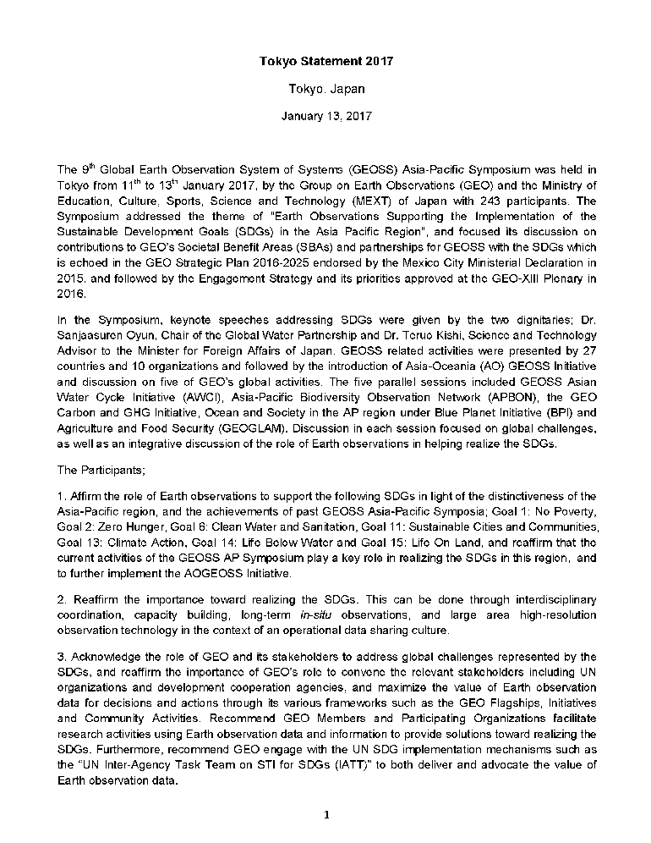
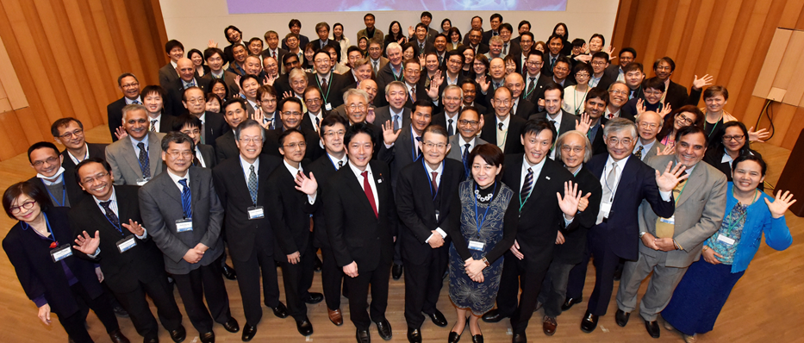
Regional Activities:
9th GEOSS Asia-Pacific Symposium in January 2017
Shared the goal among international science community
GEO Carbon and GHG Initiative working group discussed how research community support policy implementation.
Tokyo Statement 2017
“importance of the use of carbon cycle and GHG related observations, from both in-situ (including air and shipborne) and space-based observations, particularly in the frame of UNFCCC and IPCC for national greenhouse gas inventory reporting.”
Purpose of GEOSS Asia-Pacific Symposium
To provide researchers, engineers and practitioners from the AP region a forum to exchange information and to discuss cooperation on specific initiatives and other activities in each thematic area, to promote the effort of GEOSS and to make further cooperation in the AP region.
Total over 2,100 participants (as of the 9th Symposium)

Slide 8
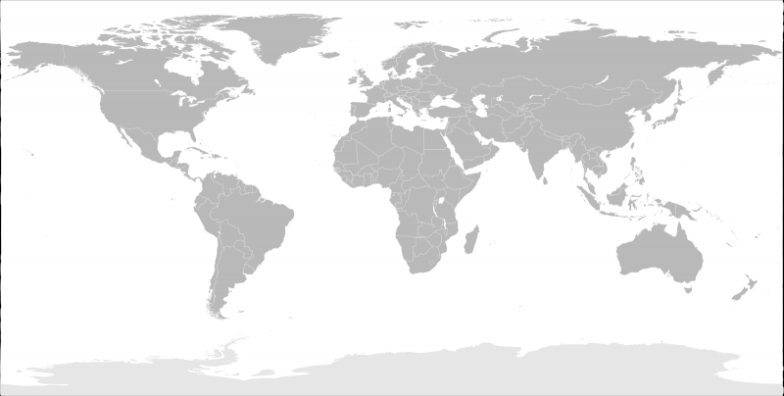



Regional Activities:
10th GEOSS Asia-Pacific Symposium in September 2017
Continue regional dialogue of importance of global GHG observation
Build the partnership with other policy supporting community;
  WMO’s the Integrated Global Greenhouse Gas Information System (IG3IS)
  Global Carbon Project (GCP)
GEOSS-AP Symposium is a flexible and inclusive convening platform of Asia Pacific region.

Slide 9
Global Activities:
COP-23, Bonn, November 2017
Highlight the advancement of Satellite GHG observation and scientific outcomes using good practices.
  the advancement of satellite Greenhouse Gas observation since 2006 IPCC Guidelines;
  scientific outcomes by satellite GHG data which are beneficial for improvement of national GHG inventory reporting;
  cooperation among space agencies to contribute to enhance transparency framework and promote effective implementation of the Paris agreement by providing accurate and reliable GHG data from space.
Opportunities
  Official side event: Proposal has submitted jointly with GEO
  Japan Pavilion: 2 GHG related side events are planned.
  Other possible opportunities (under discussion with ESA)
  Exhibition: Official exhibition and national Pavilions

Slide 10
Beyond 2019
Satellite data to become scientific evidence for understanding Climate Change
Etc…
Adaptation and Mitigation Plan
Assimilation model
a
In-situ
data
Scientific Body
・analyzation
・value-added data
Inventory Office
・Verify the data
Political Body
(National governments and UN,etc)
Inventory
Reports
Satellite Data
Direct detection form space?

Slide 11
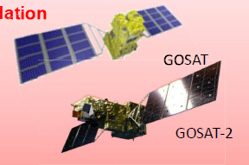
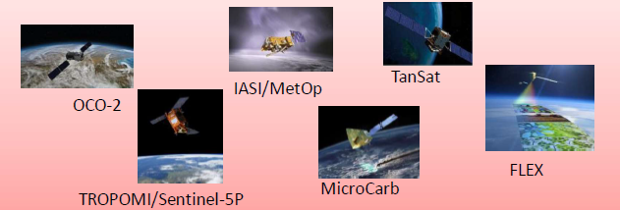
IPCC GHG Inventory Guidelines
Parties of the Paris Agreement are required to submit Nationally Determined Contributions (NDC) every 5 years.
Reporting of national GHG emissions and removals is required to comply with the guidelines adopted by IPCC. The guidelines are important to enhance transparency framework for building mutual trust and confidence and promote effective implementation of the Paris agreement.
Developed in 2006, and will be refined in 2019
○ Existing Guideline (IPCC Developed in 2006)
”Even the availability of satellite-borne sensors for greenhouse gas concentration measurements will not fully resolve this problem, due to limitations in spatial, vertical and temporal resolution.”
○ 43rd Session of the IPCC (in 2016, Kenya)
“To maintain the scientific validity of 2006 IPCC Guidelines, certain refinement may be required, taking into account scientific and other technical advances that have matured sufficiently since 2006.”
○ 44th Session of the IPCC (in 2017, Thailand)
“Lead authors must consider all recent scientific developments and national methods used by countries in their inventories.”
2009～
＋
○ Refinement of Guideline (2019)
In addition to the ground networks, there is aim for Satellite data to be included as one of methods to support accuracy of national GHG emissions and removals．(As reference data)

Slide 12
Timeline for Guidelines Refinement
2016 Sep | Scoping Group meeting
2016 Oct | IPCC decision on outline
2017 Feb | Decision on selection of Authors
2017 Jun | First Lead Author Meeting (LAM1)
2017 Sep | Second Lead Author Meeting (LAM2)
2017 Dec – 2018 Feb | First Order Draft (FOD) Expert Review
2018 Mar | Science Meeting
2018 Apr | Third Lead Author Meeting (LAM3)
2018 July - Sep | Second Order Draft (SOD) Government & Expert Review
2018 Oct | Forth Lead Author Meeting (LAM4)
2019 Jan - Mar | Final Government Distribution (FGD) Government Review
2019 May | IPCC adoption/acceptance

