Slide 1
Leadership Changes and Issues
Committee on Earth Observation Satellites
Stéphane Chalifoux, WG Disasters Chair
SIT Tech Workshop 2017 Agenda Item # 21
DIS: Observations for Disasters
CEOS Strategic Implementation Team Tech Workshop
ESA/ESRIN, Frascati, Italy
13th-14th September 2017

Slide 2
Accomplishments
Three thematic pilots completed
RO was triggered for Hurricane Matthew in Haiti and demonstrator to showcase/validate applications are completed; RO Operational Plan developed.
Landslide Pilot started and data starting to be collected.
Data flowing well for all existing pilots and supersites (including from the International Charter)
GSNL (new and reporting)
Awareness and Communications regarding pilots, including up-to-date website information and glossy report

Slide 3
Decision @ Plenary 2017
Items for decision
DIS-10 - GEO GSNL Proposal (Southern Andes Supersite) and Biennial Reports (Ecuador and New-Zealand Supersites).
DIS-12 - Recovery Observatory Operational Plan.
DIS-13 - Disaster Risk Management pilot initiative final reports.
DIS-13 - Report on follow-on actions to DRM Pilots Volcano and Seismic (Flood could be part of GEO-DARMA).
DIS-13 - Geohazards Lab Implementation Plan.
New Vice-Chair/Chair: NASA.

Slide 4
Reporting @ Plenary 2017
Items for reference
DIS-12 - Recovery Observatory Malawi and Nepal demonstrators final reports.
DIS-12 - Recovery Observatory status update.
DIS-13 - Landslide Pilot status update.
DIS-15 - GEO-DARMA concept phase summary.

Slide 5
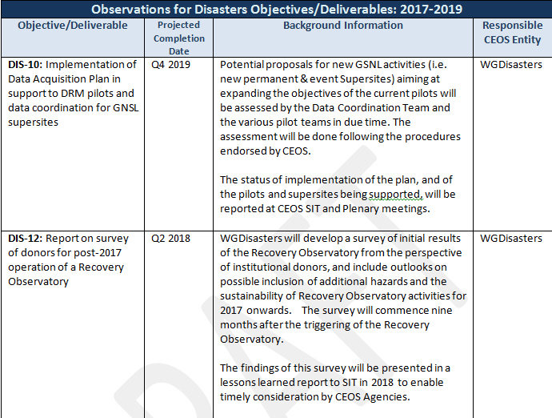
CEOS Work Plan 2017-2019 Disasters Objectives

Slide 6
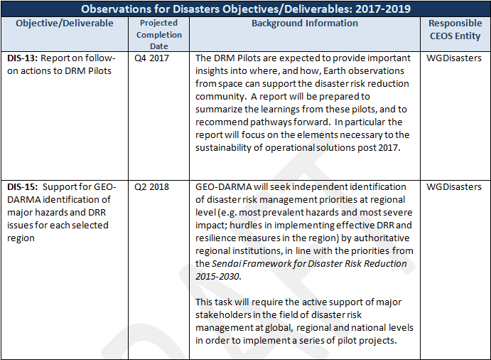
CEOS Work Plan 2017-2019 Disasters Objectives

Slide 7
Reporting @ Plenary 2017
CEOS Work Plan Milestones and Deliverables
DIS-10: Implementation of Data Acquisition Plan in support to DRM pilots and data coordination for GSNL supersites Will be amended in next round of CEOS WP Updates
DIS-12: Report on survey of donors for post-2017 operation of a Recovery Observatory (commences 9 months after Recovery Observatory triggering? Delayed: This will start in Spring 2018
DIS-13: Report on follow-on actions to DRM Pilots (already listed above)
DIS-15: Support for GEO-DARMA identification of major hazards and DRR issues for each selected region Update

